Slide 1














A
B
Guided trials
Free trials
C
$$−>$$
$$−>$$
Short condition
Game 1
H = 1
home base
Trial 1 cue
(guided)
Trial 1 response
$$→$$
Long condition
$$−>$$
$$−>$$
$$−>$$
Game 2
H = 6
home base
Trial 2 cue
(guided)
Trial 2 response
$$→$$
Extra long condition
$$−>$$
$$−>$$
$$−>$$
Game 3
home base
Trial 3 cue
(guided)
Trial 3 response
…
H = 15
$$−>$$
$$−>$$
$$−>$$
home base
Trial 4 cue
(free)
Trial 4 response
Notes:
Figure 1: Time line of the rat and human experiments. A: rats were trained to start each trial by reaching the home base (HB, no reward). They were then given one guided trial (Trial 1, one blinking light, here 1 drop). Subsequent trials consisted in 2 simultaneously blinking lights. The end of a game was signaled by a sweeping tone and a change of home base (and horizon).

Slide 2

A
B
Guided trials
Free trials
nG = 3
H = 1
H = 1
$$→$$
H = 6
nG = 1
H = 6
H = 1
$$→$$
H = 6
nG = 0
H = 1
H = 1
…
H = 6
Notes:
Figure 2: Within-version

Slide 3





A
B
XX
3
XX
2
5
XX
XX
1
4
XX
+
$$−>$$
+
+
+
+
+
H = 1
Trial 1 cue
(guided)
Trial 1 response
H = 2
XX
3
XX
3
H = 5
$$−>$$
+
$$−>$$
5
+
XX
Trial 2 cue
(free)
Trial 2 choice
H = 10
XX
3
XX
3
$$−>$$
5
+
XX
$$−>$$
5
+
XX
5
XX
Trial 3 cue
(free)
Trial 3 response
Notes:
Timeline of the human experiment: Human subjects were presented with a 2-armed bandit display of known horizon (here horizon 2). They were guided to the first bandit and obtained a visible reward (here 3 points). Subsequent trials consisted in simultaneously colored squares.
Scheme of horizon conditions: H = 1, 2, 5 and 10.

Slide 4
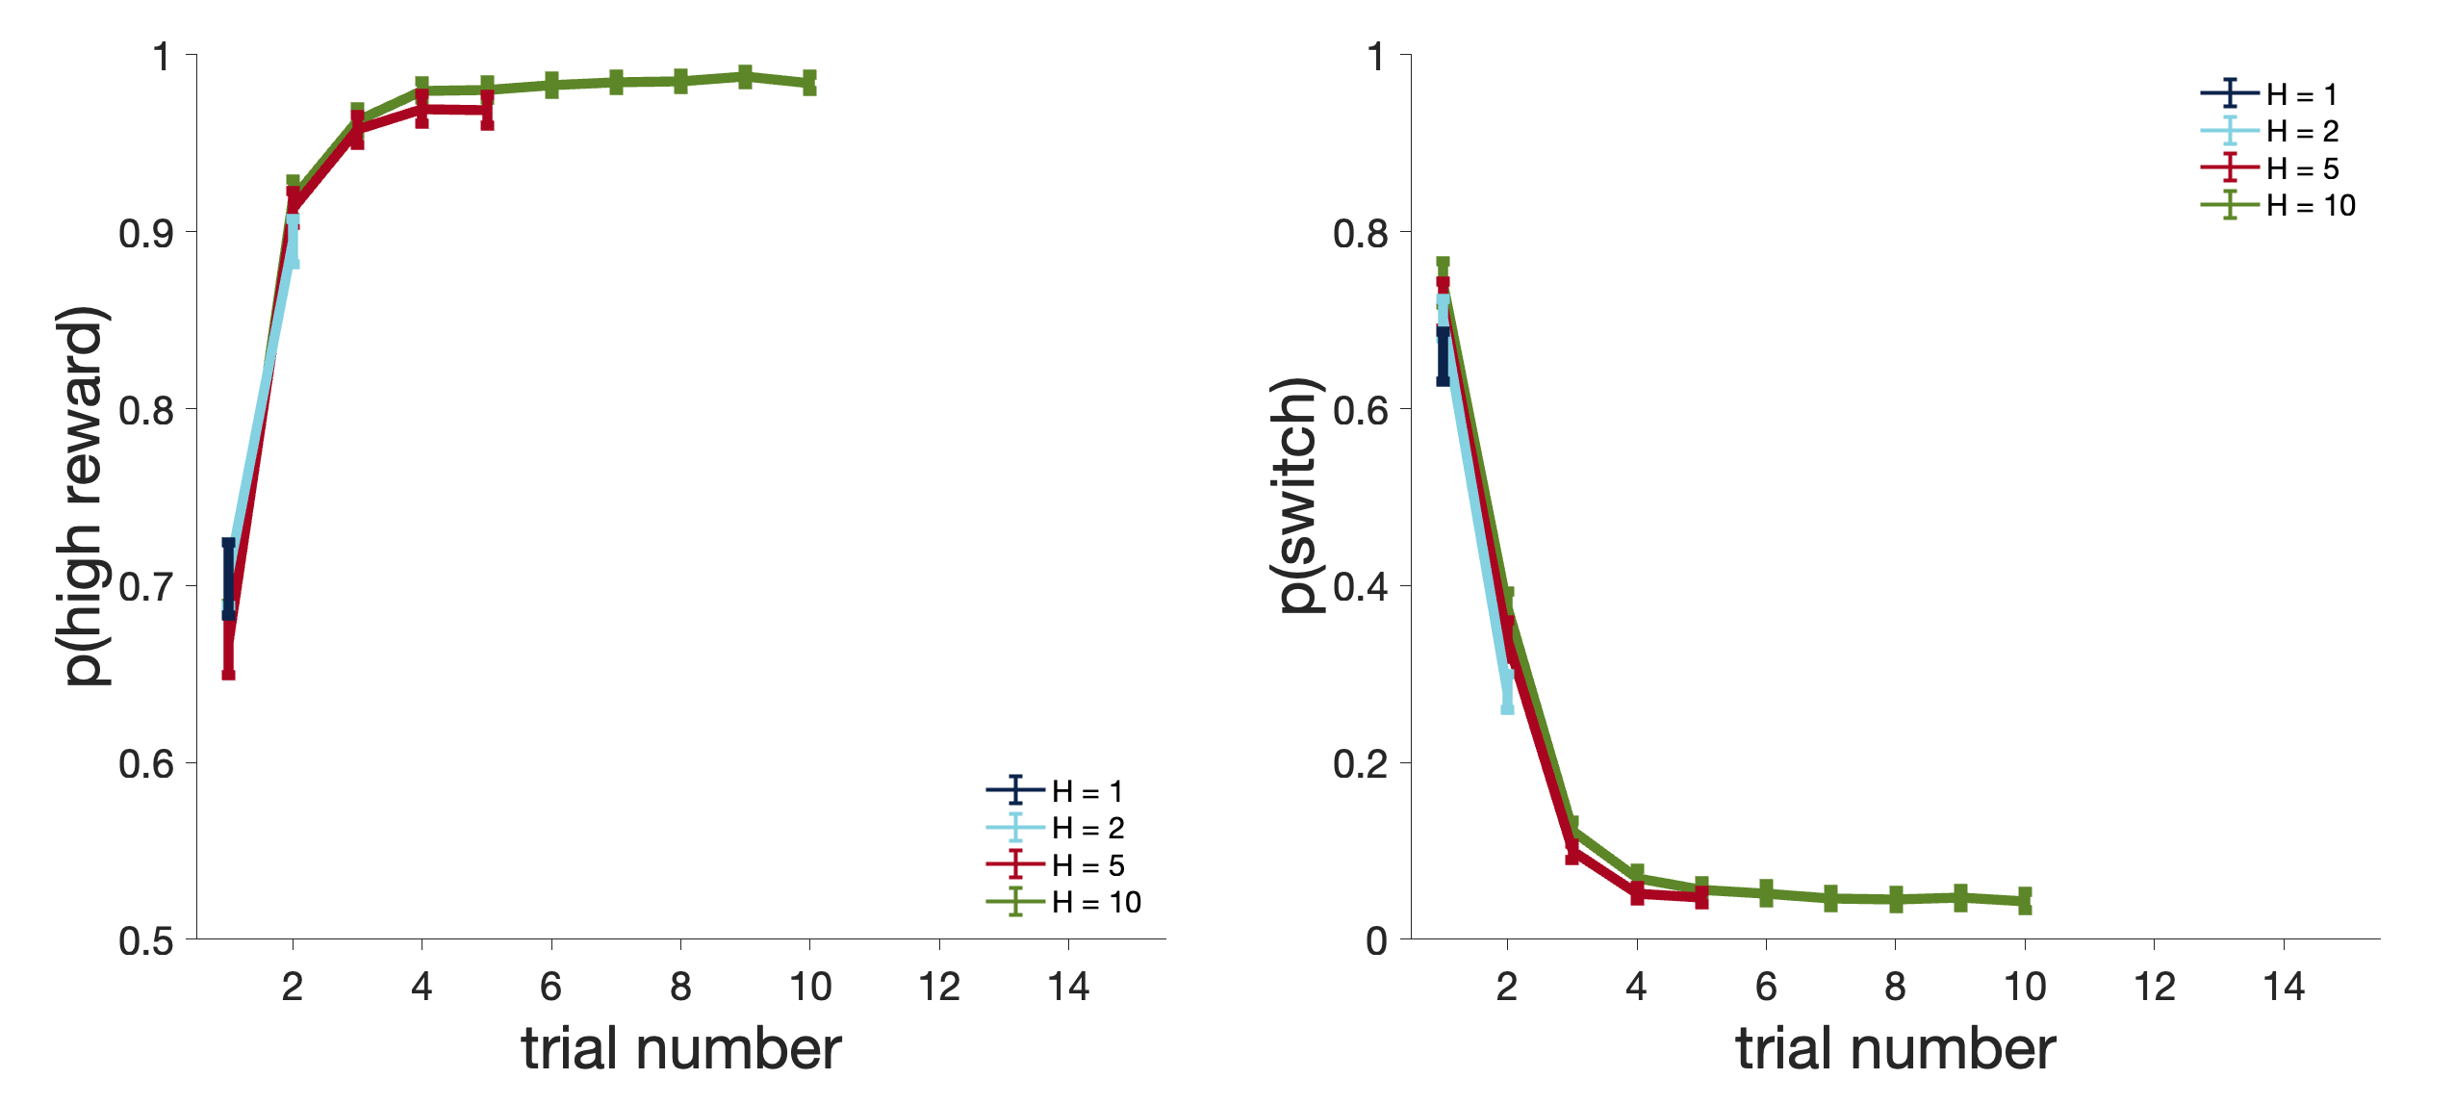
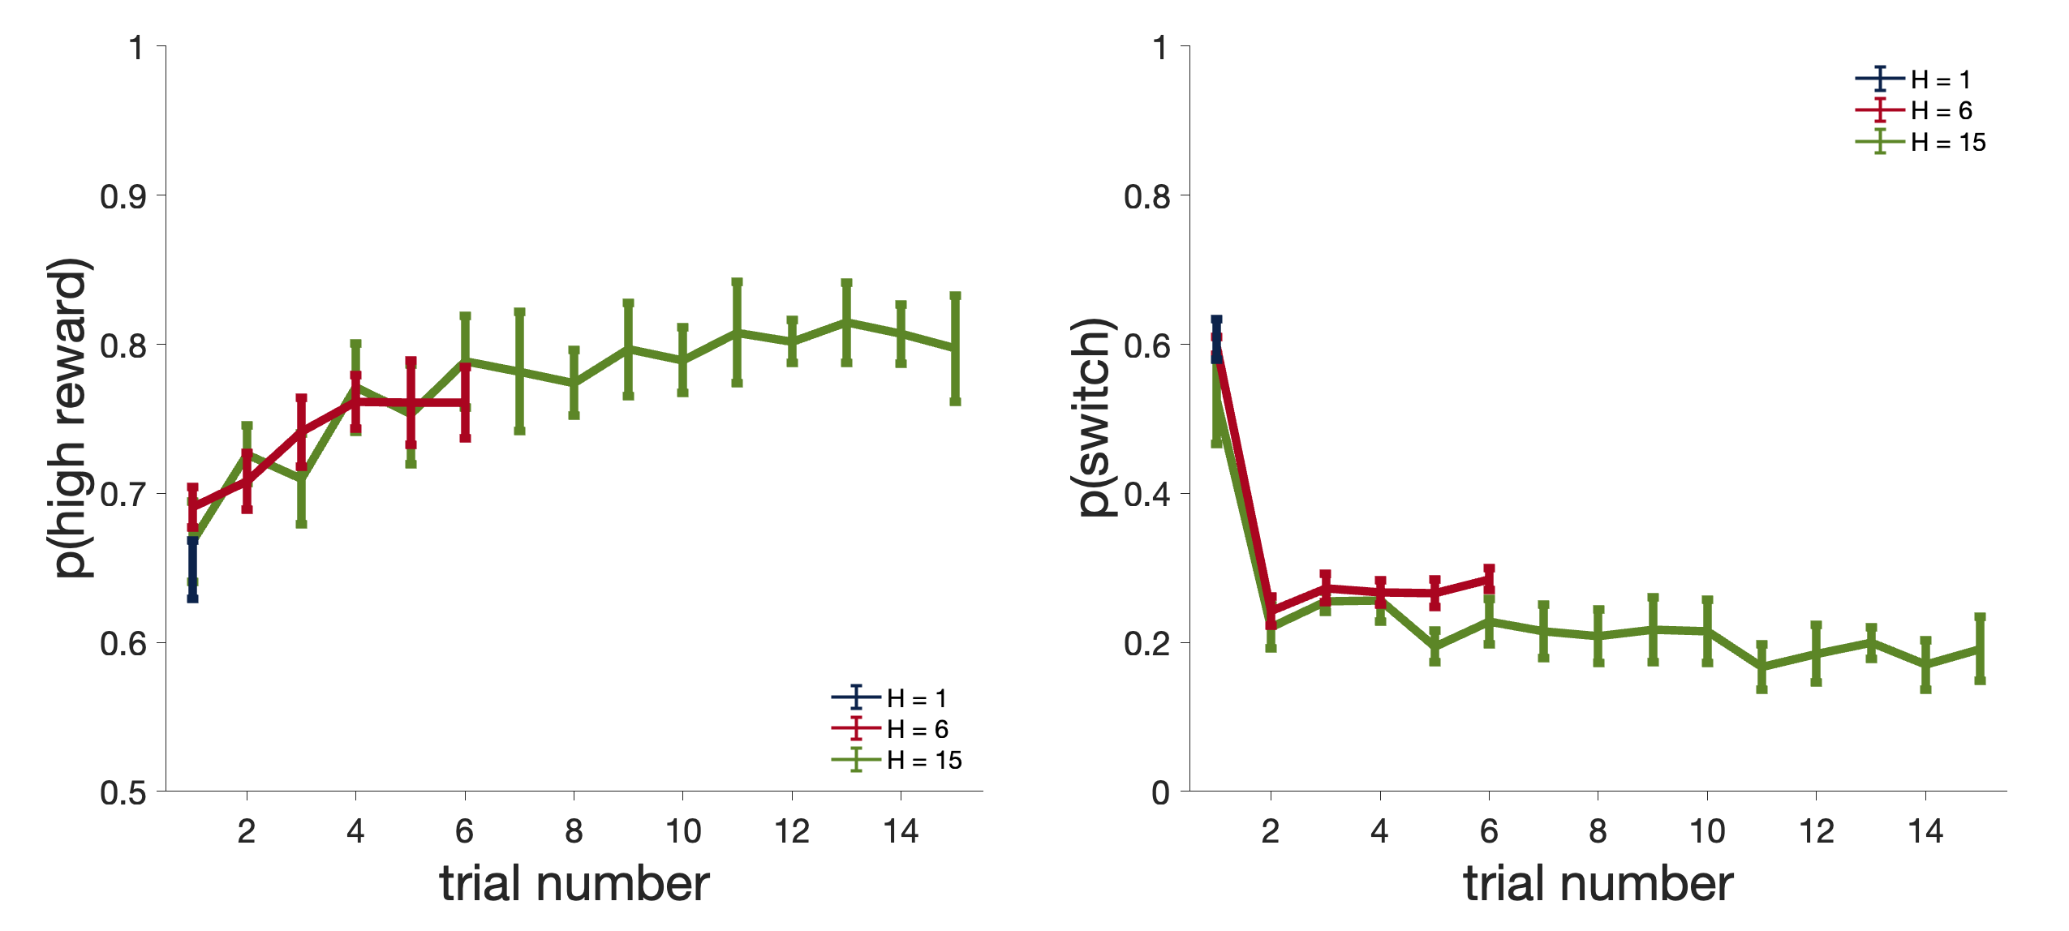
A
B
Humans
C
D
Rats
Notes:
Figure 4: Probability of choosing the option with the highest reward after the guided trials and probability of switching option immediately after the guided trials (1st choice) for humans (A) and rats (B). Up: In these experiments rodents were guided to the same feeder 3 times before the first choice was allowed (choice number 1). Two horizons were tested. Down: Human performance; same as for rats but with 4 different horizon conditions. N=1800 for all horizons (40 per human participant).

Slide 5
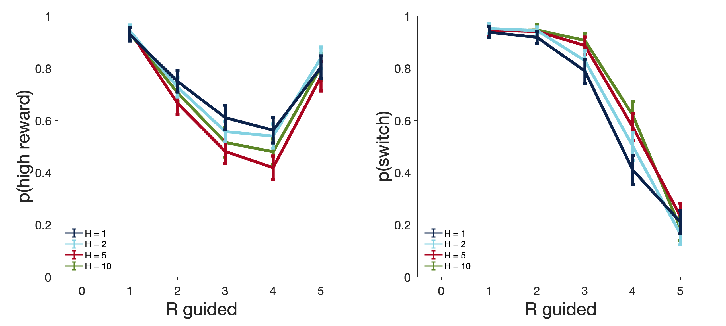
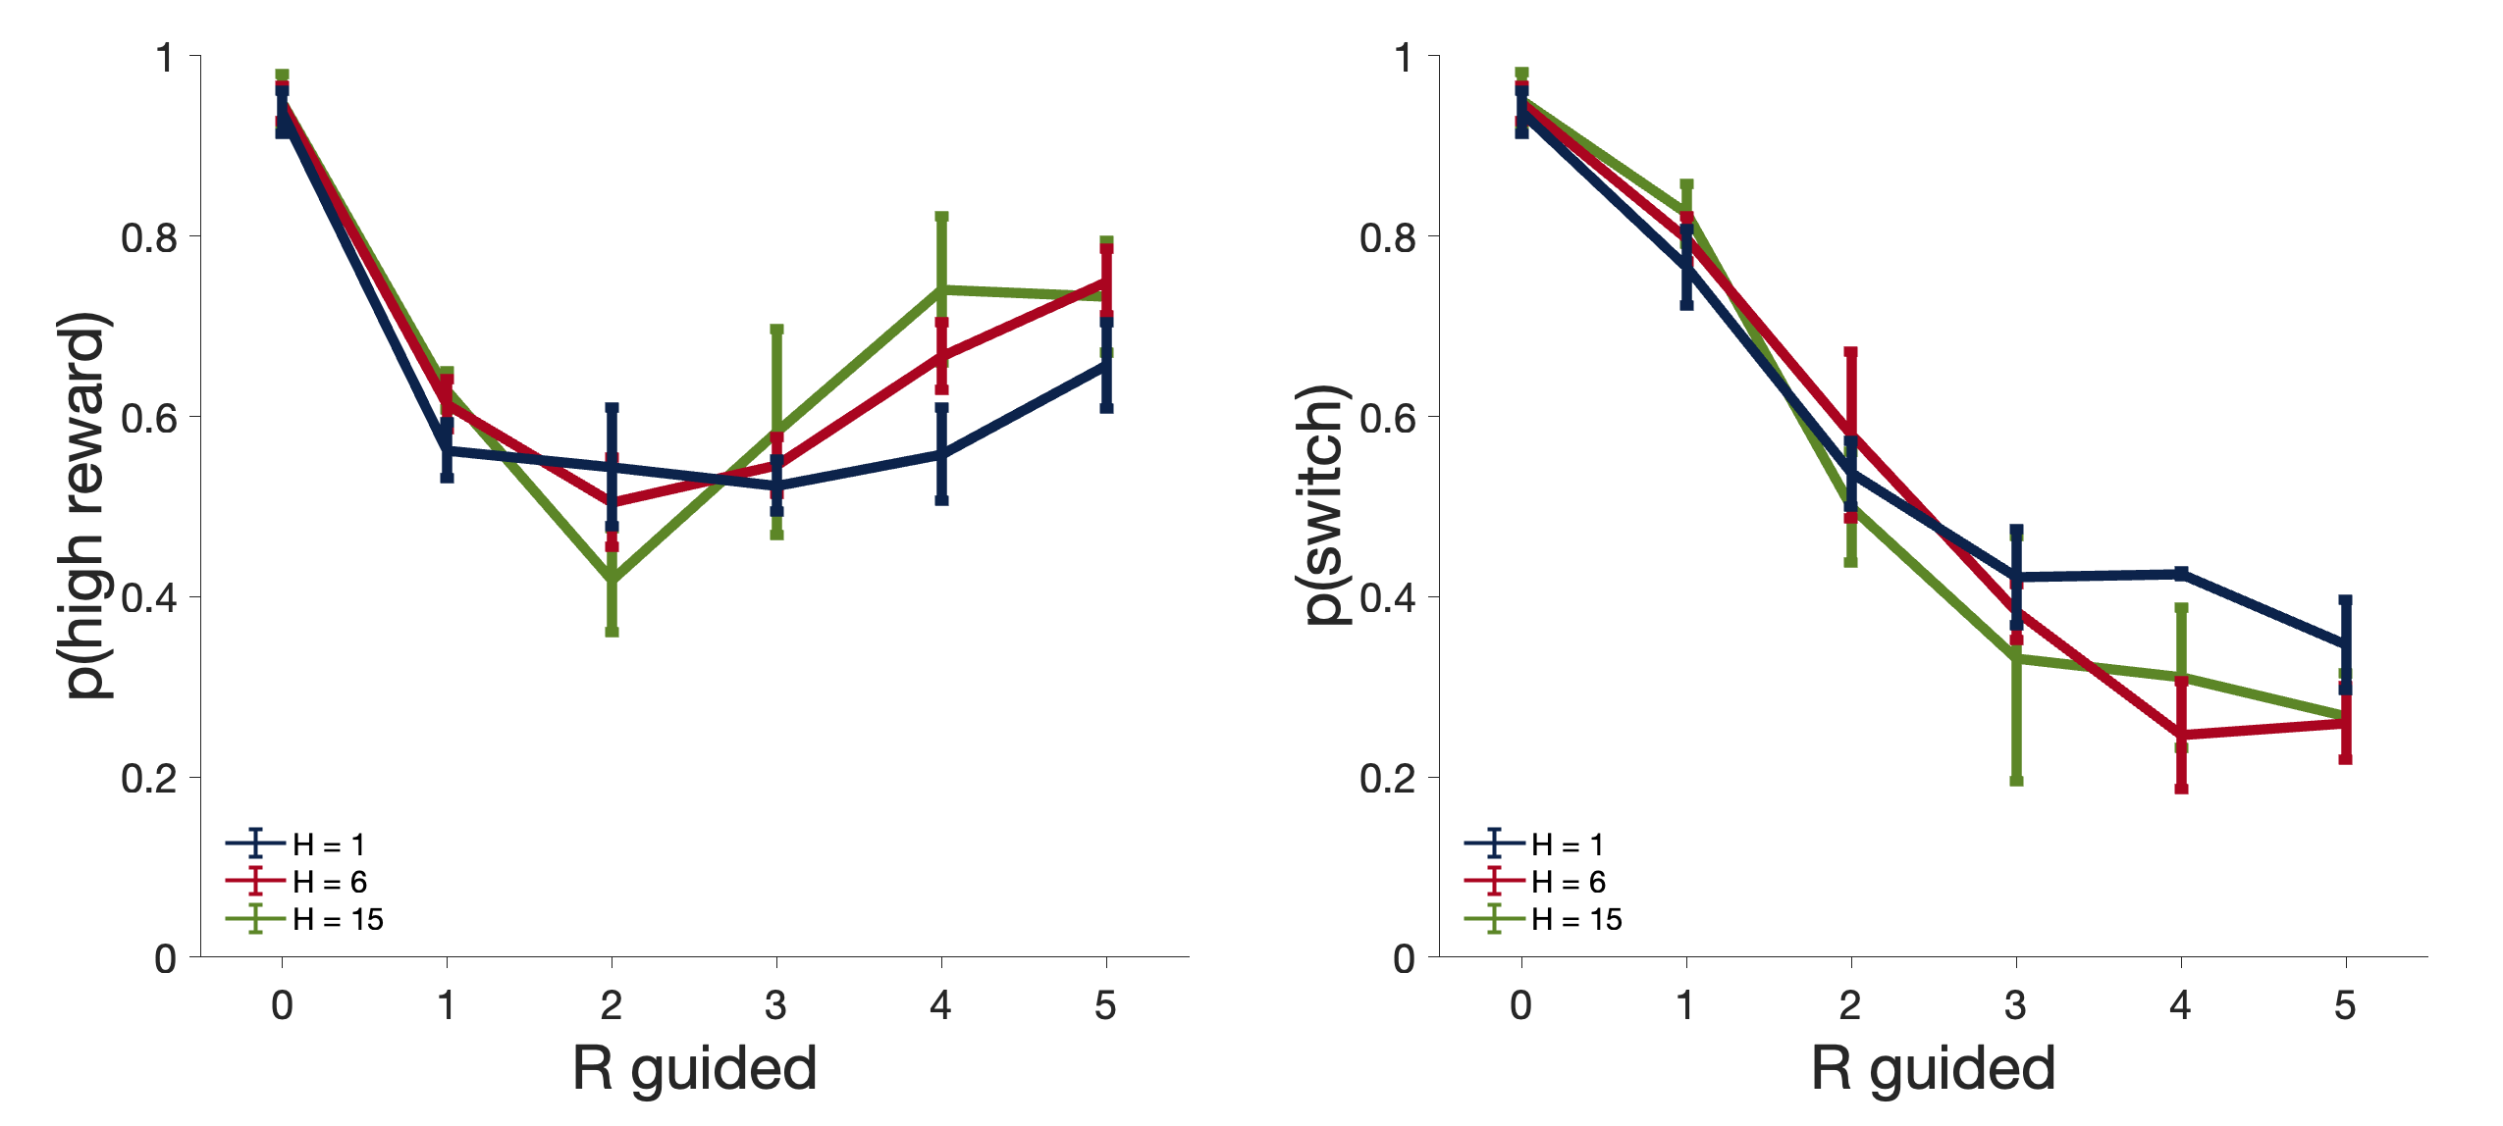
A
B
Human
C
D
Rat
Notes:
Figure 5: Influence of reward size during guided trials. Left: Probability of choosing the best option in the first choice trial after guidance. Right: probability of switch.

Slide 6
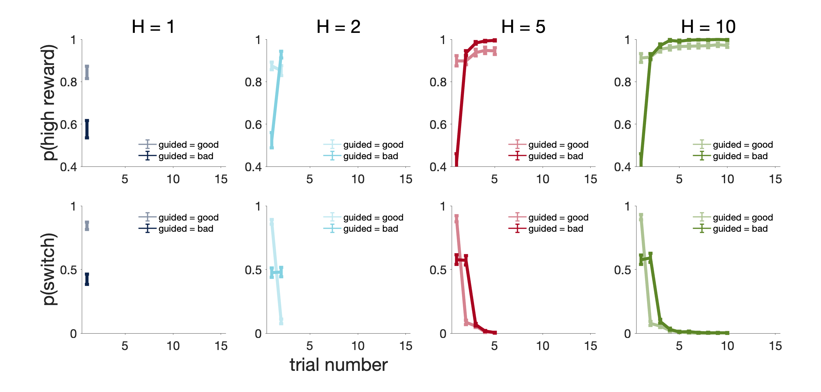
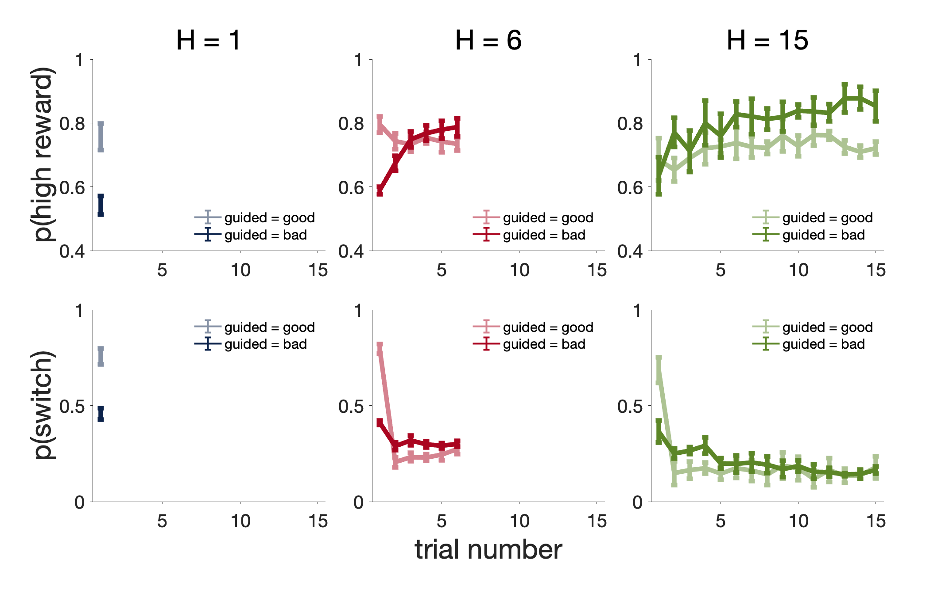
A
Human
B
Rat
Notes:
Figure 6: Probability of choosing the option with the highest reward after the guided trials and probability of switching option immediately after the guided trials (1st choice), split up by whether the guided option is the better option.

Slide 7
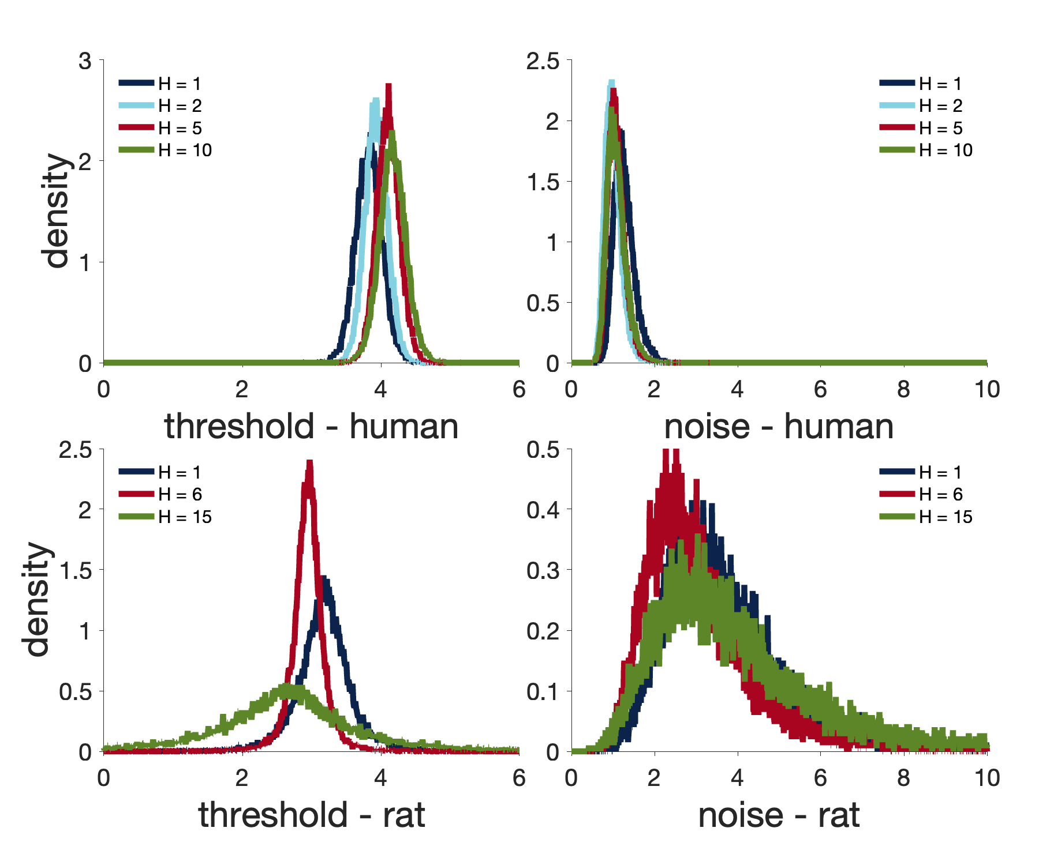
Notes:
Figure 7: Model-based estimates of exploitation threshold, decision noise.

Slide 8
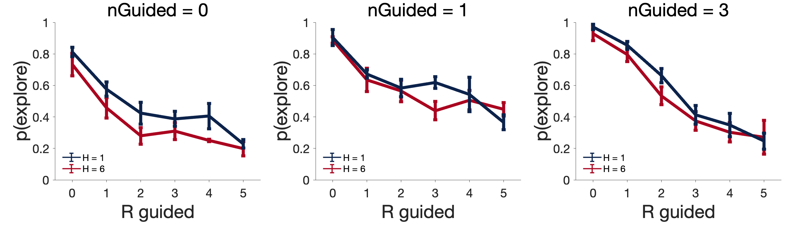
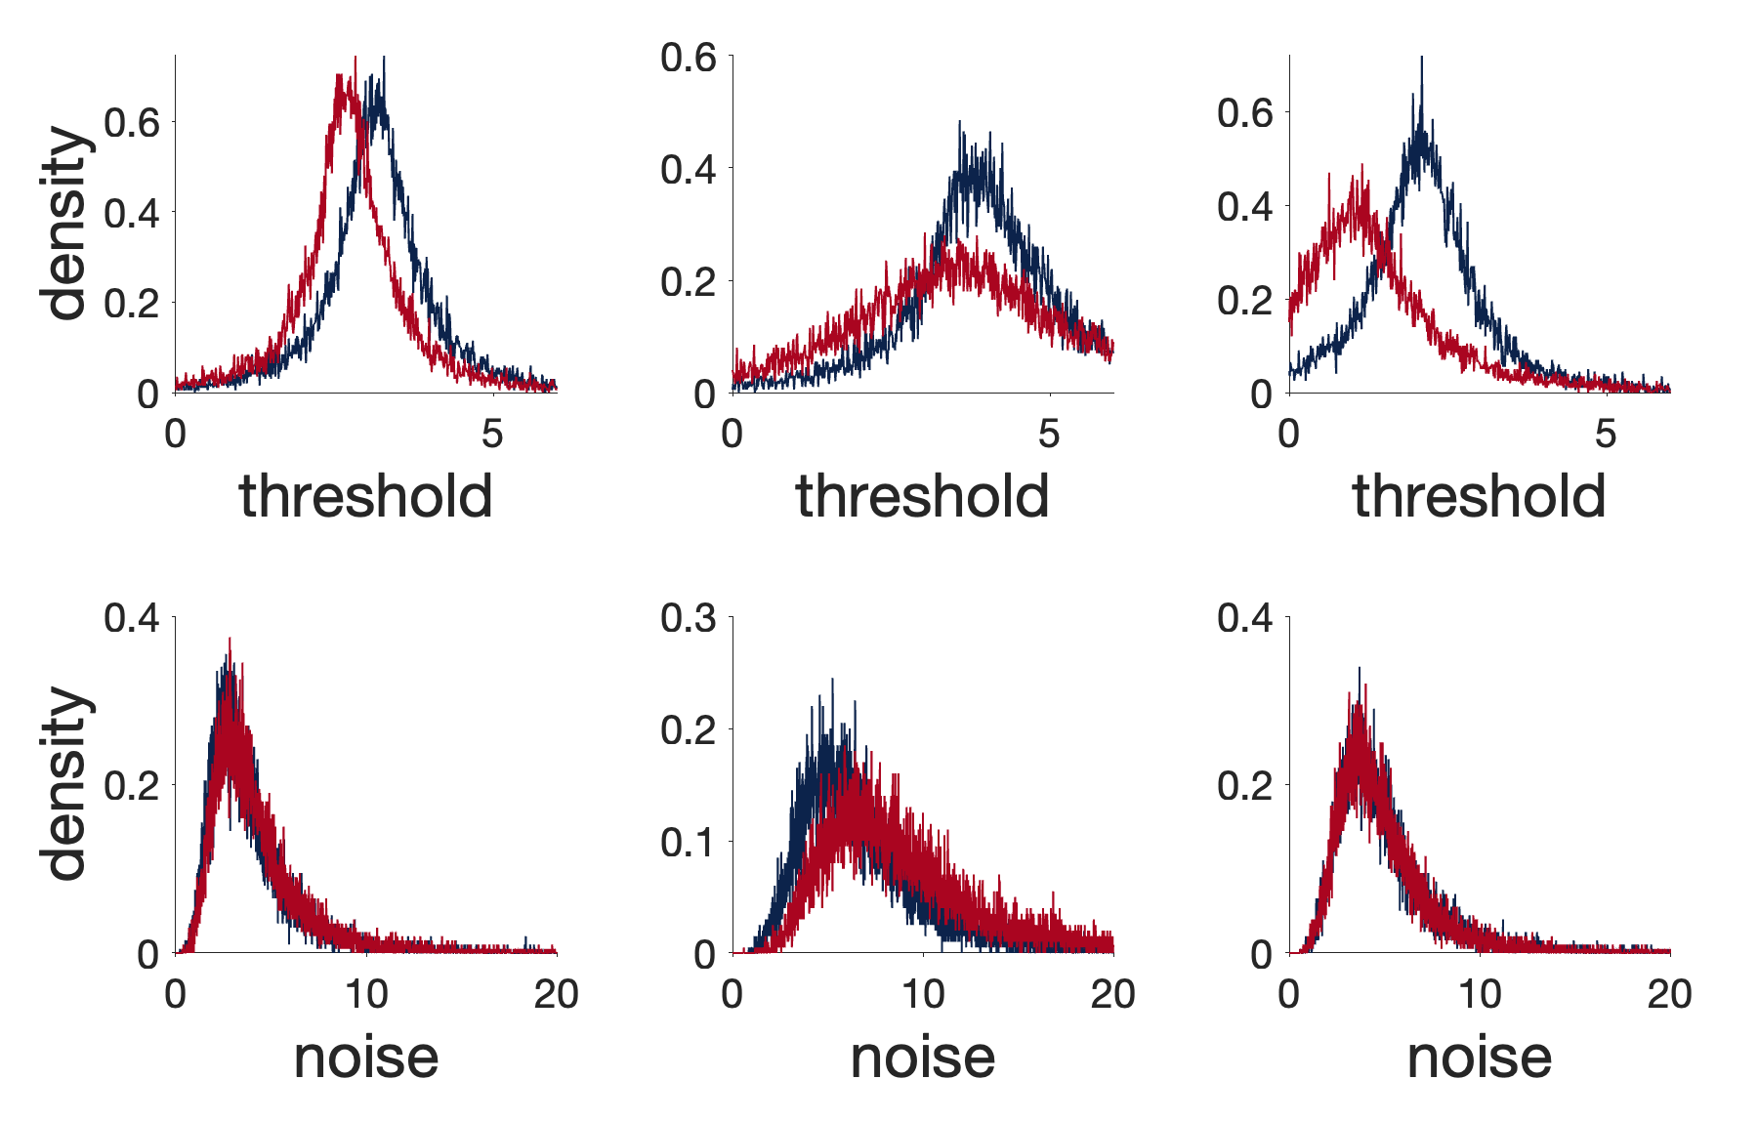
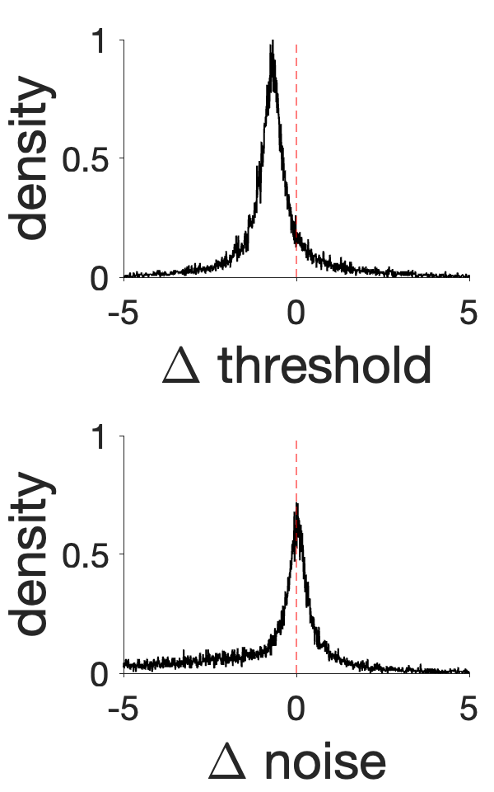
Notes:
Figure 8: Horizon difference

Slide 9
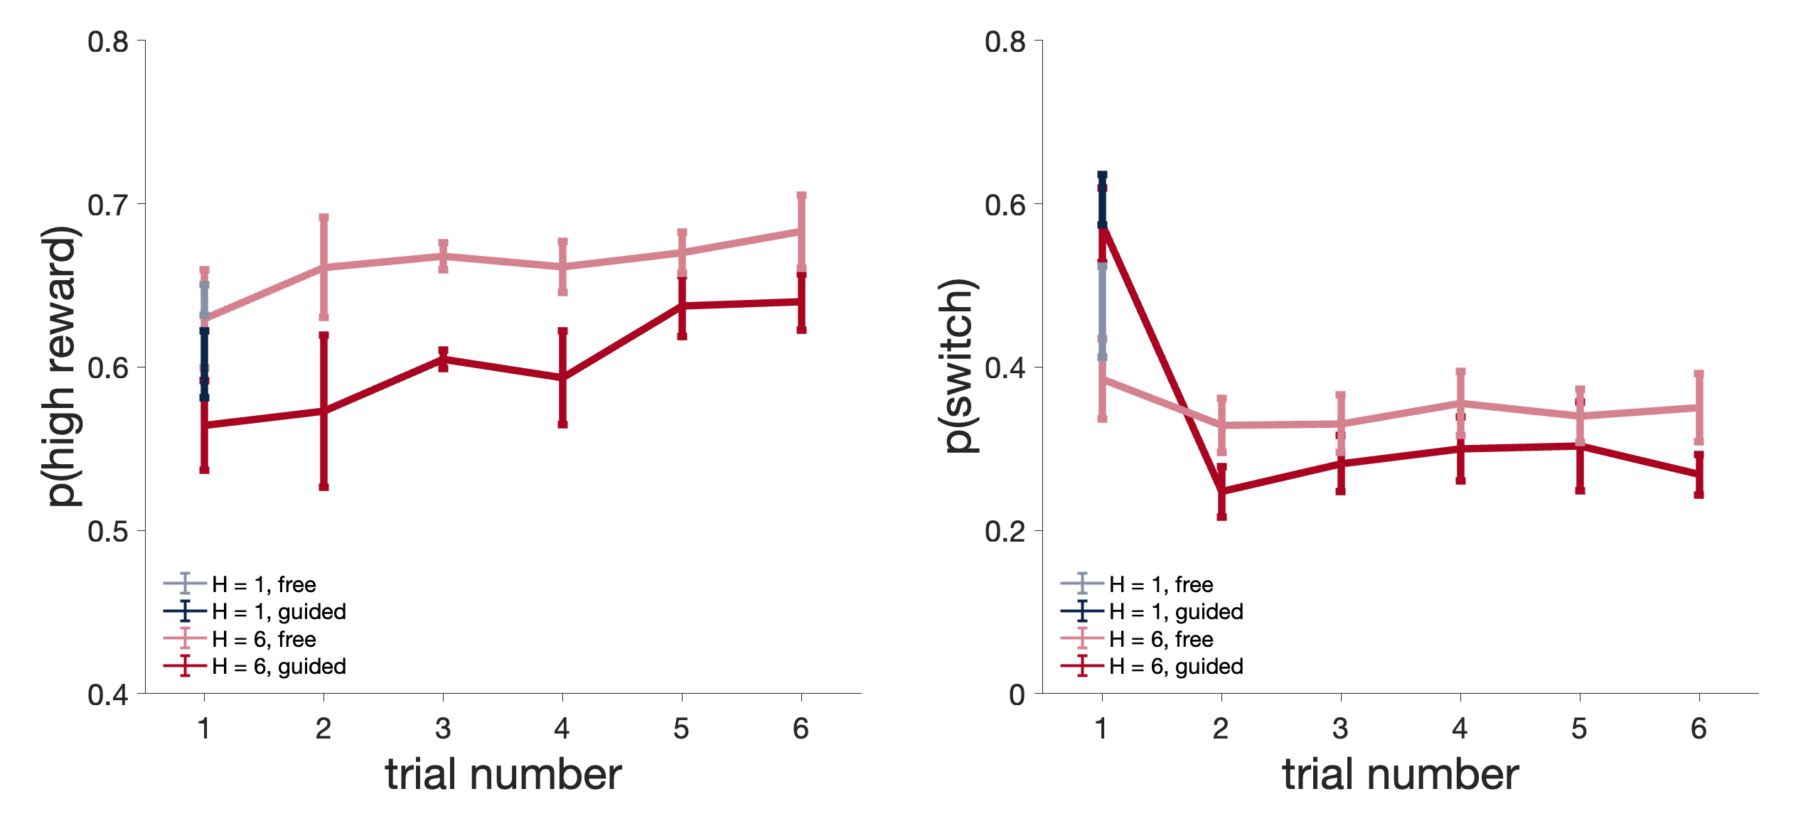
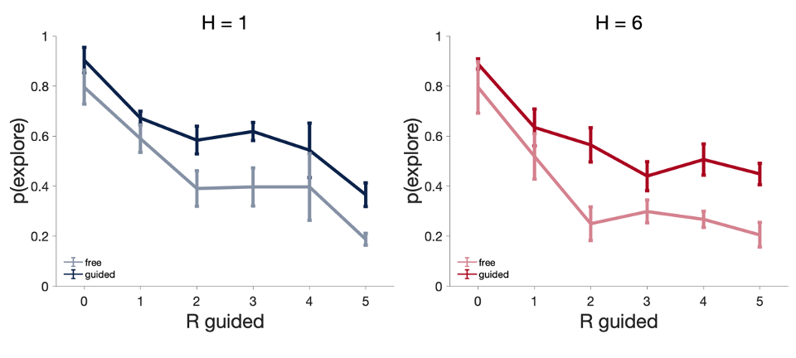
Figure 9
A
B
Notes:
Figure 9 AB: At the start of a game, rats were given one forced guided trial (1 light blinking, Fig 1, Guided) or a free choice instead (not Guided). A left: probability of choosing the correct feeder after the guided trials or after the first free choice for the 2 horizons tested. A right: probability of switching to a different feeder than the one visited after the guided trials or after the first free choice for the 2 horizons tested. This figure included data from 2 rats. Statistical significance was assessed for H=6 only.
Figure 9 B: Influence of reward size during the first trials (Guided or not Guided, as in Figure 7). B left: Probability of choosing the best feeder during the second trials (free choice). B right: probability of switching to a different feeder than the one visited during the first trials (only the first free choice is considered). Number of trials N are the same as in Figure 7.

Slide 10
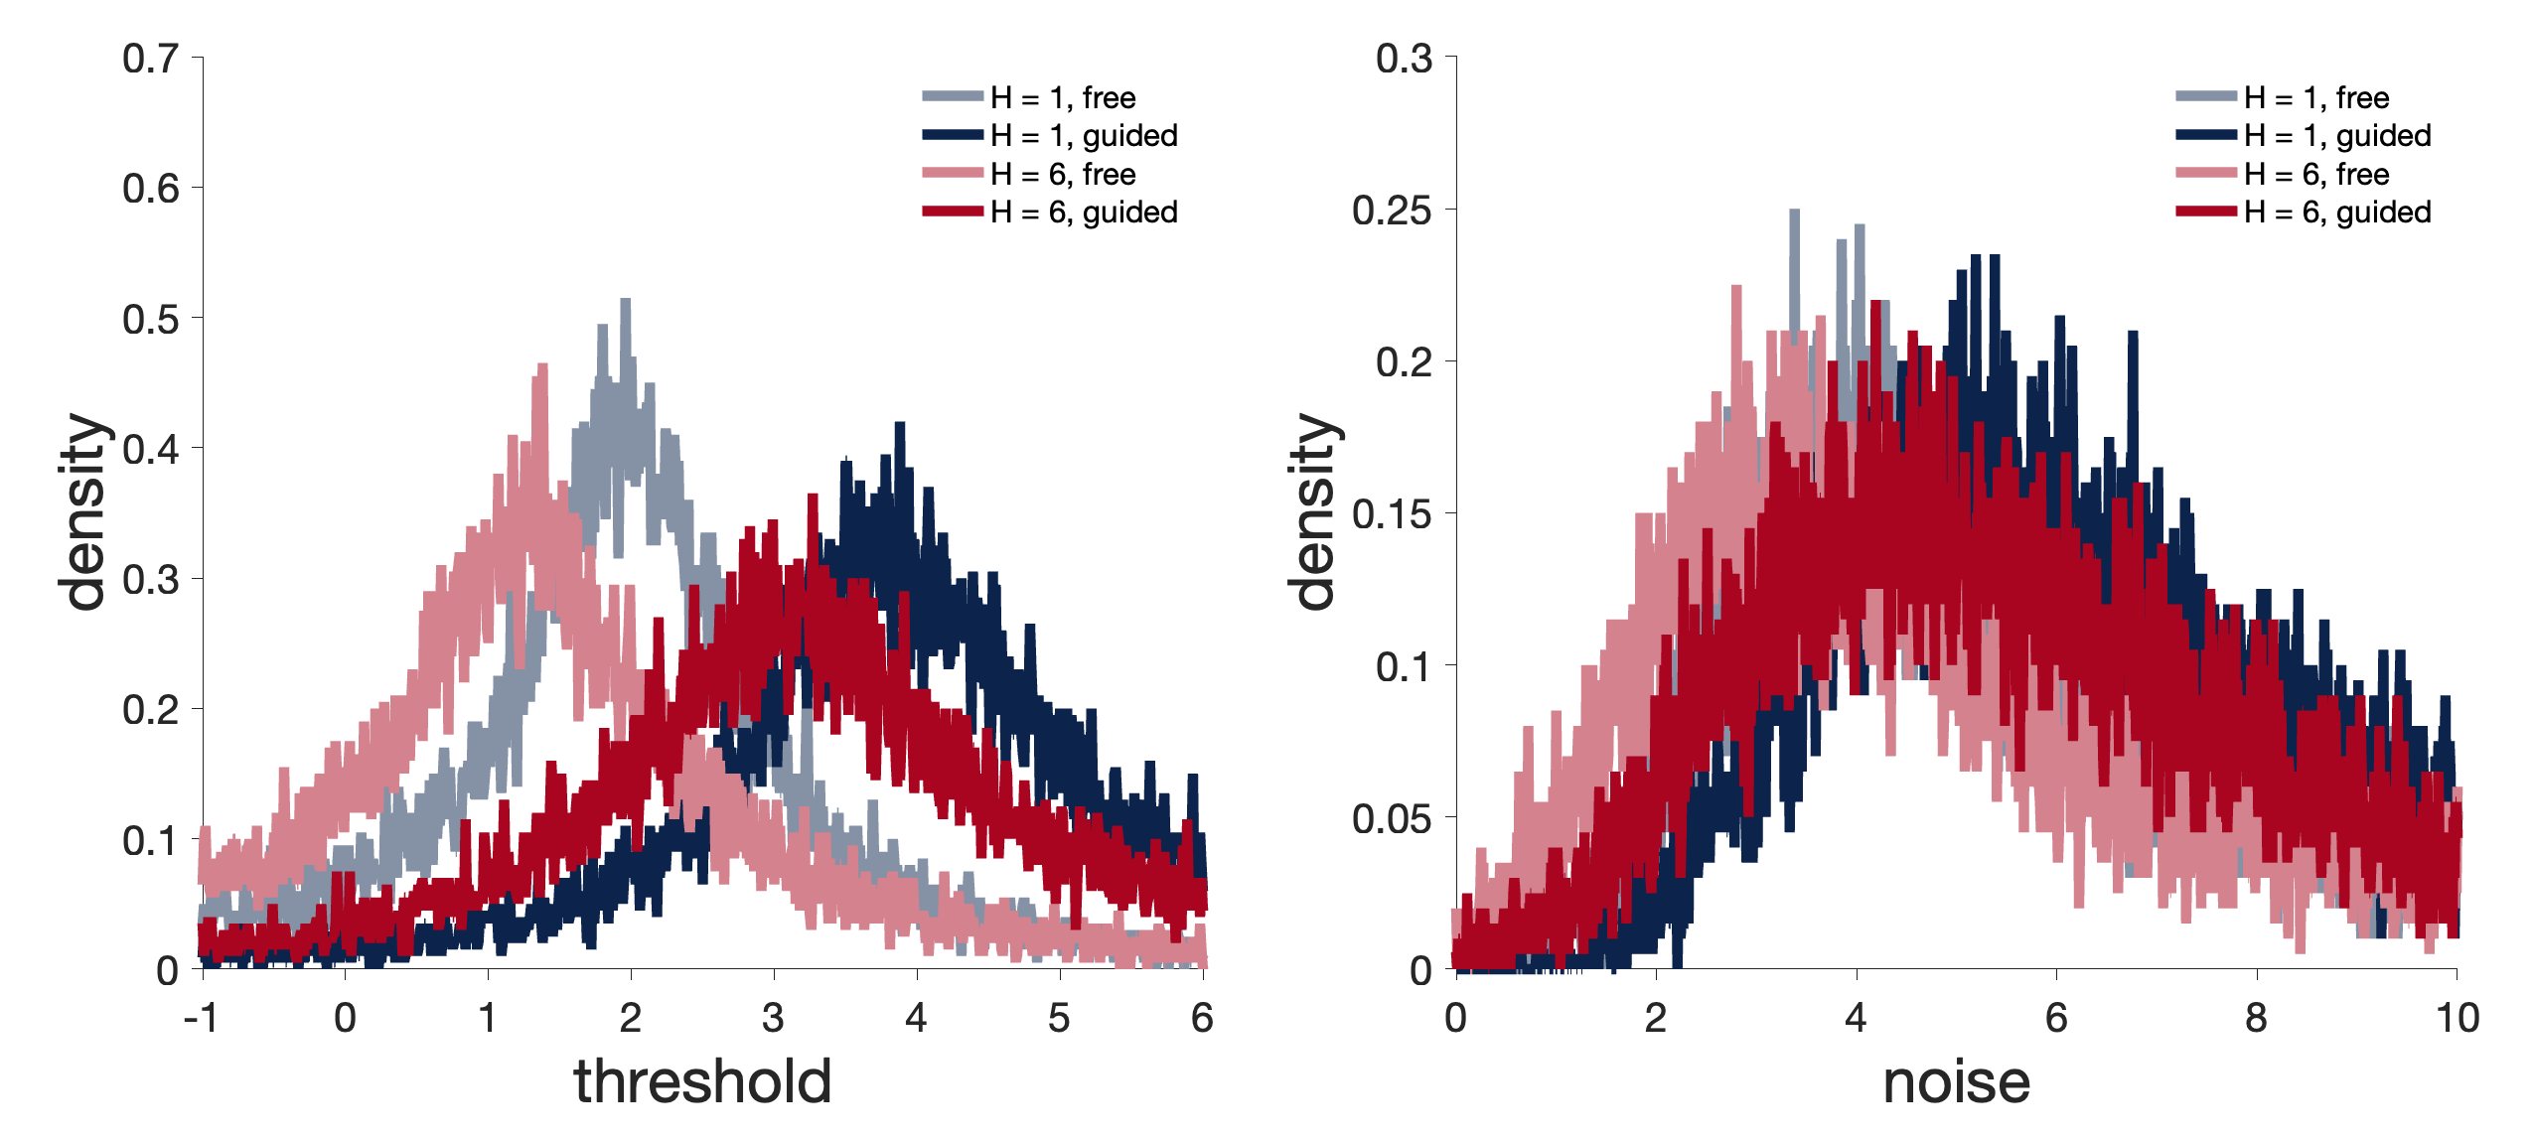
Figure 10
Notes:
Figure 10. Model estimates in free vs guided choices.

Slide 11
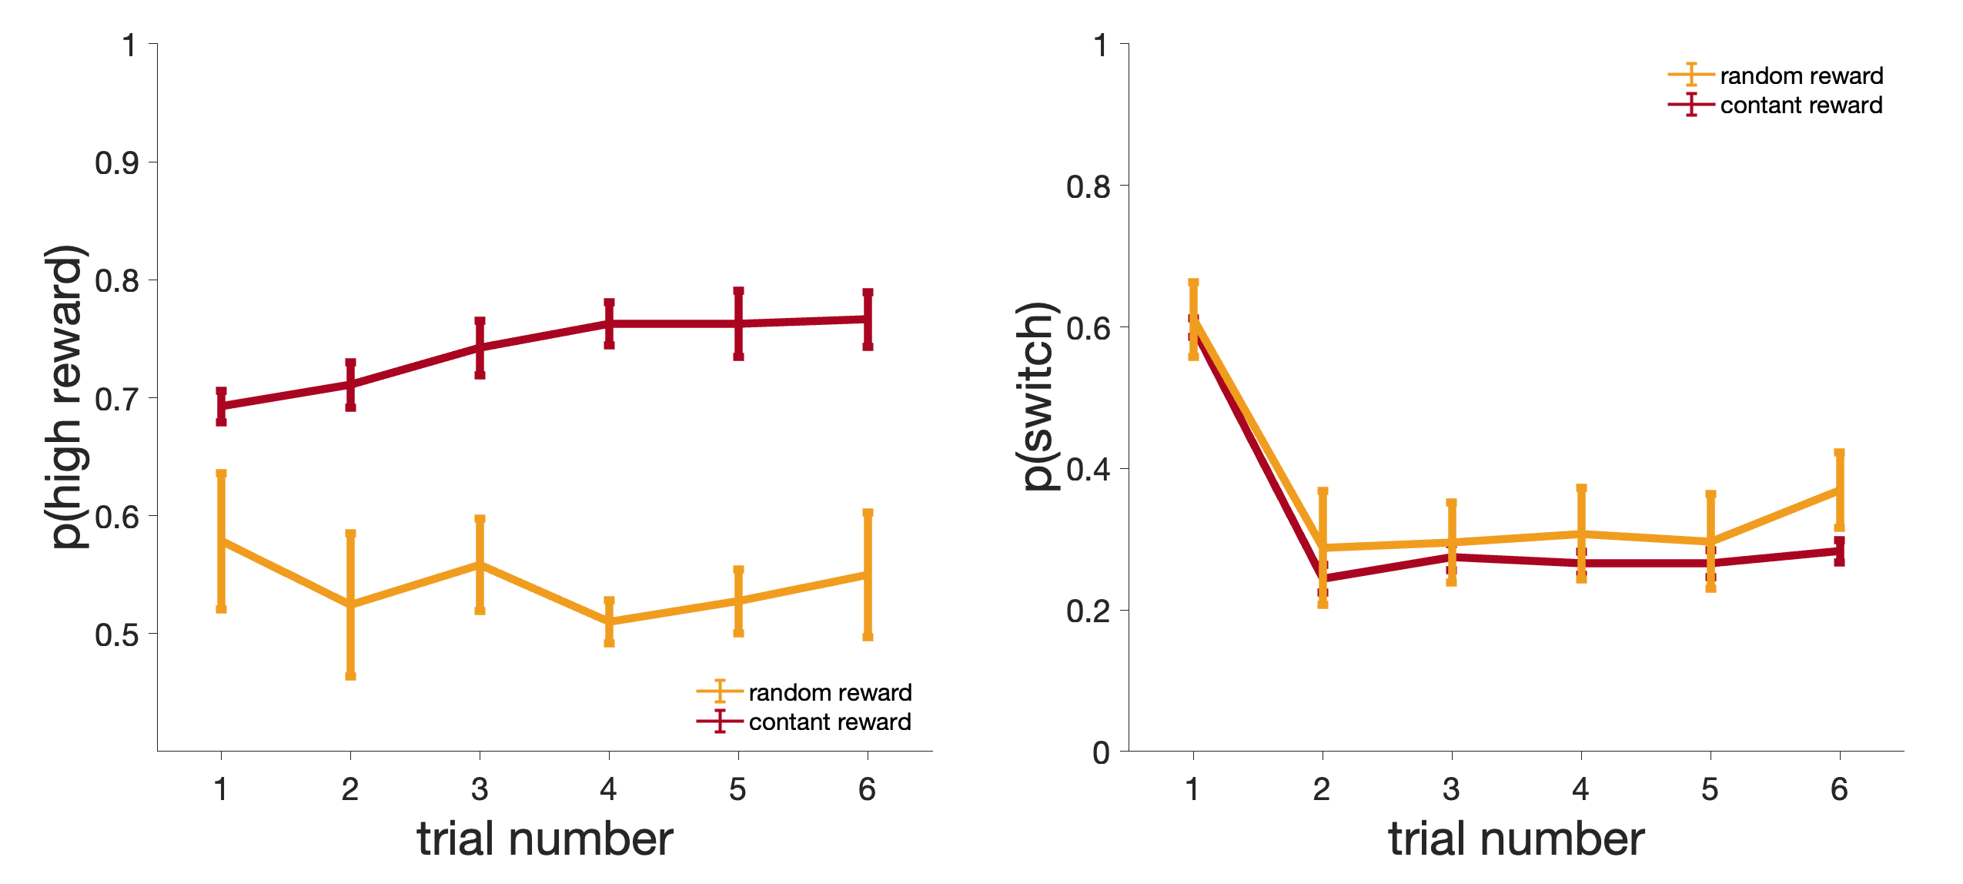
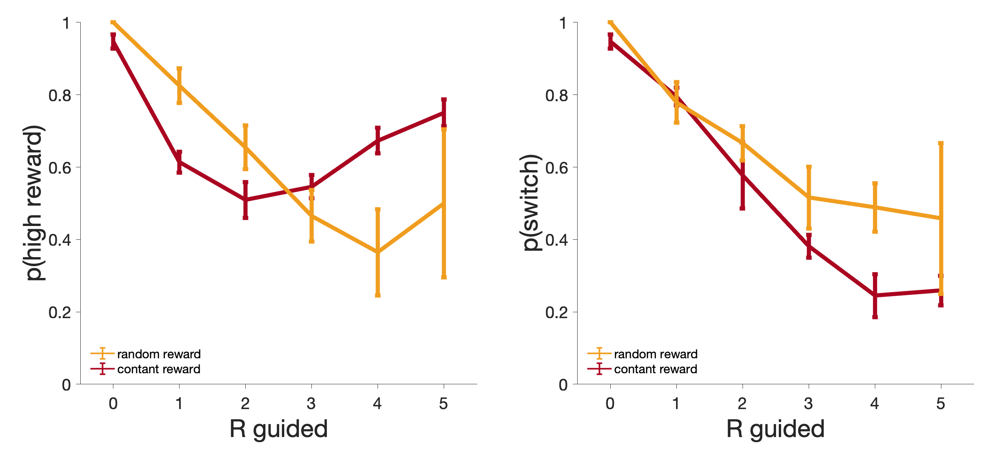
A
Figure 8
B
Notes:
Figure 11: Results from the random reward control (rat only).

Slide 12
Supplementary figures

