Slide 1
Noise paper

Slide 2
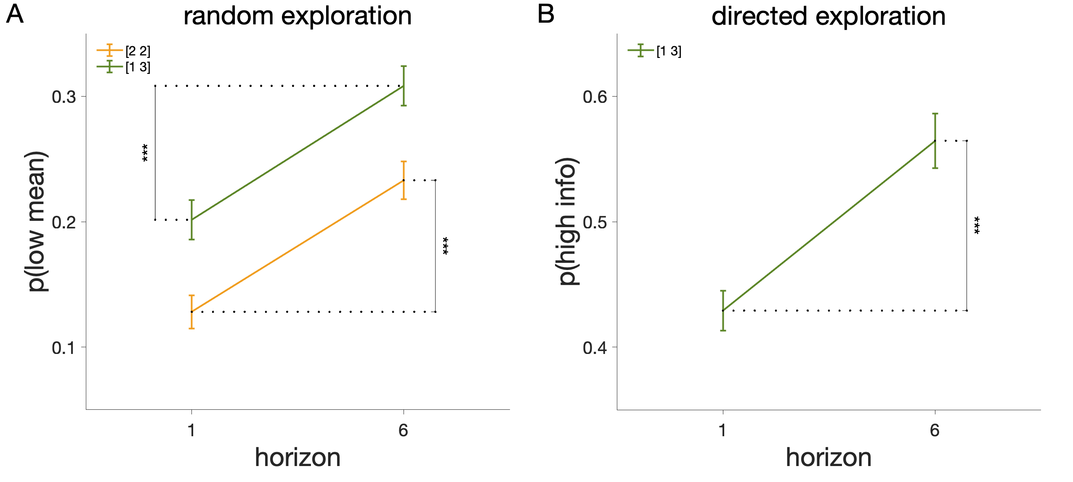

Slide 3
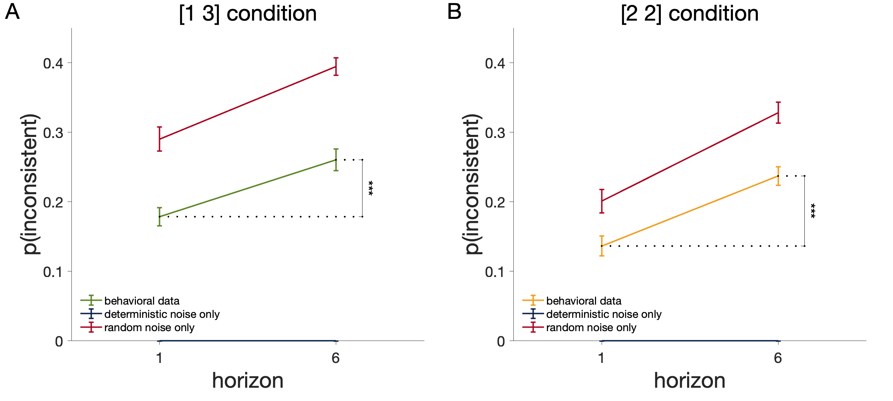

Slide 4
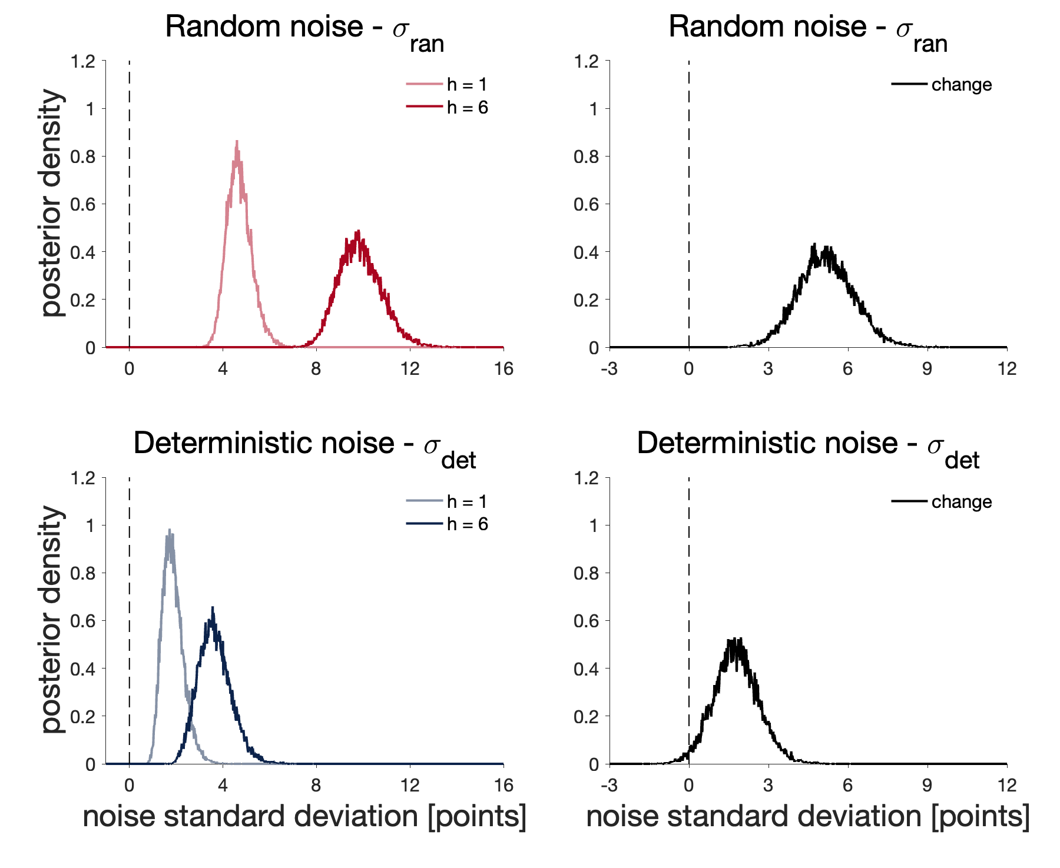
4 chains, 5000 samples, burnin 5000
50 chains, 1000 samples, burnin 2000
Bug in the code: sqrt(2) * noise

Slide 5
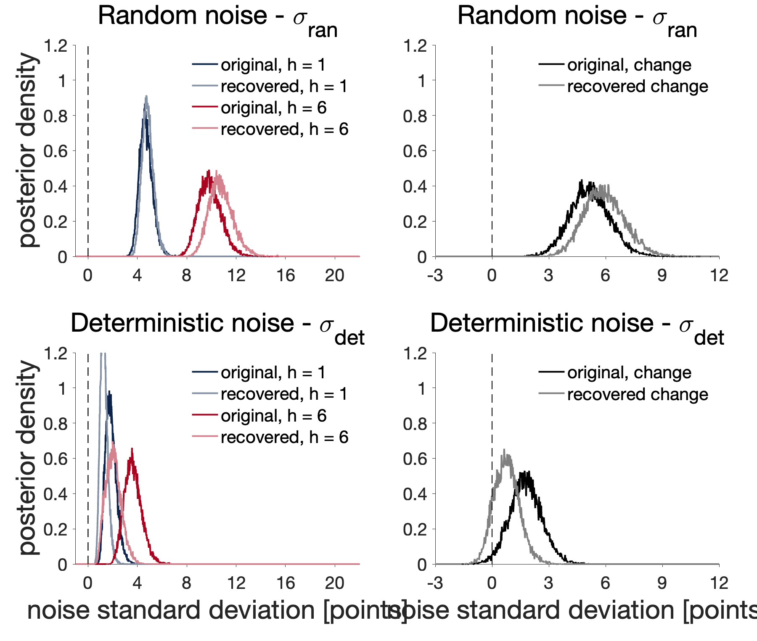
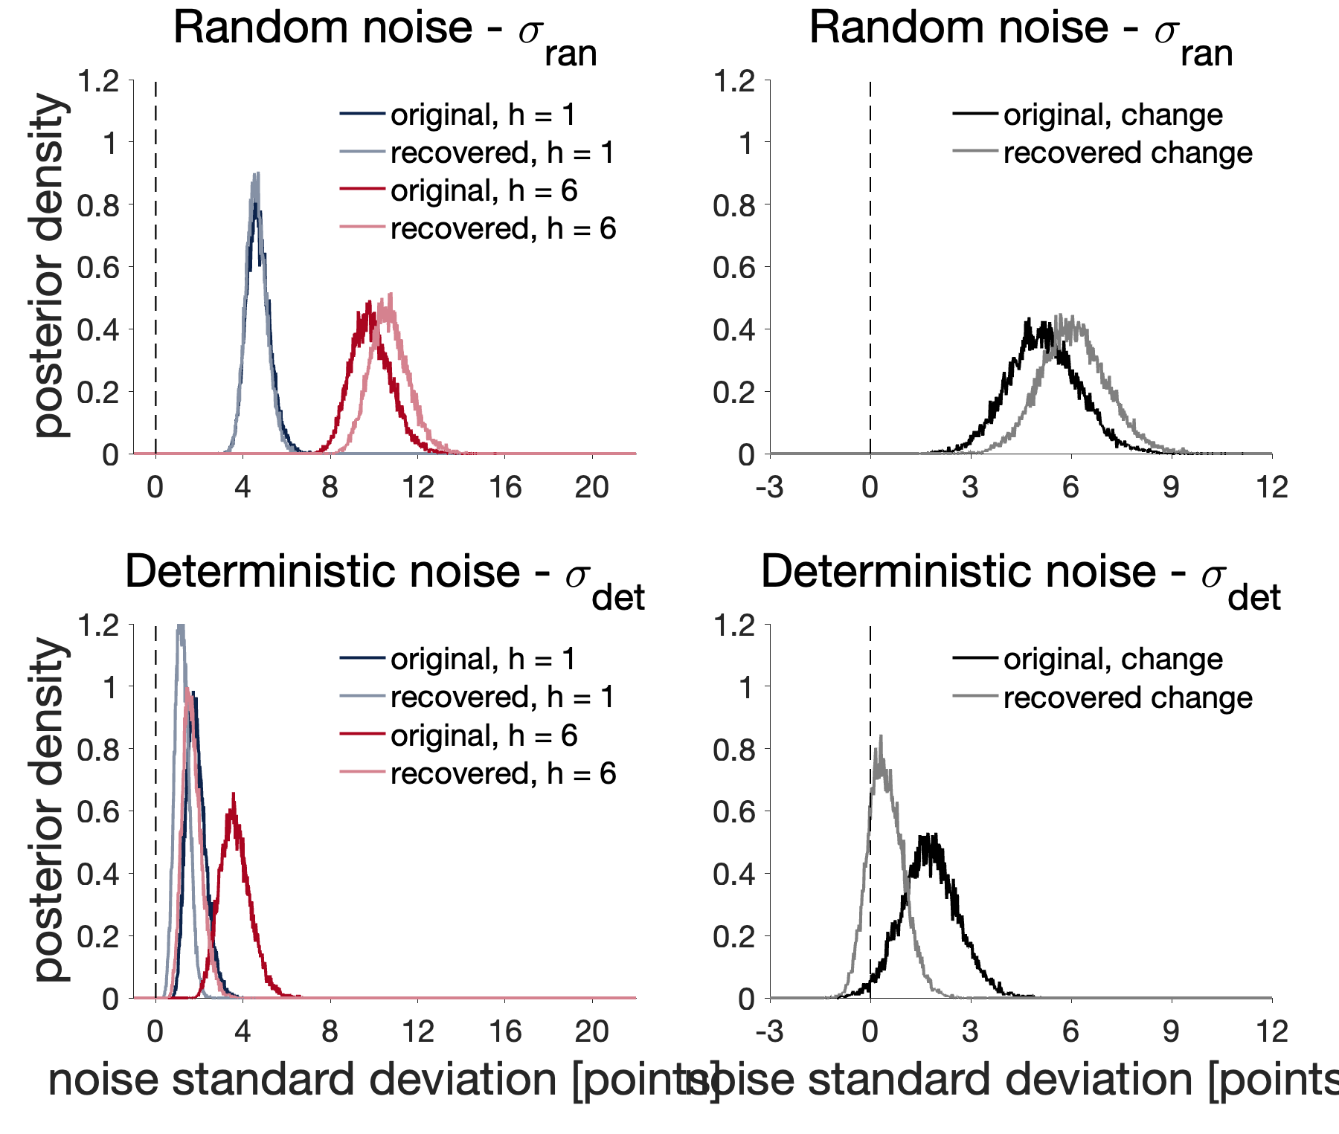
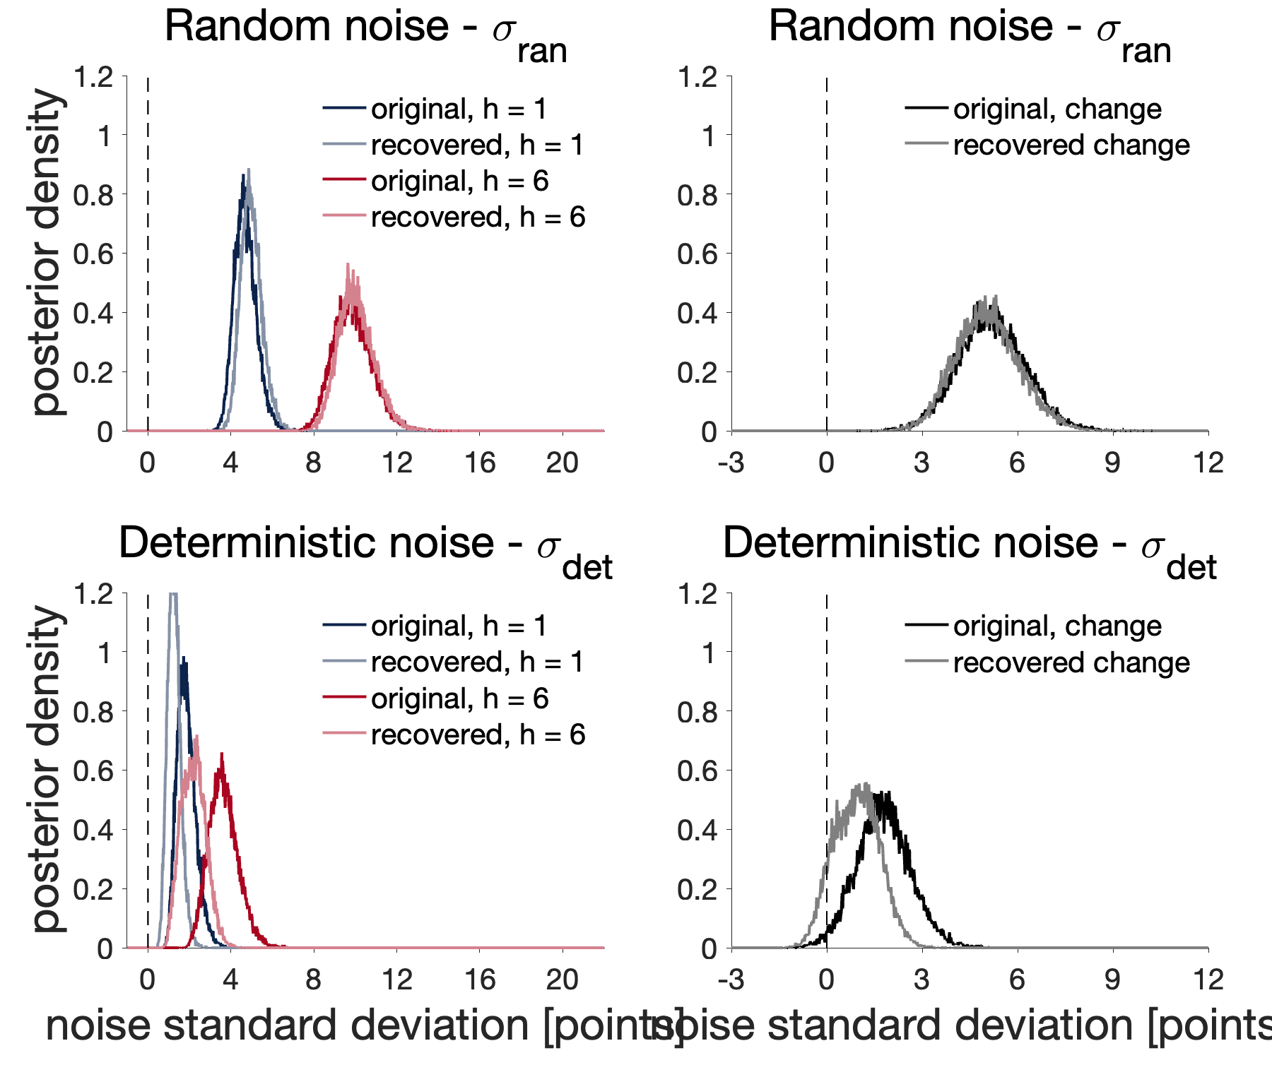
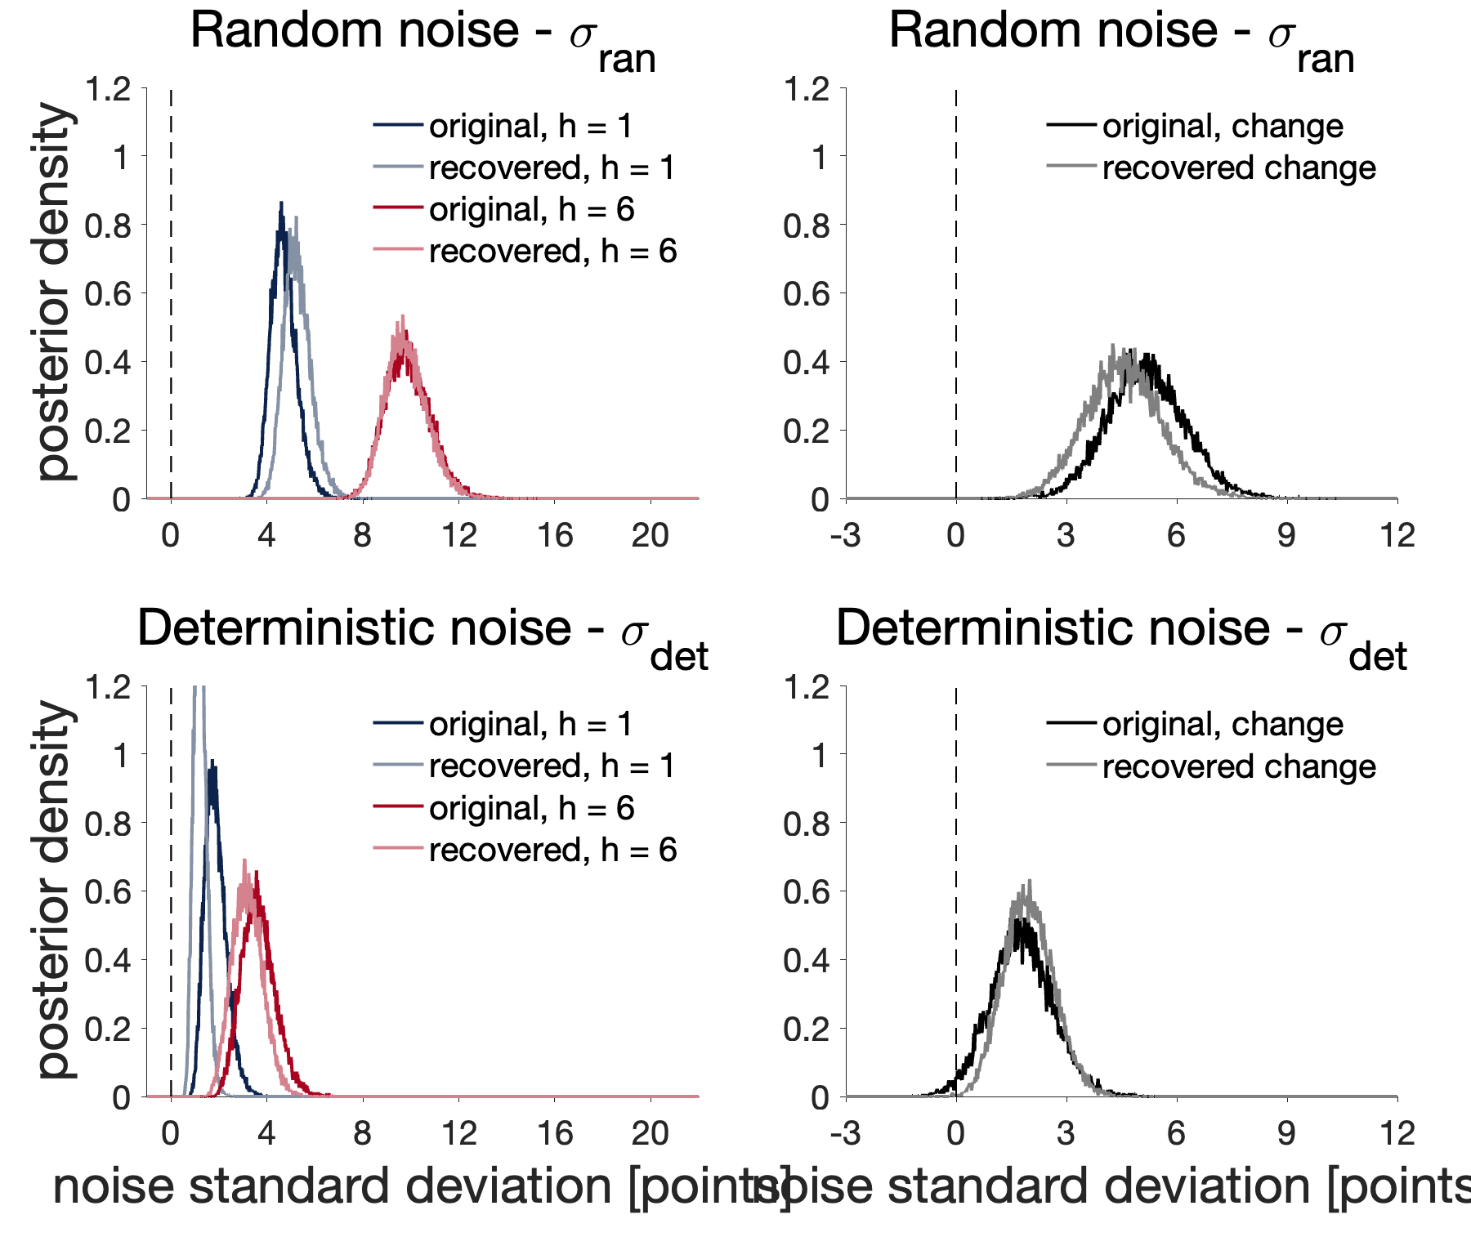
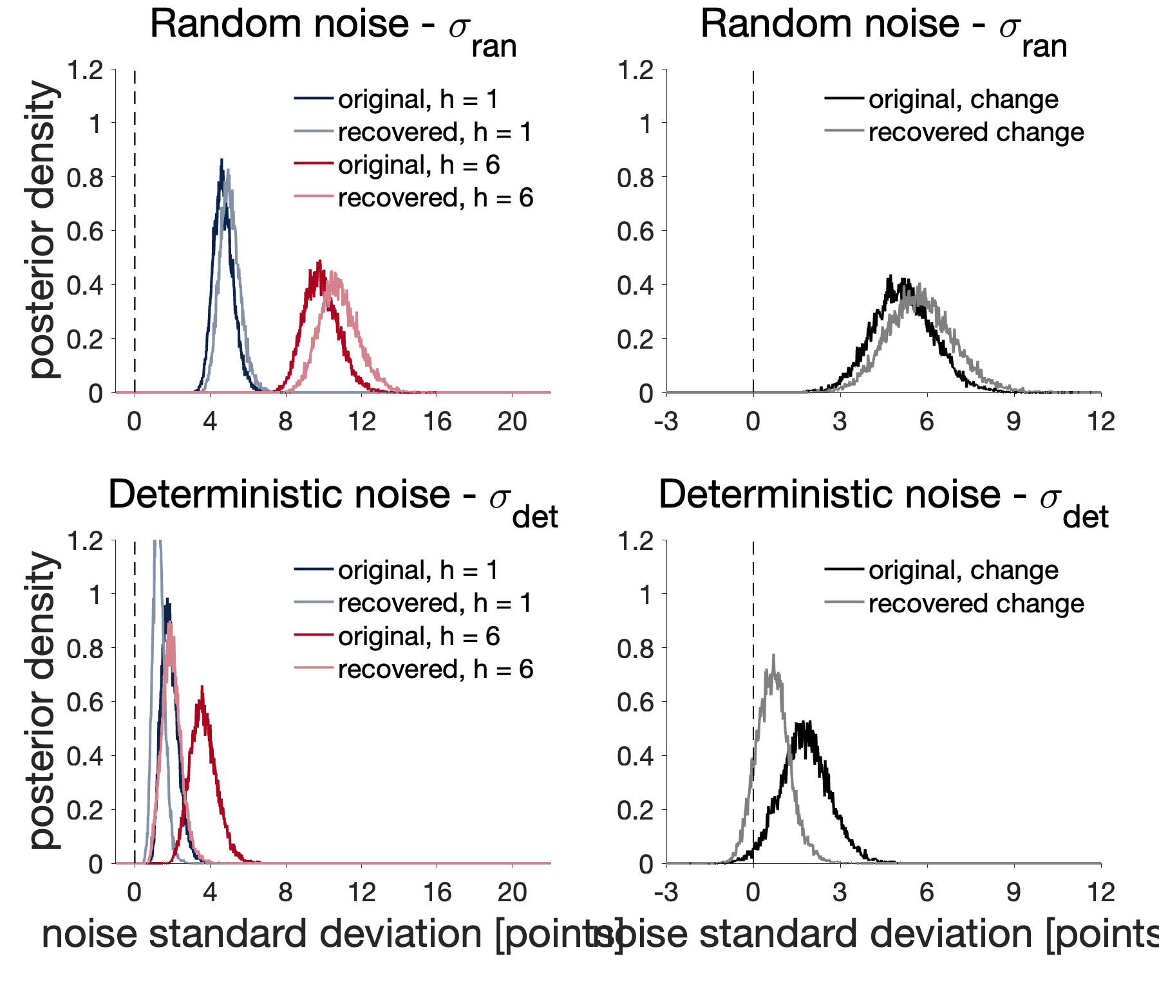
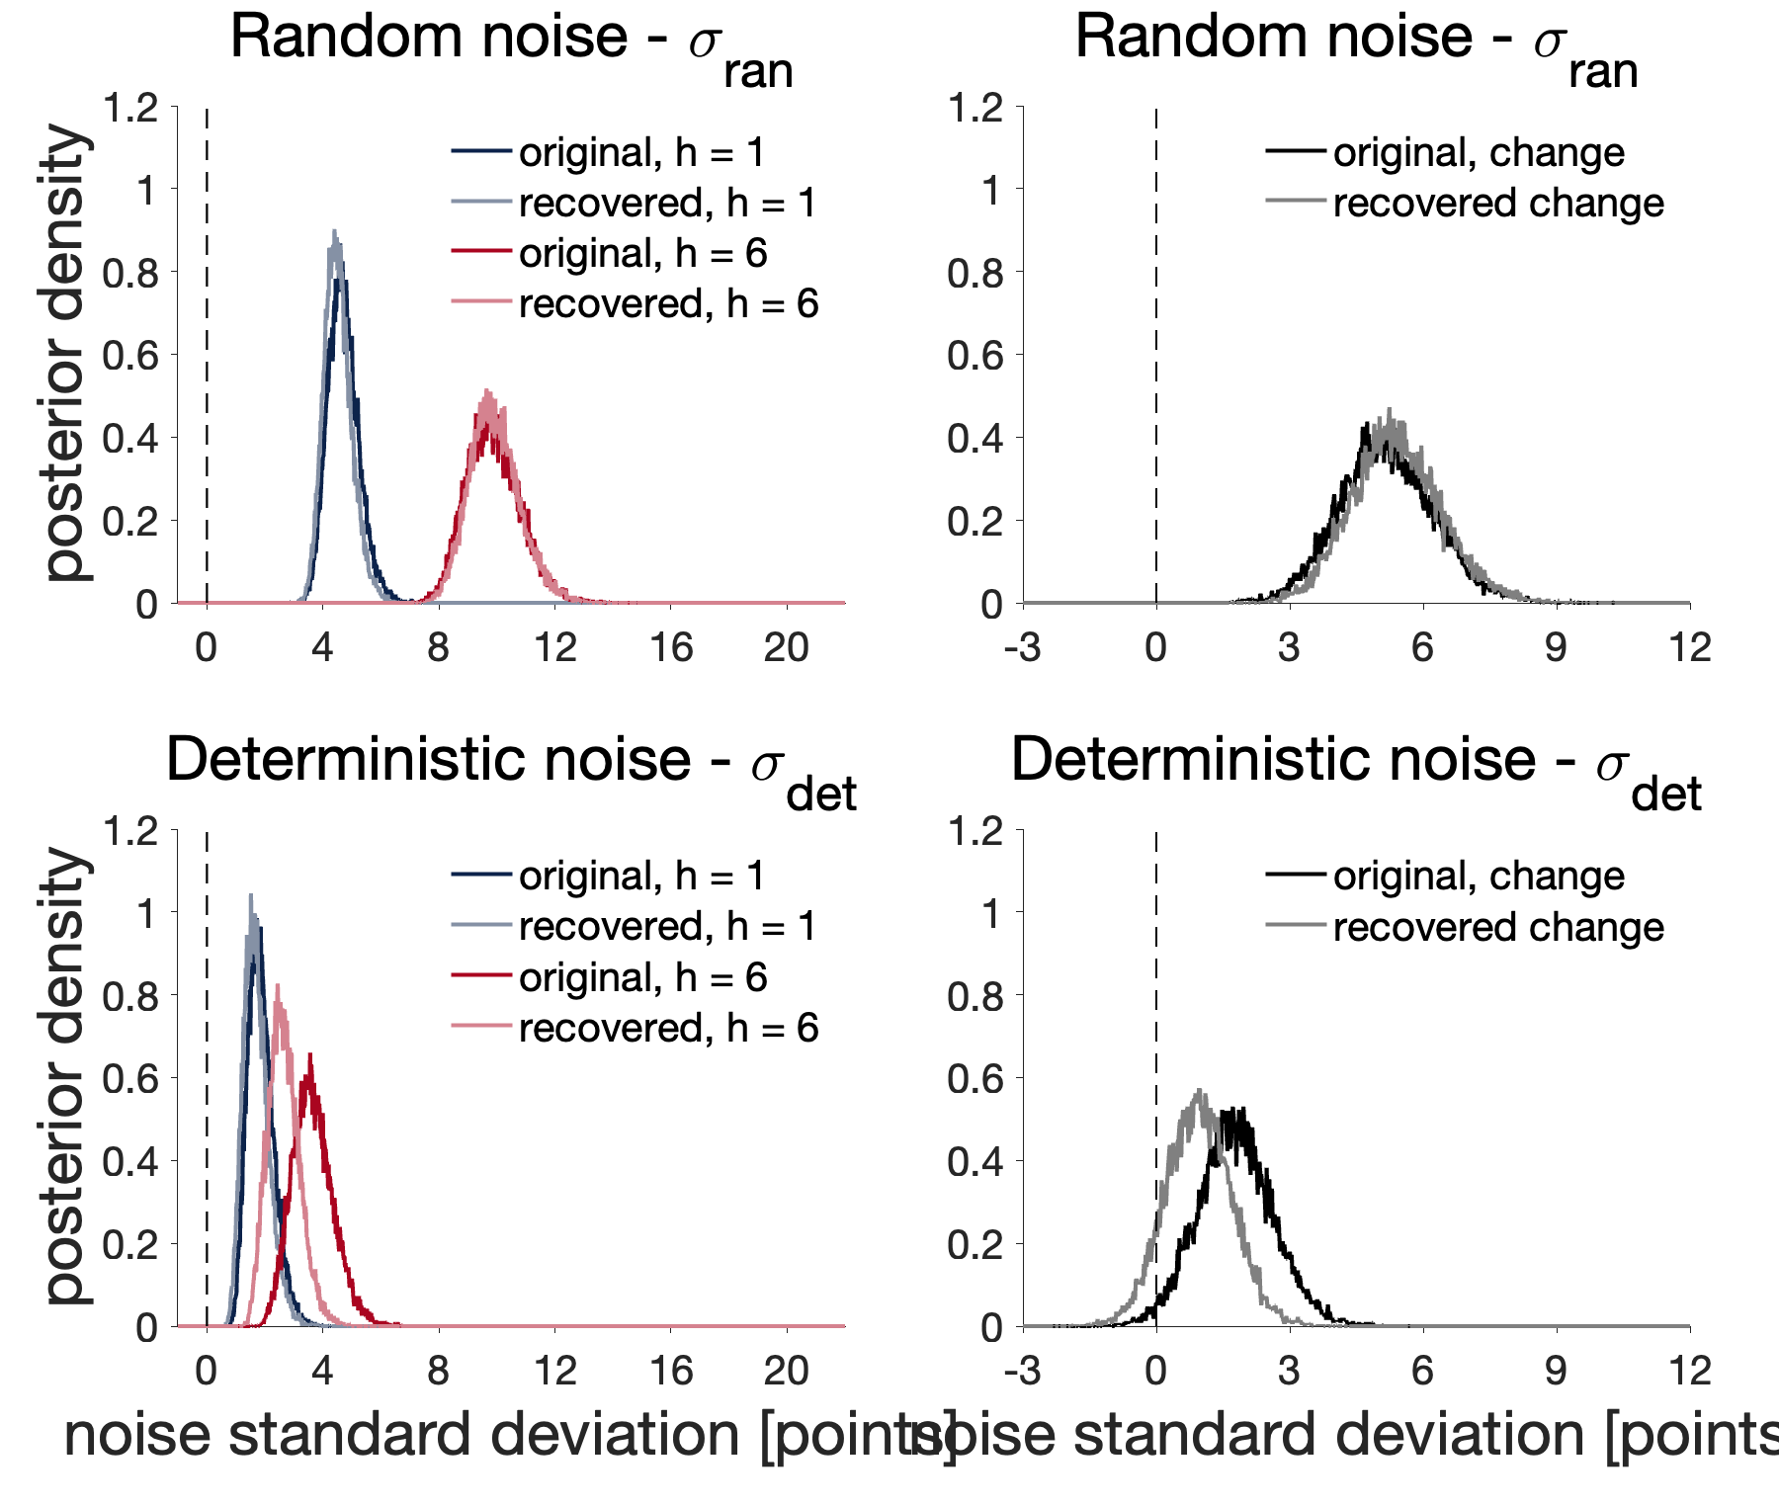
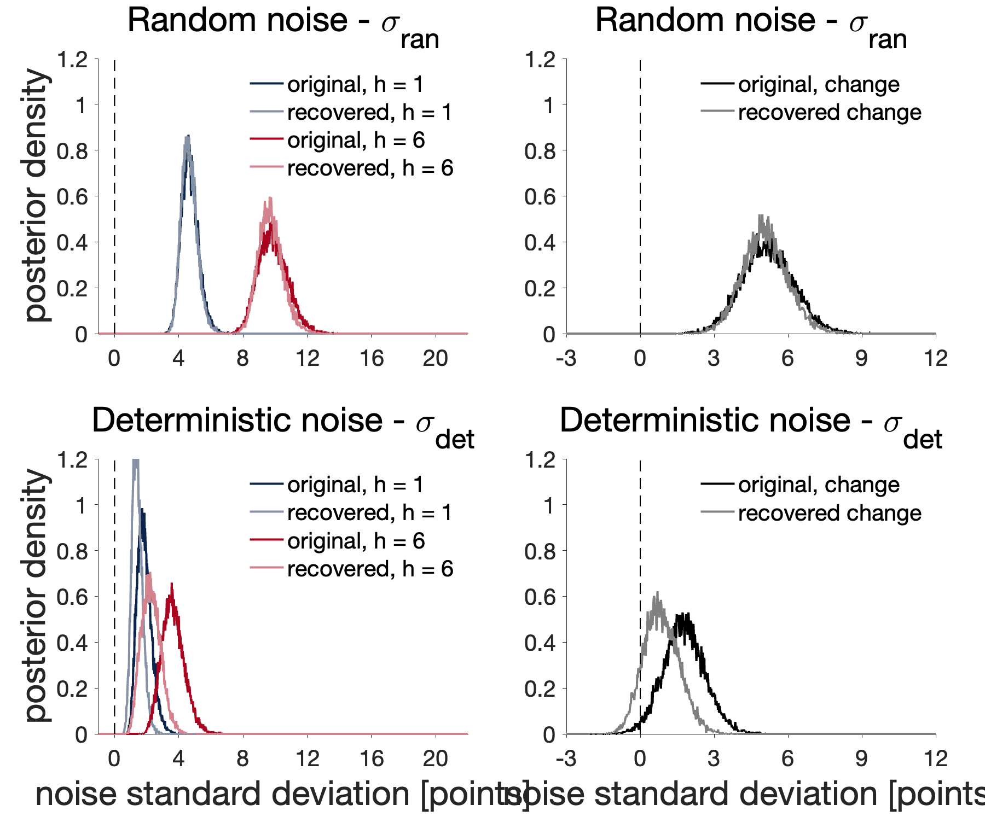
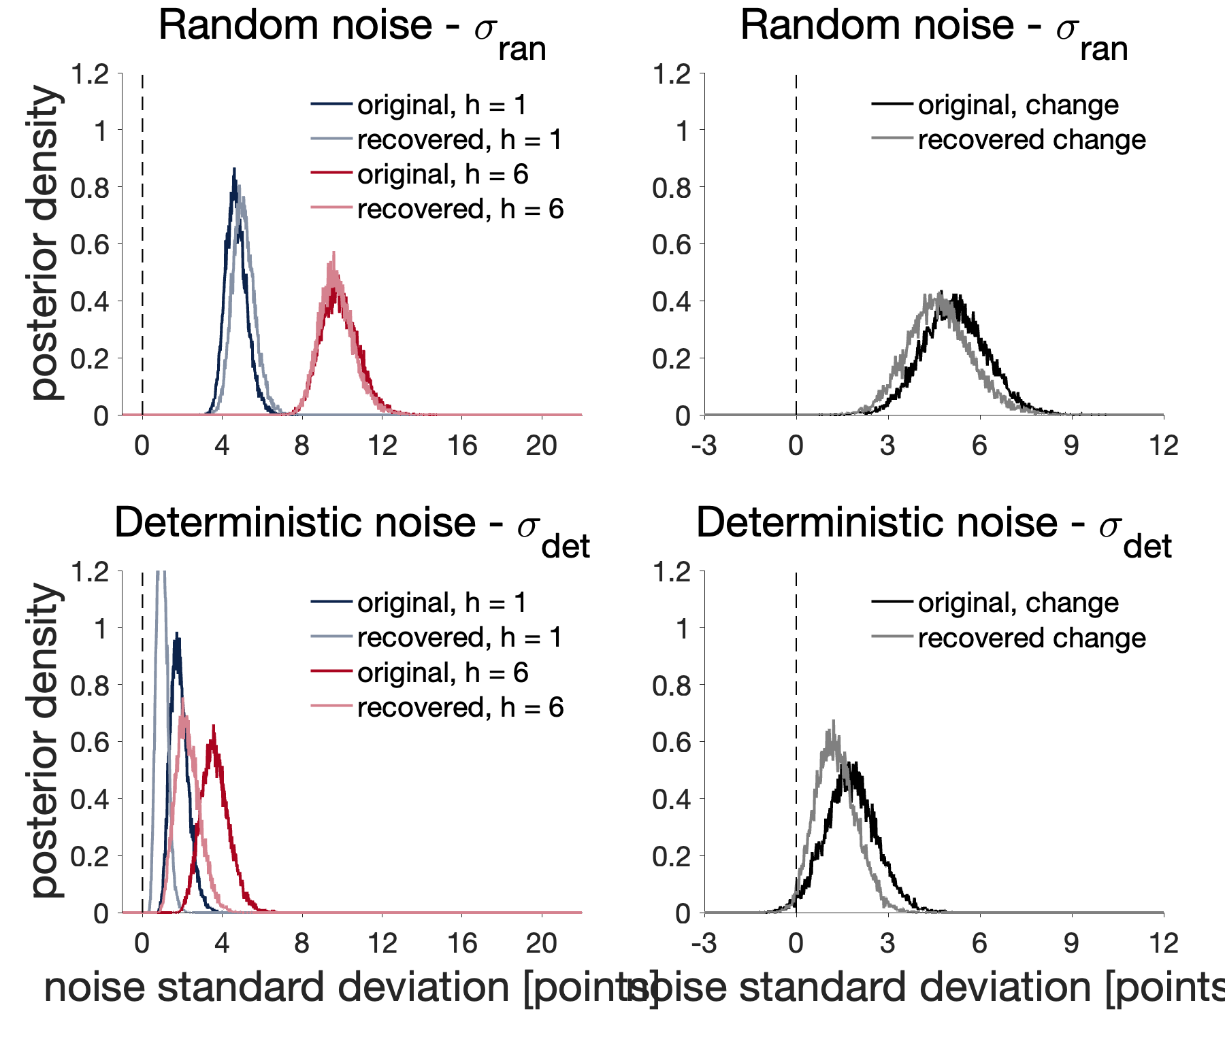
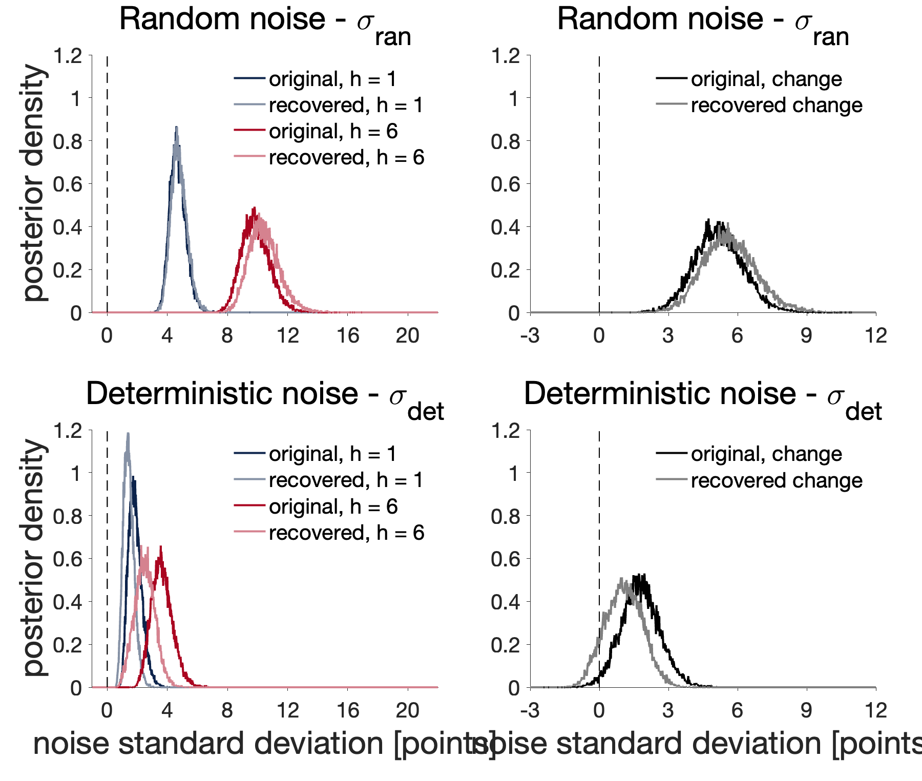
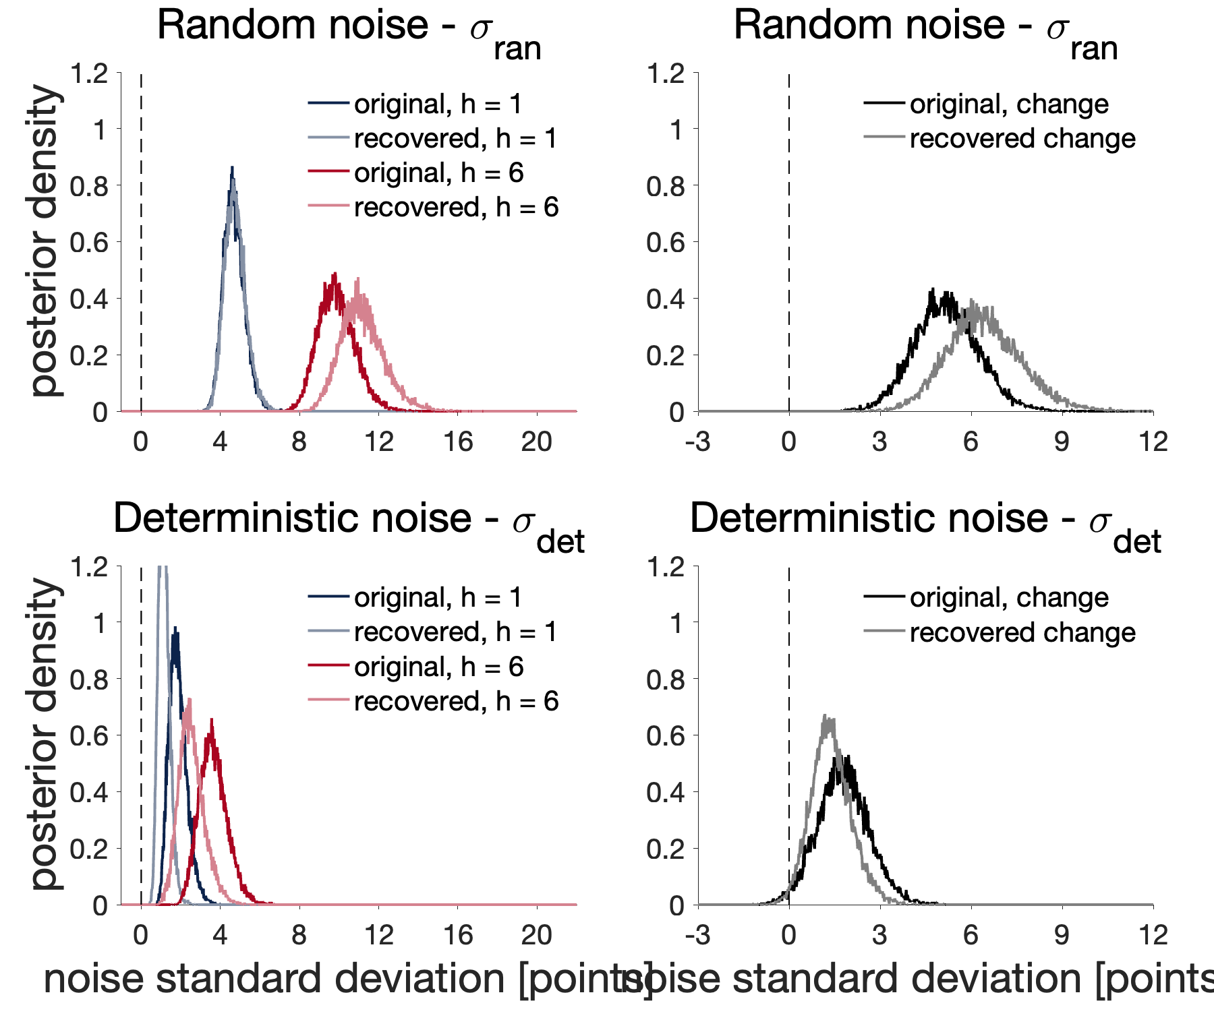
Old:
Inconsistent recovery
4 chains, 5000 samples

Slide 6
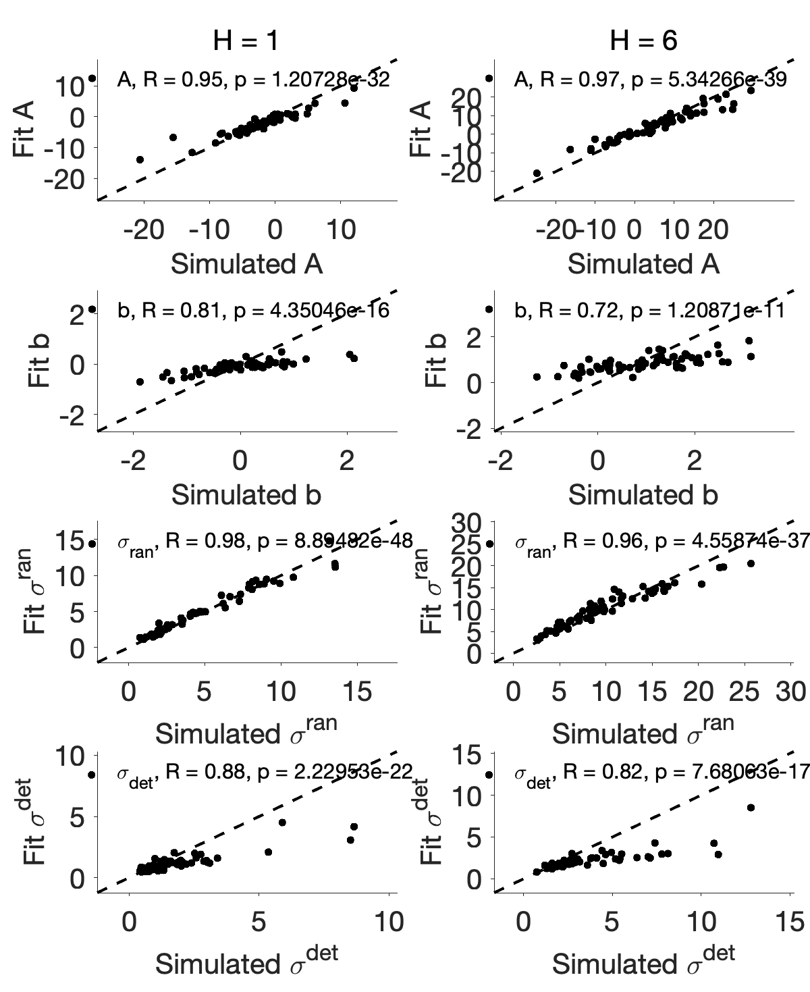

Old: average of 10 recovery
We underestimate deterministic noise…

Slide 7
New: 50 chains

Slide 8
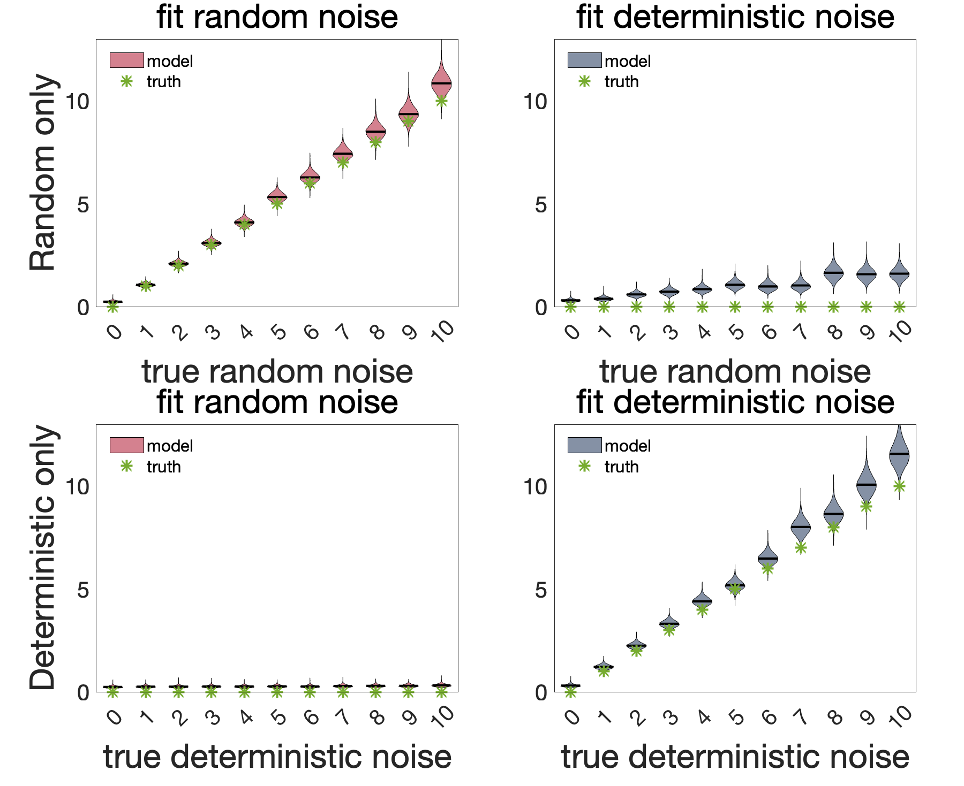
But this suggests:
If anything, we should overestimate deterministic noise…
Also, can the horizon dependence for deterministic noise arise from the leak from random noise?

Slide 9
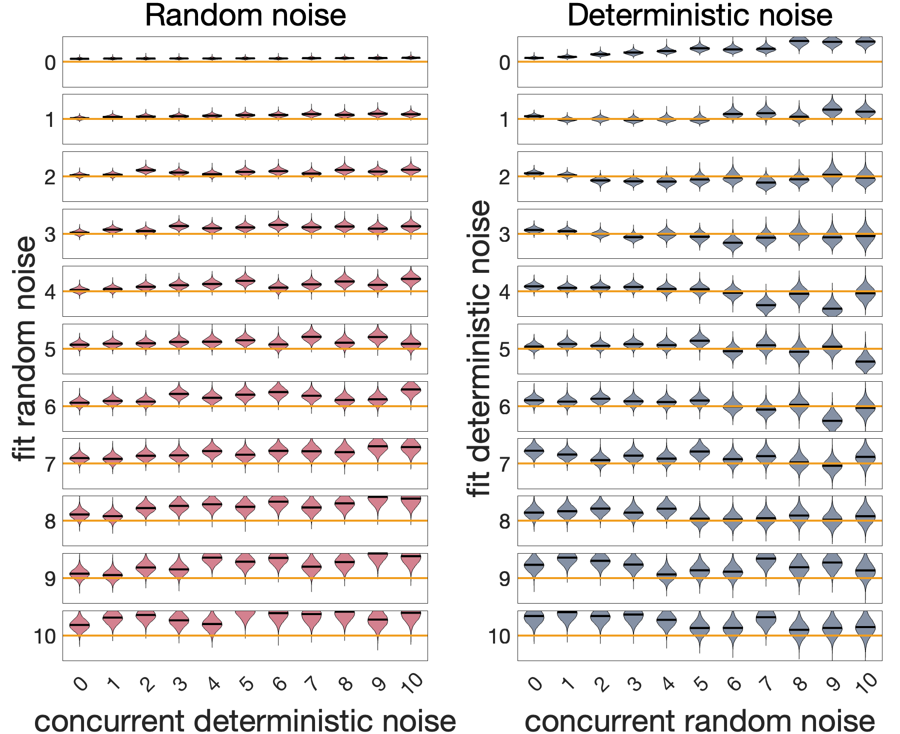
Overall, this model can separate det vs ran noise
Overestimate both for large noises…

Slide 10
Model without info bonus

Slide 11
50 chains, 1000 samples per chain, right: average across 50 simulations

Slide 12
50 chains, 1000 samples per chain, each chain fit to a different simulation

Slide 13
ratio
Without abs
With abs

