Slide 1















A
B
C
Guided trials
Free trials
Game 1
Fixed H
$$−>$$
$$−>$$
Short condition
H = 1
$$→$$
Game 1 start
home base
Trial 1 cue
(guided)
Trial 1 response
Long condition
Game 2
Fixed H
$$−>$$
$$−>$$
$$−>$$
H = 6
$$→$$
home base
Trial 2 cue
(guided)
Trial 2 response
Extra long condition
Game 3
Fixed H
$$−>$$
$$−>$$
$$−>$$
home base
Trial 3 cue
(guided)
Trial 3 response
…
H = 15
$$−>$$
$$−>$$
$$−>$$
$$−>$$
home base
Trial 4 cue
(free)
Trial 4 response
Game 2 start
home base
Notes:
Figure 1: A: In rat experiments, the 2 sets of home bases, lights and feeders were used alternatively between games. B. Timeline of the rat experiments. Rats were trained to start each trial by reaching the home base (HB, no reward). They were then given a small number (here nGuided = 3) of guided trial (e.g. Trial 1-3, one blinking light, here 1 drop). Subsequent trials consisted in 2 simultaneously blinking lights (here Horizon = 1). The end of a game was signaled by a sweeping tone and a change of home base. C. Horizon conditions (the number of free trials) in Experiment 1, the number of guided trials are always 3 in Experiment 1.

Slide 2

A
B
Guided trials
Free trials
nG = 3
H = 1
H = 1
$$→$$
H = 6
nG = 1
H = 6
H = 1
$$→$$
H = 6
nG = 0
H = 1
H = 1
…
H = 6
Notes:
Figure 2: A. In rat Experiment 2 (except for the sound cue variant), horizon conditions are alternated between games. B. Task conditions (nGuided x Horizon) in Experiment 2. The number of guided trials are 0, 1 or 3 trials, the number of free trials (horizons) are either 1 or 6 trials. Note that when nGuided = 0, there are H + 1 free trials and the first of these are treated as a (self-guided) guided trial.

Slide 3





A
B
XX
3
XX
2
5
XX
XX
1
4
XX
+
$$−>$$
+
+
+
+
+
H = 1
Trial 1 cue
(guided)
Trial 1 response
H = 2
XX
3
XX
3
H = 5
$$−>$$
+
$$−>$$
5
+
XX
Trial 2 cue
(free)
Trial 2 choice
H = 10
XX
3
XX
3
$$−>$$
5
+
XX
$$−>$$
5
+
XX
5
XX
Trial 3 cue
(free)
Trial 3 response
Notes:
Figure 3: A. Timeline of the human experiments (Experiment 4 and 5): Human subjects were presented with a 2-armed bandit display of explicit time horizon (here Horizon = 2). They were guided to the first bandit and obtained a visible reward (here 3 points). Subsequent trials consisted in simultaneously colored squares indicating free choices between the two bandits. B. Task conditions in Experiment 4 and 5. There are four horizon conditions H = 1, 2, 5 and 10.

Slide 4
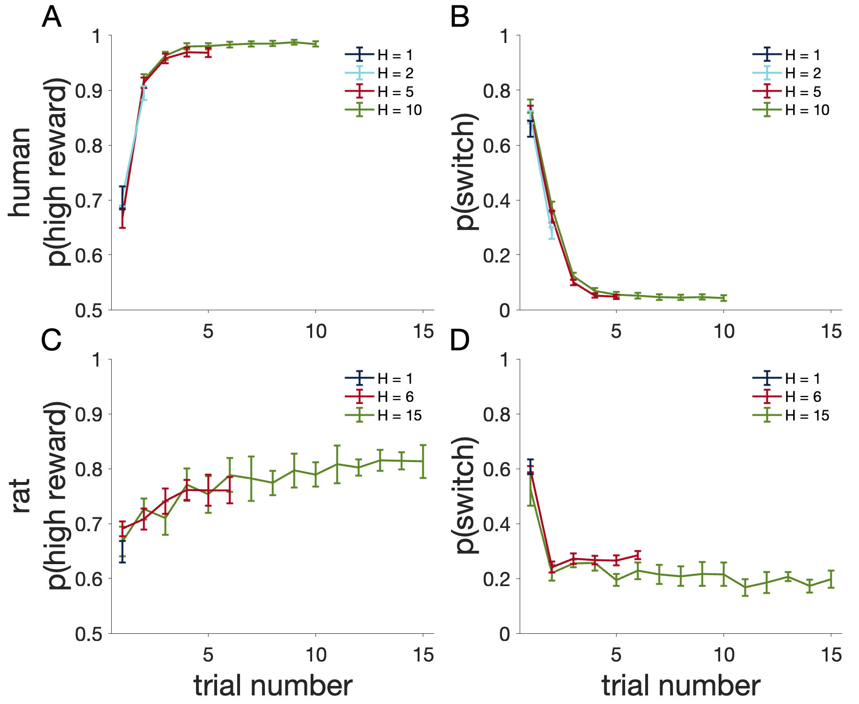
Notes:
Figure 4: A and C. Probability of choosing the option with the highest reward for humans (A) and rats (C). B and D. Probability of switching from the last chosen option in free choices for humans (B) and rats (D). The human data here is from Experiment 4 and the rat data is from Experiment 1.

Slide 5
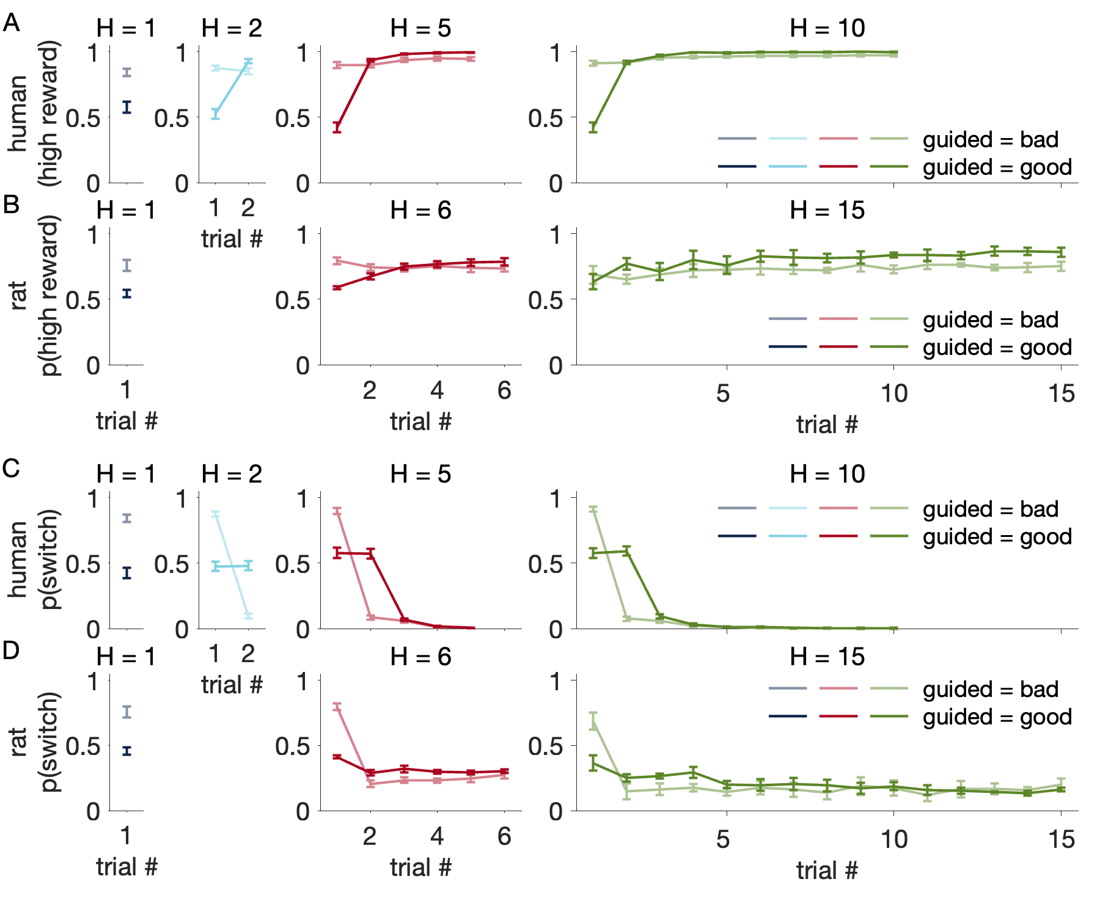
Notes:
Figure 5: Probability of choosing the option with the highest reward, i.e. p(high reward) and probability of switching from the last chosen option in free choices, i.e. p(switch), split up by whether the guided option is the objectively better option, for humans (A, C) and rats (B, D). (Experiment 1 and 4)

Slide 6
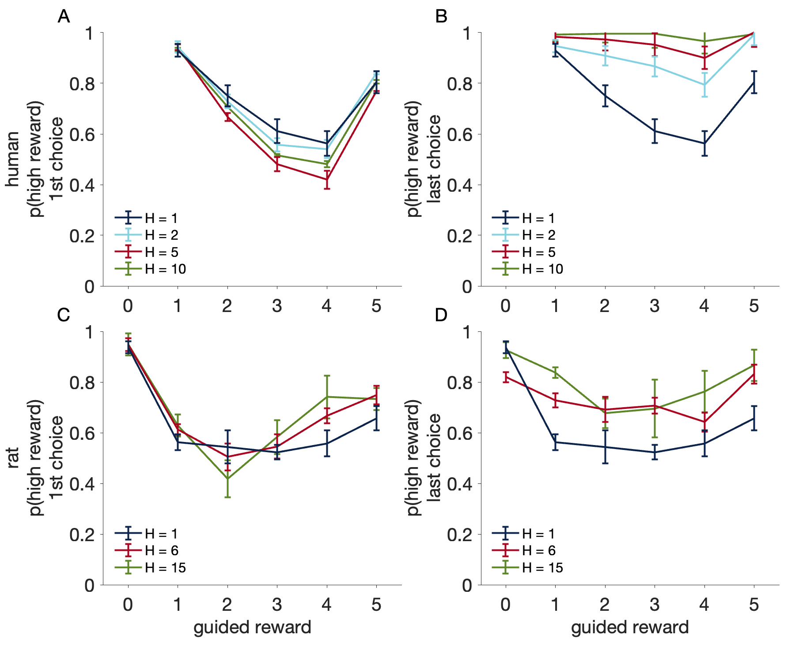
Notes:
Figure 6: Probability of choosing the option with the highest reward in the 1st and last free choice as a function of guided reward size. A and C. Probability of choosing the high reward option in the 1st choice of each horizon as a function of guided reward size for humans(A) and for rats (C). B and D. Probability of choosing the high reward option in the 1st free choice of each horizon as a function of guided reward size for humans (B) and for rats(D). (Experiment 1 and 4)

Slide 7
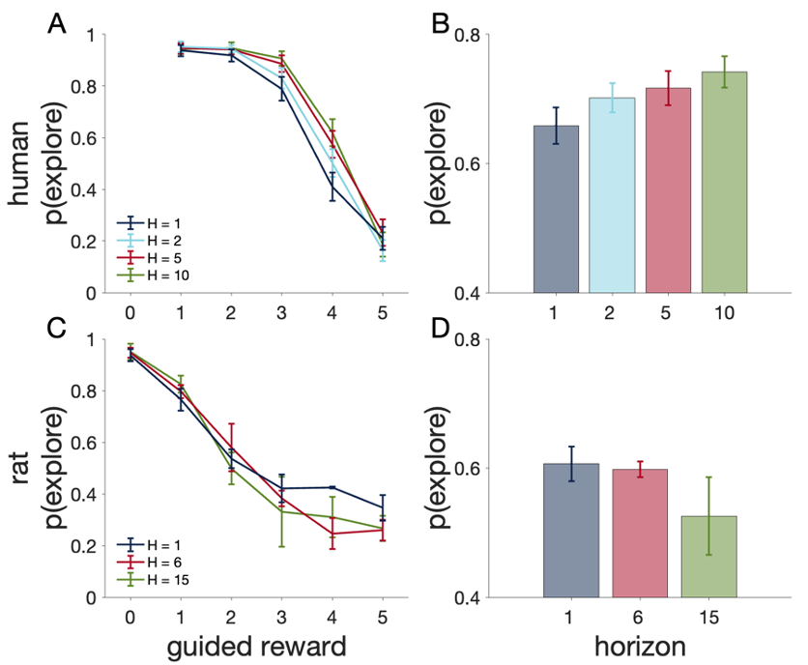
Notes:
Figure 7: A and C. Probability of exploring the unguided option (i.e. P(switch) at trial number 1) in the 1st free choice as a function of guided reward size for humans (A) and for rats (C). B and D. Probability of exploring the unguided option as a function of horizon for humans (B) and for rats (D). (Experiment 1 and 4)

Slide 8
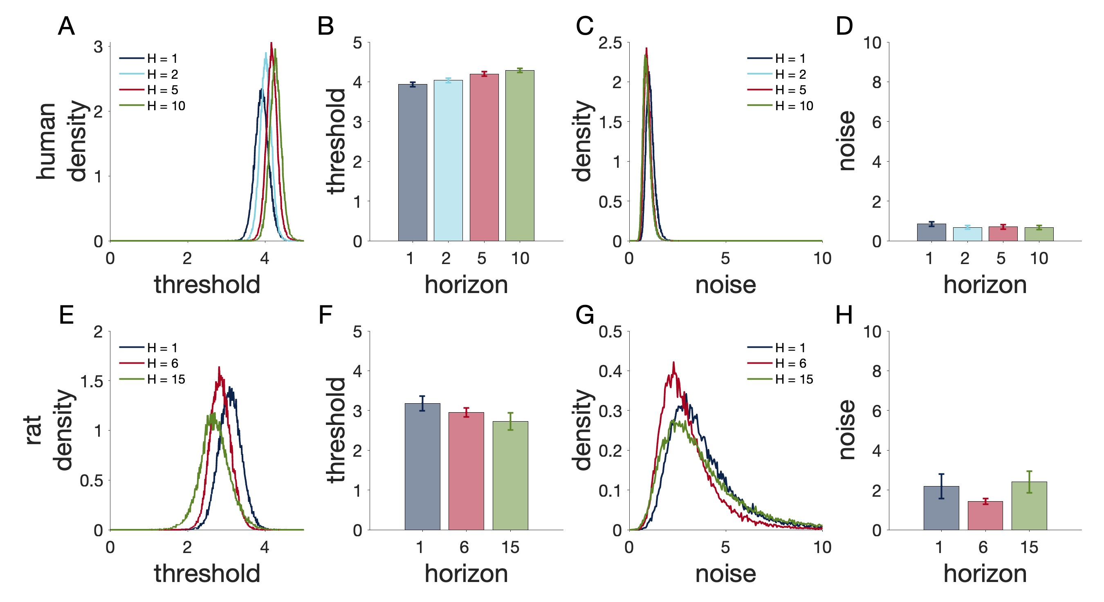
Notes:
Figure 8: Model-based estimates of exploration threshold and decision noise for humans (A-D) and rats (E-H). A and E. Posterior distributions over the group-level means of exploration threshold $θ$. B and F. Means of the subject-level estimates of exploration threshold $θ$ as a function of horizon. C and G. Posterior distributions over the group-level means of decision noise $σ$. D and H. Means of the subject-level estimates of decision noise $σ$ as a function of horizon. (Experiment 1 and 4)

Slide 9
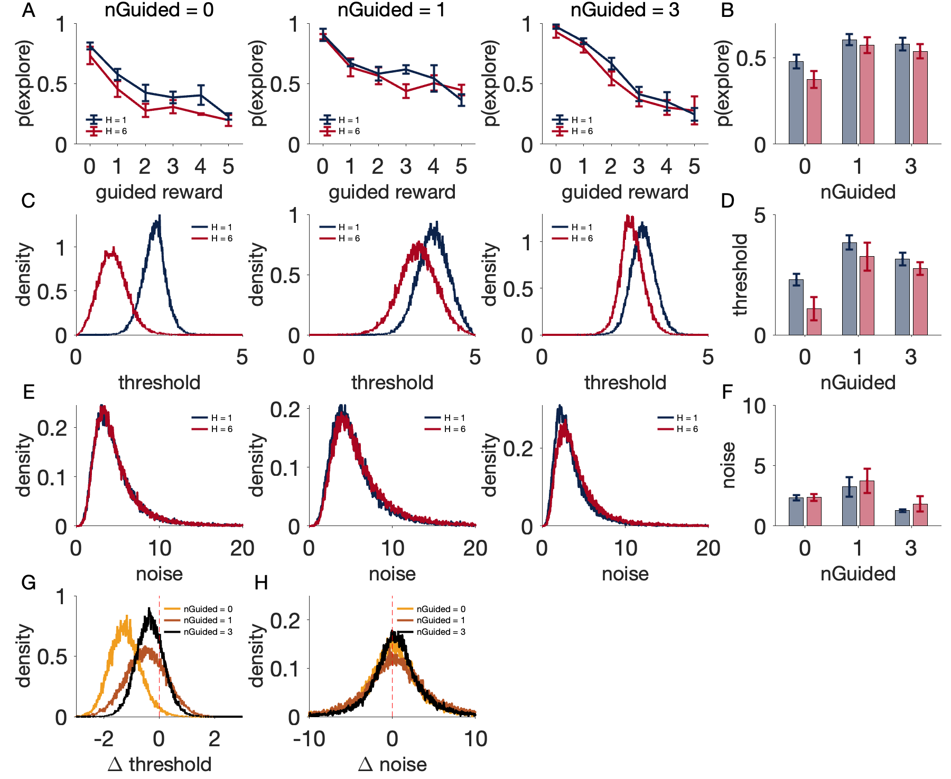
** horizon
** horizon
n.s. horizon
Notes:
Figure 9: Differences in directed and random exploration in H = 1 vs H = 6 in rats. A. Probability of exploring the unguided option vs guided reward size separated by horizon condition, for nGuided = 0, 1 and 3 respectively. B. Average p(explore) by horizon (blue is H = 1, red is H = 6) and nGuided. C. Posterior distributions over the group-level means of exploration threshold $θ\left(H=1\right)$ and $θ(H=6)$ for nGuided = 0, 1 and 3. D. Means of the subject-level estimates of exploration threshold $θ$ as a function of horizon. E. Posterior distributions over the group-level means of decision noise $σ\left(H=1\right)$ and $σ(H=6)$ for nGuided = 0, 1 and 3. F. Means of the subject-level estimates of decision noise $σ$ as a function of horizon. G. Posterior distribution over the group-level means of $θ\left(H=6\right)−θ\left(H=1\right)$. H. Posterior distribution over the group-level means of $σ\left(H=6\right)−σ\left(H=1\right).$ (Experiment 2)

Slide 10
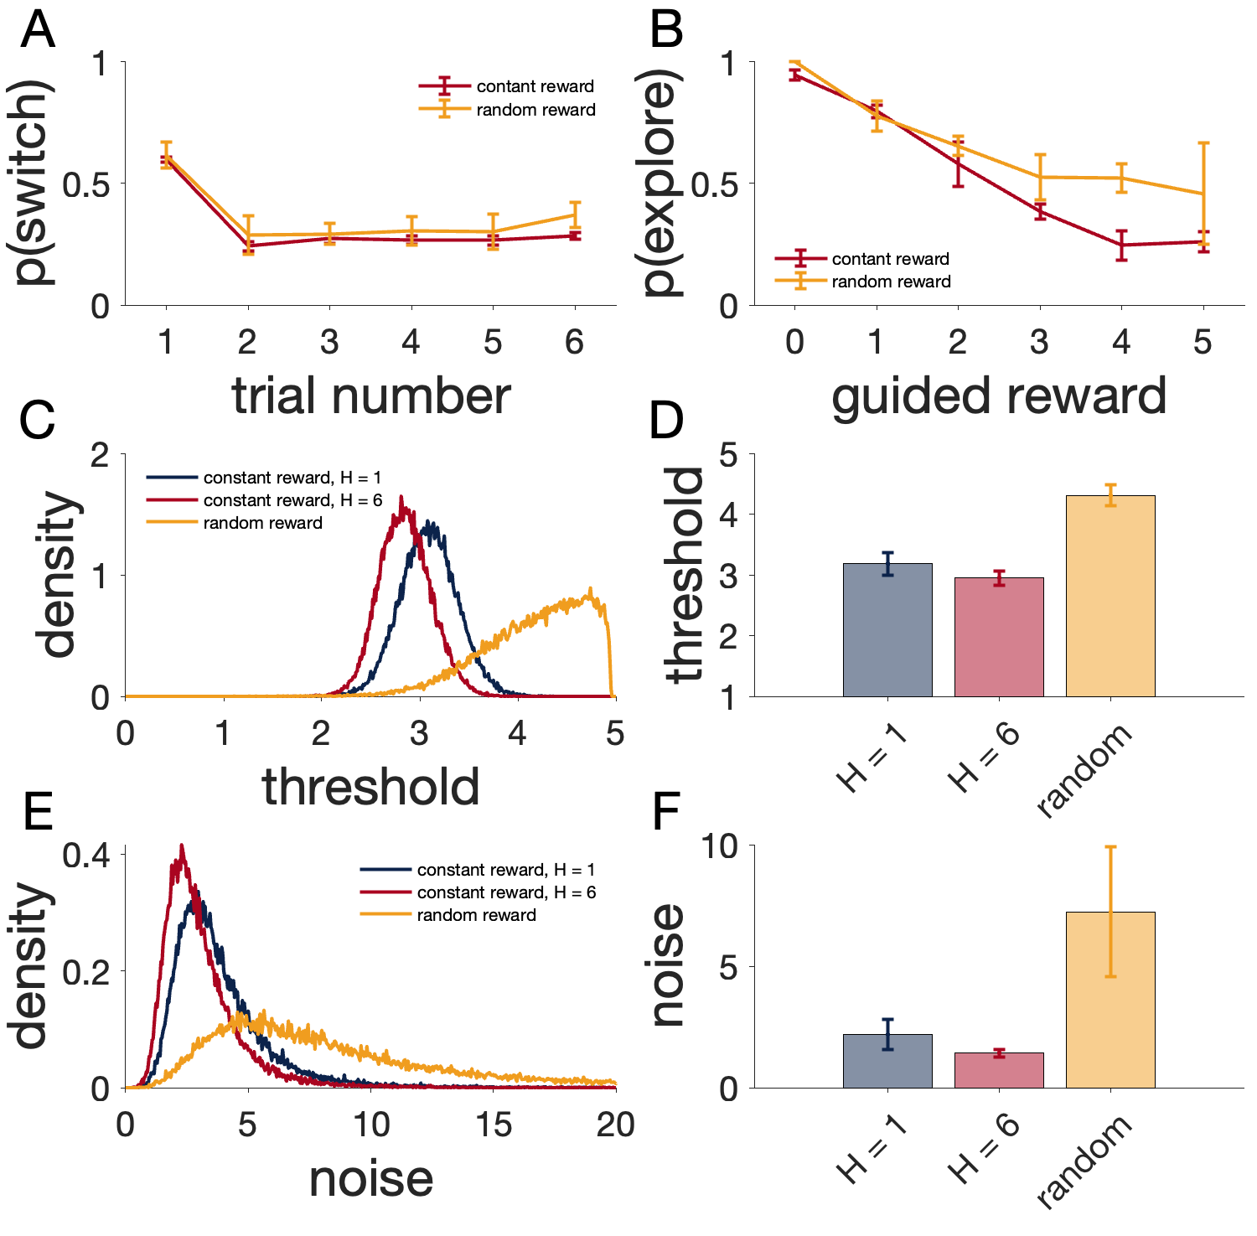
***
*
Notes:
Figure 10: Effects of volatility on exploration by comparing random vs constant reward conditions (Experiment 3). A. Probability of switching from the last chosen option as a function of trial number. B. Probability of exploring the unguided option in the 1st free choice as a function of guided reward size. C. Posterior distributions over the group-level means of exploration threshold $θ.$ D. Means of the subject-level estimates of exploration threshold $θ$. E. Posterior distributions over the group-level means of decision noise $σ$. F. Means of the subject-level estimates of decision noise $σ$.

Slide 11
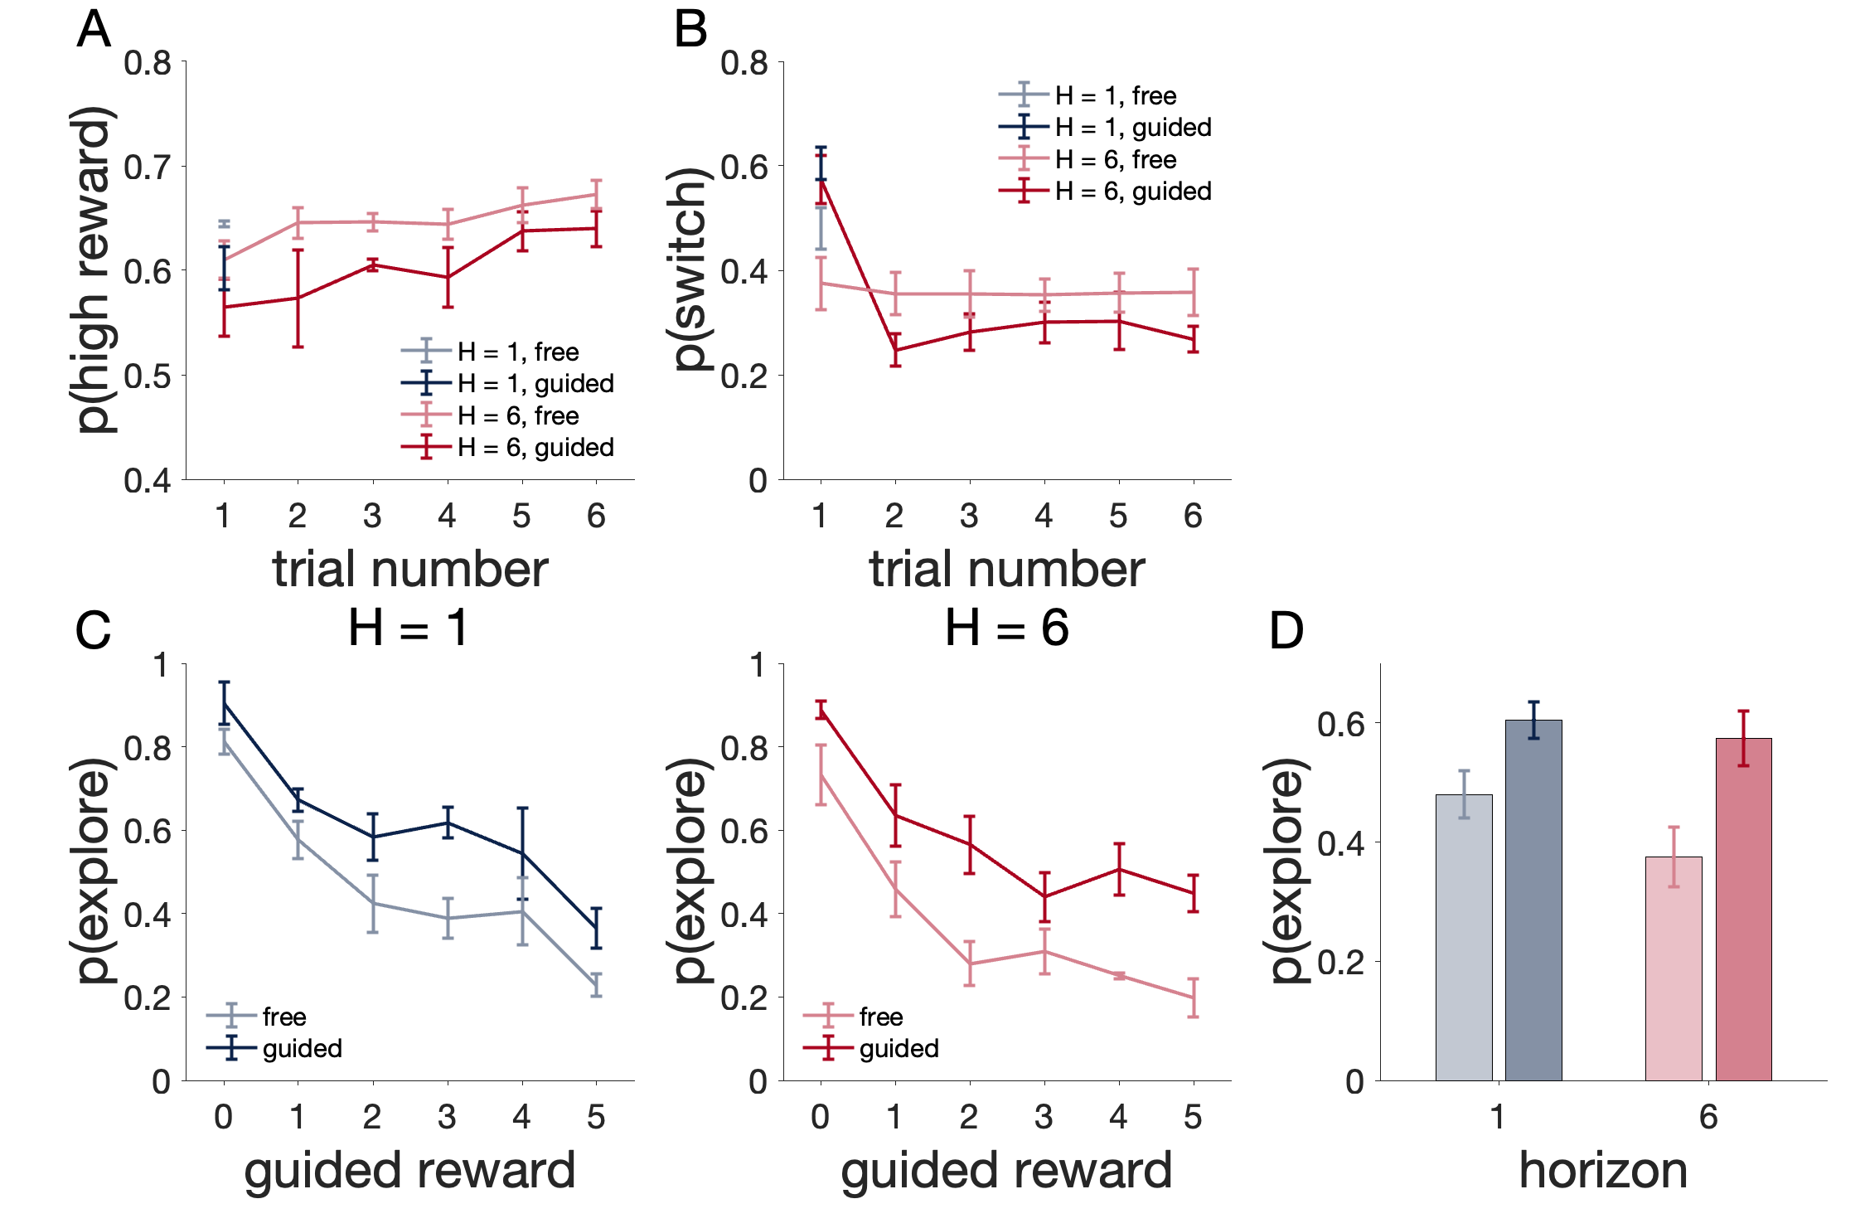
*** guided vs free
Notes:
Figure 11. Differences in exploration in Guided vs Free choice condition (Experiment 2). At the start of a game, rats were given one guided trial (1 light blinking, Guided condition) or a free choice instead (2 lights blinking, Free choice condition). A: Probability of choosing the option with the highest reward in free choices after the guided trial vs after the first free choice for H = 1 and H = 6. B: Probability of switching from the last chosen option in Guided vs Free condition for H = 1 and H = 6. C: Influence of reward size during the first trials (Guided or Free choice) on exploration. D: Average percentage of exploring the unchosen option in Guided vs Free choice condition by horizon, blue is H = 1, red is H = 6, lighter color is Free choice condition and darker color is Guided condition.

Slide 12
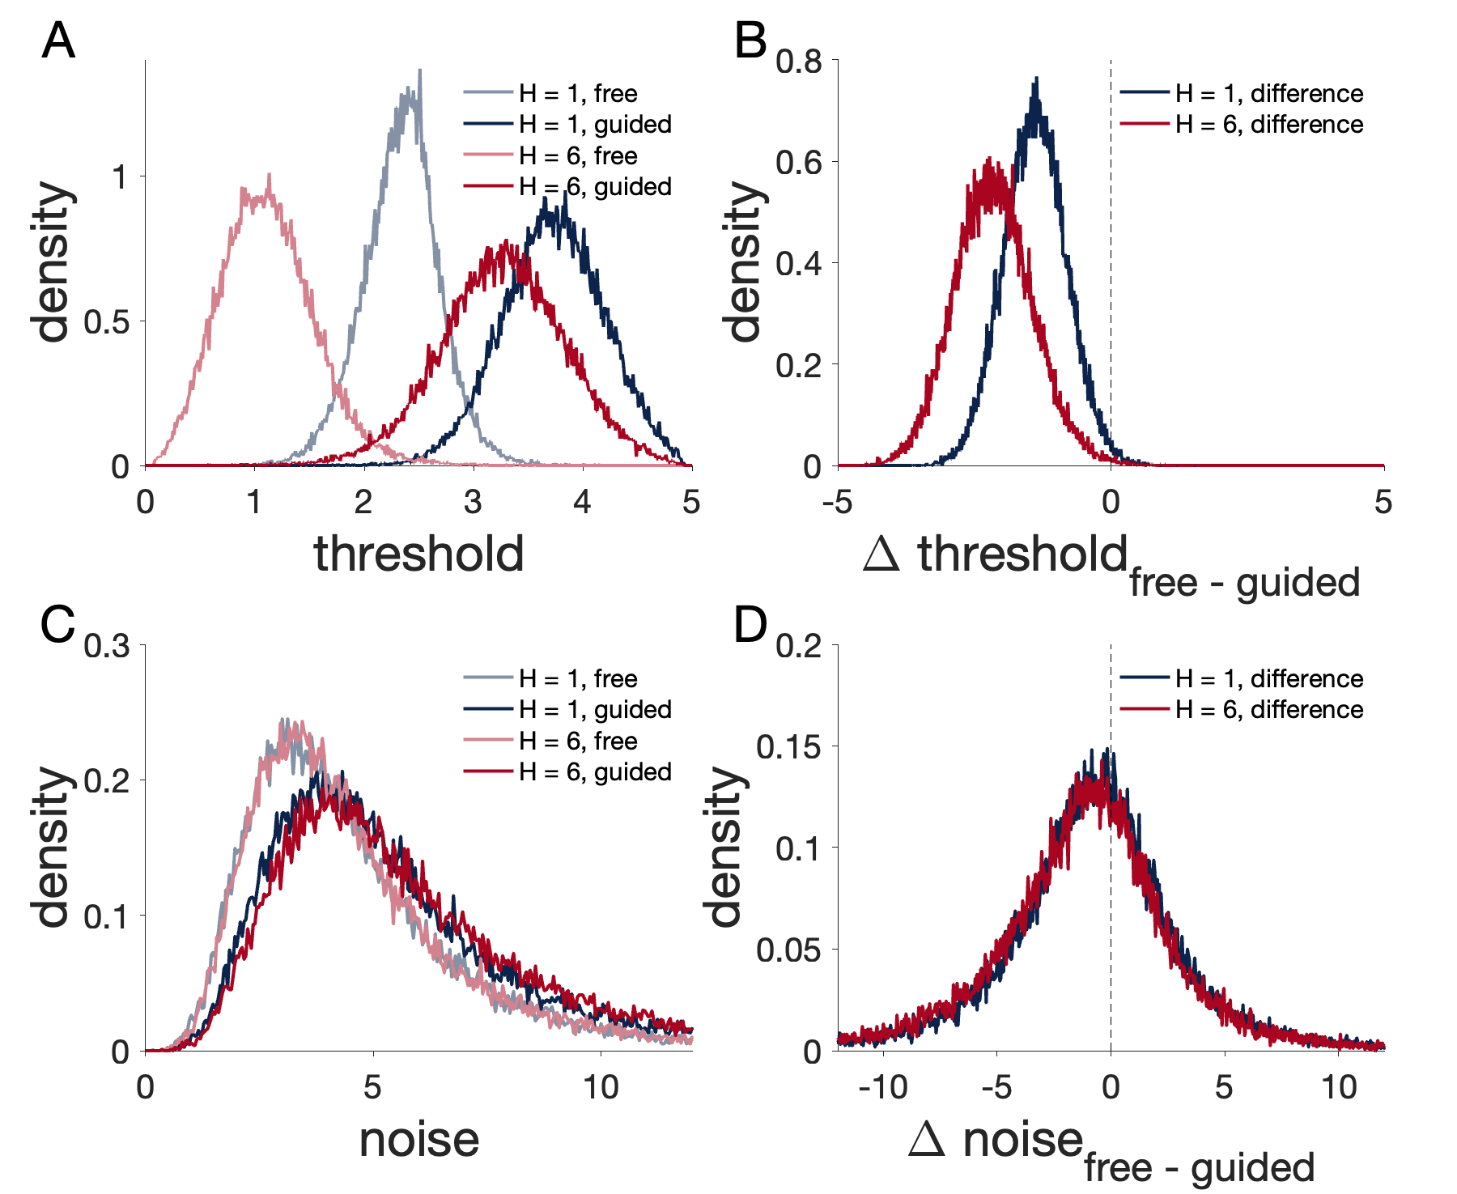
Notes:
Figure 12. Model estimates of exploration threshold and decision noise in Free choice condition vs Guided condition. A and C. Posterior distributions over the group-level means of exploration threshold $θ$ (A) and decision noise $σ$ (C). B. Posterior distribution over the group-level means of$θ\left(Free\right)−θ\left(Guided\right).$ D. Posterior distribution over the group-level means of $σ\left(Free\right)−σ\left(Guided\right).$

Slide 13
Supplementary figures

Slide 14
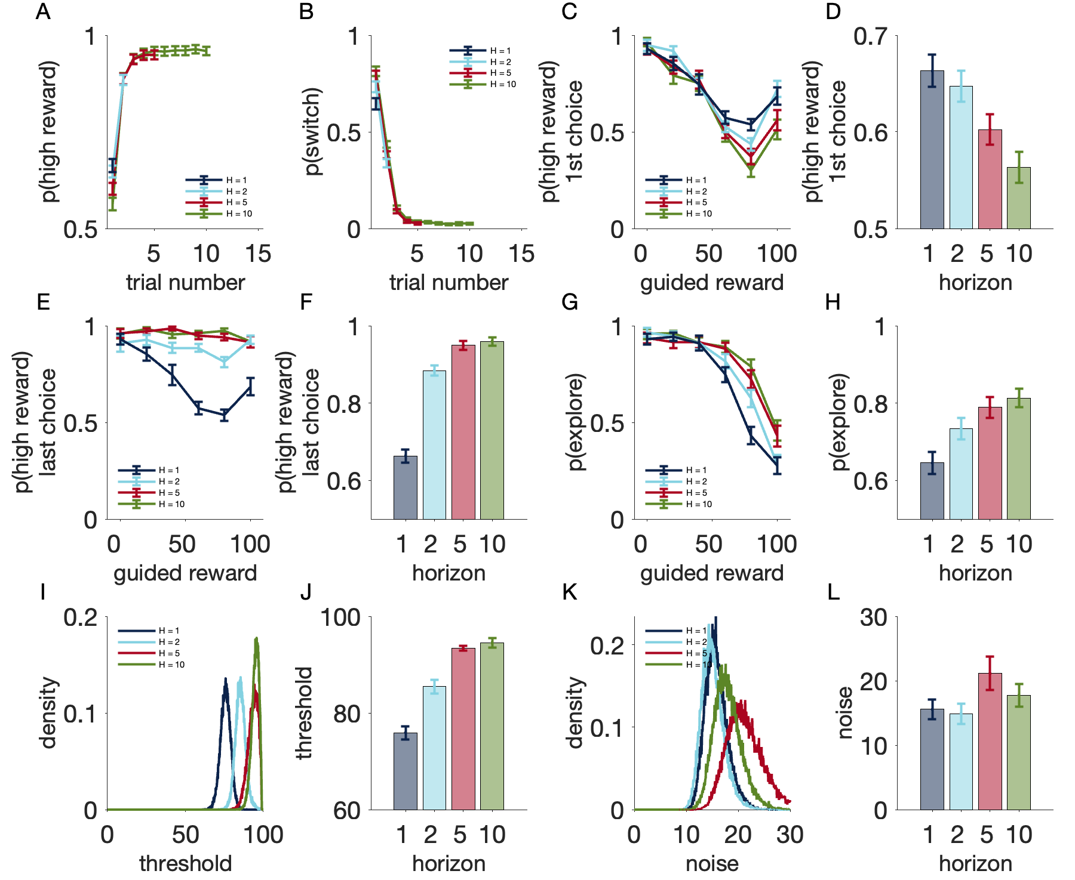
Notes:
Figure S1. Human Experiment 5 (Rewards range from 1 to 100). A: Probability of choosing the option with the highest reward as a function of trial number. B: Probability of switching from the last chosen option as a function of trial number. C: p(high reward) in the 1st free choice as a function of guided reward size by horizon. D: average p(high reward, 1st choice) by horizon. E: p(high reward) in the last free choice as a function of guided reward size by horizon. F: average p(high reward, last choice) by horizon. G: p(explore) as a function of guided reward size by horizon. H: average p(explore) by horizon. I: Model estimates of group-level exploration thresholds. J: Average of subject-level estimates of exploration thresholds by horizon. K: Model estimates of group-level decision noise. L: Average of subject-level estimates of decision noise by horizon.

Slide 15
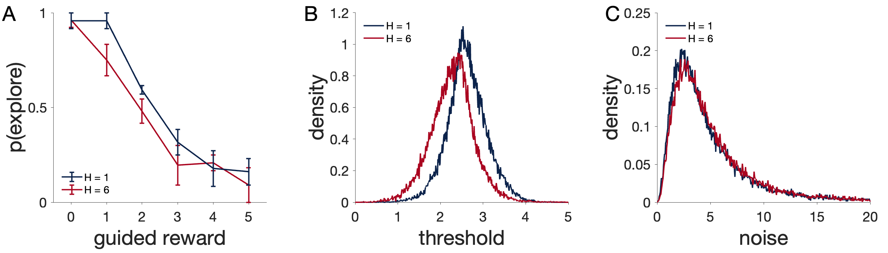
Notes:
Figure S2. Sound cue variant of Experiment 2. In this experiment, the different horizon conditions are cued by either a low-pitch sound (H = 1) or a high-pitch sound (H = 6). Games of different horizons are interleaved. A: p(explore) as a function of guided reward size. B. Model estimates of exploration threshold. C. Model estimates of decision noise.

