Slide 2




Figure 1
A
Game 1
Trial 1 response
Trial 2 start
Trial 2 cue
Trial 2 choice
Trial 1 start
Trial 1 cue (guided)
HB
Game 2
Trial N choice
Game 1 End
Trial 1 Start
Trial 1 Cue
(guided)
HB
…
…
B
Trial 1 cue
(guided)
Trial 1 response
Trial 2 cue
Trial 2 choice
Trial 3 cue
XX
3
XX
3
XX
3
XX
3
+
…
+
…
+
…
5
+
XX
…
5
+
XX
…
Notes:
Figure1: Time line of the rat and human experiments. A: rats were trained to start each trial by reaching the home base (HB, no reward). They were then given one guided trial (Trial 1, one blinking light, here 1 drop). Subsequent trials consisted in 2 simultaneously blinking lights. The end of a game was signaled by a sweeping tone and a change of home base (and horizon). B: Human subjects were presented with a 2-bandit display of known horizon (here horizon 2). They were guided to the first bandit and obtained a visible reward (here 3 points). Subsequent trials consisted in simultaneously colored squares (Wilson et al. 2014).

Slide 3
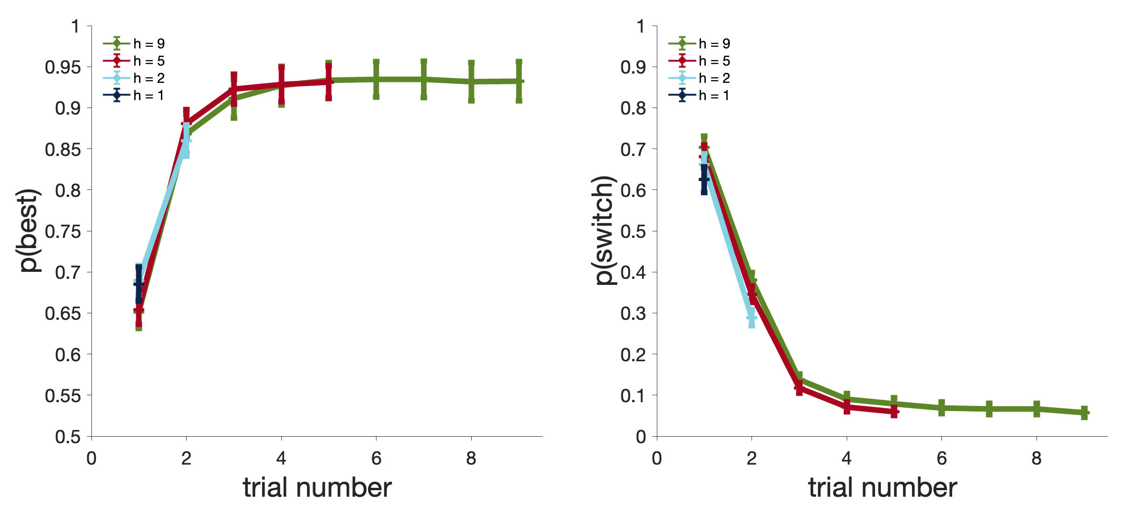
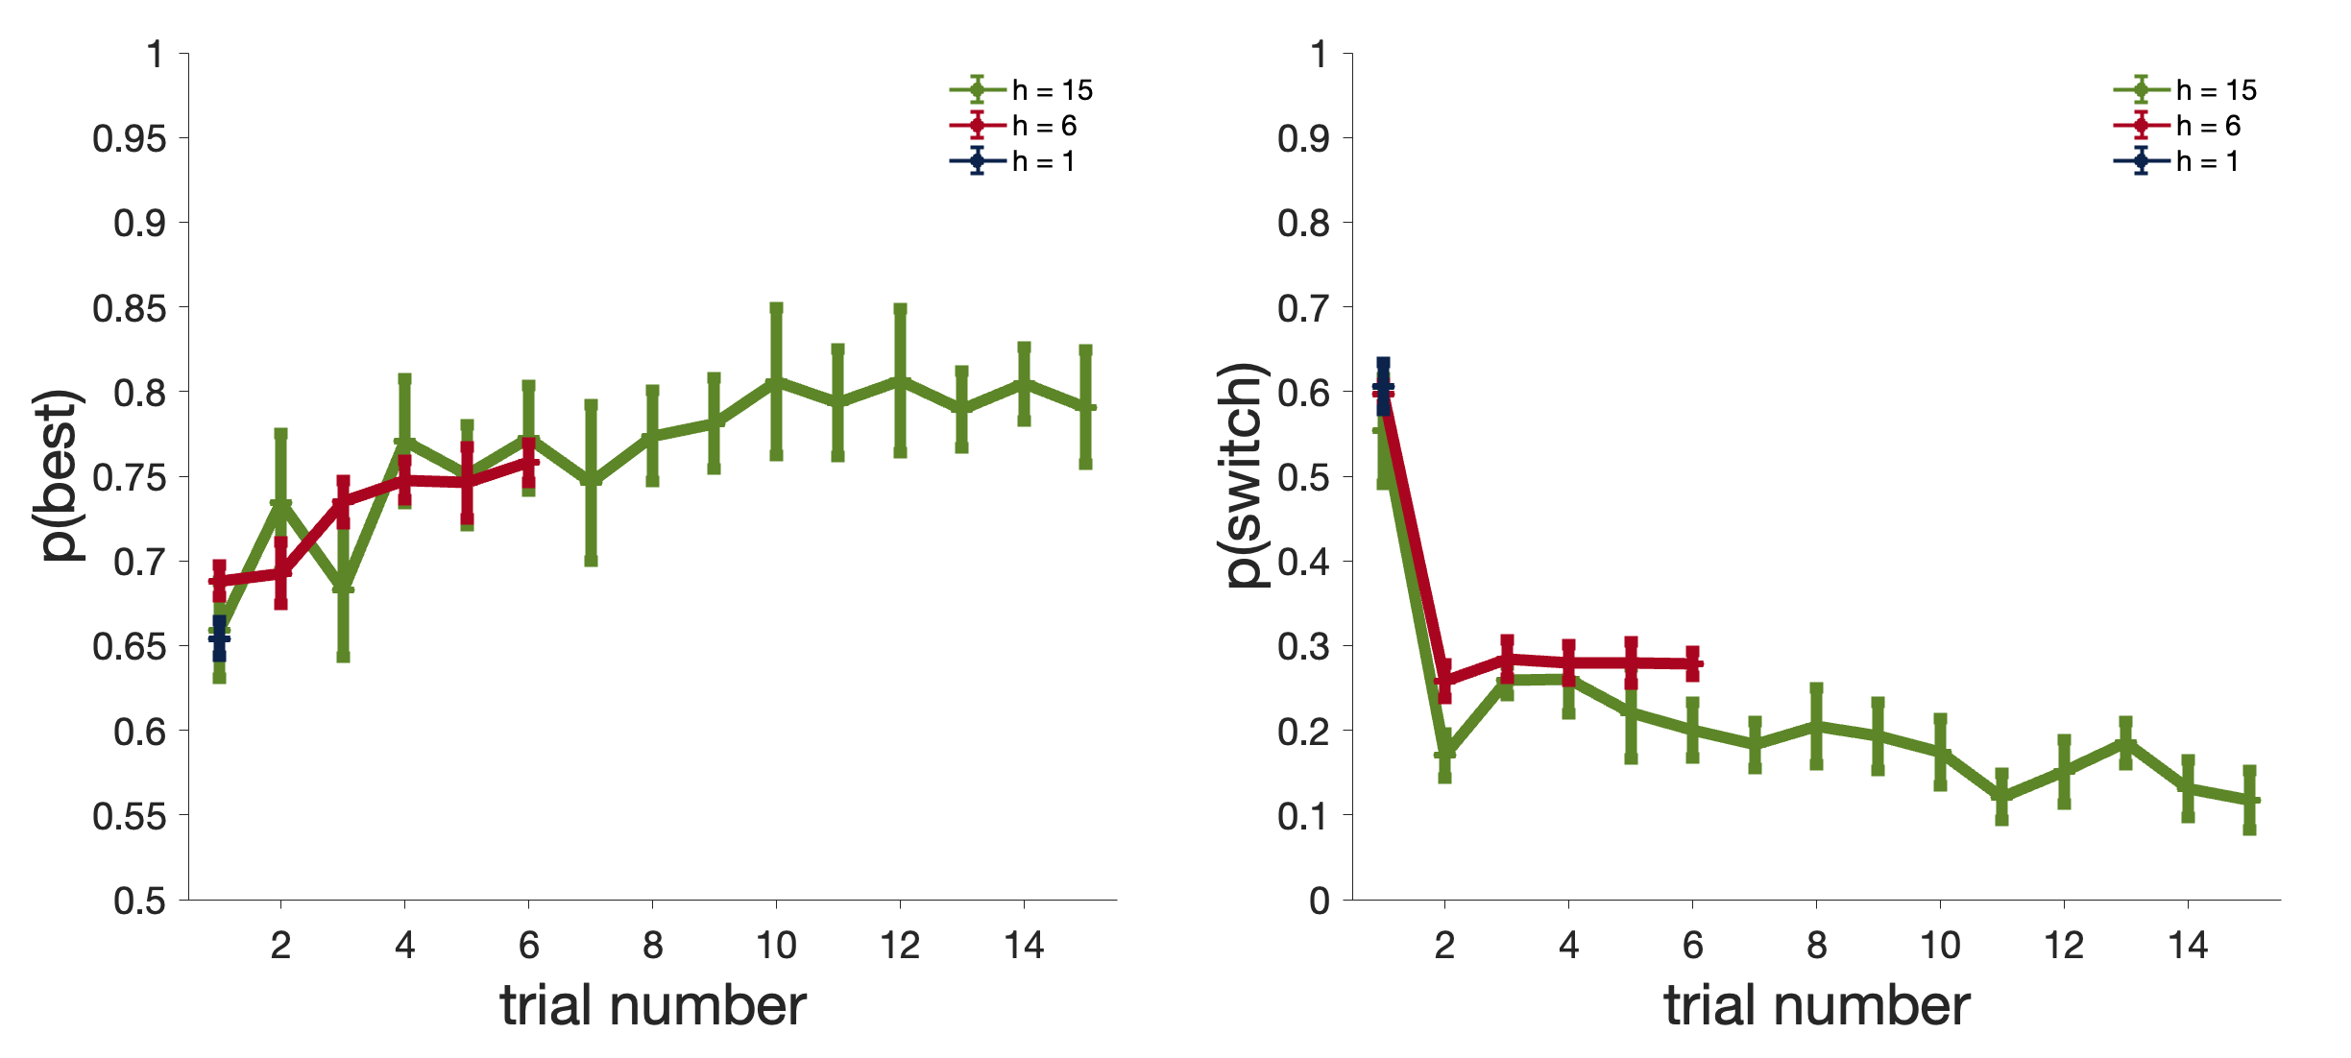
A
Figure 2
Humans
B
Rats
Notes:
Figure 2: Probability of choosing the option with the highest reward after the guided trials and probability of switching option immediately after the guided trials (1st choice) for humans (A) and rats (B). Up: In these experiments rodents were guided to the same feeder 3 times before the first choice was allowed (choice number 1). Two horizons were tested. Down: Human performance; same as for rats but with 4 different horizon conditions. N=1800 for all horizons (40 per human participant).

Slide 4
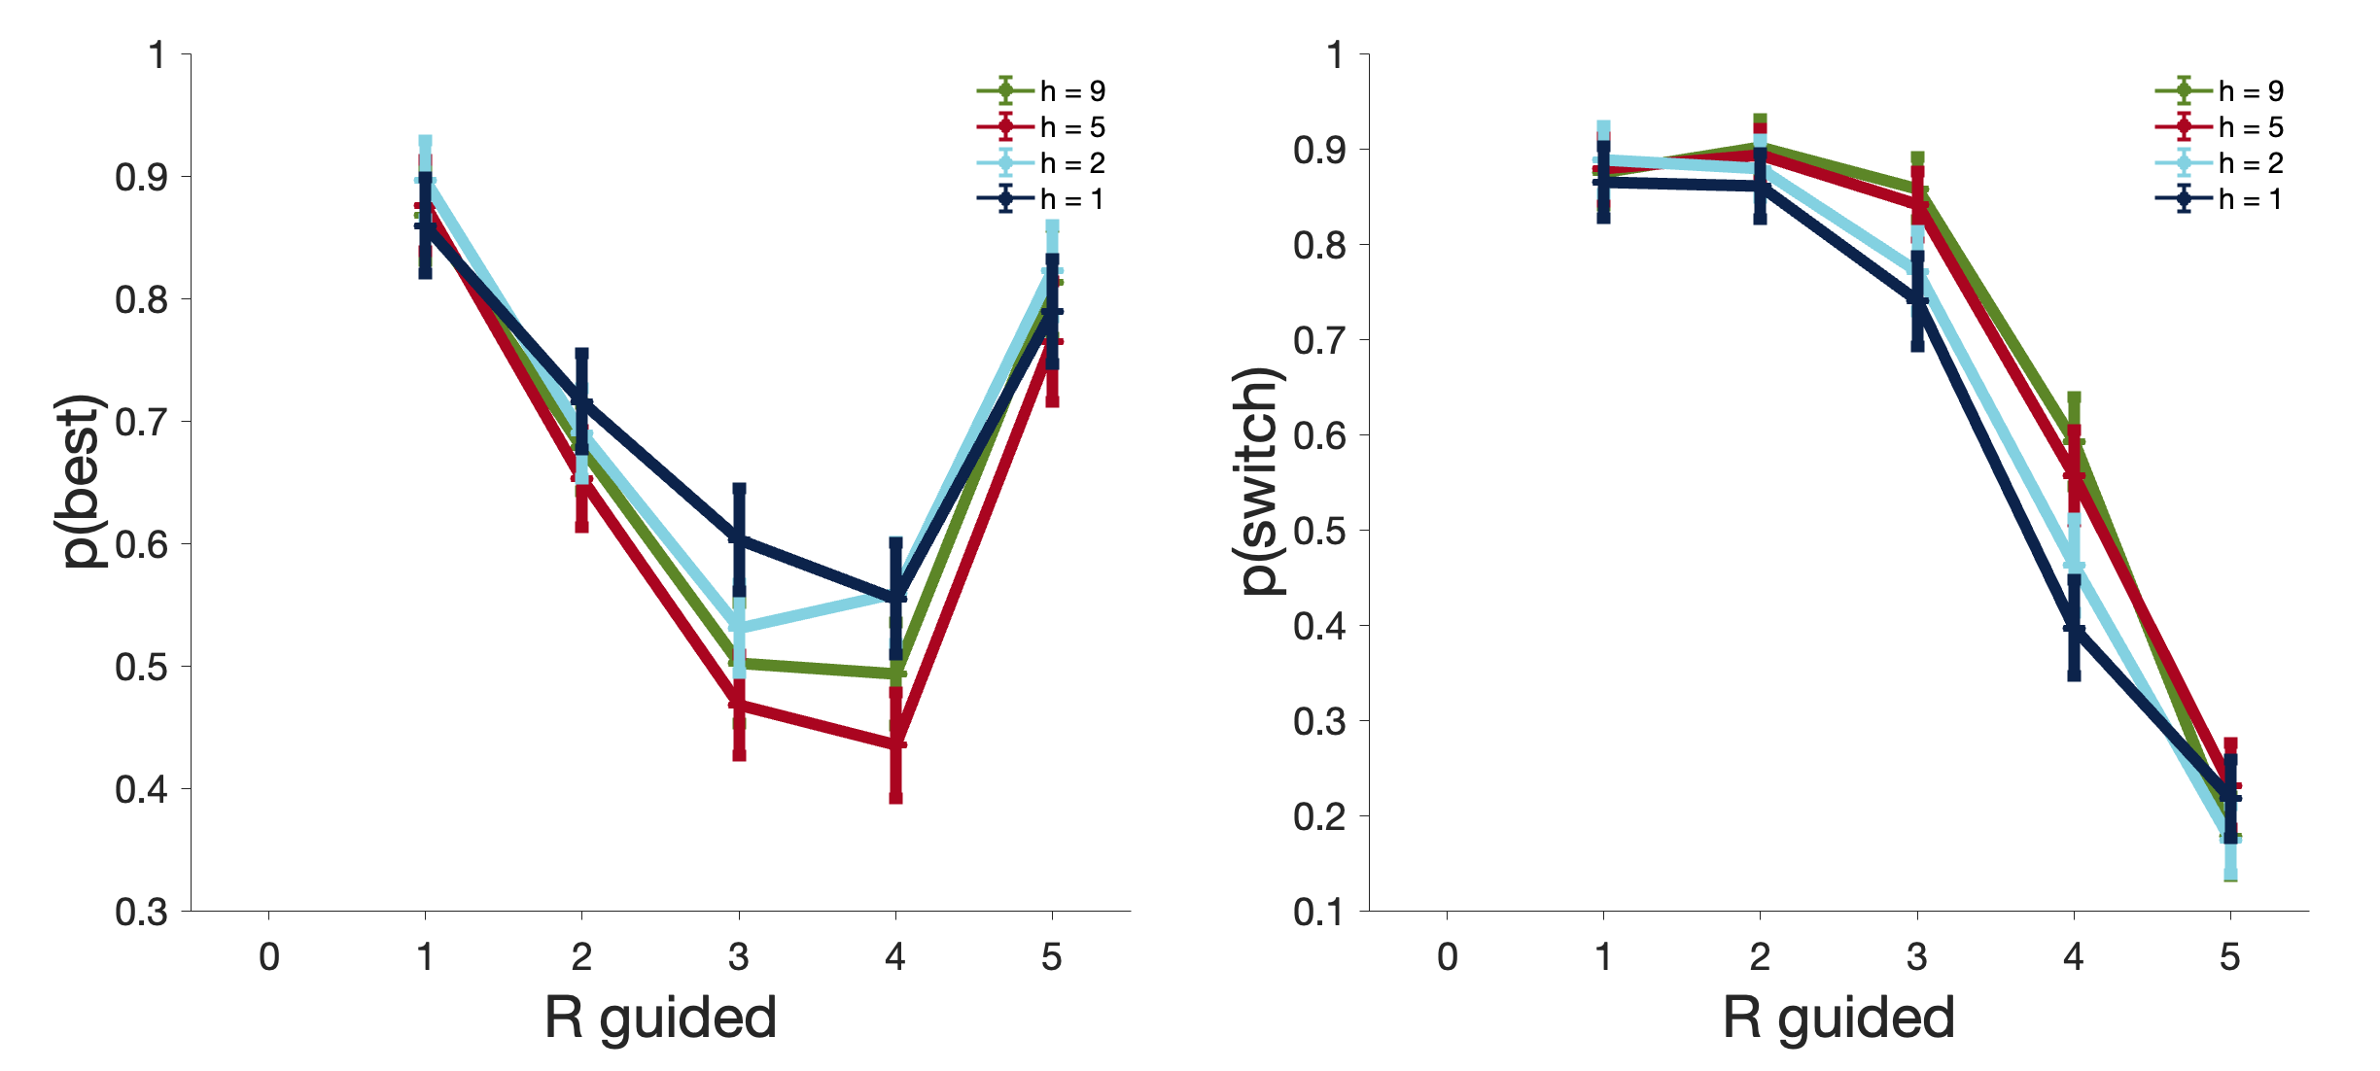
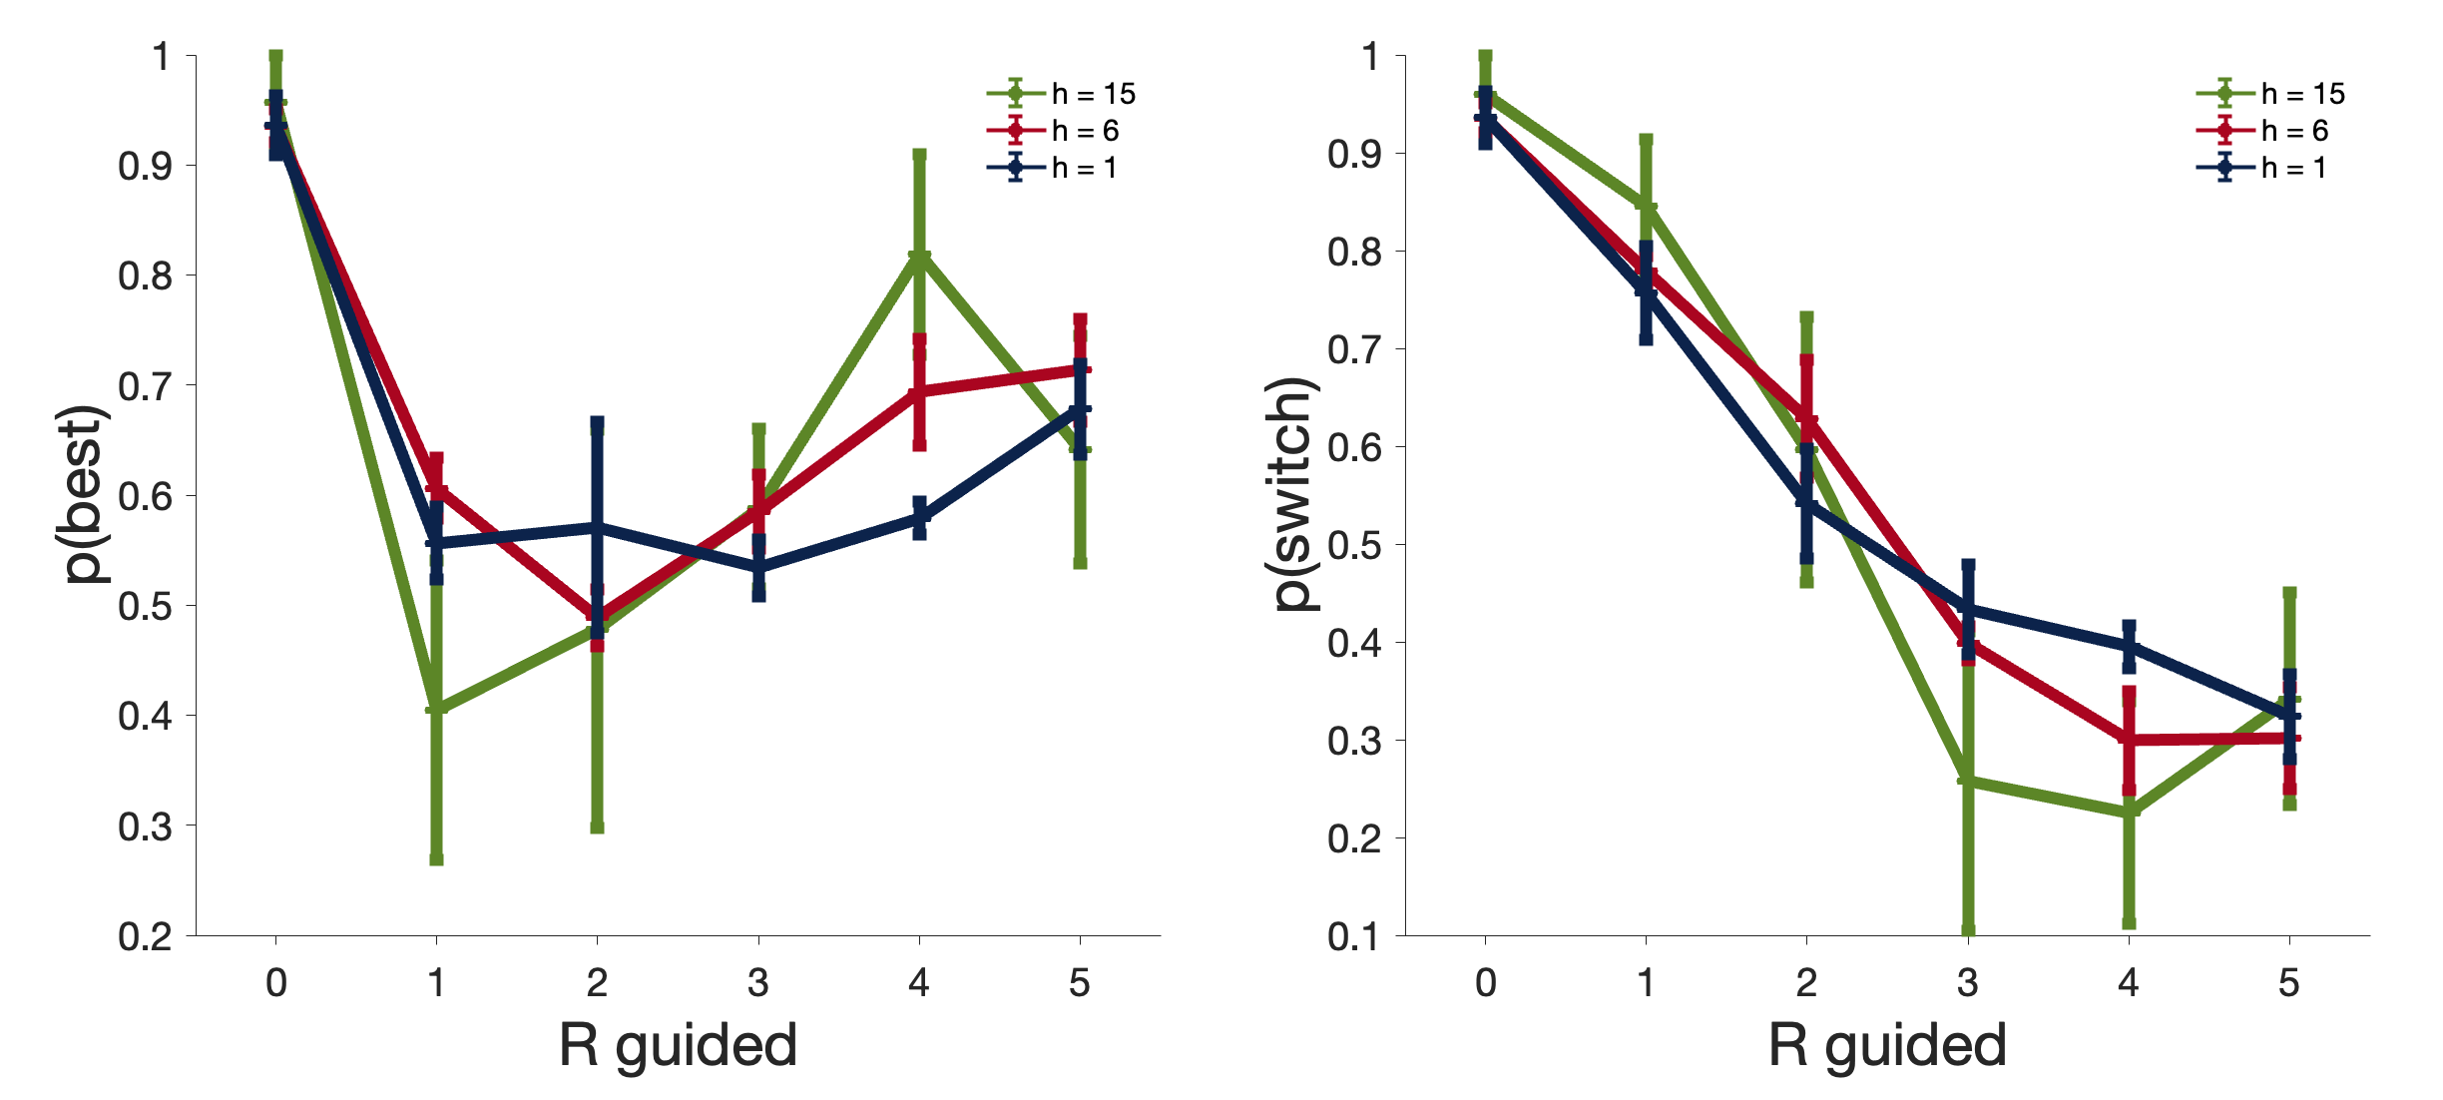
A
Figure 3
Human
B
Rat
Notes:
Figure 3: Influence of reward size during guided trials. Left: Probability of choosing the best option in the first choice trial after guidance. Right: probability of switch.

Slide 5
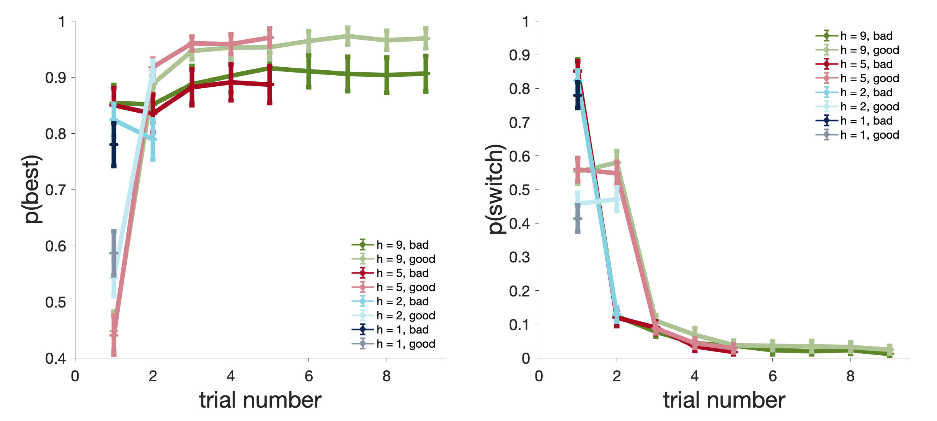
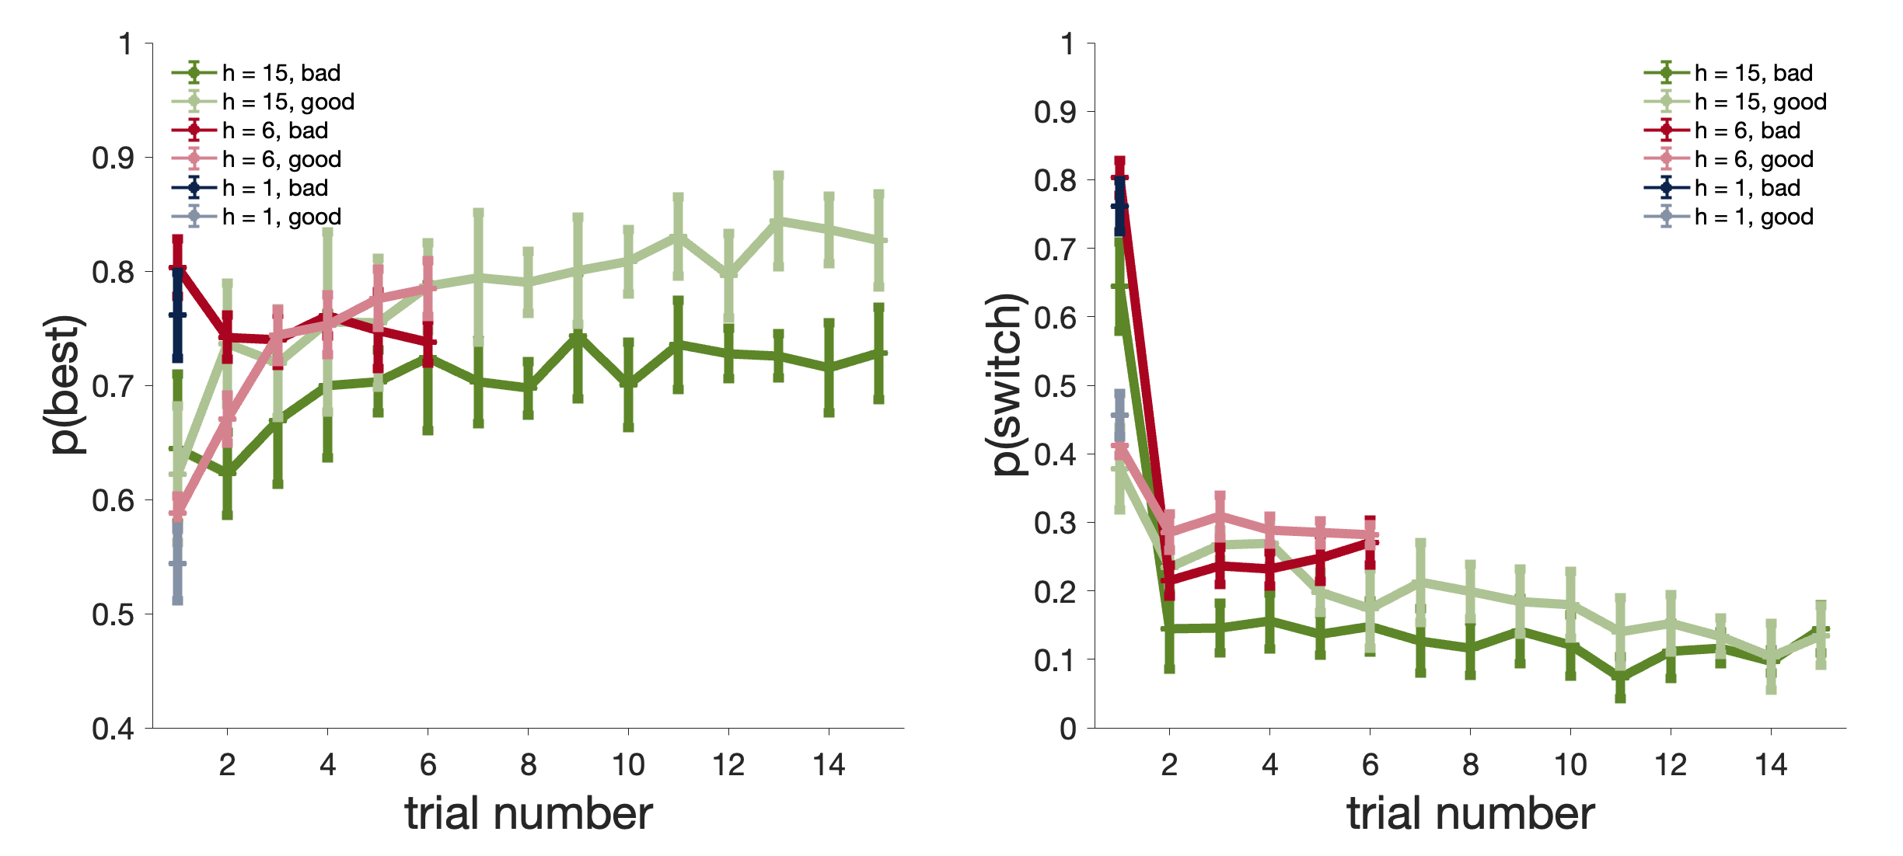
A
Figure 4
Human
B
Rat
Notes:
Figure 4: Probability of choosing the option with the highest reward after the guided trials and probability of switching option immediately after the guided trials (1st choice), split up by whether the guided option is the better option.

Slide 6
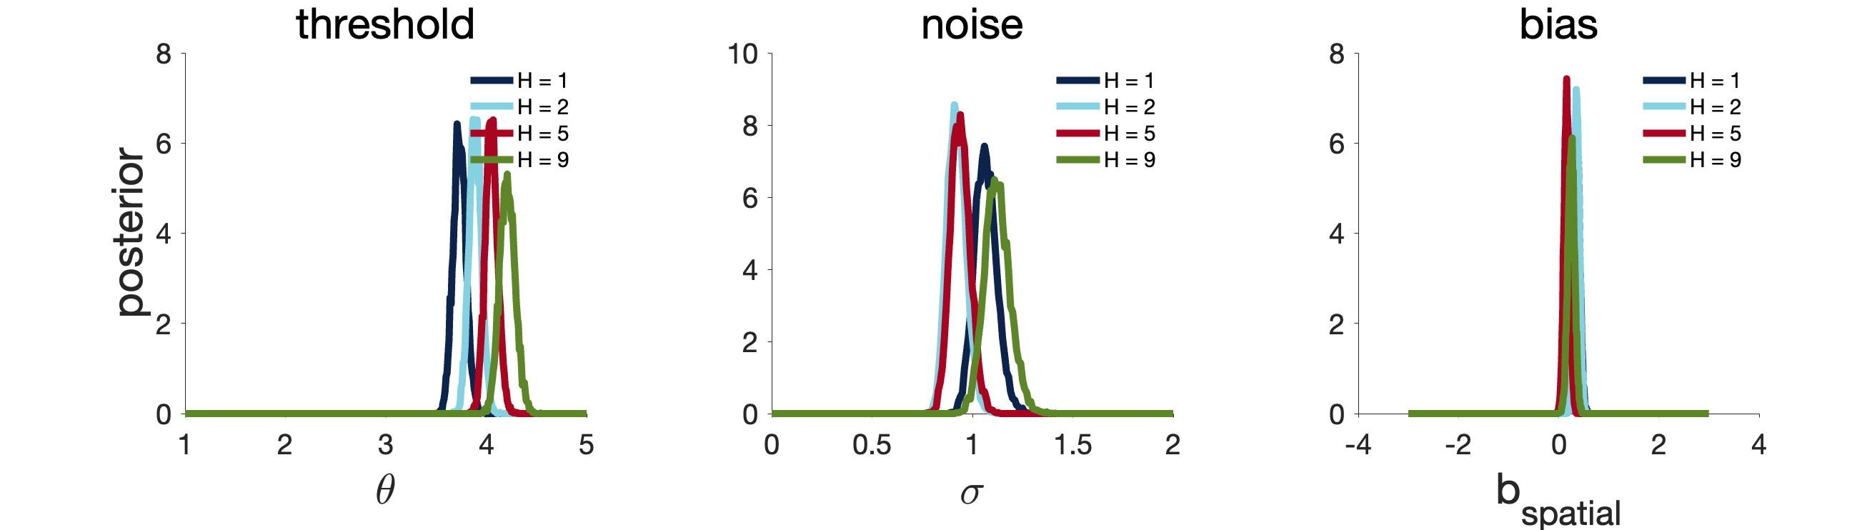
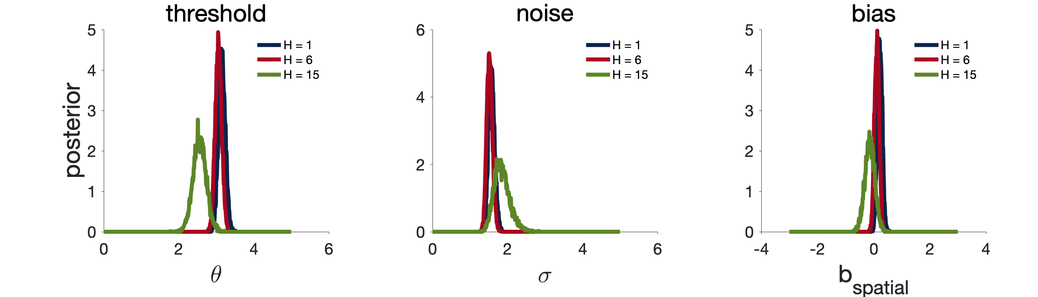
A
Figure 5
Human
B
Rat
Notes:
Figure 5: Model-based estimates of exploitation threshold, decision noise and spatial bias.

Slide 7
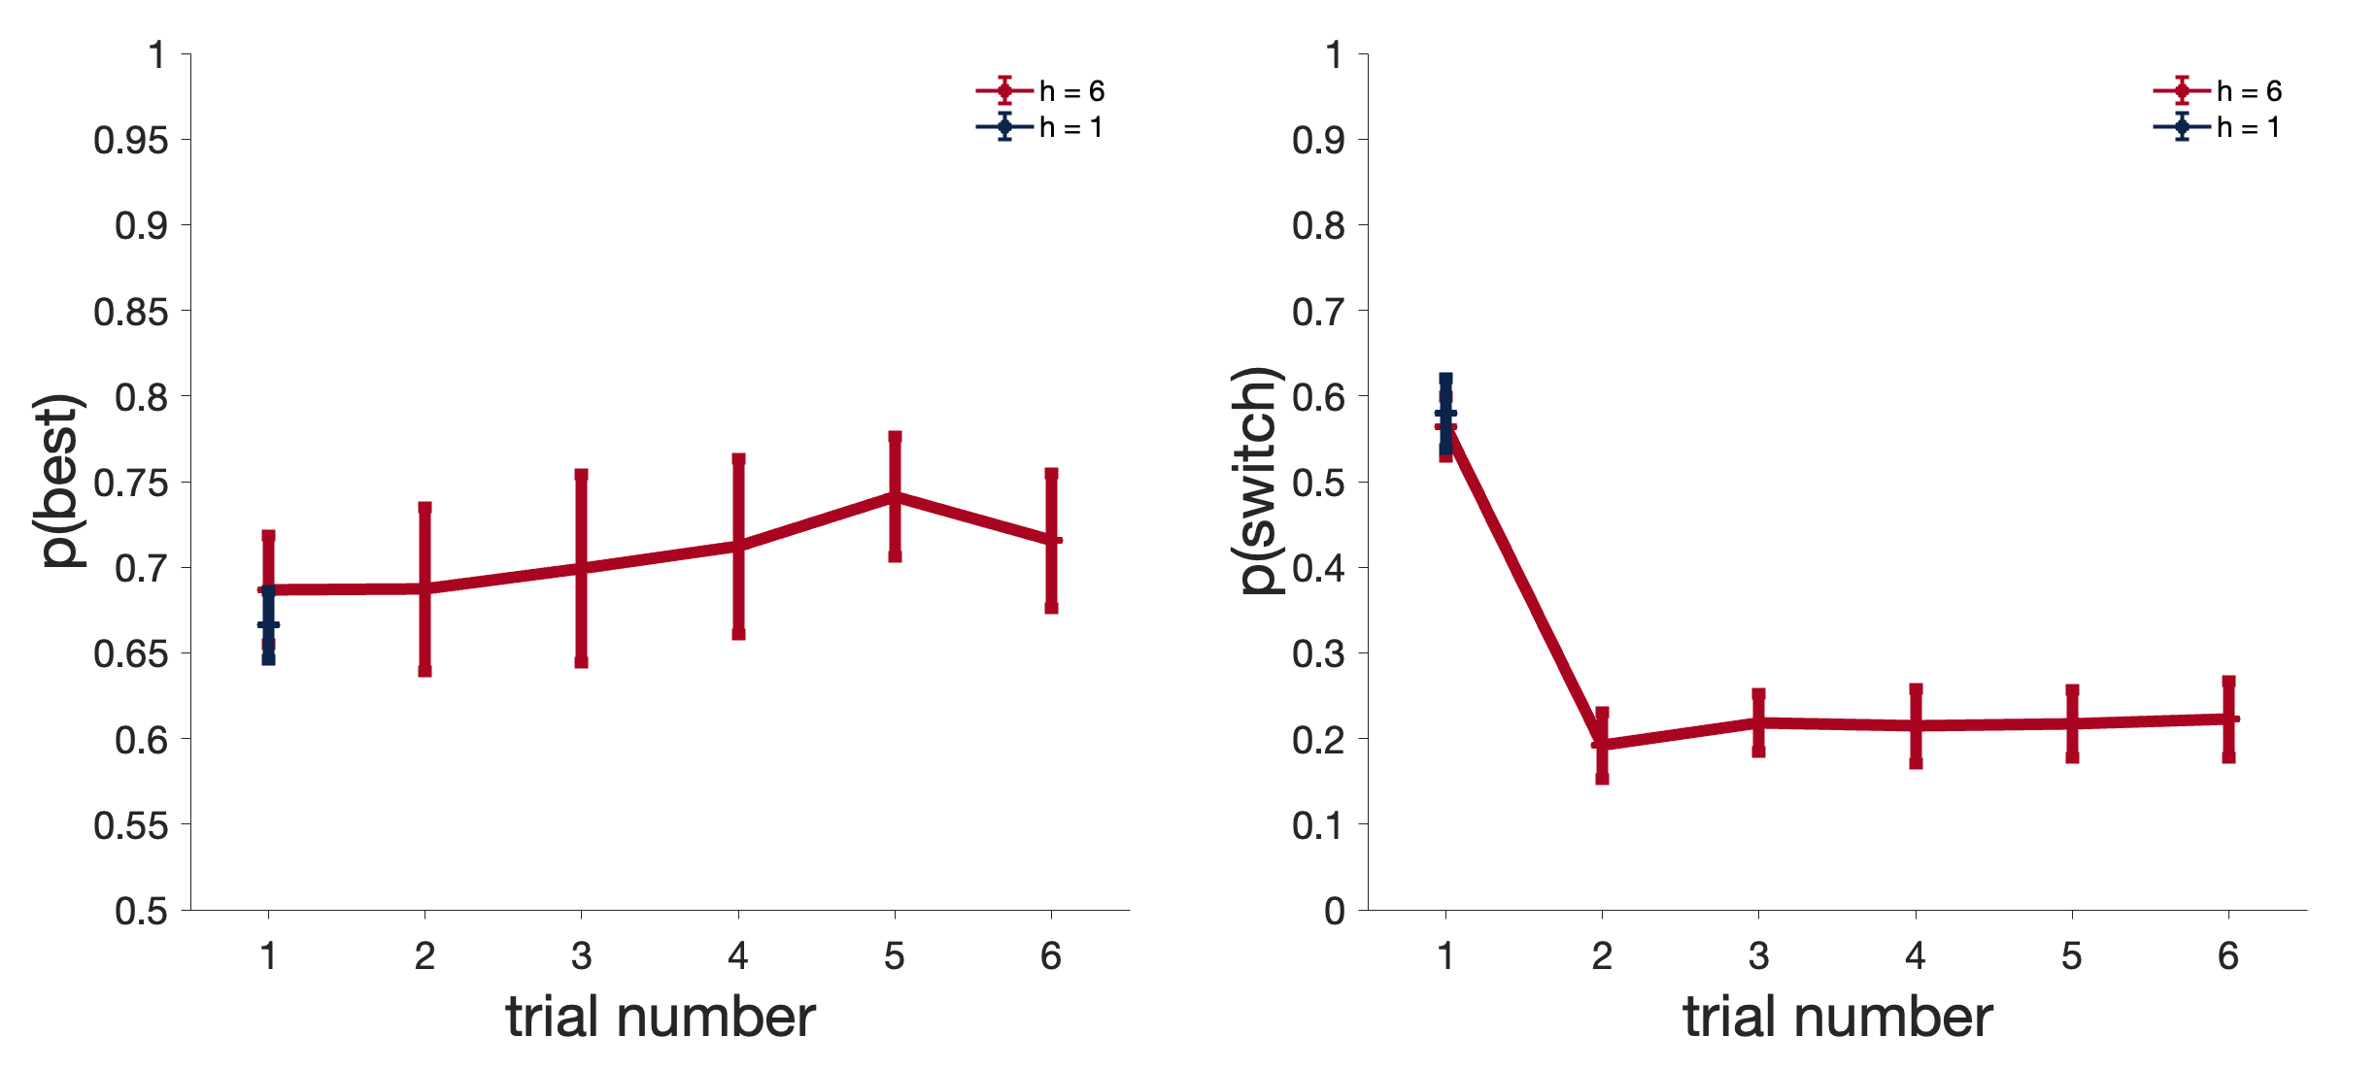
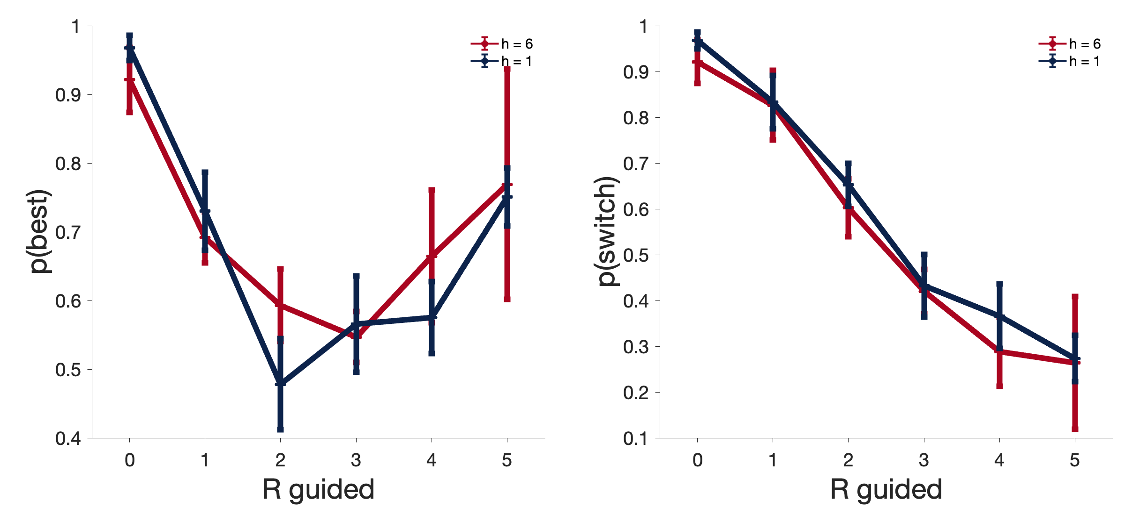
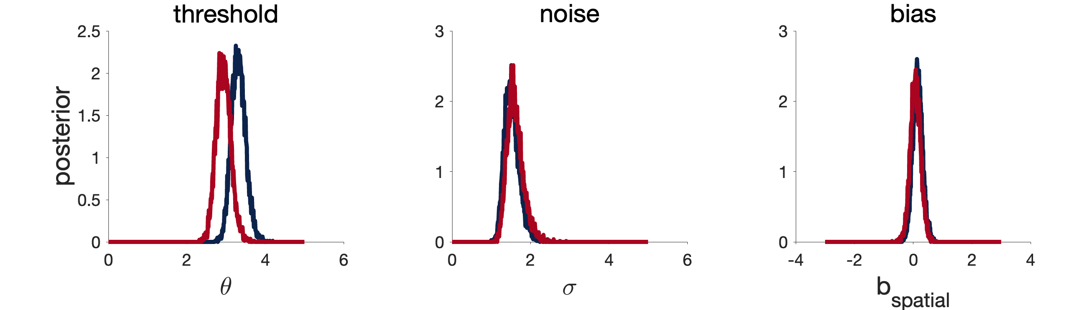
Figure 6
A
B
C
Notes:
Figure 6: Results from the within version (rat only).

Slide 8
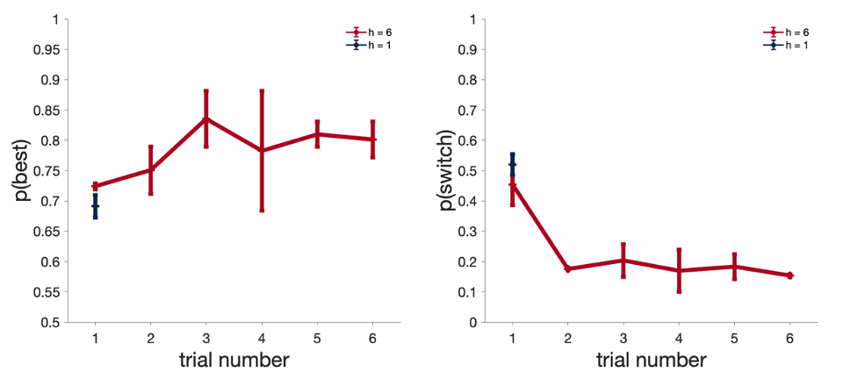
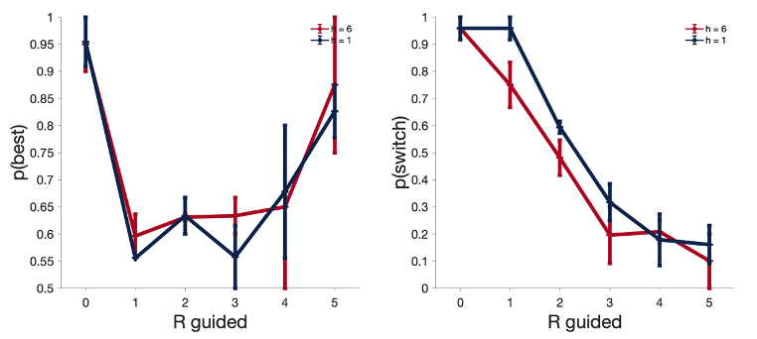
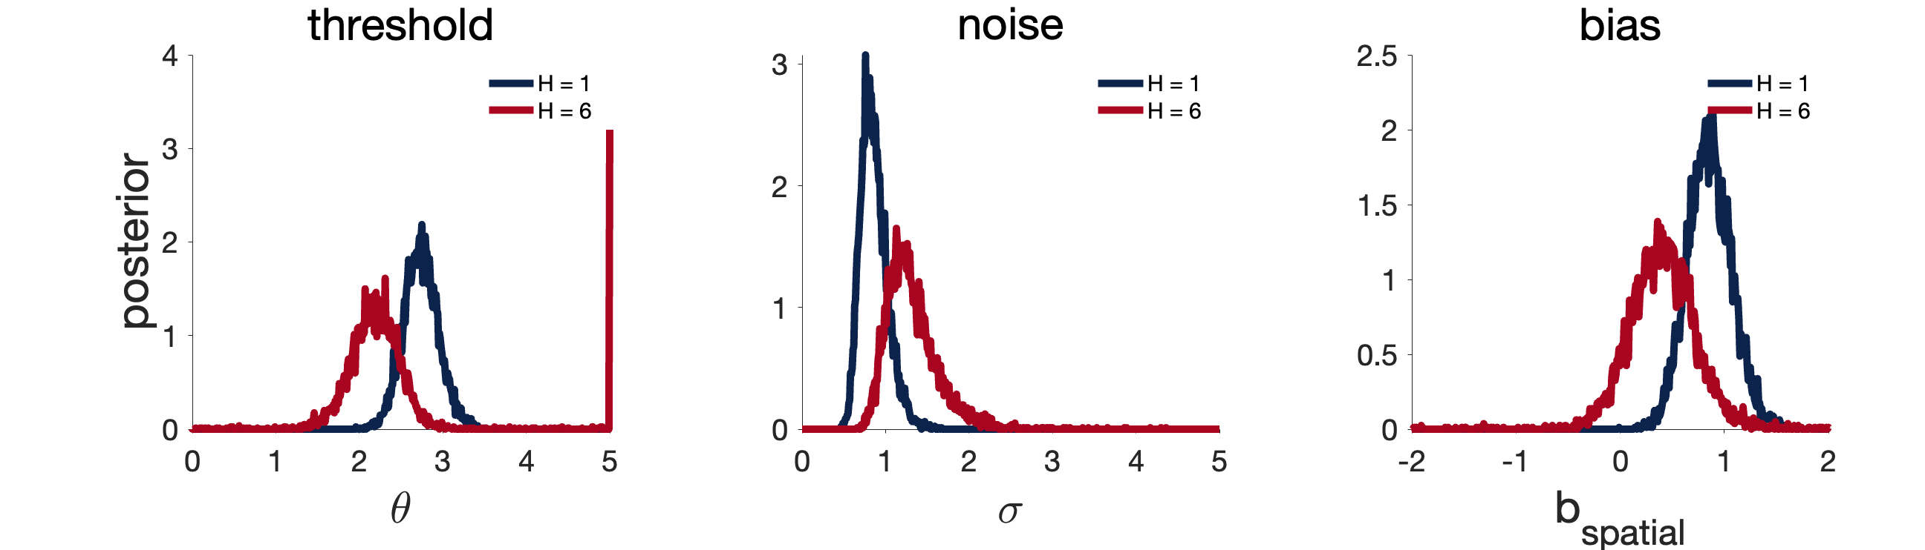
A
Figure 7
B
C
Notes:
Figure 7: Results from the sound cue version (closest to human version, rat only)

Slide 9
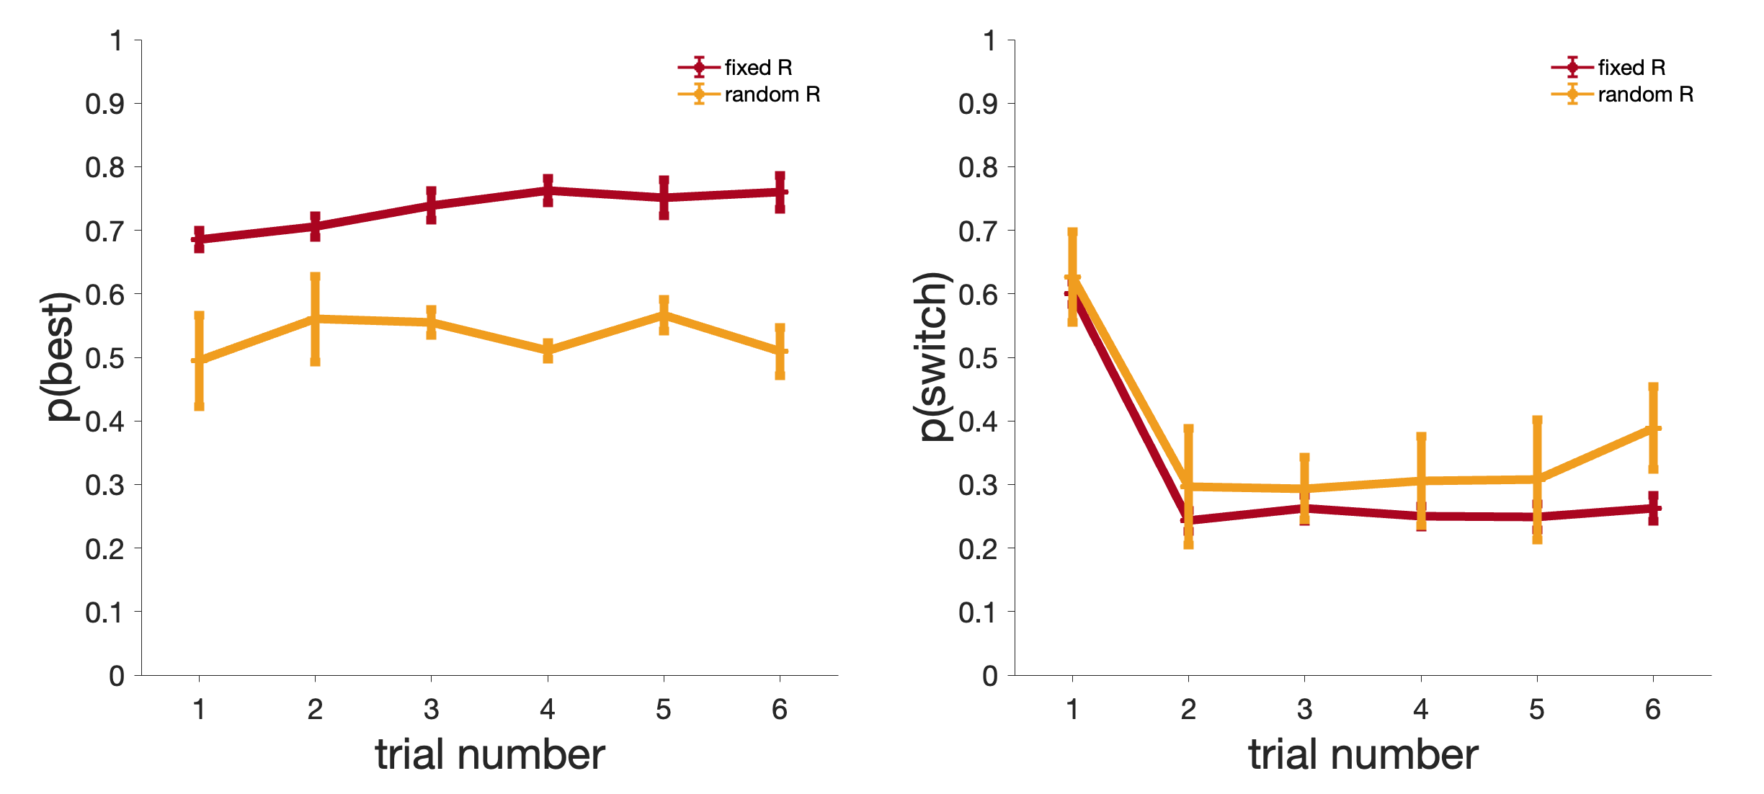
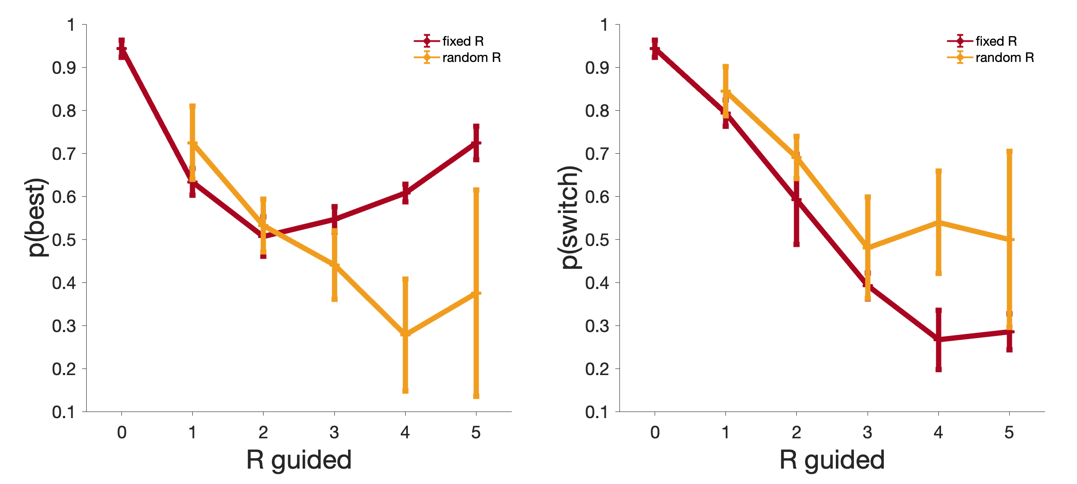
Figure 8
A
B
Notes:
Figure 8: Results from the random reward control (rat only).

Slide 10
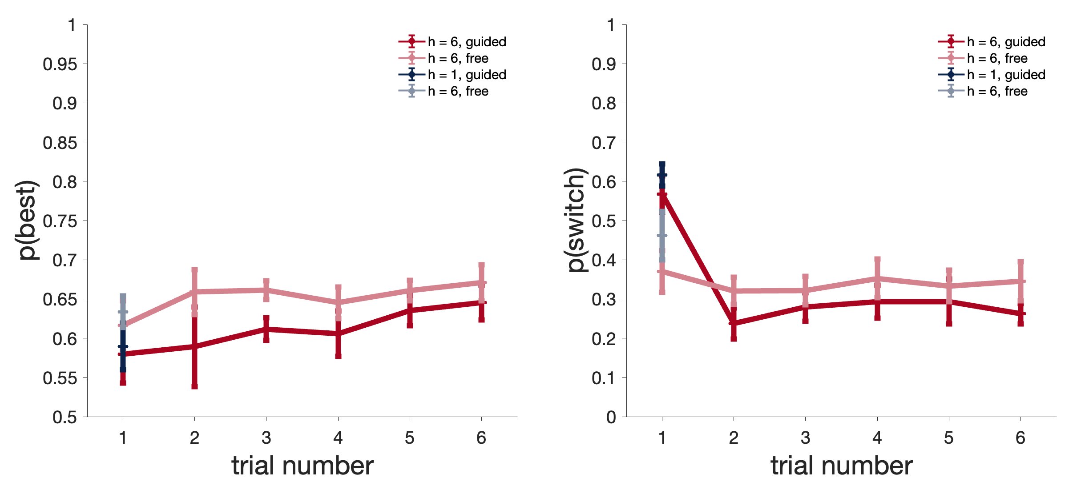
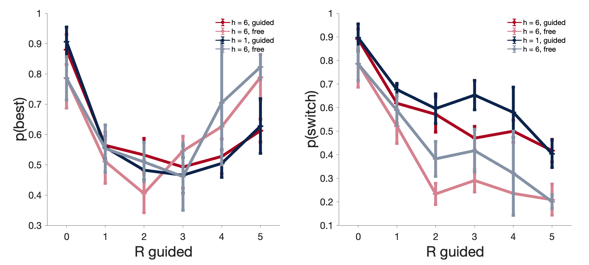
Figure 9
A
B
Notes:
Figure 9 AB: At the start of a game, rats were given one forced guided trial (1 light blinking, Fig 1, Guided) or a free choice instead (not Guided). A left: probability of choosing the correct feeder after the guided trials or after the first free choice for the 2 horizons tested. A right: probability of switching to a different feeder than the one visited after the guided trials or after the first free choice for the 2 horizons tested. This figure included data from 2 rats. Statistical significance was assessed for H=6 only.
Figure 9 B: Influence of reward size during the first trials (Guided or not Guided, as in Figure 7). B left: Probability of choosing the best feeder during the second trials (free choice). B right: probability of switching to a different feeder than the one visited during the first trials (only the first free choice is considered). Number of trials N are the same as in Figure 7.

Slide 11
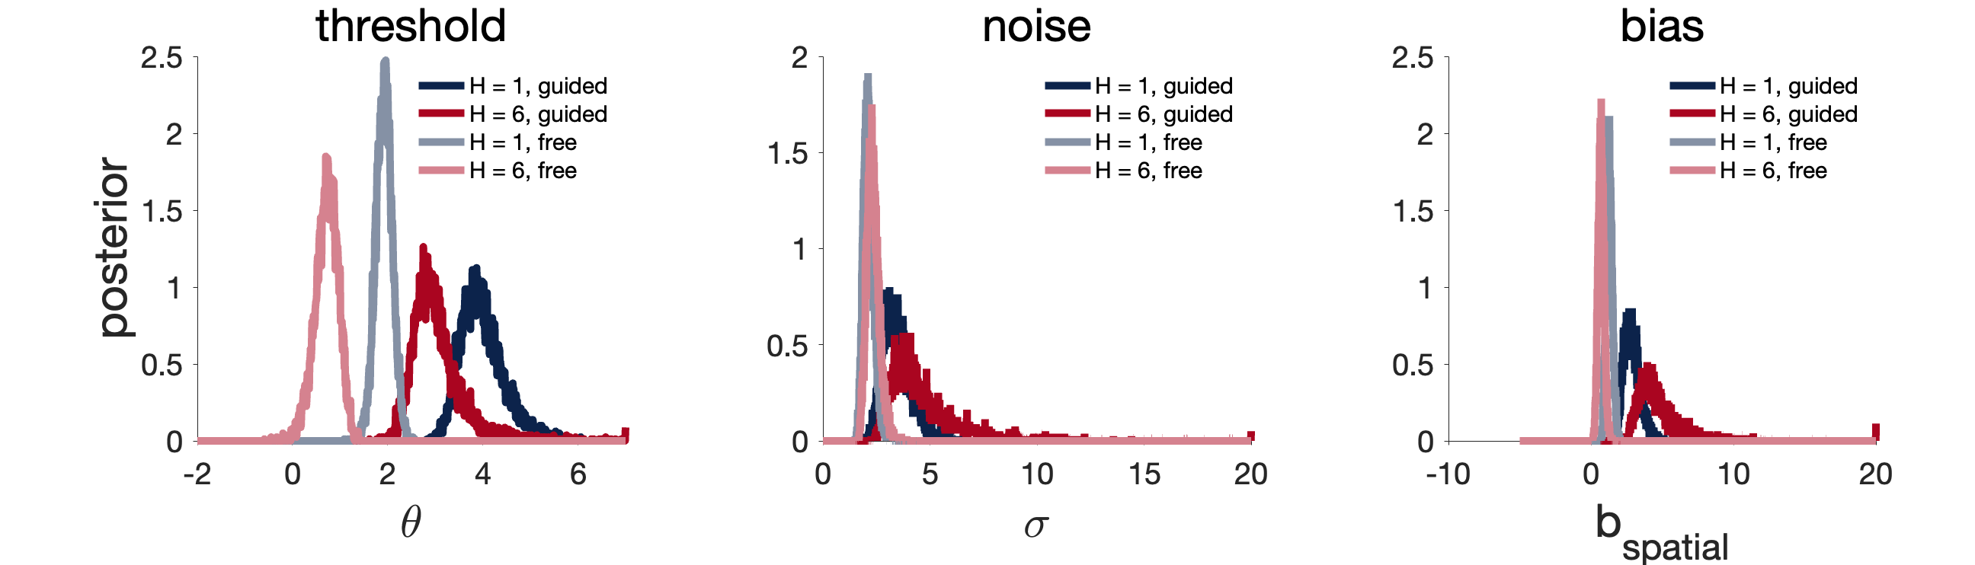
Figure 10
Notes:
Figure 10. Model estimates in free vs guided choices.

Slide 12
Figure 11
A
Rats
Humans
5
1
4.5
4
Reaction time (s)
Reaction time (s)
3.5
0.5
3
H = 1
H = 2
2.5
H = 1
H = 5
H = 6
H = 9
2
0
1
2
3
4
5
0
1
2
3
4
5
Reward size during guided trials (drops)
Reward size during guided trials (points)
B
4
1
H = 1
3.8
0.8
H = 2
H = 5
H = 9
3.6
0.6
Reaction time (s)
Reaction time (s)
3.4
0.4
3.2
H = 1
0.2
H = 6
0
3
1
2
3
4
5
6
7
8
9
1
2
3
4
5
6
Choice number
Choice number
Notes:
Fig 11: Reaction times. A: reaction time during the first choice after guided trials. Reaction times in rats is measure as the time needed to navigate from the Home Base to the chosen feeder. Reaction time in humans is measure as the time between previous reward delivery and next choice (key stroke). B: Reaction time within the games. Number of trials N are the same as in Figure 2.
Later: there is a trend that RT is faster in large H compared to small H in humans, rats show the same direction.

