Slide 1















A
B
Guided trials
Free trials
C
$$−>$$
$$−>$$
Short condition
Game 1
Fixed H
H = 1
Game 1 start
home base
Trial 1 cue
(guided)
Trial 1 response
$$→$$
Long condition
$$−>$$
$$−>$$
$$−>$$
Game 2
Fixed H
H = 6
home base
Trial 2 cue
(guided)
Trial 2 response
$$→$$
Extra long condition
$$−>$$
$$−>$$
$$−>$$
Game 3
Fixed H
home base
Trial 3 cue
(guided)
Trial 3 response
…
H = 15
$$−>$$
$$−>$$
$$−>$$
$$−>$$
home base
Trial 4 cue
(free)
Trial 4 response
Game 2 start
home base
Notes:
Figure 1: A: Time line of the rat experiments. Rats were trained to start each trial by reaching the home base (HB, no reward). They were then given a small number (here nGuided = 3) of guided trial (e.g. Trial 1, one blinking light, here 1 drop). Subsequent trials consisted in 2 simultaneously blinking lights (here Horizon = 1). The end of a game was signaled by a sweeping tone and a change of home base. B. Horizon conditions in Experiment 1. C. Switch of home bases in between games.

Slide 2

A
B
Guided trials
Free trials
nG = 3
H = 1
H = 1
$$→$$
H = 6
nG = 1
H = 6
H = 1
$$→$$
H = 6
nG = 0
H = 1
H = 1
…
H = 6
Notes:
Figure 2: A. Task conditions (nGuided by Horizon) in Experiment 2. B. Switching of home bases correspond to switching of horizon conditions (except for the sound cue variant) in Experiment 2.

Slide 3





A
B
XX
3
XX
2
5
XX
XX
1
4
XX
+
$$−>$$
+
+
+
+
+
H = 1
Trial 1 cue
(guided)
Trial 1 response
H = 2
XX
3
XX
3
H = 5
$$−>$$
+
$$−>$$
5
+
XX
Trial 2 cue
(free)
Trial 2 choice
H = 10
XX
3
XX
3
$$−>$$
5
+
XX
$$−>$$
5
+
XX
5
XX
Trial 3 cue
(free)
Trial 3 response
Notes:
Figure 2: A. Timeline of the human experiment: Human subjects were presented with a 2-armed bandit display of known horizon (here Horizon = 2). They were guided to the first bandit and obtained a visible reward (here 3 points). Subsequent trials consisted in simultaneously colored squares indicating free choices between the two bandits. B. Task conditions: H = 1, 2, 5 and 10.

Slide 4
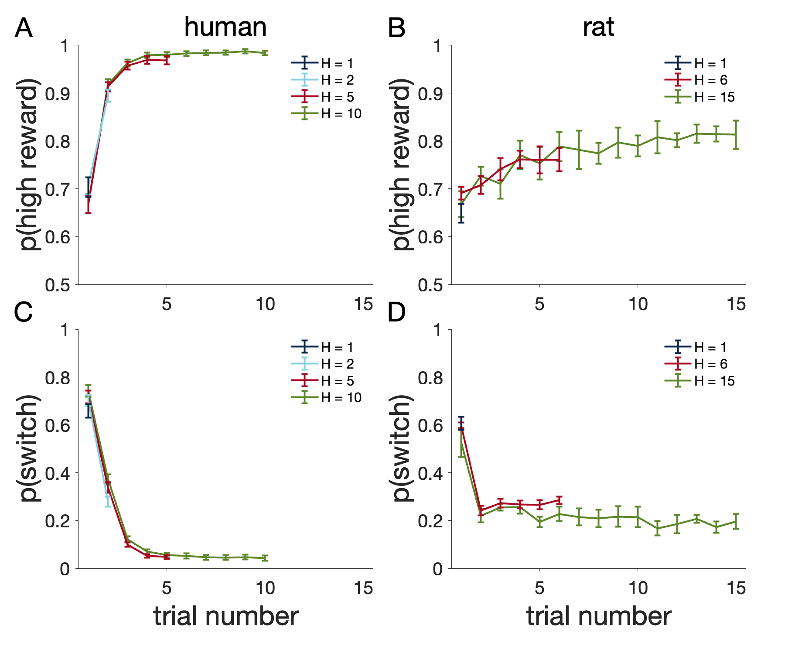
Notes:
Figure 4: Probability of choosing the option with the highest reward and probability of switching from the last chosen option in free choices for humans (A, C) and rats (B, D). Right: In these experiments rodents were guided to the same feeder 3 times before the first choice was allowed (choice number 1). Three horizons were tested. Left: Human performance; same as for rats but with 4 different horizon conditions.

Slide 5
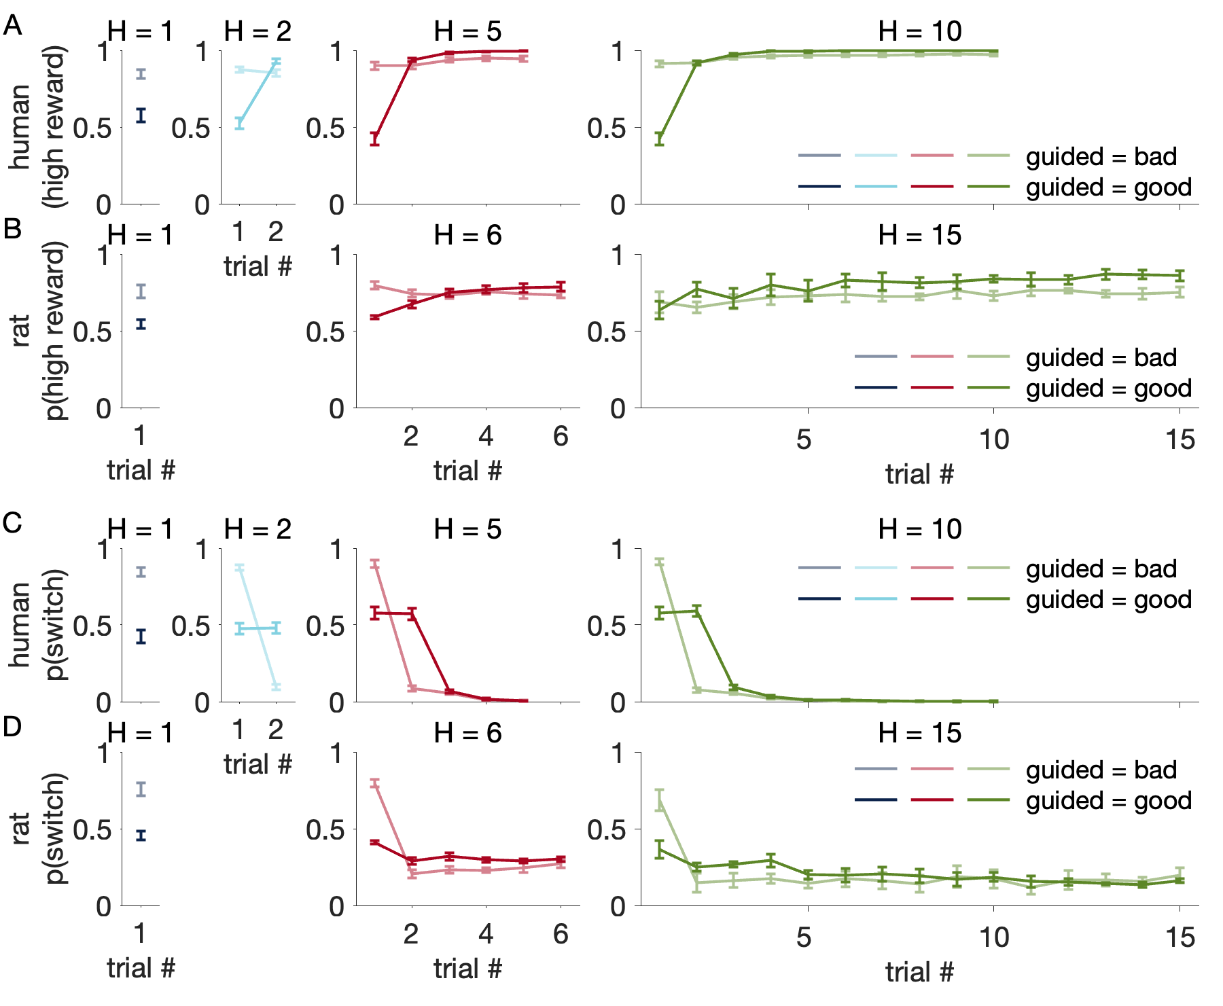
Notes:
Figure 5: p(high reward) and p(switch), split up by whether the guided option is the objectively better option, for humans (A, C) and rats (B, D).

Slide 6
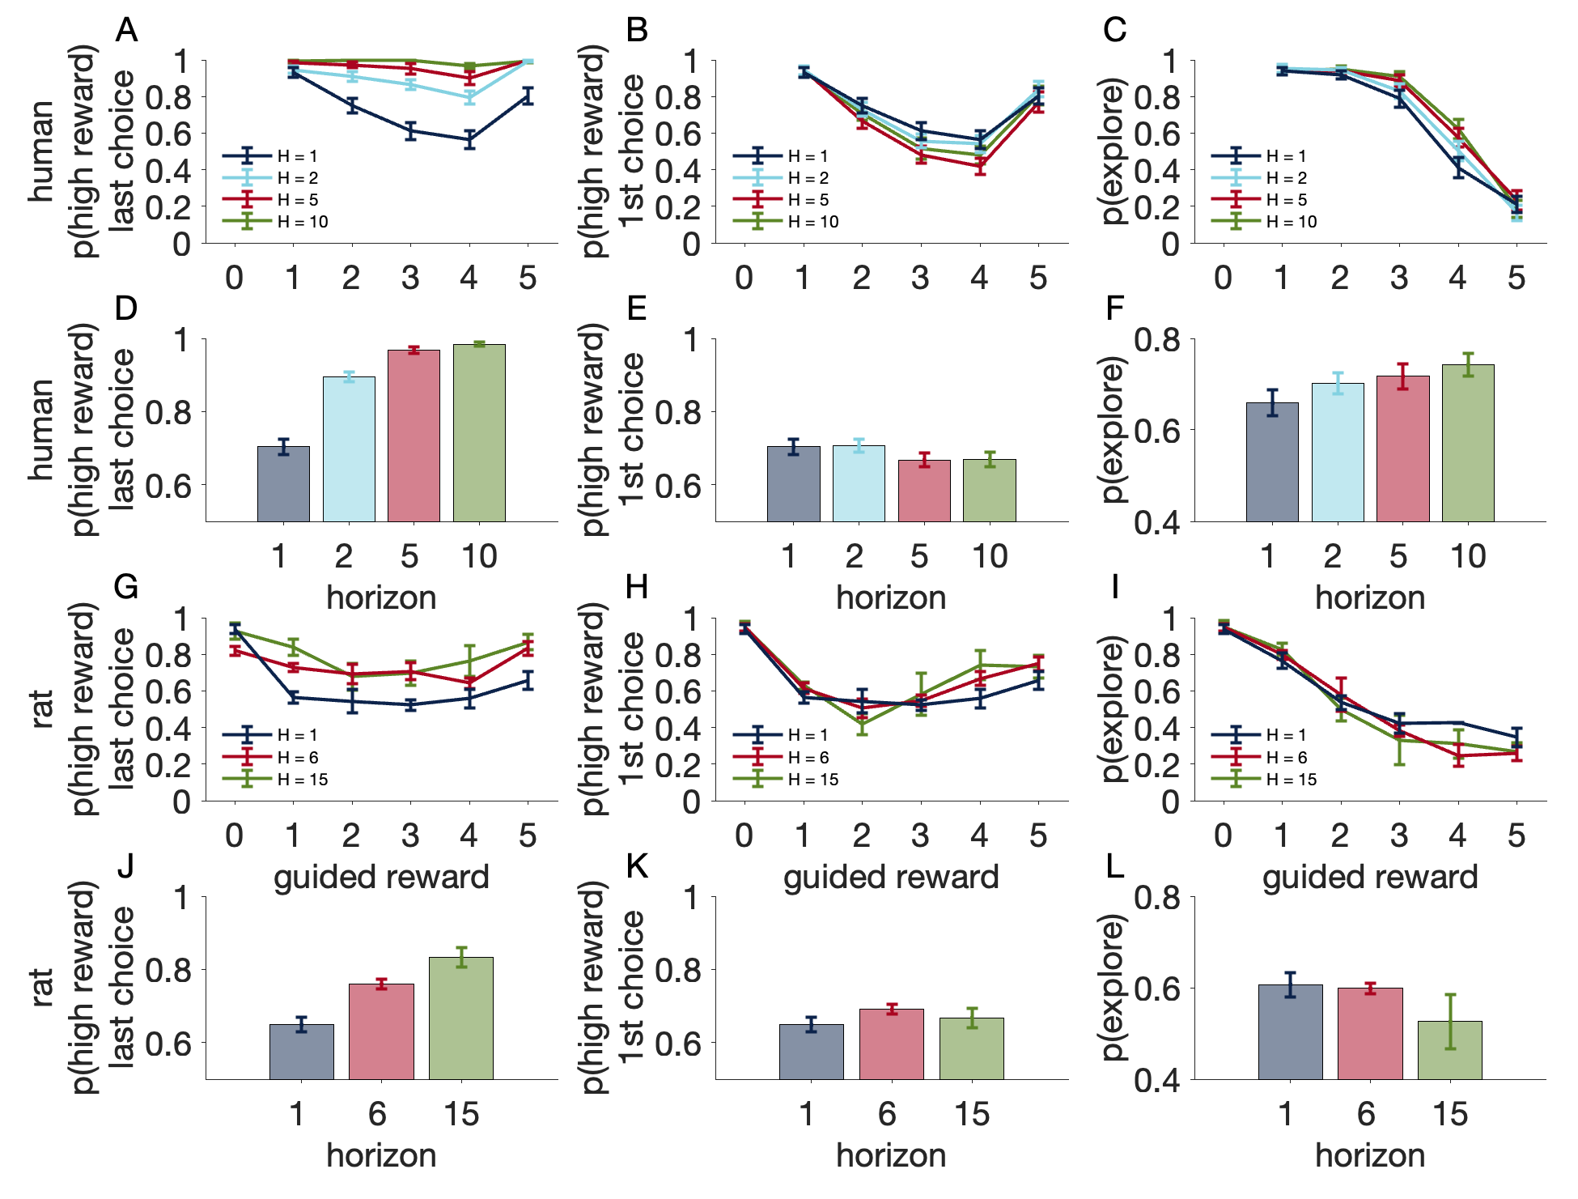
Notes:
Figure 6: Influence of reward size during guided trials. A and G. Probability of choosing the high reward option in the last choice of each horizon as a function of guided reward size. D and J. Average p(high info, last choice) vs horizon. B and H, Probability of choosing he high reward option in the first choice of each horizon as a function of guided reward size. E and K. Average p(high reward, 1st choice) vs horizon. C and I. Probability of exploring the unguided option in the first free choice (i.e. P(switch) at trial number 1) as a function of guided reward size. F and L. Average p(explore) vs horizon

Slide 7
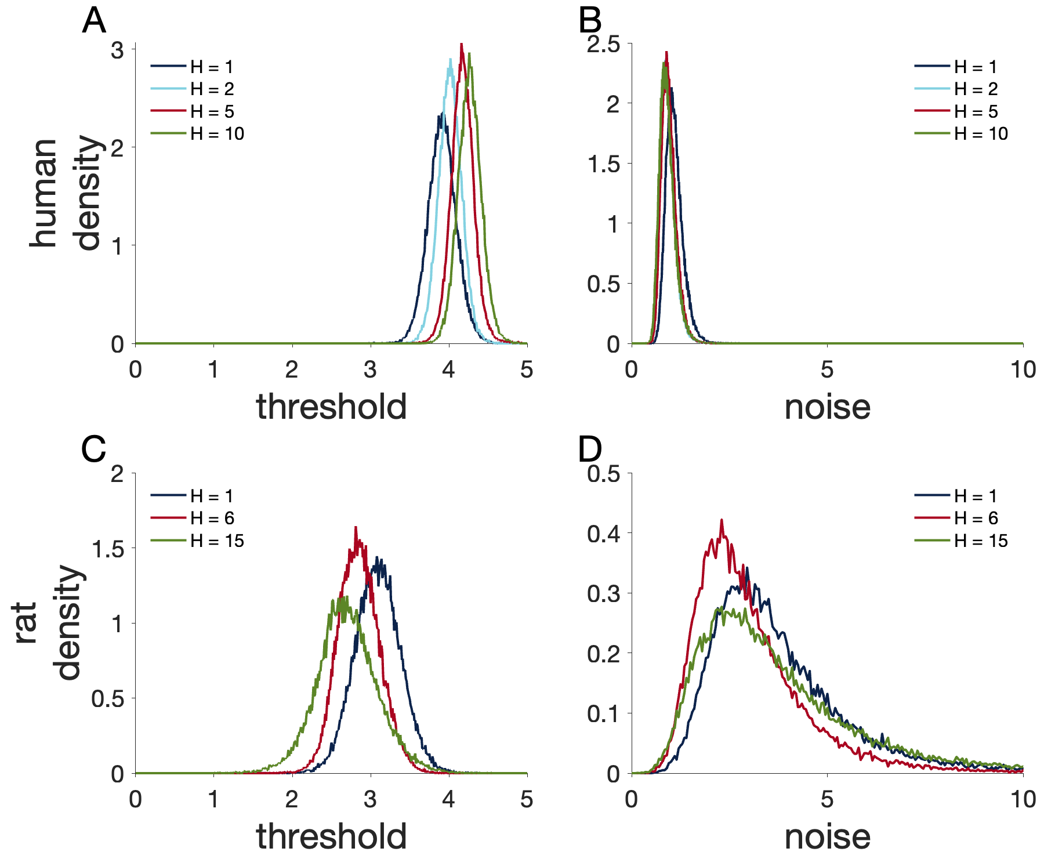
Notes:
Figure 7: Model-based estimates of exploration threshold and decision noise for humans (A, B) and rats (C, D).

Slide 8
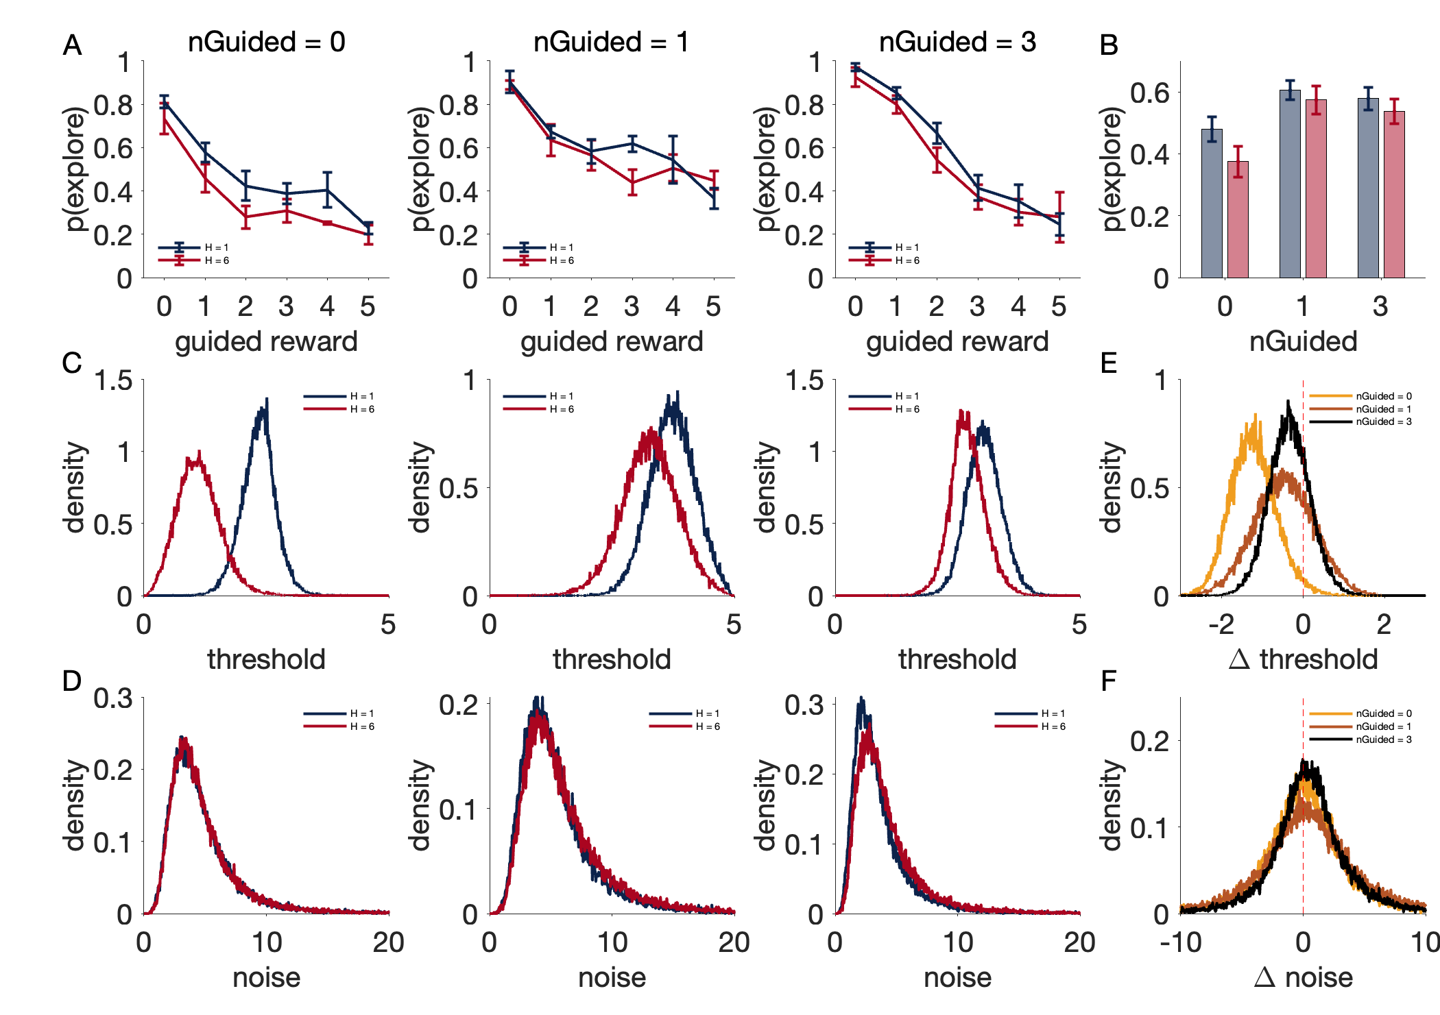
Notes:
Figure 8: Differences in exploration in H = 1 vs H = 6 in rats, Experiment 2. A. p(explore) vs guided reward separated by horizon, for nGuided = 0, 1 and 3. B. Average p(explore) by horizon and nGuided, blue is H = 1 and red is H = 6. C. Model-based estimates of exploration threshold $θ\left(H=1\right)$ and $θ(H=6)$ for nGuided = 0, 1 and 3. D. Model-based estimates of decision noise $σ\left(H=1\right)$ and $σ(H=6)$ for nGuided = 0, 1 and 3. E. Posterior distribution of $θ\left(H=6\right)−θ\left(H=1\right)$. F. Posterior distribution of $σ\left(H=6\right)−σ\left(H=1\right).$

Slide 9
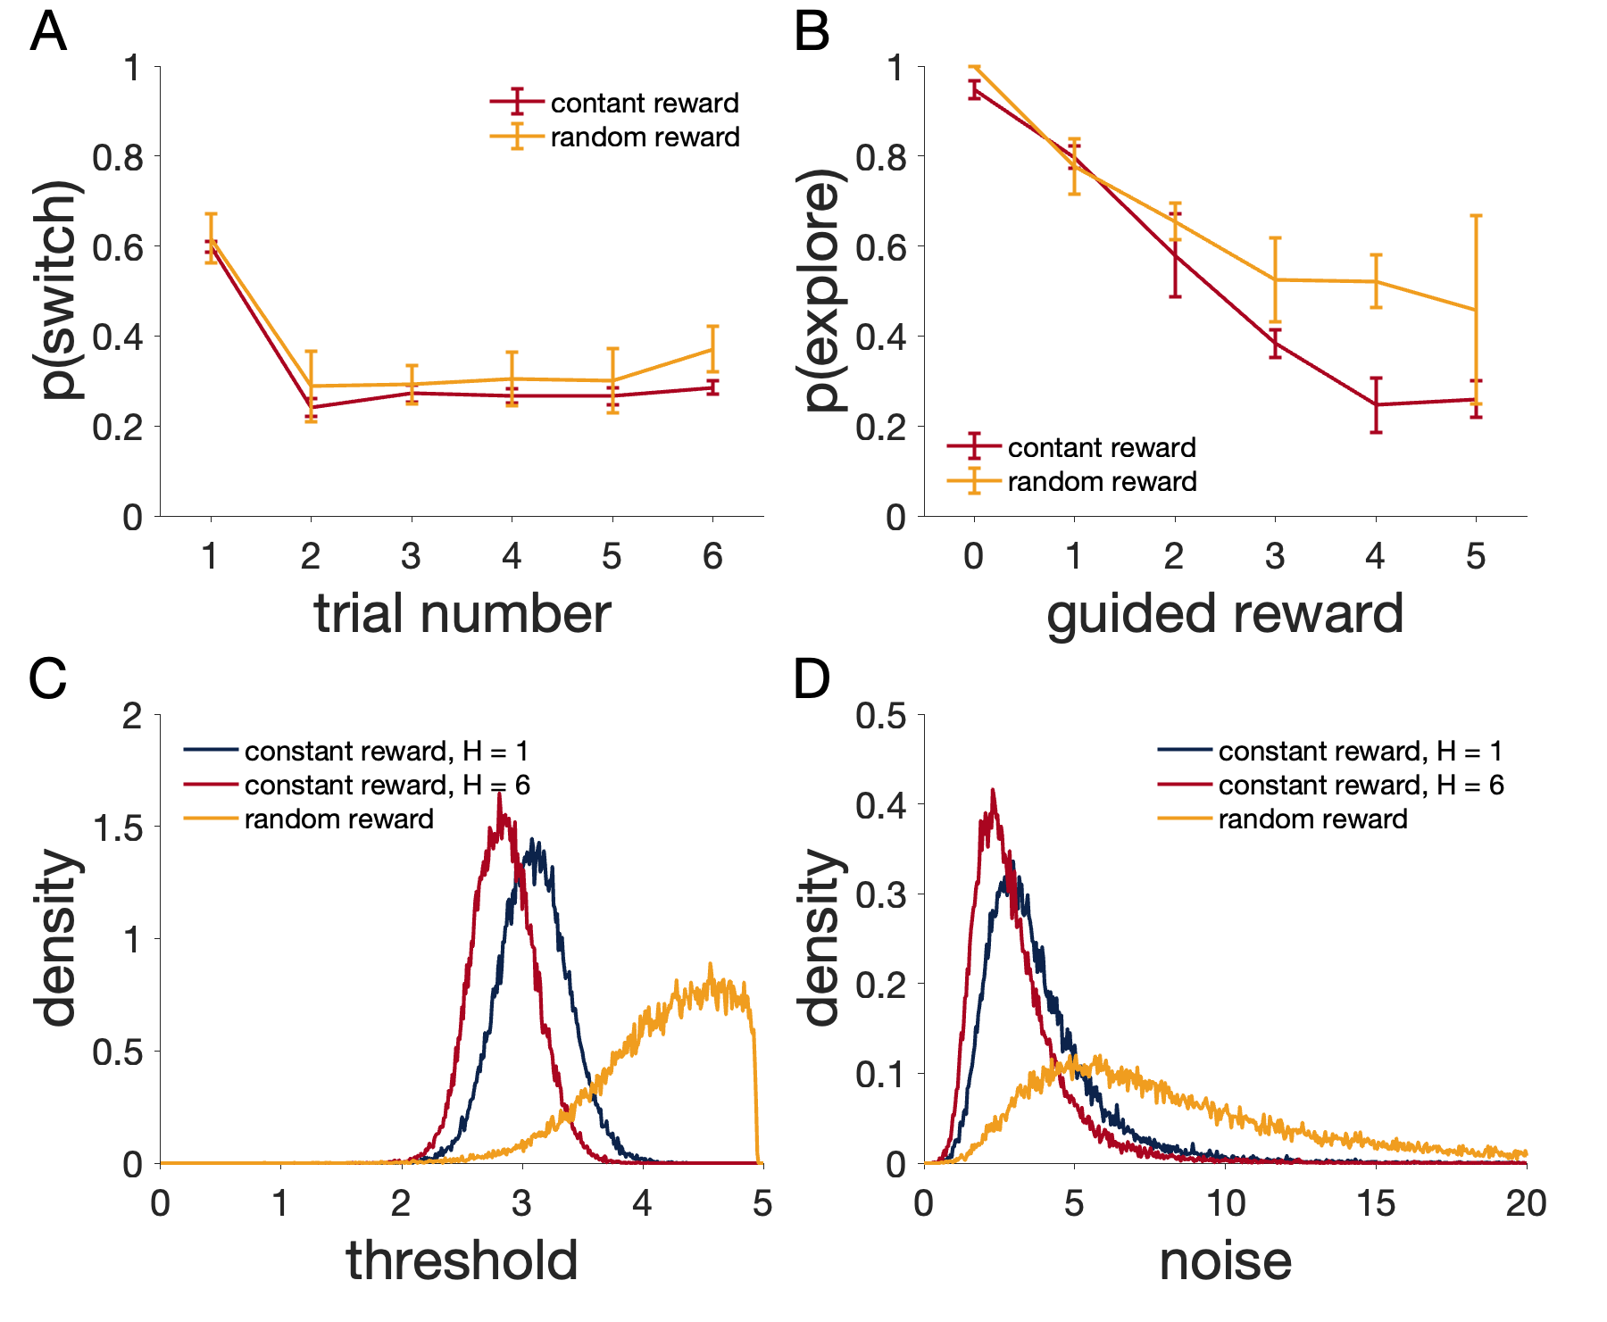
Notes:
Figure 9: Random vs constant reward, Experiment 3. A. p(switch) as a function of trial number. B. p(explore) as a function of guided reward. C. Model-based estimates of exploration threshold. D. Model-based estimates of decision noise.

Slide 10
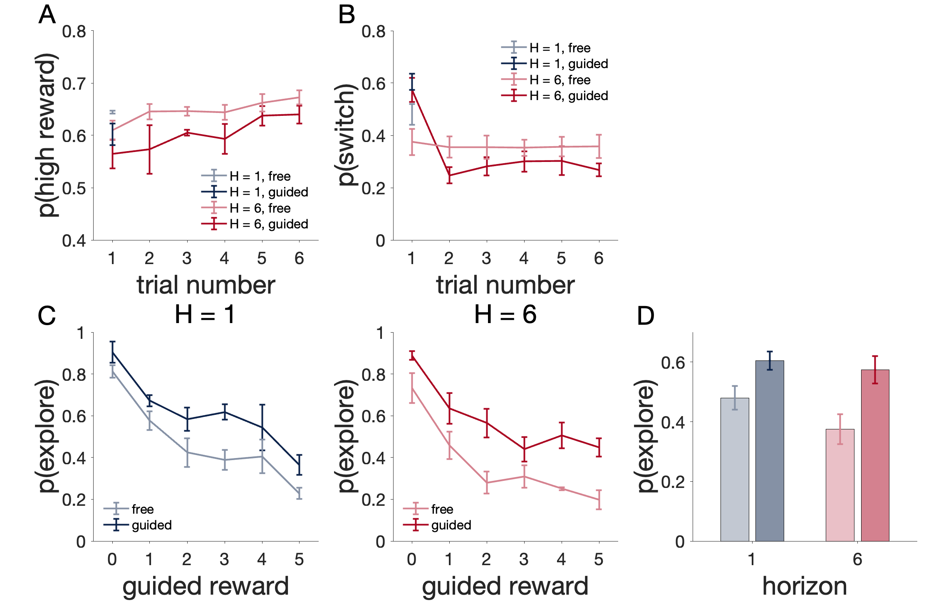
Notes:
Figure 10. Differences in exploration in Guided vs Free choice condition. At the start of a game, rats were given one guided trial (1 light blinking, Guided condition) or a free choice instead (2 lights blinking, Free choice condition). A: probability of choosing the correct feeder after the guided trials or after the first free choice for the 2 horizons tested. B: p(switch) after the guided trials or after the first free choice for the 2 horizons tested. C: Influence of reward size during the first trials (Guided or Free choice). D: average p(explore) in Guided vs Free choice condition by horizon, blue is H = 1, red is H = 6, lighter color is Free choice condition and darker color is Guided condition.

Slide 11
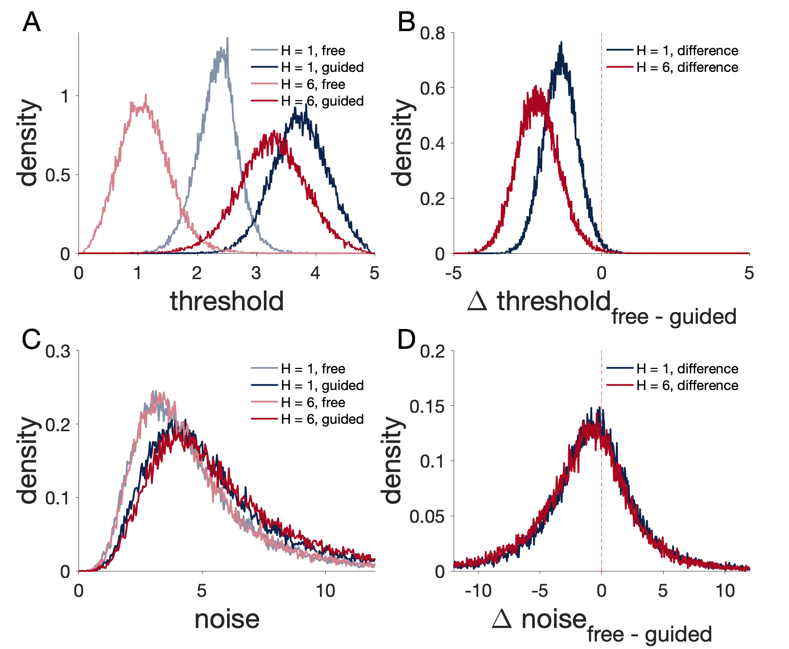
Figure 10
Notes:
Figure 11. Model estimates of exploration threshold (A, B) and decision noise (C, D) in Free choice condition vs Guided condition.

Slide 12
Supplementary figures

Slide 13
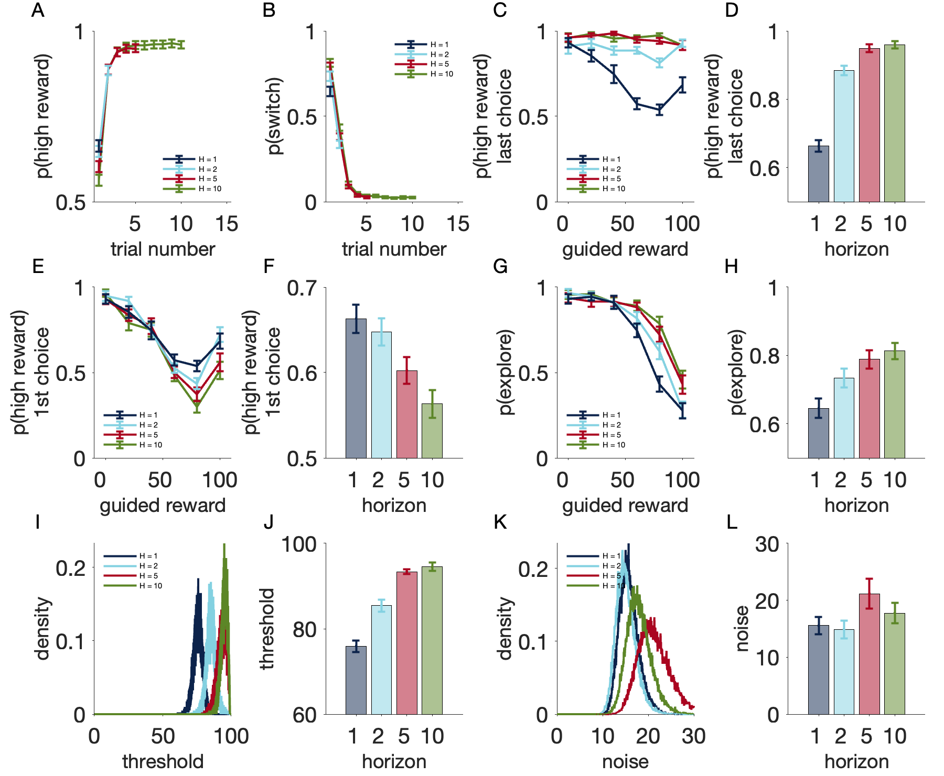
Notes:
Figure S1. Human Experiment 5: Rewards range from 1 to 100. A: p(high info) vs trial number. B: p(switch) vs trial number. C: p(high reward, last choice) vs guided reward. D: average p(high reward, last choice) by horizon. E: p(high reward, first choice) vs guided reward. F: average p(high reward, first choice) by horizon. G: p(explore) vs guided reward. H: average p(explore) by horizon. I: Model estimates of group-level exploration thresholds. J: Average of individual estimates of exploration thresholds by horizon. K: Model estimates of group-level decision noise. L: Average of individual estimates of decision noise by horizon.

Slide 14
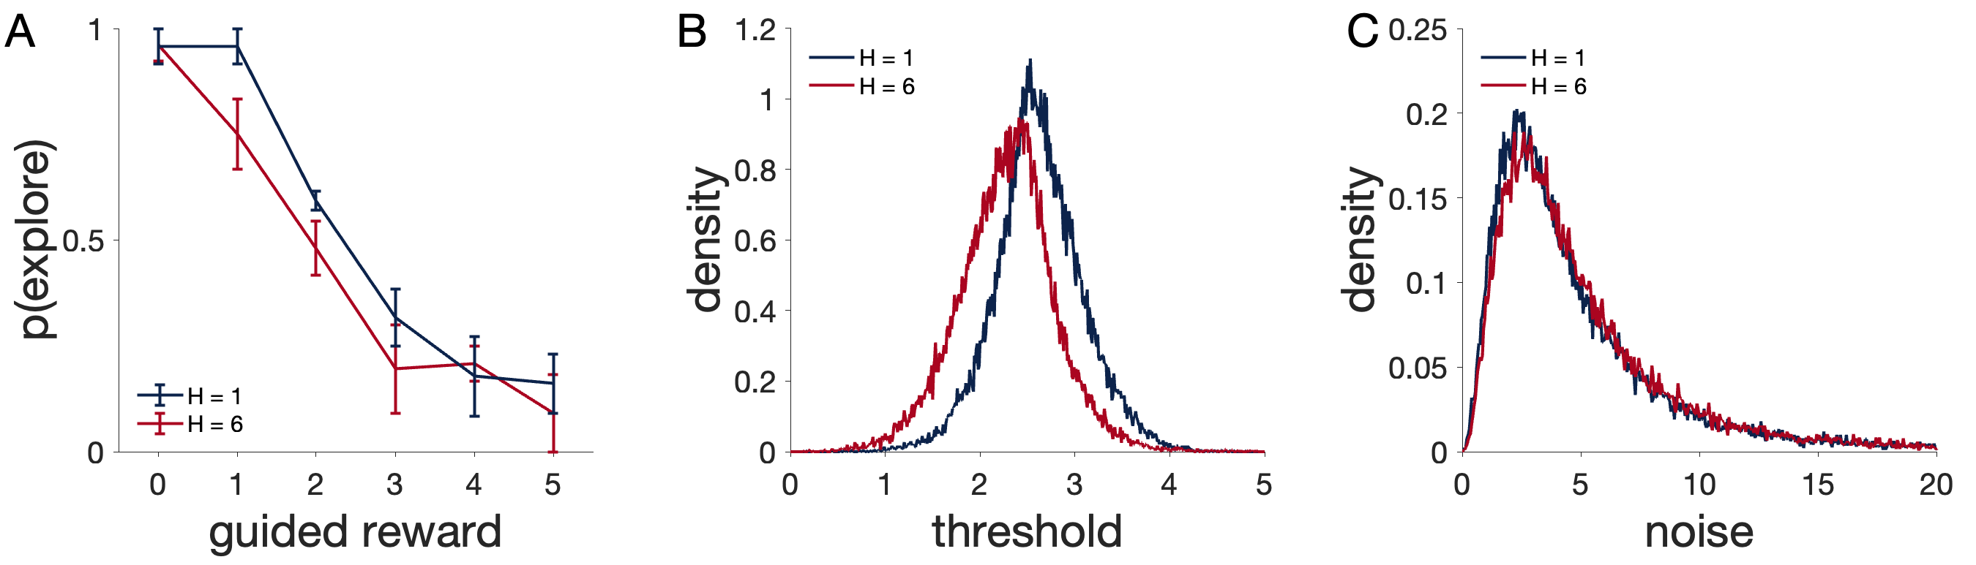
Notes:
Figure S2. Sound cue variant of Experiment 2. In this experiment, the different horizon conditions are cued by either a low-pitch sound (H = 1) or a high-pitch sound (H = 6). Games of different horizons are interleaved. A: p(explore) vs guided choice. B and C: Model estimates of exploration threshold and decision noise

