Slide 1



A
Game 1
Trial 1 start
Trial 1 cue
Trial 1 response
Trial 2 start
Trial 2 cue
Trial 2 response
Game 2
Trial N response
Game 1 End
Trial 1 Start
Trial 1 Cue
…
…
B
Trial 1 cue
Trial 1 response
Trial 2 cue
Trial 2 response
Trial 2 cue
XX
3
XX
3
XX
3
XX
3
+
…
+
…
+
…
5
+
XX
…
5
+
XX
…

Slide 2
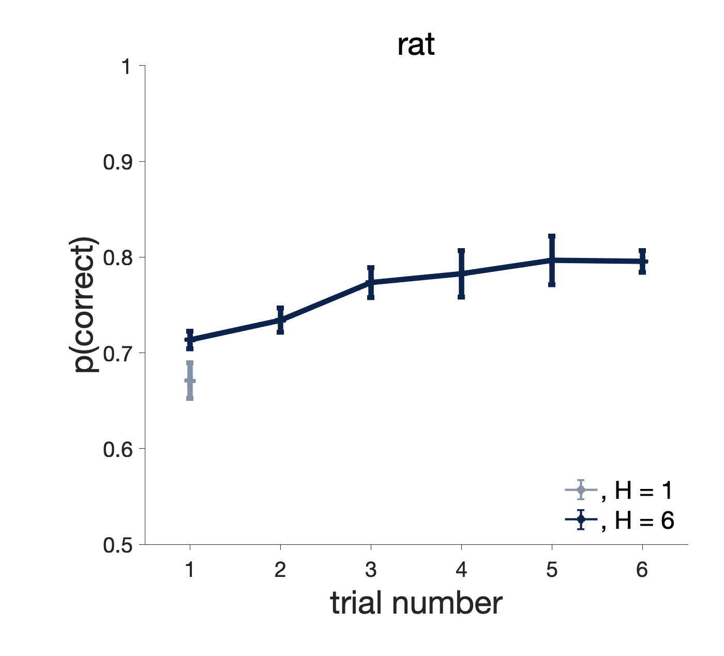
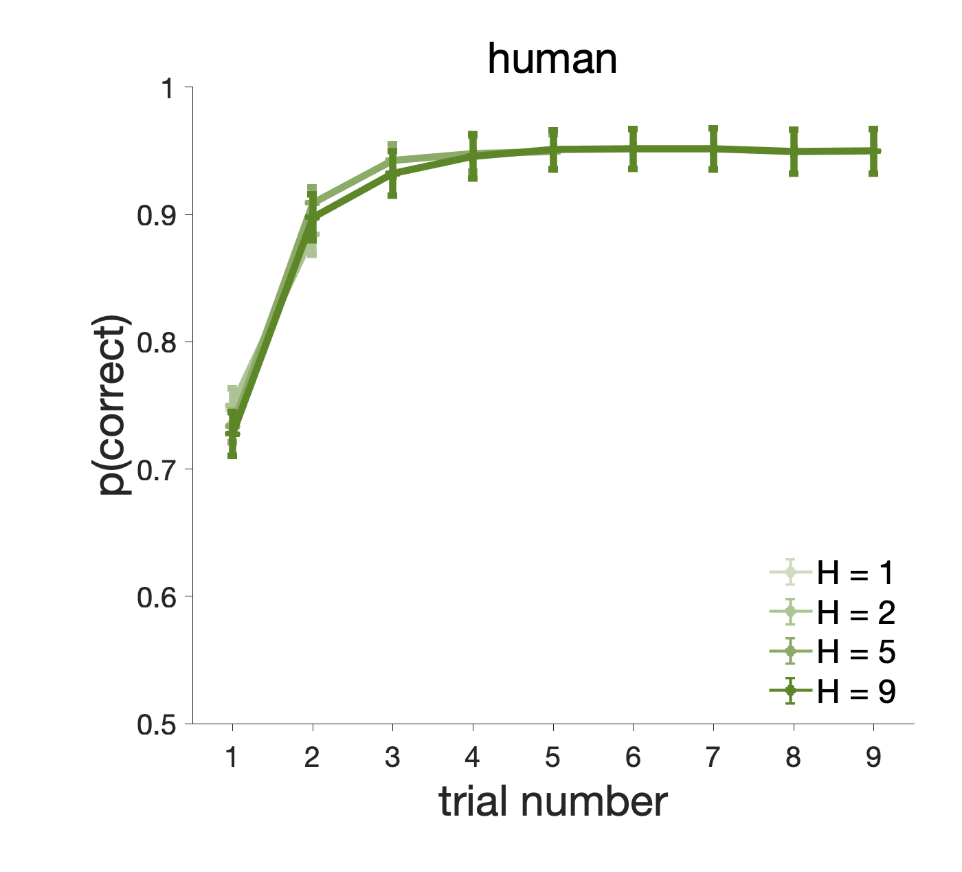
Notes:
If significant, Look at last 5 games Vs first game. If different -> rats change its behavior as ft of H on 1st trial
Later: compare cases where the tone is played or not.
Plot trial1 only by R-guided value: Are there differences depending on H? Both rats and humans.

Slide 3
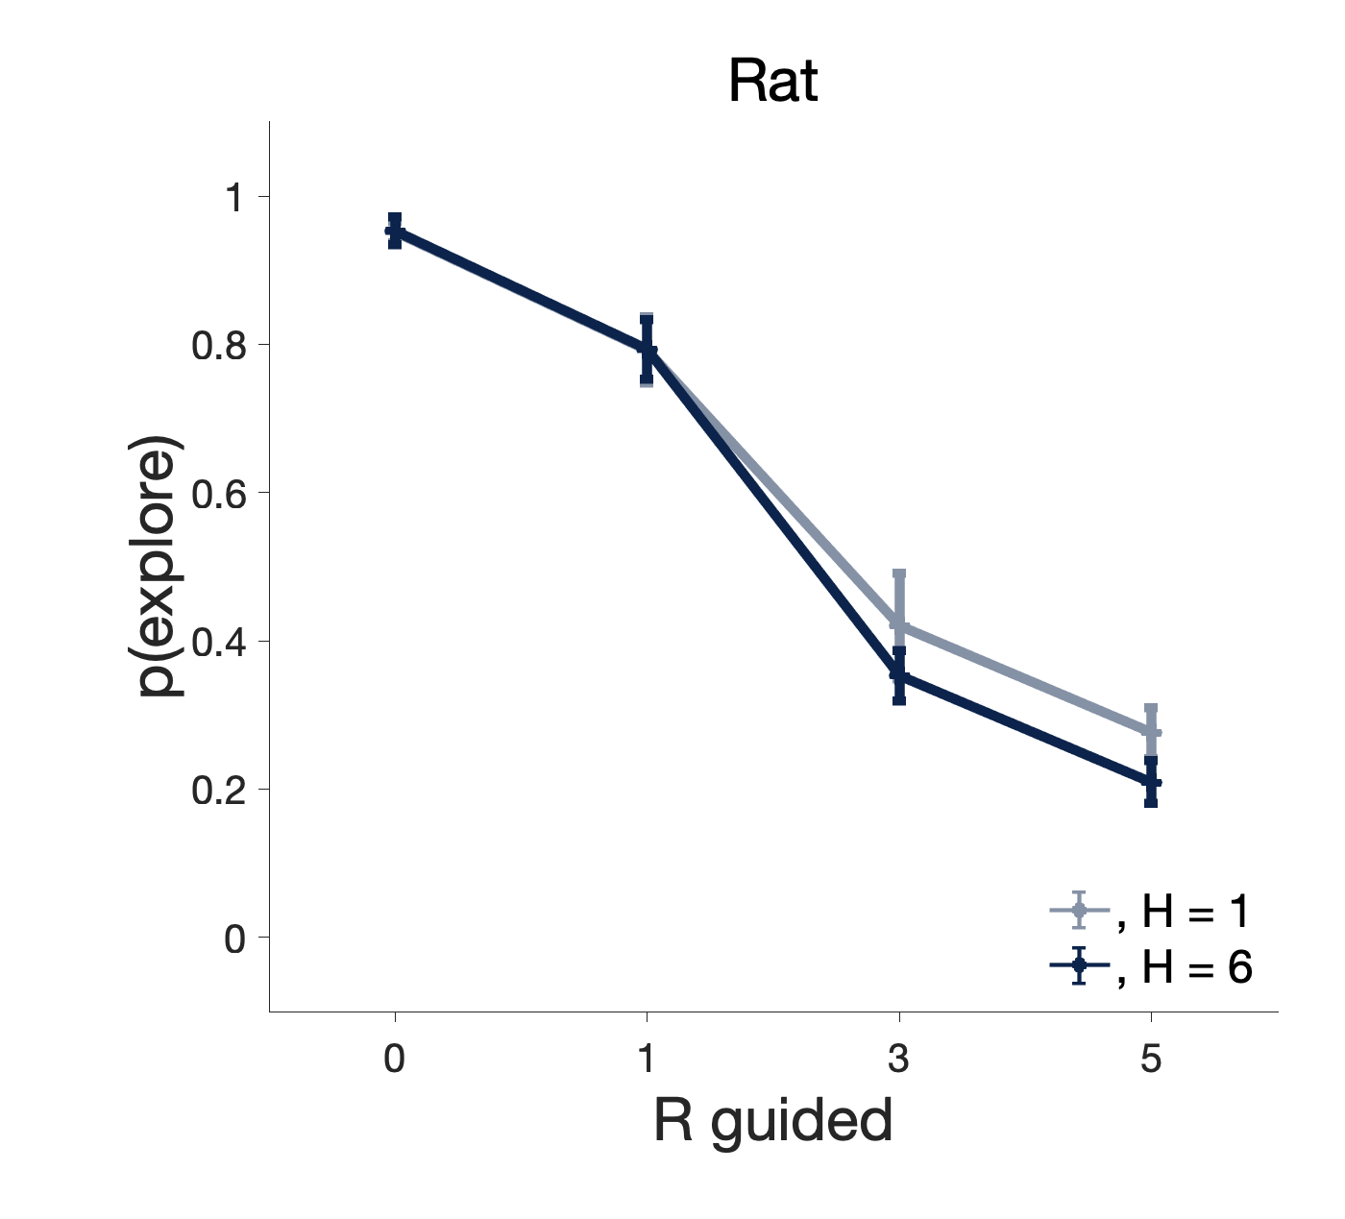
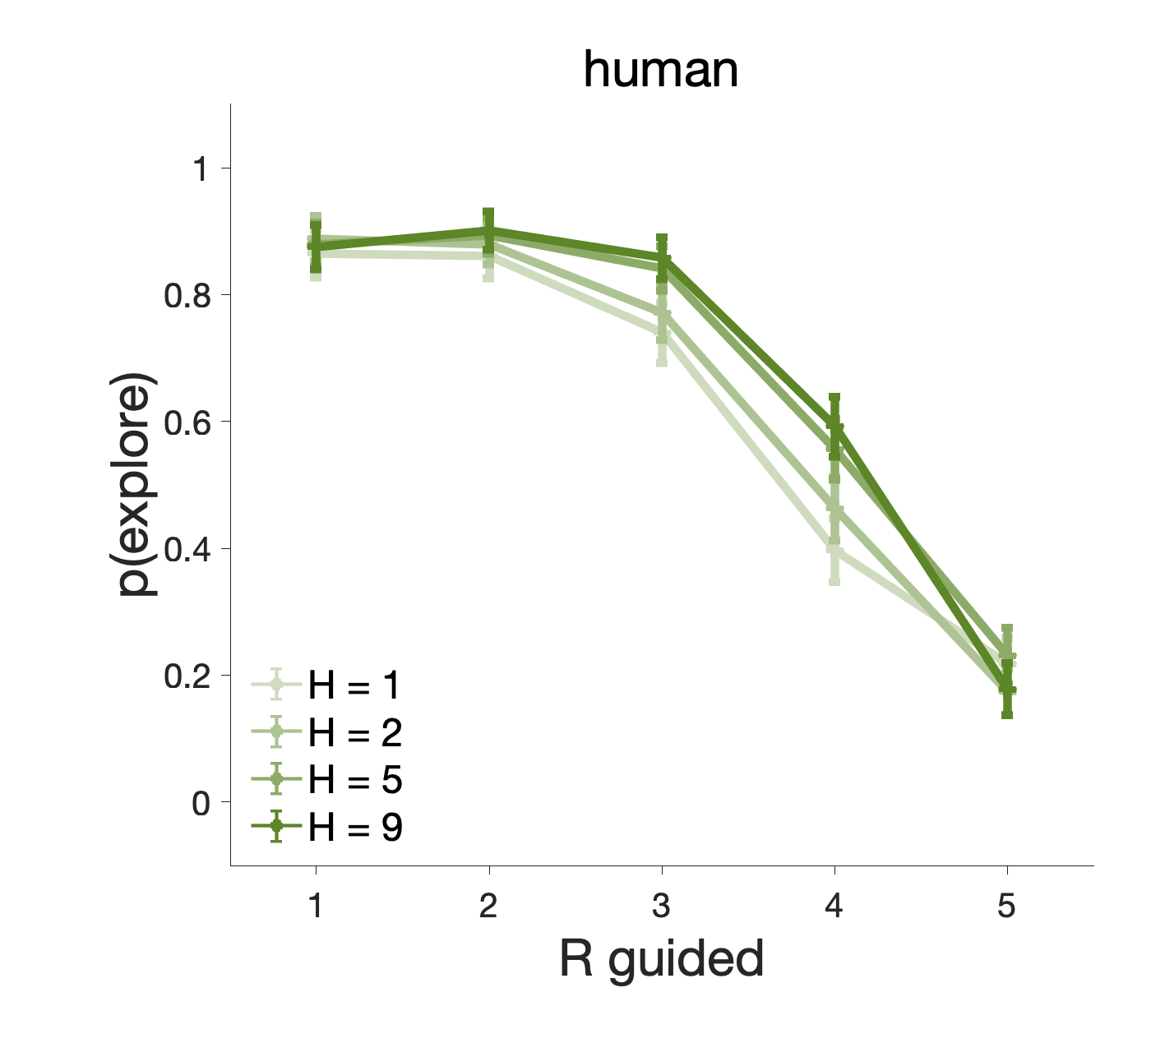

Slide 4
Reaction time
Human?
RT
RT
R Guided
reward
RT
RT
Trial
Trial
Notes:
Fig 4: The higher/Lower the reward, the shorter the RT (inverted U shape). RT decreasing with nb of trials

Slide 5
rat
Human
P(switch)
P(switch)
Trial number (H=6)
Trial number (H=6)

