Slide 1
Learning Deep CNN Denoiser Prior for Image Restoration
Xuanchen Wang

Slide 2
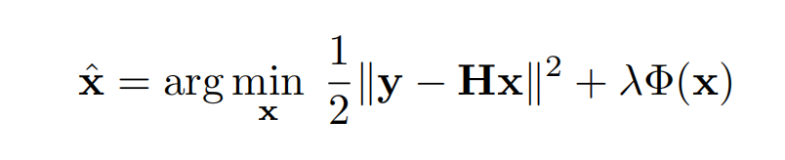
Background
The purpose of image restoration is to recover the latent clean image x from its degraded observation y = Hx + v
fidelity term
regularization term

Slide 3
Background
Model-based optimization methods
Discriminative learning methods
Half Quadratic Splitting (HQS) Method

Slide 4
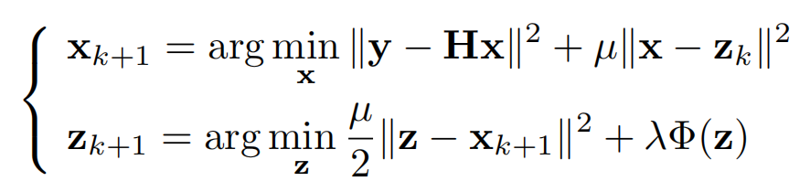
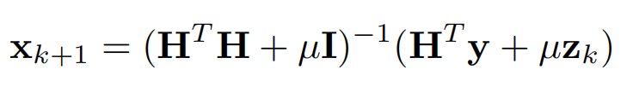
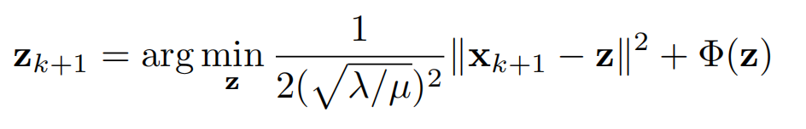
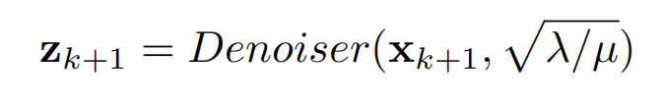
Half Quadratic Splitting (HQS) Method
Noise Level

Slide 5
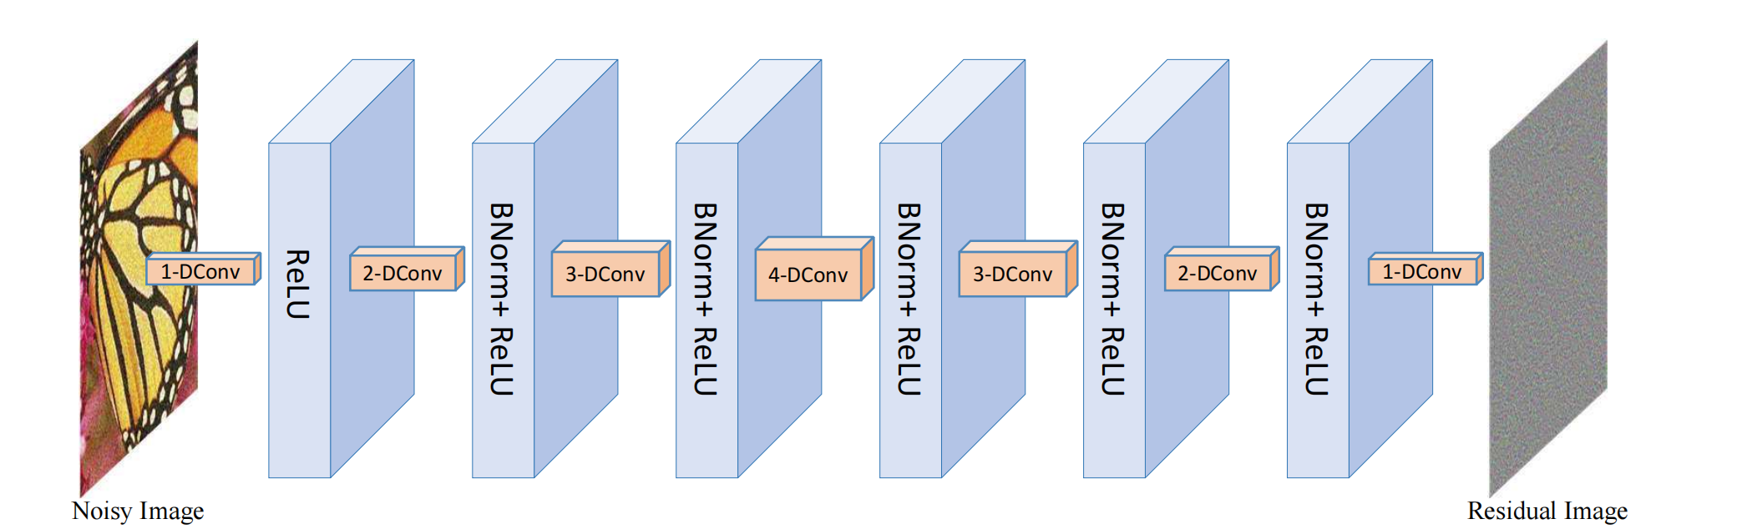
Proposed Method in Paper
The architecture of denoiser
Ref : Zhang, Kai, et al. "Learning deep CNN denoiser prior for image restoration." Proceedings of the IEEE conference on computer vision and pattern recognition. 2017.

Slide 6
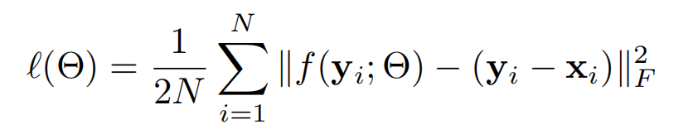
Loss Function
Noised Image
Original Image

Slide 7
New Loss Function
Original Loss Function L1:
Additional Guidance L2 : MSE( VGG(x_{i}) , VGG ( y_{i} - f (y_{i}) ) )
New Loss L : $L$1+$λL2 (λ=0.001)$

Slide 8
Training details
10744 color images from BSD (500), ImageNet(5500) and Waterloo(4744)
171904 none-overlap patches with size 64x64
25 denoisers with noise level [0,50]
Batch Size: 128

Slide 9
Experiment Result (Image Denoising)
Epochs: 200
The average PSNR(dB) results on CBSD68
Noise Level | 5 | 15 | 25 | 35 | 50
Old Loss | 40.36 | 33.86 | 31.16 | 29.50 | 27.86
New Loss | 40.68 | 34.06 | 31.61 | 30.03 | 28.16

Slide 10
Experiment Result (Image Deblurring)
Epochs: 10
Noise Level: 6.75
8 different kernels
The average PSNR(dB) results on three color images
Color Image | Butterfly | Leaves | Starfish
Old Loss | 28.76 | 29.32 | 28.87
New Loss | 26.97 | 27.33 | 27.03

Slide 11
Experiment Result (Single Image Super-Resolution)
Epochs: 10
The average PSNR(dB) results on Set5
Method | PSNR | Details
Old Loss | 32.26(Y channel) 34.67(RGB channel) | Scale: 2 Kernel: Bicubic
New Loss | 32.6(Y channel) 34.7(RGB channel) | Scale: 2 Kernel: Bicubic

Slide 12
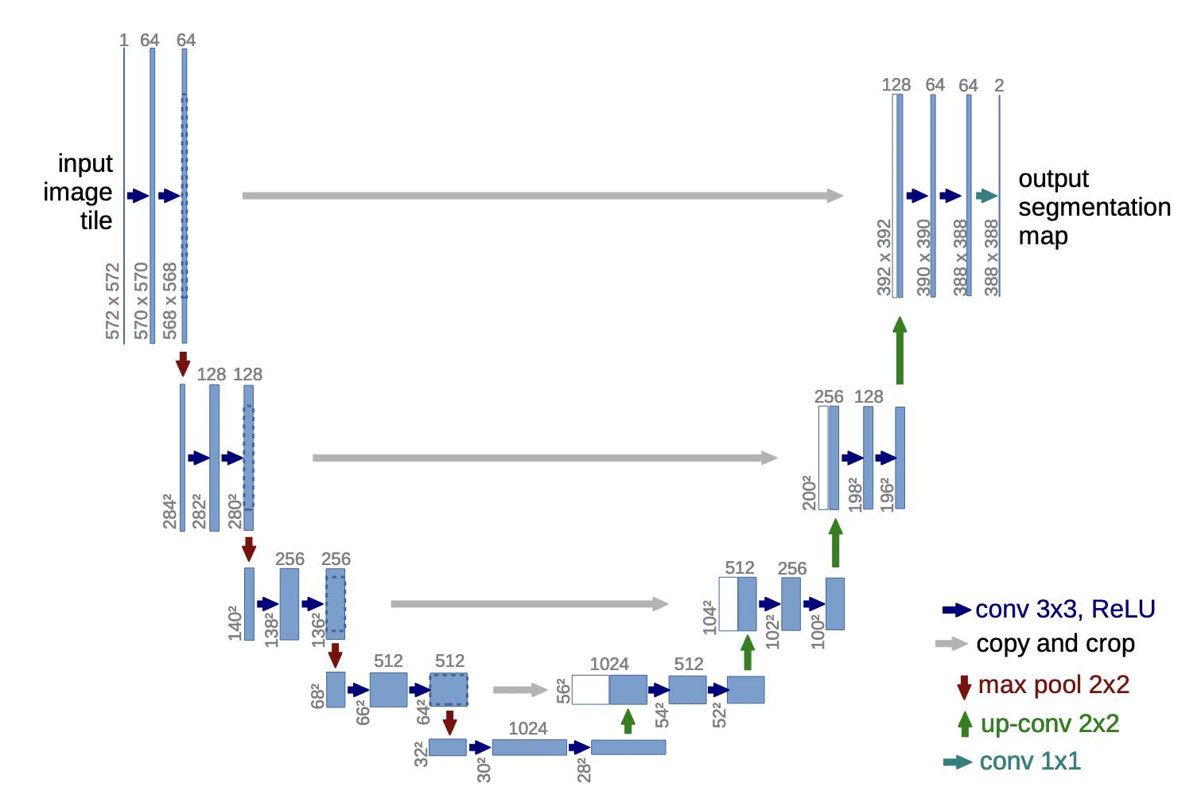
New Architecture
U-net architecture
Ref: Ronneberger O, Fischer P, Brox T (2015) “u-net: Convolutional networks for biomedical image segmentation”. In: International Conference on Medical image computing and computer-assisted intervention Springer, pp 234–241

Slide 13
Experiment Result (Image Denoising)
Epochs: 200
The average PSNR(dB) results on CBSD68
Noise Level | 5 | 15 | 25 | 35 | 50
Old Architecture | 40.36 | 33.86 | 31.16 | 29.50 | 27.86
New Architecture | 38.53 | 32.36 | 29.05 | 26.84 | 24.52

Slide 14
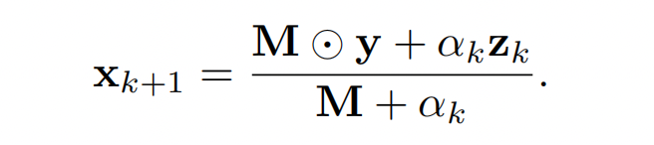

New Application (Image Demosaicing)
Demosaicing aims to estimate the missing pixel values from a one-channel mosaiced image and the corresponding color filter array(CFA) pattern to recover a three-channel image
where M is determined by CFA pattern and is a matrix with binary elements indicating the missing pixels of y, and denotes element-wise multiplication.

Slide 15
Experiment Result (Image Demosaicing)
Epochs: 10
The average PSNR(dB) results on Kodak
Method | PSRN
Old Loss | 42.16
New Loss | 39.74

Slide 16

Questions?

