Slide 1
watchodg
系统stability检测工具

Slide 2
Agenda
1.总体流程
2.设备树中解析watchdog参数
3.设置定时器pet_timer
4.唤醒msm_watchdog线程
5.向其他CPU发送IPI中断
6.狗叫

Slide 3
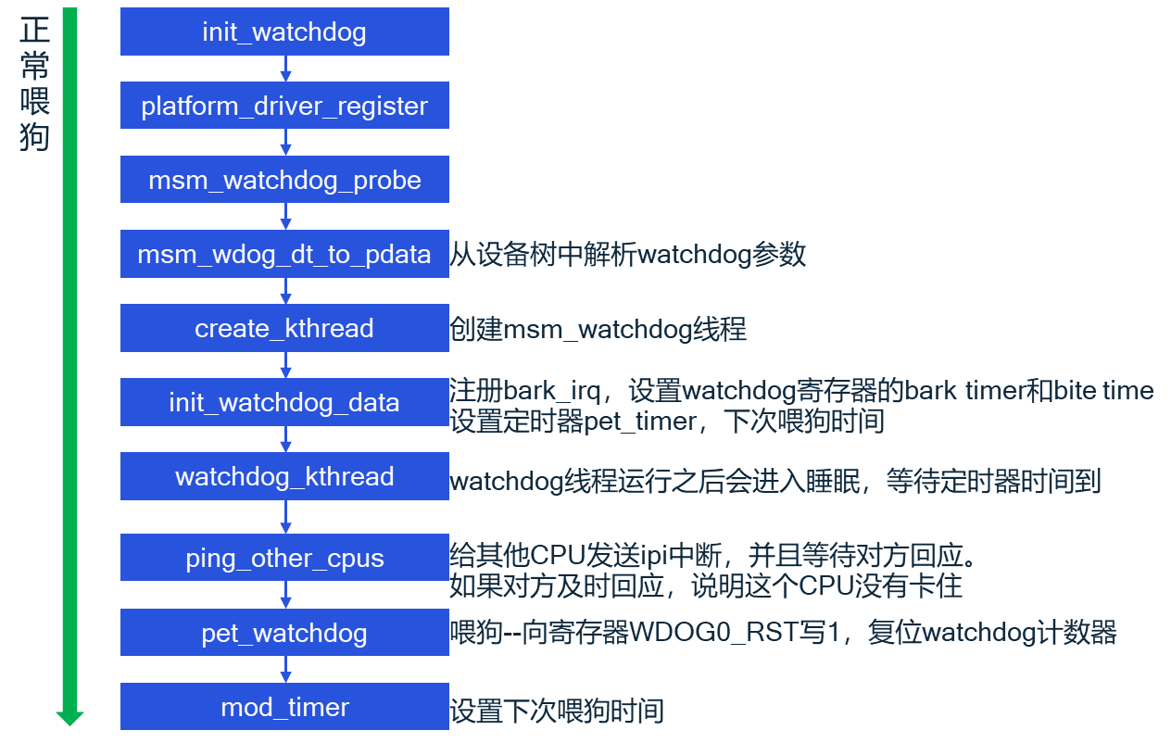
watchdog总体流程

Slide 4
设备树中解析watchdog参数
msm_wdog_dt_to_pdata
wdog: qcom,wdt@17c10000{
compatible = “qcom,msm-watchdog”;
reg = <0x17c10000 0x1000>; →wdog_data.phys_base = 0x17c10000, wdog_data.size = 0x1000
reg-names = “wdt-base”;
interrupts = <0 0 0>, <0 1 0>; →bark irq hwirq = 0x20, bite irq hwirq = 0x21(wdog_data中的bark_irq和bite_irq是虚拟中断号)
qcom,bark-time = <11000>; →wdog_data.bark_time = 11s
qcom,pet-time = <9360>; →wdog_data.pet_time = 9.36s
qcom,ipi-ping; →wdog_data.do_ipi_ping = true
qcom,wakeup-enable; →wdog_data.wakeup_irq_enable = true
qcom,scandump-size = <0x10100 0x10100 0x10100 0x10100
0x18100 0x18100 0x18100 0x18100>;
};

Slide 5
设置pet_timer
init_watchdog_data
init_watchdog_data
devm_request_irq
注册bark irq中断处理函数wdog_bark_handler
set bark_time
write bark_time to register WDT0_BARK_TIME
set pet_timer
wdog_data->pet_timer.data = wdog_data
wdog_data->pet_timer.function = pet_task_wakeup
wdog_data->pet_timer.expires = jiffies+msecs_to_jiffies(wdog_data->pet_time)
first time to pet wdog
write 1 to register WDT0_RST

Slide 6
唤醒msm_watchdog线程
msm_watchdog
wdog_data->pet_timer
watchdog_kthread
1.wachdog线程开始运行之后condition(timer_expired)
为false，会创建wq_entry
2.把wq_entry添加到pet_complete等待队列，之后设置线程状态为interruptible
3.如果condition(pet_expired)为false，进入休眠
wait_event_interruptible(
wdog_dd->pet_complete, wdog_dd->timer_expired)
Wdog_dd->pet_timer定时时间到
pet_task_wakeup
Y
wdog_dd->timer_expired == true
wdog_dd->timer_expired = true
N
初始化wq_entry
wq_entry->private = current //当前为msm_watchdog线程
wq_entry->func = autoremove_wake_function
wake_up(wdog_dd->pet_complete)
init_wait_entry
prepare_to_wait_event
把wq_entry添加到wdog_dd->pet_complete链表头部
设置线程状态为interruptible
autoremove_wake_function
wdog_dd->timer_expired == true
try_to_wake_up(wq_entry->private, mode, wake_flags, 1)
Y
唤醒wdog_dd->pet_complete链表中的线程
N
4.pet_timer定时时间到，把timer_expired置为true
5.唤醒pet_complete等待队列上的线程—msm_watchdog
signal pending
Y
N
休眠
schedule
6.Watchdog线程判断condition(timer_expired)为true,跳出循环，继续往下执行（ping other cpu）
Going on ……

Slide 7
向其他cpu发送ipi中断
target CPU接收到中断
handle_IPI
ping_other_cpus
ping_other_cpus
向online的cpu发送ipi中断
flush_smp_call_function_queue
smp_call_function_single
遍历call_single_queue链表中csd节点，执行csd->func
初始化call_single_data元素csd:
csd->flags=CSD_FLAG_LOCK|CSD_FLAG_SYNCHRONOUS,
csd->func=keep_alive_response, csd->info=watchdog_dd
并添加到call_single_queue链表
generic_exec_single
keep_alive_response
arch_send_call_function_single_ipi
设置csd->flags=0
csd_unlock
smp_cross_call_common
stlr指令clear global monitor，同时会触发event来唤醒调用wfe指令进入低功耗状态的CPU
csd->flags=0
gic_raise_softitrq
gic_send_sgi
设置寄存器SYS_ICC_SGI1R_EL1
产生SGI中断，中断号是IPI_CALL_FUNC,
指定接收中断的target cpu
csd->flags& CSD_FLAG_LOCK==0
N
csd->flags被修改
Y
cpu睡眠之前ldxr指令设置global monitor为exclusive state
N
wfe

Slide 8
watchdog bark
wdog_bark_handler
watchdog计数器到达bark time
watchdog产生bark irq
wdog_bark_handler
msm_trigger_wdog_bite
设置bite时间
向寄存器WDT_BITE_TIME中写入1，
1/WDT_HZ时间之后触发bite中断
由TZ触发crash

