Slide 1
DOA ESTIMATION METHODS
— SIMULATION & RESULTS
王颖辉
导师：王 伶
School of Electronics and Information
Northwestern Polytechnical University
2013.01

Slide 2
CONTENTS
——focus on algorithm implementation and MATLAB programming
Simulation of Capon method
Simulation of MUSIC method
Simulation of ESPRIT method

Slide 3
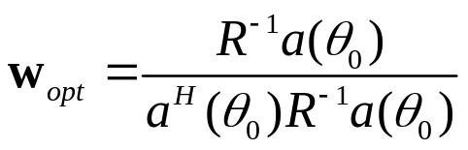


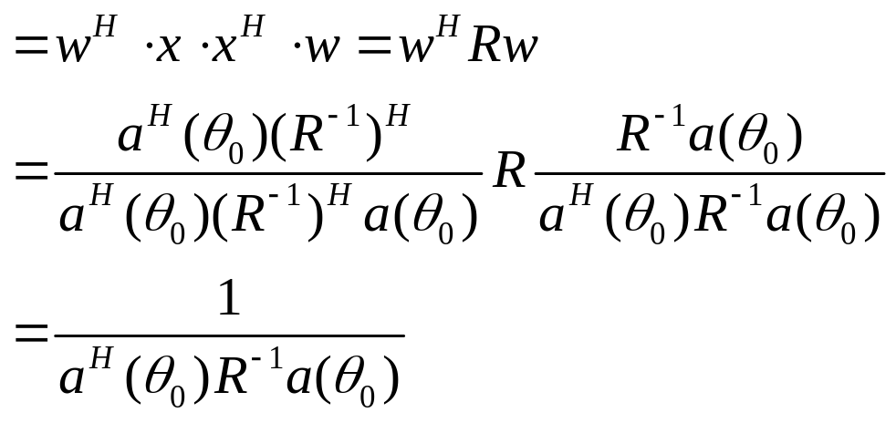
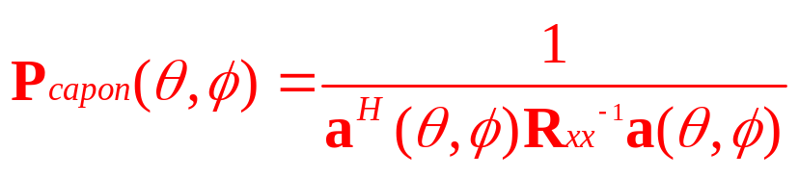
Simulation of Capon method
Weighting vector
Array output
Spatial Spectrum
Capon Spatial Spectrum
Notes:
主波束宽度 半功率宽度 3dB宽度

Slide 4
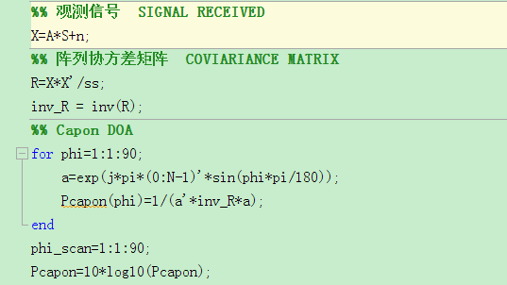
Simulation of Capon method
Doa_capon.m
Notes:
主波束宽度 半功率宽度 3dB宽度

Slide 5
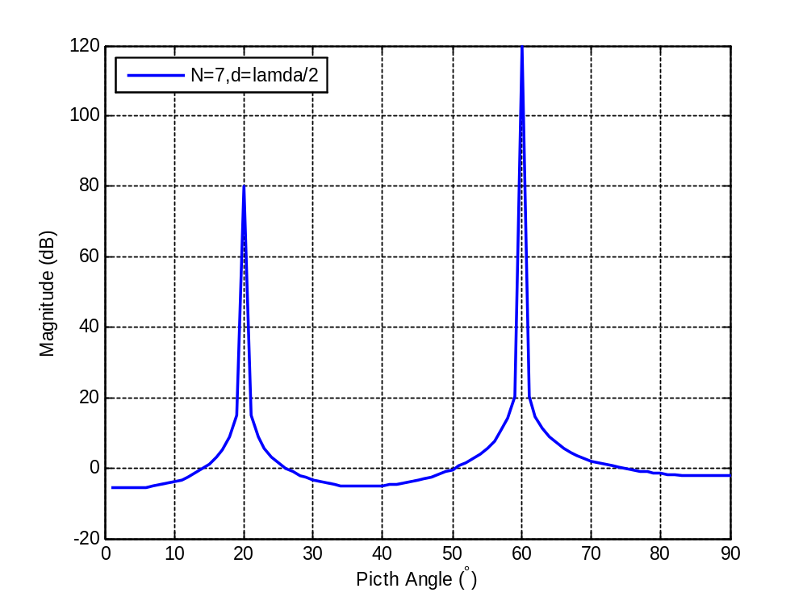
Simulation of Capon method
Notes:
主波束宽度 半功率宽度 3dB宽度

Slide 6
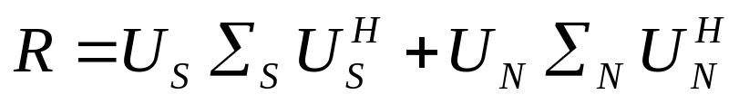
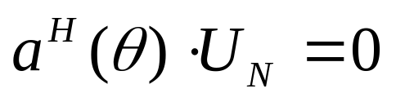
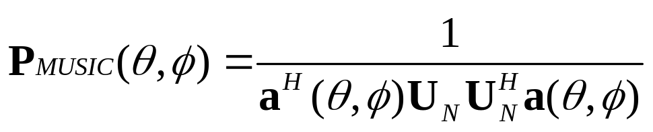
Simulation of MUSIC method
MUSIC – Multiple Signal Classification
Eigen-decomposition
Signal subspace & noise subspace Orthogonal
MUSIC Spatial Spectrum
Notes:
主波束宽度 半功率宽度 3dB宽度

Slide 7
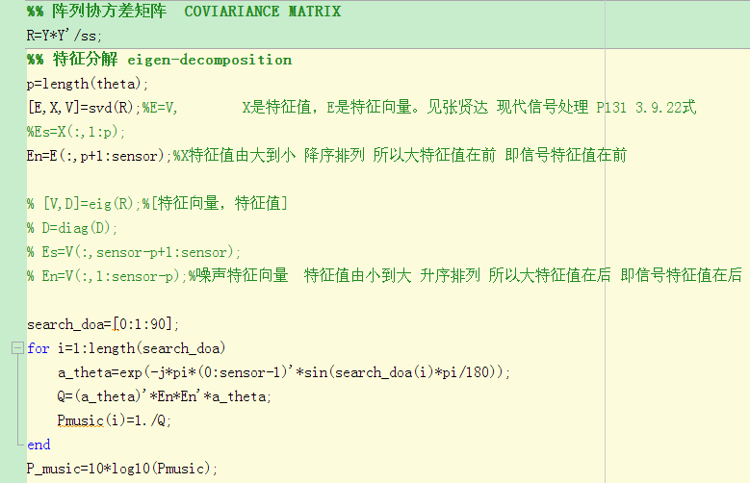
Simulation of MUSIC method
Doa_music2.m
Notes:
主波束宽度 半功率宽度 3dB宽度

Slide 8
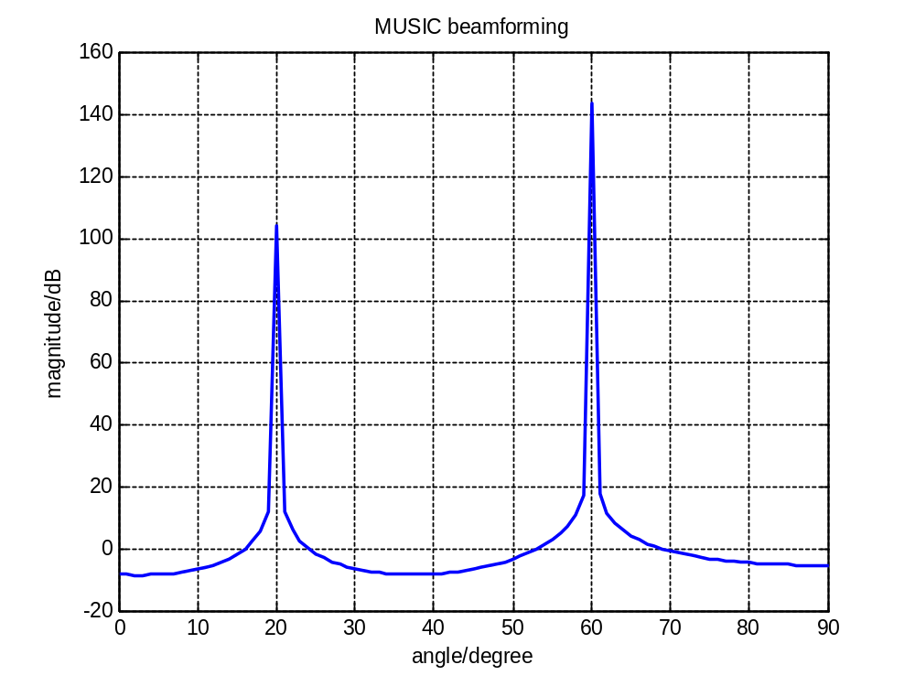
Simulation of MUSIC method
Notes:
主波束宽度 半功率宽度 3dB宽度

Slide 9
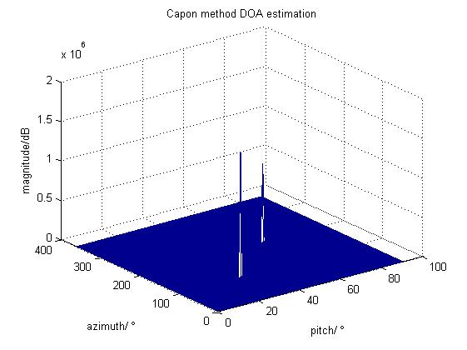

Simulation of MUSIC method
Capon_MUSIC_DOA.m
SNR 30 31
Notes:
二维谱峰搜索

Slide 10
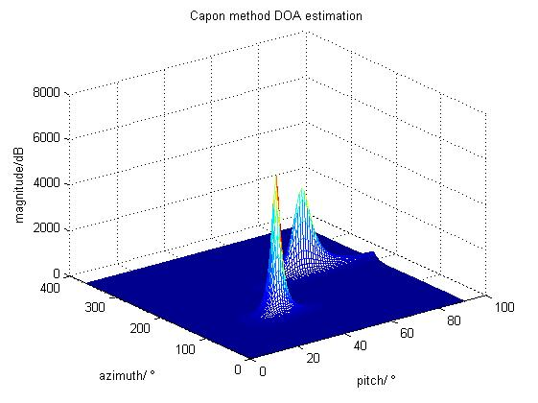
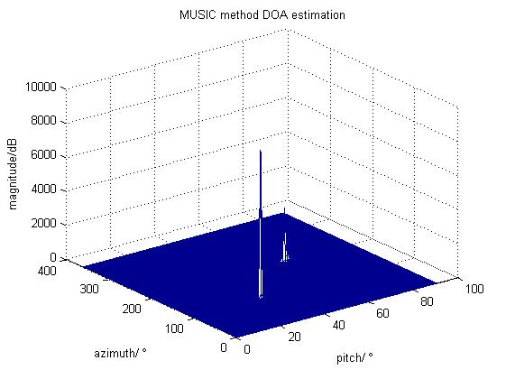
Simulation of MUSIC method
Capon_MUSIC_DOA.m
SNR 18 19
Notes:
二维谱峰搜索

Slide 11
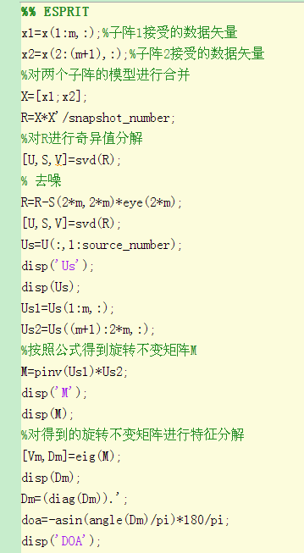
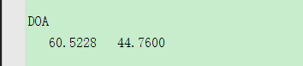
Simulation of ESPIRT method
LS_ESPRIT.m
source_doa=[45 60]
Notes:
不需要谱峰搜索

Slide 12
REFERENCE
张贤达.通信信号处理[M]. 北京:国防工业出版社,2000,12.
王永良,陈辉等.空间谱估计理论与算法[M]. 北京:清华大学出版社,2009.
Capon J., High-resolution frequency-wavenumber spectrum analysis [J], Proc. Of IEEE, 1969, 57(8), pp: 1408-1418.
Schmidt R. O. ,Multiple emitter location and signal parameter estimation. IEEE Trans. ASSP, 1989, 37(12), 1939-1949.

Slide 13
THANK YOU ！

