Slide 1
BASIC CONCEPTS OF
ARRAY SIGNAL PROCESSING
— SIMULATION AND RESULTS
王颖辉
导师：王 伶
School of Electronics and Information
Northwestern Polytechnical University
2012.12

Slide 2
CONTENTS
——focus on algorithm implementation and MATLAB programming
Simulation of Uniformly Weighting
Array Apertures
Element Spacing
Mainbeam Direction
Low Sidelobe
A Brief Review of optimal Beamforming
Simulation of Adaptive Beamforming
SMI Algorithm
LMS Algorithm

Slide 3
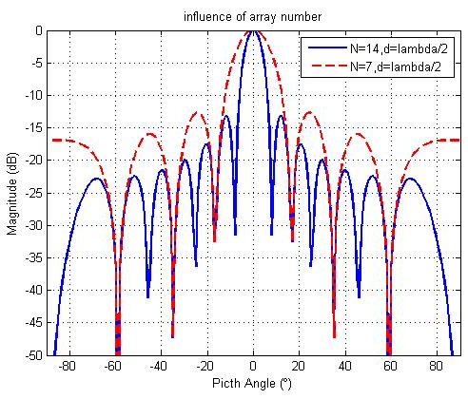
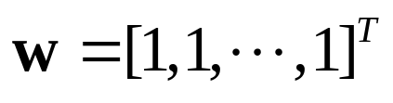
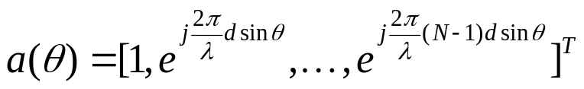
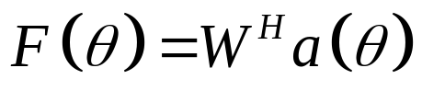
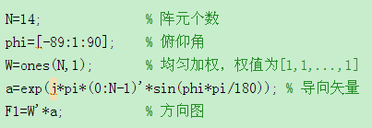
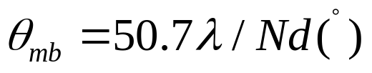
Uniformly Weighting of Uniform Linear Array
Influence of Array Aperture
P19.m
Notes:
主波束宽度 半功率宽度 3dB宽度

Slide 4

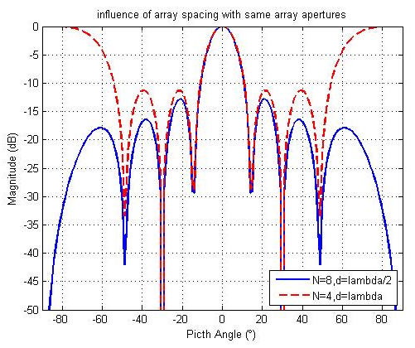
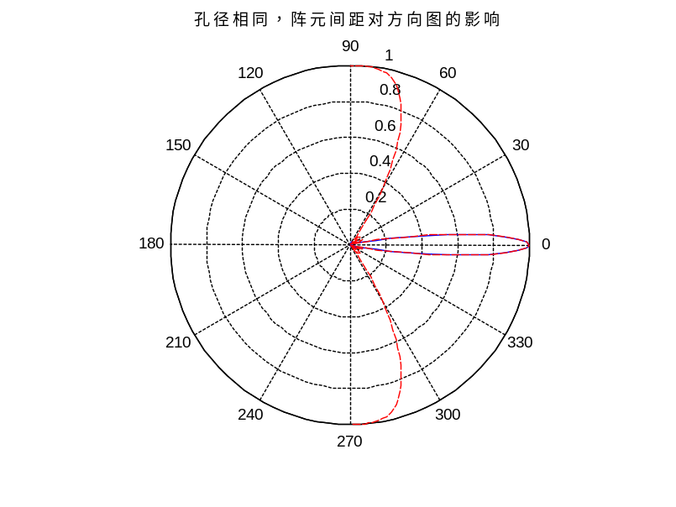
Uniformly Weighting of Uniform Linear Array
Influence of Array Spacing

Slide 5

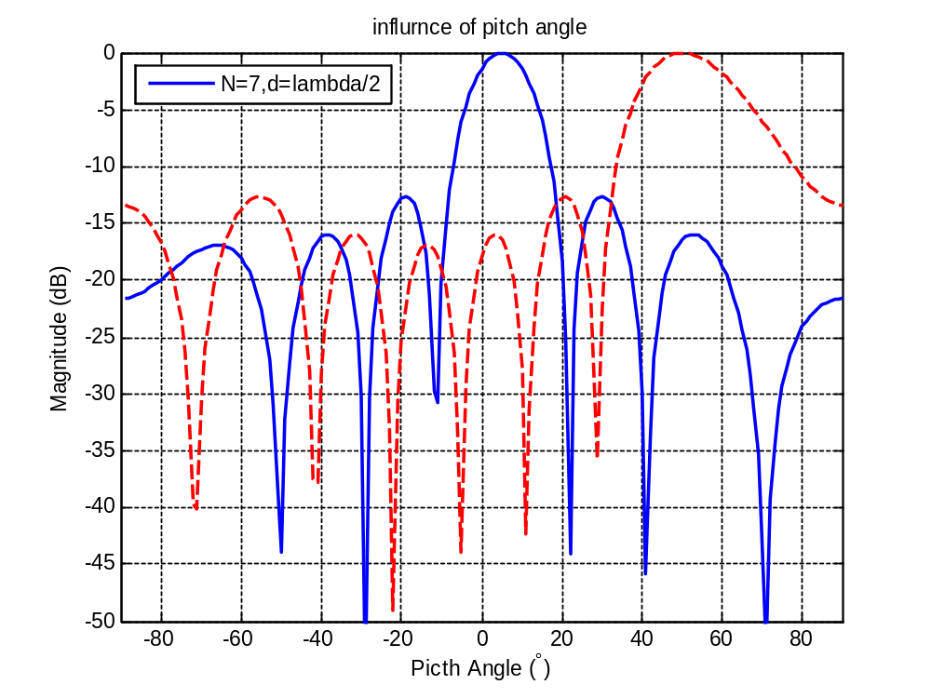
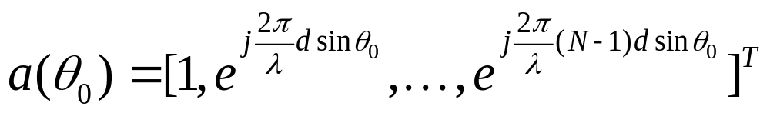
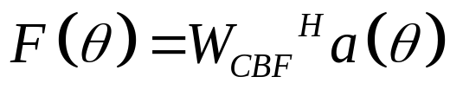
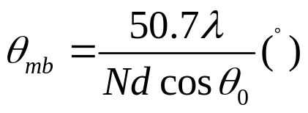

Uniformly Weighting of Uniform Linear Array
Influence of beam direction
— Spatial Matched Filter (Conventional Beamforming)
mainbeam is broadened at 50°

Slide 6
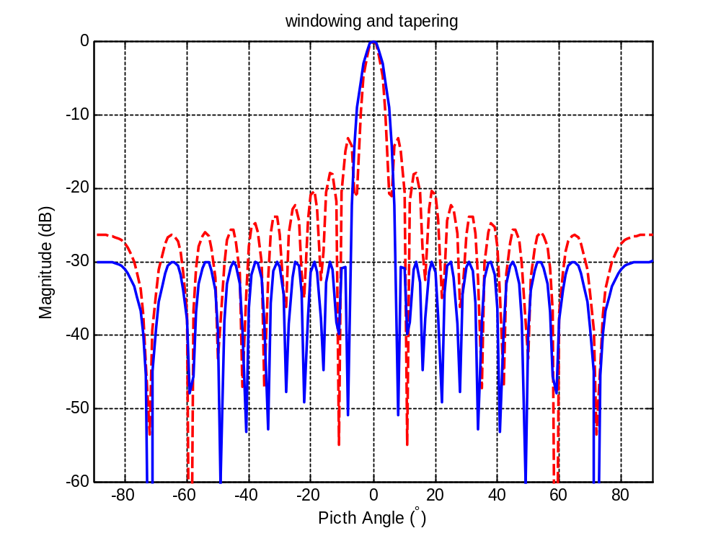


Uniformly Weighting of Uniform Linear Array
Taper Beamforming
Pattern synthesis
Low sidelobe weighting
－30 dB sidelobe level Chebyshev window (taper processing)
Mainbeam is broadened.
Sidelobe is suppressed.

Slide 7
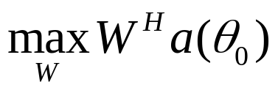

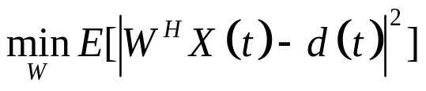
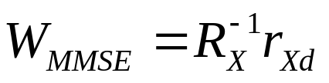
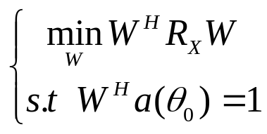
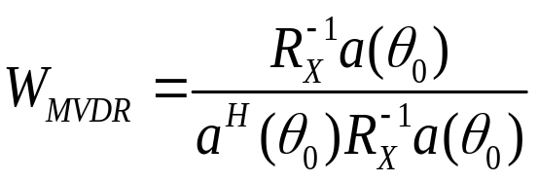
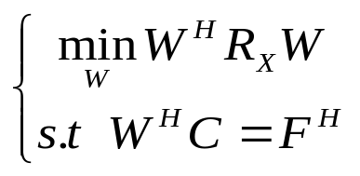
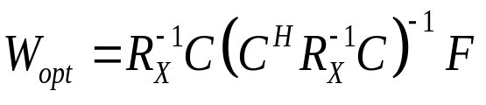
A Review of Optimal Beamforming
Optimizing criterions of optimum beamforming
 | Object function | Weighting vector | comment
Conventional beamforming |  |  | Not adaptive; Cannot suppress interference;
MMSE beamforming |  |  | Pilot signal
MVDR/Capon beamforming |  |  | Commonly used A special case of LCMV beamforming
LCMV beamforming |  |  | Commonly used

Slide 8
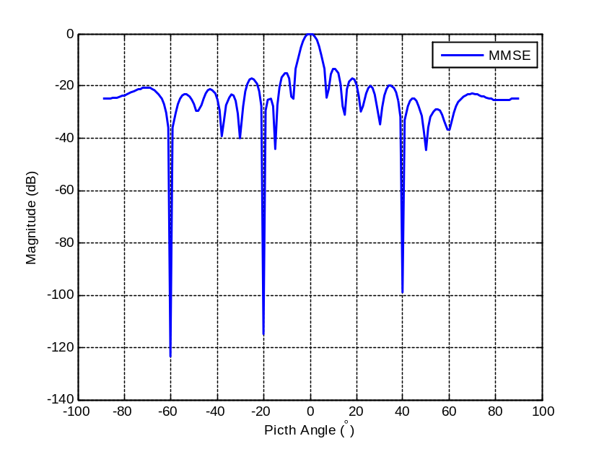
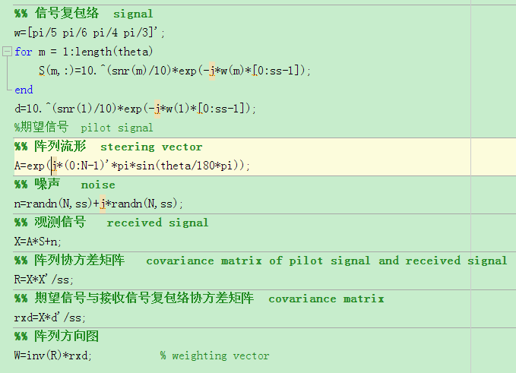

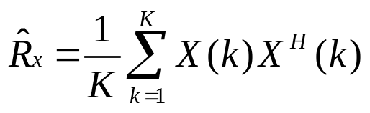
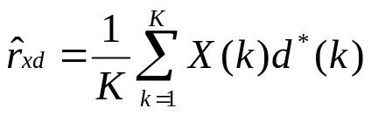
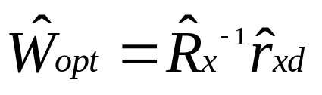
SMI ALGORITHM (MMSE criterion)
Simulation of Adaptive Beamforming

Slide 9
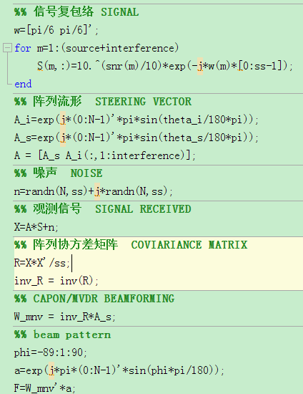
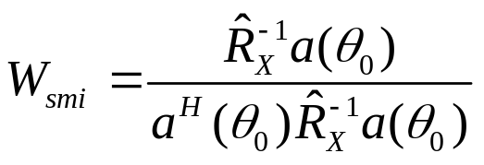
SMI ALGORITHM (MVDR criterion)
Simulation of Adaptive Beamforming

Slide 10
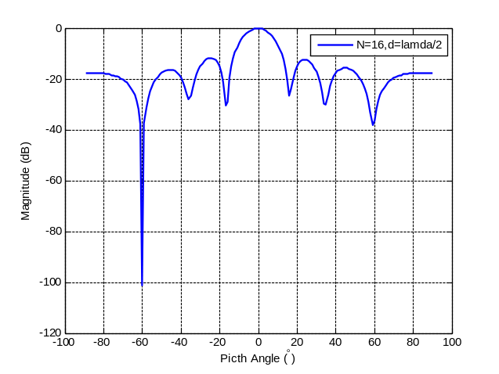
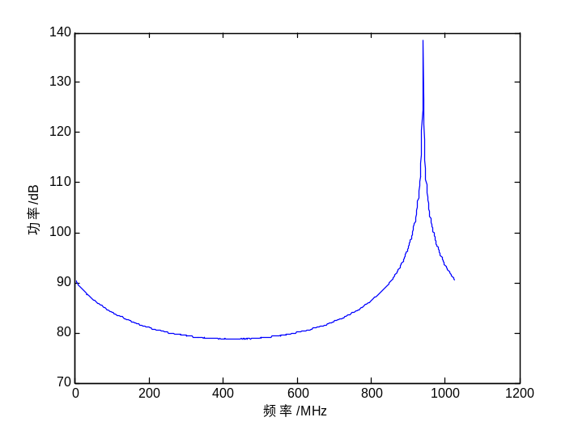
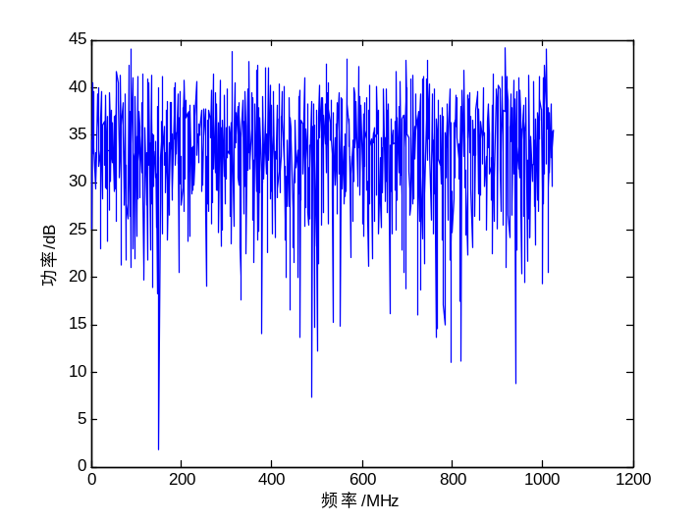
SMI ALGORITHM (MVDR criterion)
Simulation of Adaptive Beamforming

Slide 11
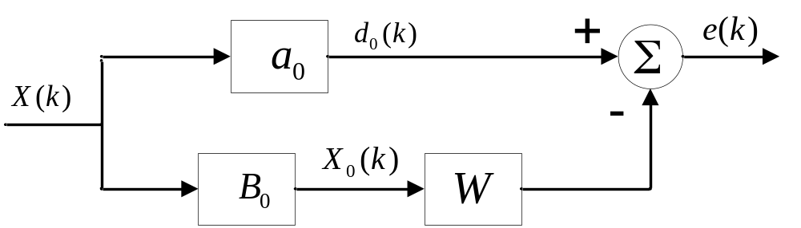
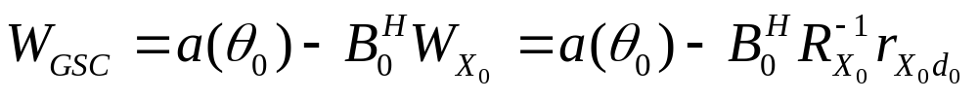
LMS ALGORITHM
Simulation of Adaptive Beamforming

Slide 12
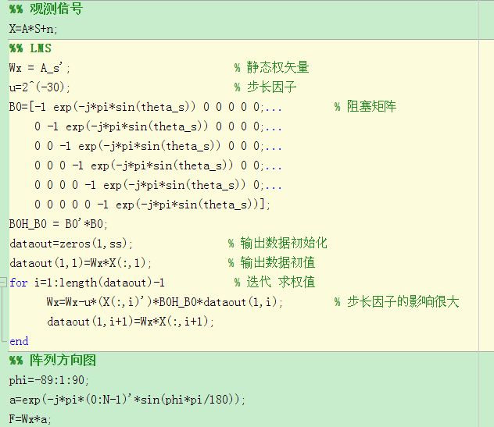
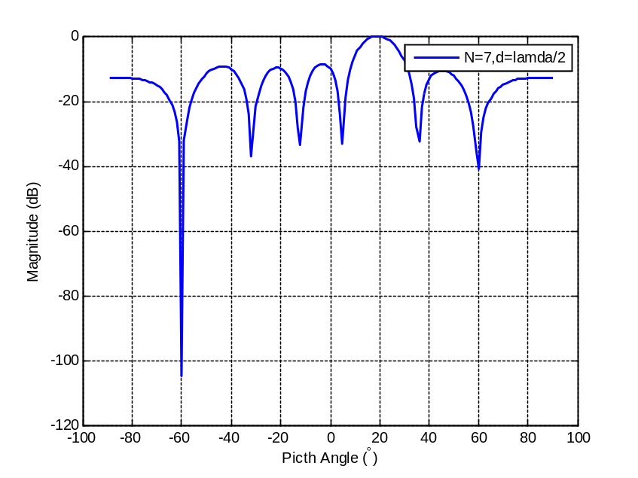



LMS ALGORITHM
Simulation of Adaptive Beamforming

Slide 13
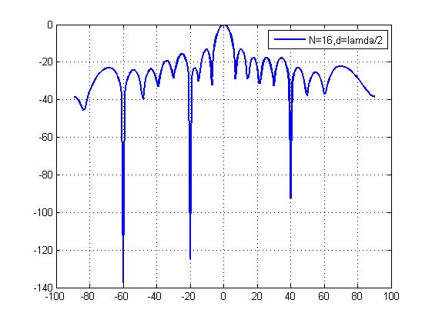
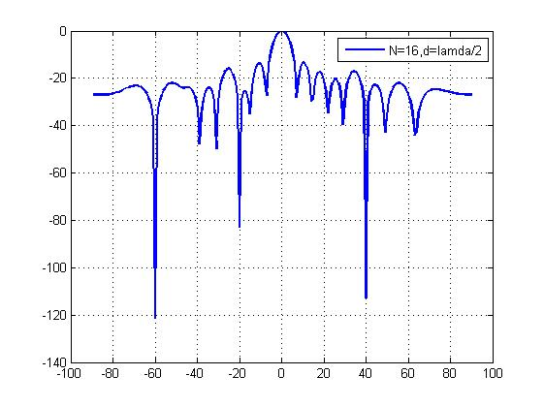
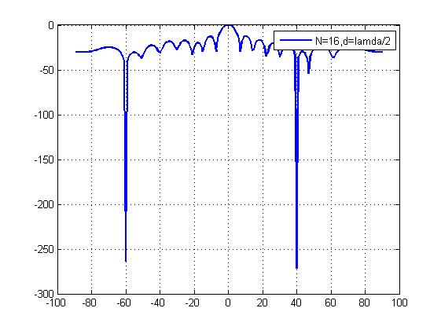
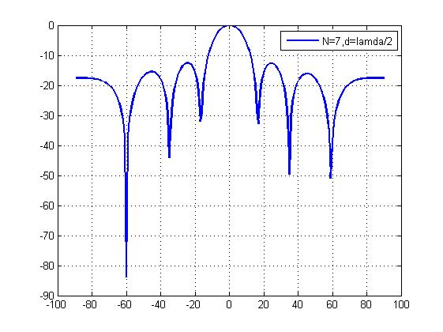
simulations
SMI algorithm based on MMSE criterion
AAPWYLp19.m
Diagonal loading technique
SMI algorithm based on MVDR criterion
MNVp33.m
Degree of freedom
SMI algorithm based on LCMV criterion
LCMVp70.m
Meanbeam widen & jamming constraint
LMS algorithm based on MVDR criterion
LMS3.m

Slide 14
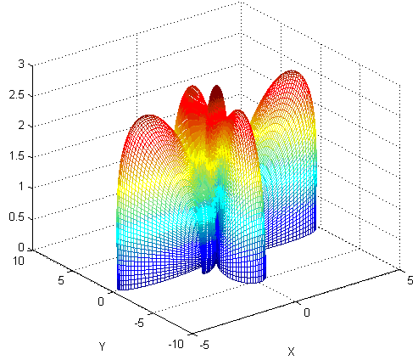
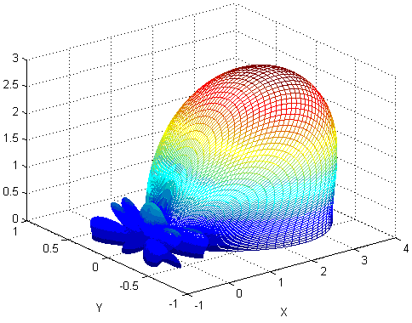
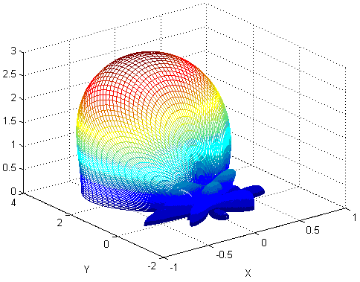
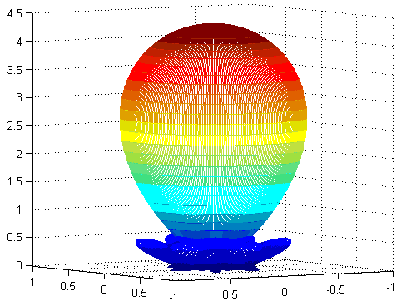
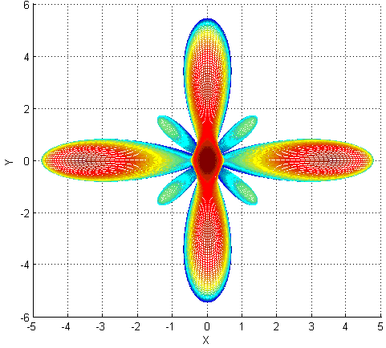
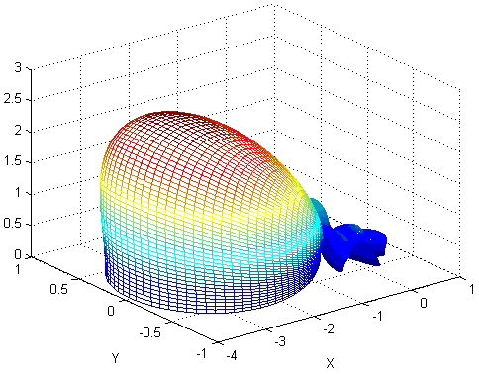
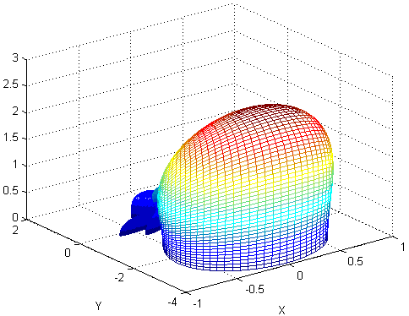
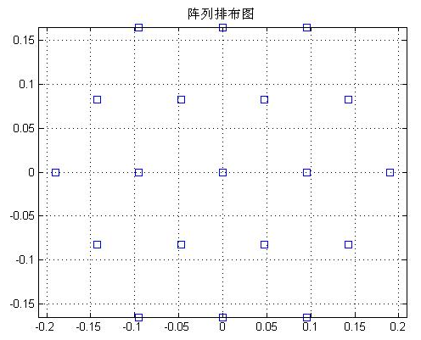
Planar Array
19 array

Slide 15
REFERENCE
张贤达.通信信号处理[M]. 北京:国防工业出版社,2000,12.
王永良,丁前军,李荣锋.自适应阵列处理[M]. 北京:清华大学出版社,2009.
Capon J., High-resolution frequency-wavenumber spectrum analysis [J], Proc. Of IEEE, 1969, 57(8), pp: 1408-1418.
Frost O L., An Algorithm For Linearly Constrained Adaptive Array Processing [J], Proc. Of IEEE , 1972, 60(8), pp: 926-935.
Zhang Xing, Wang Ling and et.al, Multi-beam interference suppression method in satellite navigation system [J], ICCEI 2011, V2-84

Slide 16
THANK YOU ！

