Slide 1
Big Data and Hadoop Introduction

Slide 2
Agenda
Big Data
Hadoop
HDFS
MapReduce
Apache Hive
Apache Pig
EMR
Kafka
Big picture?
Demo

Slide 3
Big Data
A type of data storage and data processing problems beyond the ability of traditional technologies
Characterized by Five V’s
Volume: data quantity
Velocity: speed at which data is generated
Variety: type and nature of data
Variability: evolving
Value

Slide 4
Hadoop
Apache Hadoop is an open source framework for distributed storage and processing of large sets of data on commodity hardware
Foundation of an entire ecosystem of projects
Core idea: bring computation close to data
Hadoop 1.0
Hadoop distributed file system (HDFS): data storage
Hadoop MapReduce: data processing
Hadoop 2.0¹
YARN (resource negotiator)
HDFS federation (namenode HA)
Distros: Hortonworks, Cloudera, MapR
[1] https://hortonworks.com/blog/understanding-hadoop-2-0/

Slide 5

HDFS
Scalability
Up to 200 PB
Up to 4500 nodes
Reliability
Data blocks replicated
Data locality
Data block size 128 MB

Slide 6
MapReduce
map: (k1, v1) => [(k2, v2)]
(1, “Mary had a little lamb”) => [(Mary, 1), (had, 1), (a, 1), (little, 1), (lamb, 1)]
(2, “little lamb, little lamb, little lamb”) => [(little, 3), (lamb, 3)]
reduce: (k2, [v2]) => (k3, v3)
(Mary, [1]) => (Mary, 1)
...
(lamb, [1, 3]) => (lamb, 4)
Generalization
YARN: yet another resource negotiator (cluster resource management)
Tez: computation framework supporting data-flow graphs (and MapReduce)
yarn jar tez-helloworld.jar io.github.ouyi.tez.HelloWorld -Dtez.aux.uris=/tmp/tez-helloworld.jar /tmp/input.txt /tmp/output

Slide 7
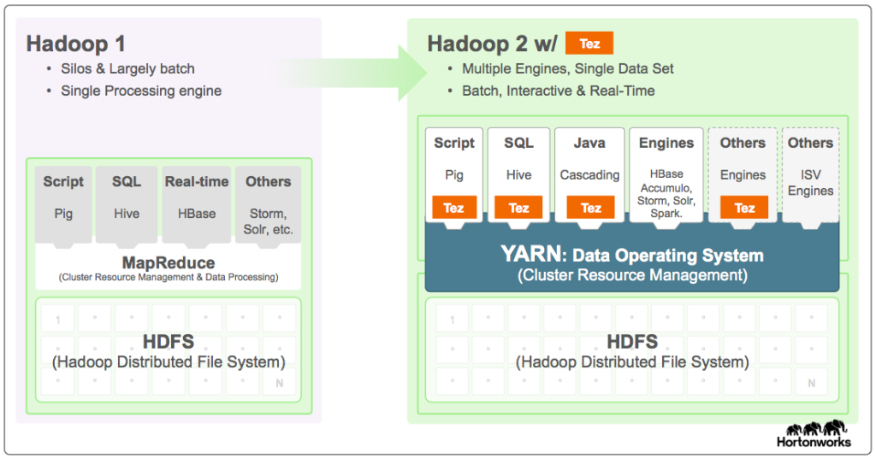

Slide 8
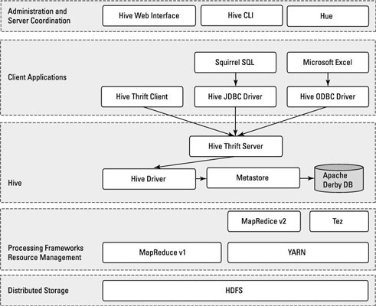
Hive
Provides a SQL-like query language for analyzing large volumes of data (e.g., those stored in HDFS)
The overall approach: project a table structure on the dataset and then manipulate it with SQL
Notes:
http://www.dummies.com/programming/big-data/hadoop/the-architecture-of-apache-hive/
https://cwiki.apache.org/confluence/display/Hive/HCatalog+UsingHCat

Slide 9
Hive demo
- time hive -e 'show tables;'
- CREATE EXTERNAL TABLE hive_input(line STRING) ROW FORMAT DELIMITED LINES TERMINATED BY '\n' STORED AS TEXTFILE LOCATION '/tmp/hive_input';
- time hive -e 'desc hive_input;'
- hive -e "select split(line, ' ') from hive_input;"
- SELECT word, COUNT(1) AS c FROM hive_input LATERAL VIEW explode(split(line, '[, ]')) splitted AS word WHERE word <> '' GROUP BY word ORDER BY c DESC;
- SELECT * FROM hive_input LATERAL VIEW explode(split(line, '[, ]')) splitted AS word;
Notes:
Input must be a directory
ZooKeeper dependency in HDP sandbox

Slide 10
Pig
Provides a high-level language to describe data flow and transformation
Pig vs. Hive
Runtimes: MapReduce, Apache Tez, or Apache Spark
Both are extensible by means of UDFs
Pig: batch processing (daily or hourly loads)
Hive: interactive analysis (ad hoc queries)
lines =
LOAD '$input'
USING PigStorage() AS (line:chararray);
words =
FOREACH lines
GENERATE
FLATTEN(TOKENIZE(line)) AS word;
grouped =
GROUP words BY word;
counted =
FOREACH grouped
GENERATE
group,
COUNT(words);
STORE counted
INTO '$output'
USING PigStorage();
pig -x tez -p input=/tmp/input.txt -p output=/tmp/output3 wordcount.pig

Slide 11
EMR
Elastic MapReduce: Hadoop as a service
Works with S3 “seamlessly” via EMRFS
http://docs.aws.amazon.com/emr/latest/ReleaseGuide/emr-release-components.html

Slide 12
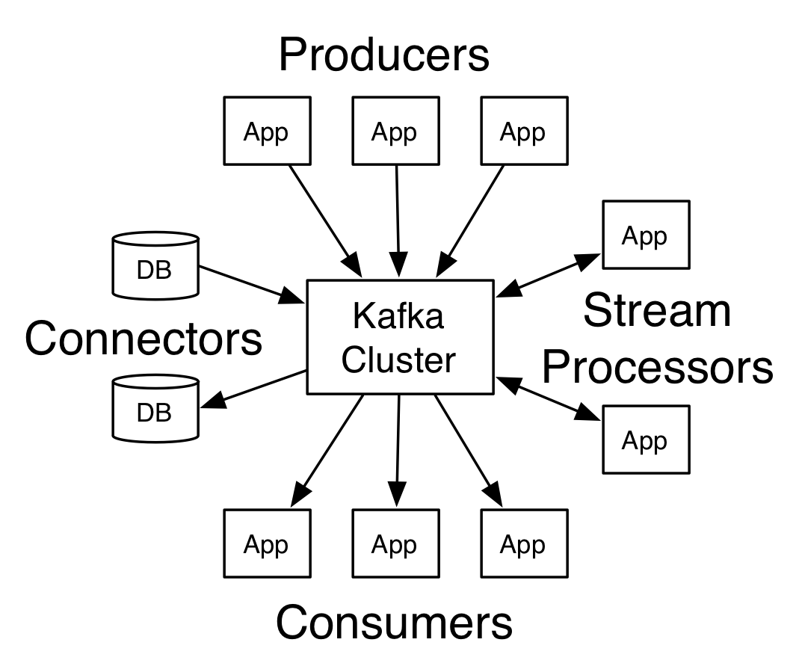
Kafka: a distributed streaming platform
publish and subscribe to streams of records (message queue)
store streams of records in a fault-tolerant way (storage system)
process streams of records as they occur (stream processing)
Notes:
Kafka demo: http://kafka.apache.org/quickstart

Slide 13
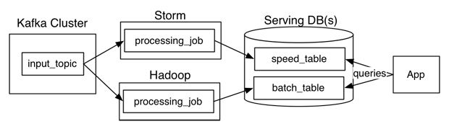
Big picture
Data collection and transportation: kafka, flume
Data storage: HDFS, HBase, kafka
Data processing: MapReduce, Tez, Spark, Storm
Data serving: HBase, column-oriented databases, druid

Slide 14
Resources
https://hortonworks.com/tutorial/hadoop-tutorial-getting-started-with-hdp/section/1/
https://www.oreilly.com/ideas/questioning-the-lambda-architecture
http://milinda.pathirage.org/kappa-architecture.com/

Slide 15
HDP sandbox
Web: HDP sandbox http://127.0.0.1:8888
raj_ops/raj_ops maria_dev/maria_dev
Ambari: admin/BigData
Shell: root/hadoop => root/BigData
$ grep aux.uri -B1 -A2 /etc/tez/2.6.1.0-129/0/tez-site.xml
<property>
<name>tez.aux.uris</name>
<value>/tmp/tez-helloworld.jar</value>
</property>
$ hadoop fs -copyFromLocal tez-helloworld.jar /tmp/
$ yarn jar tez-helloworld.jar io.github.ouyi.tez.HelloWorld /tmp/input.txt /tmp/output
Notes:
https://hortonworks.com/hadoop-tutorial/learning-the-ropes-of-the-hortonworks-sandbox/#connect-to-welcome-screen

Slide 16
TODO
Avro processing
Stream processing: Kafka Streams vs Storm vs Samza
General processing: MapReduce vs Tez vs Spark
Serving layer: HBase vs Druid
Distributed coordination and service discovery: ZooKeeper vs Consul

Slide 17
HBase
Helpful to think of an HBase table as a multi-dimensional map
Rows are sorted alphabetically by the row key (e.g., domain name in reverse)
A column family physically co-locates a set of columns and their values, often for performance reasons
column families are fixed at table creation, column qualifiers are mutable and may differ greatly between rows

