Slide 1
Introduction to Information Systems and Programming
Exception

Slide 2
What is Exception
Runtime/execution error occurs when a program is running and there is an operation that cannot be carried out
E.g. divide by zero
An exception is an object that represents such execution error
The program throws an exception when such execution error occurs
Handle the exception or the program terminates abnormally

Slide 3
Exception handling
When there is an exception, either the method handles it itself, or let the caller handle it
Some code: throw new Exception();
In the try block: code that is executed in the normal circumstance
In the catch block: code that is executed during the exception
Then, the statement after the catch block is executed

Slide 4
The try-catch block
public static int myCompute(int i, int j) {
try {
int y = i / j;
return y;
}
catch (ArithmeticException ex) {
return 0;
}
finally {
System.out.println(“clean up”);
}
}

Slide 5
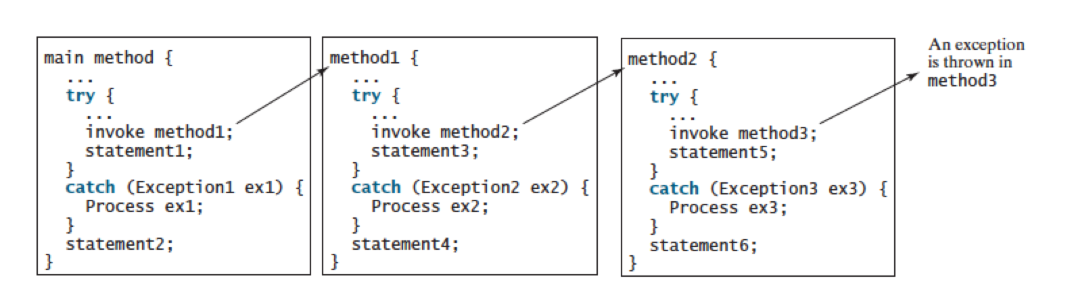
Exception handling
Method 3 throws:
Exception3: what statements are executed?
Exception2:
Exception1:
If exception is not caught:

Slide 6
Exception handling
Method 3 throws:
Exception3: statement6, 3, 4, 1, 2
Exception2: method2 aborts, statement4,1,2
Exception1: mehtod1 aborts, statement2
If exception is not caught, program terminates, no statement executed

Slide 7
Exception types
Exceptions are objects
Root class for exception is Throwable
Error: system error, not much you can handle; e.g. VirtualMachineError occurs when system runs out of resource

Slide 8
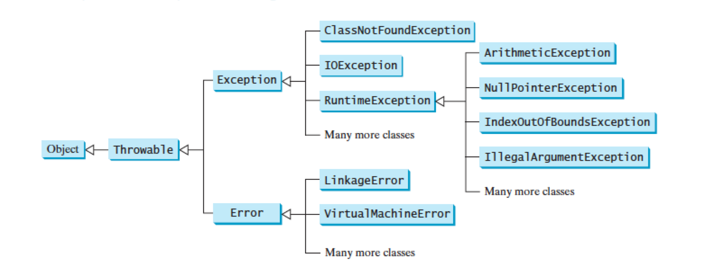
Exception types
Unchecked exception: Error, RuntimeException and their subclasses

Slide 9
Exception types
IOException: opening a nonexistent file etc.
RuntimeException: programming errors such as out-of-bounds array, numeric errors
  ArithmeticException: dividing an integer by zero
  IndexOutOfBoundsException: index to an array is out of range

Slide 10
Checked and unchecked exception
RuntimeException, Error and their subclasses are unchecked exception
All other are checked exception
Checked exception: compiler forces the programmer to explicitly check and handle them in a try-catch block, or declare in the method header to let caller handle (use throws)
Unchecked exception, e.g., ArithmeticException, can occur anywhere in the program

Slide 11
The finally clause
The finally clause is always executed regardless if an exception occurs or not, and if the exception is caught or not
Use case: file closing, clean up

Slide 12
Define your own Exception classes
Extending Exception class

