Slide 1
WebGL移动/旋转/缩放
我是董美琪

Slide 2
平移

Slide 3
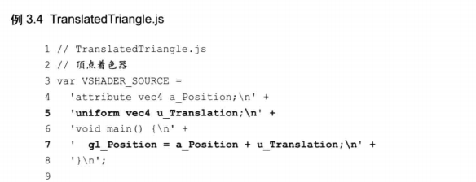
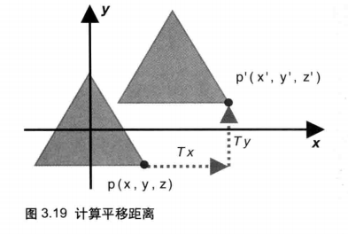
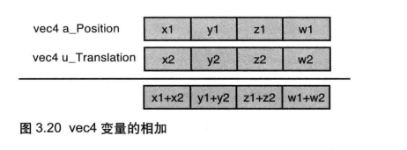
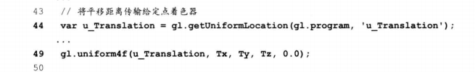
平移

Slide 4
02
旋转

Slide 5
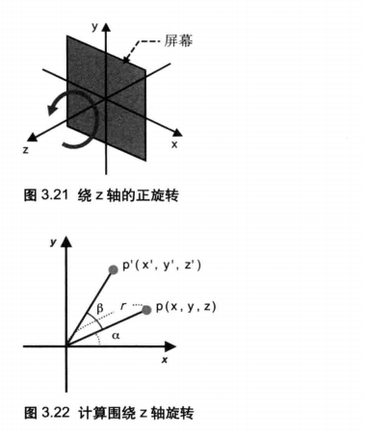
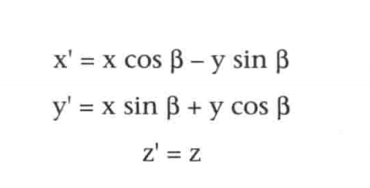
延z轴旋转
p(x, y)
三角函数：
sin(a + b) = sina * cosb + cosa * sinb
sin(a - b) = sina * cosb - cosa * sinb
cos(a + b） = cosa * cosb - sina * sinb
cos(a - b) = cosa * cosb + sina * sinb
计算得出：
sin(a + b) = y`/ r
cos(a + b) = x` / r
y` = y* cosb + x * sinb

Slide 6
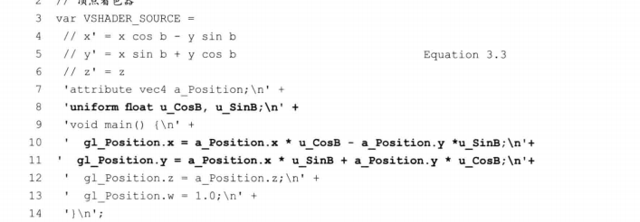
顶点着色器改变

Slide 7
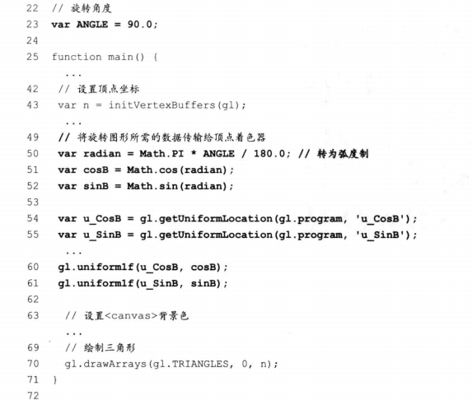
js代码改变

Slide 8
03
矩阵变换

Slide 9
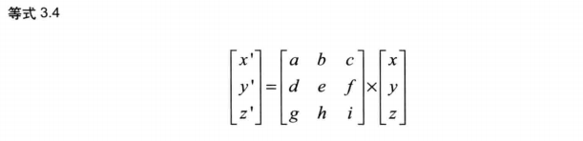
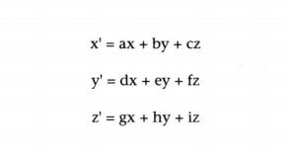
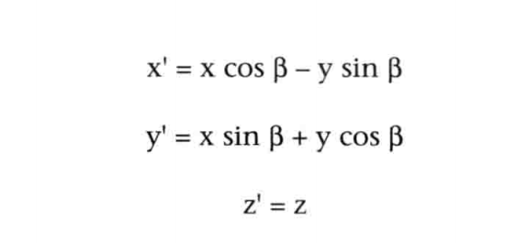
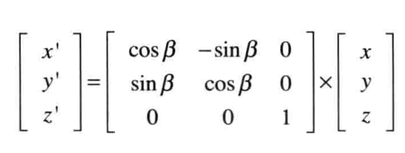
变换矩阵——旋转
变换矩阵/旋转矩阵

Slide 10
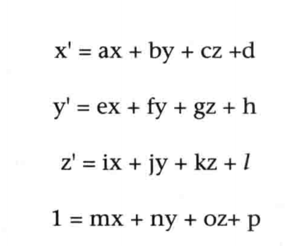
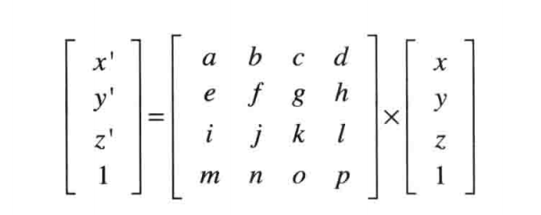
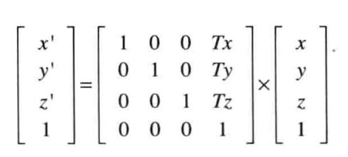
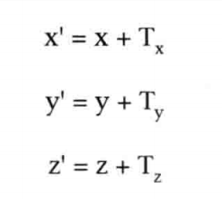
变换矩阵——平移
[1, 0, 0, 0,
0, 1, 0, 0
0, 0,1, 0
Tx, Ty, Tz, 1]
平移矩阵：

Slide 11
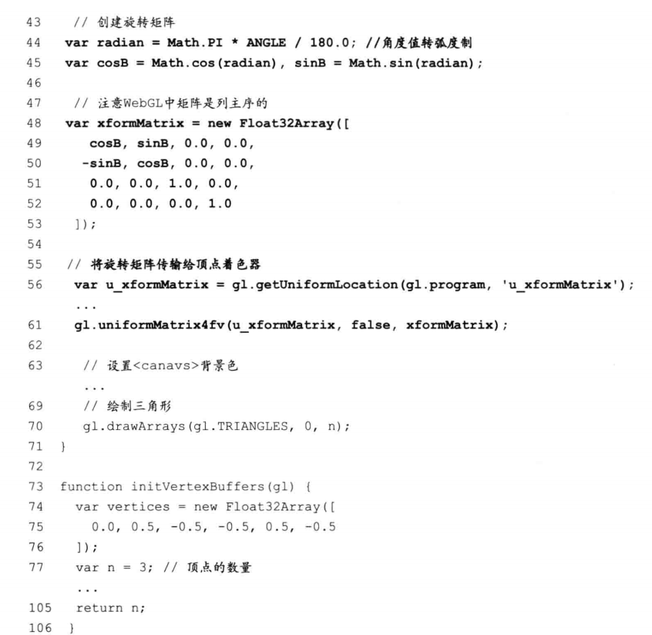
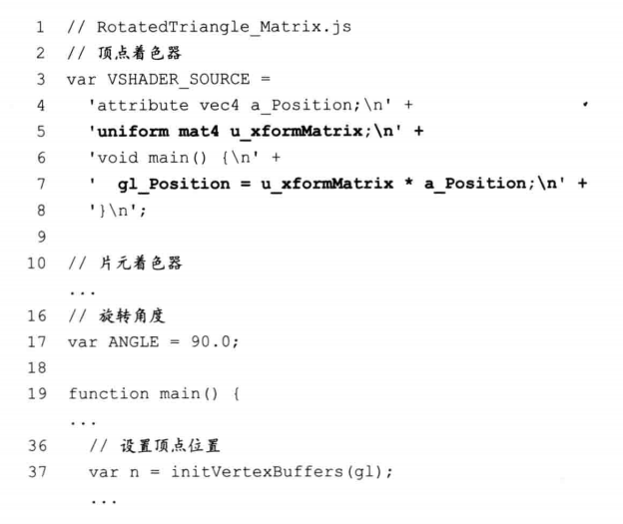
旋转矩阵着色器内代码：

Slide 12
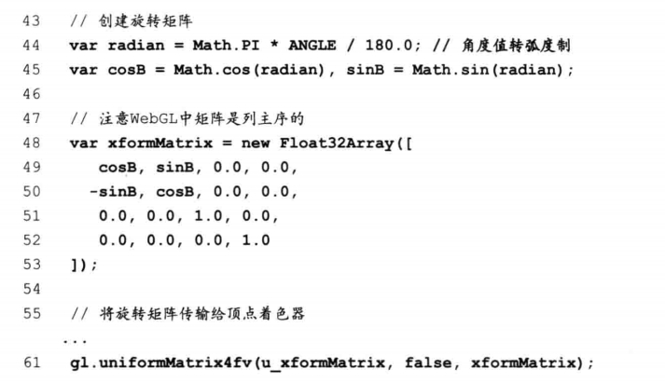
传入着色器内数据

Slide 13
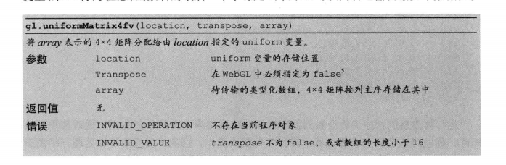

Slide 14
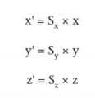
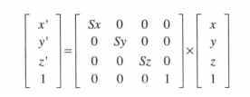
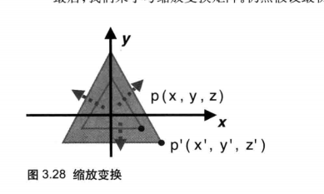
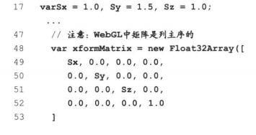
变换矩阵——缩放
</html></html>

Slide 15
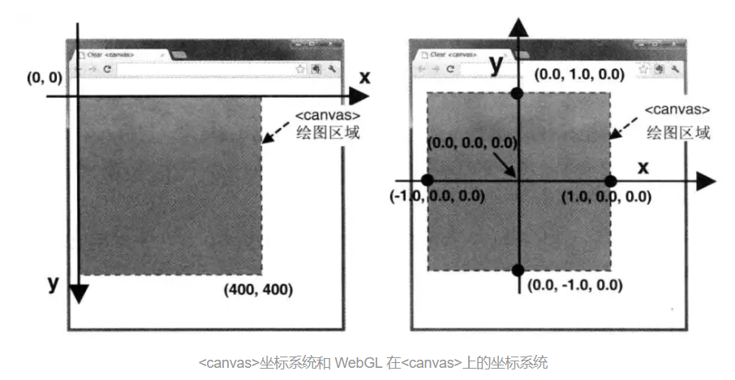

Slide 16
y`
y` = 1 - y / height * 2
x` = x / width * 2 - 1
z` = z;
1 = 1;
x
x, y
[
x,
y,
z,
1
]
[
2 / width, 0, 0, -1
0, -2/height, 0, 1,
0, 0, 1, 0,
0, 0, 0, 1,
]
x`
*
[
x`,
y`,
z`,
1,
]
y

Slide 17
[a00, a01, a02, a03
a10, a11, a12, a13,
a20, a21, a22, a23,
a30, a31, a32, a33]
[b00, b01, b02, b03
b10, b11, b12, b13,
b20, b21, b22, b23,
b30, b31, b32, b33]
[a00 * b00 + a01 * b10 + a02 * b21 + a03 * b30,
a00 * b01 + a01 * b11 + a02 * b21 + a03 * b31,
a00 * b02 + a01 * b12 + a02 * b22 + a03 * b32,
a00 * b03 + a01 * b13 + a02 * b23 + a03 * b33,
[a10 * b00 + a11 * b10 + a12 * b21 + a13 * b30,
a10 * b01 + a11 * b11 + a12 * b21 + a13 * b31,
a10 * b02 + a11 * b12 + a12 * b22 + a13 * b32,
a10 * b03 + a11 * b13 + a12 * b23 + a13 * b33,
[a20 * b00 + a21 * b10 + a22 * b21 + a23 * b30,
a20 * b01 + a21 * b11 + a22 * b21 + a23 * b31,
a20 * b02 + a21 * b12 + a22 * b22 + a23 * b32,
a20 * b03 + a21 * b13 + a22 * b23 + a23 * b33,
]

