Slide 1

The height growth curve analysis by the SITAR model
Supervisor: Catherine Hurley
Name: YANG WANG
Date: 26th June 2020

Slide 2
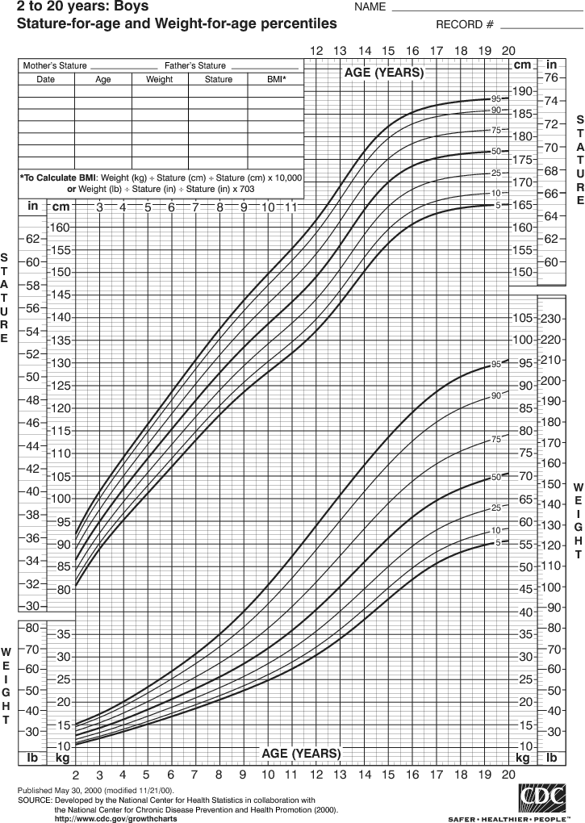
Introduction
The growth curve:
An empirical model of the evolution of a quantity over time.
It is widely used in biology for quantities such as individual body height.
The growth curve analysis:
A statistical issue in life course. Height involves a growth spurt,
the timing and intensity of which varies between individuals.
The result of the research:
A child growth curve is an important standard to help parents to find out
whether or not their children follow a normal growth pattern.
Following a normal growth pattern is a good indicator of a child’s overall good health.

Slide 3

Method
The SITAR model:
It used to summarize the individual growth curves that involves fitting the following
random effects model to the set of height growth curves.
The formula:
The yit is height for subject i at age t, h(t) is a natural cubic spline curve of height vs age,
and αi, βi and γi are subject-specific random effects.
The aim is to find the random effects to make the growth curves as similar as possible.
αi is a random height intercept that adjusts for differences in mean height—here it is termed size.
βi is a random age intercept to adjust for differences in the timing of the pubertal growth spurt in individuals,
and it is here called tempo.
γi is a random age scaling that adjusts for the duration of the growth spurt in individuals.

Slide 4
Dataset
Original dataset:
Each data record contains the individual ID, measurement date, age,
gender, height, weight, BMI, WHO z-score and WHO z-score categories.
Records: 102,642 Individuals: 14,267 (7,239 boys, and 7,028 girls)
Clean Data
The height is the research object. Deleted the 7,745 records that the height is NA.
Object Dataset:
Chose the datasets are heights for boy (31) and girl (38) at the stage
between 2007 and 2018 (6-18 year-old), and have the complete
set of 22 observations between the ages of 6 and 18 years.

Slide 5
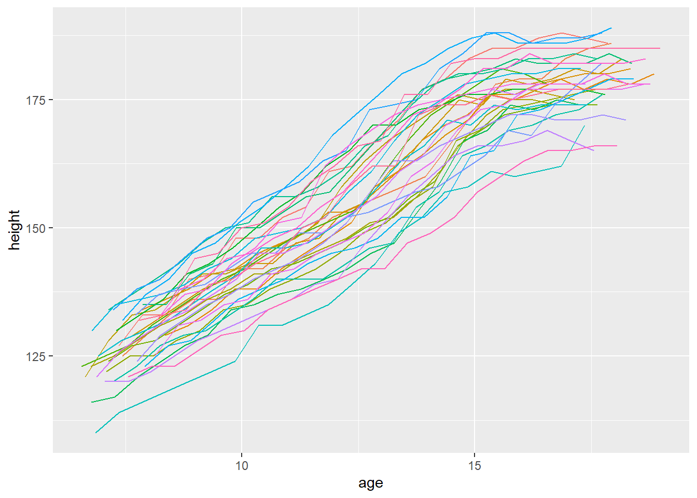
The first Dataset (Boys)
Plot the 31 boys who have the complete set of 22 observations:
No outlier.
A same trend. (Positive)
Growing fast between 6-15 year-old.

Slide 6
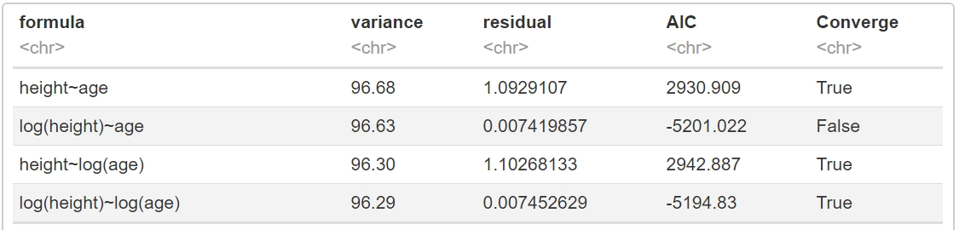
Fit the data to find out the best model
Fit and compare the four models:
Compared the residual, variance and AIC, the model log(height)~log(age) is the best.
(The converge error happened in the model log(height)~age)

Slide 7
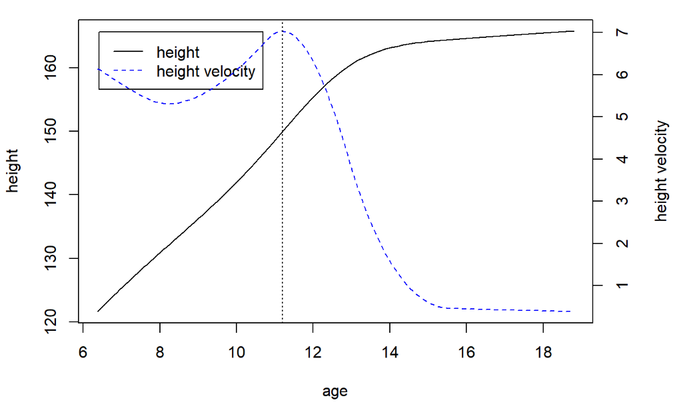
The distance and velocity curves
Growing fast between 6~16 year-old
Growing slowly after 16 year-old.
Declined slowly between 6~11 year-old.
Increased rapidly between 11~13.42 year-old.
Reached the peak at the age of 13.42.
Declined rapidly between 13.42~15 year-old.
It is relatively constant after 15 year-old.
Distance curve (left y axis) (Black solid line): The amount of height achieved at a given age.
Velocity curve (right y axis) (Blue dash line): The rate of growth at a given age.

Slide 8
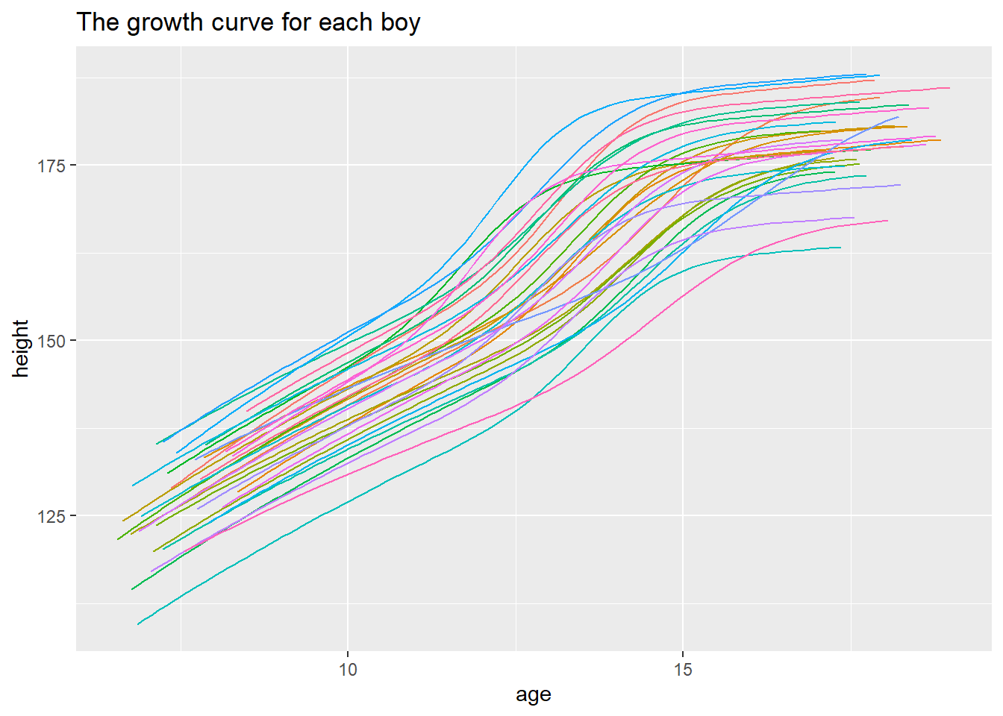
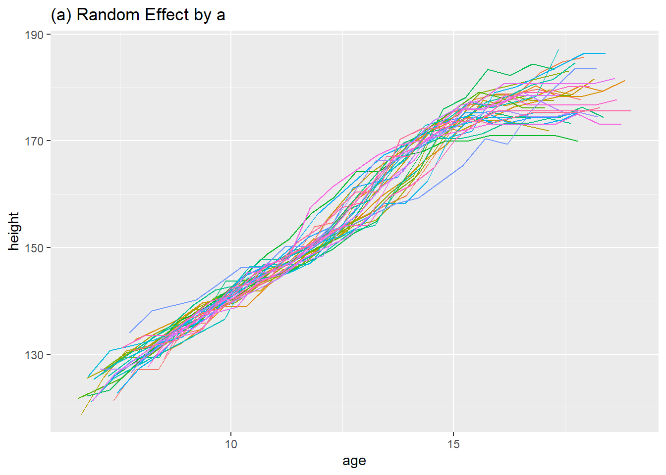
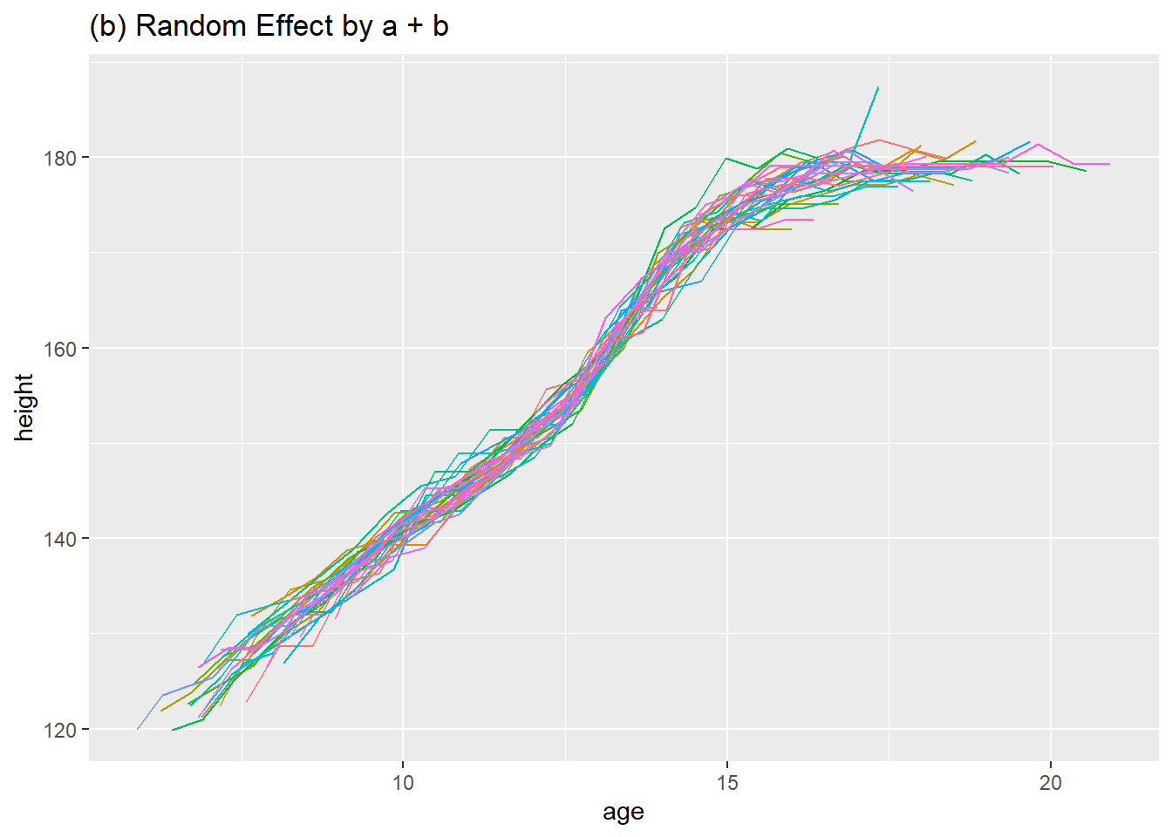
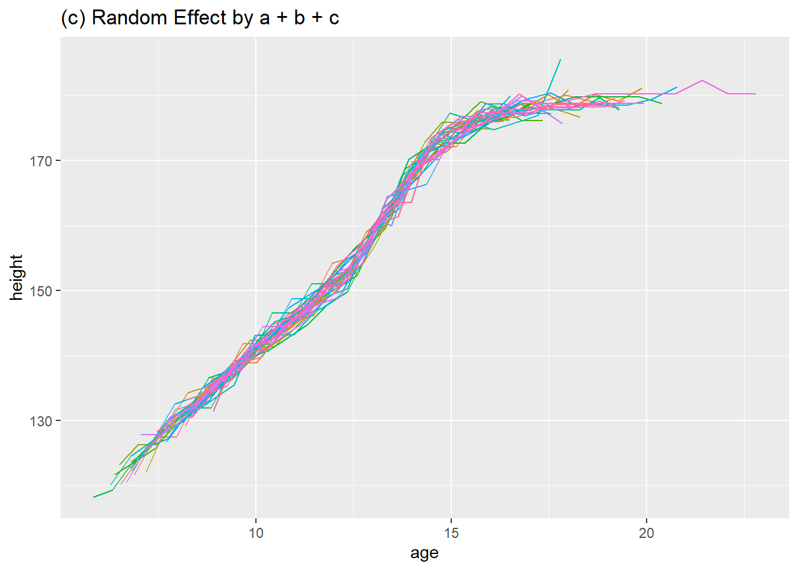
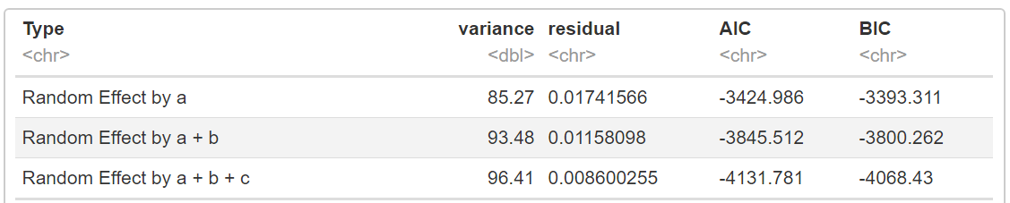
The random effect α(a) + β(b) + γ(c)

Slide 9
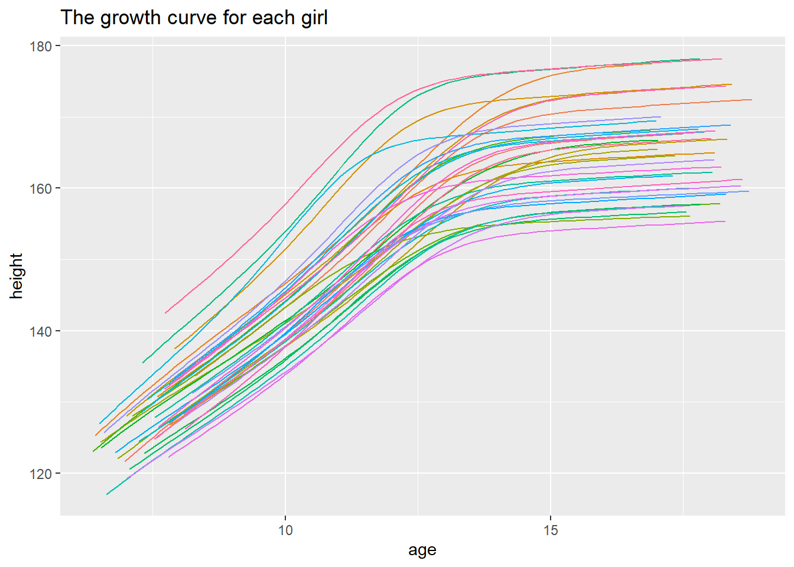
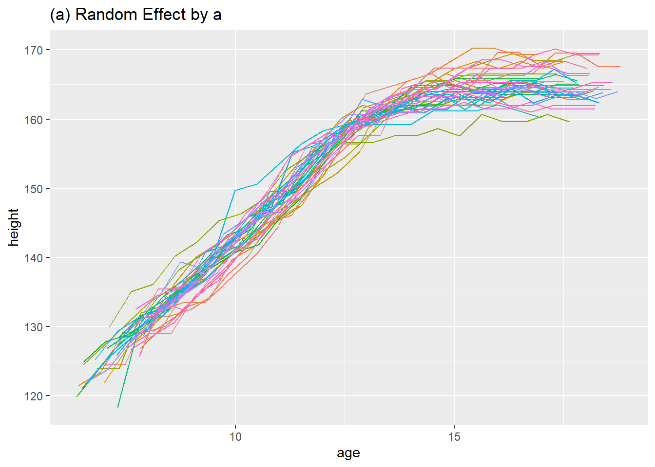
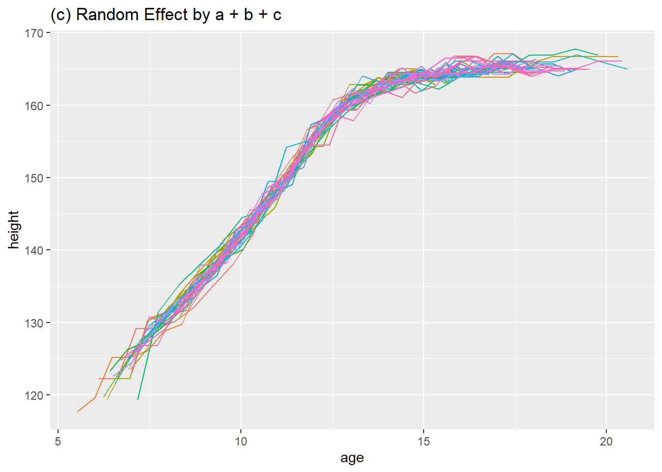
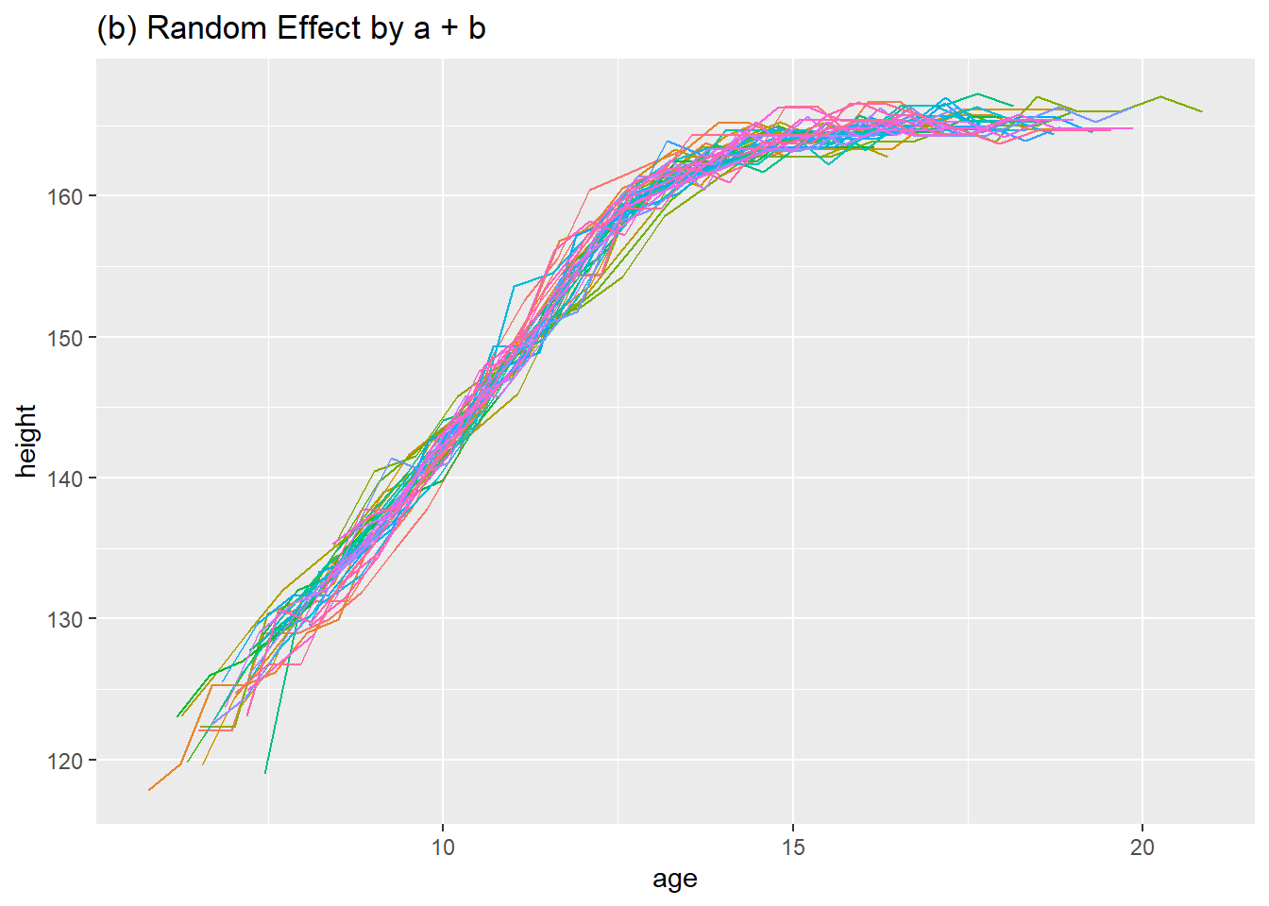
The second Dataset (Girl)
Did the same research with the girl dataset and got a growth curve for girls.
Because the time limited, I will skip the part.

Slide 10
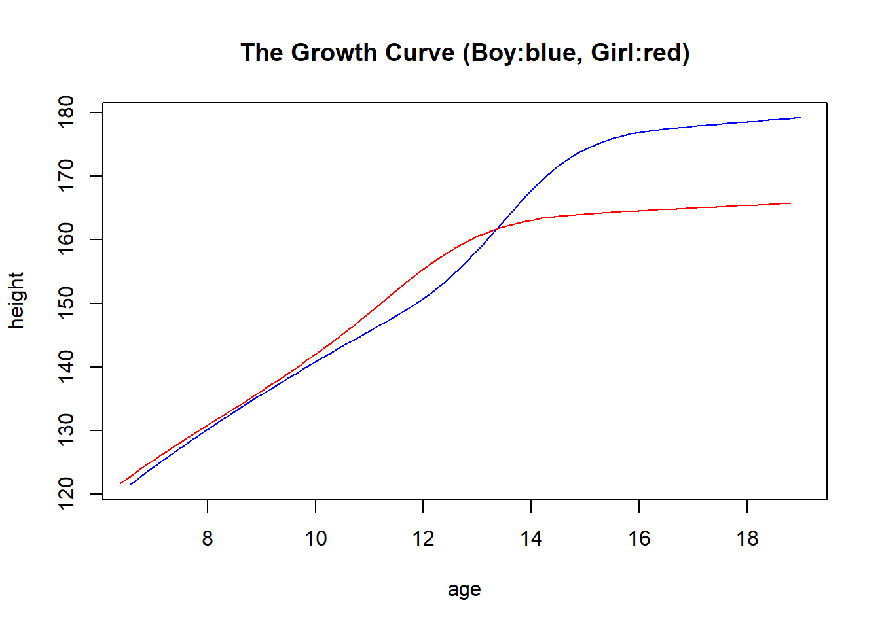
Compare the growth rate by gender
6-10 year-old:
Boys and Girls almost have the same rate.
10~13.5 year-old:
Girls are a little higher than boys.
13.6~18 year-old:
Boys are significant higher than Girls

Slide 11
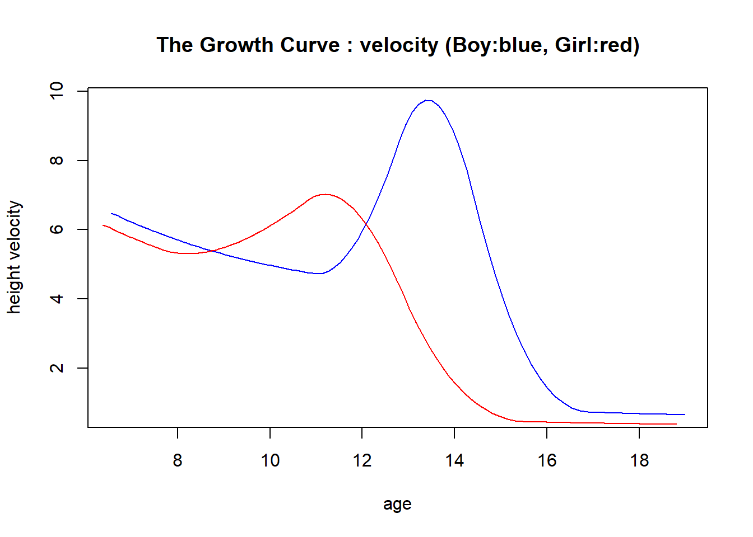
Compare the growth of velocity by gender
6~9 year-old:
Boys and Girls are near to each other and decline.
9~11 year-old:
Boys and girls have different trend,
Boys continue declining
Girls increase and reach the top at 11 year-old.
11~15.5 year-old:
Girls keep declining fast till 15.5 year-old.
Boys increase fast and reach the top at 13.5.
Then declined fast till 16.5 year-old.
Girls keep constant from 15.5 year-old
Boys keep constant from 17 year-old
And near to each other.

Slide 12
Conclusion
The fact that the SITAR model fits well both in boys and girls.
Compared the growth curve, we can see that the difference of growth rate
and velocity by gender at a certain age.
The growth curve can help us to find out whether or not the children
follow a normal growth pattern.

Slide 13
Further work
Try more transformations of model to find a better model.
Optimize the parameters of the SITAR model to make the curve better.
Analyse the fixed and random effects how to effect the model.

Slide 14
Thank you for listening
Supervisor: Catherine Hurley
Name: YANG WANG
Date: 26th June 2020

