Slide 1

Getting started into the project
Yang Wang
Softwarefirma

Slide 2
Overview
How to build the system from scratch

Slide 3
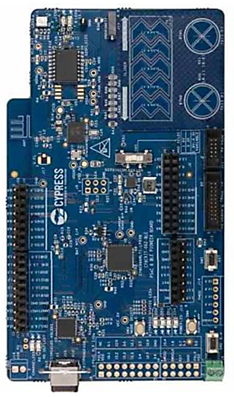
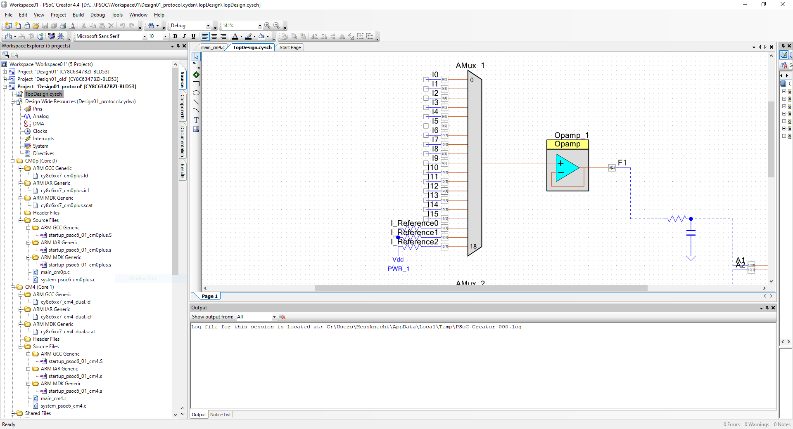
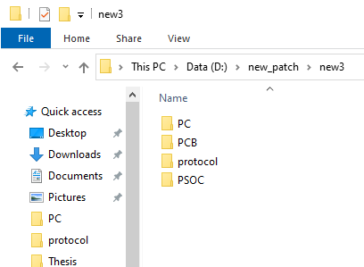
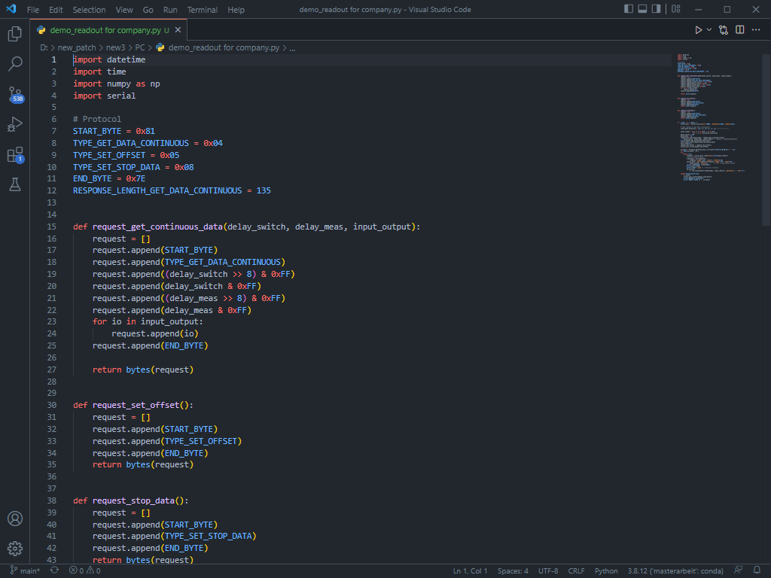
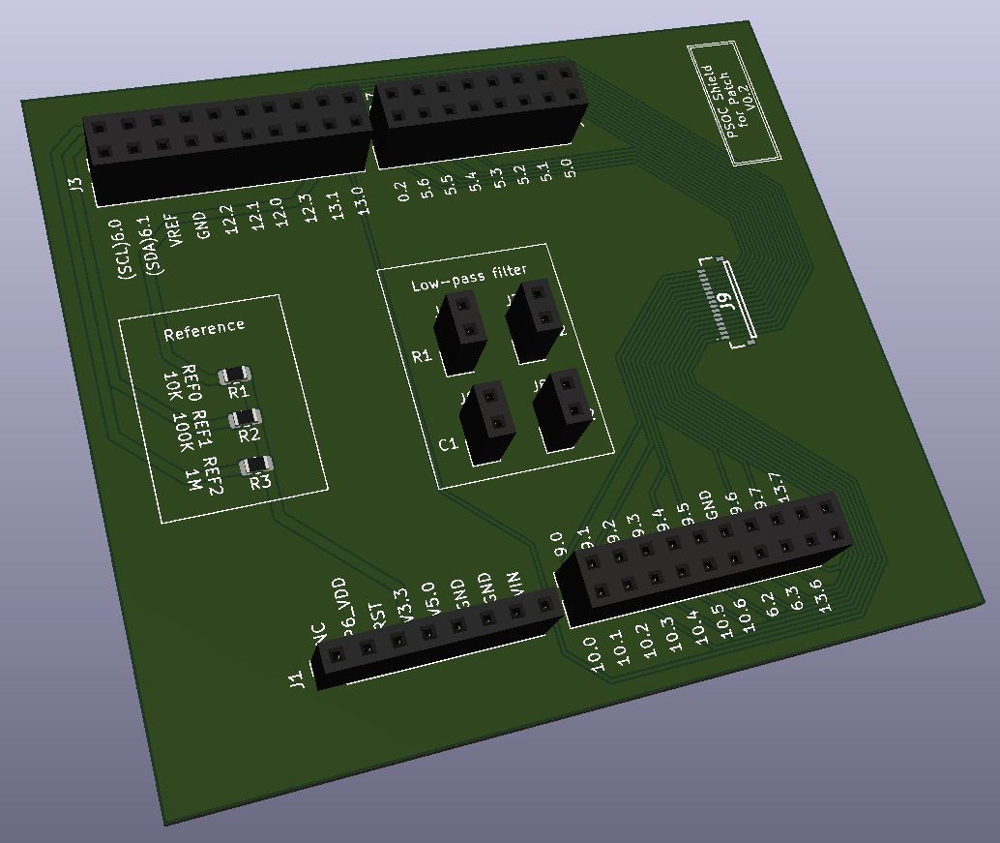
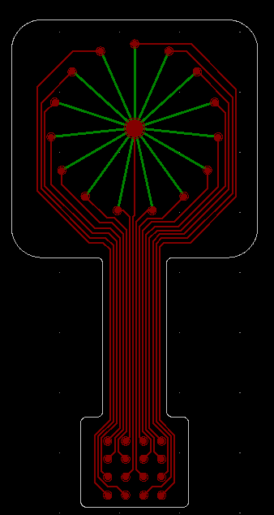
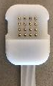
Step 1: Preparation
Hardware
Software
My PSoC project
A new PSoC
My PC program
PCB board
Adapter
Patch

Slide 4
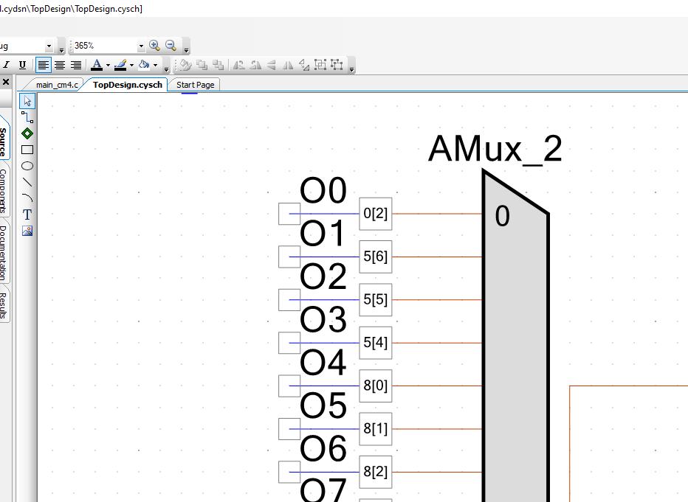
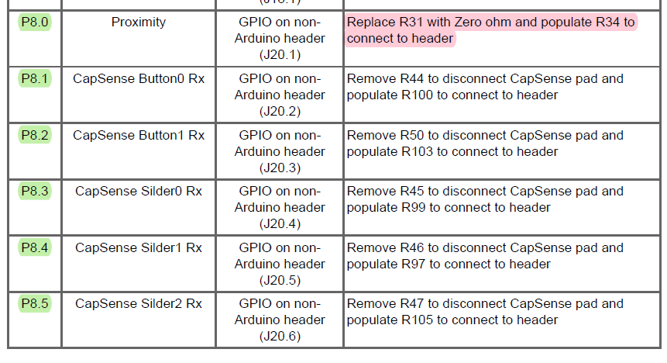
Step 2: Solder the PSoC
PSoC project
“PSoC 6 BLE Pioneer Kit Guide”, P12-16
Inaccessible
Solder the PSoC according to the description to make the pin accessable
Accessible
Check if the used pins can be accssed with the on-board headers (Accessible mostly when“GPIO on header”/“Arduino header” is primary function)
DO NOTHING

Slide 5
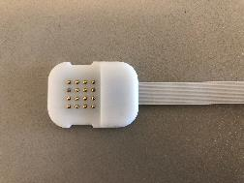
Step 3: Assemble hardware

Slide 6
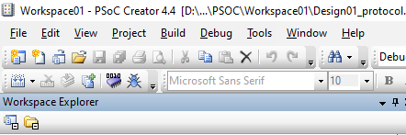
Step 4: Flash the PSoC program
Click this button to flash the program to PSoC

Slide 7
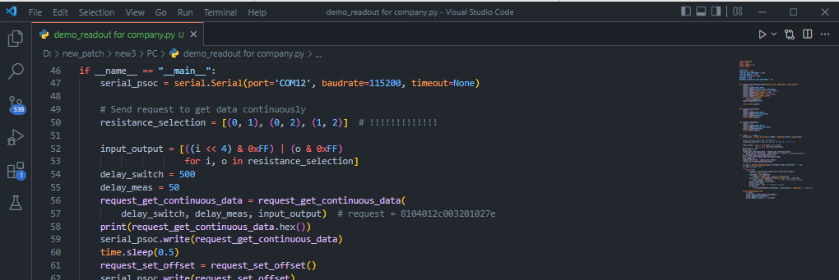
Step 5: Run PC program to start measurement
Configure the resistance you want measure
Format: [(INPUT_0, OUTPUT_0), (INPUT_1, OUTPUT_1), ….]

Slide 8
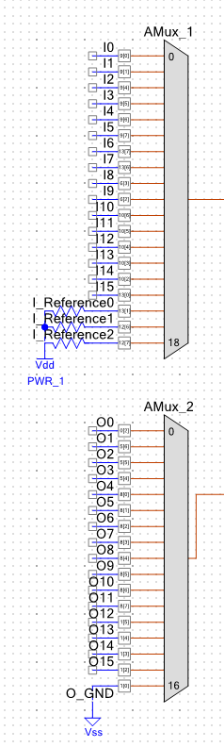
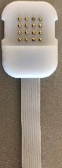
Annex 1: The index of the points on adapter
3 | 2 | 1 | 0
11 | 10 | 9 | 8
7 | 6 | 5 | 4
15 | 14 | 13 | 12
INPUT
OUTPUT

Slide 9
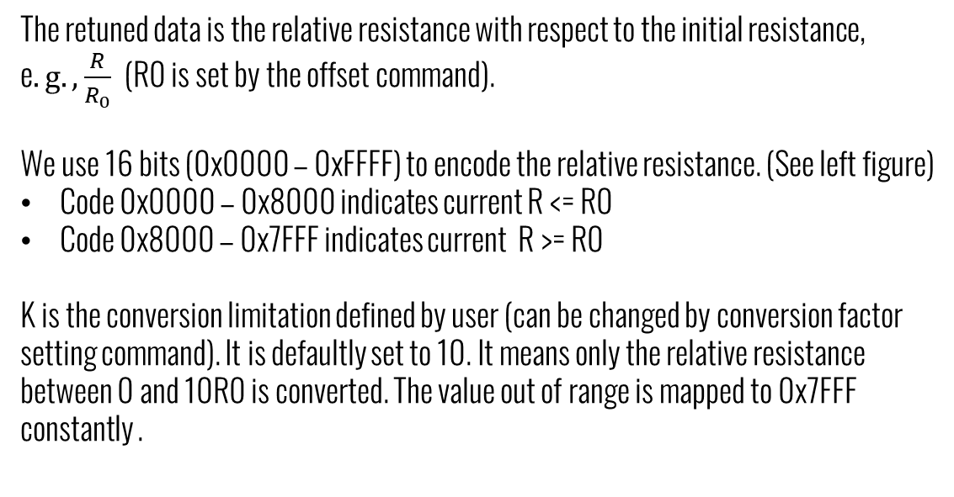

Annex 2: Explanation of returned data
16-bit Code
0x7FFF (32767)
The retuned data is the relative resistance with respect to the initial resistance, e$.g., \frac{R}{R_{0}}$ (R0 is set by the offset command).
We use 16 bits (0x0000 – 0xFFFF) to encode the relative resistance. (See left figure)
Code 0x0000 – 0x8000 indicates current R <= R0
Code 0x8000 – 0x7FFF indicates current R >= R0
K is the conversion limitation defined by user (can be changed by conversion factor setting command). It is defaultly set to 10. It means only the relative resistance between 0 and 10R0 is converted. The value out of range is mapped to 0x7FFF constantly .
0x8000 (32768)
0x0000 (0)
$$\frac{R}{R_{0}}$$
0
1
K

