Slide 1
密码锁数字识别
冉晨宇 2019/10/23

Slide 2
1. Procedure

Slide 3
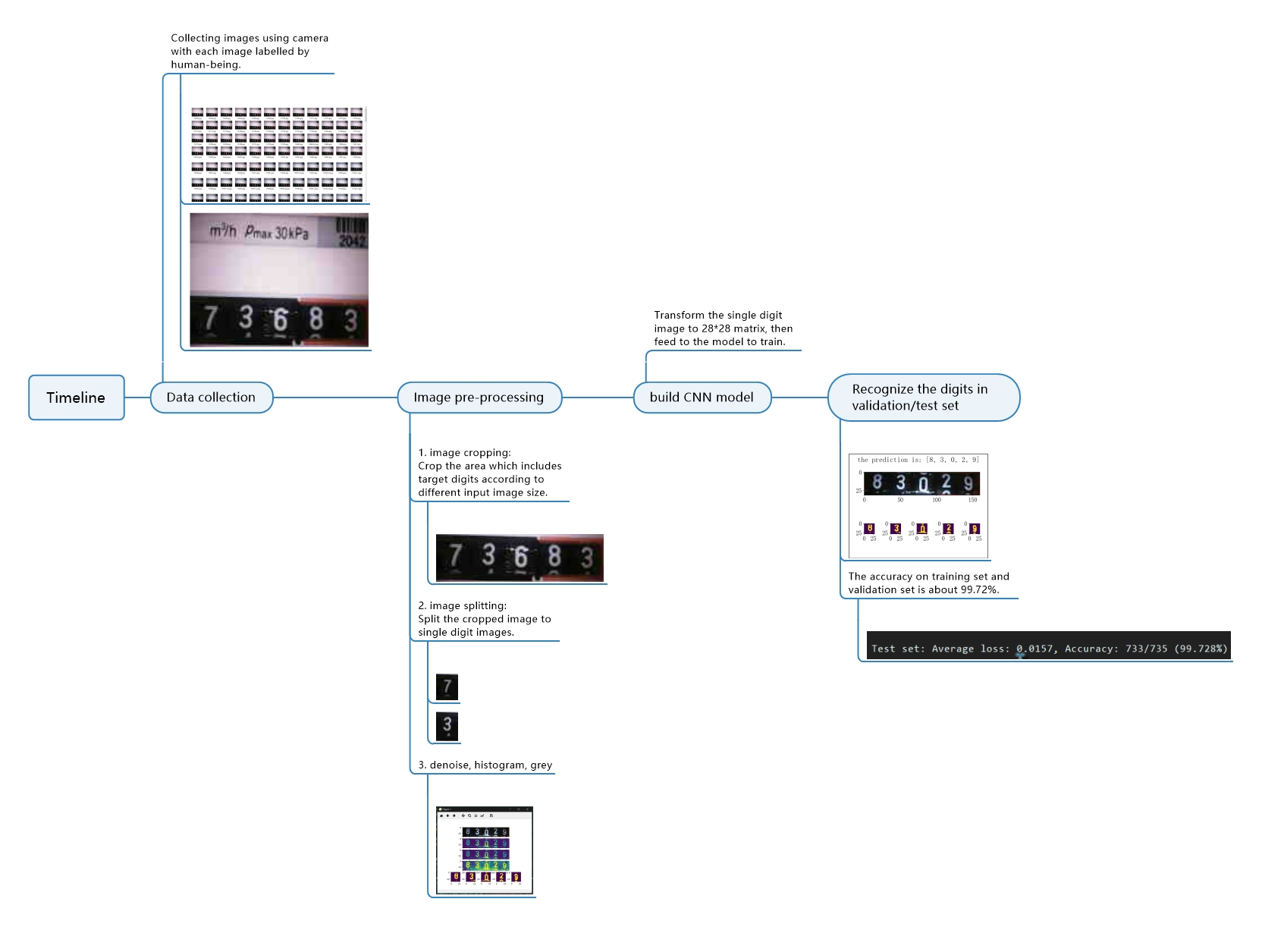

Slide 4
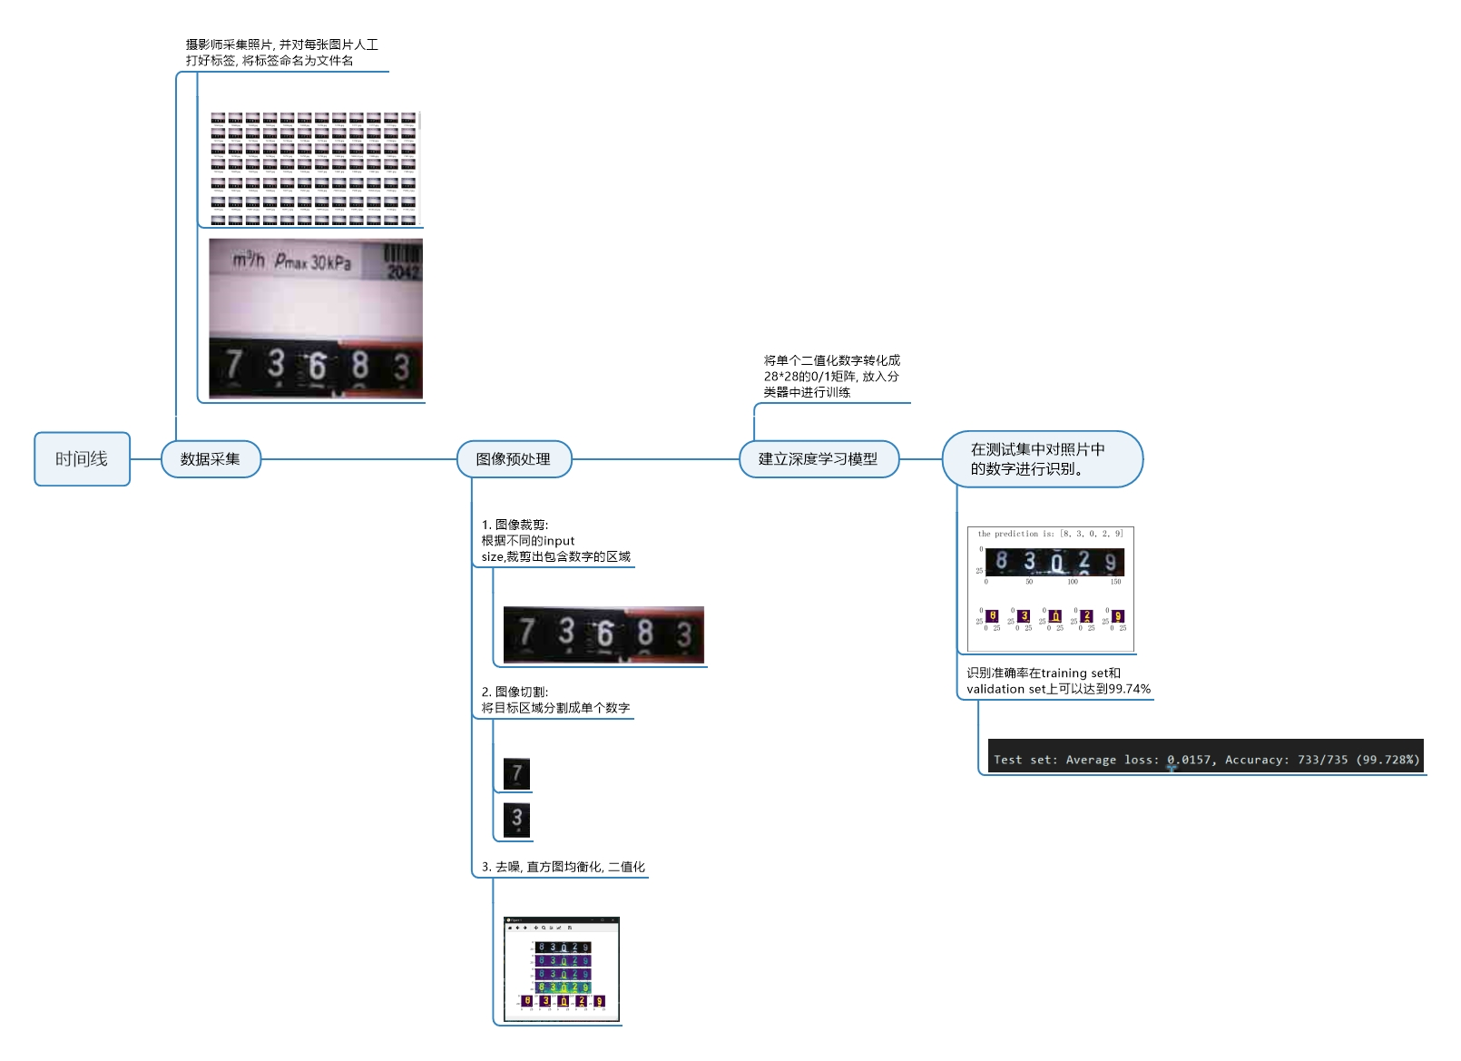

Slide 5
2. Difficulties

Slide 6
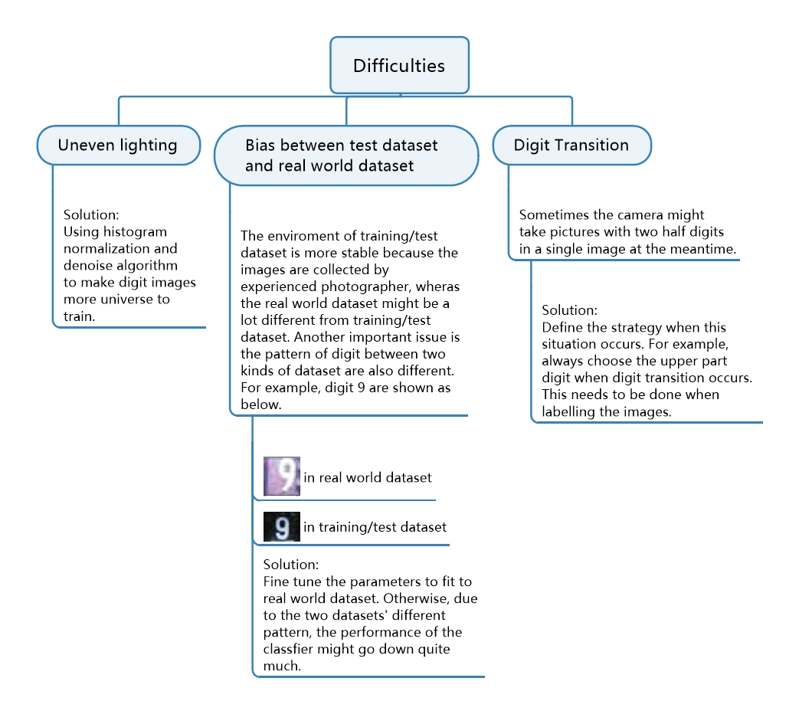

Slide 7
