Slide 1
Membrane distillation
Membrane distillation is a new type of membrane-separation processes used to treat aqueous solutions. The membrane used in membrane distillation process is a microporous membrane that is not wetted by the aqueous solution to be treated. The membrane material is generally hydrophobic polymers such as Polytetrafluoroethylene, Polyvinylidene difluoride and Polypropylene. One side of the membrane is in direct contact with the hot water, and this side is called the hot side. The water in the aqueous solution on the hot side vaporizes on the surface of the membrane;and the water vapor is transferred to the other side of the membrane through the membrane pores, and then cooled again to water (this side is called the cold side). The driving force of the membrane process is the water vapor-pressure difference on both sides of the membrane

Slide 2
Features of membrane distillation
(1) The operating conditions are mild, and there is sufficient driving force to realize the transfer of water under
atmospheric pressure and close to normal temperature, so some low-value waste heat, geothermal or solar energy can be effectively used as heat sources.
(2) Since only water vapor diffuses through the pores of the membrane to reach the cold side, inorganic salts etc,cannot pass through the pores of the membrane, so pure water can be obtained on the cold side and the solution concentration on the hot side can be achieved at the same time.

Slide 3
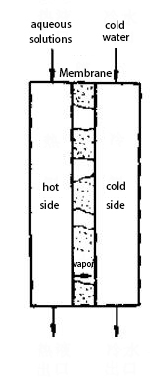
Types of membrane distillation process
According to the method of condensation or removal of water vapor on the cold side of the membrane, the membrane distillation process can be divided into four operation modes: direct contact, air gap, decompression and gas purging.
(1) Direct contact
The hot solution and the cooling water are respectively in direct contact with the two sides of the membrane, and the water vapor transferred to the cold test is directly condensed into the cooling water. The two liquids can flow countercurrent or cocurrent; the membrane used can be a flat membrane or a capillary membrane. The membrane device of this operation mode has a simple structure and a large water flux.

Slide 4
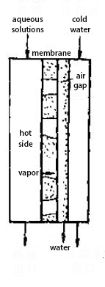
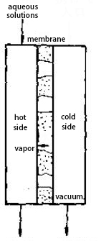
(2) Air gap type
The hot solution is in contact with the film surface, the cooling water is in contact with the cooling plate, and the water vapor transferred to the cold side through the film holes is condensed on the cooling plate after passing through an air gap. This form is suitable for flat membranes. The advantage is that the condensed pure water can be directly obtained from the gas chamber, and the purity of the cooling water is very low. However, because the water vapor transmission path is longer than the direct contact type, the flux is relatively small.
(3) Pressure reducing type
In decompression membrane distillation, on the cold side of the membrane, the diffused water vapor is evacuated by vacuuming, and the water vapor is condensed outside the membrane vessel. Since the non-condensable gas (air) in the membrane pores is eliminated at this time, the transmission of water vapor is changed from a diffusion process to a flow process, so the water flux can be increased.

Slide 5
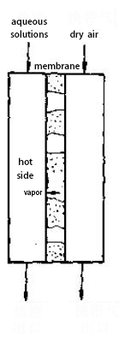
(4)gas purging type
In gas-purged membrane distillation, dry air is blown through on the cold side to carry away the water vapor that diffuses to that side. In this way, the temperature of the air on the cold side can also be higher than the temperature of the solution on the hot side. The requirement for the purge gas is that the partial pressure of water vapor should be lower than the partial pressure of the hot water vapor.

