Slide 1
Tutorial Exercises
Kokkos Random Number Generation
Duane A Labreche

Slide 2
Kokkos Random Number Generation: Sources
Two random number generators
64-bit: Kokkos::Random_XorShift64_Pool
1024-bit: Kokkos::Random_XorShift1024_Pool
Based on Marsaglia’s suggested xorshift generators
Kokkos implements Vigna (2014) scrambled generator
including a high-dimensional generator (1024 bit)
George Marsaglia. 2003. Xorshift RNGs. Journal of Statistical Software 8, 14 (2003), 1-6.
Vigna, Sebastiano (2014). "An experimental exploration of Marsaglia's xorshift generators, scrambled“ ( http://arxiv.org/abs/1402.6246 )

Slide 3
Kokkos Random Number Generation: Concepts & Code
// Create a random number generator pools for 64bit states
// Takes a 64-bit unsigned integer seed to initialize the //Random_XorShift64 generator used to fill pool of generators.
Kokkos::Random_XorShift64_Pool<> rand_pool64(5374857);
// A Functor for generating uint64_t random numbers templated on the GeneratorPool type
template<class GeneratorPool>
struct generate_random {
typdef typename GeneratorPool::generator_type gen_type;
Kokkos::View<uint64_t*> vals; // Output View for rand nums
GeneratorPool rand_pool; // The GeneratorPool
int samples;
// Initialize all members
generate_random(Kokkos::View<uint64_t*> vals_,
GeneratorPool rand_pool_,
int samples_): vals(vals_), rand_pool(rand_pool_), samples(samples_) {}
KOKKOS_INLINE_FUNCTION
void operator() (int i) const {
// random number state from pool for active thread
gen_type rren = rand_pool.get_state();
// Draw samples numbers from pool as urand64 between 0 and rand_pool.MAX_URAND64
for(int k = 0;k<samples;k++) {
vals(i*samples+k) = rgen.urand64();
//vals(i*samples+k) = Kokkos::rand<gen_type,uint64_t>(rgen);
}
rand_pool.free_state(rand_gen); // Give state back, allow other thread to acquire
}
};
User-selected generator type (e.g, 64-bit)
Defines the pool of generators,
….. for the specified seed
User-process requests a generator on CPU/GPU
the generator creates a pool of generators needed for the execution space
each CPU or GPU/thread is provided a generator
that generator produces the requested set of samples from a type of distribution
process is deterministic on CPUs; not on GPUs
Generator (state) is freed to pool for next request
Several types of range specifiers (see Kokkos_Random.hpp)

Slide 4
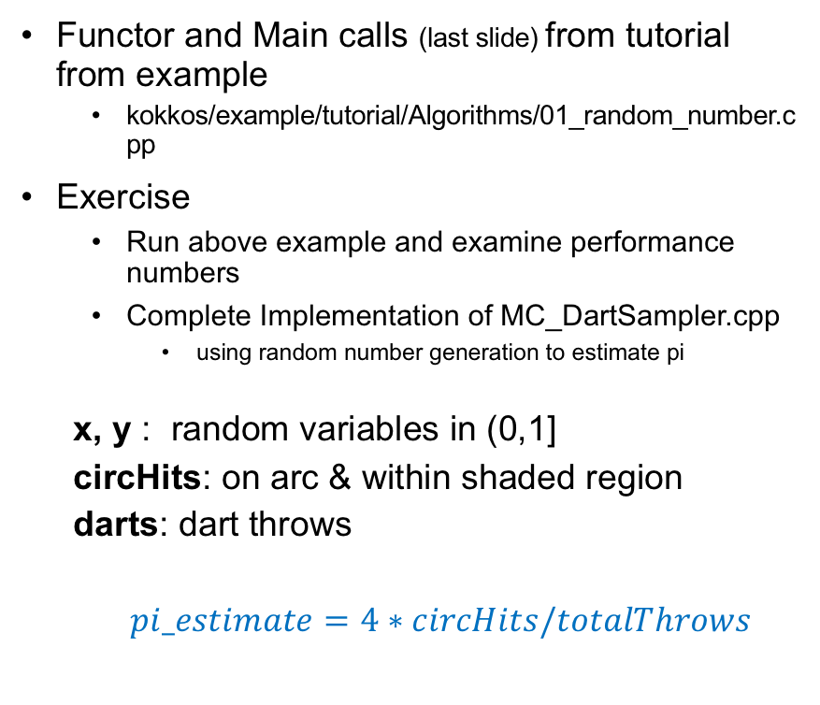
Kokkos Random Number Generation: Example
Functor and Main calls (last slide) from tutorial from example
kokkos/example/tutorial/Algorithms/01_random_number.cpp
Exercise
Run above example and examine performance numbers
Complete Implementation of MC_DartSampler.cpp
using random number generation to estimate pi
x, y : random variables in (0,1]
circHits: on arc & within shaded region
darts: dart throws
$pi_estimate=4∗circHits/totalThrows$
y
x
x
x
x
x
x
x
x
x
x
Radius, r

Slide 5
http://www.github.com/kokkos

