Slide 1



Redirection
Multi-task cGAN for 3D Building Vectorization
2020.12.03
Yi Wang

Slide 2

Outline
Re: DSM refinement
Vectorization: first result
Questions
Next Steps

Slide 3
Re: DSM refinement
Problem: DSM refinement GAN can’t run stably (D→0), making it harder if we add another task (edge)
Experience: Edge prediction depends largely on DSM result
Redefine current method: DSM refinement --> (refined DSM) edge prediction
First task: DSM refinement
Idea: train a CNN first (general info), then fine tune a GAN generator (add details)
(Ongoing CNN training with SmoothL1Loss, show progress next time)

Slide 4
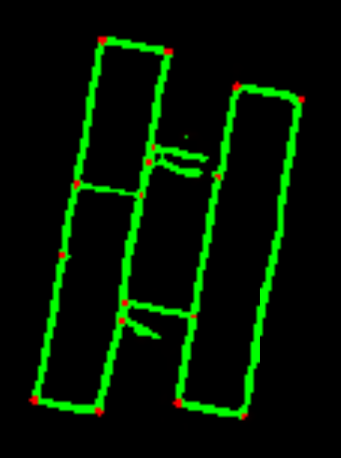
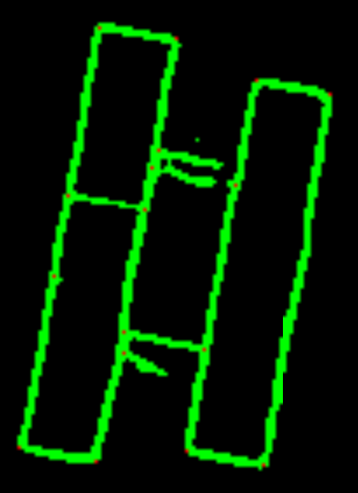
Vectorization: a first result
Input: refined DSM (unstable version) + predicted Edge (CNN on refined DSM)
Output: vectorized edge lines
Step1: predicted edge → all corners → (non-maximum suppression) → true corners

Slide 5

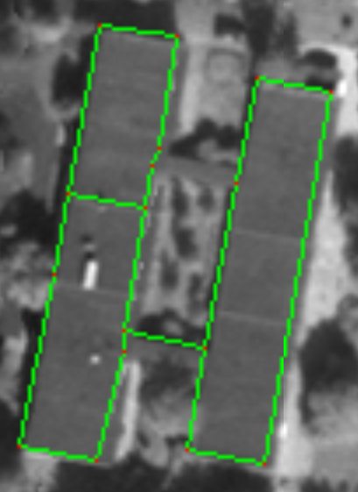
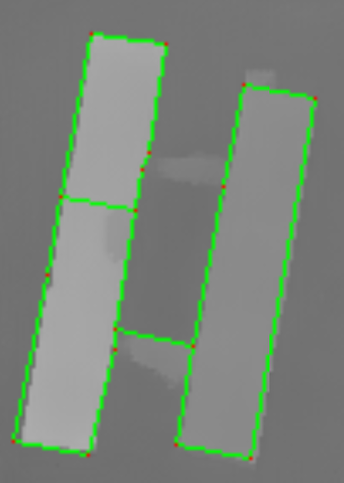
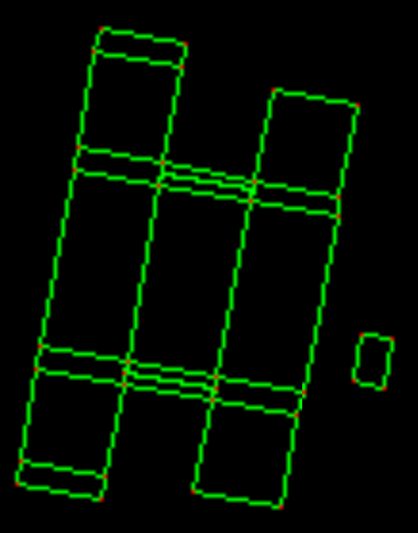
Vectorization: a first result
Step2: Build node/edge graph (find edges) → for each corner pair,
If there’s a corner between them (buffer), ‘IsEdge = False’
Else draw a thick line, if mean_edge_value>0.7, ‘IsEdge = True’
Return a list of all edges (each consists of two corners)
Step3: reconstruct the graph, create empty image, draw edge for edge in edges

Slide 6
Questions
Contents here

Slide 7
Next steps
1. Train a best dsm_refinement GAN
2. Optimize edge prediction

