Slide 1



Build Network (P2)
Multi-task cGAN for 3D Building Vectorization
2020.11.05
Yi Wang

Slide 2

Outline
Evaluation cGAN v1
Possible improvements
Questions
Next Steps

Slide 3
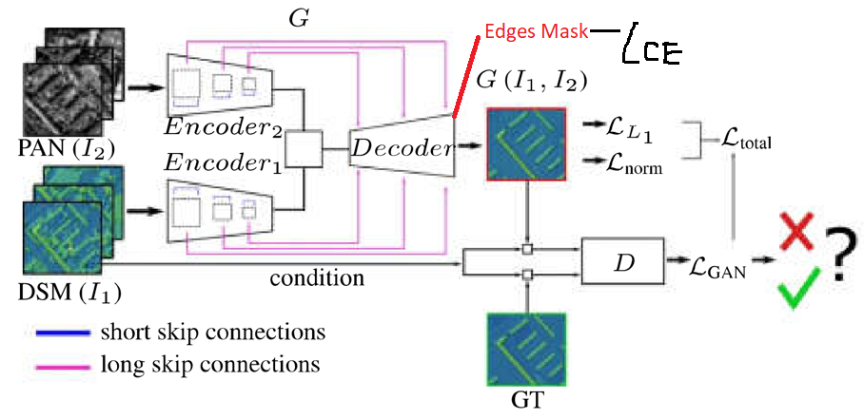
Evaluation cGAN v1
Network review
1 common decoder
Edge: Cross entropy loss

Slide 4
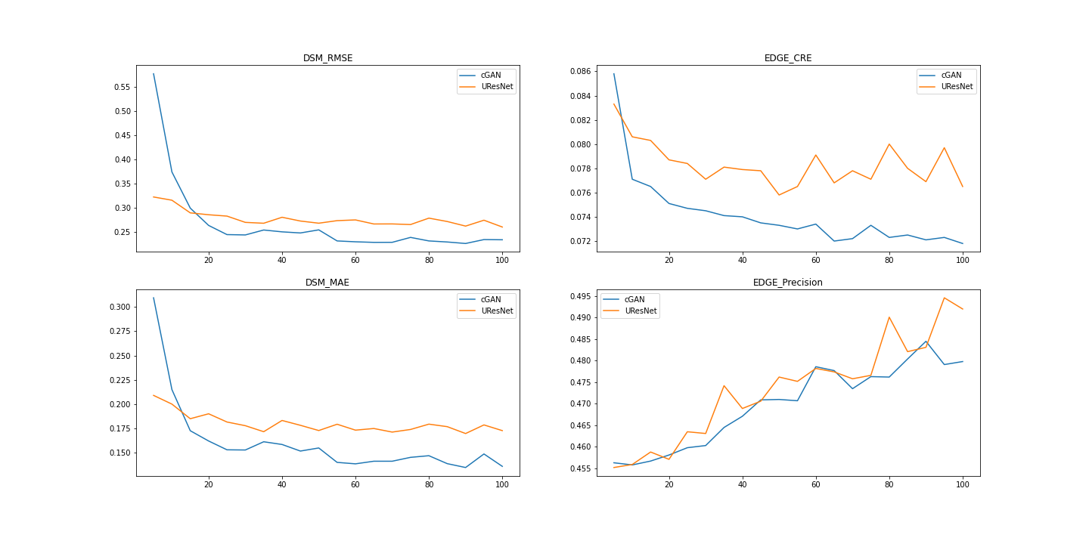
Evaluation cGAN v1
Intermediate validation result (cGAN VS URNet)
Precision = TP/(TP+FP)
Recall = TP/(TP+TN)

Slide 5


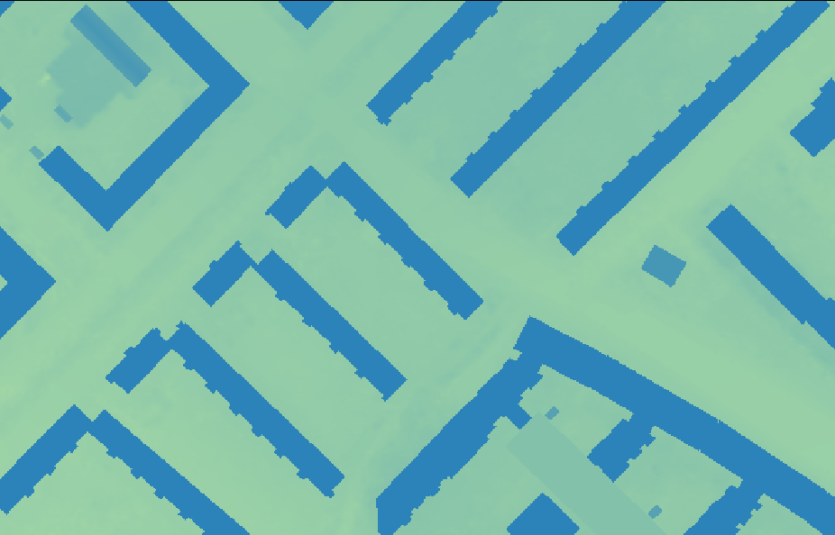

Evaluation cGAN v1
Test result
Input dsm
cGAN dsm
RMSE
GT dsm
URNet dsm

Slide 6
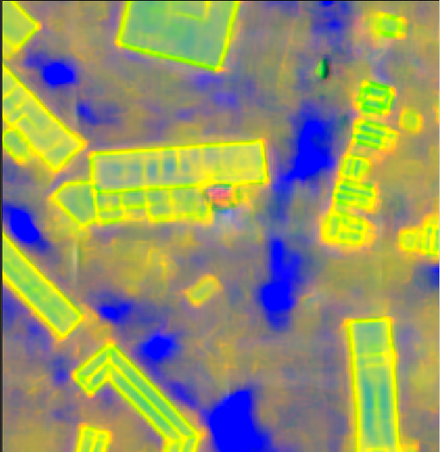
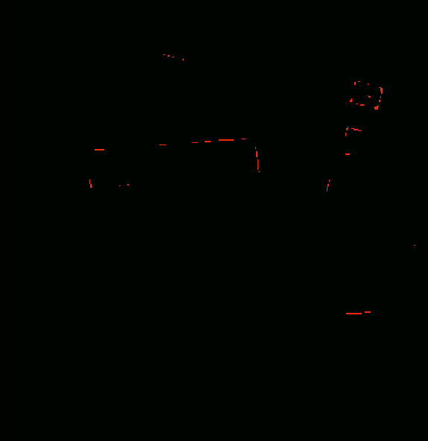
Evaluation cGAN v1
Test result
Edge Example:
(-3,0.1,0.6)
3cl Raw value
3cl argmax
Problem: Unweighted cross entropy loss ($N_{background}≫N_{edge}≫N_{corner}$)

Slide 7
Next steps
Weighted Edge loss (WBCE, Dice)
2 decoders

Slide 8
Questions
Which evaluation metric is suitable for edges? (CRE? IoU?)

