Slide 1



Build Network
Multi-task cGANs for 3D Building Vectorization
2020.10.30
Yi Wang

Slide 2

Outline
Base model: DSM refinement
New task: Edge prediction
A First Result: FCN (G-only) VS cGAN
Questions
Next Steps

Slide 3
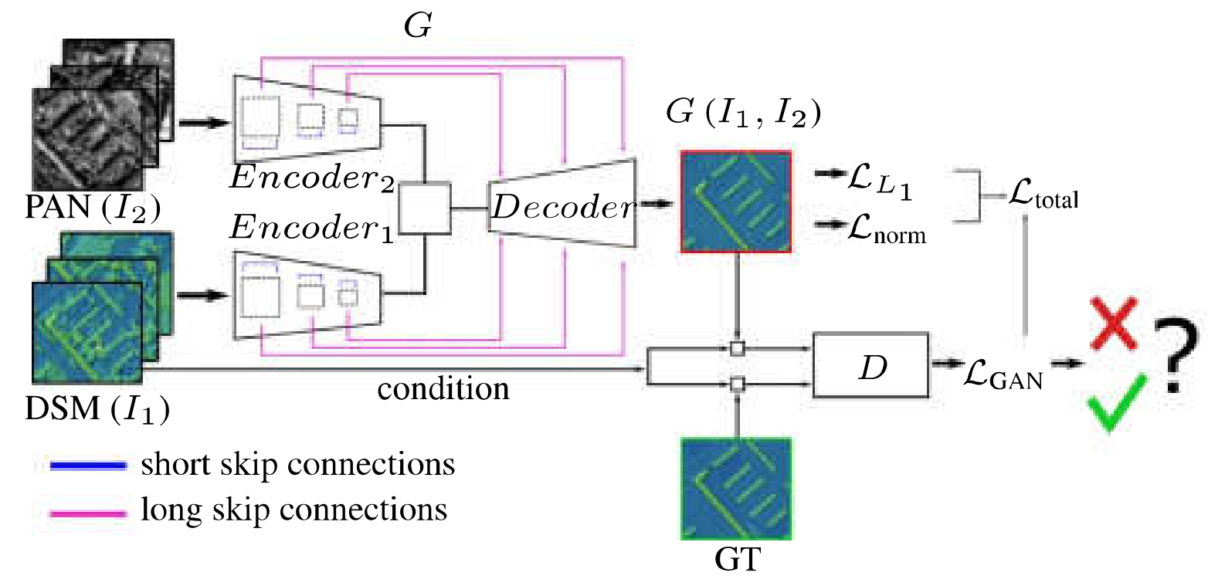
Base model: DSM refinement

Slide 4
Base model: DSM refinement
Generator
2 x Encoder: RestNet50
Bridge: 1x1 conv
Decoder: UNet UpBlock
[B,1,256,256]
[B,2048,8,8]
Conv
MaxPool
ReLU
3*Bottleneck
4*Bottleneck
6*Bottleneck
3*Bottleneck
INPUT
Latent
L-DSM
L-Ortho
Conv
BN
ReLU
Conv
BN
ReLU
[B,2048,8,8]
X
[B,1,256,256]
[B,2048,8,8]
UpBlock
UpBlock
UpBlock
UpBlock
UpBlock
OUTPUT
X

Slide 5
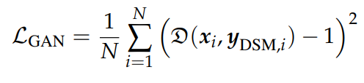

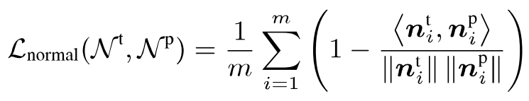
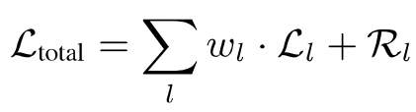
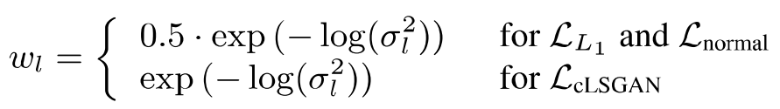
Base model: DSM refinement
Generator loss
GAN loss:
L1 loss:
Surface Normal loss:
Learned weights:
Optimizer: Adam

Slide 6
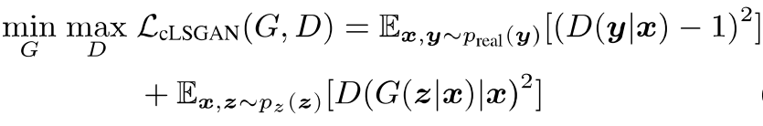
Base model: DSM refinement
Discriminator
PatchGAN CNN
Discriminator Loss
Optimizer: Adam
[B,1,256,256]
[B,1,32,32]
Conv
LeakyReLU
Conv
BN
LeakyReLU
Conv
BN
LeakyReLU
Conv
BN
LeakyReLU
Conv
BN
LeakyReLU
Conv
Sigmoid
INPUT
PATCH

Slide 7
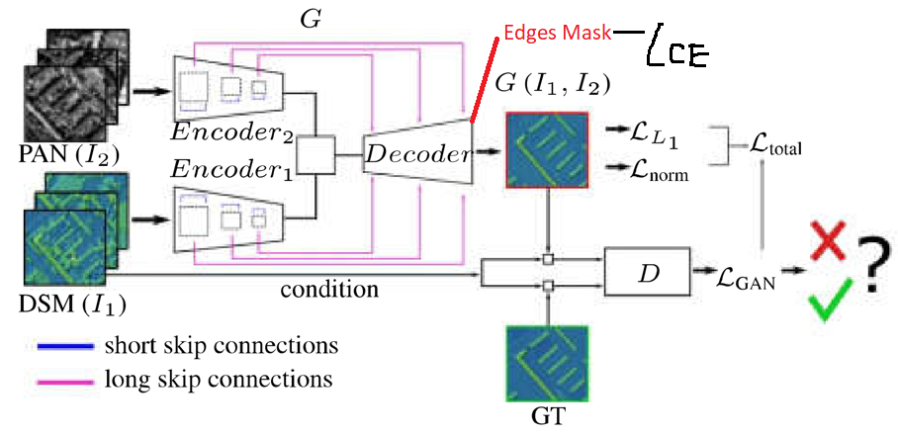
New task: Edge prediction

Slide 8
New task: Edge prediction
Generator
2 x Encoder: RestNet50
Bridge: 1x1 conv
Decoder: UNet UpBlock
[B,1,256,256]
[B,2048,8,8]
Conv
MaxPool
ReLU
3*Bottleneck
4*Bottleneck
6*Bottleneck
3*Bottleneck
INPUT
Latent
L-DSM
L-Ortho
Conv
BN
ReLU
Conv
BN
ReLU
[B,2048,8,8]
X
[B,1,256,256]
[B,2048,8,8]
OUTPUT1
OUTPUT2
UpBlock
UpBlock
UpBlock
UpBlock
UpBlock
X
[B,3,256,256]

Slide 9
New task: Edge prediction
Generator loss
GAN loss:
L1 loss:
Surface Normal loss:
Edge loss: CrossEntropy(pred,GT)
Learned weights:
Optimizer: Adam
Discriminator remains the same

Slide 10
A first result
cGAN

Slide 11
A first result
Generator-only

Slide 12
Questions
????

Slide 13
Next steps
1 decoder → 2 decoders
???

