Slide 1



thesis outline & plan
Multi-task cGAN for 3D Building Vectorization
2021.01.21
Yi Wang

Slide 2

Outline
Final version
Evaluation metrics
Thesis outline
Questions
Next Steps

Slide 3
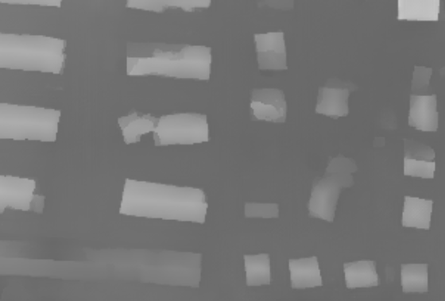
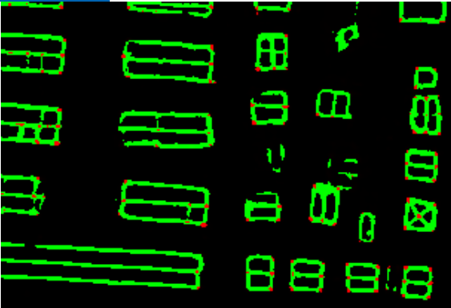
Final Version
Self-attention module:
DSM: LSGAN + L1 + SN; fine tuning + network interpolation
Edge/Corner: Cross Entropy
D
dsm
Refined DSM
Fake or Real?
ortho
resnet50
CBAM
Refined DSM
ortho
Edge/corner

Slide 4
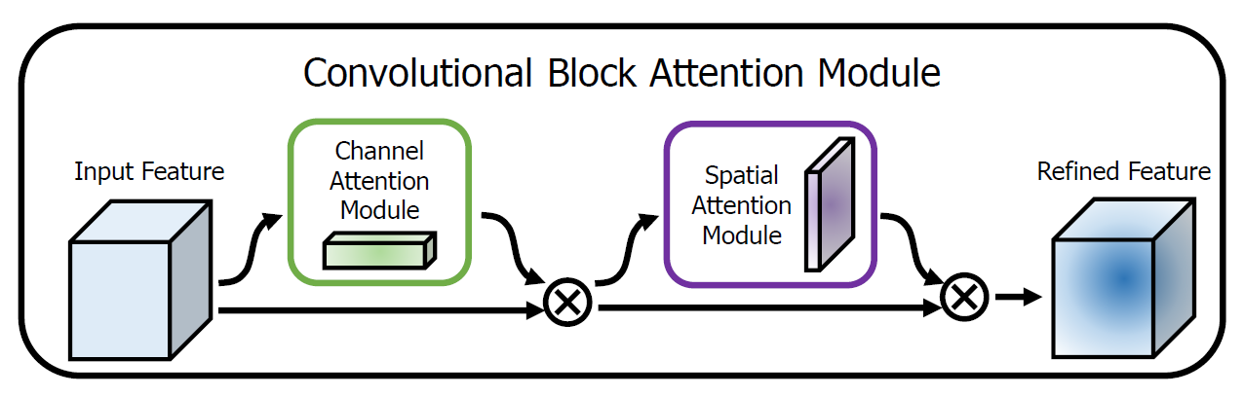
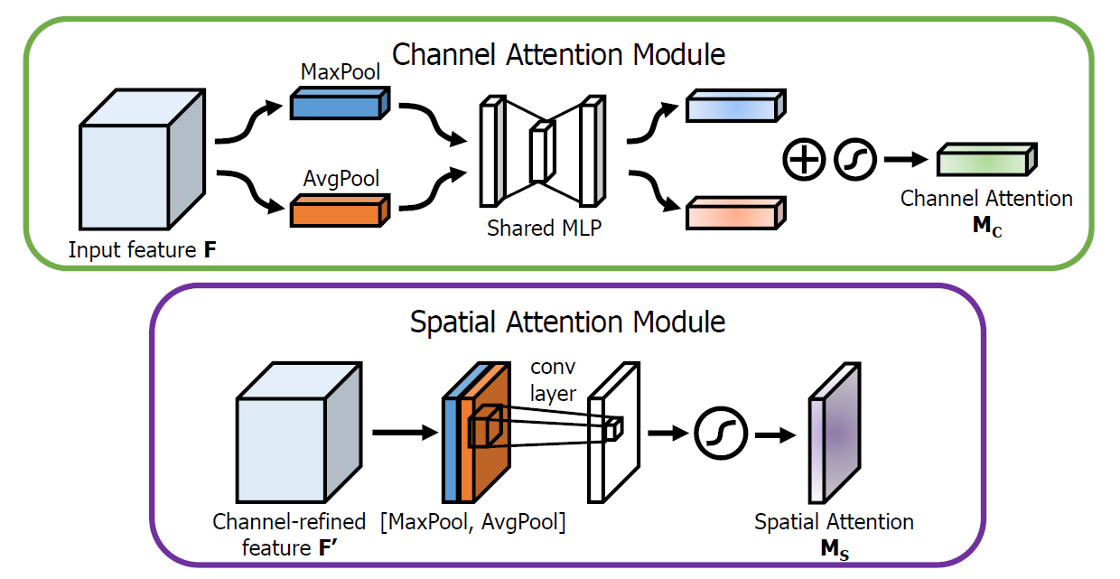
Final Version
Self-attention module:
[1] Woo, Sanghyun, et al. "Cbam: Convolutional block attention module." Proceedings of the European conference on computer vision (ECCV). 2018.

Slide 5
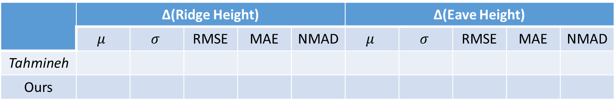
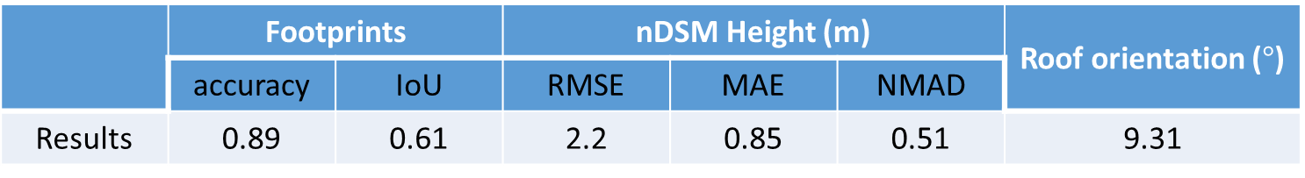
Evaluation metrics
DSM refinement (validation area)
Edge detection → 3D model (sample area)
 | RMSE (m) | MAE (m) | NMAD (m)
Coupled-cGAN (200 epoch) | 4.07 | 1.85 | 0.99
Attn-cGAN (100 epoch) | 3.86 | 1.67 | 0.91
 | Footprints |  | nDSM Height (m) |  |  | Roof orientation ($°$)
 | accuracy | IoU | RMSE | MAE | NMAD
Results | 0.89 | 0.61 | 2.2 | 0.85 | 0.51 | 9.31
 | ∆(Ridge Height) |  |  |  |  | ∆(Eave Height)
 | $$μ$$ | $$σ$$ | RMSE | MAE | NMAD | $$μ$$ | $$σ$$ | RMSE | MAE | NMAD
Tahmineh
Ours

Slide 6
Thesis outline
Title: Machine-learned 3D Building Vectorization from Satellite Imagery
Abstract:
1. Introduction:
We propose a machine-learning based approach for automatic 3D building reconstruction and vectorization.
Taking single-channel photogrammetric DSM and pan-chromatic (PAN) image as input, we first refine the
DSM shapes with a conditional generative adversarial neural network (GAN). The refined DSM combined with
PAN image are then used to detect roof edges and corners, which are later vectorized to parameterized polygons.
Finally, we add height information from refined DSM to obtain full 3D building models.
1.1 Background and Motivation
1.2 Related work
DSM refinement
Edge detection
3D building model reconstruction
1.3 Our work (highlights)
DSM refinement
Edge/corner detection
3D building vectorization

Slide 7
Thesis outline
2. Theory
2.1 High-resolution Satellite Imagery (PAN + DSM)
2.2 Convolutional Neural Network (CNN + FCN + UNet + ResNet)
2.3 Generative Adversarial Network (GAN + cGAN + pix2pix translation)
3. Methodology
3.1 DSM refinement
3.2 Edge/corner detection
3.3 3D building model
Corner: non-maximum suppression
Edge: corner connectivity
2D polygon: closed edges
3D model: roof + wall + ground

Slide 8
Thesis outline
4. Experiments
4.1 study area and dataset
4.2 network implementation details
4.3 results and evaluation
4.3.1 result figures (DSM + Edge + 3D model)
4.3.2 Evaluation DSM
4.3.3 Evaluation 3D model
Footprints
nDSM
Roof orientation
4.3.4 compared to another approach

Slide 9
Thesis outline
4. Conclusion
Summary, conclusion, future work
5. References

Slide 10
Next steps
Introduction & Related Work (--28.01.2021, 1 week)
Methodology (--04.02.2021, 1 week)
Experiments & Conclusion (--25.02.2021, 2-3 weeks)
Acknowledgement, Appendix, …, modification (--04.03.2021, 1-2 weeks)
Thesis Presentation (--03.2021)

