Slide 1



Loss Function
Multi-task cGAN for 3D Building Vectorization
2020.11.12
Yi Wang

Slide 2

Outline
Previously
Decoder
Edge losses
Next Steps
Questions

Slide 3
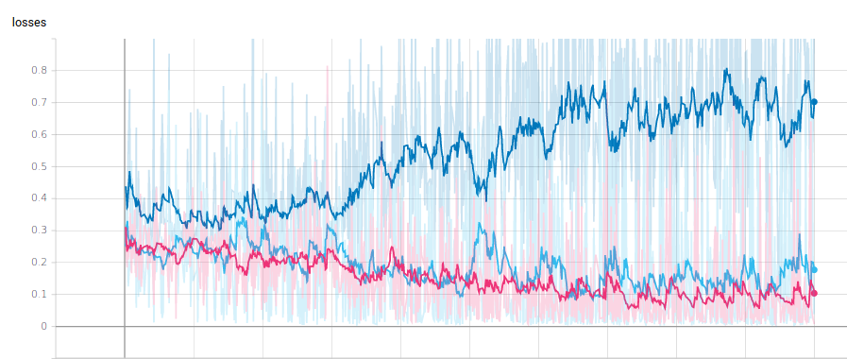

Previously
GAN loss: G→1,D→0
a mistake for GAN weights ($L_{all}=w_{1}∗L_{G}+w_{2}∗L_{1}+w_{3}∗L_{N}+w_{4}∗L_{cre}$)
Result after correction:

Slide 4
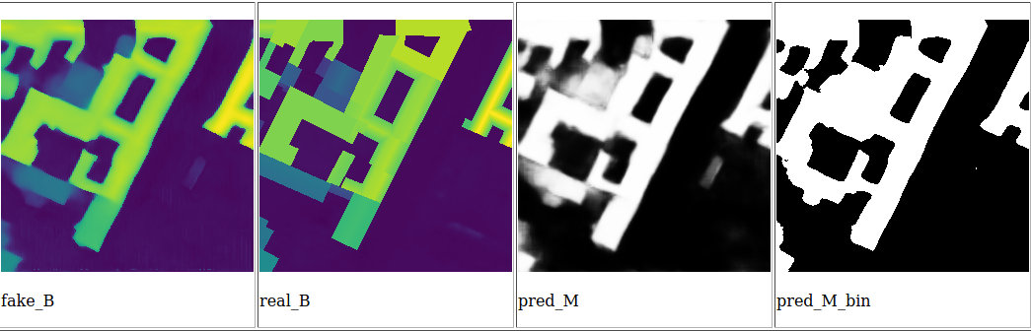
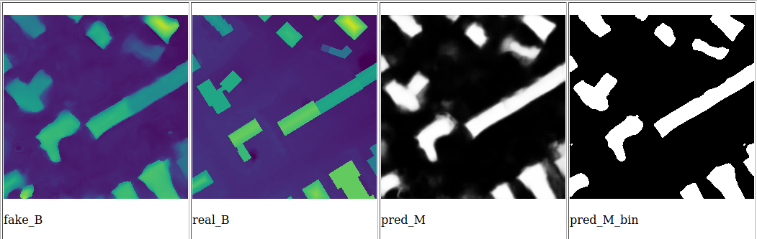
Previously
Result of building mask prediction:

Slide 5
Decoder
2 decoders → much more network parameters
Generative result similar to 1 decoder (if not trained for too long)
Use 1 decoder currently, until further make changes to network structure

Slide 6
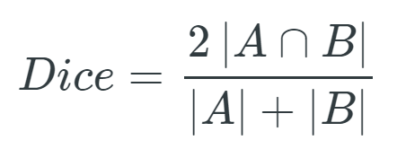
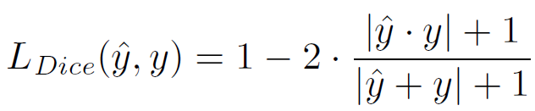
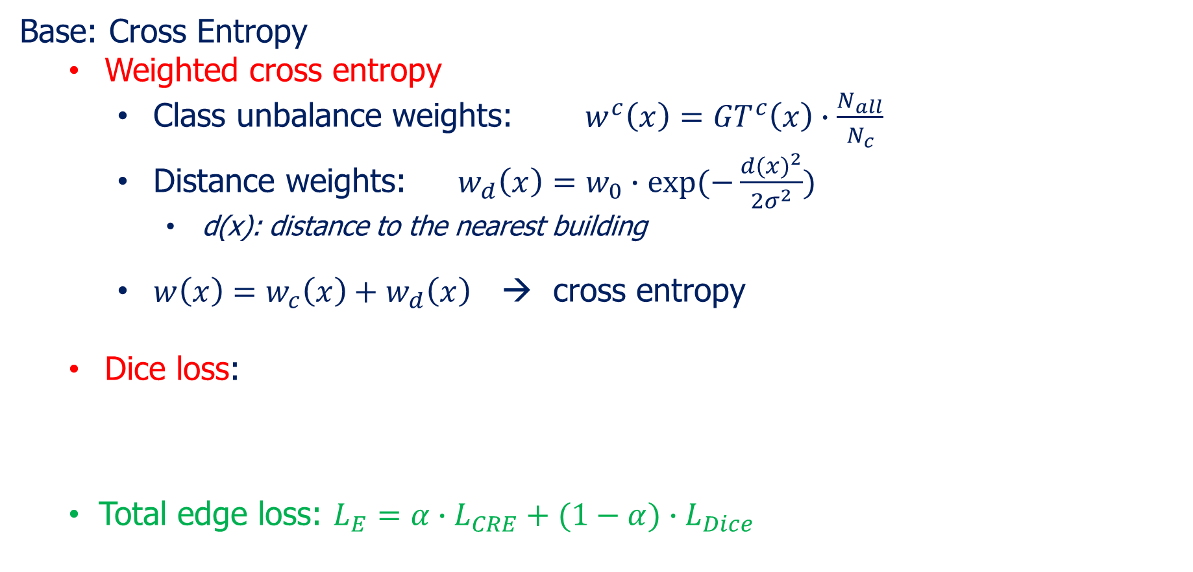
Edge losses
Base: Cross Entropy
Weighted cross entropy
Class unbalance weights: $w^{c}\left(x\right)={GT}^{c}\left(x\right)∙\frac{N_{all}}{N_{c}}$
Distance weights: $w_{d}\left(x\right)=w_{0}∙exp⁡(−\frac{{d(x)}^{2}}{2σ^{2}})$
d(x): distance to the nearest building
$w\left(x\right)=w_{c}\left(x\right)+w_{d}\left(x\right)$ → cross entropy
Dice loss:
Total edge loss: $L_{E}=α∙L_{CRE}+(1−α)∙L_{Dice}$
Girard, Nicolas, et al. "Polygonal Building Segmentation by Frame Field Learning." arXiv preprint arXiv:2004.14875 (2020).

Slide 7
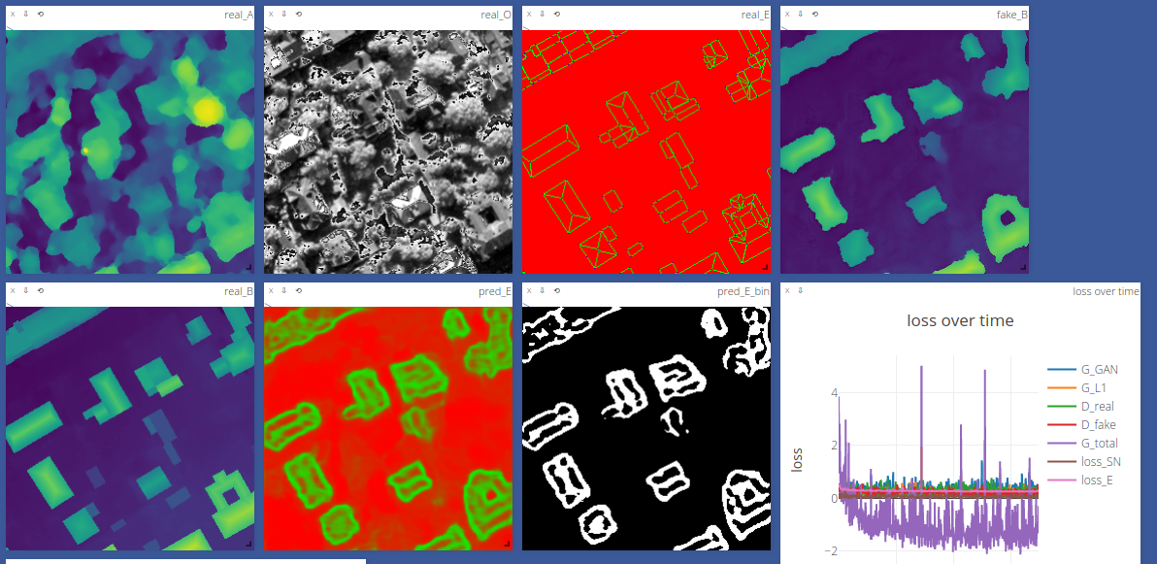
Edge losses
Some results (edges only)

Slide 8
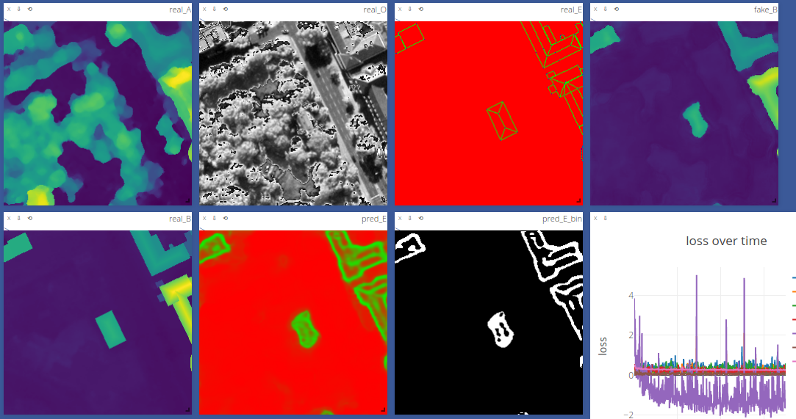
Edge losses
Some results (edges only)

Slide 9
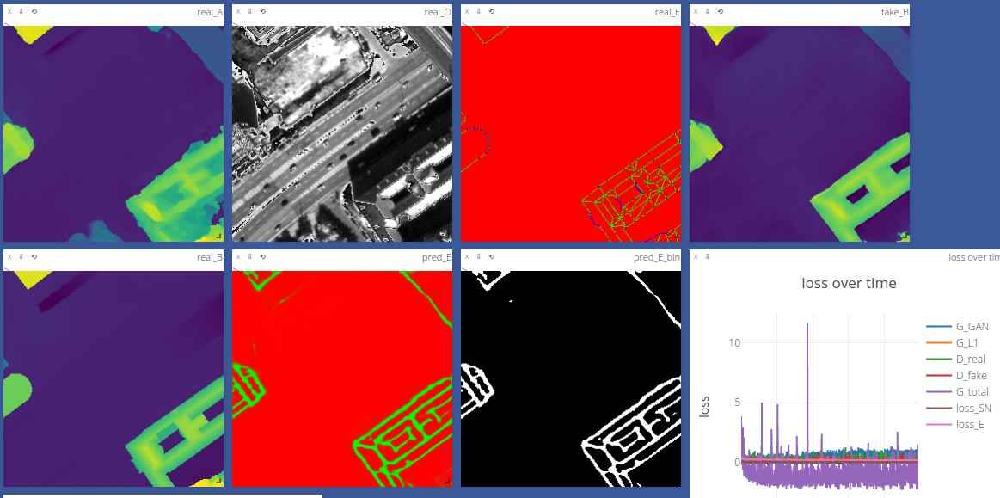
Edge losses
Some results (edges only)

Slide 10
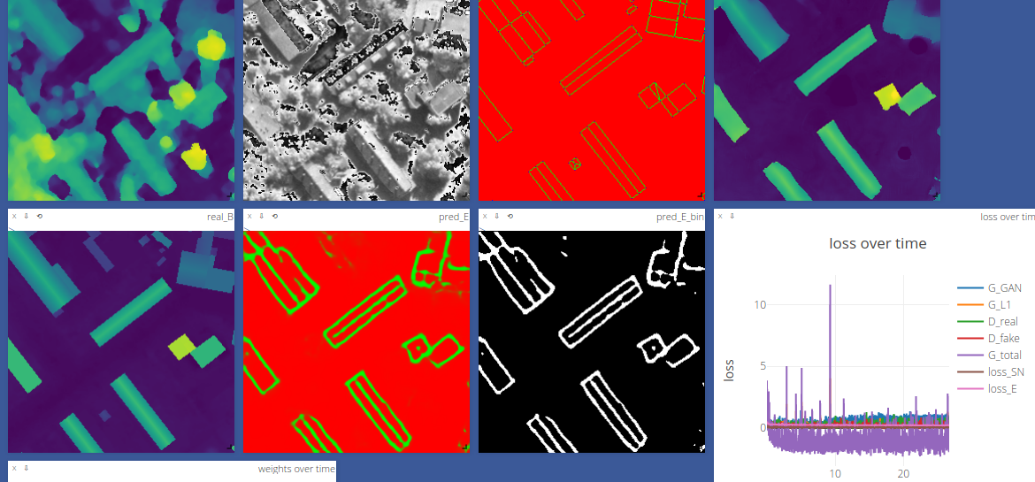
Edge losses
Some results (edges only)

Slide 11
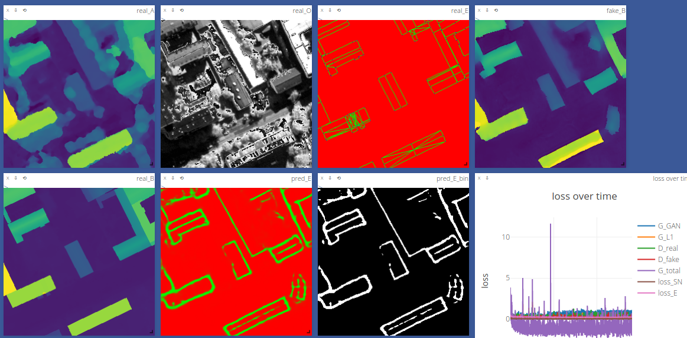
Edge losses
Some results (edges only)

Slide 12
Thoughts
Segmentation result is highly correlated to refined DSM
Ground truth too complicated & Input Ortho relatively weak
Idea1: use refined DSM + Ortho to predict edges (GAN or UNet)
Idea2: use WV-4 RGB image (Q: How to align tif image?)
How to get regularized boundry in early stage?
Thick edge prediction result -> How to vectorize?

Slide 13
Next steps
Contents here

