Slide 1



Loss Function
Multi-task cGAN for 3D Building Vectorization
2020.11.19
Yi Wang

Slide 2

Outline
Losses
thresholds
New discriminator
Rethink: vectorization
Questions&Next Steps

Slide 3
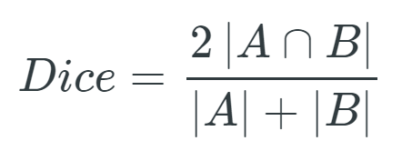
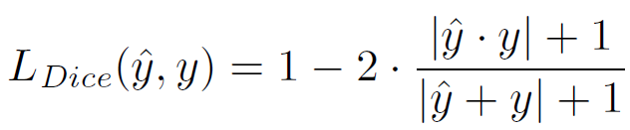
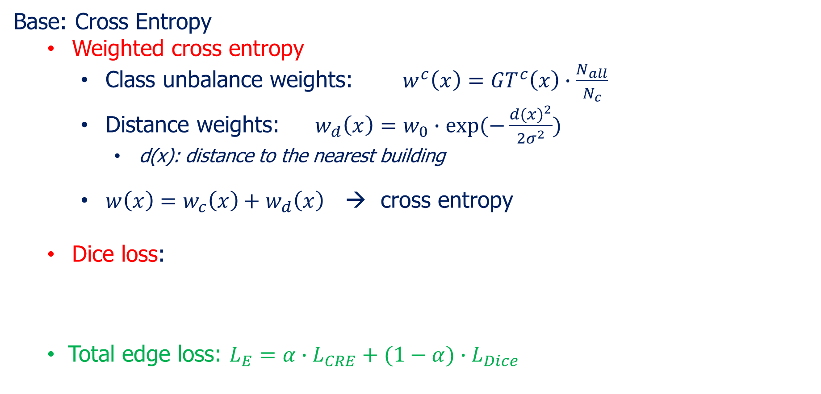
Previously
Base: Cross Entropy
Weighted cross entropy
Class unbalance weights: $w^{c}\left(x\right)={GT}^{c}\left(x\right)∙\frac{N_{all}}{N_{c}}$
Distance weights: $w_{d}\left(x\right)=w_{0}∙exp⁡(−\frac{{d(x)}^{2}}{2σ^{2}})$
d(x): distance to the nearest building
$w\left(x\right)=w_{c}\left(x\right)+w_{d}\left(x\right)$ → cross entropy
Dice loss:
Total edge loss: $L_{E}=α∙L_{CRE}+(1−α)∙L_{Dice}$
Girard, Nicolas, et al. "Polygonal Building Segmentation by Frame Field Learning." arXiv preprint arXiv:2004.14875 (2020).

Slide 4
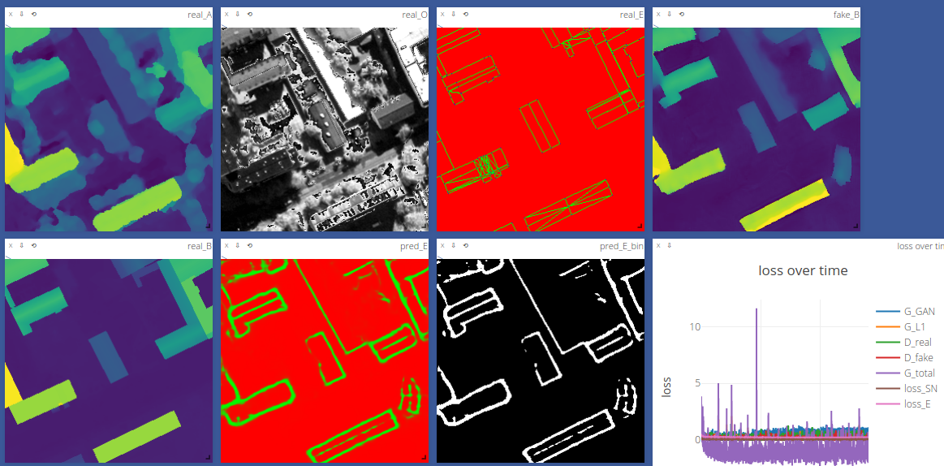
Previously
Some results (edges only)

Slide 5
Losses
Integrated loss
Weighted CRE + Dice loss: relatively thick edges / poor corners
Independent loss
Cross entropy: visualization good; argmax poor
Class weighted CRE: both poor (very think edges)
Distance weighted CRE: both poor (blank prediction)
Dice loss: both poor (thick edges)
--> Change thresholds for prediction

Slide 6
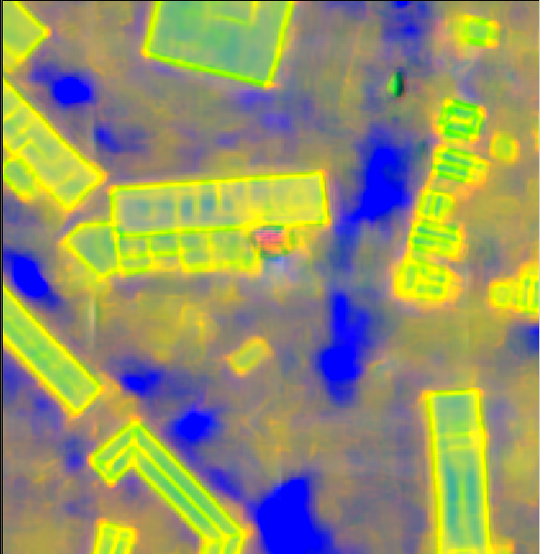
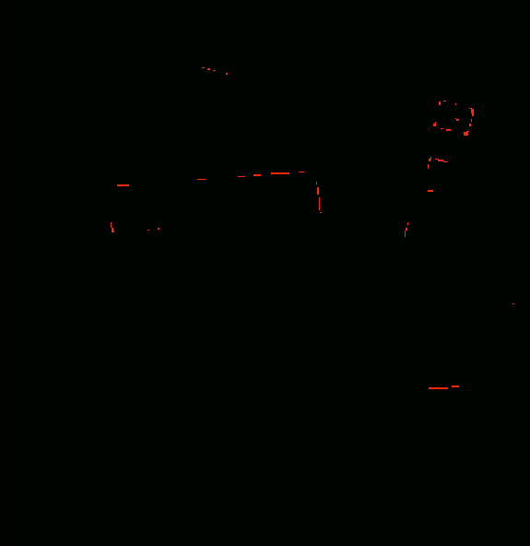
Unweighted CRE loss
Test result
Edge Example:
(-3,0.1,0.6)
3cl Raw value
3cl argmax
Problem: Unweighted cross entropy loss ($N_{background}≫N_{edge}≫N_{corner}$)

Slide 7
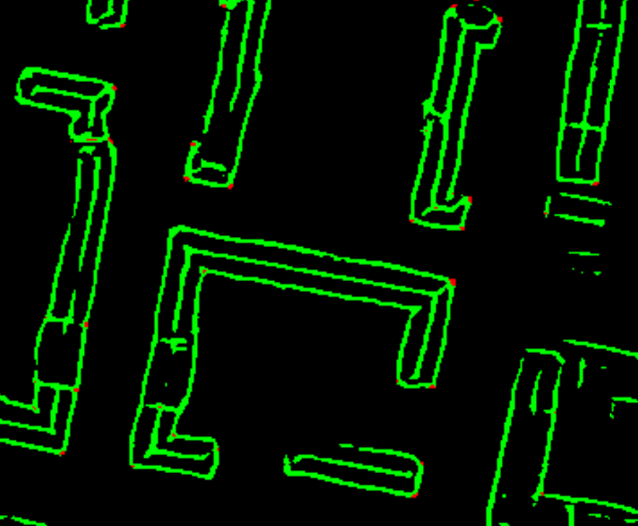
Thresholds
Edge: 0.2, Corner: 0.05

Slide 8
Discriminator for edges
Add a discriminator for edge prediction
Easily gradient variation
some trials:
GT label (0/1) → randn(0.8,1.1)
Input_D_real = GT_E * (inputDSM, inputOrtho)
Input_D_fake = pred_E * (inputDSM,inputOrtho)
No big improvement

Slide 9
Rethink the vectorization
2 ways of vectorization
instance mask + corner points:
Traverse all corners of a certain instance with an order to form a complete polygon
Store polygons (ordered vertices)
Edges + corner points:
Build a graph describing the connection of corners
Store edge graph
 | V1 | V2 | V3 | V4
V1 |  | 1 | 1 | 0
V2 |  |  | 0 | 1
V3 |  |  |  | 1
V4
1
2
3
4

Slide 10
Questions
How to accurately extract corners?
If refined DSM poor → edge poor (learn more from ortho?)
Usually inner edges/corners are more difficult than outer edges

Slide 11
Next steps
Contents here

