Slide 1



Redirection
Multi-task cGAN for 3D Building Vectorization
2020.11.26
Yi Wang

Slide 2

Outline
Previously
Optimizer corners/edges
vectorization
Questions
Next Steps

Slide 3
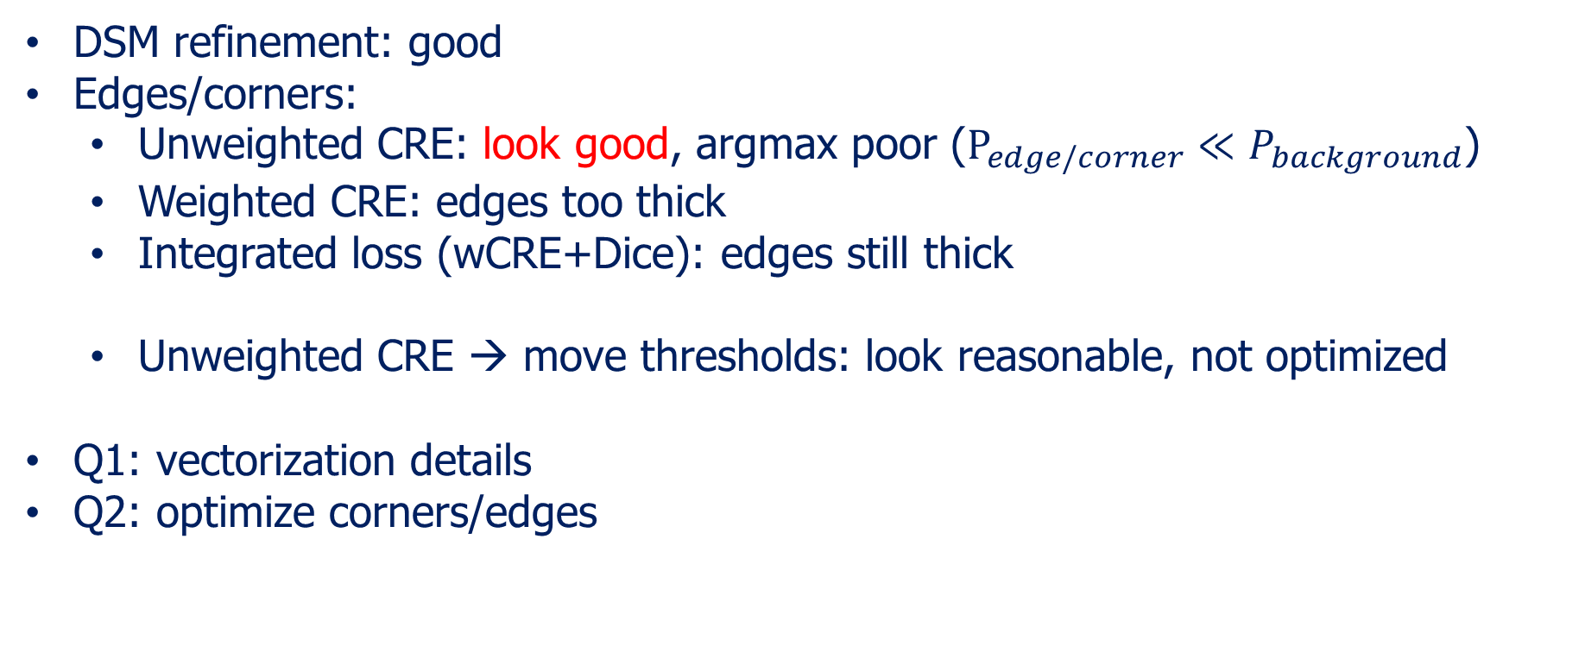
Previously
DSM refinement: good
Edges/corners:
Unweighted CRE: look good, argmax poor ($P_{edge/corner}≪P_{background}$)
Weighted CRE: edges too thick
Integrated loss (wCRE+Dice): edges still thick
Unweighted CRE → move thresholds: look reasonable, not optimized
Q1: vectorization details
Q2: optimize corners/edges

Slide 4
Optimize corners/edges
Trial1: predict edges/corners after dsm refinement → better
Trial2: tricks for edge prediction (label smoothing, new losses, network, …)
Not good so far, keep Working …

Slide 5
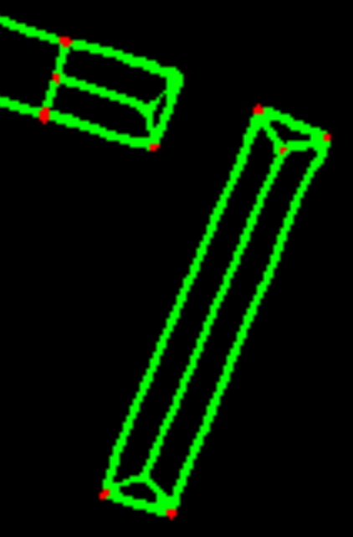
Vectorization details
Corner extraction & non-maximum regression
initialize nodes graph
Traverse corner pairs, calculate and judge edge info
Mean pixel values > threshold
No middle corners
Update and store this graph

Slide 6
Questions & next steps
Optimize corners!!!
Optimize edges
Optimize dsm boundaries

