Slide 1



Ground Truth Generation
Multi-task cGANs for 3D Building Vectorization
2020.10.11
Yi Wang

Slide 2

Outline
Set up virtual environment
Create Ground Truth: Corners
Create Ground Truth: Corners/Edges & Building Instances
Questions
Next Steps

Slide 3
Set up virtual environment
Create virtual environment with python 2.7
Install necessary packages:
Numpy
Shapely
Pytorch+cuda9.2
Torchvision+cuda9.2
Visdom
Scikit-learn
Scikit-image
Pyyaml
Dominate
Tqdm
Opencv
Source xdibias: ‘$ source ~xdibias/xdibias2-Ubuntu-14.04/current/setenv_xdibias.sh’

Slide 4
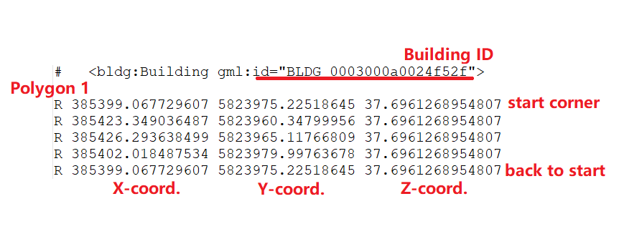
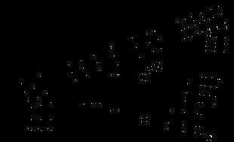
Create ground truth: corners
Source: .dat file
Corner Extraction: cornerGT.py

Slide 5
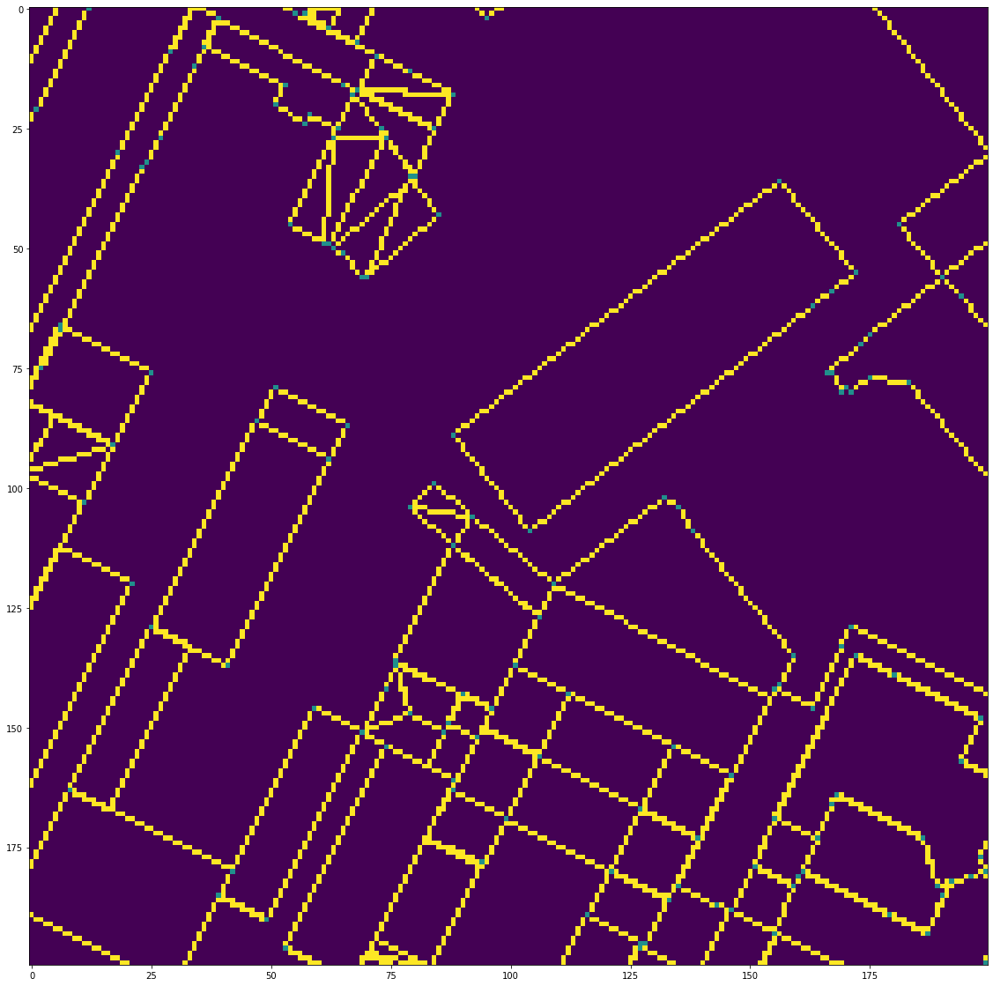
Create ground truth: edges & building instances
Edge extraction: instanceGT.py
skimage.draw.polygon_perimeter(r,c)

Slide 6
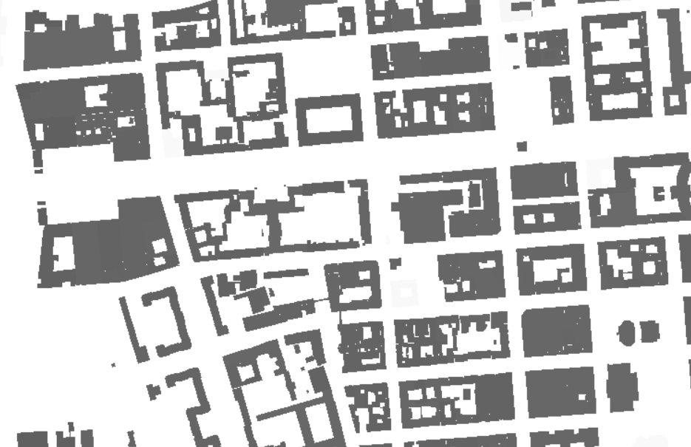
Create ground truth: edges & building instances
Instance extraction: instanceGT.py
skimage.draw.polygon(r,c)

Slide 7
Questions
1. Form of generated ground truth (corners, edges & instances)
Current:
Could also be:
Two channels: corner (1,0) / edge (0,1)
Combine all into one image
2. Exported xdibias edge images can’t show in QGIS (all 0)
Xdibias tutorial/documentation?
Img1: building instances (1,2,3,…)
.dat
Img2: building edges (corner--1 / edge--2)

Slide 8
Questions
3. Visdom port 8097/8098 always already in use
4. When remote training:
Cannot turn off laptop?
Can the laptop go to sleep mode?
5. Is xdibias DLR-private? Can I install this package on my own PC?

Slide 9
Next steps
Merge 12 parts of generated GT to one GT file
Read, understand and experiment with Coupled-cGAN codes

Slide 10
Answers (2020.10.12)
1. Two images (edge_img with 2 channels would be better)
2. QGIS visualization: set classes
4. Remote training: Use screen
Create new screen before training: ‘screen –S NewScreen’
Start training (open visdom/ training)
To detach: press ‘ctrl+A+D’ or command ‘screen –d NewScreen’
To connect back: ‘screen –r NewScreen’
To kill the screen: press ‘ctrl+D’ or command ‘screen –XS NewScreen quit’
To check current screens: ‘screen -ls’

