Slide 1



Write title here
Multi-task cGANs for 3D Building Vectorization
2020.10.19
Yi Wang

Slide 2

Outline
Generate ground truth (part2)
Outline 2
Outline 3
Questions
Next Steps

Slide 3
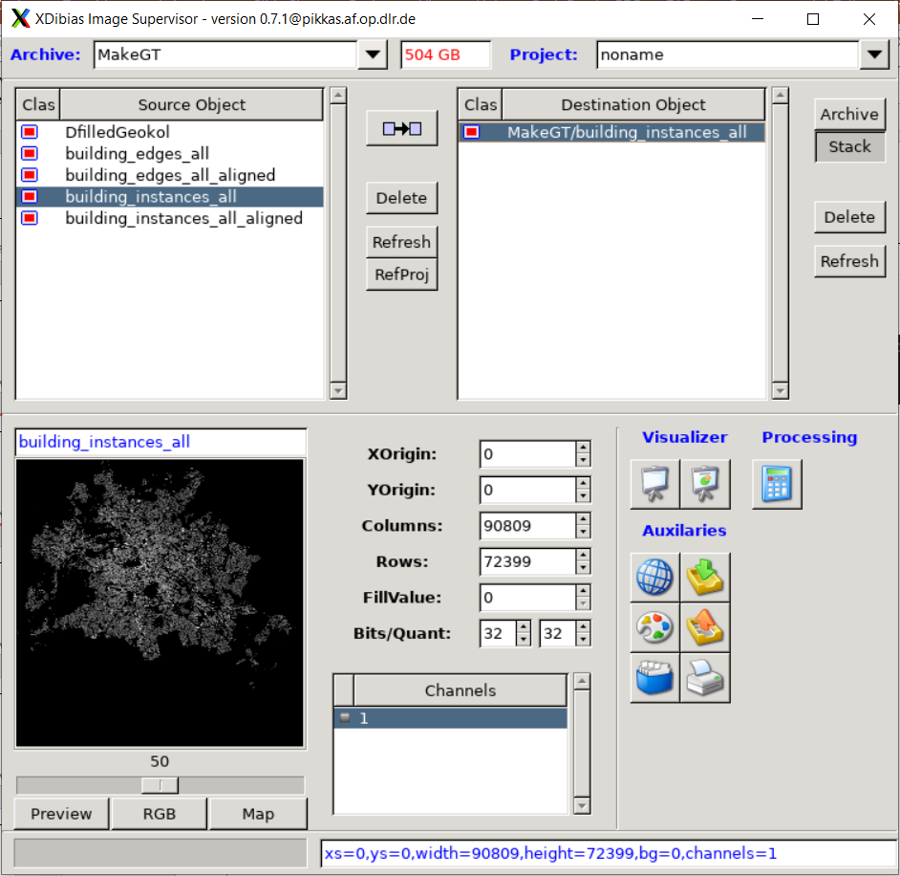
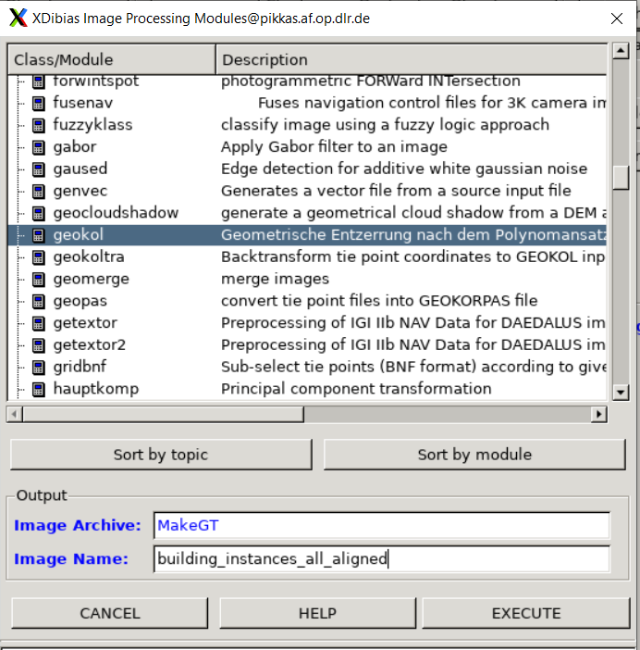
Generate ground truth (part 2)
Merge all parts and cut ROI:
Align with satellite data:
(~la)$ imgadm
Operate with geokol
cutROI.py

Slide 4
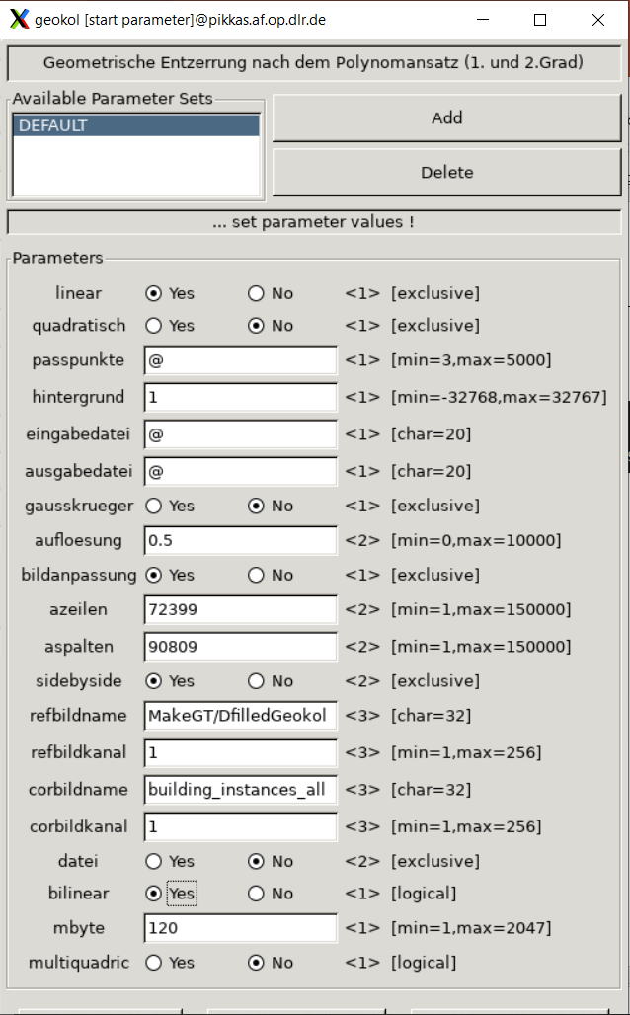
Generate ground truth (part 2)
‘_cpdb1_building_instances_all_1’
In the reference image DfilledGeokol

Slide 5
Contents here

Slide 6
Questions
Contents here

Slide 7
Next steps
Contents here

