Slide 1



Multi-task cGAN for 3D Building Vectorization
Build Network
2020.10.30
Yi Wang

Slide 2

Outline
Base model: DSM refinement
New task: Edge prediction
A First Result: FCN (G-only) VS cGAN
Questions
Next Steps
1

Slide 3
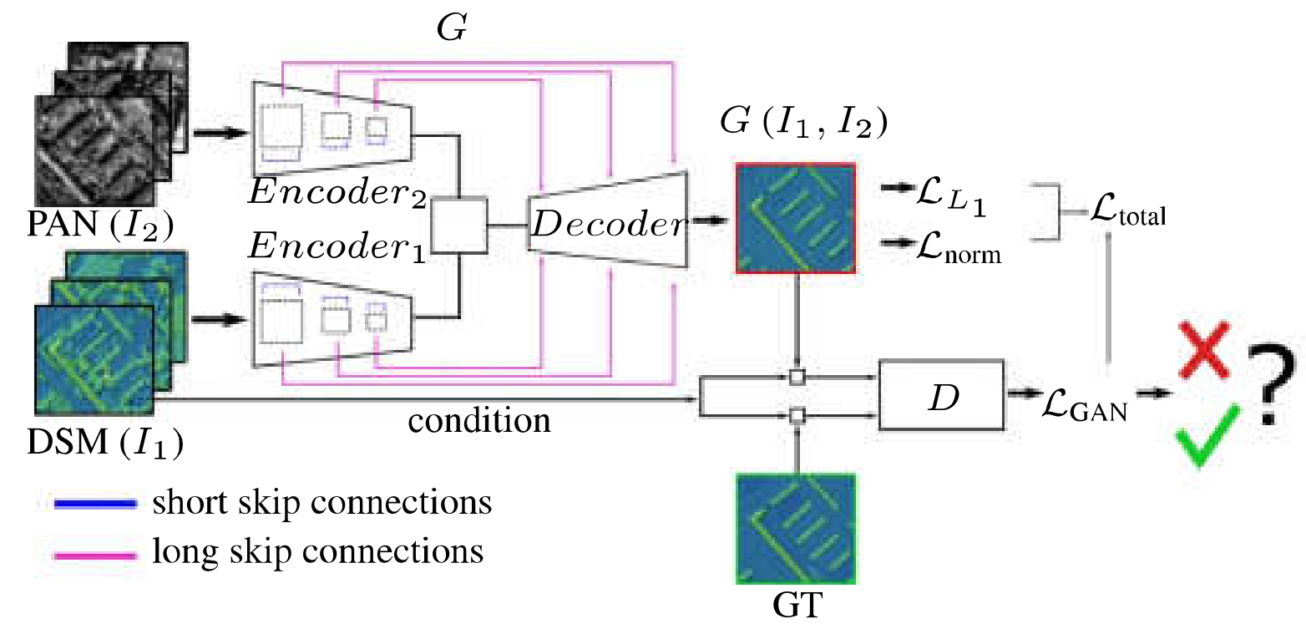
Base model: DSM refinement
1

Slide 4
Base model: DSM refinement
Generator
2 x Encoder: RestNet50
Bridge: 1x1 conv
Decoder: UNet UpBlock
[B,1,256,256]
[B,2048,8,8]
Conv
MaxPool
ReLU
3*Bottleneck
4*Bottleneck
6*Bottleneck
3*Bottleneck
INPUT
Latent
L-DSM
L-Ortho
Conv
BN
ReLU
Conv
BN
ReLU
[B,2048,8,8]
X
[B,1,256,256]
[B,2048,8,8]
UpBlock
UpBlock
UpBlock
UpBlock
UpBlock
OUTPUT
X
1

Slide 5
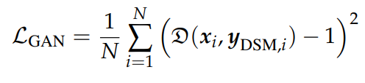

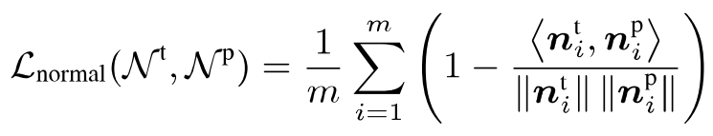
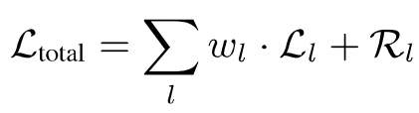
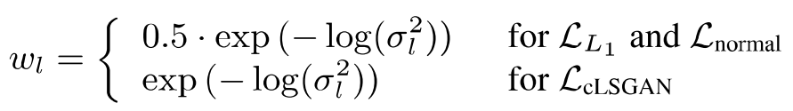
Base model: DSM refinement
Generator loss
GAN loss:
L1 loss:
Surface Normal loss:
Learned weights:
Optimizer: Adam
1

Slide 6
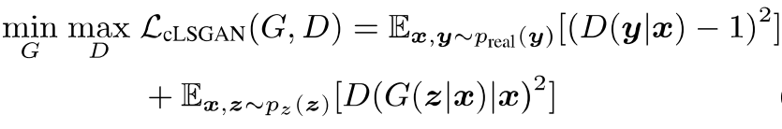
Base model: DSM refinement
Discriminator
PatchGAN CNN
Discriminator Loss
Optimizer: Adam
[B,1,256,256]
[B,1,32,32]
Conv
LeakyReLU
Conv
BN
LeakyReLU
Conv
BN
LeakyReLU
Conv
BN
LeakyReLU
Conv
BN
LeakyReLU
Conv
Sigmoid
INPUT
PATCH
1

Slide 7
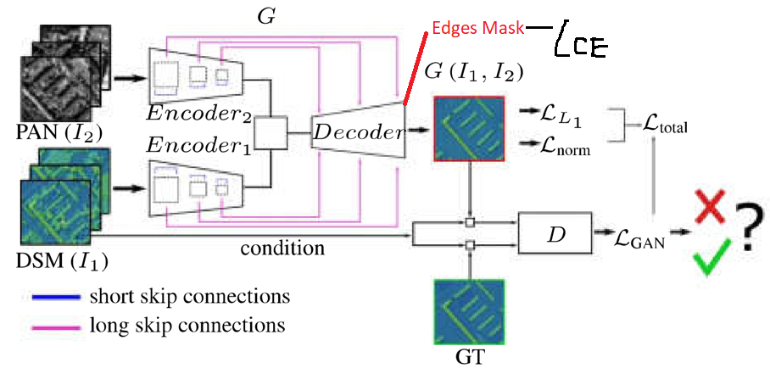
New task: Edge prediction
1

Slide 8
New task: Edge prediction
Generator
2 x Encoder: RestNet50
Bridge: 1x1 conv
Decoder: UNet UpBlock
[B,1,256,256]
[B,2048,8,8]
Conv
MaxPool
ReLU
3*Bottleneck
4*Bottleneck
6*Bottleneck
3*Bottleneck
INPUT
Latent
L-DSM
L-Ortho
Conv
BN
ReLU
Conv
BN
ReLU
[B,2048,8,8]
X
[B,1,256,256]
[B,2048,8,8]
OUTPUT1
OUTPUT2
UpBlock
UpBlock
UpBlock
UpBlock
UpBlock
X
[B,3,256,256]
1

Slide 9
New task: Edge prediction
Generator loss
GAN loss:
L1 loss:
Surface Normal loss:
Edge loss: CrossEntropy(pred,GT)
Learned weights:
Optimizer: Adam
Discriminator remains the same
1

Slide 10
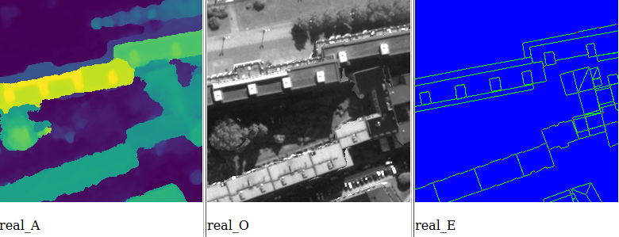
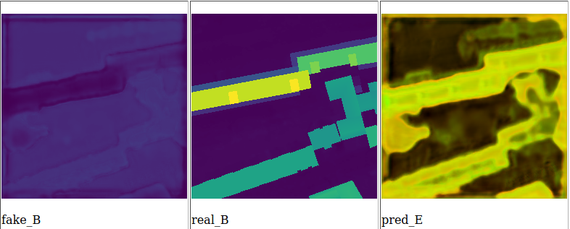
A first result (GAN)
Epoch1
1

Slide 11
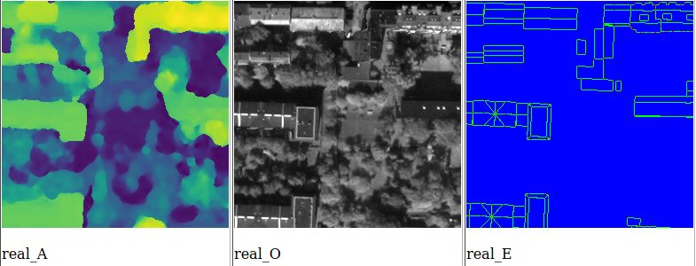
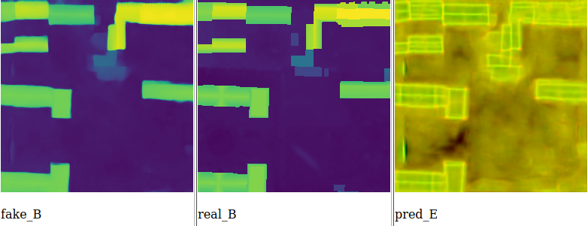
A first result (GAN)
Epoch80
1

Slide 12
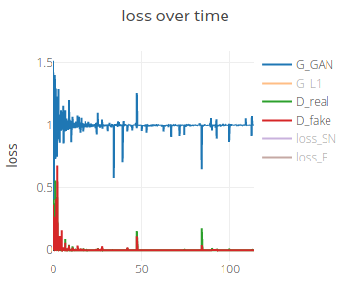
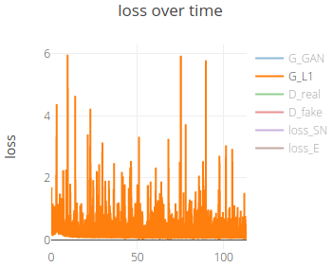
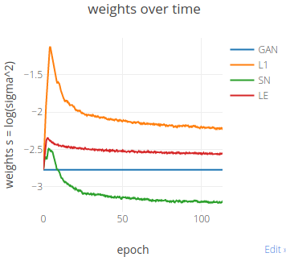
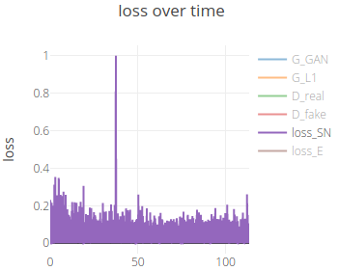
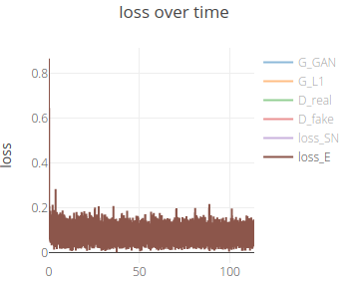
A first result (GAN)
Losses
1

Slide 13
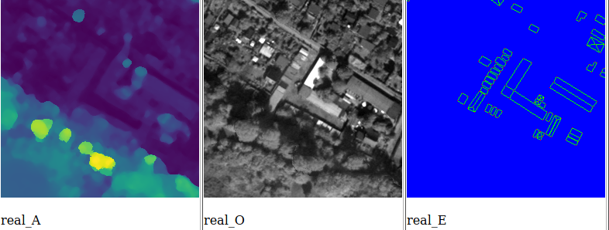
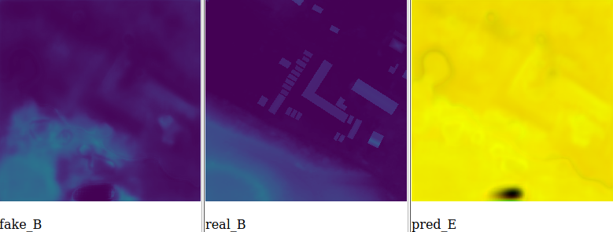
A first result (G-only)
Epoch1
1

Slide 14
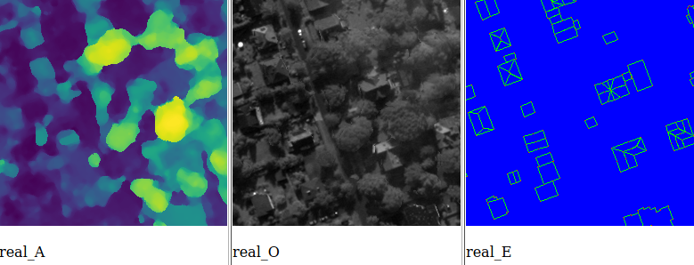
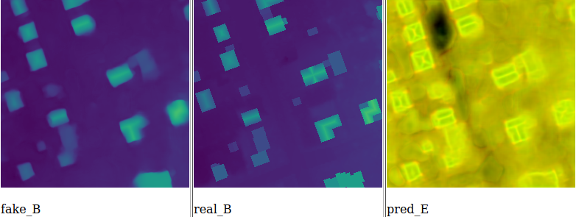
A first result (G-only)
Epoch60
1

Slide 15
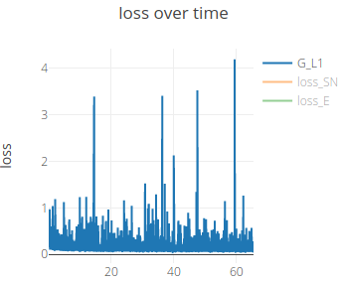
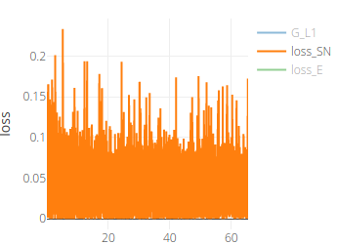
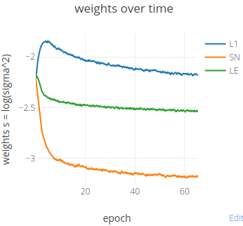
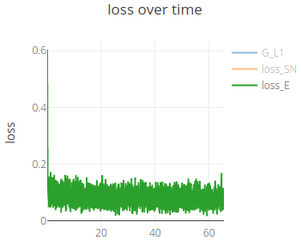
A first result (G-only)
Losses
1

Slide 16
Questions
D_loss → 0, G_loss → 1 quickly (GAN stops working??)
A system to evaluate those two trainings (loss, val_loss, RMSE, which epoch is good enough, convergence speed/scale, etc.)
<number>

Slide 17
Next steps
1 decoder --> 2 decoders
Evaluate training
<number>

