Slide 1



Thesis Introduction
Multi-task cGAN for 3D Building Vectorization
2020.10.15
Yi Wang
Supervisor: Dr. Ksenia Bittner
Prof. Norbert Haala

Slide 2

Outline
General idea
Methodology
Work plan
References

Slide 3
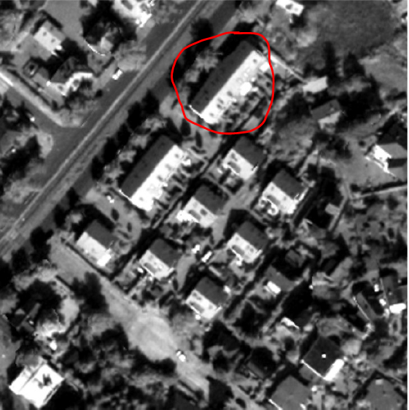
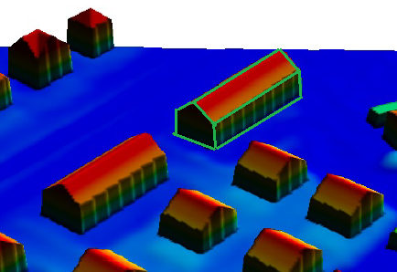
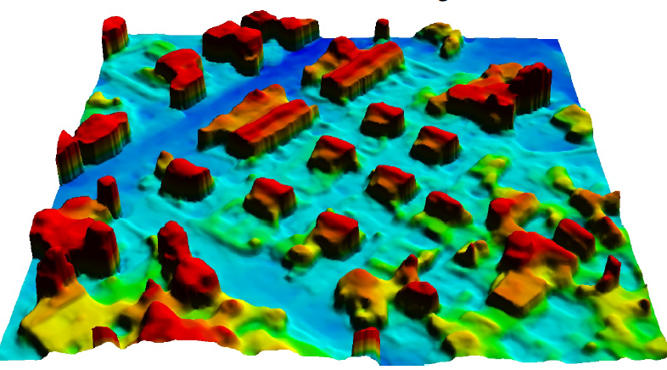
General idea
Core idea: Machine-learnt 3D vectorization of buildings from satellite imagery
Methodology: multi-task conditional generative adversarial network (cGAN)
Objective: refined DSM + (building instance segmentation) + 3D vectorization
Source data: stereo DSM + Panchromatic image (WV-1) → RGB image (WV-4)
[1]

Slide 4
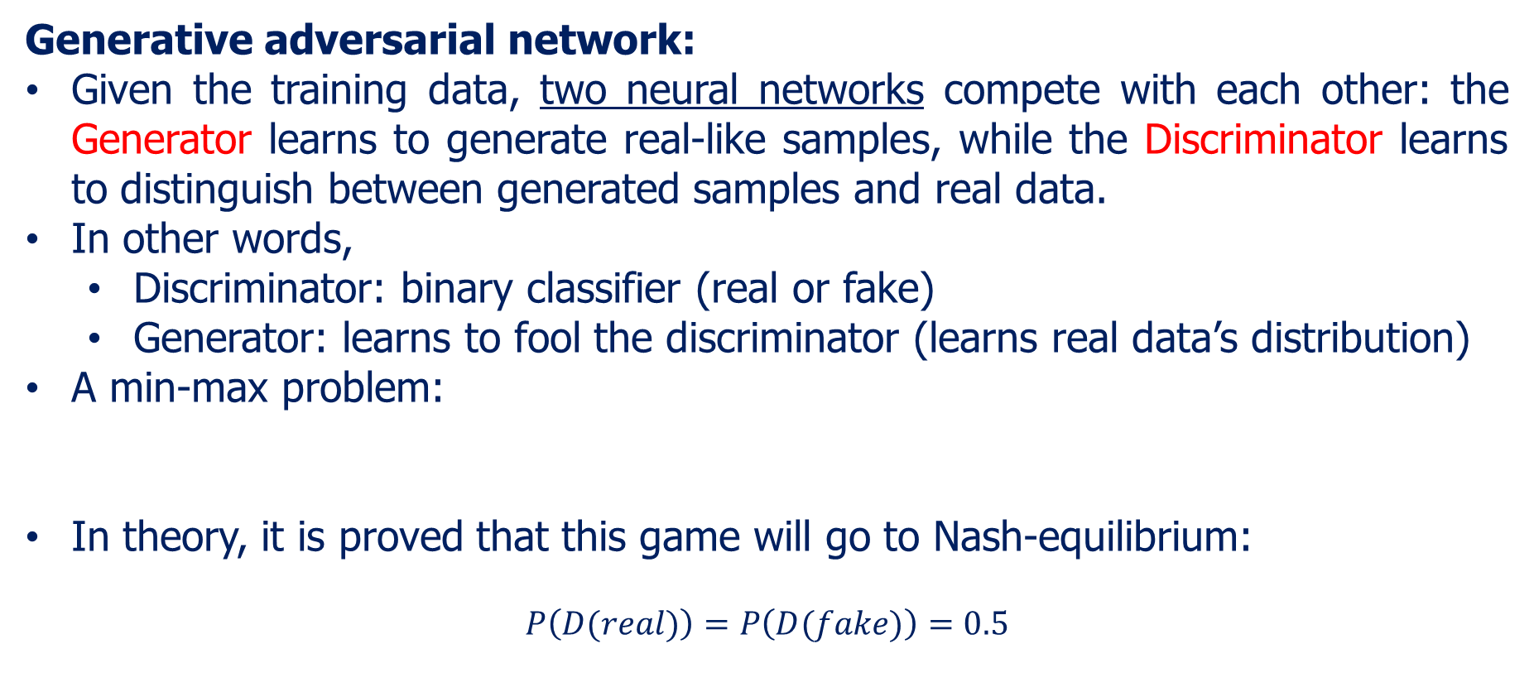
Methodology
Generative adversarial network:
Given the training data, two neural networks compete with each other: the Generator learns to generate real-like samples, while the Discriminator learns to distinguish between generated samples and real data.
In other words,
Discriminator: binary classifier (real or fake)
Generator: learns to fool the discriminator (learns real data’s distribution)
A min-max problem:
In theory, it is proved that this game will go to Nash-equilibrium:
$$P\left(D(real)\right)=P\left(D(fake)\right)=0.5$$
[2]

Slide 5
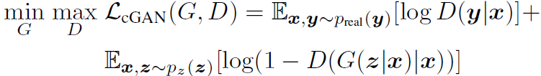
Methodology
Conditional GAN: (Generally) apart from random noise, input also other constraints (label, text, image, etc.) to control the generated outputs.
Pix2pix: train source & destination image pairs to perform image to image style translation.
During training, we build generator (usually ResNet/UNet structure) and discriminator (usually simple CNN) as two independent networks, train and optimize them alternately.
[3]

Slide 6
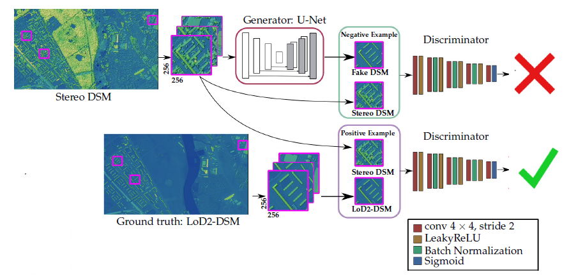
Methodology
cGAN -> DSM refinement:
[4]

Slide 7
Methodology
Building instance segmentation (optional):
Give each building a unique ID to extract building instance masks
Building vectorization:
previous research --- 2D polygonization; my task --- 3D vectorization
Step1: Extract corners and edges from satellite image (DSM+orthophoto)
Step2: Connect the corners and edges as polygons and combine these polygons for vectorized building (not very clear yet)
Multi-task learning:
multiple learning tasks are solved at the same time, while exploiting commonalities and differences across tasks.
In our case, the building instance masks (optional), the core points extraction and the DSM refinement should have big commonalities, thus we expect the combination of all tasks can improve each other.

Slide 8
Methodology
Whole Process:
For the GAN network,
Input: Panchromatic/RGB image + stereo DSM
Output: refined DSM + building instance mask (optional) + extracted core points
Afterwards,
Connect the core points with the help of all outputs to get vectorized 3D buildings
To be mentioned, the ground truth consists of:
Ground truth DSM
Ground truth core points
Ground truth instance mask (optional)
All these three are to be generated from cityGML data

Slide 9
Work plan
1st month:
Literature review
Make ground truth data (in progress)
Build initial (basic) network framework
2nd – 3rd month:
Adjust and run the network, trying to get a first accessible result for GAN
Think about vectorization, trying to get a first result for vectorization
4th – 5th month:
Test different network structures (decoder, attention, …)
Test different optimization methods (losses, SN, … )
Change input optic images (WV-1 pan only → WV-4 RGB+pan)
Other improvements or new ideas
6th month:
Write thesis and prepare final presentation

Slide 10
References
[1] Bittner, Ksenia, Peter Reinartz, and Marco Korner. "Late or Earlier Information Fusion from Depth and Spectral Data? Large-Scale Digital Surface Model Refinement by Hybrid-cGAN.“ Proceedings of the IEEE Conference on Computer Vision and Pattern Recognition Workshops. 2019.
[2] Goodfellow, Ian, et al. "Generative adversarial nets." Advances in neural information processing systems. 2014.
[3] Isola, Phillip, et al. "Image-to-image translation with conditional adversarial networks." Proceedings of the IEEE conference on computer vision and pattern recognition. 2017.
[4] Bittner, Ksenia, et al. "Dsm-to-lod2: Spaceborne stereo digital surface model refinement." Remote Sensing 10.12 (2018): 1926.

