Slide 1



DSM & GAN
Multi-task cGAN for 3D Building Vectorization
2020.12.10
Yi Wang

Slide 2

Outline
DSM refinement: fine tune a GAN
Network interpolation
Next steps

Slide 3
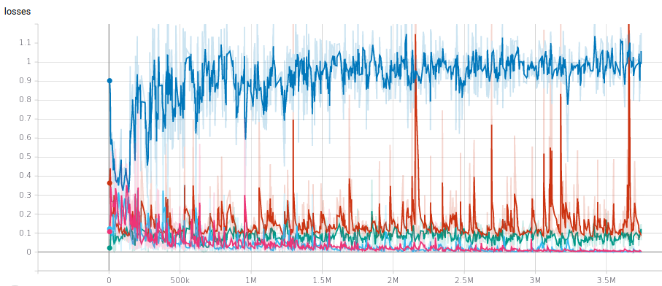
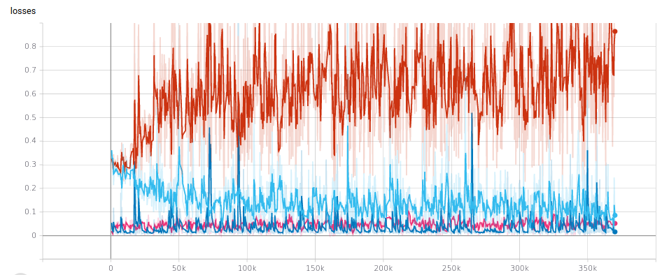
DSM refinement
CNN: UResNet, smoothed L1 loss + surface normal loss, 200 epochs
GAN: Generator (UResNet), Discriminator (PatchGAN), LSGAN loss
Without pre-trained CNN
With pre-trained CNN

Slide 4
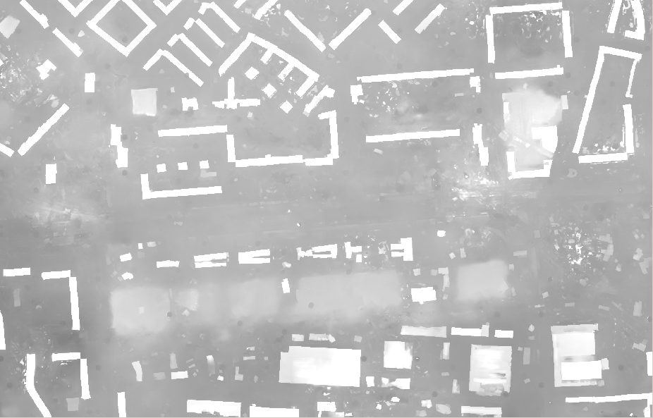
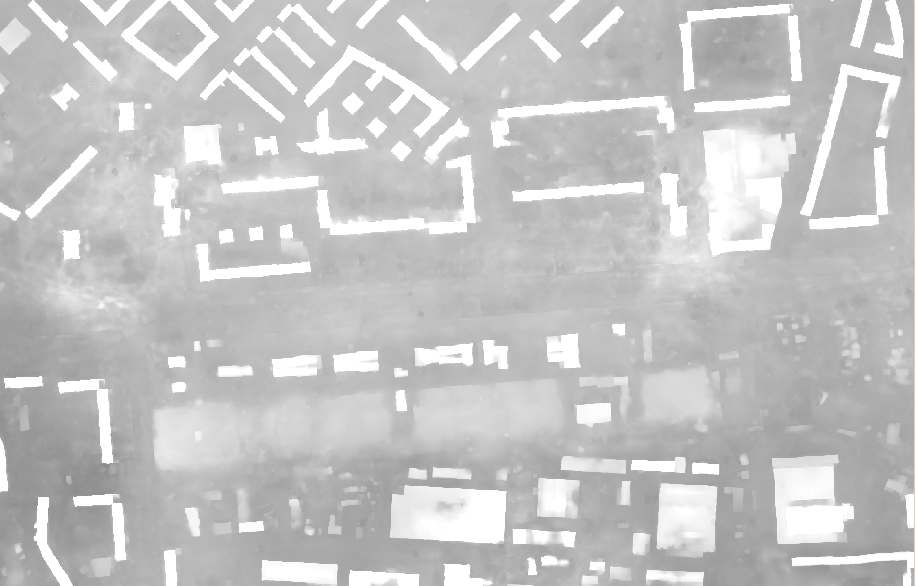
DSM refinement
Without pretrained CNN
With pretrained CNN

Slide 5
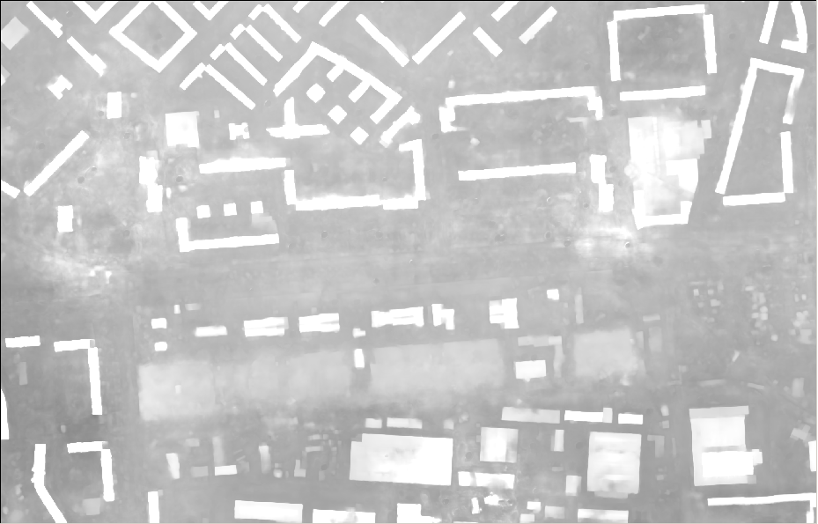
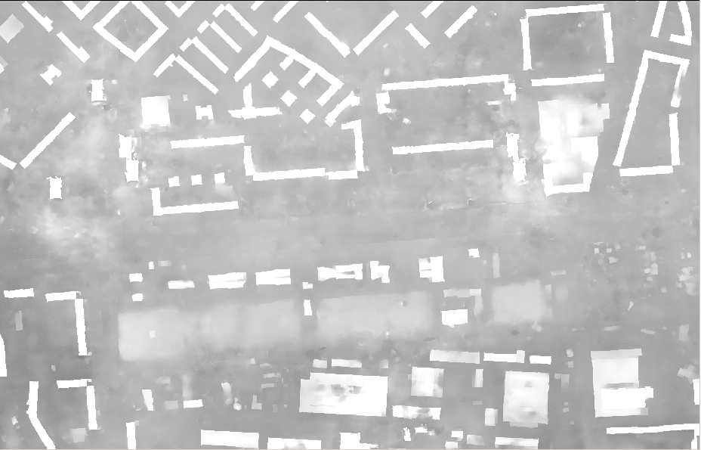


Network interpolation
GAN problem: unpleasant noise
CNN problem: lead to blur
Network interpolation:
$$θ_{G}^{interp}=(1−α)∙θ_{G}^{CNN}+α∙θ_{G}^{GAN}$$
CNN
Interp ($α$=0.5)

Slide 6
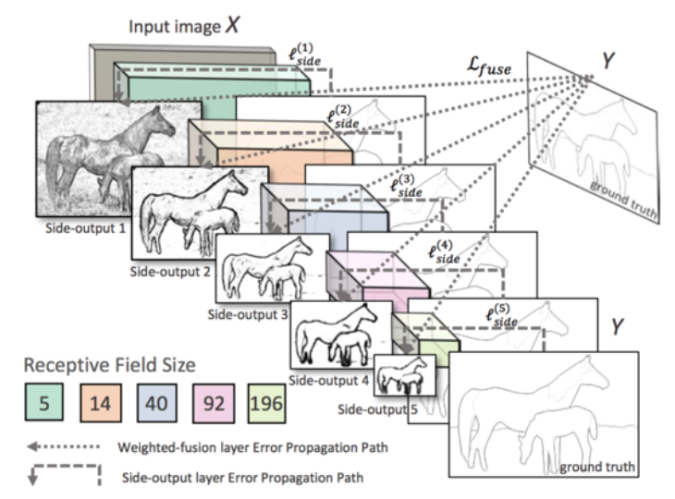
Next steps
Edge/corner optimization:
Encoder-decoder → semantic segmentation
Encoder only → HED (holistically-nested edge detection)
Xie, Saining, and Zhuowen Tu. "Holistically-nested edge detection." Proceedings of the IEEE international conference on computer vision. 2015.

