Slide 1



Mid-term Report
Multi-task cGAN for 3D Building Vectorization
2020.12.17
Yi Wang

Slide 2

Outline
General idea
Current result: Version 1
Next step: Version 2
Questions
Next Steps

Slide 3
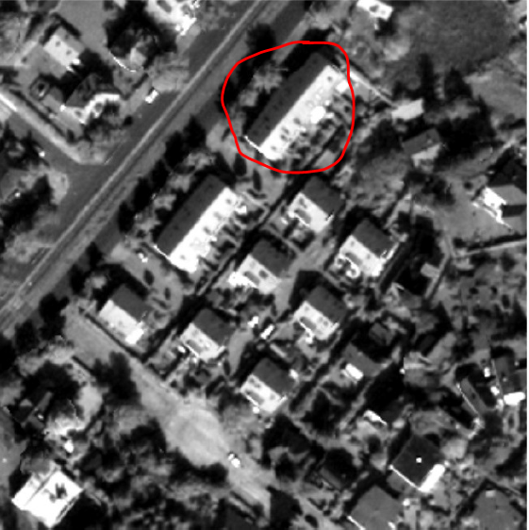
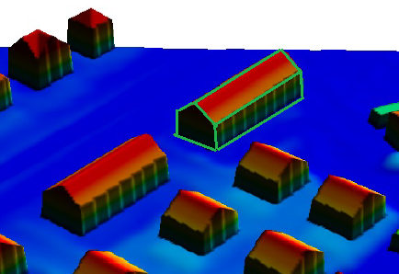
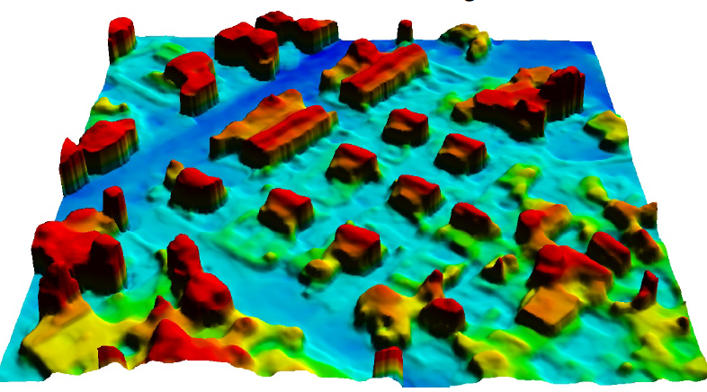
General idea
Core idea: Machine-learnt 3D vectorization of buildings from satellite imagery
Methodology: adversarial training + multi-task learning + 3D parameterizing
Objective: refined DSM + edge/corner → vectorized 3D building
Source data: stereo DSM + Panchromatic image (WV-1) / RGB image (WV-4)
[1]

Slide 4
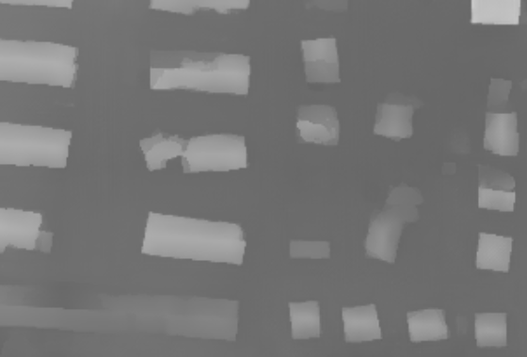
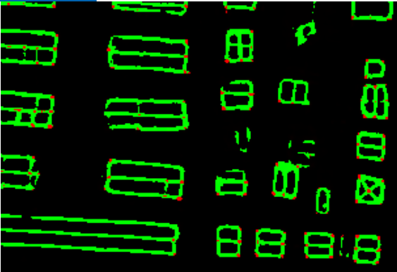
Version 1
3-stage: DSM refinement → Edge/Corner detection → Vectorization
DSM: cLSGAN + L1 + SN; network interpolation
Edge/Corner: Cross Entropy
D
dsm
Refined DSM
Fake or Real?
ortho
Refined DSM
ortho
Edge/corner

Slide 5




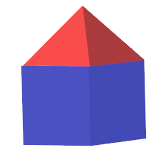

Version 1
3-stage: DSM refinement → Edge/Corner detection → Vectorization
Vectorization
Corner: Non-maximum suppression
Edge: connectivity (buffer threshold)
Face: min-closed polygon
3D building model
?

Slide 6
Version 2
2-stage: DSM refinement + Edge/Corner → vectorization
Possible constraints: HED (multi-scale output), attention module
D
dsm
Refined DSM
Fake or Real?
ortho
Edge/corner
Some constraints

Slide 7
Next steps
1. Implement version 2 with HED
2. Implement version 2 with attention module
3. Get height above ground: get nDSM (or predict it in the DSM refinement)
4. 3D roof → 3D building

Slide 8
Questions
Contents here

