Slide 1



A first complete version
Multi-task cGAN for 3D Building Vectorization
2021.01.07
Yi Wang

Slide 2

Outline
Network structure
Vectorization (2D-->3D)
Result
Evaluation (ideas)
Next steps

Slide 3
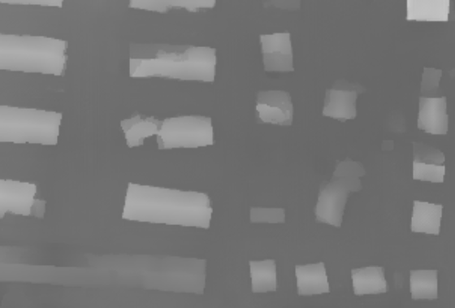
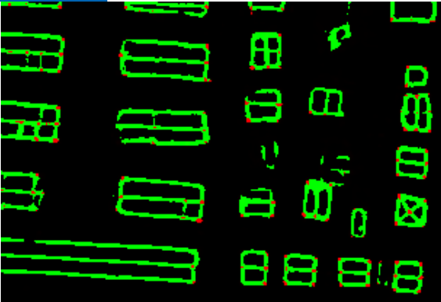
Network structure
3-stage: DSM refinement → Edge/Corner detection → Vectorization
DSM: LSGAN + L1 + SN; fine tuning + network interpolation
Edge/Corner: Cross Entropy
D
dsm
Refined DSM
Fake or Real?
ortho
Refined DSM
ortho
Edge/corner

Slide 4




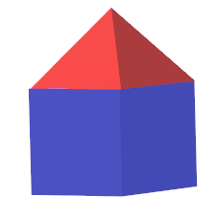
Vectorization
3-stage: DSM refinement → Edge/Corner detection → Vectorization
Vectorization (2D)
Corner: Non-maximum suppression
Edge: connectivity (buffer threshold)
Face: min-closed polygon
Vectorization (3D)
nDSM

Slide 5
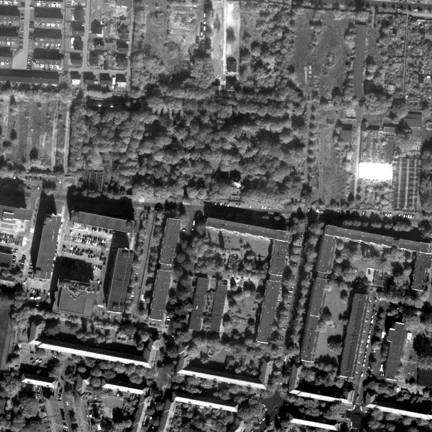
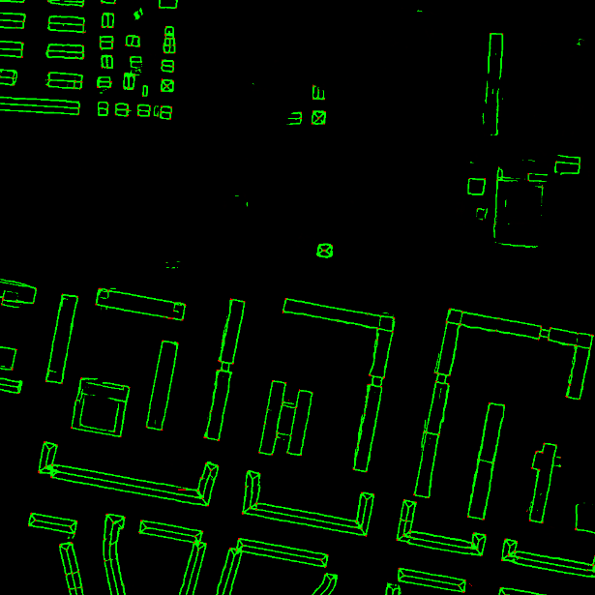
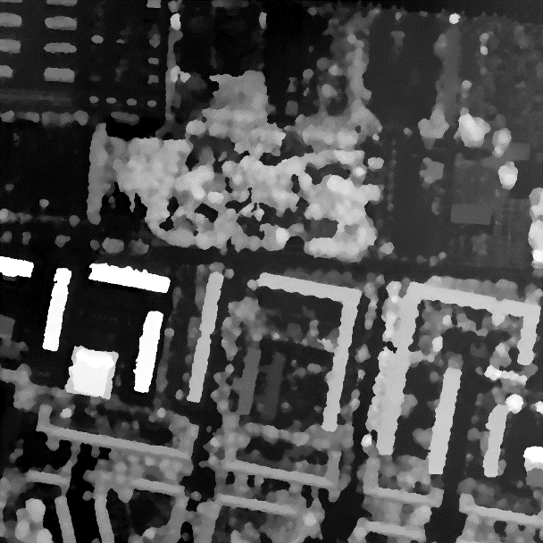
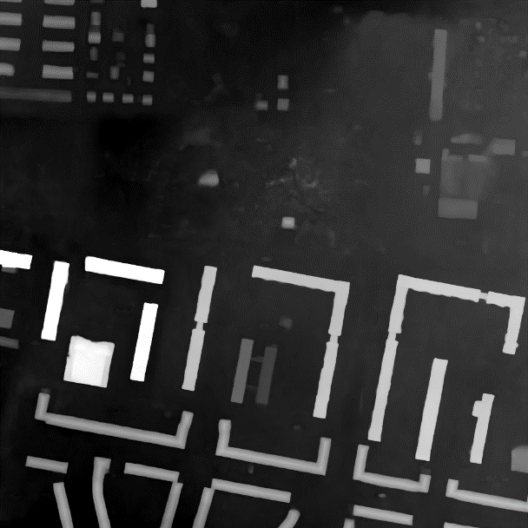
Result
5

Slide 6
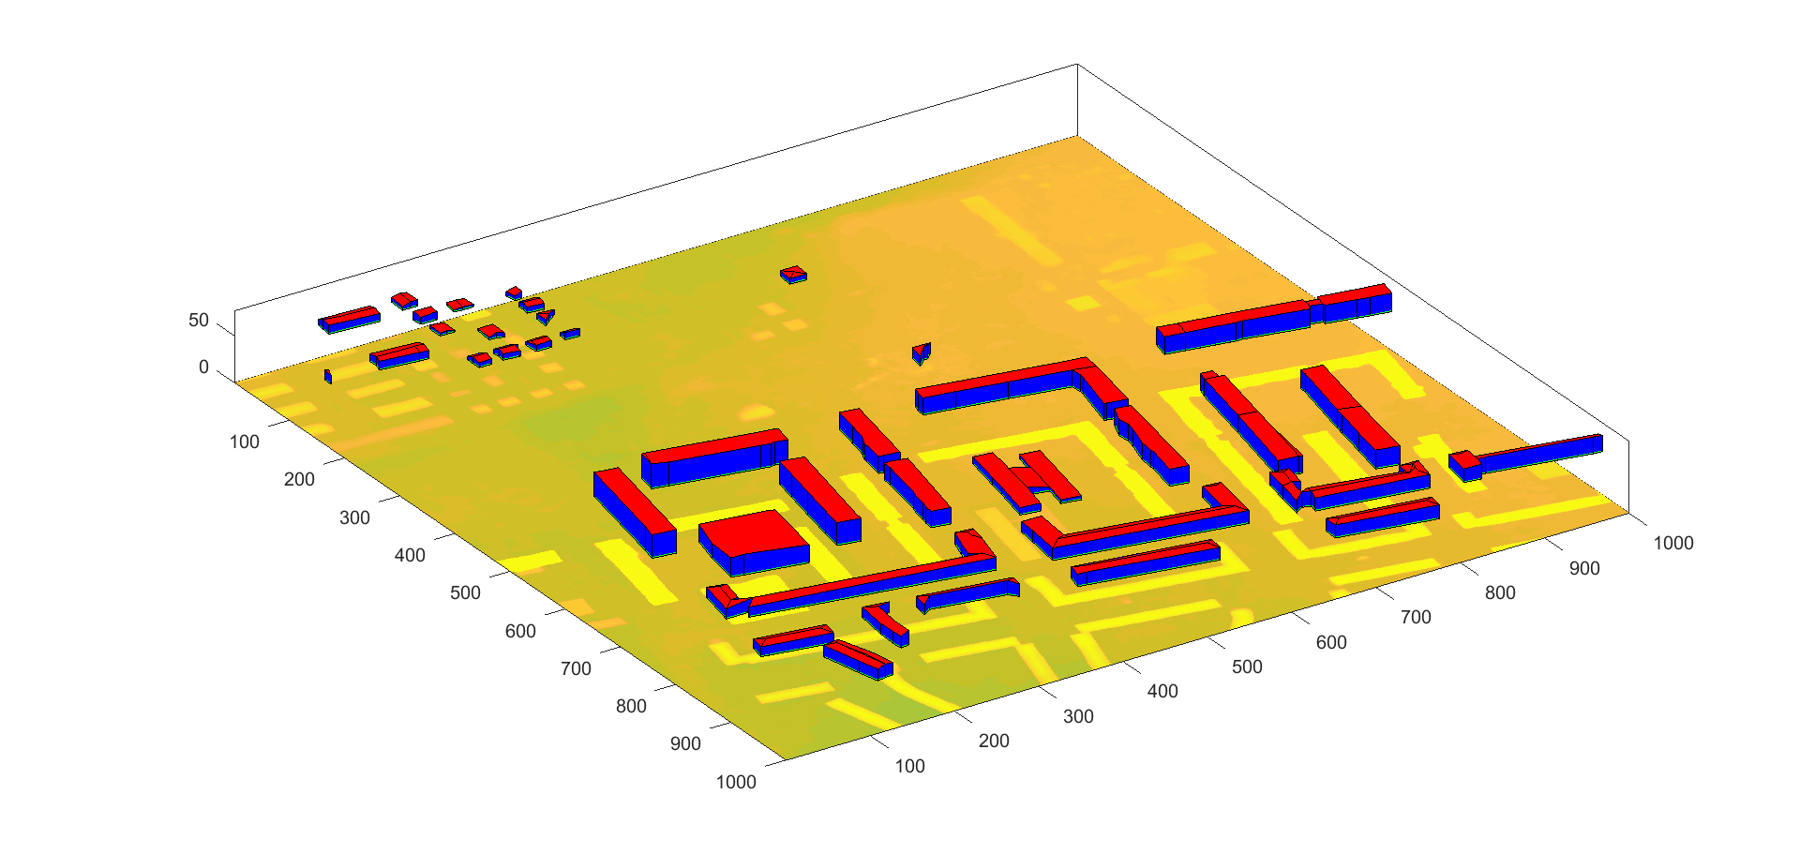
Result
3D building model

Slide 7
Evaluation
DSM (all testing area)
Edge/Corner ?
All testing area + directly compared to GT
Randomly selected buildings + vectorized roof lines? (about 70%-80%)
 | RMSE (m) | MAE (m) | NMAD (m)
Coupled-cGAN | 4.07 | 1.85 | 0.99
UResNet | 4.08 | 1.87 | 0.99
Interp-cGAN | 4.02 | 1.73 | 0.93
 | Precision | Recall | F1 Score
Edge |  | 40%
Corner |  | 10%

Slide 8
Evaluation
3D building model ?
Accuracy of roof mask (building mask) ?
How many buildings (big & small) are successfully detected?
In those detected buildings, how many are well shaped?
In those not well-shaped buildings, how well are they shaped?

Slide 9
Next steps
Improving edges?
Metrics
Some other algorithm to compared to?
Thesis writing

Slide 10

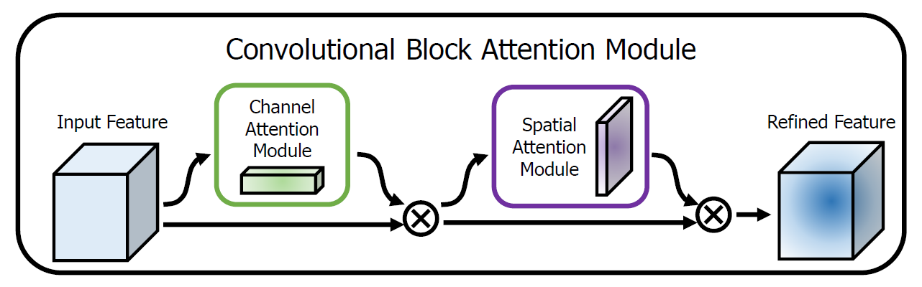
Ideal objective
Network structure:
Loss function:
LSGAN + L1 + Surface Normal
Cross Entropy
D
dsm
Refined DSM
Fake or Real?
ortho
Edge/corner
resnet50
[1]
[1] Woo, Sanghyun, et al. "Cbam: Convolutional block attention module." Proceedings of the European conference on computer vision (ECCV). 2018.

