Slide 1

Satellite Geodesy Observation Techniques Introduction
Mohammad Tourian
tourian@gis.uni-stuttgart.de
Institute of Geodesy
Universität Stuttgart
10.2019

Slide 2
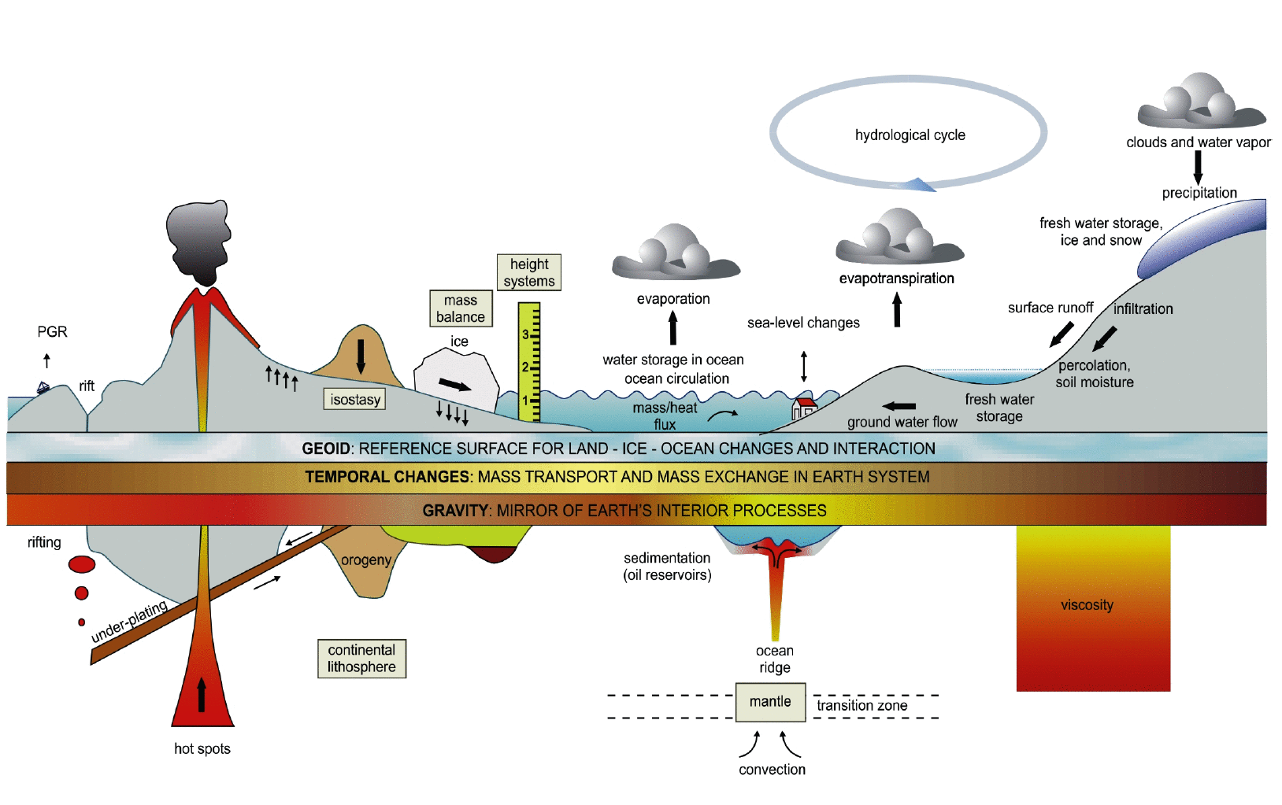
Earth system

Slide 3
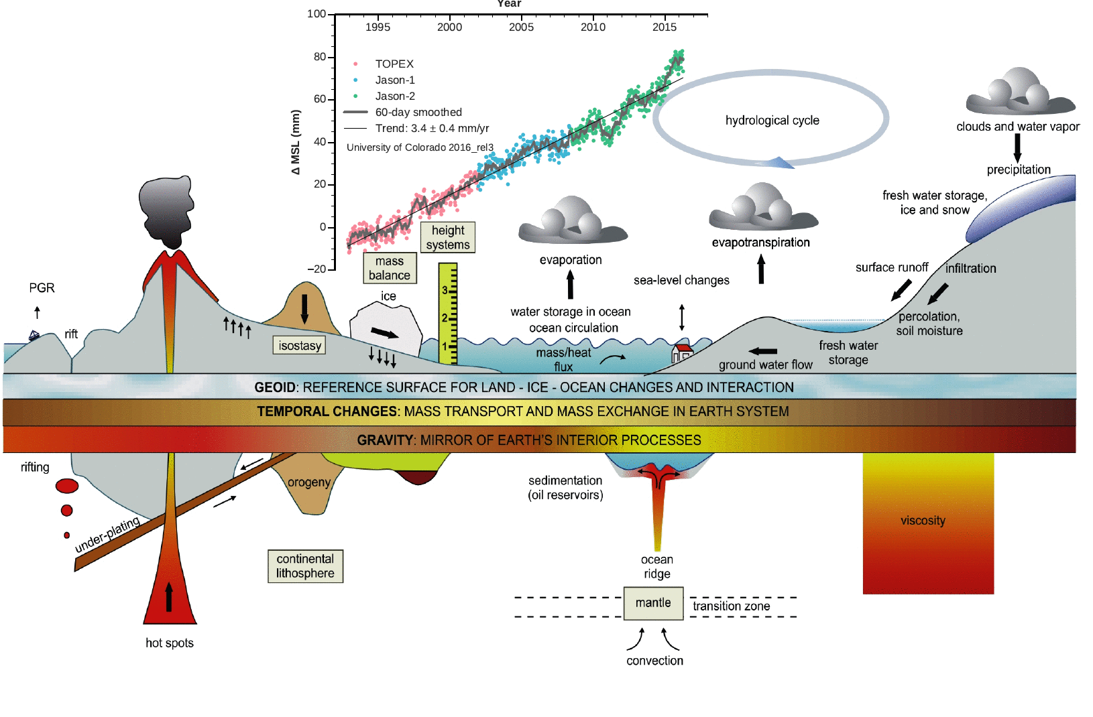
Earth system

Slide 4
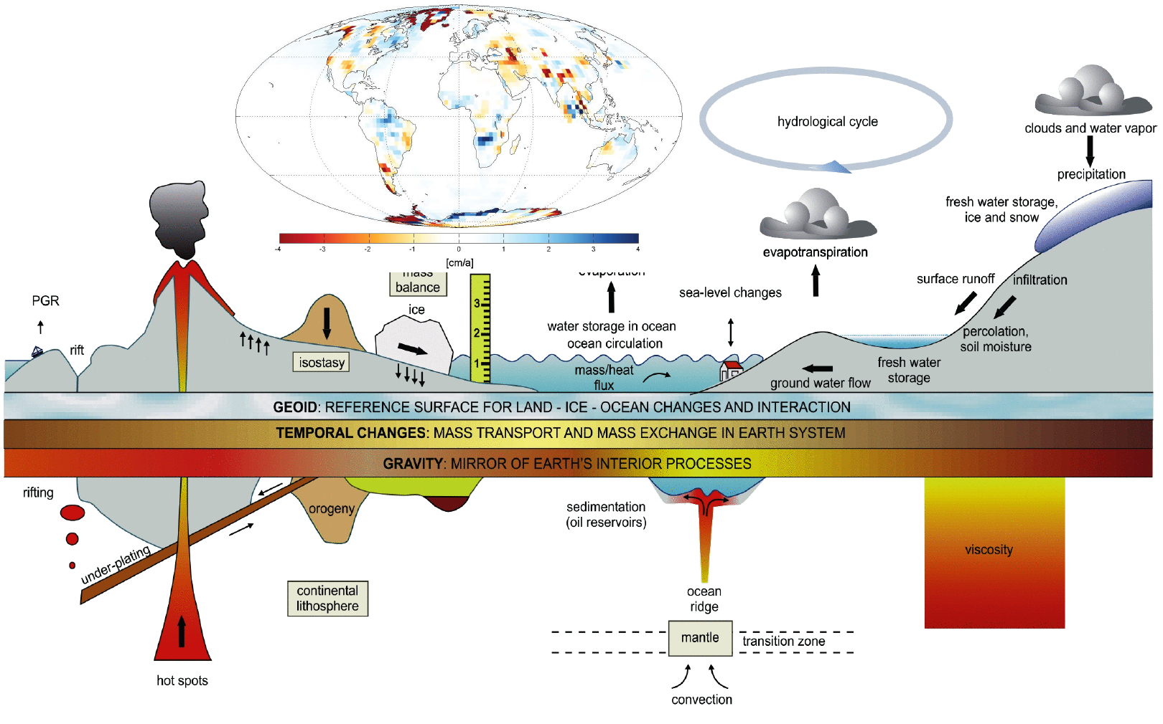
Earth system

Slide 5
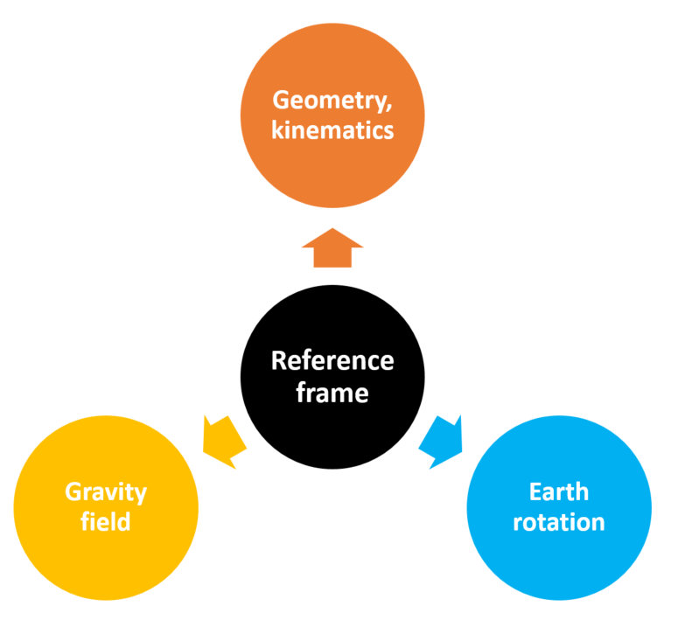
Three pillars of geodesy

Slide 6
History
An orbiting artificial satellite, that is visible by optical techniques from long distances was always desired
Artificial satellite could serve as
1) high target reference point,
2) proof mass in gravitational field,
3) gyroscope for inertial orientation and/or
4) a platform for observation.
Such approach was obviously limited as the magnitude of a moving target is a function of many limiting factors e.g. energy consumption, atmospheric friction, etc

Slide 7
History
Finally all the notions and ideas were realized by launching the Sputnik 1 on October 4, 1957
Sputnik 1 helped to identify the upper atmospheric layers’s density through measuring the satellite’s orbital changes
In the year after, the launch of Explorer 1 and Sputnik 2 helped to determine the Earth flattening more accurately
The demand of having a positioning system led to the launch of Transit satellite in 1960, which was designed to provide accurate location information by being located in a orbit with an altitude of 1100km.

Slide 8
History
The demand of determining the leading spherical harmonic coefficients of the geopotential field led to the launch of the first dedicated geodetic satellite ANNA-1B in October 1962
ANNA-1B was one of the first active satellites as it was emitting very bright flashes of light for being captured by ground stations.
Shortly after, the first two GEOS satellites (launched in 1965 and 1968) were developed under the Explorer program. They consisted of a number of optical and wireless systems for accurate tracking, and laser reflectors.

Slide 9
History
By increasing the number of launched satellites, the community came to realize the need for a world geodetic system. World Geodetic System (WGS) 60, 66, 72 and 84 are samples of geodetic systems, which were established through a worldwide triangulation on the observations of satellites
The Global Positioning System (GPS) project was developed in 1973 to overcome the limitations of previous navigation systems and positioning the low orbit satellites. It became fully operational in 1994

Slide 10
History
After launching GPS satellites and serving them as space-based reference points, satellite geodesy entered into the geo-dynamics and earthquake studies
Using the precise positioning of GPS, other artificial satellites could be considered as accurate sensors. Especially non-active geodetic satellites could sense the gravity field and help to determine its parameters.
Active geodetic satellites could be designed as sensors to monitor the changes over the globe by sensing the varying parameters e.g. sea or inland water level.

Slide 11
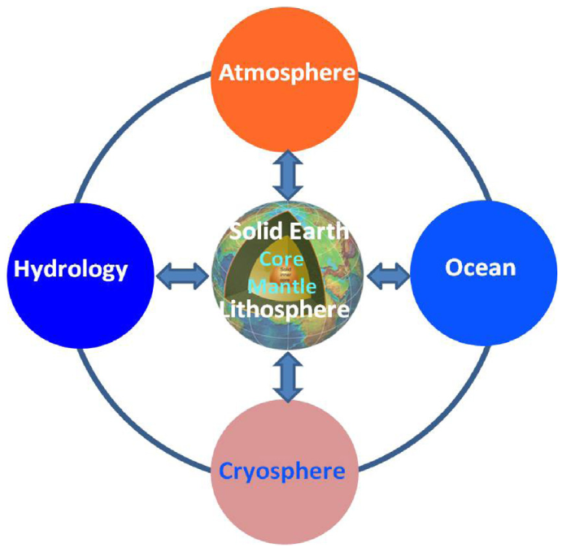
Earth system components and interaction
Jin et al, 2013

Slide 12
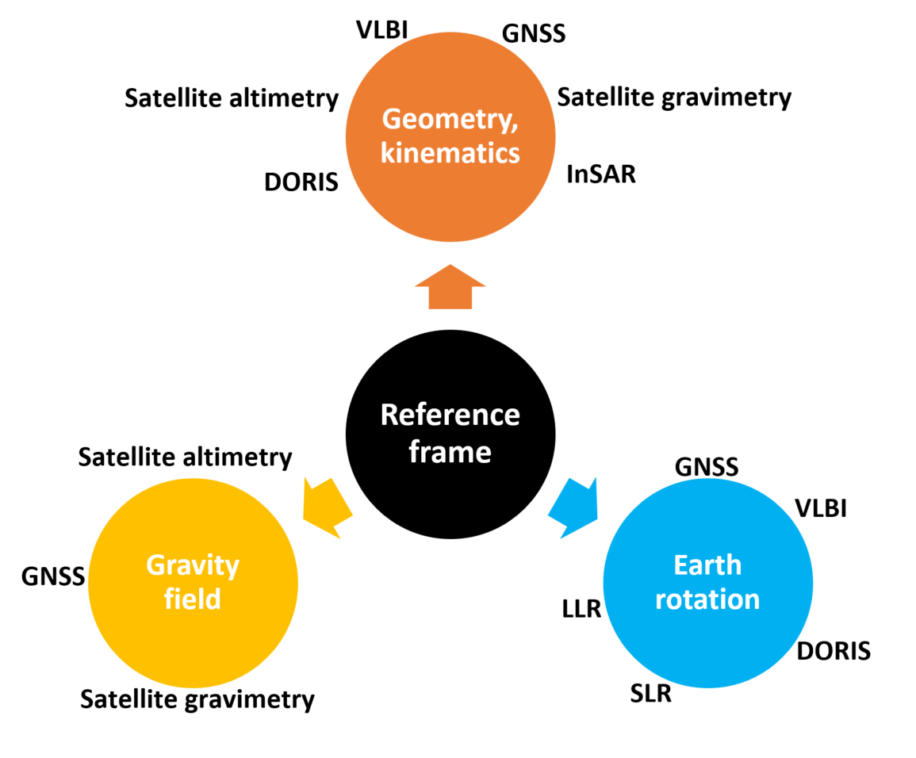
Spaceborne geodetic sensors

Slide 13
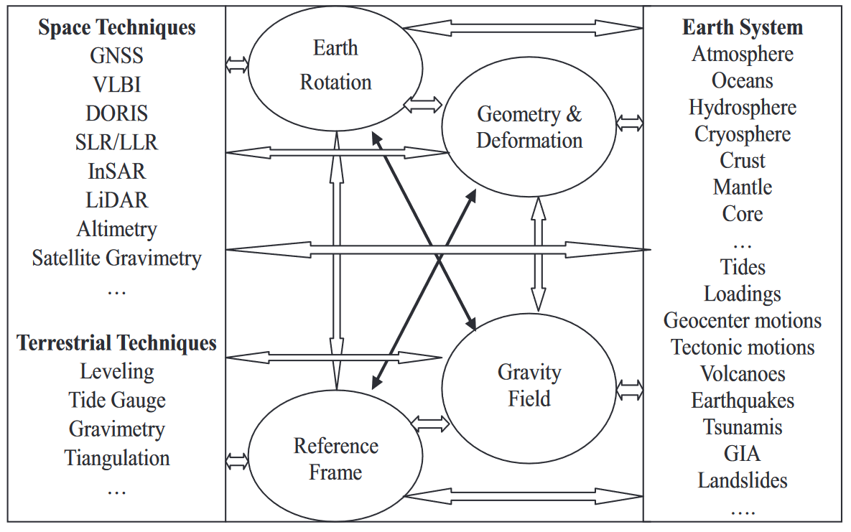
Space geodesy and earth system interaction
Jin et al, 2013

Slide 14
Observation techniques
Earth to Space methods
directions from camera observations,
satellite laser ranging (SLR),
Doppler positioning (TRANSIT, DORIS), and
geodetic use of the Global Positioning System (GPS,GLONASS, future GNSS).
Space to Earth methods
radar altimetry,
spaceborne laser, and
satellite gradiometry.
Space to Space methods
satellite-to-satellite tracking (SST).

Slide 15
Applications of Satellite Geodesy
Global Geodesy
general shape of Earth’s figure and gravity field,
dimensions of a mean Earth ellipsoid,
establishment of a global terrestrial reference frame,
detailed geoid as a reference surface on land and at sea,
connection between different existing geodetic datums, and
connection of national datums with a global geodetic datum.
Geodetic Control
establishment of geodetic control for national networks,
installation of three-dimensional homogeneous networks,
analysis and improvement of existing terrestrial networks,
establishment of geodetic connections between islands or with the mainland,
densification of existing networks up to short interstation distances.
Geodynamics
control points for crustal motion,
permanent arrays for 3D-control in active areas,
polar motion, Earth rotation, and
solid Earth tides.

Slide 16
Applications of Satellite Geodesy
Applied and Plane Geodesy
detailed plane surveying (land register, urban and rural surveying, geographic
information systems (GIS), town planning, boundary demarcation etc.),
installation of special networks and control for engineering tasks,
terrestrial control points in photogrammetry and remote sensing,
position and orientation of airborne sensors like photogrammetric cameras,
control and position information at different accuracy levels in forestry, agriculture,
archaeology, expedition cartography etc.
Navigation and Marine Geodesy
precise navigation of land-, sea-, and air-vehicles,
precise positioning for marine mapping, exploration, hydrography, oceanography,
marine geology, and geophysics,
connection and control of tide gauges (unification of height systems).
Hydology
water storage change monitoring,
surface water monitoring
Teleconnection in global water cycle
Related Fields
position and velocity determination for geophysical observations (gravimetric,
magnetic, seismic surveys), also at sea and in the air,
− determination of ice motion in glaciology, Antarctic research, oceanography,
− determination of satellite orbits, and
− tomography of the atmosphere (ionosphere, troposphere).

Slide 17
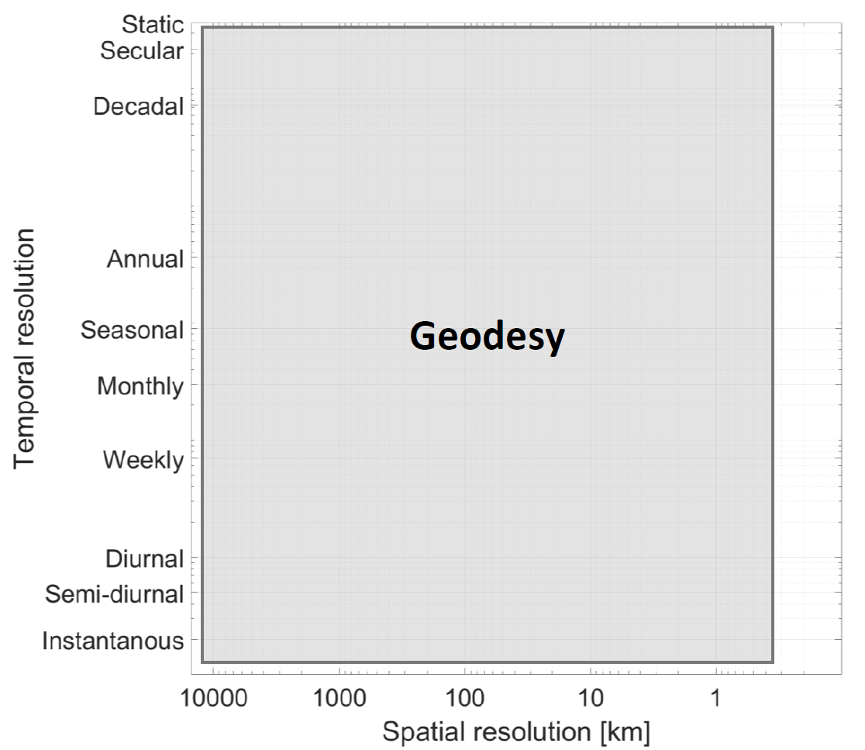
Geodesy, spaceborne sensors

Slide 18
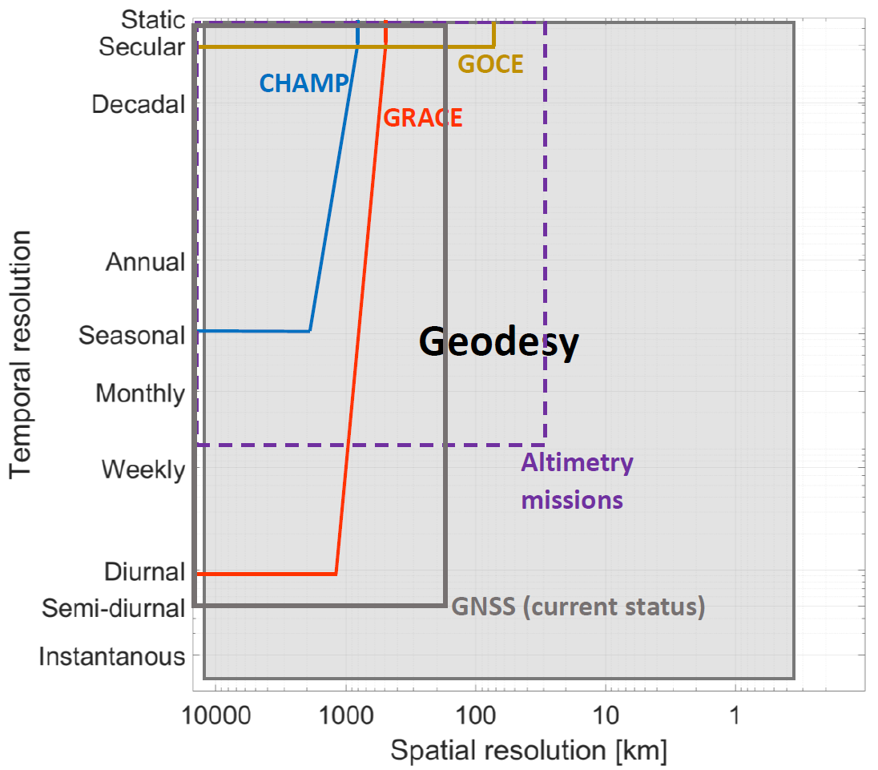
Geodesy, spaceborne sensors

Slide 19
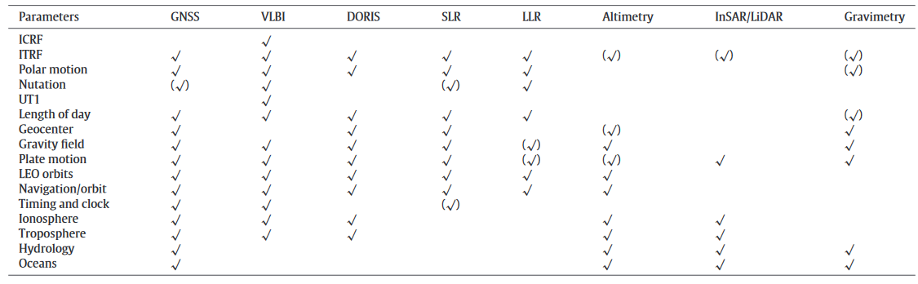
Roles and uses of space geodetic technique
Jin et al, 2013

