Slide 1
Doppler Techniques
Nico Sneeuw
Mohammad Tourian
Institute of Geodesy
University of Stuttgart
Satellite Geodesy Observation Techniques, MSc G&G
WS2019/2020, Stuttgart
Notes:
TBD: Folie mit „Schwebung“:
Grafik mit Superposition zweier Sinuswellen
Formel sin(f_1*t) + sin(f_2*t) =…

Slide 2
table of content
Doppler principle
observation equation
DORIS implementation
ground segment
space segment
products / applications

Slide 3
principle

Slide 4
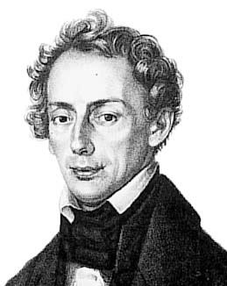
Christian Doppler (1803−1853)
Austrian mathematician / physicist
physically unfit to take over family business (stonemason)
1841: professor of physics and mathematics at Charles University, Prague
1842: Über das farbige Licht der Doppelsterne und einiger anderer Gestirne des Himmels
1850: Direktor, Institute of Physics at University Vienna (1st professor of experimental physics)
Wikipedia

Slide 5
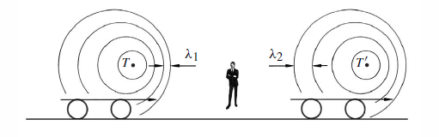
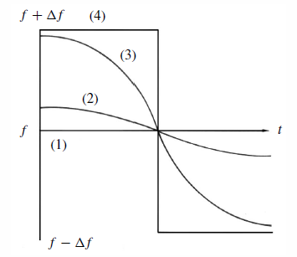
Doppler effect
source infinitely far away
source far away
observer near source
source “through” observer
time of closest approach
(TCA)
Seeber, Satellite Geodesy

Slide 6
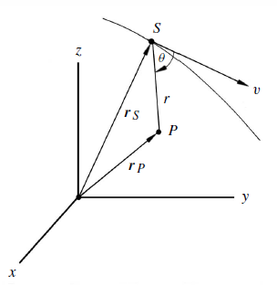
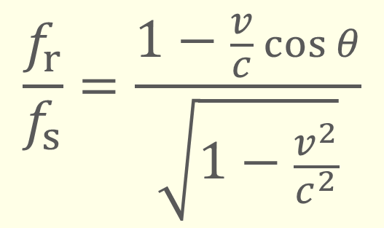
Doppler effect under arbitrary angle
angle between velocity vector and line source-receiver
received frequency (variable)
$$\frac{f_{r}}{f_{s}}=\frac{1−\frac{v}{c}\cos{θ}}{\sqrt{1−\frac{v^{2}}{c^{2}}}}$$
sender frequency (stable)

Slide 7

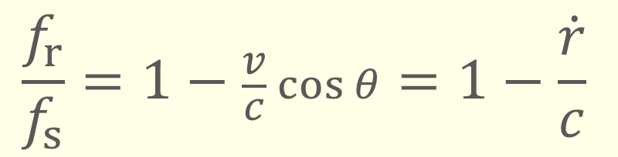
Doppler effect under arbitrary angle
radial velocity
under $v≪c$:
received frequency (variable)
$$\frac{f_{r}}{f_{s}}=1−\frac{v}{c}\cos{θ}=1−\frac{\dot{r}}{c}$$
sender frequency (stable)
A. Kleusberg (1984)
Diagnose und Therapie von geodätischen Satellitennetzen vom Typ Doppler
DGK C293

Slide 8
observation equation

Slide 9



observation equation (1/4)
Doppler frequency shift
Numerical example, e.g. @ $f_{s}=2 \text{GHz}$
$$\frac{f_{r}}{f_{s}}=1−\frac{\dot{r}}{c}$$
$$⟹ ∆f=f_{s}−f_{r}=\frac{\dot{r}}{c}f_{s}$$
$$∆f=…$$

Slide 10


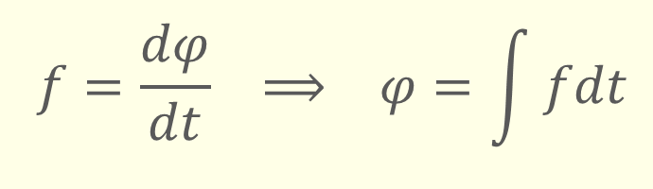
observation equation (2/4)
Subtract Doppler-shifted frequency $f_{r}$ from stable frequency $f_{g}$, generated in receiver. Choose $f_{g}$ such that
beat frequency is always positive.
Frequencies are hard to observe. Phase observations (zero-crossings or fringes) are easier
$$f_{g}−f_{r}$$
$$f=\frac{dφ}{dt} ⟹ φ=\int{fdt}$$

Slide 11



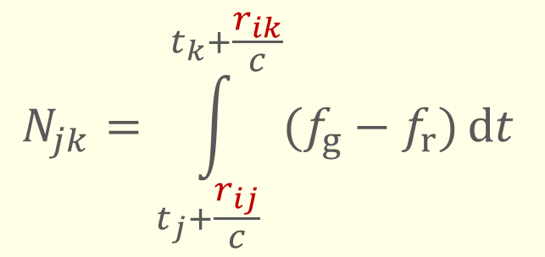
observation equation (3/4)
Integrated Doppler count
With $T_{j}=t_{j}+r_{ij}/c$ , etc.
beat frequency
$$N_{jk}=\int_{T_{j}}^{T_{k}}{(f_{g}−f_{r})}\text{d}t$$
$t_{j}$ = emitted time mark, when emitted by sender
$T_{j}$ = emitted time mark, when it reaches the receiver
emitted time marks
generated in receiver
$$N_{jk}=\int_{t_{j}+\frac{r_{ij}}{c}}^{t_{k}+\frac{r_{ik}}{c}}{(f_{g}−f_{r})}\text{d}t$$

Slide 12
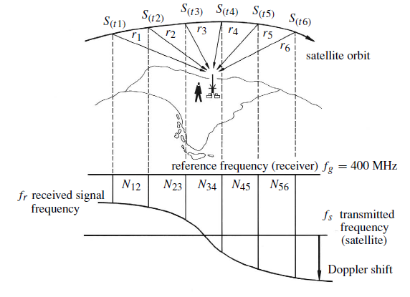
integrated Doppler count visualized
Seeber, Satellite Geodesy

Slide 13
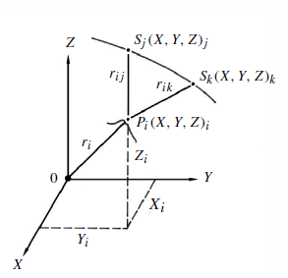
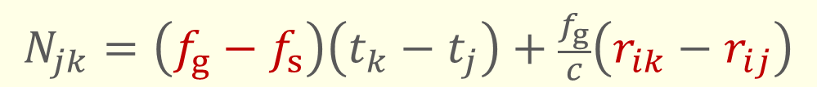


observation equation (4/4)
#cycles transmitted between $t_{j}$ and $t_{k}$ equals #cycles received between time marks $T_{j}$ and $T_{k}$.
observation equation
1 observation, 4 unknowns, orbit considered known
atmospheric and relativistic terms ignored here
$$\int_{t_{j}}^{t_{k}}{f_{s}}\text{d}t=\int_{T_{j}}^{T_{k}}{f_{r}}\text{d}t=\int_{t_{j}+\frac{r_{ij}}{c}}^{t_{k}+\frac{r_{ik}}{c}}{f_{r}}\text{d}t$$
$$N_{jk}=\left(f_{g}−f_{s}\right)\left(t_{k}−t_{j}\right)+\frac{f_{g}}{c}\left(r_{ik}−r_{ij}\right)$$

Slide 14
Error Budget and Corrections
Orbit errors: predicted ephemerides differ from true satellite positions
Atmospheric refraction: the signla propagation is not in vacuum
Signal processing in the reciever
Ionospheric refraction
Tropospheric correction: wet, dry
Aberration: Earth rotation while the signal propagation
Relativistic effects

Slide 15
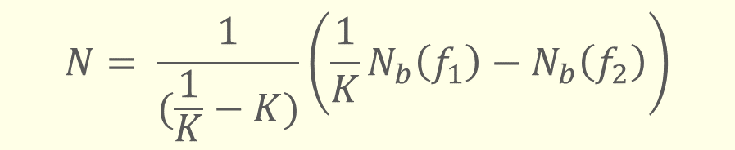
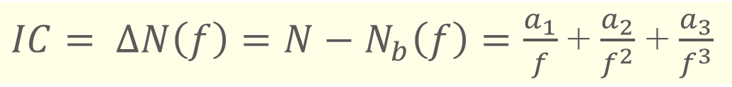
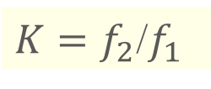
Atmospheric refraction
Ionospheric refraction
Single frequency
Double frequency
Observed Doppler count
First-order
contribution
True Doppler count
$IC= ∆N\left(f\right)=N−N_{b}\left(f\right)=\frac{a_{1}}{f}$+ $\frac{a_{2}}{f^{2}}$ + $\frac{a_{3}}{f^{3}}$
$$N= \frac{1}{(\frac{1}{K}−K)}\left(\frac{1}{K}N_{b}\left(f_{1}\right)−N_{b}\left(f_{2}\right)\right)$$
$K=f_{2}$/$f_{1}$

Slide 16
Transit implementation
see Seeber, Section 6.2

Slide 17
DORIS implementation

Slide 18
DORIS
Doppler principle upside-down, i.e.
stable frequency at ground stations (beacons)
receiver (Doppler count measurement) at satellite
developed by the French space agency CNES (Centre National d’Études Spatiales) in cooperation with IGN and GRGS
1990 first realization of the system onboard the remote sensing satellite mission SPOT-2
original purpose: precise orbit determination
The average precision of the range rate observations is about 0.3−0.5 mm/s
positioning not instantaneous (post-processing required)

Slide 19
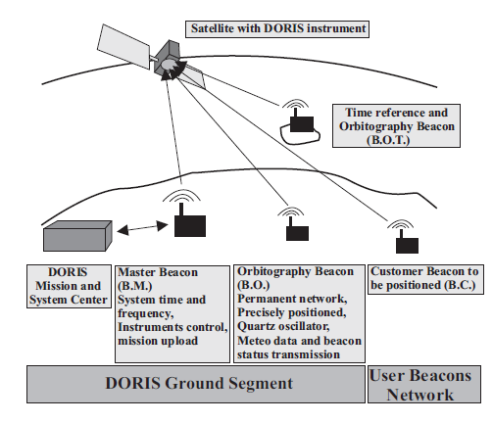
DORIS system overview

Slide 20
ground segment

Slide 21
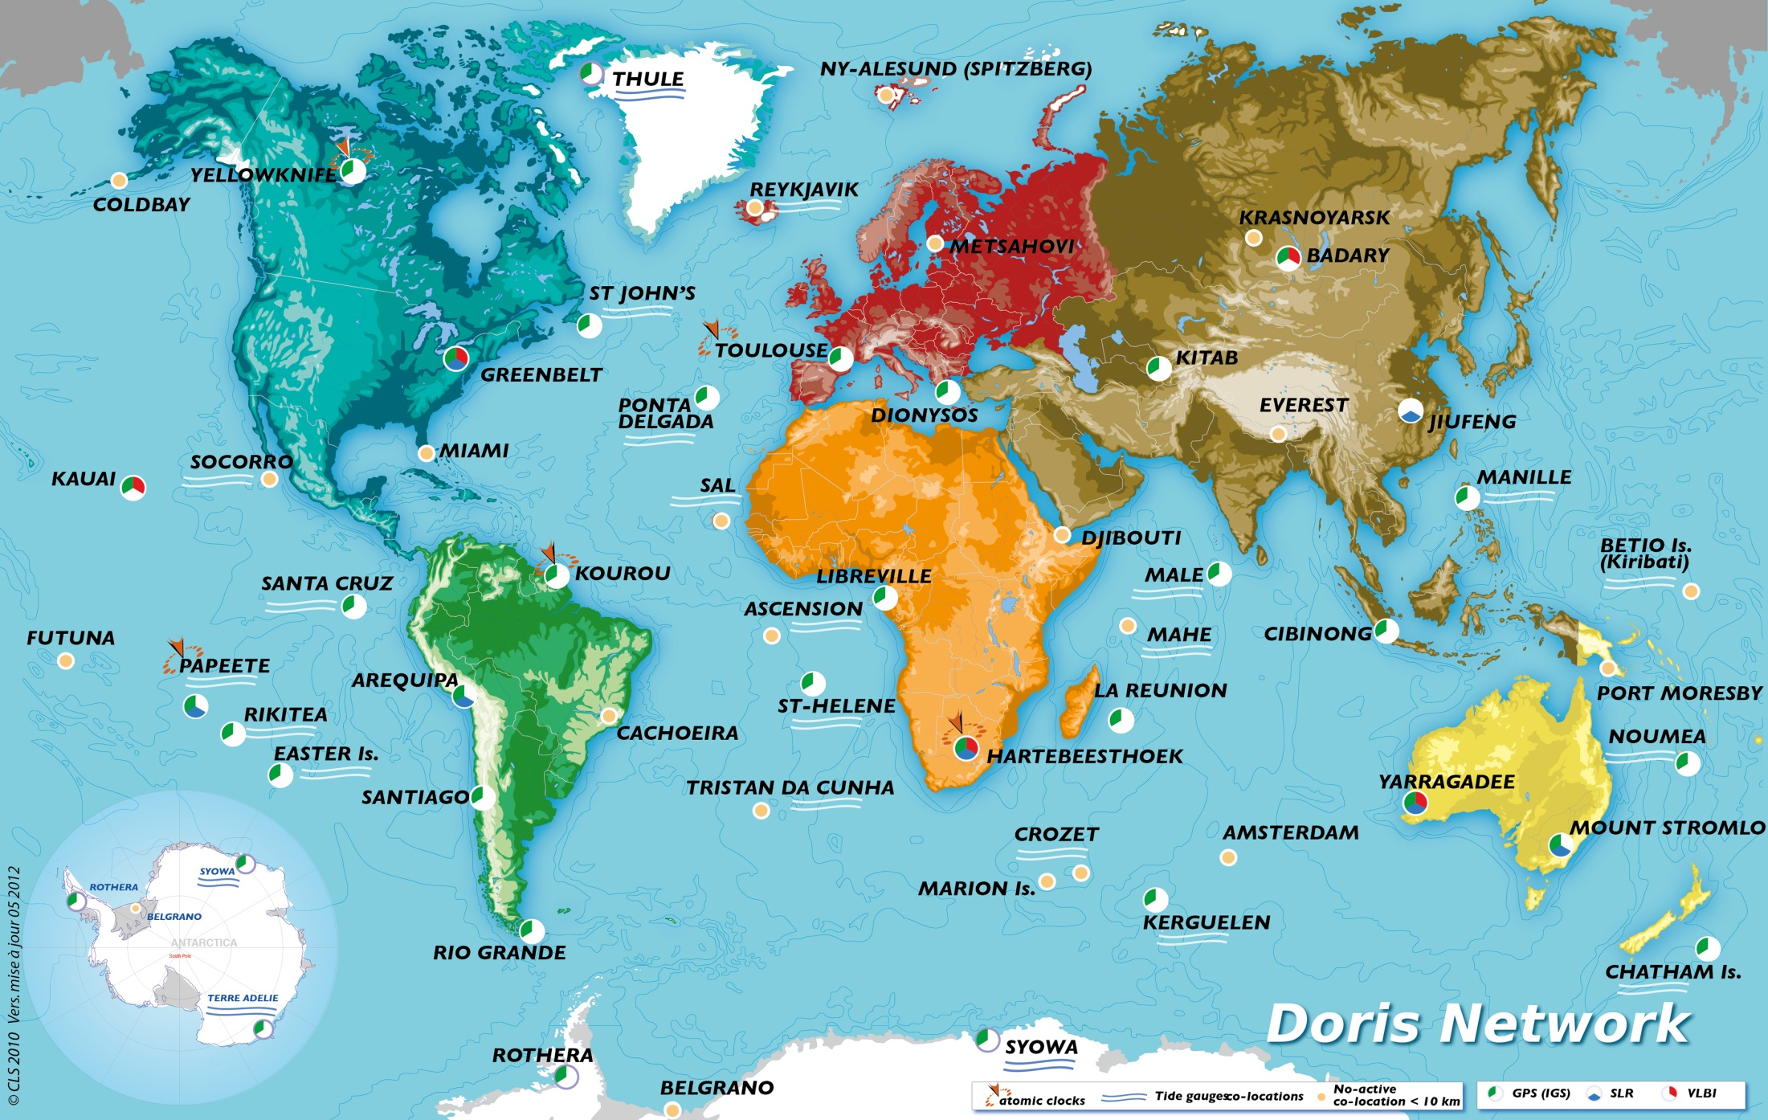
as on May 2012

Slide 22
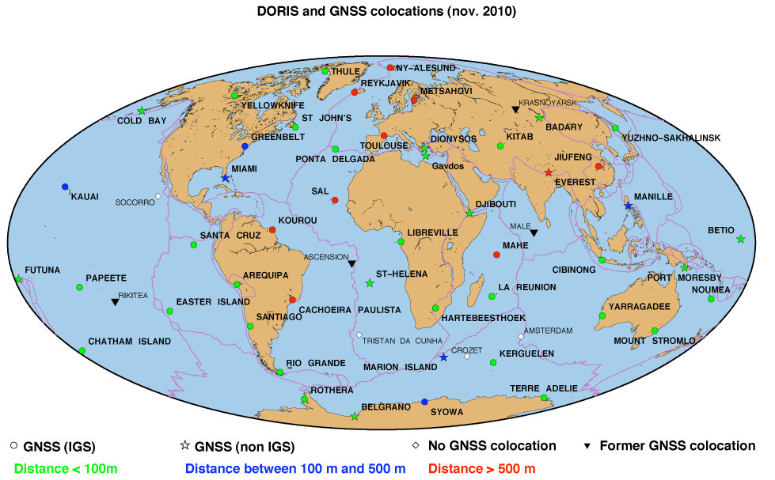
global DORIS network
about 60 sites

Slide 23
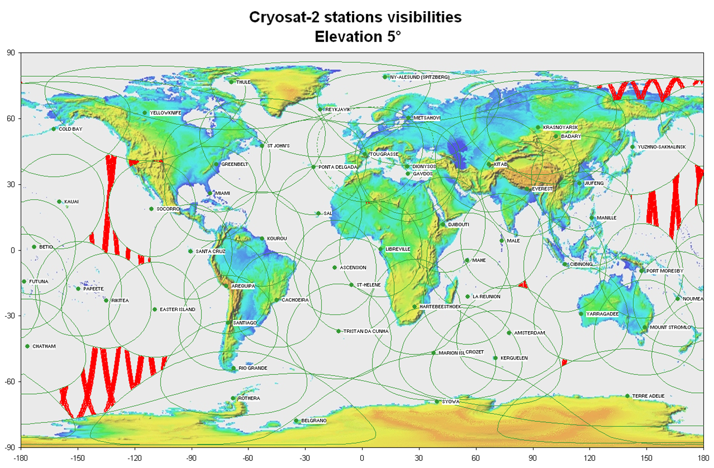
visibility

Slide 24
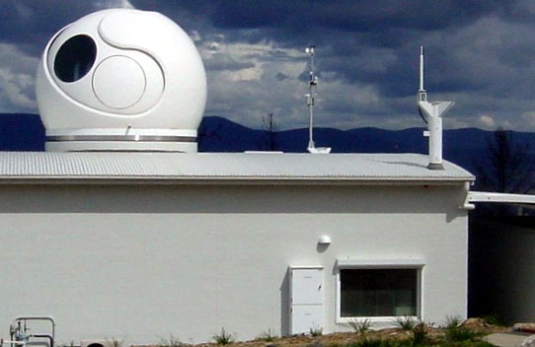
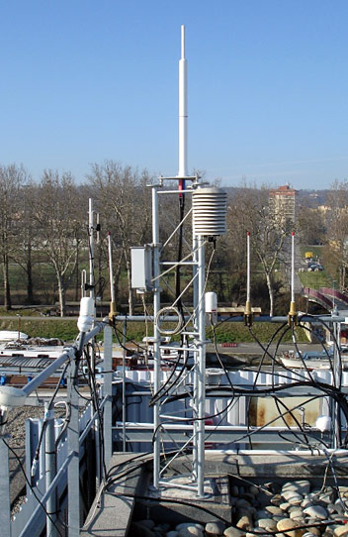
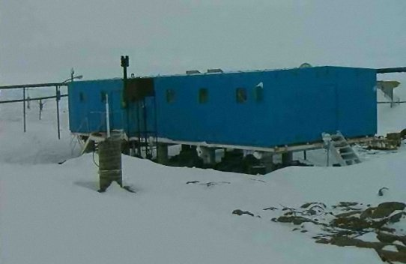
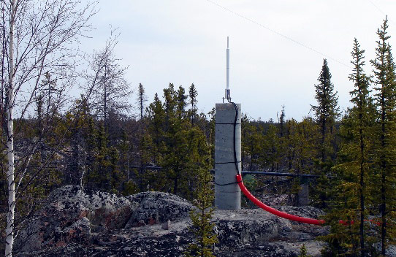
ground beacons
Mount Stromlo - Australia
Syowa - Antarctica (Japan)
Toulouse - France
Yellowknife - Canada

Slide 25
ground segment
main signal frequency 2036.25 MHz
secondary frequency 401.25 MHz (used for ionospheric correction)
continuous and omnidirectional signals
Receiver onboard the satellite receives signal and measures Doppler shift over a short count interval, e.g. 10 seconds
Data are time tagged with respect to an ultra-stable onboard crystal oscillator
control segment: master beacon and control center in Toulouse, France

Slide 26
space segment

Slide 27
DORIS-equipped satellites
COSPAR # | Satellite name | Launch date | Perigee (km) | Apogee (km) | T (min) | I (deg) | e | DORIS receiver generation | Other tracking system | DORIS instrument end | Mission End
9000501 | SPOT-2 | 22-Jan-1990 | 802 | 831 | 100.9 | 98.7 | .002014 | 1G | - | 29-Jul-2009 | 29-Jul-2009
9205201 | TOPEX/ POSEIDON | 10-Aug-1992 | 1322 | 1341 | 112.0 | 66.5 | .000095 | 1G | SLR+GPS | 1-Nov-2004 | 9-Oct-2005
9306101 | SPOT-3 | 26-Sep-1993 | 819 | 846 | 101.2 | 98.6 | .001872 | 1G | - | 9-Nov-1996 | 14-Nov-1996
9801701 | SPOT-4 | 24-Mar-1998 | 791 | 811 | 100.9 | 98.8 | .001392 | 1G | - |  | 24-Jun-2013
0105501 | JASON-1 | 7-Dec-2001 | 1328 | 1340 | 112.0 | 66.0 | .000778 | 2GM | SLR+GPS |  | 21-Jun-2013
0200901 | ENVISAT | 1-Apr-2002 | 785 | 791 | 100.6 | 98.6 | .000419 | 2G | SLR | 8-Apr-2012 | 9-May-2012
0202101 | SPOT-5 | 4-May-2002 | 825 | 826 | 101.4 | 98.8 | .000069 | 2GM | -
0700604 | STPSat-1 | 9-Mar-2007 | 558 | 561 | 95.8 | 35.4 |  | CITRIS | GPS |  | 7-Oct-2009
0803201 | JASON-2 | 20-Jun-2008 | 1328 | 1340 | 112.0 | 66.0 | .000702 | DGXX | SLR+GPS
1001301 | CRYOSAT-2 | 8-Apr-2010 | 707 | 727 | 99.4 | 92.0 | .001407 | DGXX | SLR
1104301 | HY-2A (Haiyang 2A) | 15-Aug-2011 | 963 | 963 | 104.4 | 99.4 | .00117 | DGXX | SLR+GPS
1300901 | SARAL | 25-Feb-2013 | 706 | 772 | 99.59 | 98.65 | .001165 | DGXX | SLR

Slide 28
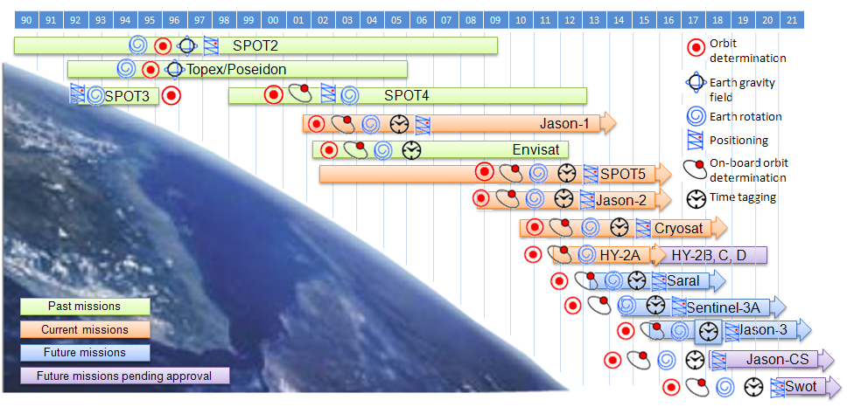

Slide 29
products / applications

Slide 30
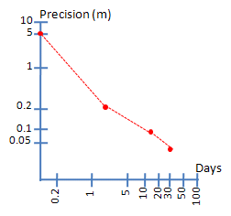
products / applications
precise orbit determination (orbitography)
real-time accuracy ~ 1 m
with 48 h latency: sub-meter accuracy
post-processing: sub-dm accuracy; ~ 1 cm for radial direction
positioning of DORIS beacons
permanent network accuracy ~ 1 cm and 1 mm/year
contribution to ITRFxx
dedicated beacons (users) ~ 1−2 dm
geodesy/geodynamics
plate tectonics
Earth rotation parameters
geocenter motion
ionosphere
time transfer

Slide 31
further reading
Seeber (2003), Satellite Geodesy
Doppler in general: chapter 6
DORIS: section 6.7
A. Kleusberg (1984) Diagnose und Therapie von geodätischen Satellitennetzen vom Typ Doppler, Deutsche Geodätische Kommission, C293
International DORIS Service http://ids-doris.org/
http://www.aviso.oceanobs.com/en/doris.html

