Slide 1
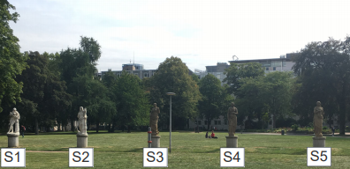
Computer Vision Project:
3D Reconstruction
Yi Wang 3371561
Yi Wei 3371480

Slide 2

Content
Data collection
Data Processing 1. Metashape
Data Processing 2. Pixel 4D
(3D model Printing)
Result Analysis

Slide 3
Data Collection
Camera | GOPRO Hero6 4000*3000
Object | Statue 4
Number of photos | 100
Photographing info | 19.11.2019, 12 pm, sunny

Slide 4
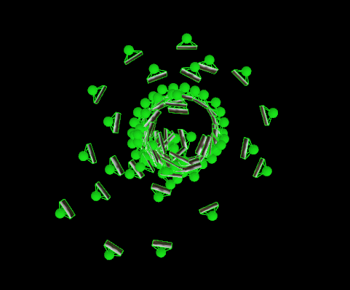
Data Collection

Slide 5
Metashape Processing
Load image
Align Photos: Camera calibration & Tie points generating
Build dense cloud
Build Mesh
Export Model (*.obj)

Slide 6
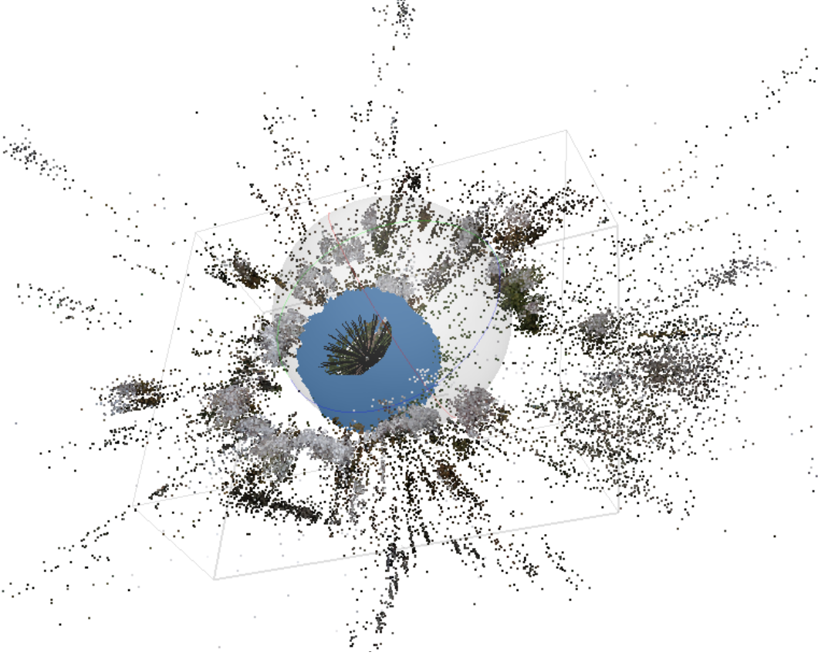
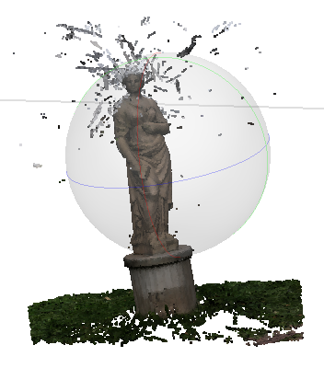
Metashape Processing
16218 Tie Points
Dense Cloud

Slide 7
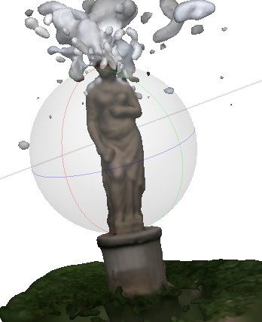
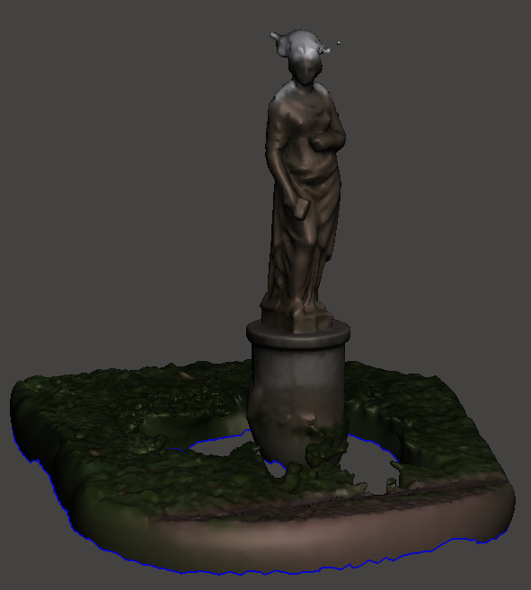
Metashape Processing
3D mesh
Roughly-processed 3D mesh

Slide 8
Pix4D Processing
Load image (set geolocation & orientation)
Initial Processing (camera calibration & tie points generating)
Point Cloud and Mesh
(Auto-Export Model *.obj)

Slide 9
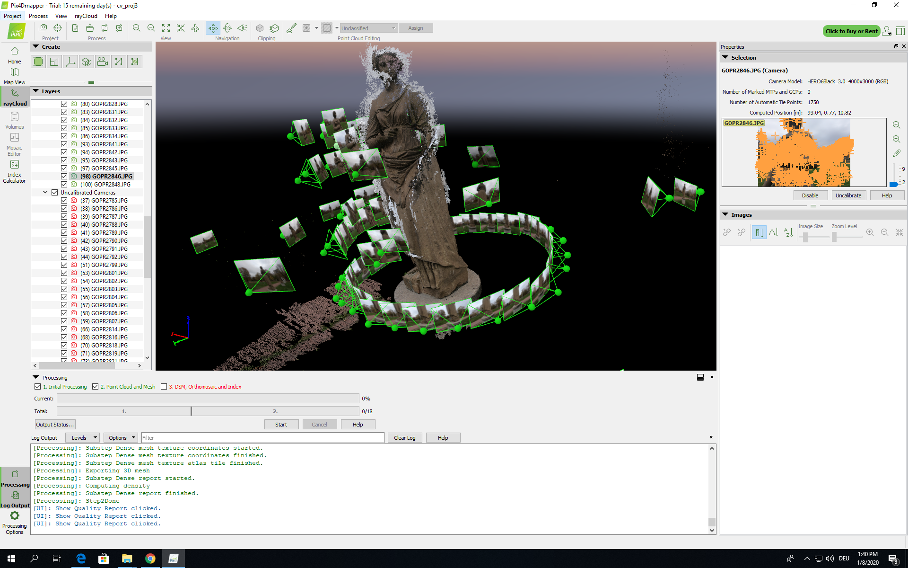
Pix4D Processing

Slide 10
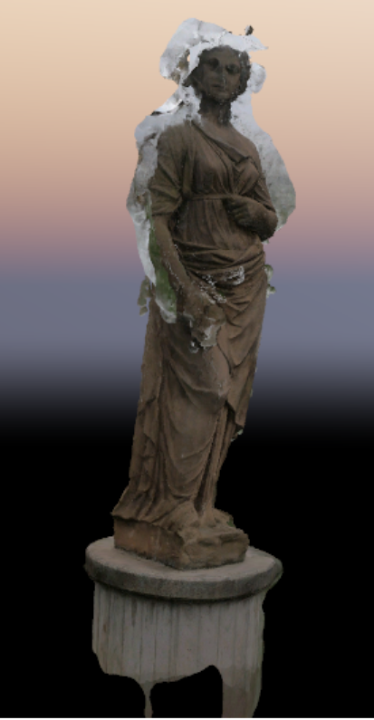
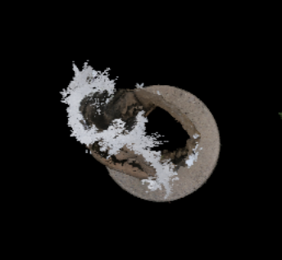
Pix4D Processing

Slide 11
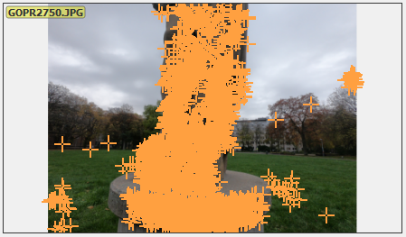
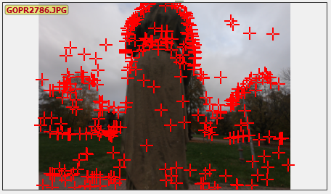
Pix4D Processing

Slide 12
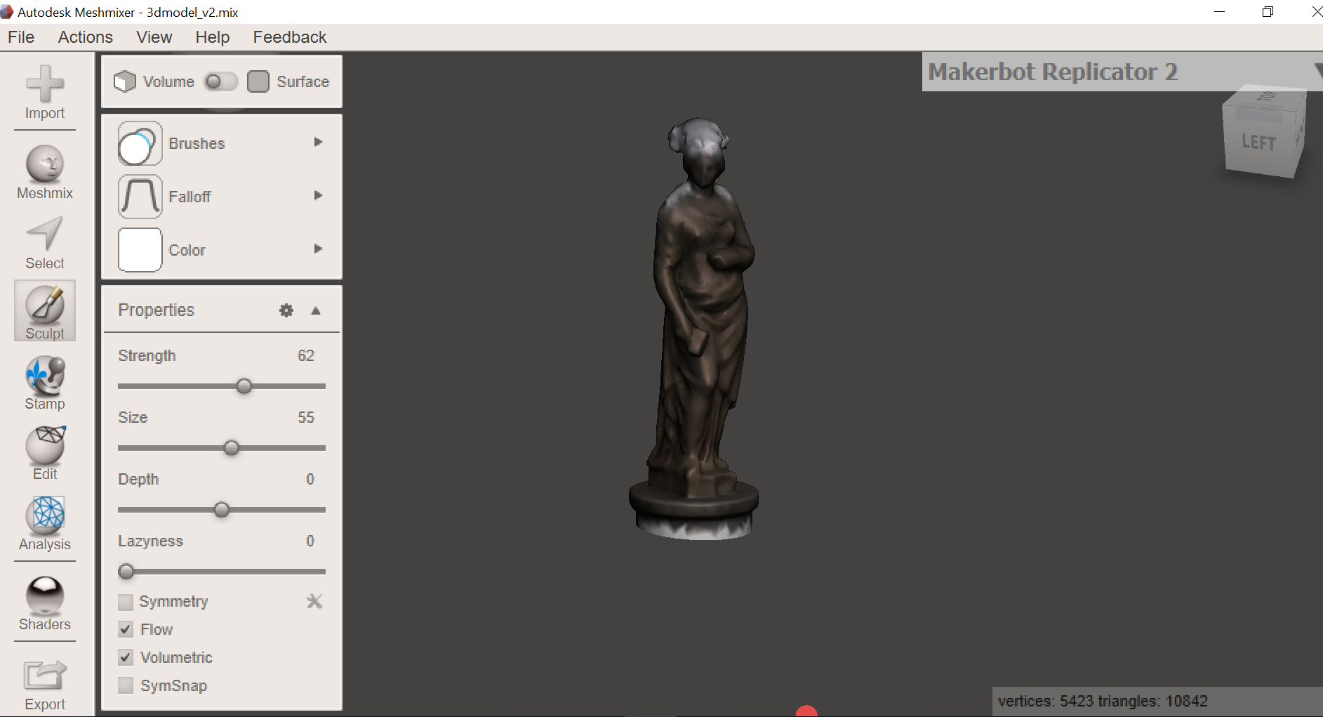
3D model printing: Meshmixer

Slide 13
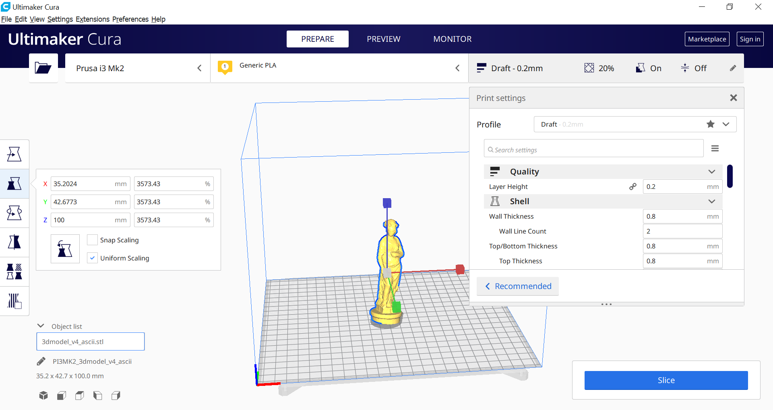
3D model printing: Cura

Slide 14
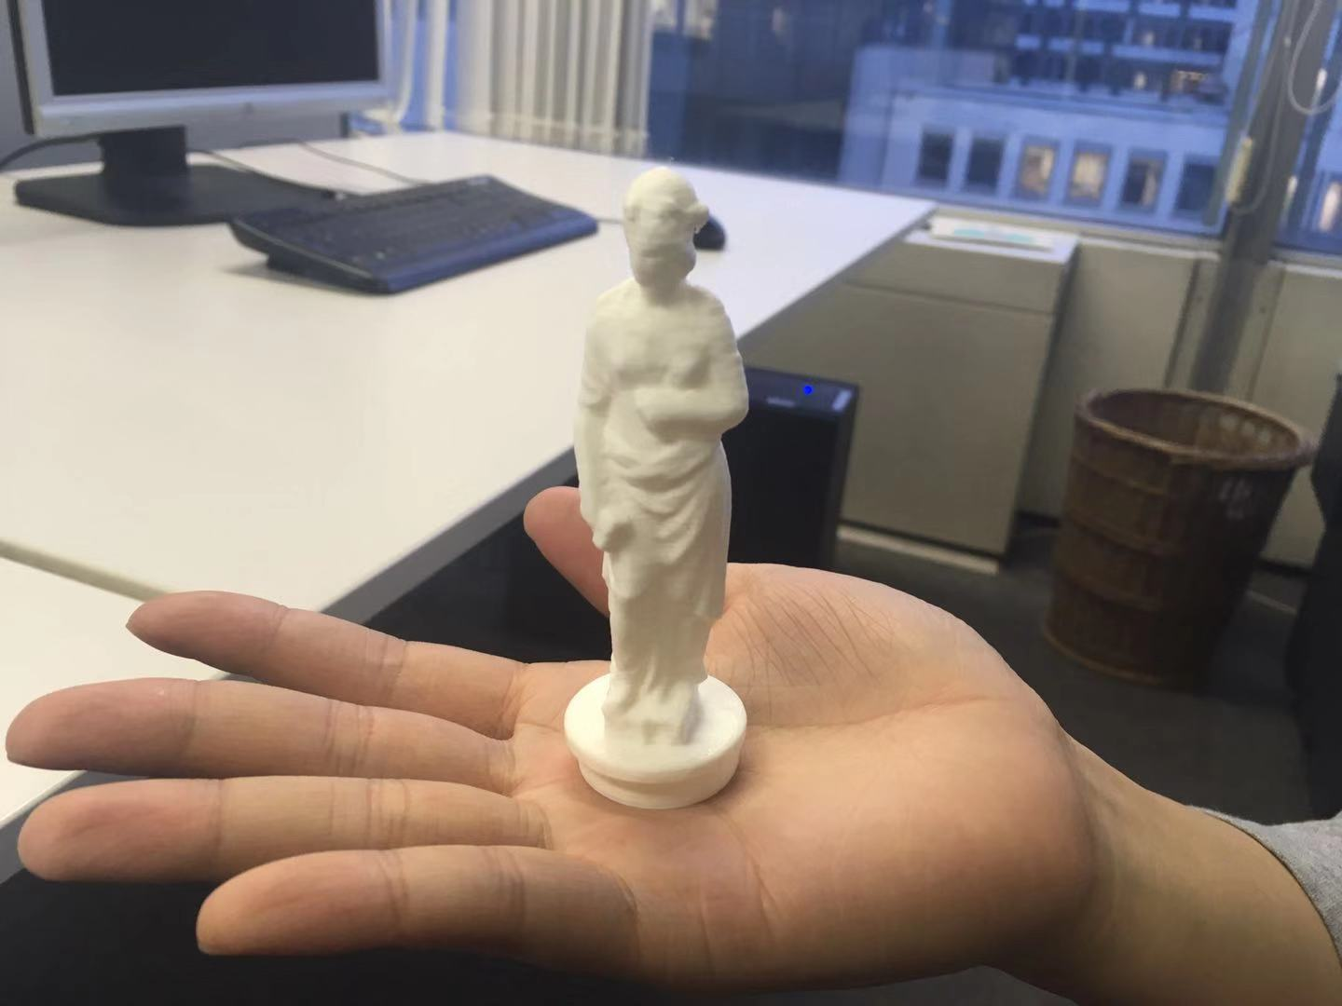
Printed 3D model

Slide 15
Result Analysis: Metashape Vs Pix4D
 | Metashape | Pix4D
Calibrated focal length (mm) | 3.4 | 3.3
Number of tie points | 86652 | 110852
RMS reprojection error | 0.164821 | 0.230

Slide 16
Thank you!

