Slide 1
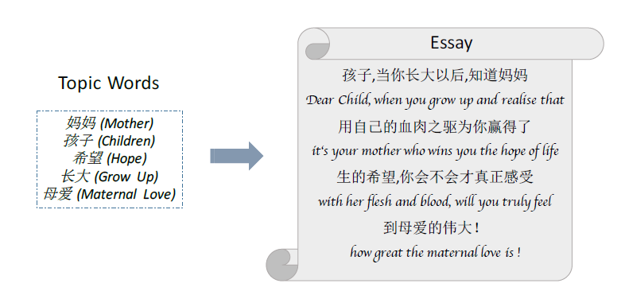
Topic-to-Essay Generation with Neural Networks
IJCAI:2018
Xiaocheng Feng, Ming Liu, Jiahao Liu, Bing Qin, Yibo Sun, Ting Liu
Harbin Institute of Technology, China

Slide 2
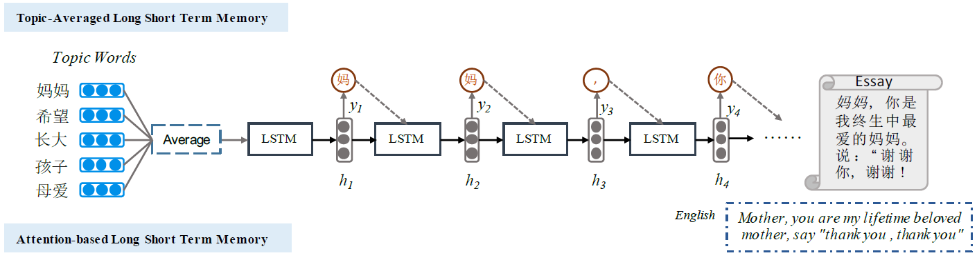



Topic表示输入词的词嵌入向量
LSTM隐藏层的更新，f(·)为激活函数
生成词， g(·)为线性函数

Slide 3
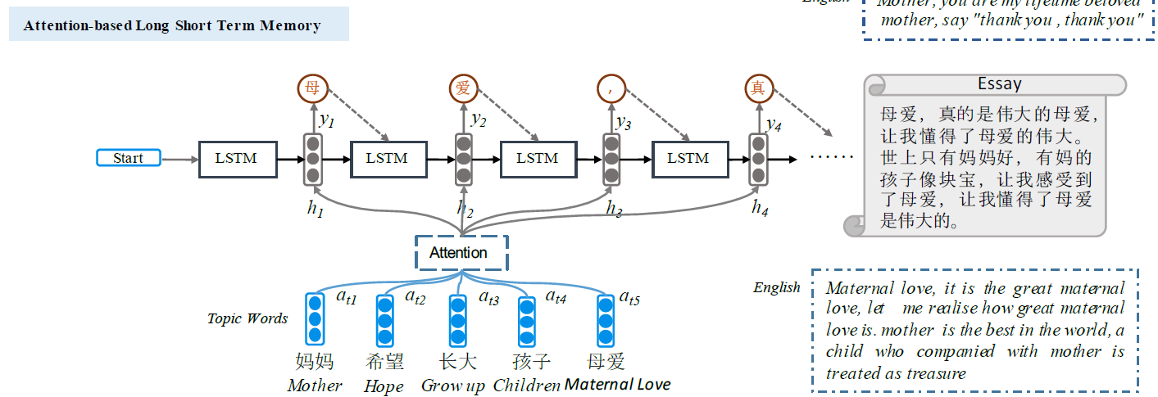

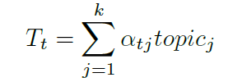



Slide 4
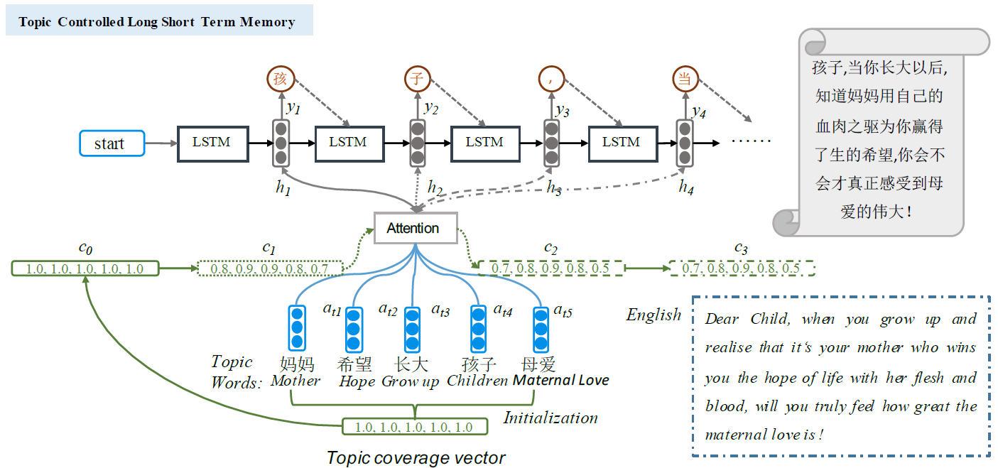

Slide 5




覆盖机制
初始化
C0
C1
C2
g(t-1)j
g(t)j
g(t+1)j
C1
C2
C3

Slide 6
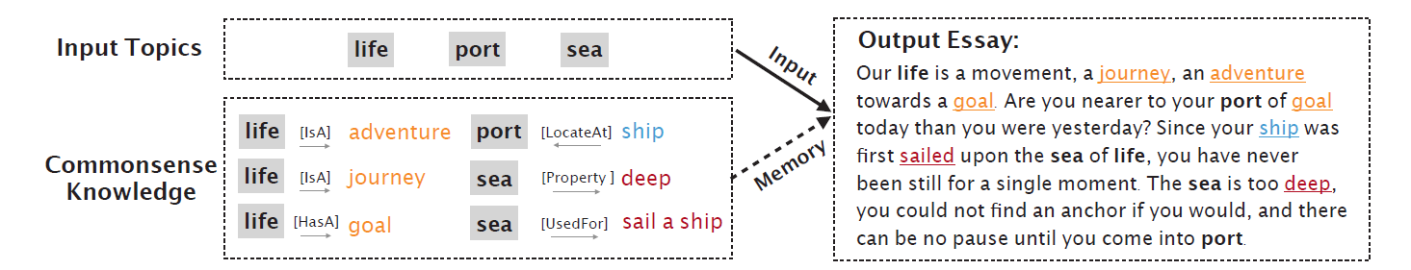
Enhancing Topic-to-Essay Generation with External Commonsense
Knowledge
ACL:2019
Pengcheng Yang, Lei Li, Fuli Luo, Tianyu Liu, Xu Sun
Deep Learning Lab, Beijing Institute of Big Data Research, Peking University
MOE Key Lab of Computational Linguistics, School of EECS, Peking University

Slide 7
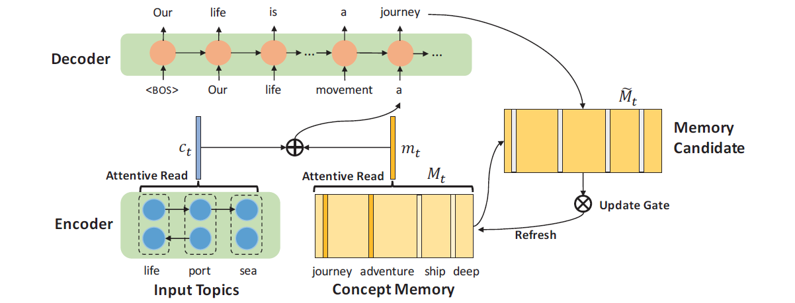
模型

Slide 8
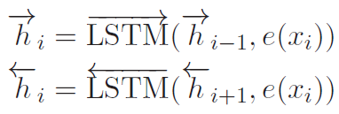

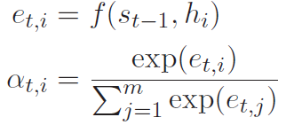
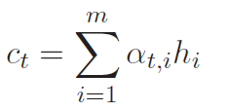
编码
Encoder
Decoder

Slide 9






记忆机制
动态内存机制
根据当前生成的词更新记忆
更新门机制动态选择哪些记忆应该更新
动态更新记忆矩阵

Slide 10
Jiuge: A Human-Machine Collaborative Chinese Classical
Poetry Generation System
ACL:2019
Zhipeng Guo , Xiaoyuan Yi, Maosong Sun ,
Wenhao Li, Cheng Yang, Jiannan Liang, Huimin Chen, Yuhui Zhang, Ruoyu Li
Department of Computer Science and Technology, Tsinghua University, Beijing, China
Institute for Artificial Intelligence, Tsinghua University, Beijing, China
State Key Lab on Intelligent Technology and Systems, Tsinghua University, Beijing, China
ESTATES PTE LTD, Singapore

Slide 11

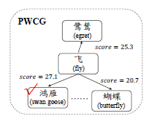

输入主题处理
关键词抽取
关键词扩展
得分计算：

Slide 12
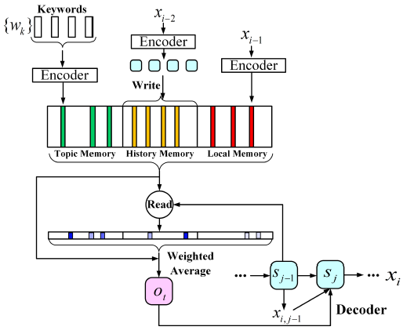
模型

