Slide 1
基于特征表示的新闻推荐
2019/9/8-2019/9/14

Slide 2
基本过程

Slide 3
1.Neural News Recommendation with Topic-Aware News Representation
• ACL 2019
• ChuhanWu, FangzhaoWu, MingxiaoAn, Yongfeng Huang and Xing Xie
• Department of Electronic Engineering, Tsinghua University, Beijing, China
Microsoft Research Asia, Beijing
China University of Science and Technology of China, Hefei, China

Slide 4
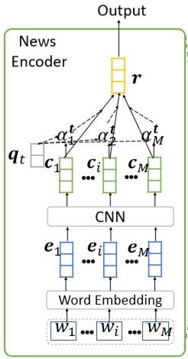






1.Neural News Recommendation with Topic-Aware News Representation
News Encoder
Input
新闻标题的单词
Glove Embedding
CNN
Filters:400, window:3
Words Attention
Output

Slide 5
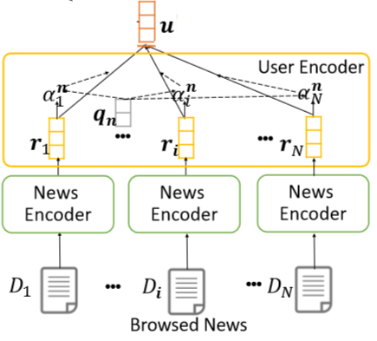



1.Neural News Recommendation with Topic-Aware News Representation
User Encoder
Input
已浏览的新闻经过News Encoder的表示
News Attention
Output

Slide 6
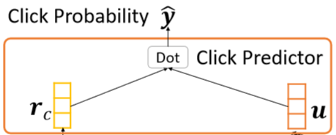



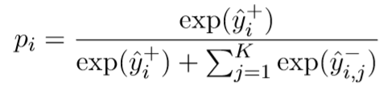

1.Neural News Recommendation with Topic-Aware News Representation
Click Predictor
Input
r, u
Output
Negative Sampling
对每个正样本的分数
随机选择K个负样本
loss function

Slide 7
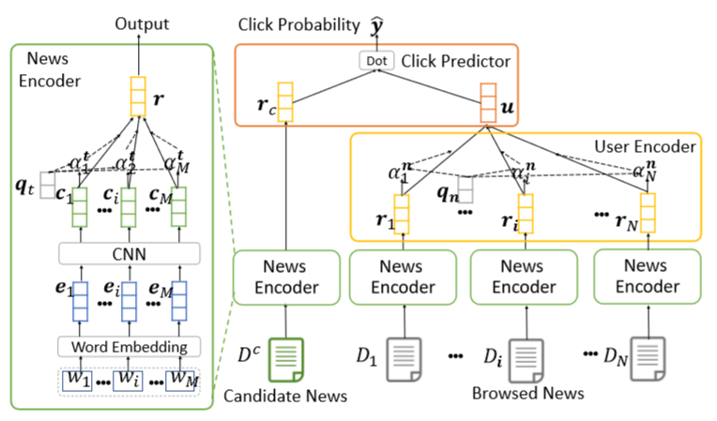
1.Neural News Recommendation with Topic-Aware News Representation
The framework of the basic model

Slide 8
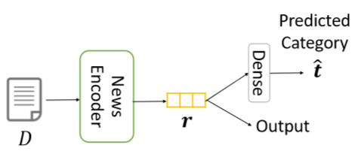



1.Neural News Recommendation with Topic-Aware News Representation
Why topic-aware?
Probability distribution
Topic loss
Joint loss

Slide 9
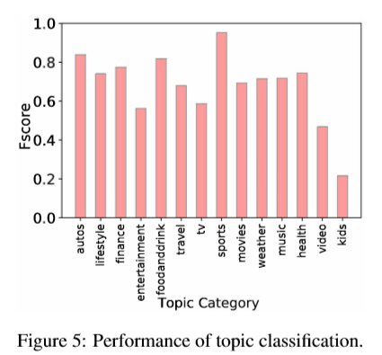
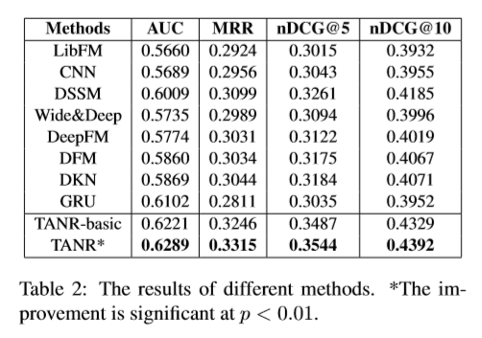
1.Neural News Recommendation with Topic-Aware News Representation

Slide 10
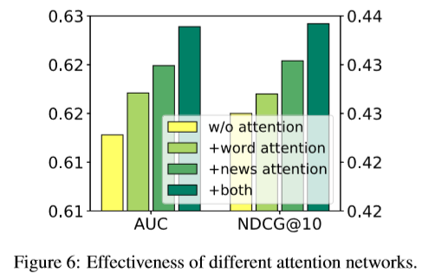
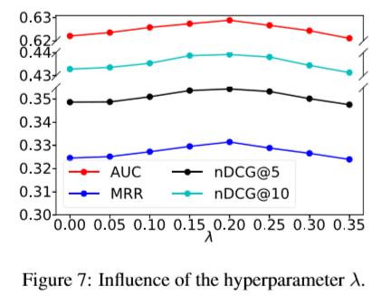
1.Neural News Recommendation with Topic-Aware News Representation

Slide 11
2.Neural News Recommendation with Attentive Multi-View Learning
• IJCAI 2019
• ChuhanWu, FangzhaoWu, MingxiaoAn, Yongfeng Huang and Xing Xie
• Department of Electronic Engineering, Tsinghua University, Beijing, China
Microsoft Research Asia, Beijing
China University of Science and Technology of China, Hefei, China

Slide 12
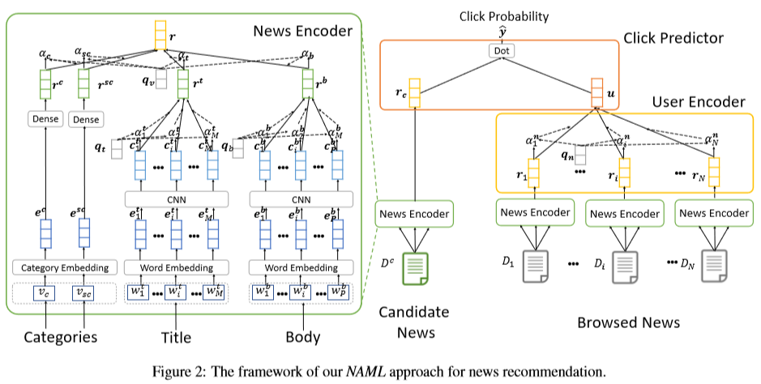
2.Neural News Recommendation with Attentive Multi-View Learning

Slide 13
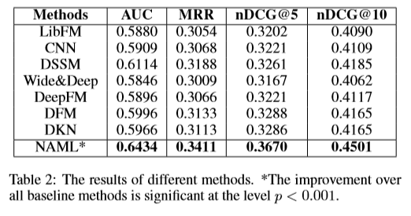
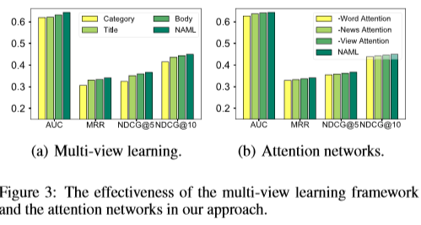
2.Neural News Recommendation with Attentive Multi-View Learning

Slide 14
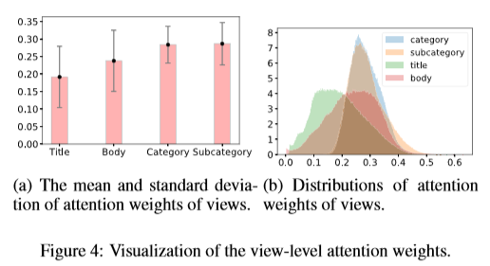
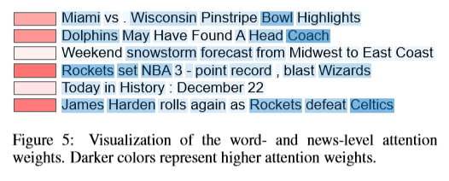
2.Neural News Recommendation with Attentive Multi-View Learning

Slide 15
3. Neural News Recommendationwith Long-and Short-term User Representations
• ACL 2019
• Mingxiao An, Fangzhao Wu, ChuhanWu, KunZhang, ZhengLiu, XingXi
• China University of Science and Technology of China, Hefei, China
Microsoft Research Asia, Beijing
Department of Electronic Engineering, Tsinghua University, Beijing, China

Slide 16
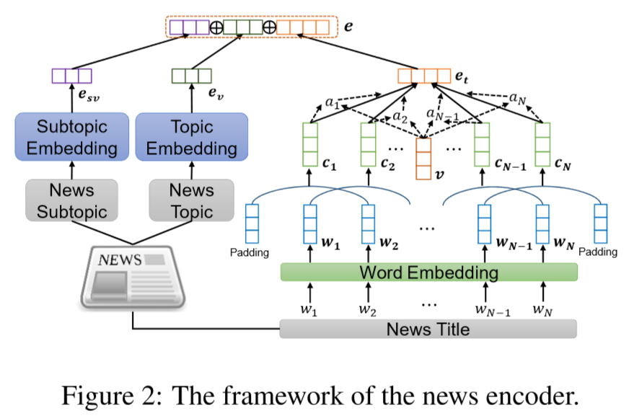
3. Neural News Recommendation with Long-and Short-term User Representations

Slide 17
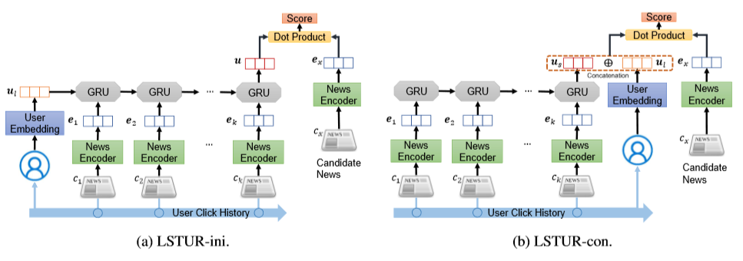
3. Neural News Recommendation with Long-and Short-term User Representations

Slide 18
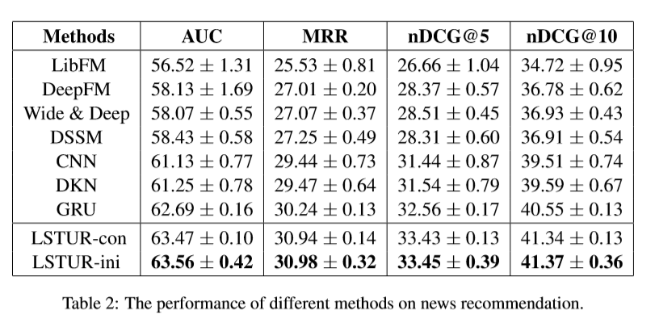
3. Neural News Recommendation with Long-and Short-term User Representations

Slide 19
Future work
• 加入多模态信息，如新闻图片、视频、评论
• 加入异构的用户行为（查询、点击、广告）
• 图网络（新闻与新闻之间的联系，用户和用户之间的联系）
• 隐私安全的推荐（将用户数据存在本地，只上传训练结果）

Slide 20
一些想法
• 用新闻内容来预测新闻的点击率是不合理的
• 点击只能反映用户对新闻的部分兴趣，如标题中的实体、类型，不能完全反应对内容的兴趣
• 可以考虑加入用户对新闻的实际阅读时间（需要考虑新闻本身的长度）
• 能不能将将荐分成两个部分，由新闻标题、类别等预测点击概率，由新闻内容预测阅读时间
（可能需要新的评估参数）

