Slide 1
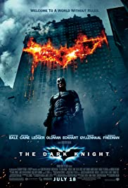
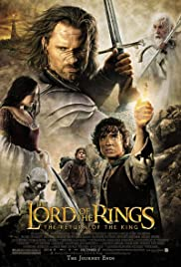
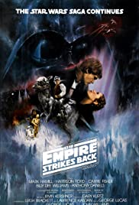
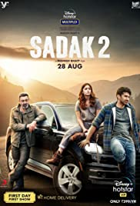
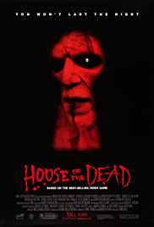
What makes a hit / flop Action movie?
Presented by: Shuheng.Ma, Yikang Wang, Nicole (Yue) Jiang, Rongzhi Xu, Yiqun Tian
Cohort: Section B
Notes:
yiqun

Slide 2





Agenda
Problem Statement
Methodology
Result & Models
Analysis
Conclusion
Data Source
Pre-processing
Topic Modeling
Notes:
Methodology
- which data source we use
- how we pre-process our data
-

Slide 3

Problem Statement
Background:
For movie companies efficiently select the movie scripts worth their investment
Help movie companies to find what are the popular topics in current market
Movie companies to evaluate if a new movie will perform well in the market
To do better in forecast movie’ sales
Goal: Identify the features that make Action Movies succeed or fail.
Notes:
The background of our problem is we find it is really important
So we want to
Our goal is to identify the features from user comments that what topics will make action movies succeed or fail

Slide 4
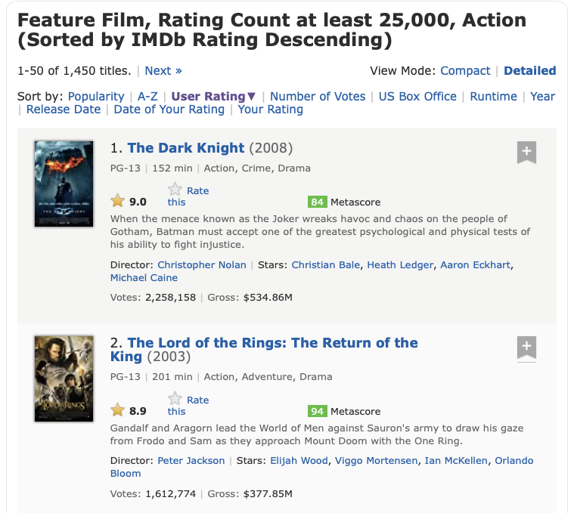
Methodology
Data Sources: IMDB movie comments
Website link: https://www.imdb.com/search/title/?title_type=feature&num_votes=25000,&genres=action&sort=user_rating,desc
Scrape features
Top 20 best action movies and top 20 worst action movies, with 200 comments from each movie
Notes:
马
Scrape data - from the website, scrape top 30 movies each with 300 reviews. Same for worst movies. Since some of the movies have really reviews that require login(warning), we will delete the reviews that we are not able to get from the website. As well as for the movie that does not have 200 reveiws. And eventually, we will get the best 20 and worst 20, each with 200 reviews, their scores, casting. But for this assignment, the most important thing are the movie names and user comments

Slide 5
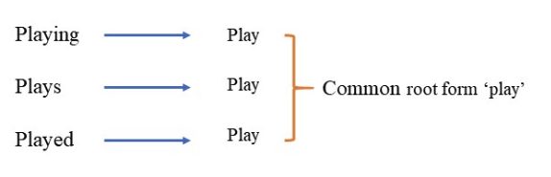
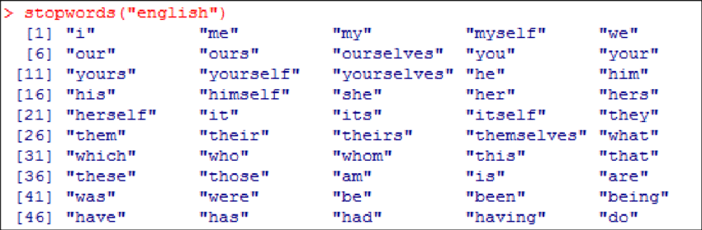
Methodology
Pre-processing:
Comments Lowercase
Lemmatization
Stopwords with additional movie common phrases (E.g. movie, film)
Regular expression - > Tokenization
Notes:
Our dataset contains User reviews from IMDB website and they are normally consists many types of users, it could be written by normal movies fans just like me, or famous critics that have lots of followers on Twitter. So, we need to preprocess the reviews to reduce the noise of the data. Of course, we started by making all the words in the reviews lower case, and then we use lemmatization to convert the inflected forms of words into the same root. Then we remove the stops words using the NLTK library and adding few additional frequent words that Yue will talked about later. Last but not least, in order to make the vector of the words for all the reviews so that we could feed into the LDA models easier, we used regular expression to tokenize the words more accurately.

Slide 6
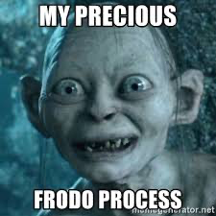

Methodology
Topic Modeling:
For the best/worst 20 action movies, obtain 5 topics for each
Use Excel to obtain the specific five topics
Topic_ID | Best 20 Action Movie | Keywords
1 | Sci-Fi | Star wars, Jedi
2 | Family | Samurai, family, father
3 | Fantasy | Lord of rings, frodo
4 | Superhero | Terminator, batman, joker
5 | Drama | Story, characters, scenes
Notes:
After preprocessing the data, we used our topic modeling to try to find out what really makes a movie hits and flops.
Specifically, we used vector of words we talked about earlier and feed that into LDA with the proper parameters for us to get the best results. After a few tries, we found out, for both best and worst movies, 5 topics are giving us the highest log likelihood and giving us the best result. Then we export the data frame into excel to manually label the topics based on the descending order of the keywords for each topic.
The topic are classified as follows:
The first topic would be Science-fiction: Star Wars series, a really famous space opera everyone has heard of
Second topic is Family: Dangal, an Indian movie that talks about how the young girl in india raised by her father to become one the best wrestlers in the world. By the way I think this is a very popular movie in Asia, probably not that popular in the US.
The third topic is Fantasy: a movie that fall into this category would be the all time great Lord of the Rings series, which talks about the rivalry between good and evil revolving around one magical ring
Topic four is Superhero: Probably a more popular one in our time. A terrific of example this would be Terminator in the last century , or Batman, a more contemporary one. And they all talks about exciting stories about superhero vs villain
The last topic is Drama: I think the drama here means good storytelling and vivid plot. This is a really important finding and there is no example for this topic because based on our results, almost every good movies should have the best-in-class story as well in order to be hits, which Yue will talk about later.

Slide 7
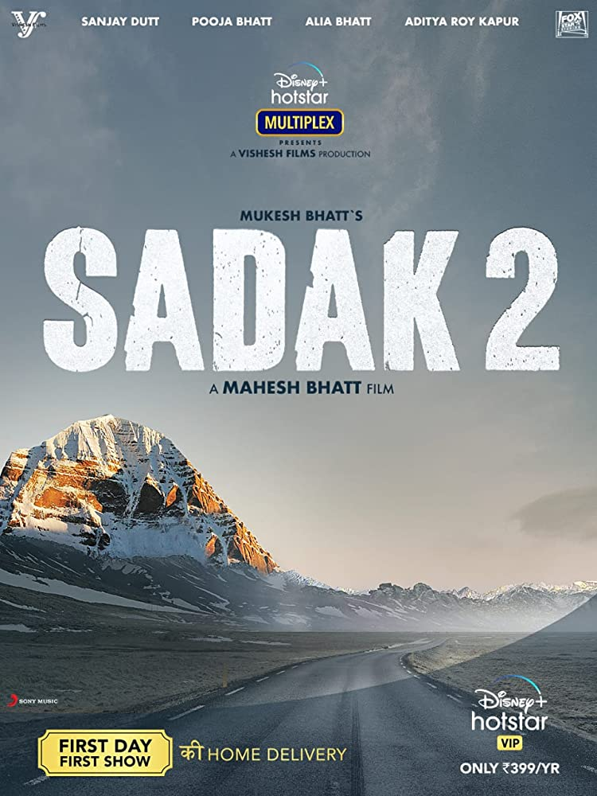
Methodology
Topic Modeling:
For the best/worst 20 action movies, obtain 5 topics for each
Use Excel to obtain the specific five topics
Topic_ID | Worst 20 Action Movie | Keywords
1 | Special Effect | Special Effects, Explosive
2 | Acting | Bad/poor Acting, Performance
3 | Superhero Comic | Batman, Catwoman, Robin
4 | Cultural | History, Tradition
5 | Drama | Story, Plot
Notes:
Using the same method as the Best Action Movies, and sorting the log likelihood score
We can conclude the following topic - Special Effect; Acting, Superhero Comic, cultural and Drama
Our interesting finding is that
- Superhero Comic (copycat from the comic book)
- Batman and Robin
- Avengers
- Movie audience pay attention to
- drama
-

Slide 8
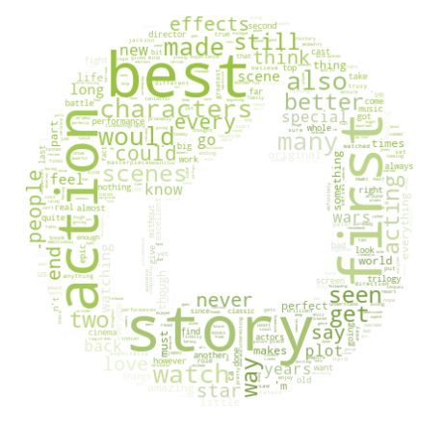
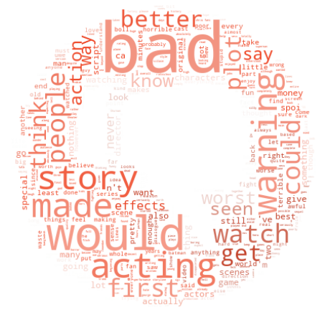
Results and Analysis
Word frequency for best & worst movies
Notes:
nico

Slide 9
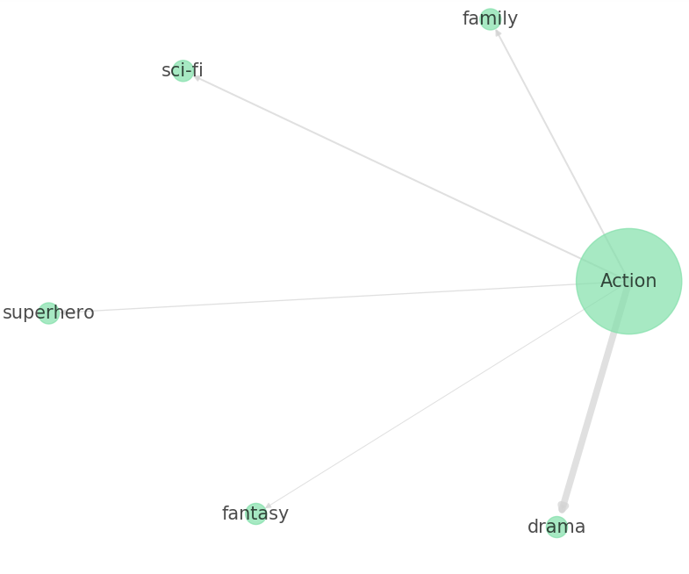
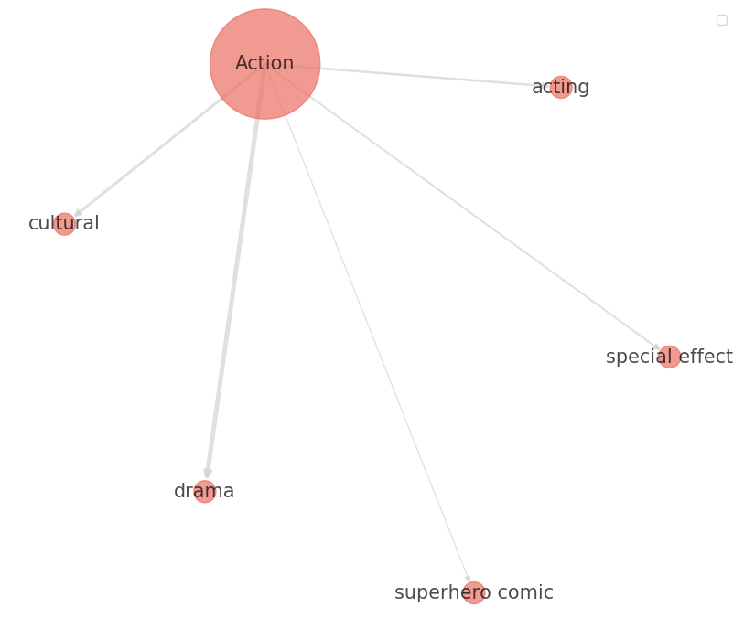
Results and Analysis
Notes:
nico

Slide 10
Conclusion
For the top 20 action movies, they shared the common features:
Family, fantasy, sci-fi, drama, and superhero as the flags of successful movies.
For the worst 20 action movies, they are:
Special effect, acting, superhero comic, cultural, and drama
Film companies could use these as indicators to locate potential successful scripts and to avoid highly difficult ones
Film companies can also use these indicators as factors to forecast movie sales.
Notes:
In conclusion, from our analysis
Some topics (family, fantasy, sci-fi) can have positive effect to the movie performance
Some topics (drama, special effect) may serve as an amplifier to movie performance

Slide 11
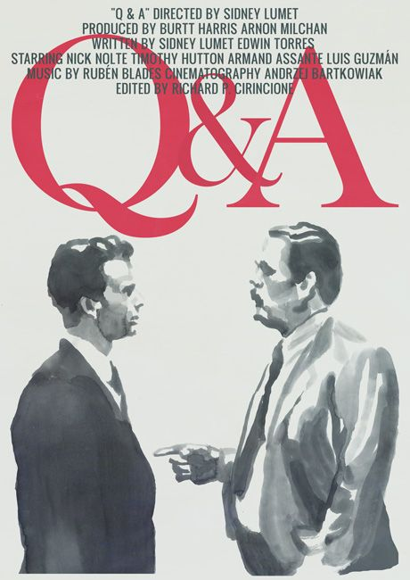
Q&A

