Slide 1
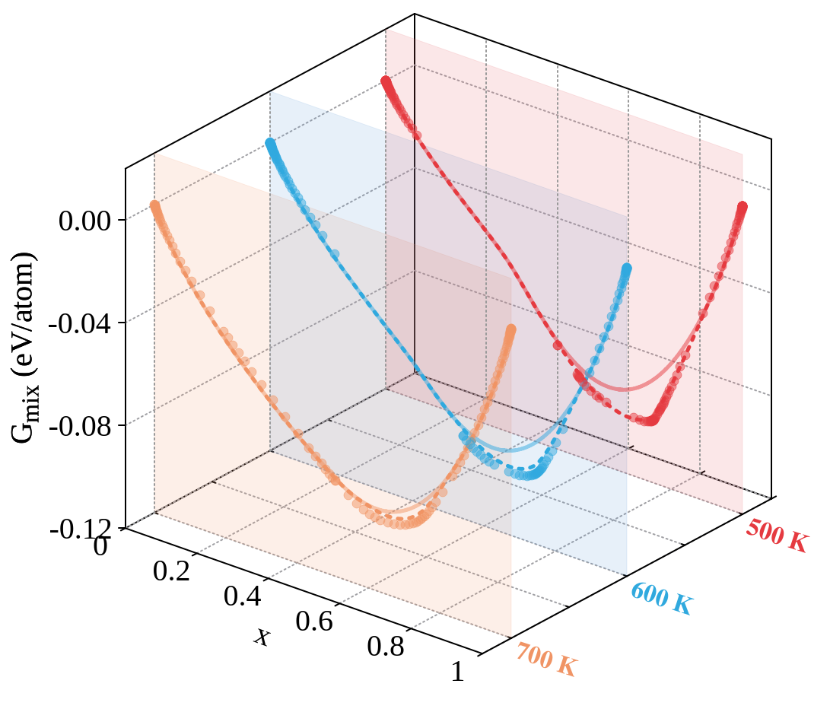
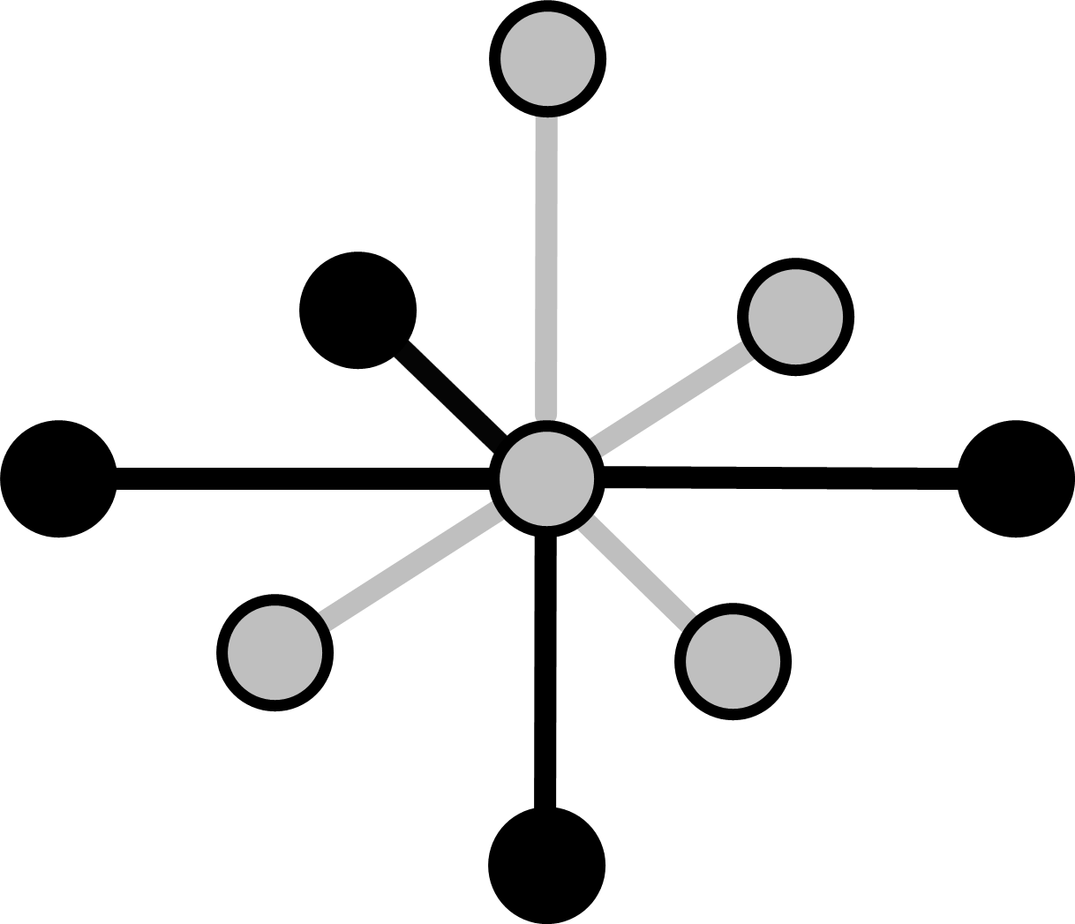
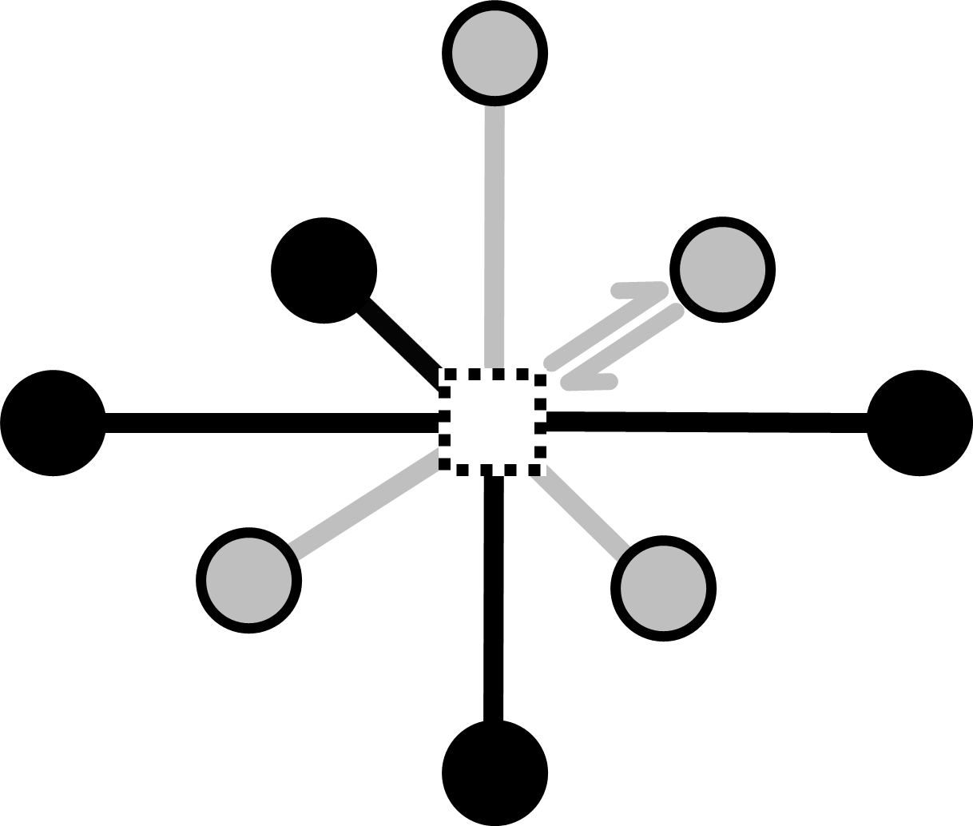
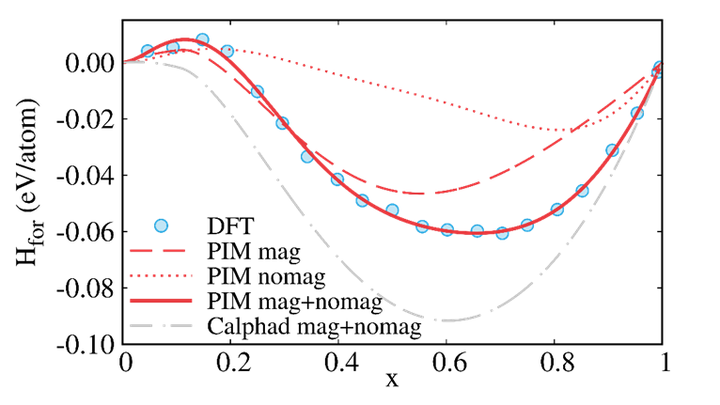
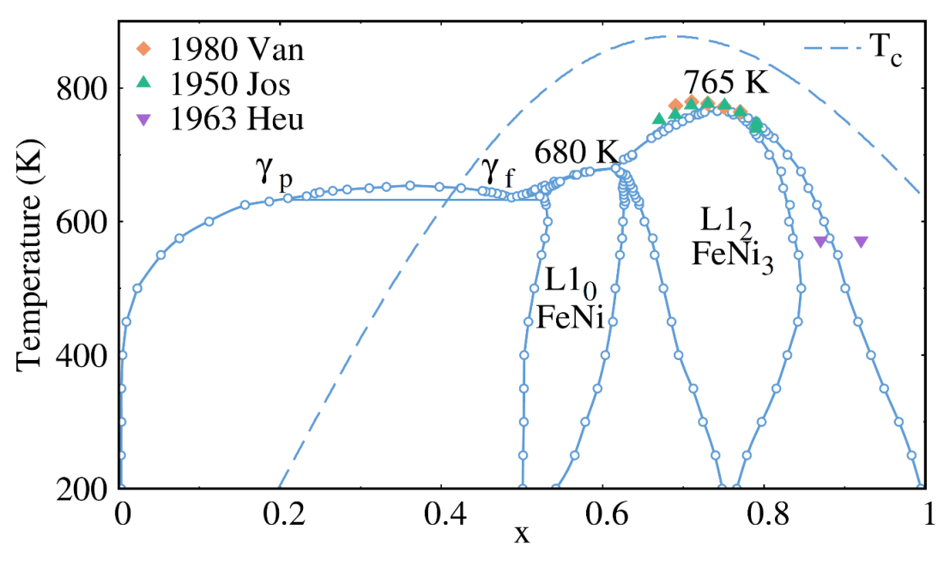
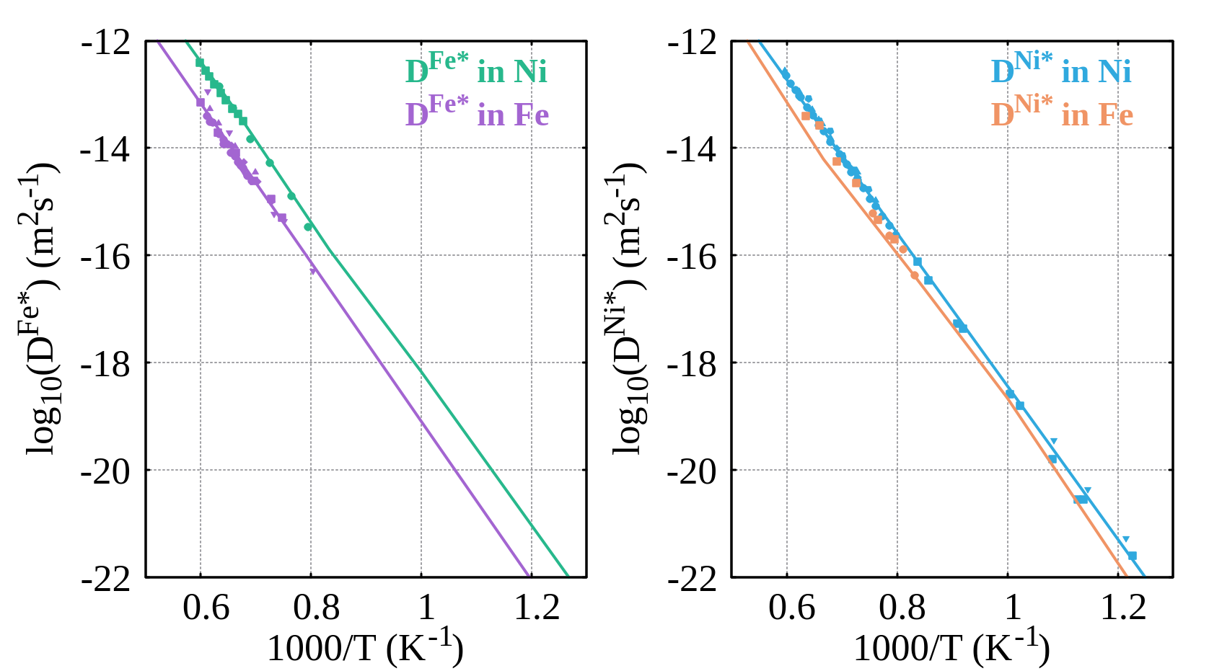



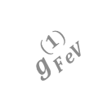


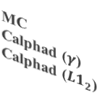
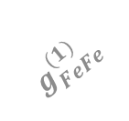


MC
Calphad ($γ$)
Calphad (${L1}_{2}$)
$$Fe$$
$$Fe$$
$$g_{FeFe}^{(1)}$$
$$g_{FeV}^{(1)}$$
$$g_{FeNi}^{(2)}$$
$$g_{NiV}^{(2)}$$
$$V$$
$$Ni$$
$$Ni$$

Slide 4
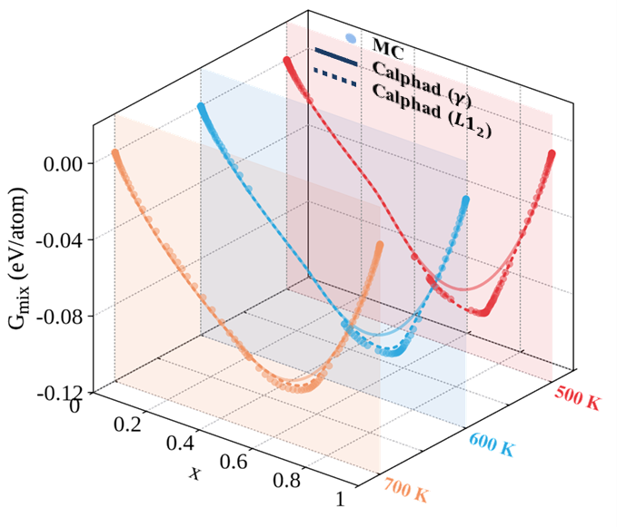

Slide 5
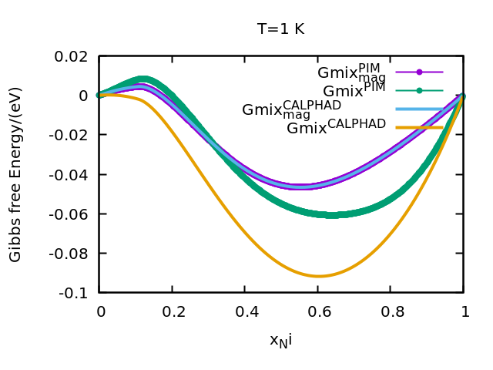

Slide 6
