Slide 1
服务器日志监控报告
生成时间: 2026-06-13 12:03:52
System Log Analytics Dashboard - 企业级实时监控与智能预警平台

Slide 2
监控概览
总日志数
5,000
错误日志数
2,155
错误率
43.10%
滑动窗口
5 分钟
服务节点数
10
调用链记录
2
System Log Analytics Dashboard - 企业级实时监控平台

Slide 3
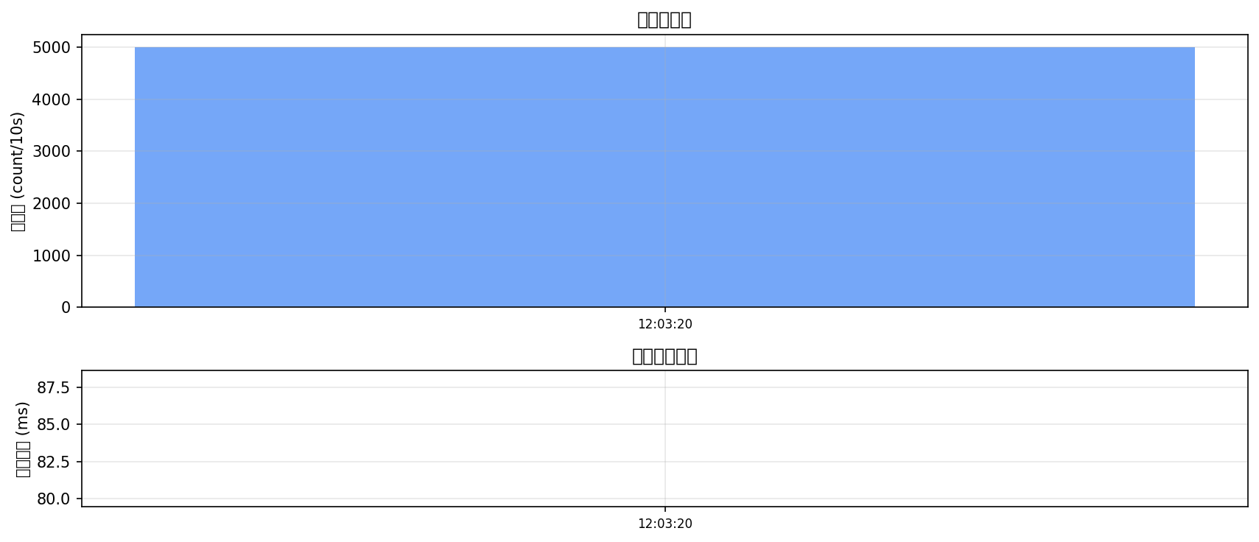
请求量与响应时间趋势
System Log Analytics Dashboard - 企业级实时监控平台

Slide 4
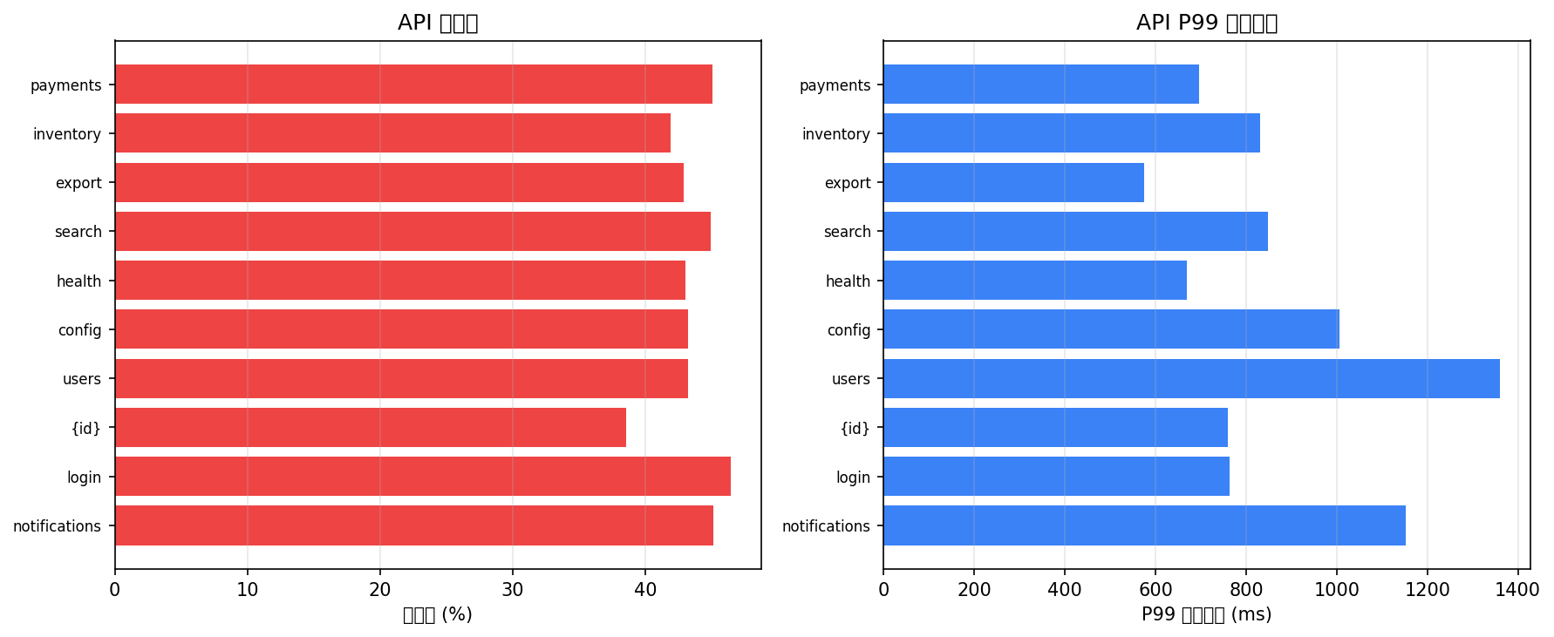
API 接口性能排行 (Top 10)
System Log Analytics Dashboard - 企业级实时监控平台

Slide 5
服务节点健康状态
服务 | 请求数 | 错误数 | 错误率(%) | P99响应(ms)
gateway | 529 | 231 | 43.67 | 873.79
inventory-service | 526 | 257 | 48.86 | 926.23
notification-service | 513 | 244 | 47.56 | 743.84
search-service | 510 | 194 | 38.04 | 860.25
analytics-service | 509 | 205 | 40.28 | 902.21
user-service | 502 | 225 | 44.82 | 1048.51
order-service | 496 | 207 | 41.73 | 747.58
auth-service | 481 | 200 | 41.58 | 1024.7
payment-service | 480 | 205 | 42.71 | 813.01
config-service | 454 | 187 | 41.19 | 989.07
System Log Analytics Dashboard - 企业级实时监控平台

Slide 6
异常检测事件 (共 10 条)
时间 | 严重程度 | 类型 | 实体 | 指标 | 当前值 | 阈值 | Z分数
12:03:37 | critical | systemic_error_outbreak | SYSTEM | systemic_error_rate | 14 | 3.0 | None
12:03:38 | critical | systemic_error_outbreak | SYSTEM | systemic_error_rate | 14 | 3.0 | None
12:03:40 | critical | systemic_error_outbreak | SYSTEM | systemic_error_rate | 14 | 3.0 | None
12:03:41 | critical | systemic_error_outbreak | SYSTEM | systemic_error_rate | 14 | 3.0 | None
12:03:43 | critical | systemic_error_outbreak | SYSTEM | systemic_error_rate | 14 | 3.0 | None
12:03:44 | critical | systemic_error_outbreak | SYSTEM | systemic_error_rate | 14 | 3.0 | None
12:03:47 | critical | systemic_error_outbreak | SYSTEM | systemic_error_rate | 14 | 3.0 | None
12:03:49 | critical | systemic_error_outbreak | SYSTEM | systemic_error_rate | 14 | 3.0 | None
12:03:50 | critical | systemic_error_outbreak | SYSTEM | systemic_error_rate | 14 | 3.0 | None
12:03:52 | critical | systemic_error_outbreak | SYSTEM | systemic_error_rate | 14 | 3.0 | None
System Log Analytics Dashboard - 企业级实时监控平台

Slide 7
流量预测与预警
暂无预测数据
System Log Analytics Dashboard - 企业级实时监控平台

Slide 8
服务调用依赖概览
服务节点数
10
调用连边数
19
总调用次数
3,335
总错误数
1,404
平均响应(ms)
79.77
跟踪的调用链
2
System Log Analytics Dashboard - 企业级实时监控平台

