Slide 1
Structure-Texture Decomposition of Image with Interval Gradient
Yishuo Wang
108533945

Slide 2
Project Description
IDE: Visual Studio 2015
Language: C++
Library: opencv 3.1
Given a image as an input, we will filter the texture of the image and save the structure. The new image will be the output. However, we can not move the texture completely, just try best to move.(next page has sample)
The project define a new gradient, named “Interval Gradient”

Slide 3
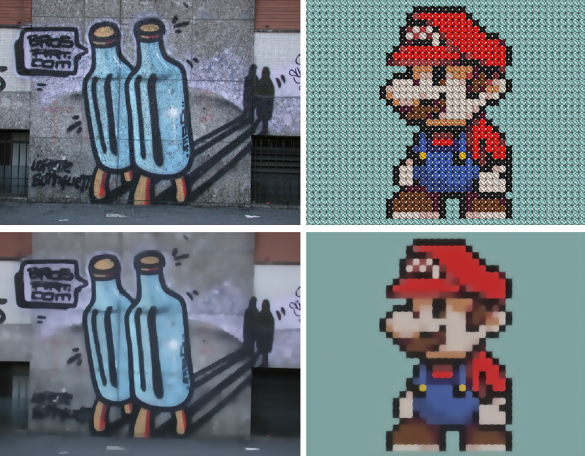
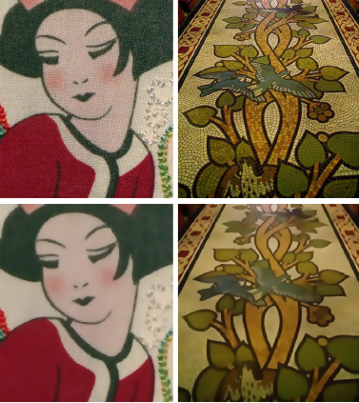
Sample input and output of the project

Slide 4

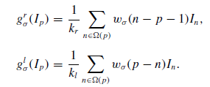



Get Interval Gradient
This is for get the normal gradient
W function here is exponential weighting
Function. Sigma is a scale parameter. The
range in the paper is [2,5], I will use 3

Slide 5





Gradient rescaling with Interval gradient
Normal gradient
Compare the sign of the normal gradient and the Interval gradient to do the gradient rescaling.
The size of the three gradient are same, and also same as the input image.
Interval gradient
Rescaled gradient
Rescaling weight
Error is 10^-4 in the project.
For not let the bot to be 0.

Slide 6

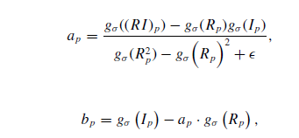



get the new image
Ps1: For the ap and bp, paper said they are for
the equation to get the mini
Ps2: In the ap, bp, g function is the gaussing
Smoothing function.
Ps3: opencv has the gaussing function.
epsilon range in the paper is [0.01^2,0.03^2],
I will use 0.03^2.

Slide 7
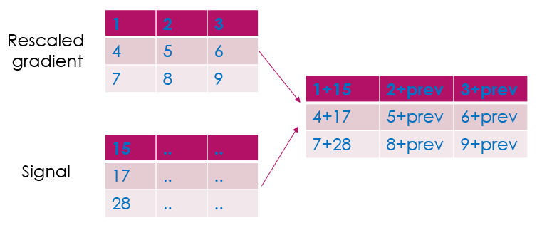
get the new image
Ps4: I think the Rp function is wrong

Slide 8
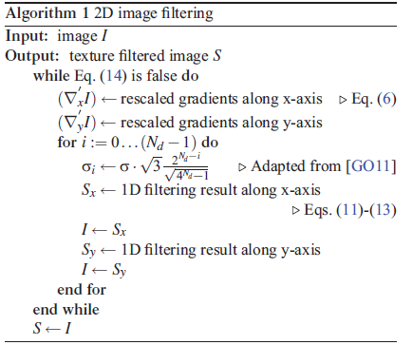

Algorithm
Sigma function is from the paper: (GO11)
Domain Transform for Edge-Aware Image and Video Processing
Iteration times, range is 3~5
the standard deviation of the desired kernel
standard deviation for the kernel used in each iteration

Slide 9
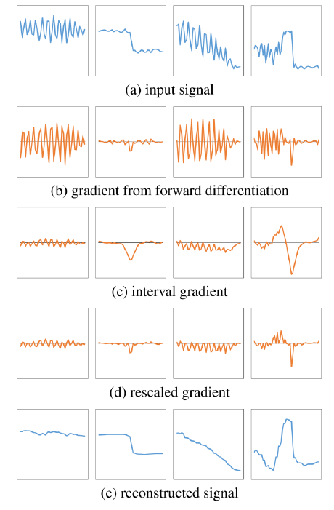

Slide 10
Thank you!

