Slide 1
Main project
Trace route and delay analysis
Yinglai wang, guangshi he

Slide 2
Design and Implementation
Data collection is done by using crontab running shell script on ecn machines.
Data frame work is implemented using MySQL and Java.
Data analysis is implemented by using Java and Python.
Result visualization is done by using Python.

Slide 3
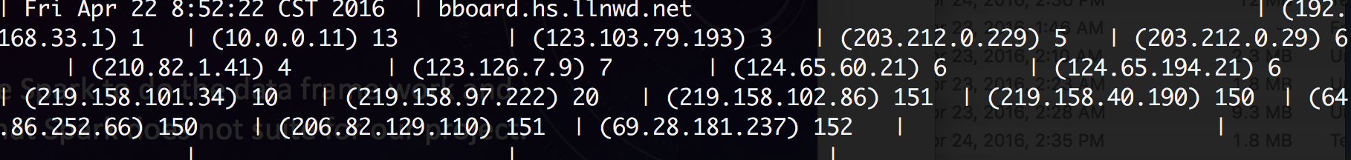
Main Setbacks
At the beginning of the project, we are planning use Apache Spark to do the data frame work and analysis. After 2 weeks of learning and trying, it turns out that Spark does not suite for our project.
As an alternative, MySQL is used as database.
The data collections is running on 2 ends, one in Purdue ECN, the other in Beijing China. But when the collection finished, the data from China shows some anomalies that causes it is not useable.
The data should have this form in the database:
But in the data from China, the server name has changed for some reason, now it has this form:

Slide 4
Now, some analysis result.

Slide 5
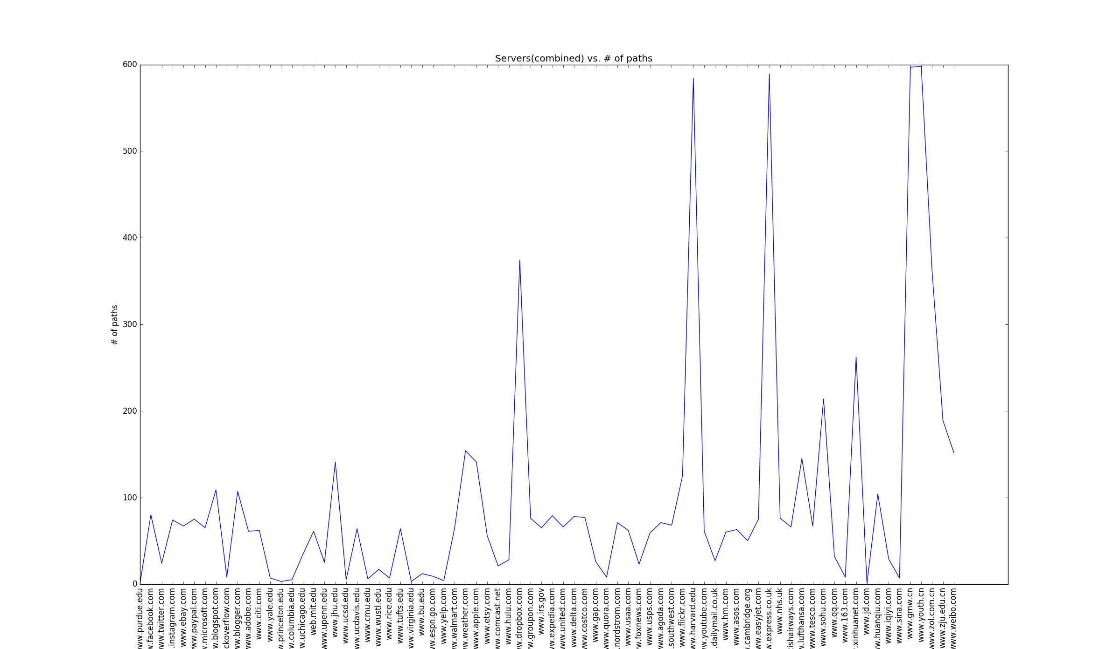
Number of paths corresponding to servers

Slide 6
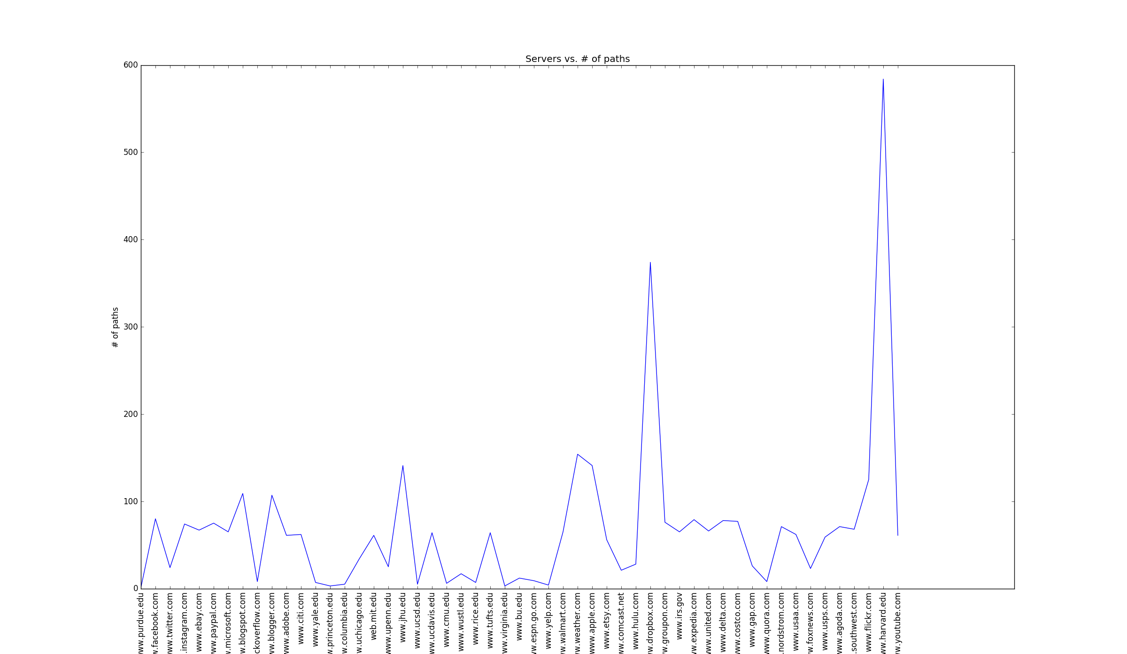
Number of paths corresponding to servers(US)

Slide 7
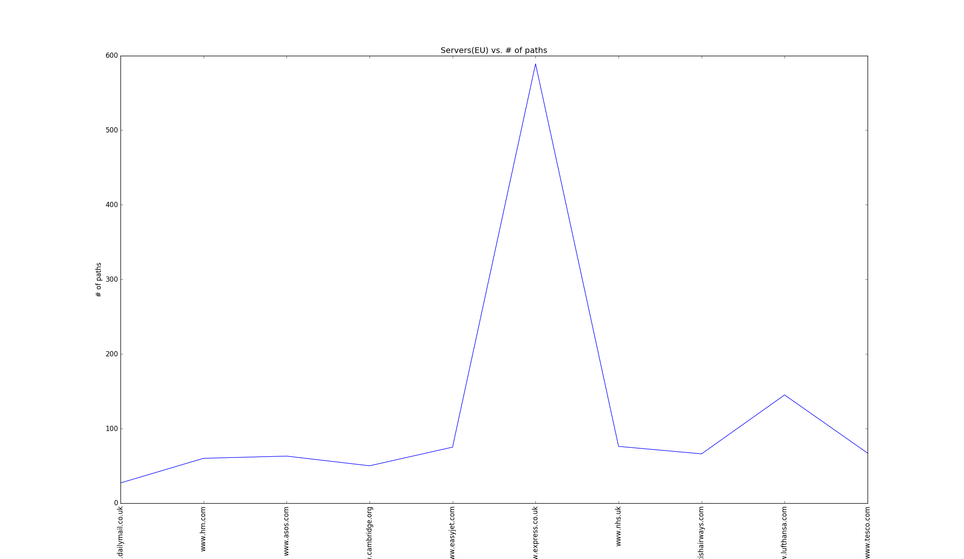
Number of paths corresponding to servers(EU)

Slide 8
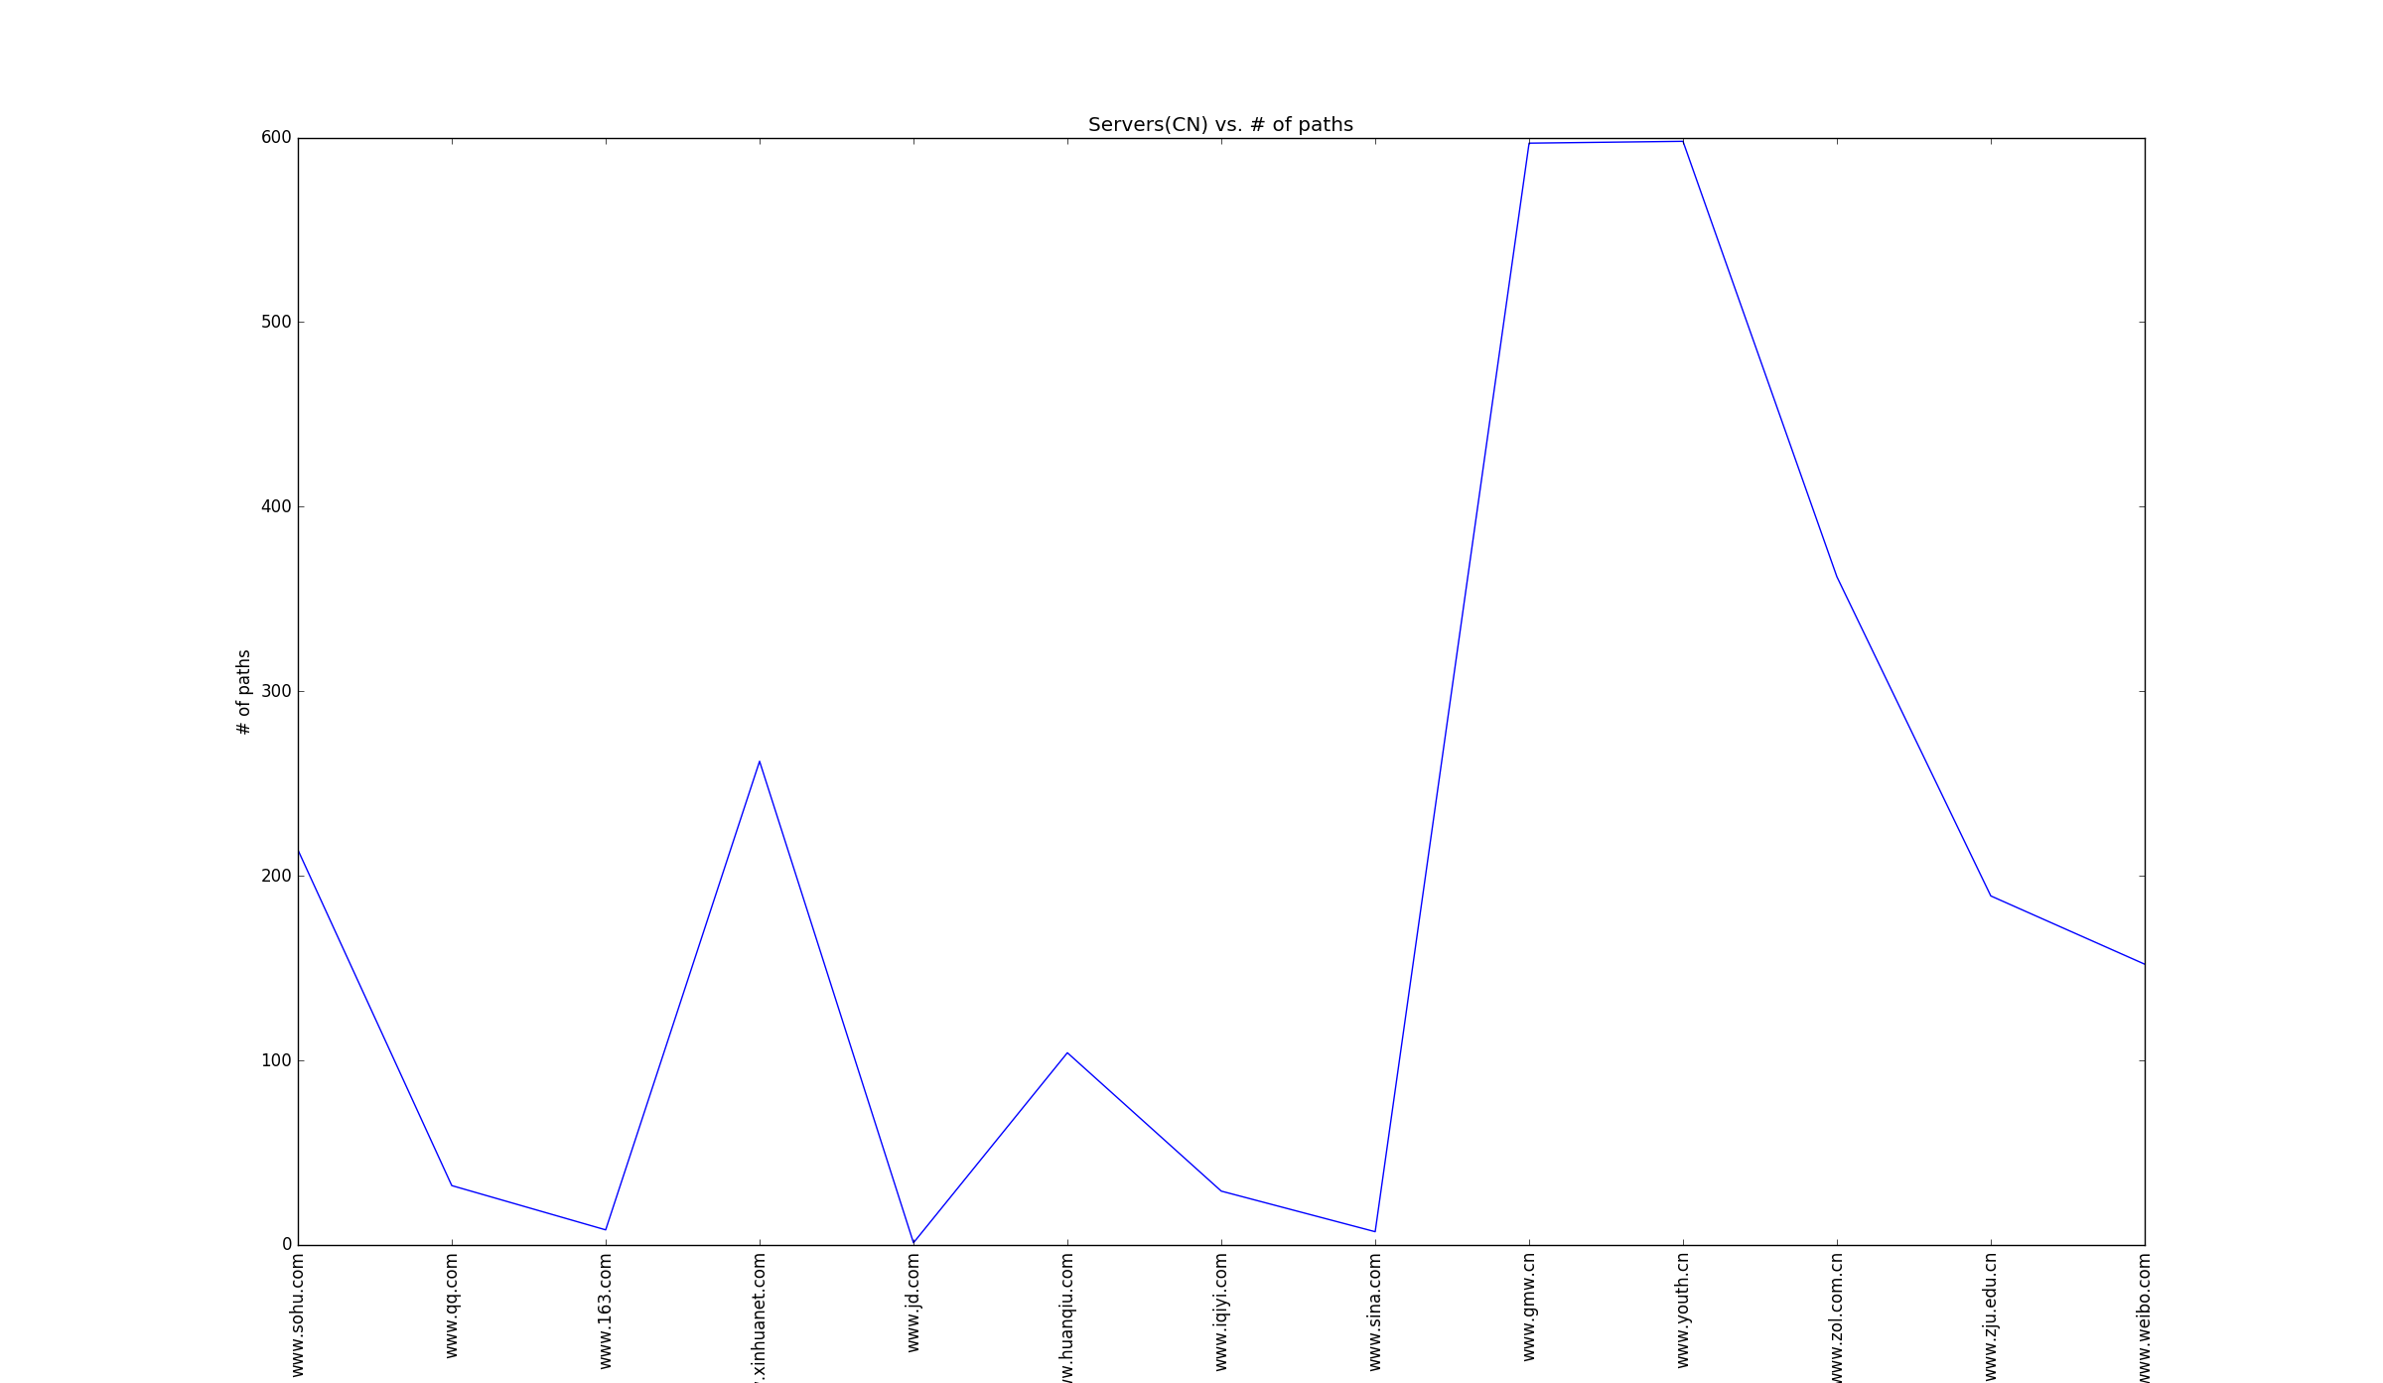
Number of paths corresponding to servers(CN)

Slide 9
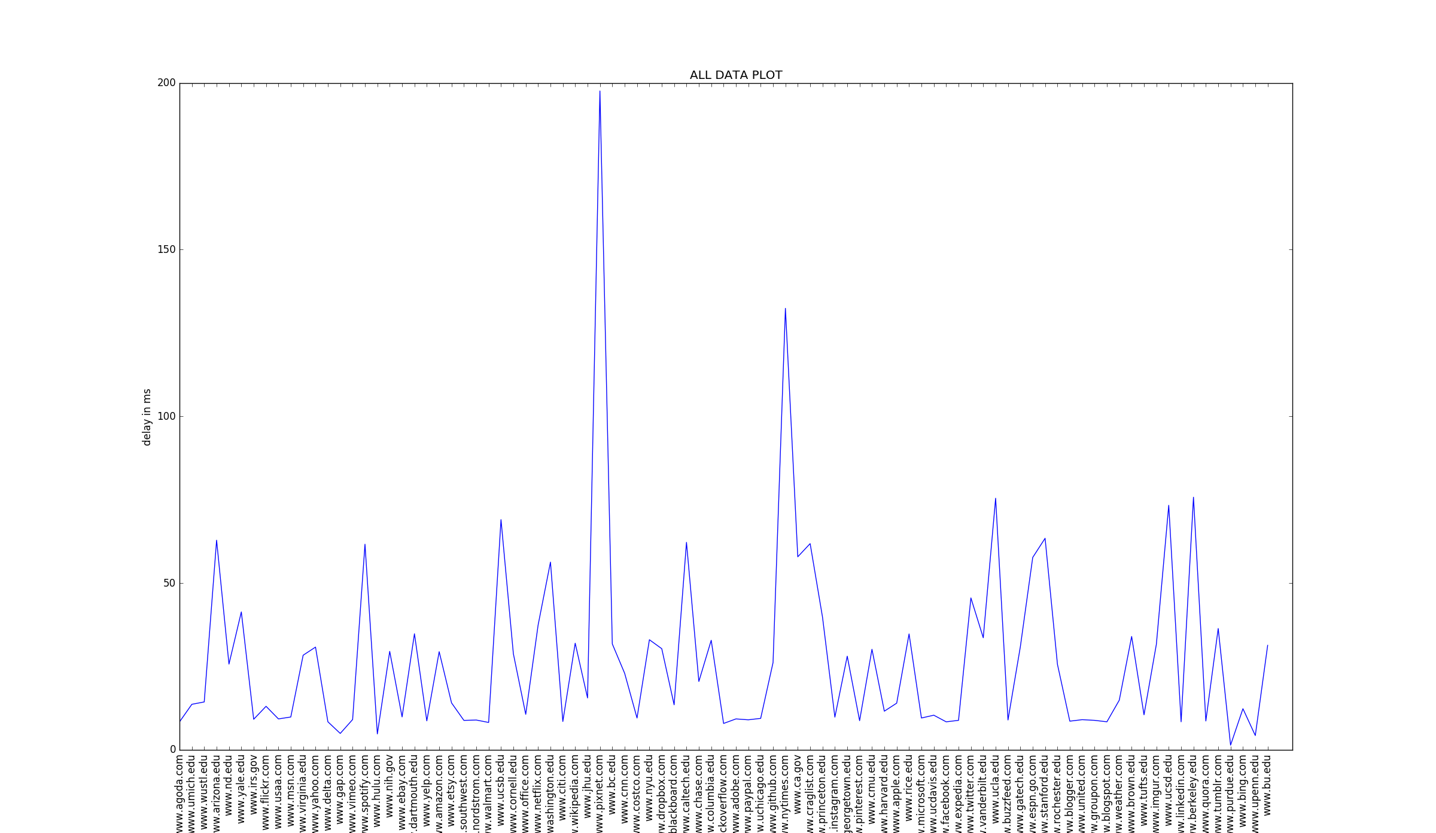
Delay data from ECN to US servers

Slide 10
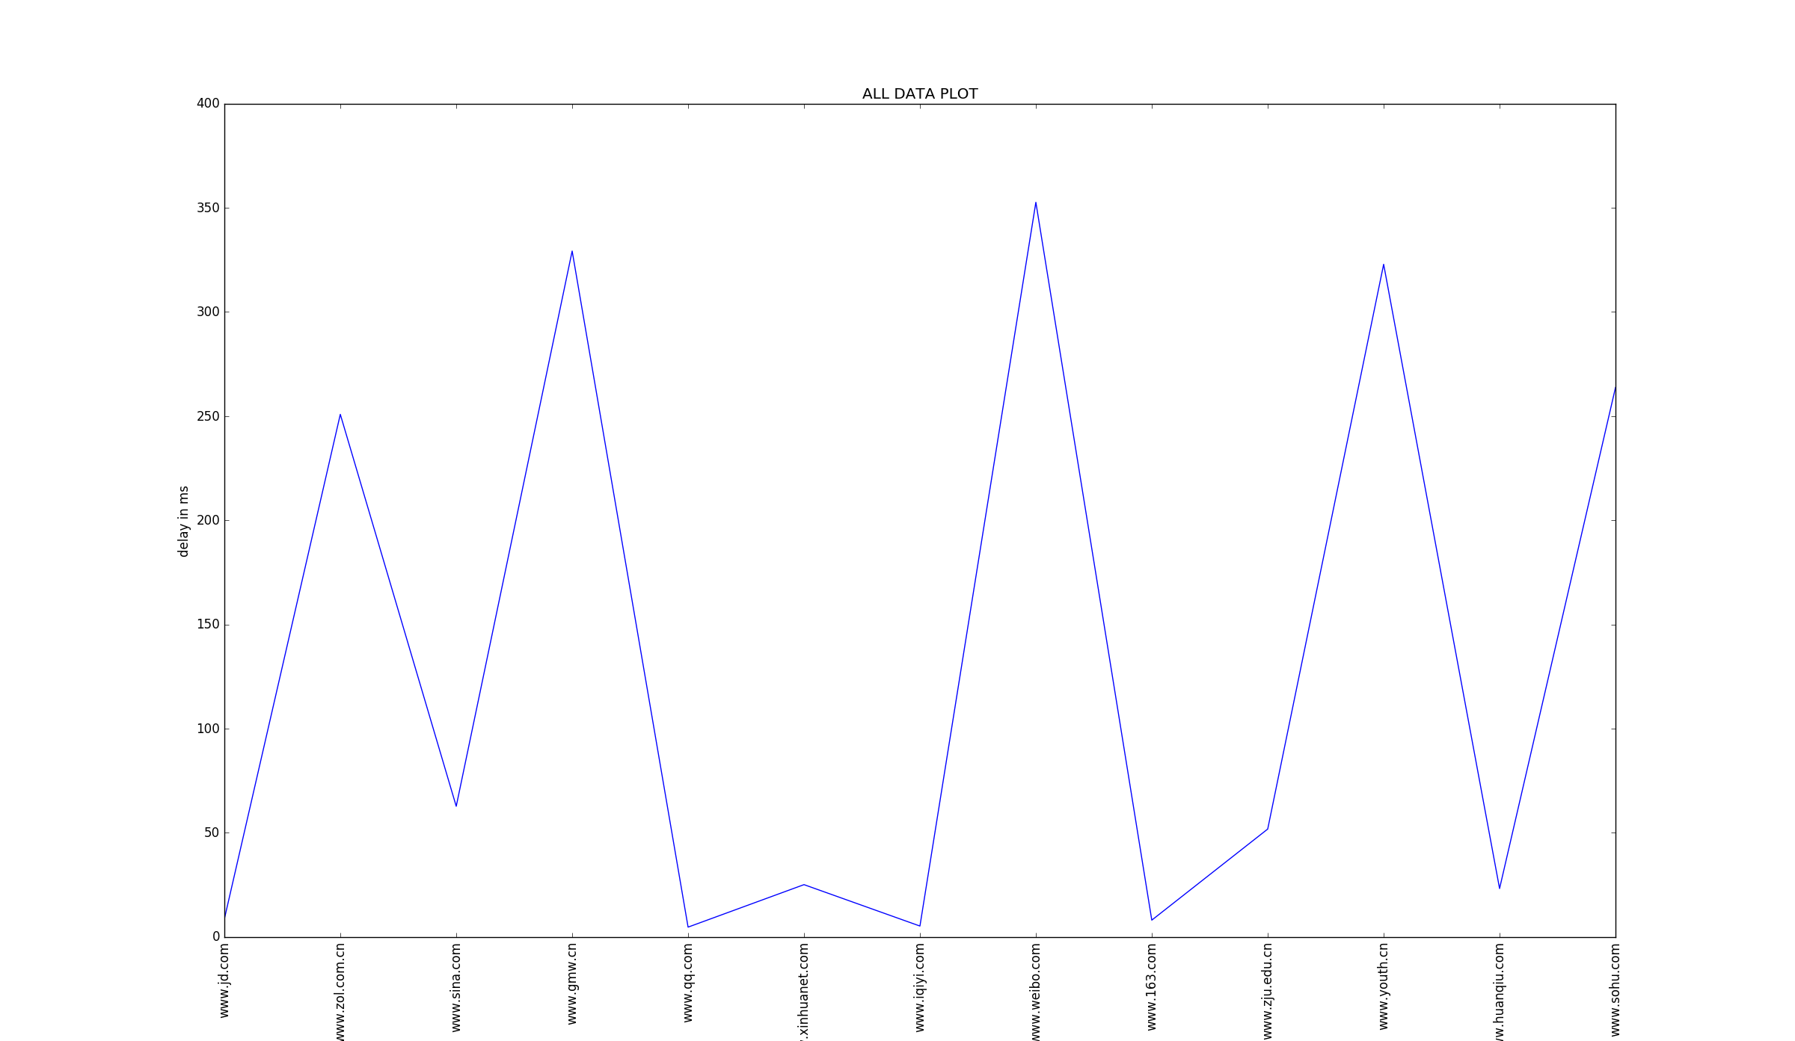
Delay data from ECN to CN servers

Slide 11
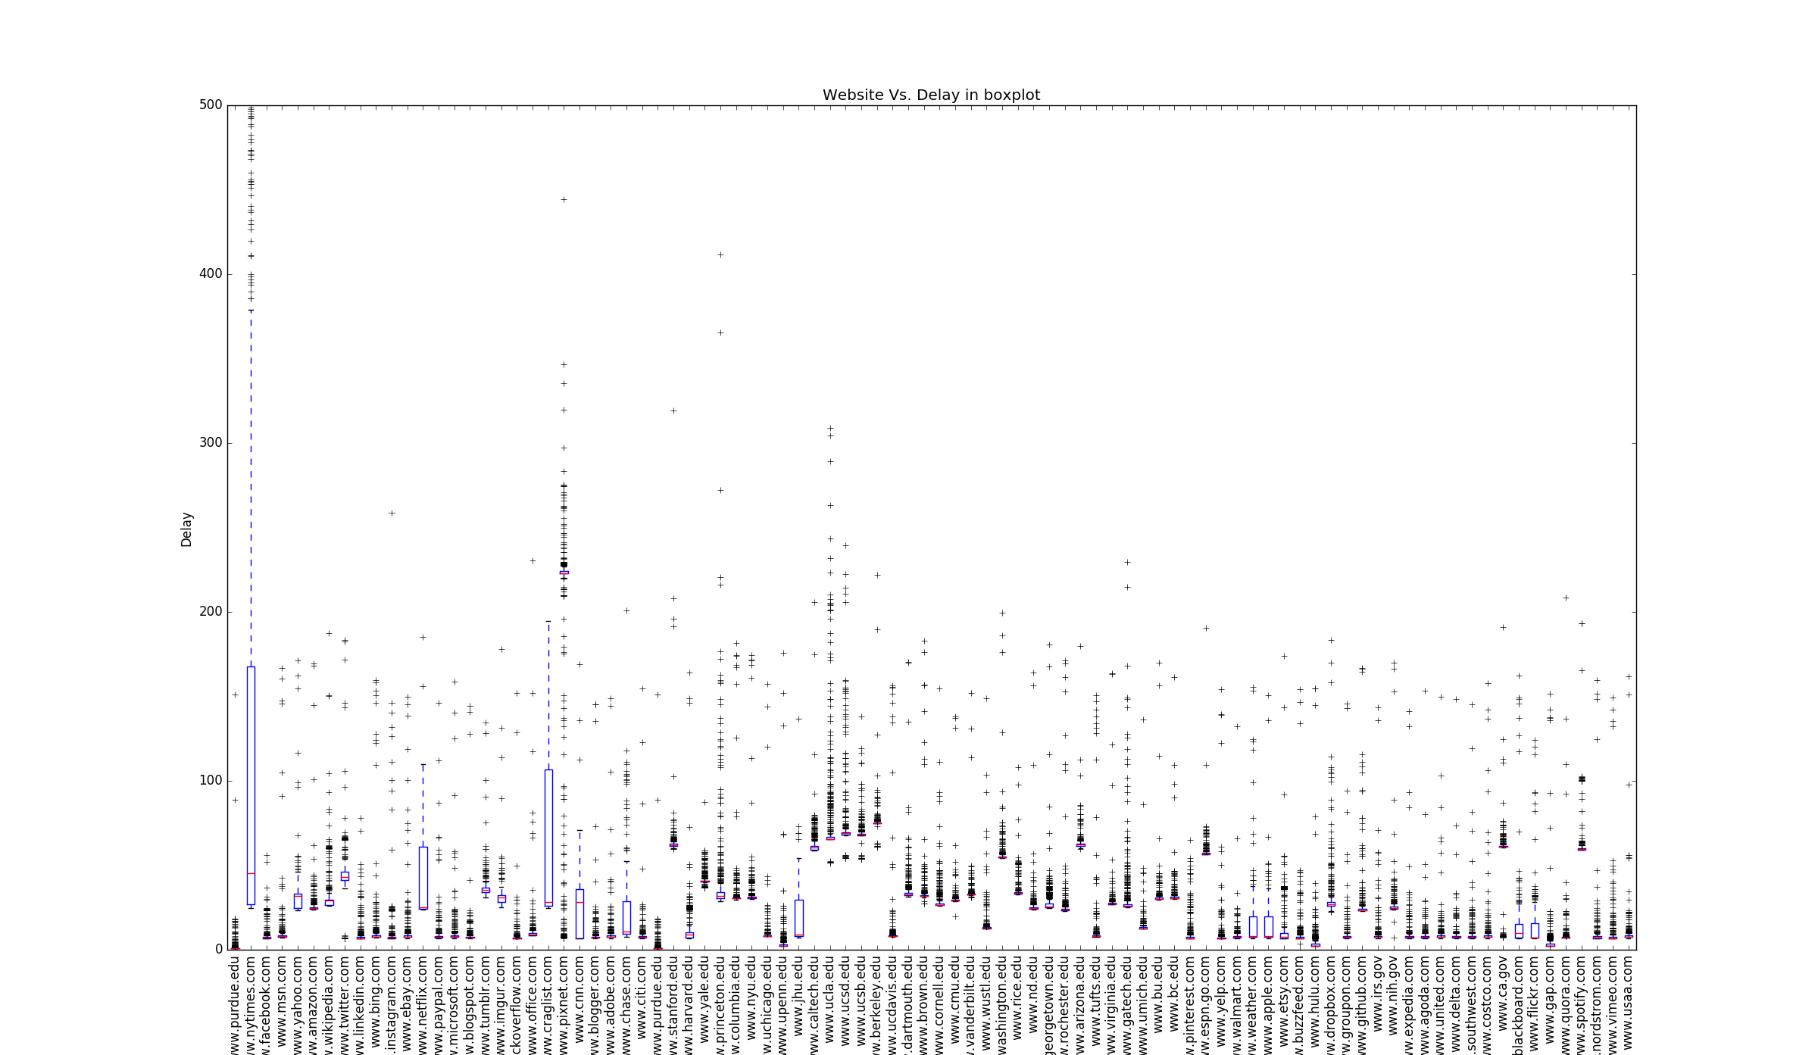
Delay variation data from ECN to US servers

Slide 12
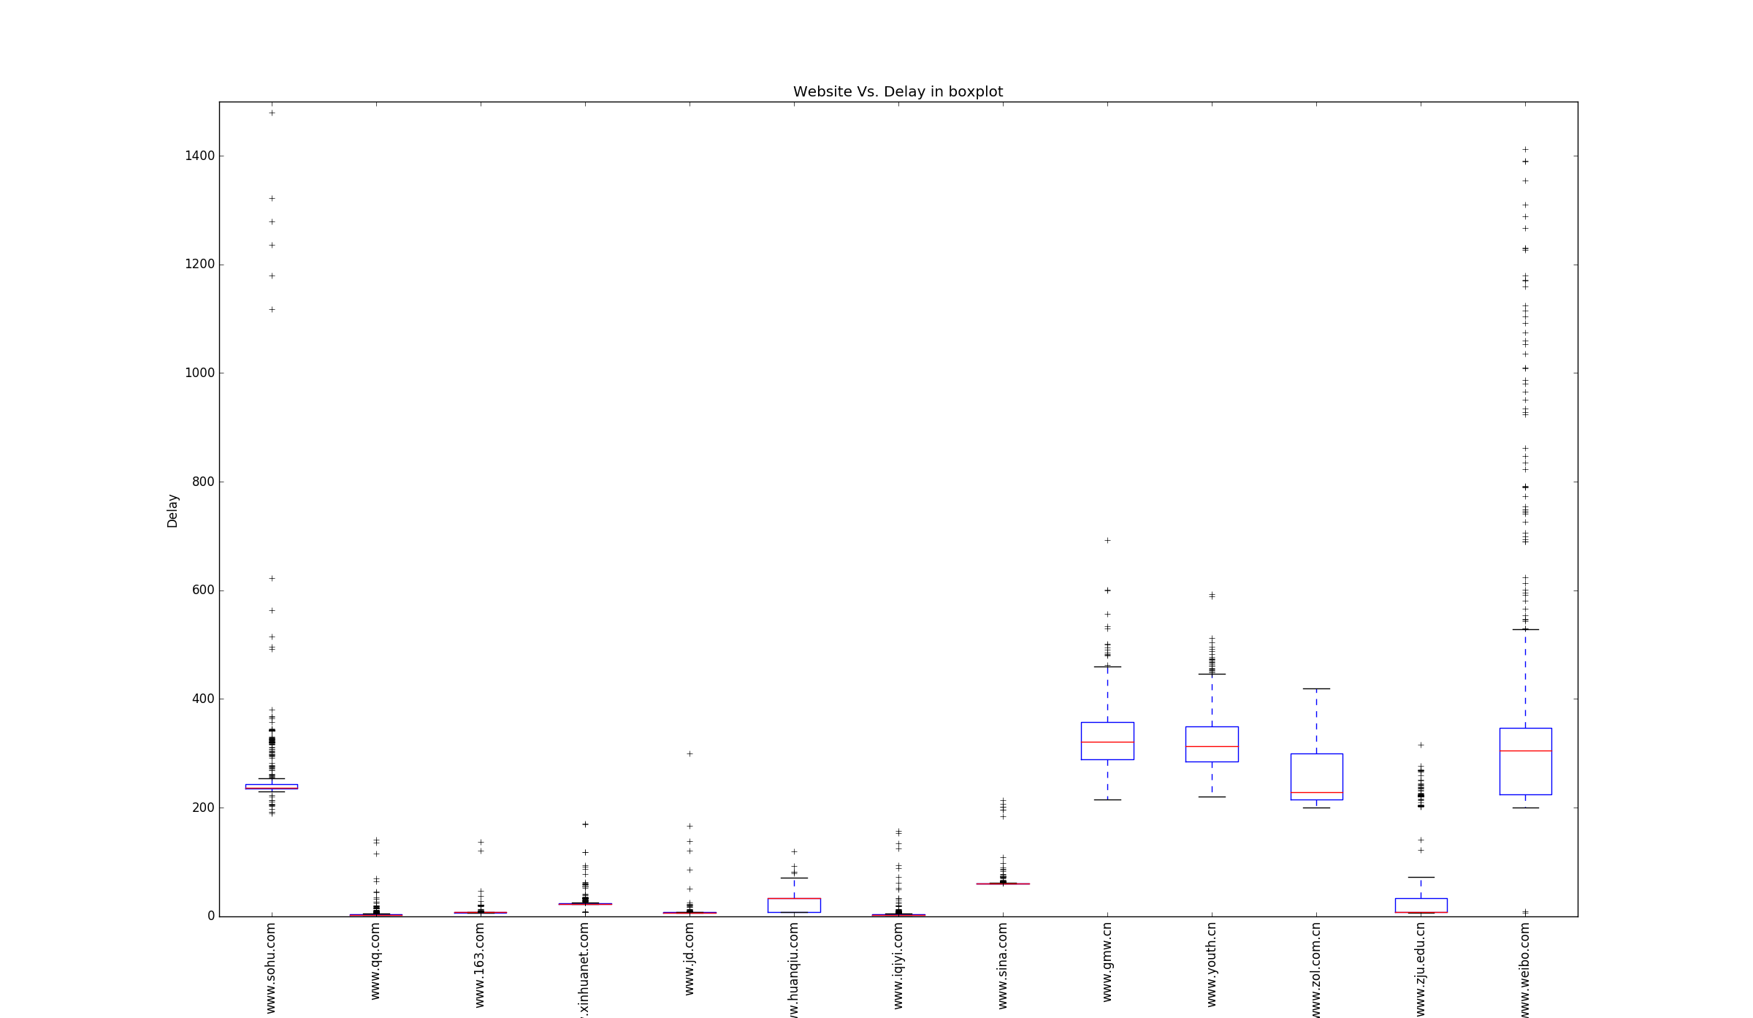
Delay variation data from ECN to CN servers

Slide 13
Analysis on specific site
We pick www.sohu.com as an example.
In the plot, it is clear that tracing to www.sohu.com most of the time is stable, but it is also clear that contains anomaly links, which lead its max value very high.
And we are able to detect the unstable links using the detect_problematic links algorithm we implemented.(will demo later)
There are 3 unusual routing paths we detected, we chose one of them to explore:
1 (128.46.4.1) 0.802
2 (192.5.40.8) 4.899
3 (192.5.40.82) 2.135
4 (64.57.21.13) 6.913
5 (64.57.20.150) 7.114
6 (64.57.20.148) 17.941
7 (64.57.20.146) 38.274
8 (64.57.20.144) 50.569
9 (64.57.20.127) 50.540
10 (162.252.69.139) 55.001
11 (202.97.50.29) 54.701
12 (202.97.35.217) 239.908
13 (101.95.120.185) 262.176
14 (101.95.207.50) 193.247
15 (101.95.225.230) 3977.932

Slide 14
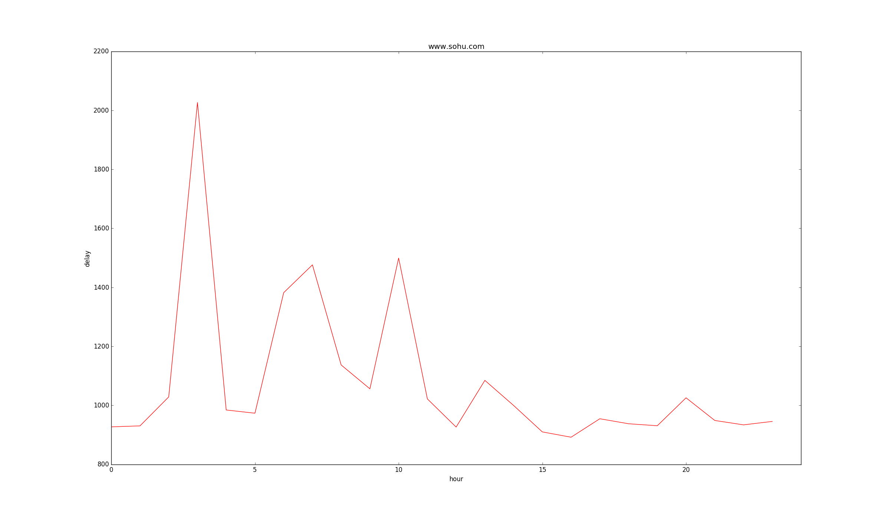
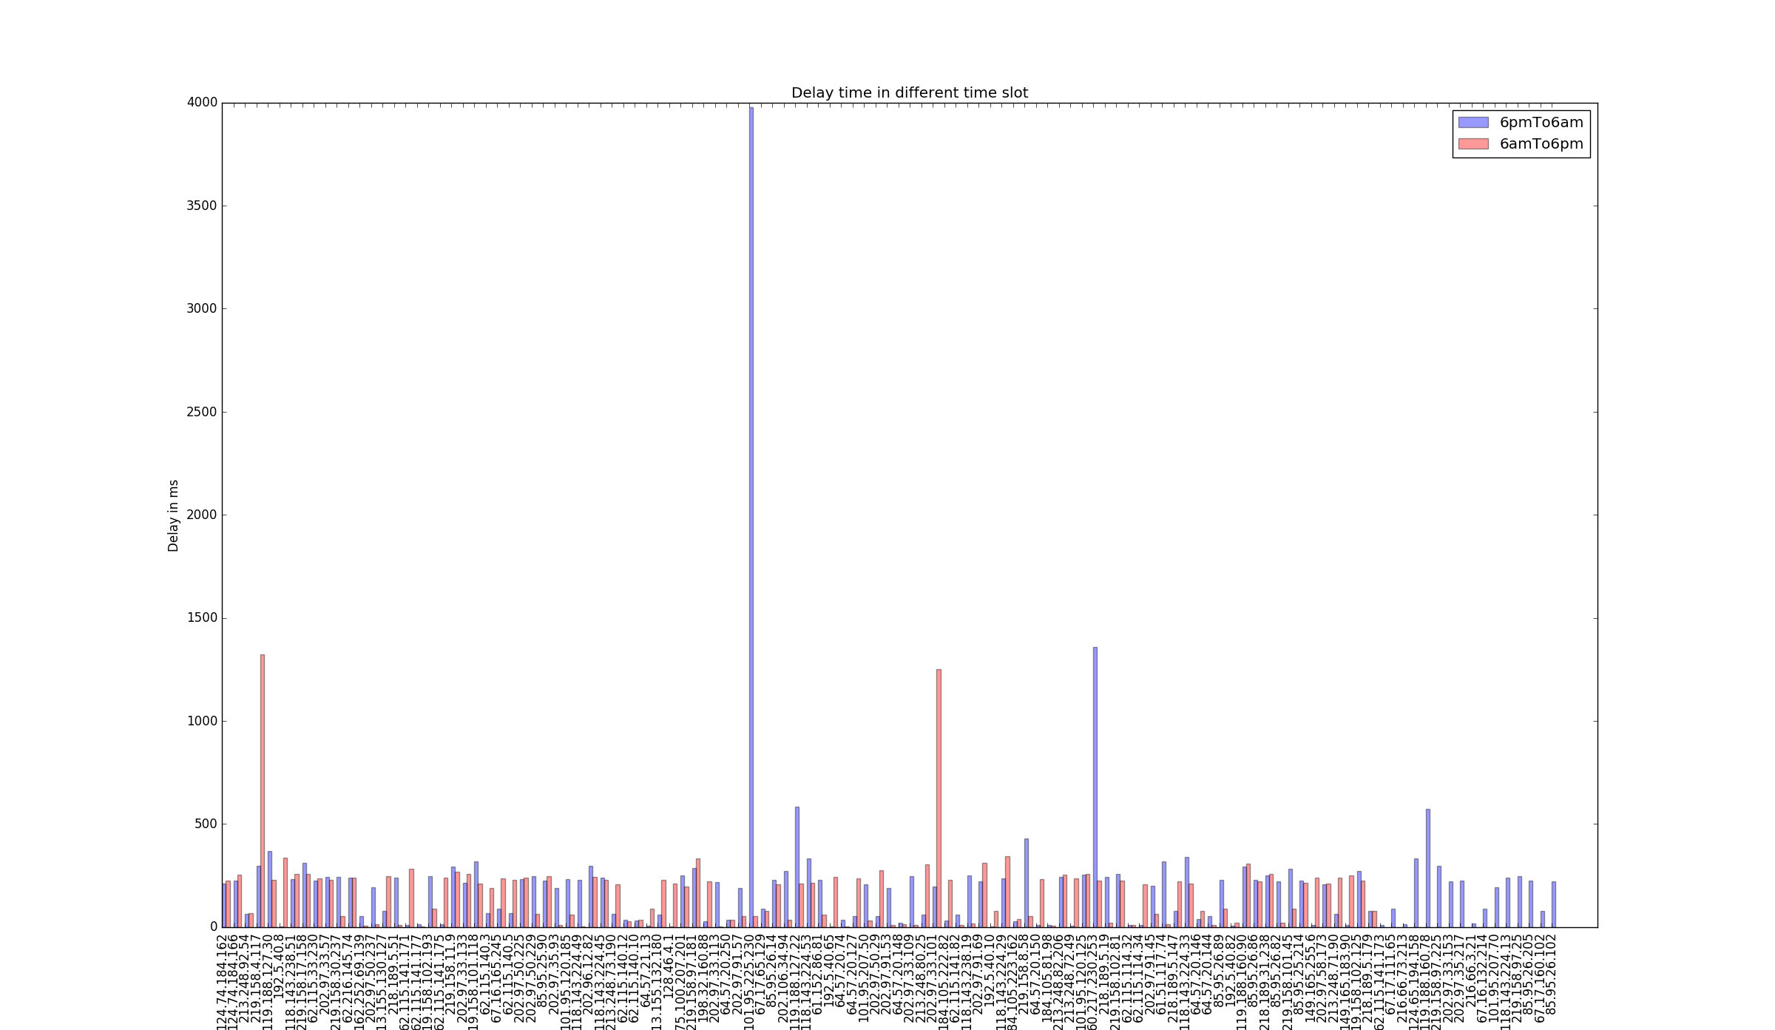
Analysis on specific site(Ct.)

Slide 15
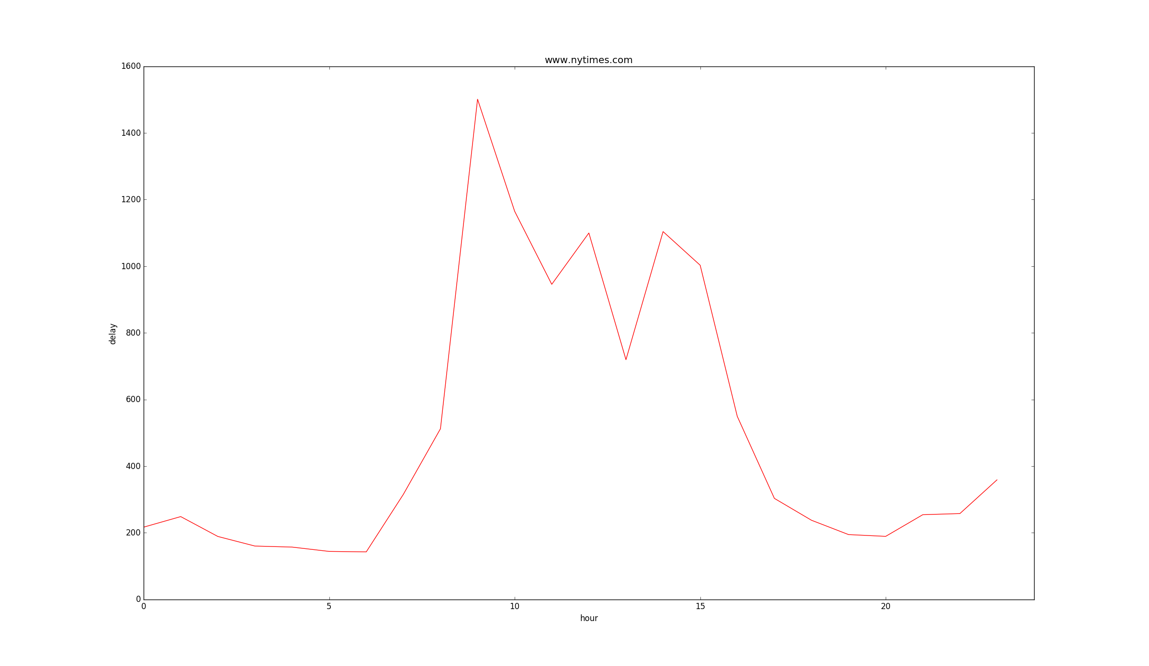
Analysis on specific site(Ct.)
From the box plot, we can tell that in all us servers, www.nytimes.com stands out.
Normally, we will suspect that it might have problematic links.
Now, a plot of delay over all hours in a day will explain.
During day times, there is an extremely high delay point.
We would need more data to explore this issue.

Slide 16

Now, we can see there is an extreme high delay through one specific router.
But the algorithm failed to pick up this problematic link.
We combined the plot result with the path result, which is the total path of trace to www.nytimes.com takes and how many times each path appeared.
A interesting fact is found, this link is actually belongs to the steady routing path. It explains why it is not counted as problematic link, because this link appears multiple times in the routing path and only one time has a higher delay than usual.

Slide 17
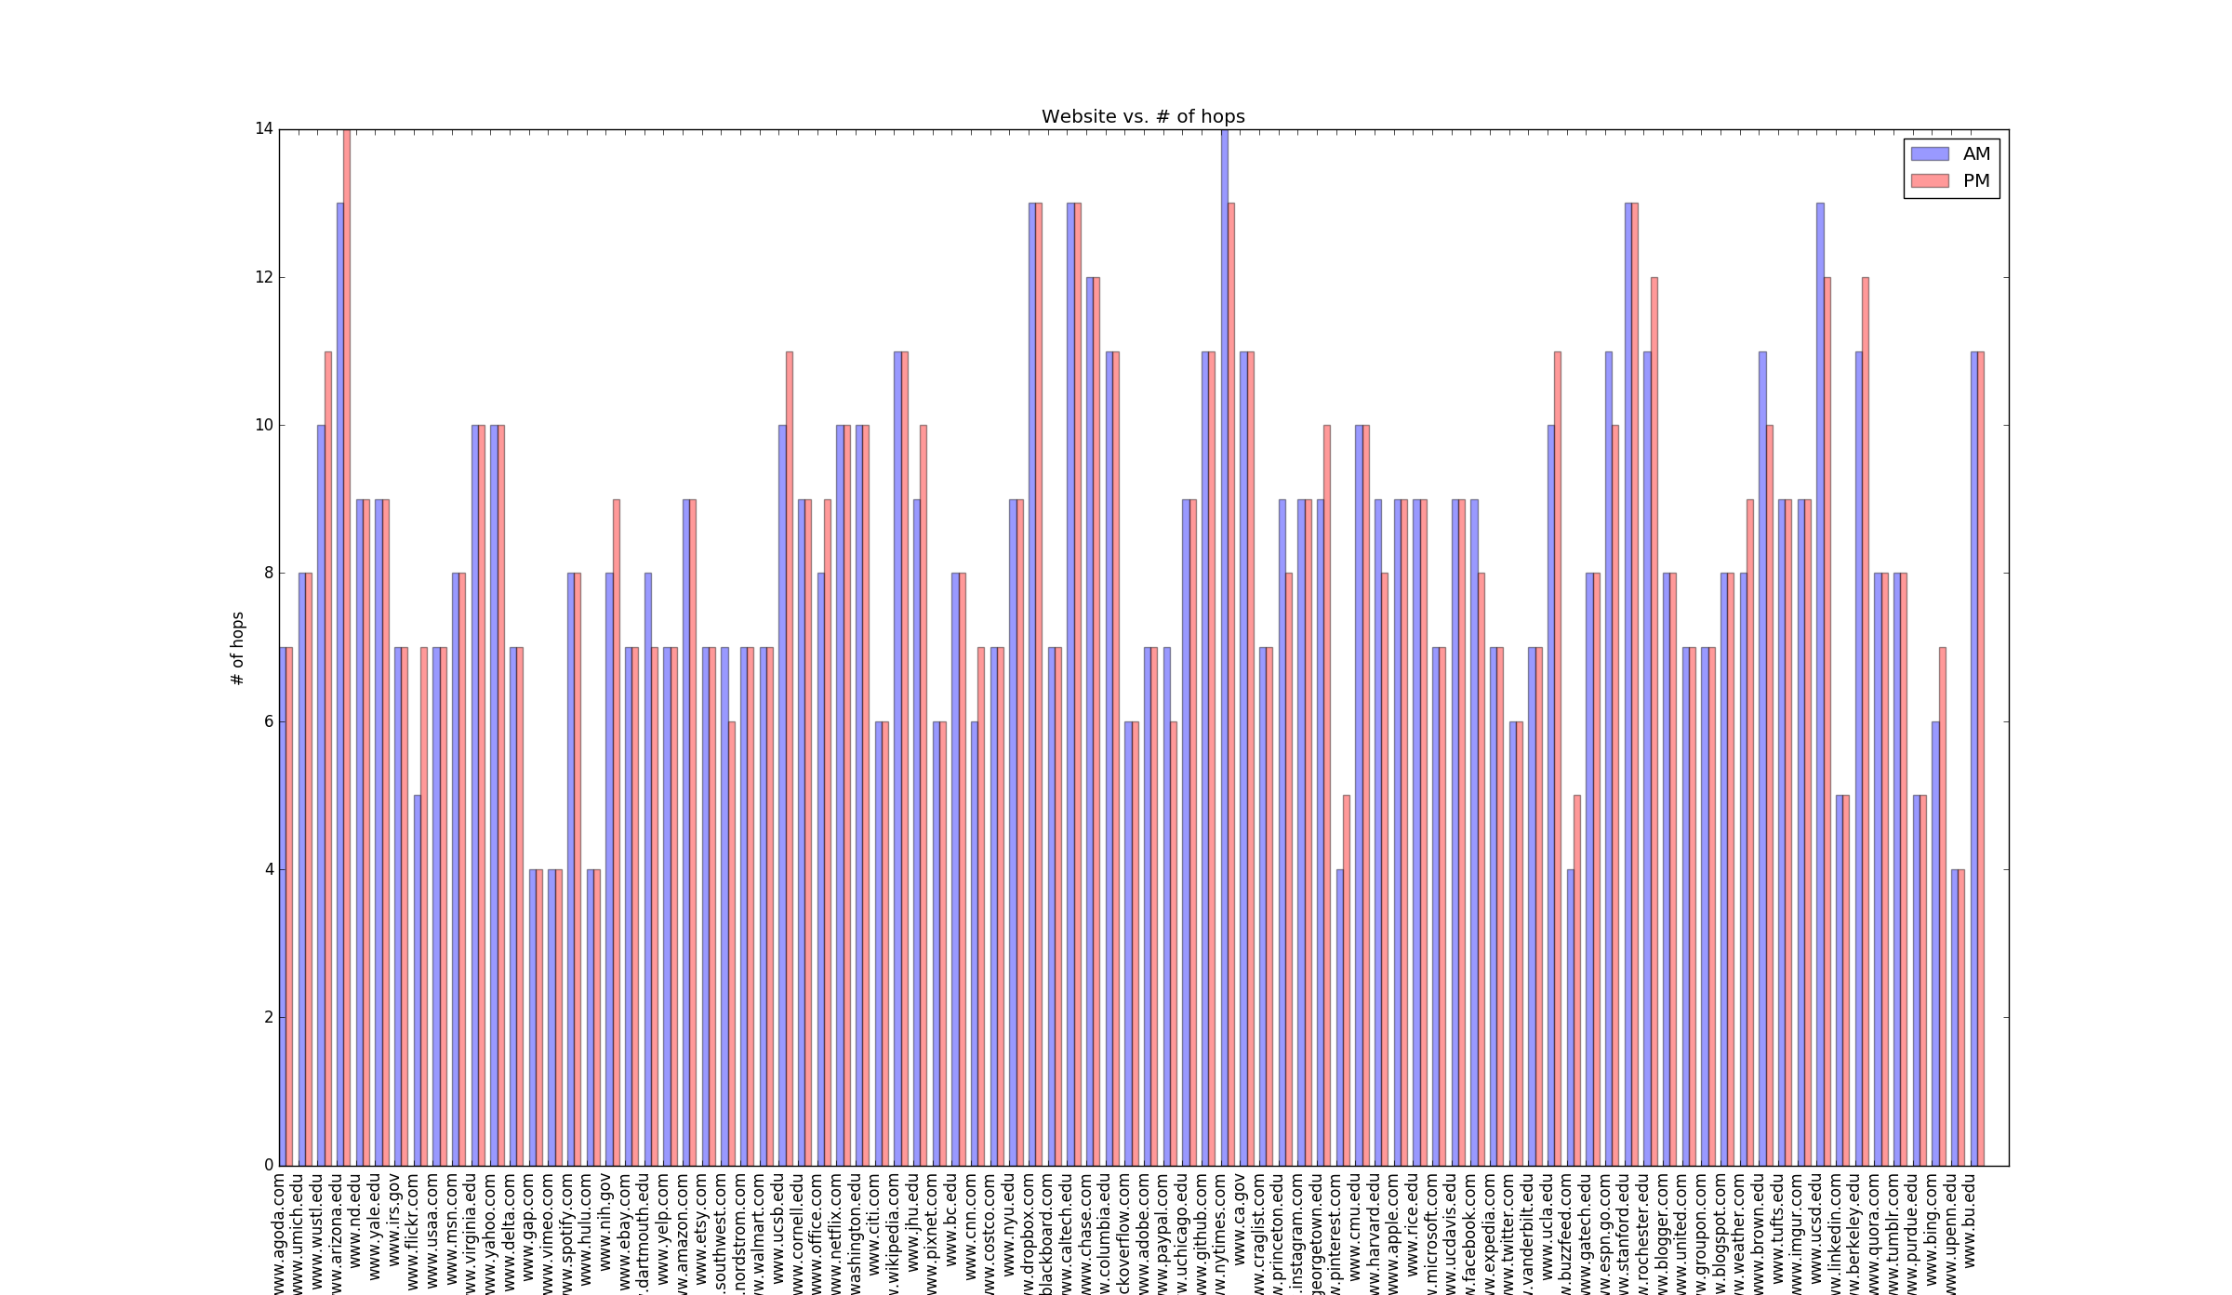

Slide 18
Additional Implementation
Many different kinds of statistical analysis
Trace route prediction
Given a steady routing path during a specific time period
Detect problematic link

Slide 19
Work Distribution
Most data analysis and all result visualization is done by member Guanshi He.
Path analysis and statistical analysis during different time period over nearly 200 servers
Delay statistic over time and variation
Detailed routing information of above
All data collection and data frame work and some portion of the analysis is done by member Yinglai Wang.
Set up crontab and shell script on all machines
Import Data into SQL database, reorganize data for analysis using(include oath analysis)
Detect problematic path, finding stable path, tracing prediction

