Slide 1
Learning From Mistakes — A Comprehensive Study on Real World Concurrency Bug Characteristics
Shan Lu, soyeon park, eunsoo seo & yuanyuan zhou
BY
Yinglai wang

Slide 2
INTRODUCTION
Real-World Concurrency Bug Characteristic Study
105 Real-World concurrency bugs
MySQL
Apache
Mozilla
OpenOffice

Slide 3
METHODOLOGY
Why Select?
MySQL
Apache
Mozilla
OpenOffice
1-4 Million Lines of code
Well maintained bug database
Different type of server/client applications
Concurrency is extensively used (100/1000) Threads

Slide 4
METHODOLOGY
Bug Source
Collect 500 bugs from thousands based on the keywords in bug report
Race(s)
Dead-lock(s)
Synchronization(s)
Concurrency
Locks(s)
Mutex(es)
Atmoic
Compete(s)

Slide 5
METHODOLOGY
Deadlock / Non-Deadlock Concurrency Bugs

Slide 6
FINDINGS
1/3 bugs result from order of the code
34% bugs involve variable addressing problems
92% bugs can be triggered by enforcing order < 4 memory accesses
73% bugs not fixed by adding/changing locks

Slide 7
BUG PATTERN STUDY
Transactional Memory
Concurrent programming by allowing a group of load and store instructions to execute in an atomic way

Slide 8
Concurrency Bugs Characteristics
Non-Deadlock bugs
Atomicity-violation
Order-Violation
Others (Note: Data race is not considered as a bug pattern)
Required Condition – How Many?
Threads
Variables
Memory Accesses
Bug fix strategy

Slide 9
BUG PATTERN STUDY
Root Causes of Non-Deadlock Bugs

Slide 10
BUG PATTERN STUDY
Finding
Most (72 out of 74) of the examined non-deadlock concurrency bugs are covered by two simple patterns: atomicity- violation and order-violation.
Implications
Concurrent program bug detection, testing and language design should first focus on these two major bug patterns.

Slide 11
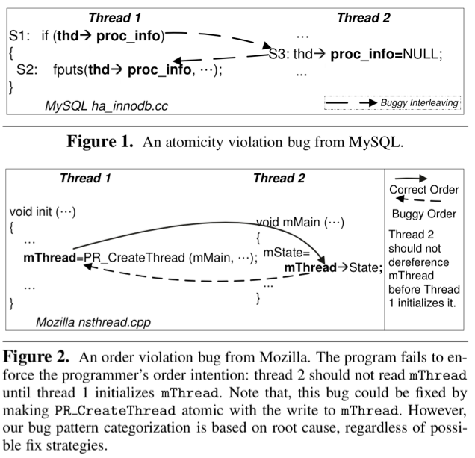

Slide 12
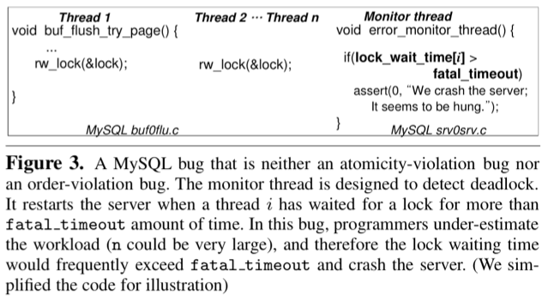

Slide 13
BUG MINFESTATION
Finding
66% (49 out of 74) of the examined non-deadlock concurrency bugs involve only one variable.
97% (30 out of 31) of the examined deadlock concurrency bugs involve at most two resources
Implications
Focusing on concurrent accesses to one variable is a good simplification for concurrency bug detection.
Deadlock-oriented testing can pairwise test the order of acquisition and release of two resources

Slide 14
FIX STRATEGIES
Non-Deadlock Concurrency Bugs
4 Strategies
Condition Check (e.g. Figure 8)
Code Switch (Figure 4)
Algorithm / Data Structure design change
Locks

Slide 15
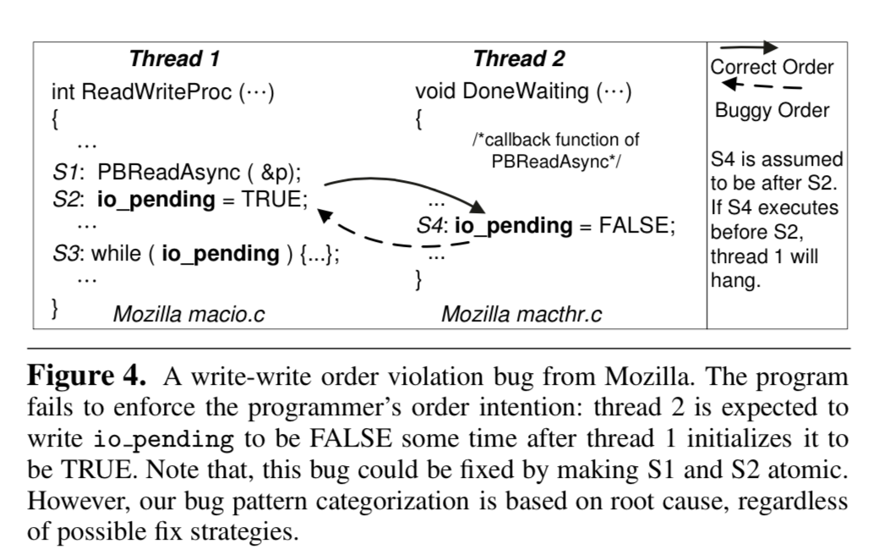

Slide 16
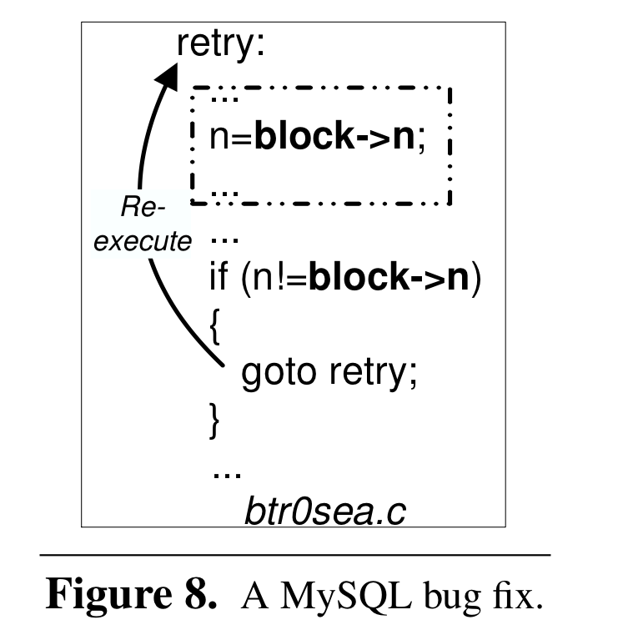

Slide 17
