Slide 1
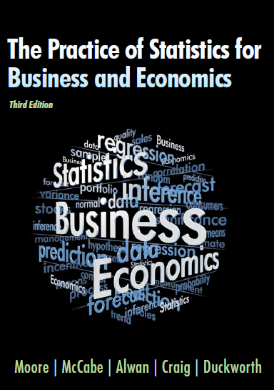
The Practice of Statistics for Business and Economics Third Edition
David S. Moore
George P. McCabe
Layth C. Alwan
Bruce A. Craig
William M. Duckworth
© 2011 W.H. Freeman and Company

Slide 2
Probability and Sampling Distributions Randomness and Probability Models
PSBE Chapters 4.1 and 4.2
© 2011 W.H. Freeman and Company

Slide 3
Objectives (PSBE Chapters 4.1 and 4.2)
Randomness and Probability Models
Randomness and probability
Probability rules
Assigning probabilities: finite number of outcomes
Assigning probabilities: intervals of outcomes
Normal probability models

Slide 4
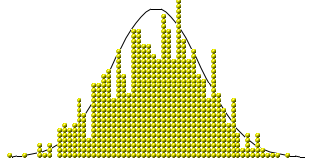
Randomness and probability
A phenomenon is random if individual outcomes are uncertain, but there is nonetheless a regular distribution of outcomes in a large number of repetitions.
The probability of any outcome of a random phenomenon can be defined as the proportion of times the outcome would occur in a very long series of repetitions.

Slide 5
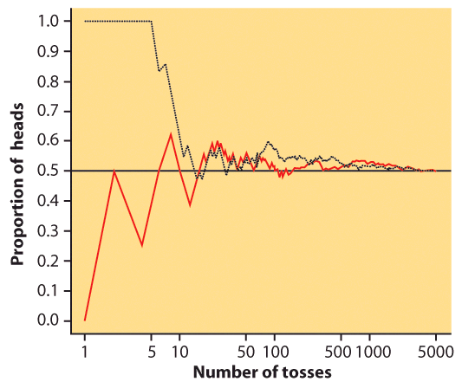
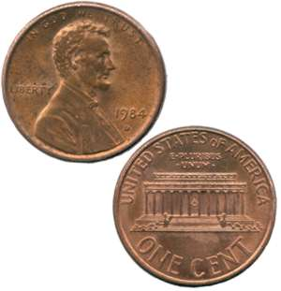
Coin toss
The result of any single coin toss is random. But the result over many tosses is predictable, as long as the trials are independent (i.e., the outcome of a new coin flip is not influenced by the result of the previous flip).
The probability of heads is 0.5 = the proportion of times you get heads in many repeated trials.
First series of tosses
Second series

Slide 6
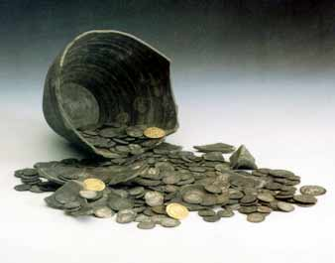
Two events are independent if the probability that one event occurs on any given trial of an experiment is not affected or changed by the occurrence of the other event.
When are trials not independent?
Imagine that these coins were spread out so that half were heads up and half were tails up. Close your eyes and pick one. The probability of it being heads is 0.5. However, if you don’t put it back in the pile, the probability of picking up another coin and having it be heads is now less than 0.5.
The trials are independent only when you put the coin back each time. It is called sampling with replacement.

Slide 7
Probability models
Probability models describe mathematically the outcome of random processes and consist of two parts:
1) S = Sample Space: This is a set, or list, of all possible outcomes of a random process. An event is a subset of the sample space.
2) A probability for each possible event in the sample space S.
Example: Probability Model for a Coin Toss:
S = {Head, Tail}
Probability of heads = 0.5
Probability of tails = 0.5

Slide 8
Sample spaces It’s the question that determines the sample space.
H - HHH
A. A basketball player shoots three free throws. What are the possible sequences of hits (H) and misses (M)?
H
M - HHM
H
S = { HHH, HHM, HMH, HMM, MHH, MHM, MMH, MMM }
Note: 8 elements, 2³
M
H - HMH
M - HMM
M …
…
B. A basketball player shoots three free throws. What is the number of baskets made?
S = { 0, 1, 2, 3 }

Slide 9
Probability rules
Coin Toss Example:
S = {Head, Tail}
Probability of heads = 0.5
Probability of tails = 0.5
1) Probabilities range from 0 (no chance of the event) to 1 (the event has to happen).
For any event A, 0 ≤ P(A) ≤ 1
Probability of getting a Head = 0.5
We write this as: P(Head) = 0.5
P(neither Head nor Tail) = 0
P(getting either a Head or a Tail) = 1
2) Because some outcome must occur on every trial, the sum of the probabilities for all possible outcomes (the sample space) must be exactly 1.
P(sample space) = 1
Coin toss: S = {Head, Tail}
P(head) + P(tail) = 0.5 + 0.5 =1
→ P(sample space) = 1

Slide 10
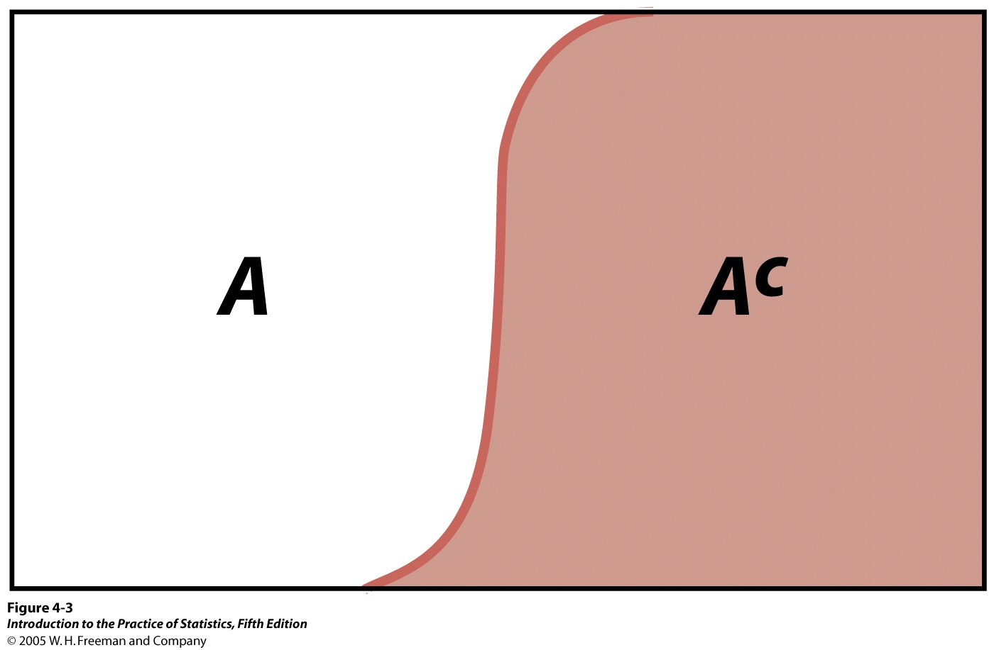
Coin Toss Example:
S = {Head, Tail}
Probability of heads = 0.5
Probability of tails = 0.5
Probability rules (cont.)
3) The complement of any event A is the event that A does not occur, written as A^{c}.
The complement rule states that the probability of an event not occurring is 1 minus the probability that it does occur.
P(not A) = P(A^{c}) = 1 − P(A)
Tail^{c} = not Tail = Head
P(Tail^{c}) = 1 − P(Head) = 0.5
Venn diagram:
Sample space made up of an event A and its complementary A^{c}, i.e., everything that is not A.

Slide 11
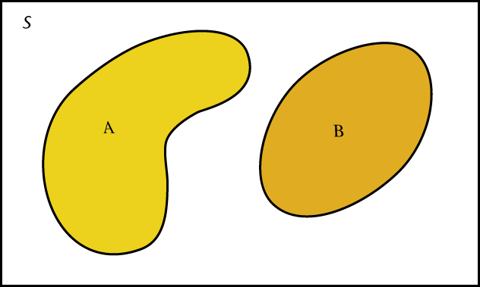
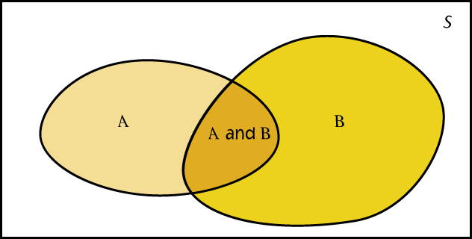
Probability rules (cont. )
Venn diagrams:
A and B disjoint
4) Two events A and B are disjoint if they have no outcomes in common and can never happen together. The probability that A or B occurs is then the sum of their individual probabilities.
P(A or B) = “P(A U B)” = P(A) + P(B)
This is the addition rule for disjoint events.
A and B not disjoint
Example: If you flip two coins, and the first flip does not affect the second flip: S = {HH, HT, TH, TT}. The probability of each of these events is 1/4, or 0.25.
The probability that you obtain “only heads or only tails” is: P(HH or TT) = P(HH) + P(TT) = 0.25 + 0.25 = 0.50

Slide 12

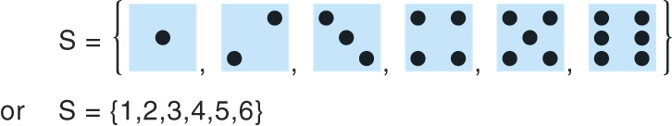
Assigning probabilities: finite number of outcomes
Finite sample spaces deal with discrete data — data that can only take on a limited number of values. These values are often integers or whole numbers.
The individual outcomes of a random phenomenon are always disjoint. ➔ The probability of any event is the sum of the probabilities of the outcomes making up the event (addition rule).
Throwing a die:
S = {1, 2, 3, 4, 5, 6}

Slide 13
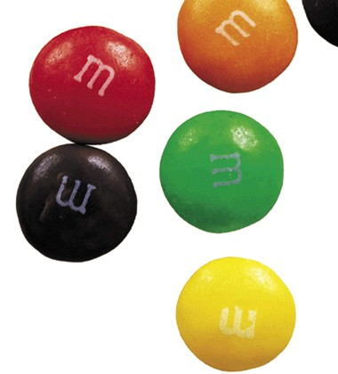
M&M’s® candies
If you draw an M&M’s® candy at random from a bag, the candy will have one of six colors. The probability of drawing each color depends on the proportions manufactured, as described here:
What is the probability that an M&M’s® candy chosen at random is blue?
Color | Brown | Red | Yellow | Green | Orange | Blue
Probability | 0.3 | 0.2 | 0.2 | 0.1 | 0.1 | ?
S = {brown, red, yellow, green, orange, blue}
P(S) = P(brown) + P(red) + P(yellow) + P(green) + P(orange) + P(blue) = 1
P(blue) = 1 – [P(brown) + P(red) + P(yellow) + P(green) + P(orange)]
= 1 – [0.3 + 0.2 + 0.2 + 0.1 + 0.1] = 0.1
What is the probability that a random M&M’s® candy is red, yellow, or orange?
P(red or yellow or orange) = P(red) + P(yellow) + P(orange)
= 0.2 + 0.2 + 0.1 = 0.5

Slide 14
Probabilities: equally likely outcomes
We can assign probabilities either:
empirically → from our knowledge of numerous similar past events
Mendel discovered the probabilities of inheritance of a given trait from experiments on peas without knowing about genes or DNA.
or theoretically → from our understanding the phenomenon and symmetries in the problem
A six-sided fair die: each side has the same chance of turning up
Genetic laws of inheritance based on meiosis process
If a random phenomenon has k equally likely possible outcomes, then each individual outcome has probability 1/k.
And, for any event A:

Slide 15
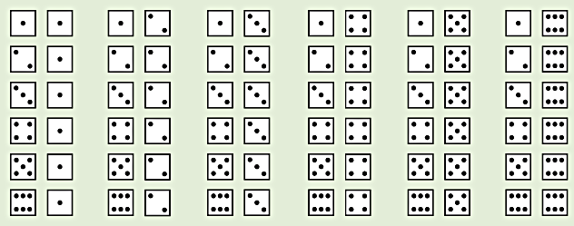
Dice
You toss two dice. What is the probability of the outcomes summing to 5?
This is S:
{(1,1), (1,2), (1,3), ……etc.}
There are 36 possible outcomes in S, all equally likely (given fair dice). Thus, the probability of any one of them is 1/36.
P(the roll of two dice sums to 5) =
P(1,4) + P(2,3) + P(3,2) + P(4,1) = 4 / 36 = 0.111

Slide 16
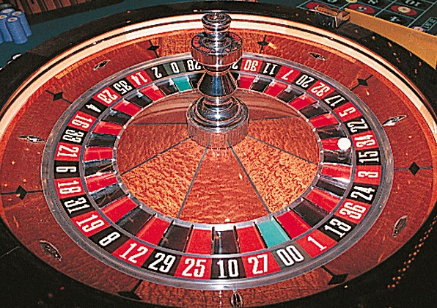
The gambling industry relies on probability distributions to calculate the odds of winning. The rewards are then fixed precisely so that, on average, players lose and the house wins.
The industry is very tough on so-called “cheaters” because their probability to win exceeds that of the house. Remember that it is a business, and therefore it has to be profitable.

Slide 17

A couple wants three children. What are the arrangements of boys (B) and girls (G)?
Genetics tell us that the probability that a baby is a boy or a girl is the same, 0.5.
Sample space: {BBB, BBG, BGB, GBB, GGB, GBG, BGG, GGG} ➔ All eight outcomes in the sample space are equally likely. The probability of each is thus 1/8.
➔ Each birth is independent of the next, so we can use the multiplication rule.
Example: P(BBB) = P(B)* P(B)* P(B) = (1/2)*(1/2)*(1/2) = 1/8
A couple wants three children. What are the numbers of girls (X) they could have?
The same genetic laws apply. We can use the probabilities above and the addition rule for disjoint events to calculate the probabilities for X.
Sample space: {0, 1, 2, 3} ➔ P(X = 0) = P(BBB) = 1/8 ➔ P(X = 1) = P(BBG or BGB or GBB) = P(BBG) + P(BGB) + P(GBB) = 3/8 …

Slide 18
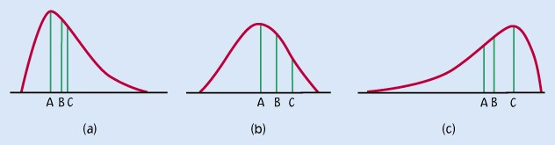
Assigning probabilities: intervals of outcomes
A sample space may contain all numbers within a range.
For continuous outcomes, the probability model is a density curve.
Area under the entire density curve is equal to 1.
Probability model assigns probabilities as areas under the density curve.

Slide 19
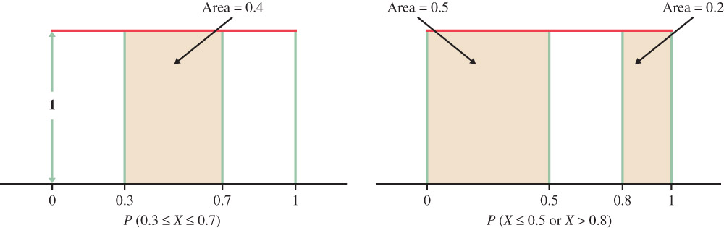
Assigning probabilities: intervals of outcomes
Software random number generators may use
S = {all numbers between 0 and 1}
All possible outcomes are equally likely. The results of many trials are represented by the uniform density curve.
Probabilities are computed as areas
P(0.3 ≤ X ≤ 0.7) = 0.4
Similarly, P(X < 0.5 or X > 0.8) = 0.5 +0.2 = 0.7

Slide 20
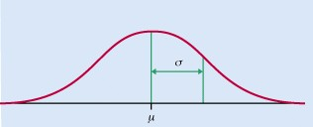
Normal probability models
Normal distributions are probability models.
The scores of students on the ACT college entrance examination in a recent year had the normal distribution with mean μ =18.6 and standard deviation σ = 5.9. What is the probability that a randomly chosen student scores 21 or higher?
The calculation is the same as those we did in Chapter 1. Only the language of probability is new.

Slide 21
Case Study 4.1 Uncovering Fraud by Digital Analysis
“Digital analysis” is one of the big new tools among auditors and investigators looking for fraud. Faked numbers in tax returns, payment records, invoices, expense account claims, and many other settings often display patterns that aren’t present in legitimate records. Some patterns, like too many round numbers, are obvious and easily avoided by a clever crook. Others are more subtle. It is a striking fact that the first digits of numbers in legitimate records often follow a distribution known as Benford’s law. Here it is:
But a surprising variety of data from natural science, social affairs, and business obeys this distribution

Slide 22
Probability and Sampling Distributions Random variables
PSBE Chapter 4.3
© 2011 W.H. Freeman and Company

Slide 23
Objectives (PSBE Chapter 4.3)
Random Variables
Random variables
Probability distributions
Mean of a random variable
Variance of a random variable
Rules for means and variances

Slide 24
Random variable
A random variable is a variable whose value is a numerical outcome of a random phenomenon.
A basketball player shoots three free throws. We define the random variable X as the number of baskets successfully made.
A discrete random variable X has a finite number of possible values.
A continuous random variable X takes all values in an interval.

Slide 25
Probability distributions
The probability distribution of a random variable X tells us what values X can take and how to assign probabilities to those values.
Because of the differences in the nature of sample spaces for discrete and continuous sample random variables, we describe probability distributions for the two types of random variables separately.

Slide 26

Discrete Probability Distributions
The probability distribution of a discrete random variable X lists the possible values of X and their probabilities:
The probabilities p(i) must satisfy two requirements:
Every probability p(i) is a number between 0 and 1, 0 ≤ p(i) ≤ 1.
The sum of the probabilities is exactly 1, p(1) + p(2) + + p(k) = 1.

Slide 27

Example 4.9 Hard-Drive Sizes
Buyers of a laptop computer model may choose to purchase either a 120-, 160-, 250-, or 320-gigabyte (GB) internal hard drive. Choose customers from the last 60 days at random to ask what size internal hard drive they purchased for their computer. To “choose at random” means to give every customer of the last 60 days the same chance to be chosen. The size (in gigabytes) of the internal hard drive purchased by a randomly selected customer is a random variable X.
The value of X changes when we repeatedly choose customers at random, but it is always one of 120, 160, 250, or 320 GB. Here is the distribution of X:
What is the probability that a randomly selected customer purchased at least a 250-GB hard drive?

Slide 28
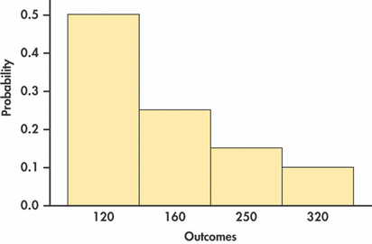
Probability Histogram
The value of X changes when we repeatedly choose customers at random, but it is always one of 120, 160, 250, or 320 GB. Here is the distribution of X:

Slide 29
Example 4.10 Four Coin Tosses
Toss a balanced coin four times; the discrete random variable X counts the number of heads. Find the probability distribution of X.
Possible values of X:

Slide 30

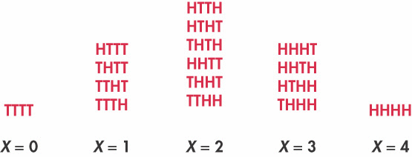
Example 4.10 Four Coin Tosses
Toss a balanced coin four times; the discrete random variable X counts the number of heads. Find the probability distribution of X.

Slide 31
Example 4.10 Four Coin Tosses
Toss a balanced coin four times; the discrete random variable X counts the number of heads.
What is the probability of tossing at least two heads?
What is the probability of tossing at least one heads?

Slide 32
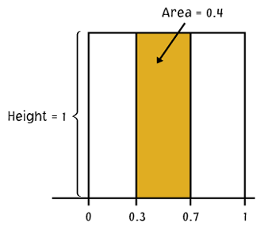
Continuous probability distributions
A continuous random variable X takes all values in an interval.
Example: There is an infinity of numbers between 0 and 1 (e.g., 0.001, 0.4, 0.0063876).
The probability distribution of a continuous random variable is described by a density curve.
The probability of any event is the area under the density curve for the values of X that make up the event.
This is a uniform density curve for the variable X.
The probability that X falls between 0.3 and 0.7 is the area under the density curve for that interval:
P(0.3 ≤ X ≤ 0.7) = (0.7 – 0.3)*1 = 0.4
X

Slide 33

Intervals
All Continuous probability distributions assign probability 0 to every individual outcome. Only intervals can have a positive probability, represented by the area under the density curve for that interval.
The probability of a single event is zero:
P(X=1) = (1 – 1)*1 = 0
Height
= 1
The probability of an interval is the same whether boundary values are included or excluded:
P(0 ≤ X ≤ 0.5) = (0.5 – 0)*1 = 0.5
P(0 < X < 0.5) = (0.5 – 0)*1 = 0.5
P(0 ≤ X < 0.5) = (0.5 – 0)*1 = 0.5
X
P(X < 0.5 or X > 0.8) = P(X < 0.5) + P(X > 0.8) = 1 – P(0.5 < X < 0.8) = 0.7

Slide 34
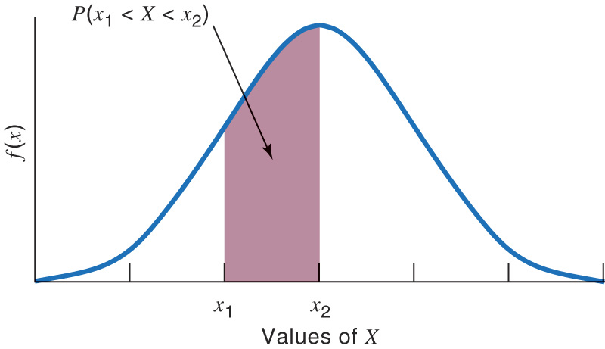
Continuous random variable and population distribution
% individuals with X such that x₁ < X < x₂
The shaded area under a density curve shows the proportion, or %, of individuals in a population with values of X between x₁ and x₂.
Because the probability of drawing one individual at random depends on the frequency of this type of individual in the population, the probability is also the shaded area under the curve.

Slide 35
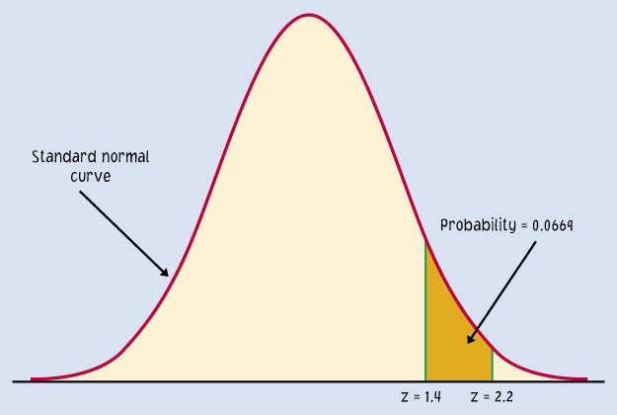
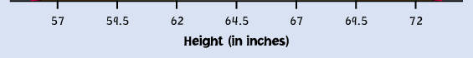
Normal probability distributions
The probability distribution of many random variables is a normal distribution. It shows what values the random variable can take and is used to assign probabilities to those values.
Example: Probability distribution of women’s heights.
Here, because we chose a woman randomly, her height, X, is a random variable.
To calculate probabilities with the normal distribution, we will standardize the random variable (z score) and use Table A.

Slide 36
What is the probability, if we pick one woman at random, that her height will be some value X? For instance, between 68 and 70 inches P(68 < X < 70)?
Because the woman is selected at random, X is a random variable.
N(µ, σ) = N(64.5, 2.5)
As before, we calculate the z-scores for 68 and 70.
For x = 68",
For x = 70",
0.9192
0.9861
The area under the curve for the interval [68" to 70"] is 0.9861 − 0.9192 = 0.0669.
Thus, the probability that a randomly chosen woman falls into this range is 6.69%.
P(68 < X < 70) = 6.69%

Slide 37
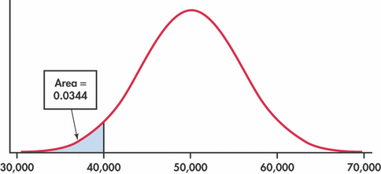
Example 4.11 Tread Life
The actual tread life X of a 40,000-mile automobile tire has a Normal probability distribution with μ = 50,000 miles and σ = 5500 miles. We say X has an N(50,000,5500) distribution.
From a manufacturer’s perspective, it would be useful to know the percent of tires that fail to meet the guaranteed wear life of 40,000 miles. This implies we want to find the probability that a randomly selected tire has a tread life less than 40,000 miles:

Slide 38

Mean of a random variable
The mean of a set of observations is their arithmetic average.
The mean µ of a random variable X is a weighted average of the possible values of X, reflecting the fact that all outcomes might not be equally likely.
A basketball player shoots three free throws. The random variable X is the number of baskets successfully made (“H”).
HMM HHM
MHM HMH
MMM MMH MHH HHH
Value of X | 0 1 2 3
Probability | 1/8 3/8 3/8 1/8
The mean of a random variable X is also called expected value of X.

Slide 39


Mean of a discrete random variable
For a discrete random variable X with probability distribution →
the mean µ of X is found by multiplying each possible value of X by its probability, and then adding the products.
A basketball player shoots three free throws. The random variable X is the number of baskets successfully made.
The mean µ of X is
µ = (0*1/8) + (1*3/8) + (2*3/8) + (3*1/8)
= 12/8 = 3/2 = 1.5
Value of X | 0 1 2 3
Probability | 1/8 3/8 3/8 1/8

Slide 40

Example 4.13 Pick 3
Most states and Canadian provinces have government-sponsored lotteries. Here is a simple lottery wager, from the Tri-State Pick 3 game that New Hampshire shares with Maine and Vermont. You choose a three-digit number; the state chooses a three-digit winning number at random and pays you $500 if your number is chosen.
Taking X to be the amount your ticket pays you, the probability distribution of X is
What is your average payoff from many tickets?
(Tickets cost $1)

Slide 41

Mean of a Discrete Random Variable

Slide 42
Case 4.1
If first digits in a set of records appear “at random,” the nine possible digits 1 to 9 all have the same probability. The mean of this distribution is ________
If, on the other hand, the records obey Benford’s law, the mean of this distribution is: _____________
Benford’s Law:

Slide 43
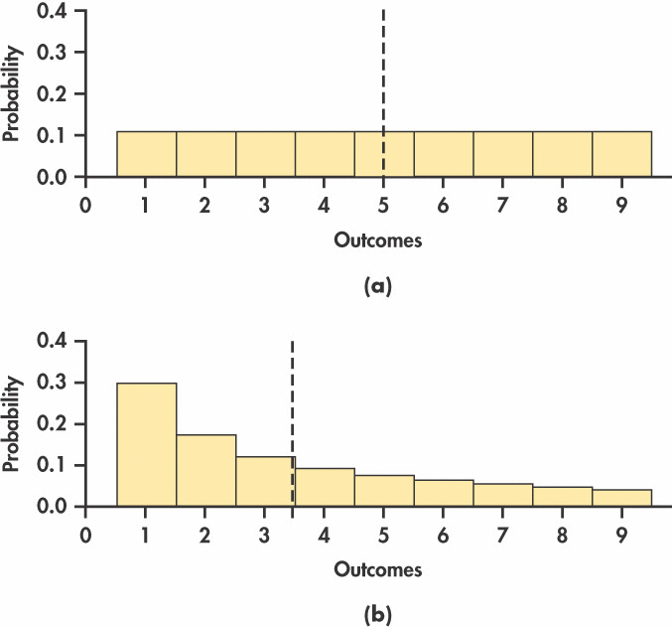
Example 4.14

Slide 44
Randomness
A basketball player makes 160 out of 200 free throws. We would estimate the probability that he makes his next free throw to be which of the following?
0.16
0.80
50/50. Either he makes it or he doesn’t.
1.2

Slide 45
Randomness (answer)
A basketball player makes 160 out of 200 free throws. We would estimate the probability that he makes his next free throw to be which of the following?
0.16
0.80
50/50. Either he makes it or he doesn’t.
1.2

Slide 46
Probability Models
The San Francisco Bay Area's commuter rail system is called BART (Bay Area Rapid Transit). According to BART's 2001 annual report, 92.2% of all trains were on time in that year. If we assume that the probability a train was on time in 2001 was 0.922, which of the following is true?
The probability that a train was early was −0.078.
The probability that two trains in a row were on time was 1.844.
Neither of the above.

Slide 47
Probability Models (answer)
The San Francisco Bay Area's commuter rail system is called BART (Bay Area Rapid Transit). According to BART's 2001 annual report, 92.2% of all trains were on time in that year. If we assume that the probability a train was on time in 2001 was 0.922, which of the following is true?
The probability that a train was early was −0.078.
The probability that two trains in a row were on time was 1.844.
Neither of the above.

Slide 48
Random Variables
Let the random variable X be a random number with the uniform density function given below. P(X = 0.25) is:
0.00
0.25
0.75
1.00

Slide 49
Random Variables (answer)
Let the random variable X be a random number with the uniform density curve given below. P(X = 0.25) is:
0.00 (note: always the case for any continuous r.v.)
0.25
0.75
1.00

Slide 50
Variance of a random variable
The variance and the standard deviation are the measures of spread that accompany the choice of the mean to measure center.
The variance σ²_{X} of a random variable is a weighted average of the squared deviations (X − µ_{X})² of the variable X from its mean µ_{X}. Each outcome is weighted by its probability in order to take into account outcomes that are not equally likely.
The larger the variance of X, the more scattered the values of X on average. The positive square root of the variance gives the standard deviation σ of X.

Slide 51

Variance of a discrete random variable
For a discrete random variable X with probability distribution →
and mean µ_{X}, the variance σ² of X is found by multiplying each squared deviation of X by its probability and then adding all the products.

Slide 52

Example 4.16 Gain Communications
Gain Communications sells aircraft communications units to both the military and the civilian markets. Next year’s sales depend on market conditions that cannot be predicted exactly. Gain follows the modern practice of using probability estimates of sales. The military division estimates its sales (X) as follows:
Find the mean and the variance of X

Slide 53
Example 4.17
x(i) | p(i) | x(i)p(i) | (x(i)-μ_{X})² p(i)
1000 | 0.1 | 100 | 1,600,000
3000 | 0.3 | 900 | 1,200,000
5000 | 0.4 | 2000 | 0
10000 | 0.2 | 2000 | 5,000,000
Mean = 5000; Variance = 7,800,000; Standard Deviation = 2792.8

Slide 54
Rules for means and variances
If X is a random variable and a and b are fixed numbers, then
µ_{a+bX} = a + bµ_{X}
σ²_{a+bX} = b²σ²_{X}
If X and Y are two independent random variables, then
µ_{X+Y} = µ_{X} + µ_{Y}
σ²_{X+Y} = σ²_{X} + σ²_{Y}
σ²_{X-Y} = σ²_{X} + σ²_{Y}
If X and Y are NOT independent but have correlation ρ, then
µ_{X+Y} = µ_{X} + µ_{Y}
σ²_{X+Y} = σ²_{X} + σ²_{Y} + 2ρσ_{X}σ_{Y}
σ²_{X-Y} = σ²_{X} + σ²_{Y} - 2ρσ_{X}σ_{Y}

Slide 55
Investment
$$$
You invest 20% of your funds in Treasury bills and 80% in an “index fund” that represents all U.S. common stocks. Your rate of return over time is proportional to that of the T-bills (X) and of the index fund (Y), such that R = 0.2X + 0.8Y.
Based on annual returns between 1950 and 2003:
Annual return on T-bills µX = 5.0% σX = 2.9%
Annual return on stocks µY = 13.2% σY = 17.6%
Correlation between X and Yρ = −0.11
µ_{R} = 0.2µ_{X} + 0.8µ_{Y} = (0.2*5) + (0.8*13.2) = 11.56%
σ²_{R} = σ²_{0.2X} + σ²_{0.8Y} + 2ρσ_{0.2X}σ_{0.8Y}
= 0.2*2σ²_{X} + 0.8*2σ²_{Y} + 2ρ*0.2*σ_{X}*0.8*σ_{Y}
= (0.2)2(2.9)2 + (0.8)2(17.6)2 + (2)(−0.11)(0.2*2.9)(0.8*17.6) = 196.786
σ_{R} = √196.786 = 14.03%
The portfolio has a smaller mean return than an all-stock portfolio, but it is also less risky.

Slide 56


Example 4.16 Gain Communications
Gain Communications sells aircraft communications units to both the military and the civilian markets. Next year’s sales depend on market conditions that cannot be predicted exactly. Gain follows the modern practice of using probability estimates of sales.
The military division estimates its sales as follows:
The corresponding sales estimates for the civilian division are:
Gain makes a profit of $2000 on each military unit sold and $3500 on each civilian unit. What is the expected total profit?

Slide 57
Example 4.18 Pick 3
The payoff X of a $1 ticket in the Tri-State Pick 3 game is $500 with probability 1/1000 and 0 the rest of the time.
What is the variance and the standard deviation?
If you buy a Pick 3 ticket, your net winnings are W = X − 1 because the dollar you pay for the ticket must be subtracted from the payoff.
What is the mean and variance of W?

Slide 58
Example 4.18 Pick 3
Suppose now that you buy a $1 ticket on each of two different days. The payoffs X and Y on the two tickets are independent because separate drawings are held each day.
What are the mean, variance, and the standard deviation of X+Y?

Slide 59
Example 4.10 Four Coin Tosses
Toss a balanced coin four times; the discrete random variable X counts the number of heads. Find the probability distribution of X.

Slide 60
Probability and Sampling Distributions The Sampling Distribution of a Sample Mean
PSBE Chapter 4.4
© 2011 W.H. Freeman and Company

Slide 61
Objectives (PSBE Chapter 4.4)
Sampling distribution of a sample mean
Law of large numbers
Sampling distributions
The mean and standard deviation of
The central limit theorem

Slide 62
Example 4.21 Does this wine smell bad?
Sulfur compounds such as dimethyl sulfide (DMS) are sometimes present in wine. DMS causes “off-odors” in wine, which from the winemakers’ perspective is an important product quality attribute to monitor and control. Too high a DMS level can result in loss of sales. On the other hand, there is a cost for lowering DMS levels.
It makes good business sense for winemakers to study the odor threshold, the lowest concentration of DMS that the human nose can detect. Different people have different thresholds, so we start by asking about the mean threshold μ in the population of all adults. The number μ is a parameter that describes this population.

Slide 63
Example 4.21 Does this wine smell bad?
To estimate μ, we present tasters with both natural wine and the same wine spiked with DMS at different concentrations to find the lowest concentration at which they can identify the spiked wine. Here are the odor thresholds (measured in micrograms of DMS per liter of wine) for 10 randomly chosen subjects:
The mean threshold for these subjects is 27.4 .
This sample mean is a statistic that
we use to estimate the parameter μ,
it is probably not exactly equal to μ
a different 10 subjects would give us a different sample mean.

Slide 64
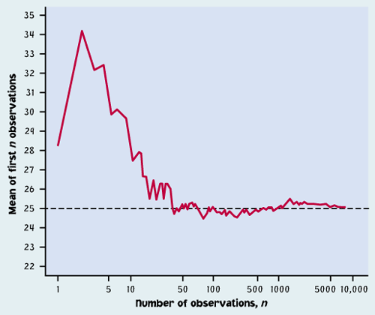
Law of large numbers
Law of large number: As the number of randomly drawn observations in a sample increases, the mean of the sample gets closer and closer to the population mean μ.
valid for any population.
Note: We often intuitively expect predictability over a few random observations, but it is wrong. The law of large numbers only applies to really large numbers.

Slide 65
Reminder: What is a sampling distribution?
The sampling distribution of a statistic is the distribution of all possible values taken by the statistic when all possible samples of a fixed size n are taken from the population. It is a theoretical idea — we do not actually build it.
The sampling distribution of a statistic is the probability distribution of that statistic.

Slide 66
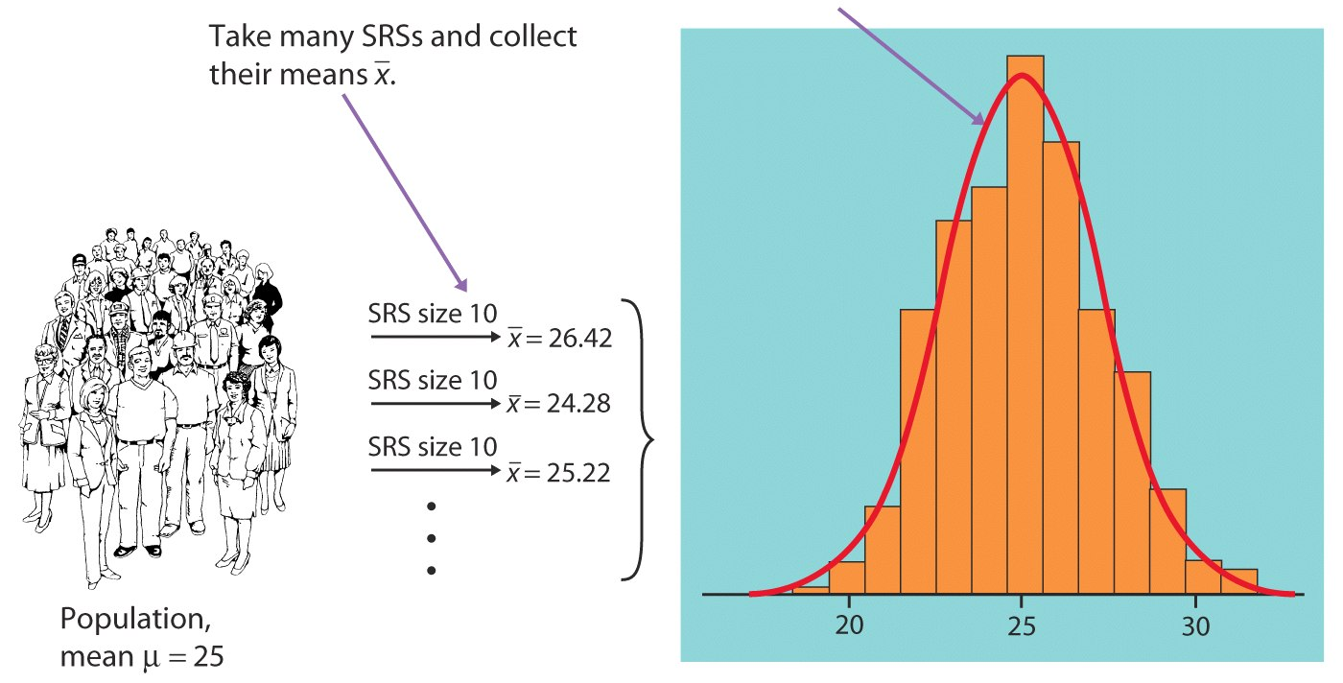
Sampling distribution of sample mean
We take many random samples of a given size n from a population with mean μ and standard deviation σ.
Some sample means will be above the population mean μ and some will be below, making up the sampling distribution.
Sampling distribution of “x bar”
Histogram of some sample averages

Slide 67
For any population with mean μ and standard deviation σ :
The mean of the sampling distribution is equal to the population mean μ.
The standard deviation of the sampling distribution is σ/√n, where n is the sample size.
Sampling distribution of x bar
σ/√n
μ

Slide 68
Mean and standard deviation of sample mean
Mean of a sampling distribution of
There is no tendency for a sample mean to fall systematically above or below μ, even if the distribution of the raw data is skewed. Thus, the mean of the sampling distribution is an unbiased estimate of the population mean μ — it will be “correct on average” in many samples.
Standard deviation of a sampling distribution of
The standard deviation of the sampling distribution is smaller than the standard deviation of the population by a factor of √n. ➔ Averages are less variable than individual observations. Also, the results of large samples are less variable than the results of small samples.

Slide 69
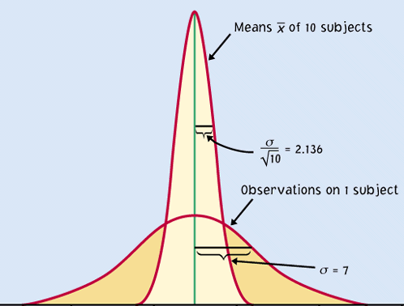
For normally distributed populations
When a variable in a population is normally distributed, the sampling distribution of the sample mean for all possible samples of size n is also normally distributed.
Sampling distribution
If the population is N(μ, σ) then the sample means distribution is N(μ, σ/√n).
Population

Slide 70

Central Limit Theorem
Draw an SRS of size n from any population with mean μ and finite standard deviation σ. When n is large, the sampling distribution of the sample mean X is approximately Normal:

Slide 71
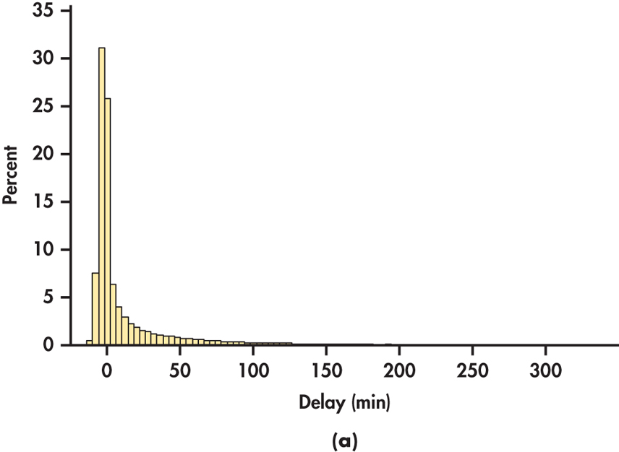
Example 4.24 The Central Limit Theorem in Action
In 2009, there were 73,423 departures for United Airlines from its largest hub airport, O’Hare Airport in Chicago.
Figure below is a histogram of the departure delay times (in minutes) for the entire population of United flights from O’Hare

Slide 72
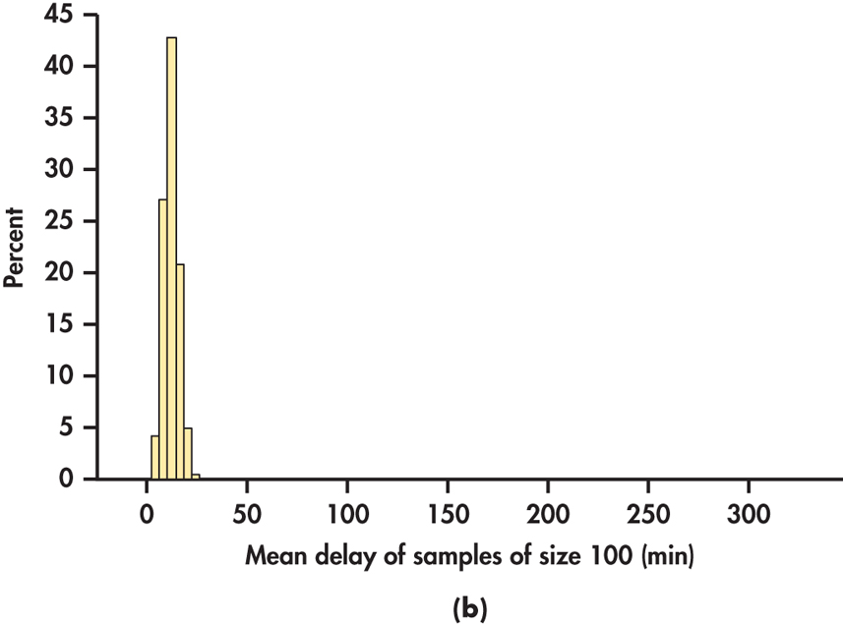
The central limit theorem (Delay times)
The means of 100 flight delay times are less variable and appear Normally distributed.

Slide 73
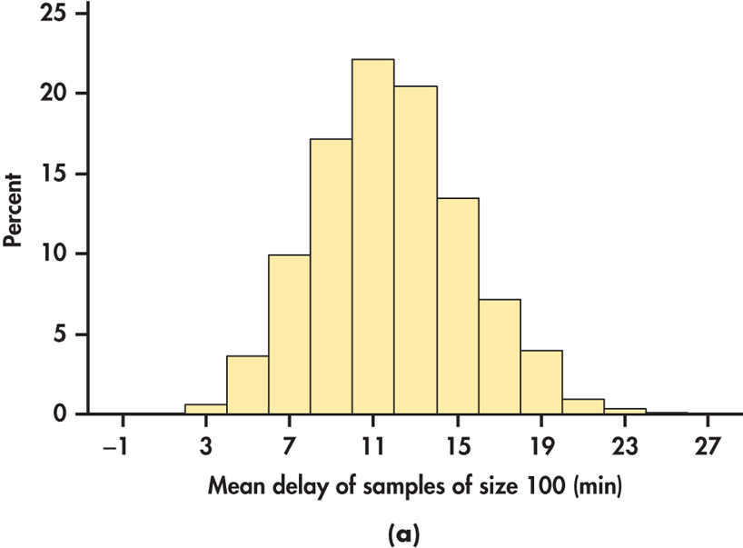
The central limit theorem (Delay times)
Using a different scale better shows the Normal distribution.
The histogram is centered on the population mean.

Slide 74
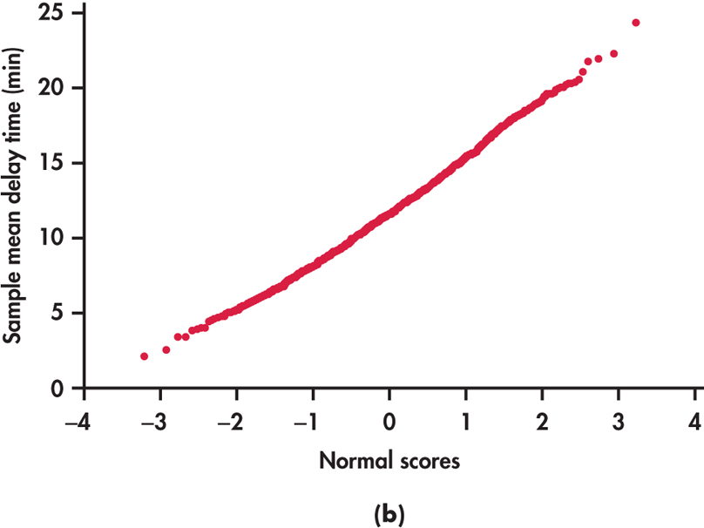
The central limit theorem (Delay times)
A Normal quantile plot confirms the Normal distribution.

Slide 75
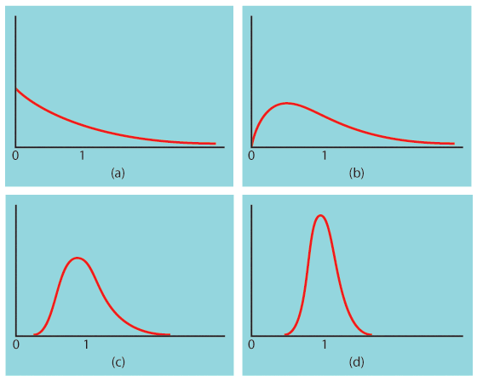
The central limit theorem
Central Limit Theorem: When randomly sampling from any population with mean μ and standard deviation σ, when n is large enough, the sampling distribution of x bar is approximately normal: ~ N(μ, σ/√n).
Population with strongly skewed distribution
Sampling distribution of for n = 2 observations
Sampling distribution of for n = 10 observations
Sampling distribution of
for n = 25
observations

Slide 76
IQ scores: population vs. sample
In a large population of adults, the mean IQ is 112 with standard deviation 20. Suppose 200 adults are randomly selected for a market research campaign.
The distribution of the sample mean IQ is:
A) Exactly normal, mean 112, standard deviation 20
B) Approximately normal, mean 112, standard deviation 20
C) Approximately normal, mean 112 , standard deviation 1.414
D) Approximately normal, mean 112, standard deviation 0.1
C) Approximately normal, mean 112 , standard deviation 1.414

Slide 77
Application
Hypokalemia is diagnosed when blood potassium levels are low, below 3.5mEq/dl. Let’s assume that we know a patient whose measured potassium levels vary daily according to a normal distribution N(μ = 3.8, σ = 0.2).
If only one measurement is made, what is the probability that this patient will be misdiagnosed hypokalemic?
z = −1.5, P(z < −1.5) = 0.0668 ≈ 7%
If instead measurements are taken on four separate days, what is the probability of such a misdiagnosis?
z = −3, P(z < −1.5) = 0.0013 ≈ 0.1%
Note: Make sure to standardize (z) using the standard deviation for the sampling distribution.

Slide 78
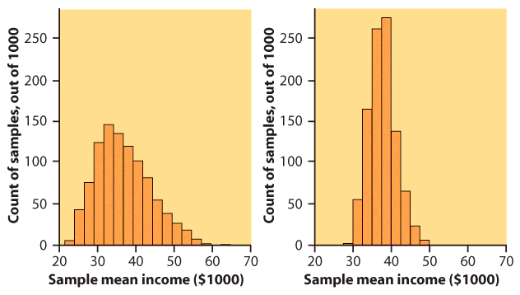
Income distribution
Let’s consider the very large database of individual incomes from the Bureau of Labor Statistics as our population. It is strongly right skewed.
We take 1000 SRSs of 100 incomes, calculate the sample mean for each, and make a histogram of these 1000 means.
We also take 1000 SRSs of 25 incomes, calculate the sample mean for each, and make a histogram of these 1000 means.
Which histogram corresponds to the samples of size 100? 25?
$$$

Slide 79
How large a sample size?
It depends on the population distribution. More observations are required if the population distribution is far from normal.
A sample size of 25 is generally enough to obtain a normal sampling distribution from a strong skewness or even mild outliers.
A sample size of 40 will typically be good enough to overcome extreme skewness and outliers.
In many cases, n = 25 isn’t a huge sample. Thus, even for strange population distributions we can assume a normal sampling distribution of the mean and work with it to solve problems.

Slide 80
Important Facts on Sample Means
Sample means are less variable than individual observations.
the distribution of the sample means is centered at μ.
Sample means are more Normal than individual observations.

