Slide 1

The Practice of Statistics for Business and Economics
Third Edition
David S. Moore
George P. McCabe
Layth C. Alwan
Bruce A. Craig
William M. Duckworth
© 2011 W.H. Freeman and Company

Slide 2
Probability Theory
General Probability Rules
PSBE Chapter 5.1
© 2011 W.H. Freeman and Company

Slide 3
Objectives (PSBE Chapter 5.1)
General probability rules
Independence and the multiplication rule
Applying the multiplication rule
The general addition rule

Slide 4
Probability rules (review)
We already met the following four rules in Chapter 4:
1) Probabilities range from 0
(no chance of the event) to
1 (the event has to happen).
For any event A, 0 ≤ P(A) ≤ 1
Probability of getting a Head = 0.5
We write this as: P(Head) = 0.5
P(neither Head nor Tail) = 0
P(getting either a Head or a Tail) = 1
2) Because some outcome must occur
on every trial, the sum of the probabilities
for all possible outcomes (the sample
space) must be exactly 1.
P(sample space) = 1
Coin toss: S = {Head, Tail}
P(head) + P(tail) = 0.5 + 0.5 =1
→ P(sample space) = 1

Slide 5
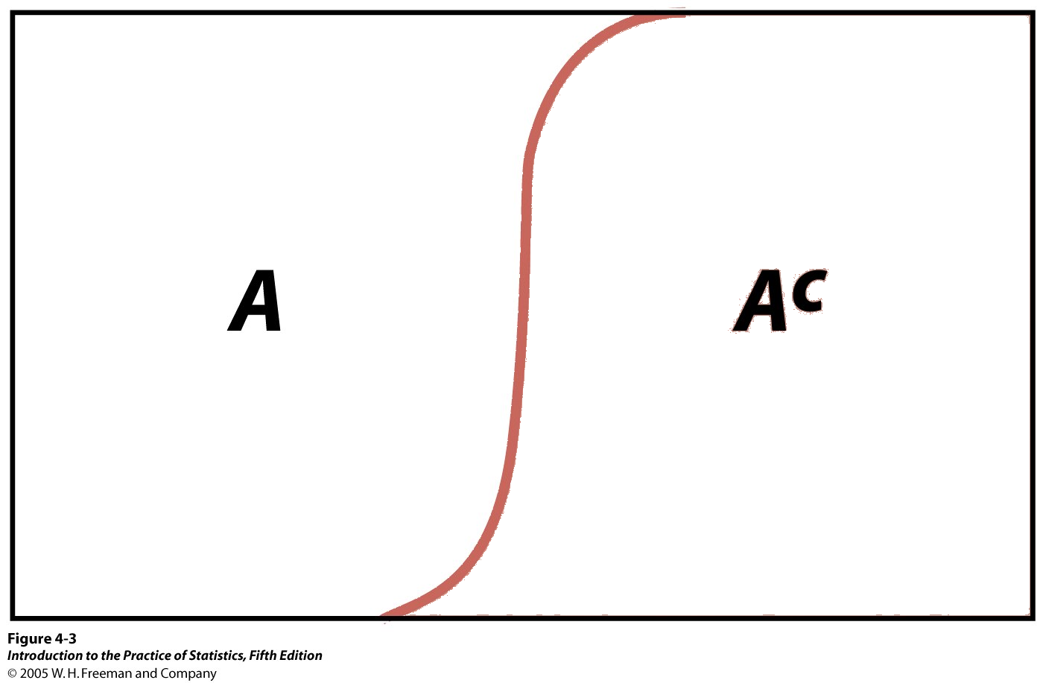
Coin Toss Example:
S = {Head, Tail}
Probability of heads = 0.5
Probability of tails = 0.5
Probability rules (cont.)
3) The complement of any event A is the event that A does not occur, written as A^{c}.
The complement rule states that the probability of an event not occurring is 1 minus the probability that is does occur.
P(not A) = P(A^{c}) = 1 − P(A)
Tail^{c} = not Tail = Head
P(Tail^{c}) = 1 − P(Head) = 0.5
Venn diagram:
Sample space made up of an event A and its complementary A^{c}, i.e., everything that is not A.

Slide 6
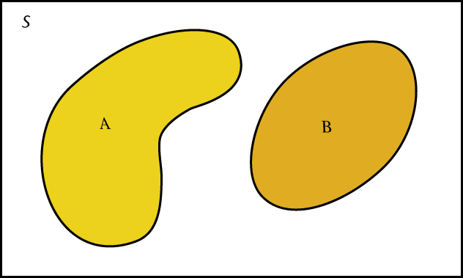
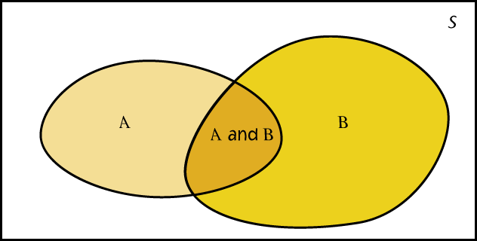
Probability rules (cont.)
Venn diagrams:
A and B disjoint
4) Two events A and B are disjoint if they have no outcomes in common and can never happen together. The probability that A or B occurs is then the sum of their individual probabilities.
P(A or B) = “P(A U B)” = P(A) + P(B)
This is the addition rule for disjoint events.
A and B not disjoint
Example: If you flip two coins, and the first flip does not affect the second flip:
S = {HH, HT, TH, TT}. The probability of each of these events is 1/4, or 0.25.
The probability that you obtain “only heads or only tails” is:
P(HH or TT) = P(HH) + P(TT) = 0.25 + 0.25 = 0.50

Slide 7
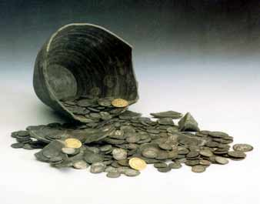
Independence
Two events are independent if the probability that one event occurs on any given trial of an experiment is not affected or changed by the occurrence of the other event.
When are trials not independent?
Imagine that these coins were spread out so that half were heads up and half were tails up. Close your eyes and pick one. The probability of it being heads is 0.5. However, if you don’t put it back in the pile, the probability of picking up another coin and having it be heads is now less than 0.5.
The trials are independent only when you put the coin back each time. It is called sampling with replacement.

Slide 8
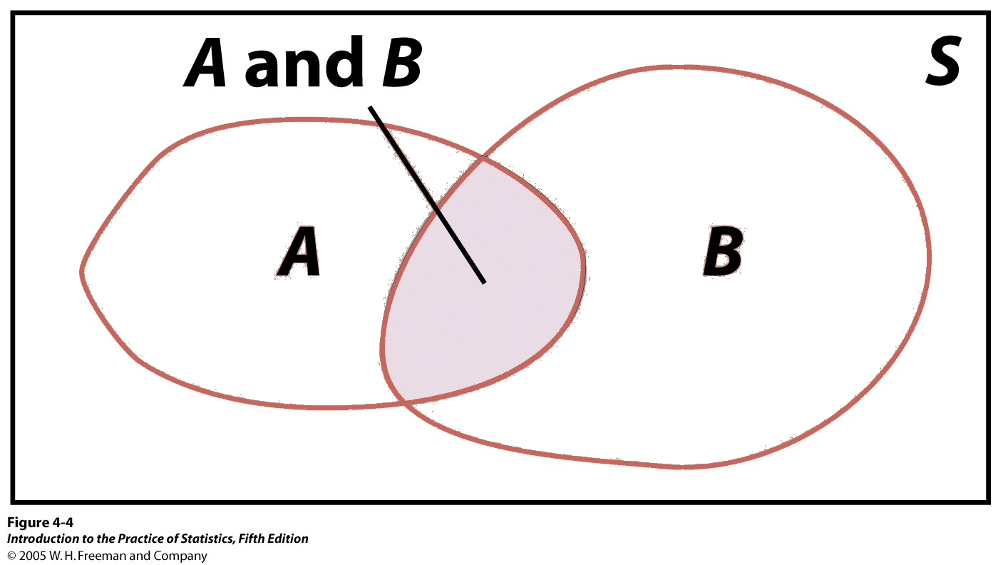
Multiplication rule for independent events
Two events A and B are independent if knowing that one occurs does not change the probability that the other occurs.
If A and B are independent, P(A and B) = P(A)P(B)
This is the multiplication rule for independent events.
Two consecutive coin tosses:
P(first Tail and second Tail) = P(first Tail) * P(second Tail) = 0.5 * 0.5 = 0.25
Venn diagram:
Event A and event B. The intersection represents the event {A and B} and outcomes common to both A and B.

Slide 9
Independent vs. disjoint events
Disjoint events are not independent.
If A and B are disjoint, then the fact that A occurs tells us that B cannot occur. So A and B are not independent.
Independence cannot be pictured in a Venn Diagram.

Slide 10
Example 5.3 Undersea Cables
Repeaters in undersea cables must be very reliable. To see why, suppose that each repeater has probability 0.999 of functioning without failure for 25 years. Repeaters fail independently of each other. (This assumption means that there are no “common causes” such as earthquakes that would affect several repeaters at once.) Denote by Ai the event that the ith repeater operates successfully for 25 years.
For a cable with 2 repeaters, What is the probability that 2 repeaters both last 25 years?
For a cable with 10 repeaters, what is the probability of no failure in 25 years?
The last copper cable, laid in 1983 and retired in 1994, had 662 repeaters. What is the probability of no failure in 25 years?

Slide 11
Applying the multiplication rule
If two events A and B are independent, the event that A does not occur is also independent of B.
The Multiplication Rule extends to collections of more than two events, provided that all are independent.
Example: A transatlantic data cable contains repeaters to amplify the signal. Each repeater has probability 0.999 of functioning without failure for 25 years. Repeaters fail independently of each other. Let A₁ denote the event that the first repeater operates without failure for 25 years, A₂ denote the event that the second repeater operates without failure for 25 years, and so on. The last transatlantic cable had 662 repeaters. The probability that all 662 will work for 25 years is:
P(A₁ and A₂ and…and A₆₆₂) = 0.999⁶⁶² = 0.516

Slide 12
Applying the multiplication rule
If two events A and B are independent, the event that A does not occur is also independent of B.
  A^{c} and B are independent
  A and B^{c} are independent
  A^{c} and B^{c} are independent
The Multiplication Rule extends to collections of more than two events, provided that all are independent.

Slide 13
Example 5.4 False Positives in Job Drug Testing
The enzyme multiplied immunoassay technique, or EMIT, applied to urine samples is one of the most common tests for illegal drugs because it is fast and inexpensive.
Applied to people who are free of illegal drugs, EMIT has been reported to have false positive rates ranging from 0.2% to 2.5%. If 150 employees are tested and all 150 are free of illegal drugs, what is the probability that at least 1 false positive will occur, assuming a 0.2% false positive rate?

Slide 14
Applying the multiplication rule
If two events A and B are independent, the event that A does not occur is also independent of B.
The Multiplication Rule extends to collections of more than two events, provided that all are independent.
Example: The probability of positive result for one person is 0.2% or 0.002. What is the probability of at least one false positive drug test result occurring if 150 drug-free employees are tested?:
P(single negative) = 1 – P(single positive) = 1 – 0.002 = 0.998
P(at least 1 positive) = 1 – P(no positives)
= 1 – P(150 negatives)
= 1 – (1 – 0.998)¹⁵⁰
= 1 – 0.741 = 0.259

Slide 15
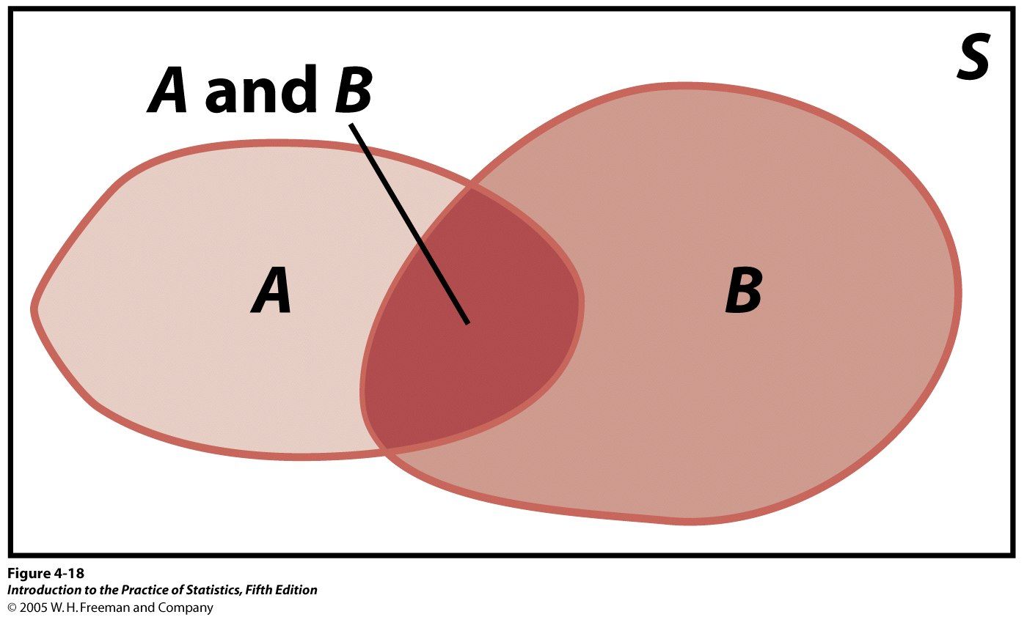
General addition rule
General addition rule for any two events A and B:
The probability that A occurs,
or B occurs, or both events occur is:
P(A or B) = P(A) + P(B) – P(A and B)
What is the probability of randomly drawing either an ace or a heart from a deck of 52 playing cards? There are 4 aces in the pack and 13 hearts. However, 1 card is both an ace and a heart. Thus:
P(ace or heart) = P(ace) + P(heart) – P(ace and heart)
= 4/52 + 13/52 − 1/52 = 16/52 ≈ .3

Slide 16
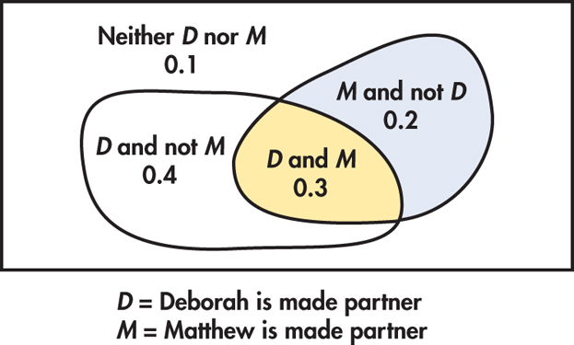
General addition rule
Deborah thinks she has probability 0.7 of being promoted and that Matthew has probability 0.5 of being promoted. She also believes there is probability 0.3 that they will both be promoted.
What is the probability of at least one of them being promoted?
P(at least one is promoted)
= P(Deborah) + P(Matt) – P(both)
= 0.7 + 0.5 – 0.3 = 0.9

Slide 17
Probability Theory
Conditional Probability
PSBE Chapter 5.2
© 2011 W.H. Freeman and Company

Slide 18
Objectives (PSBE Chapter 5.2)
Conditional Probability
General multiplication rule
Conditional probability and independence
Tree diagrams
Bayes’s rule

Slide 19
General multiplication rule
Conditional probability gives the probability of one event under the condition that we know another event.
General multiplication rule: The probability that any two events, A and B, happen together is:
P(A and B) = P(A)P(B|A)
Here P(B|A) is the conditional probability that B occurs, given the information that A occurs.

Slide 20
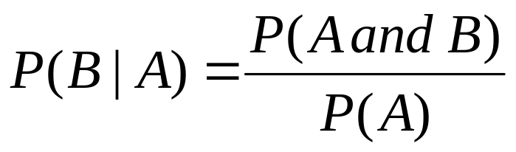
Conditional probability
Conditional probabilities reflect how the probability of an event can change if we know that some other event has occurred/is occurring.
  Example: The probability that a cloudy day will result in rain is different if you live in Los Angeles than if you live in Seattle.
  Our brains effortlessly calculate conditional probabilities, updating our “degree of belief” with each new piece of evidence.
The conditional probability
of event B given event A is:
(provided that P(A) ≠ 0)

Slide 21
Independent events
Recall: A and B are independent when they have no influence on each other’s occurrence.
Two events A and B that both have positive probability are independent if P(B|A) = P(B).
The general multiplication rule then becomes: P(A and B) = P(A)P(B).
What is the probability of randomly drawing an ace of hearts from a deck of 52 playing cards? There are 4 aces in the pack and 13 hearts.
P(heart|ace) = 1/4 P(ace) = 4/52
P(ace and heart) = P(ace)* P(heart|ace) = (4/52)*(1/4) = 1/52
Notice that heart and ace are independent events.

Slide 22
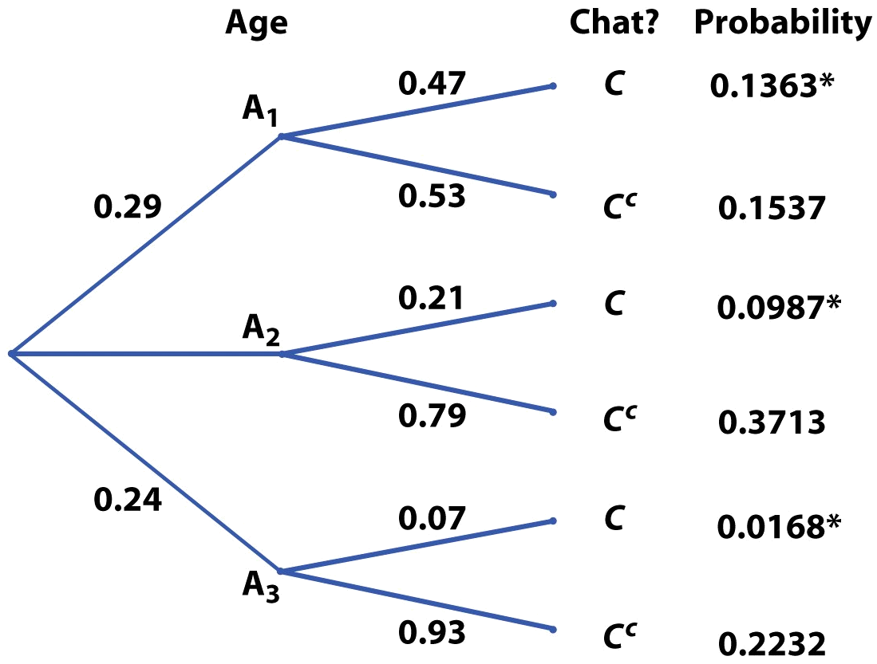
Tree diagrams
Conditional probabilities can get complex, and it is often a good strategy to build a probability tree that represents all possible outcomes graphically and assigns conditional probabilities to subsets of events.
Tree diagram for chat room habits for three adult age groups
Internet user
0.47
P(chatting) = 0.136 + 0.099 + 0.017
= 0.252
About 25% of all adult Internet users visit chat rooms.

Slide 23
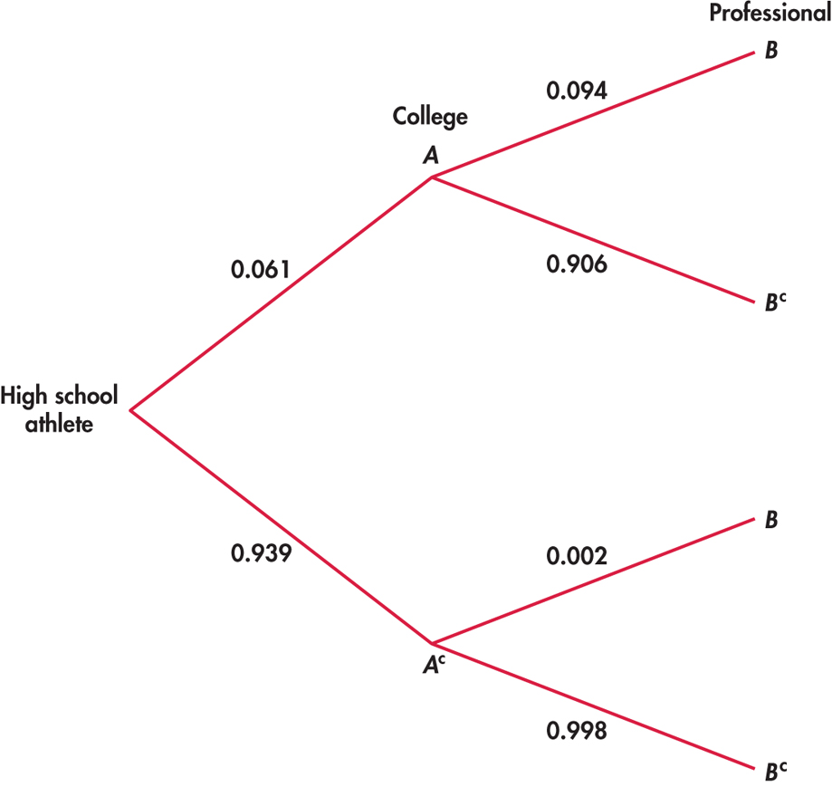
Baseball
What is the probability of a high-school athlete playing professional baseball?
P(B and A) = P(A)P(B | A)
= (0.061)(0.094) = 0.00573
P(B and A^{c}) = P(A)P(B | A^{c})
= (0.939)(0.002) = 0.00188
P(B) = 0.00573 + 0.00188 = 0.00761
The probability of a high-school athlete playing in the MLB is about 8%.

Slide 24
Baseball
What proportion of professional baseball players competed in college?
P(A | B) = P(A and B)/P(B)
= 0.00573/0.00761
= 0.753
About 75% of MLB players competed in college.

Slide 25
Breast cancer screening
If a woman in her 20s gets screened for breast cancer and receives a positive test result, what is the probability that she does have breast cancer?
Diagnosis sensitivity
Disease incidence
0.8
Positive
0.0004
Cancer
0.2
Negative
False negative
Mammography
0.1
Positive
False positive
0.9996
No cancer
Incidence of breast cancer among women ages 20–30
0.9
Negative
Diagnosis specificity
Mammography performance
She could either have a positive test and have breast cancer or have a positive test but not have cancer (false positive).

Slide 26
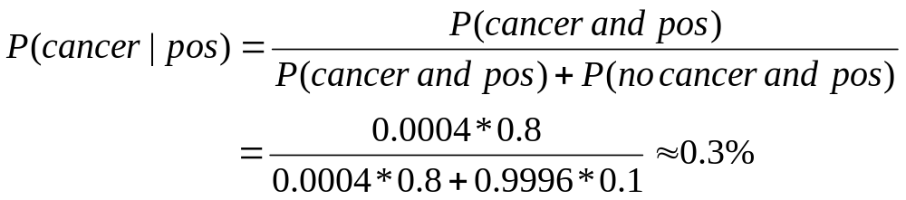
Diagnosis sensitivity
Disease incidence
0.8
Positive
Cancer
0.0004
Negative
False negative
0.2
Mammography
0.1
0.9996
Positive
False positive
No cancer
Incidence of breast cancer among women ages 20–30
Negative
0.9
Diagnosis specificity
Mammography performance
Possible outcomes given the positive diagnosis: positive test and breast cancer or positive test but no cancer (false positive).
This value is called the positive predictive value, or PV+. It is an important piece of information but, unfortunately, is rarely communicated to patients.

Slide 27

Bayes’s rule
An important application of conditional probabilities is Bayes’s rule. It is the foundation of many modern statistical applications beyond the scope of this textbook.
* If a sample space is decomposed in k disjoint events, A₁, A₂, … , A_{k} — none with a null probability but P(A₁) + P(A₂) + … + P(A_{k}) = 1,
* And if C is any other event such that P(C) is not 0 or 1, then:
However, it is often intuitively much easier to work out answers with a probability tree than with these lengthy formulas.

Slide 28
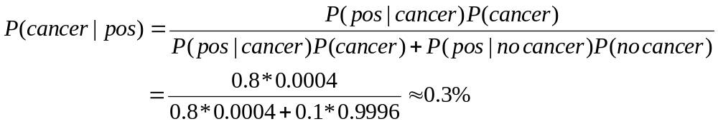
If a woman in her 20s gets screened for breast cancer and receives a positive test result, what is the
probability that
she does have
breast cancer?
Diagnosis sensitivity
Disease incidence
0.8
Positive
Cancer
0.0004
Negative
False negative
0.2
Mammography
0.1
0.9996
Positive
False positive
No cancer
Incidence of breast cancer among women ages 20–30
Negative
0.9
Diagnosis specificity
Mammography performance
This time, we use Bayes’s rule:
A1 is cancer, A2 is no cancer, C is a positive test result.

Slide 29
Probability Theory
The Binomial and Poisson Distributions
PSBE Chapters 5.3 and 5.4
© 2011 W. H. Freeman and Company

Slide 30
Objectives (PSBE Chapter 5.3 and 5.4)
Binomial and Poisson Distributions
The binomial setting
Binomial probabilities
Binomial mean and standard deviation
The Normal approximation
The Poisson setting
The Poisson model

Slide 31
Binomial setting
Binomial distributions are models for some categorical variables, typically representing the number of successes in a series of n trials.
The observations must meet these requirements:
  The total number of observations n is fixed in advance.
  The outcomes of all n observations are statistically independent.
  Each observation falls into just one of two categories: success and failure.
  All n observations have the same probability of “success,” p.
We record the next 50 vehicles sold at a dealership. Each buyer either purchases or leases; each vehicle sold is either an SUV or not.

Slide 32
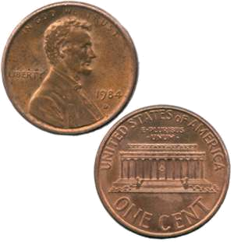
Binomial distribution
The distribution of the count X of successes in the binomial setting is the binomial distribution with parameters n and p: B(n,p).
The parameter n is the total number of observations.
The parameter p is the probability of success on each observation.
The count of successes X can be any whole number between 0 and n.
A coin is flipped 10 times. Each outcome is either a head or a tail.
The variable X is the number of heads among those 10 flips, our count of “successes.”
On each flip, the probability of success, “head,” is 0.5. The number X of heads among 10 flips has the binomial distribution B(n = 10, p = 0.5).

Slide 33
Applications for binomial distributions
Binomial distributions describe the possible number of times that a particular event will occur in a sequence of observations.
They are used when we want to know about the occurrence of an event, not its magnitude.
  In a clinical trial, a patient’s condition may improve or not. We study the number of patients who improved, not how much better they feel.
  Was a sales transaction considered pleasant? The binomial distribution describes the number of pleasant transactions, not how pleasant they are.
  In quality control we assess the number of defective items in a lot of goods, irrespective of the type of defect.

Slide 34
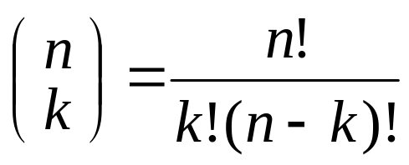
Binomial probabilities
The number of ways of arranging k successes in a series of n observations (with constant probability p of success) is the number of possible combinations (unordered sequences).
This can be calculated with the binomial coefficient:
Where k = 0, 1, 2, ..., or n.

Slide 35
Binomial formulas
The binomial coefficient “n_choose_k” uses the factorial notation “!”.
The factorial n! for any strictly positive whole number n is:
n! = n × (n − 1) × (n − 2) × · · · × 3 × 2 × 1
For example: 5! = 5 × 4 × 3 × 2 × 1 = 120
Note that 0! = 1.

Slide 36
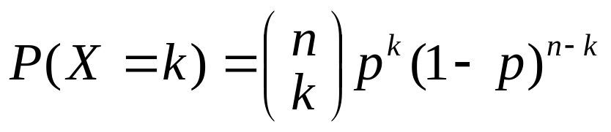
Calculations for binomial probabilities
The binomial coefficient counts the number of ways in which k successes can be arranged among n observations.
The binomial probability P(X = k) is this count multiplied by the probability of any specific arrangement of the k successes:
X | P(X)
0 1 2 … k … n | _{n}C₀ p⁰q^{n} = q^{n} _{n}C₁ p¹q^{n-1} _{n}C₂ p²q^{n-2} … _{n}C_{x} p^{k}q^{n-k} … _{n}C_{n} p^{n}q⁰ = p^{n}
Total | 1
The probability that a binomial random variable takes any range of values is the sum of each probability for getting exactly that many successes in n observations.
P(X ≤ 2) = P(X = 0) + P(X = 1) + P(X = 2)

Slide 37
Customer satisfaction
Each consumer has probability of 0.25 of preferring your product over a competitor’s product. If we question five consumers, what is the probability that exactly three of them prefer your product?
  Use Excel “=BINOMDIST(number_s,trials,probability_s,cumulative)”
  P(x = 3) = BINOMDIST(3, 5, 0.25, 0) = 0.08789
  P(x = 3) = (n! / k!(n − k)!)p^{k}(1 − p)^{n-k} = (5! / ((3!)(2!)) * 0.25³ * 0.75²
  P(x = 3) = (5*4) / (2*1) * 0.25³ * 0.75²
  P(x = 3) = 10 * 0.015625 * 0.5625 = 0.08789

Slide 38
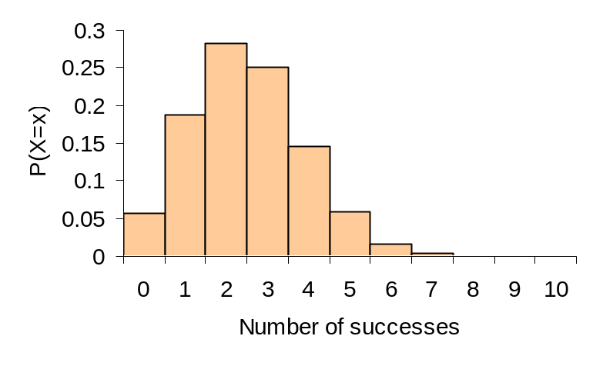
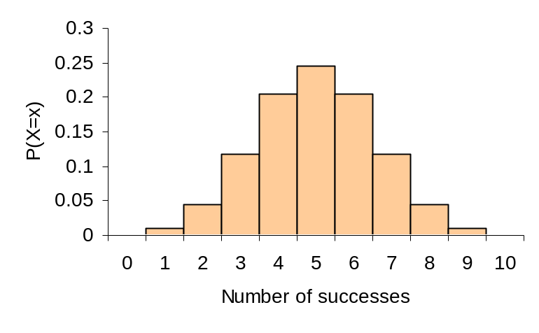
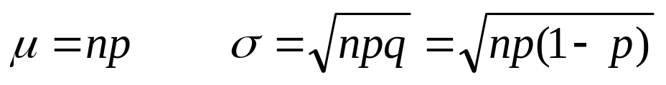
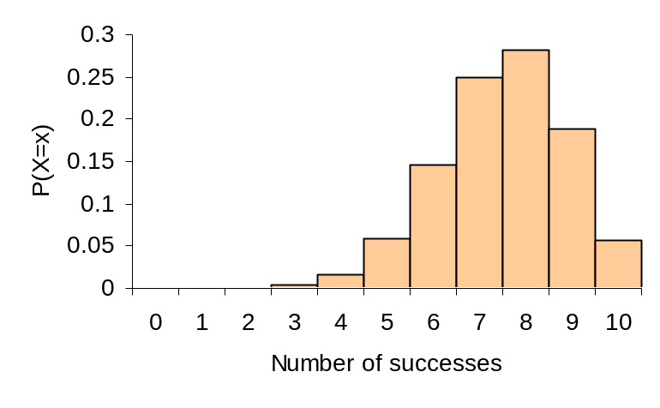
Binomial mean and standard deviation
The center and spread of the binomial distribution for a count X are defined by the mean μ and standard deviation σ:
a)
b)
Effect of changing p when n is fixed.
a) n = 10, p = 0.25
b) n = 10, p = 0.5
c) n = 10, p = 0.75
For small samples, binomial distributions are skewed when p is different from 0.5.
c)

Slide 39
Binomial setting
The observations must meet these requirements:
  The total number of observations n is fixed in advance.
  The outcomes of all n observations are statistically independent.
  Each observation falls into just one of two categories: success and failure.
  All n observations have the same probability of “success,” p.

Slide 40
Normal approximation
If n is large, and p is not too close to 0 or 1, the binomial distribution can be approximated by the normal distribution
N(µ = np, σ² = np(1 − p))
Practically, the Normal approximation can be used when both
np ≥10 and n(1 − p) ≥10.
If X is the count of successes in the sample, the sampling distributions for large n is:
X approximately N(µ = np, σ² = np(1 − p))

Slide 41
Normal approximation
If 605 of people claim to be satisfied with their lives, what is the probability that at least 610 people out of 1010 surveyed will say they are satisfied with their lives?
µ = np = (1010)(0.60) = 606
σ = √(np(1 − p)) = √(1010(0.60)(0.40)) = 15.57
So X is N(606, 15.57); Note: np ≥10 and n(1 − p) ≥10.
P(X > 610) = P((X – 606)/15.57 > (610 – 606)/15.57)
= P(Z > 0.26) = 0.3974

Slide 42
The Poisson setting
A count X of successes has a Poisson distribution in the Poisson setting:
The number of successes that occur in any unit of measure is independent of the number of successes that occur in any non-overlapping unit of measure.
The probability that a success will occur in a unit of measure is the same for all units of equal size and is proportional to the size of the unit.
The probability that two or more successes will occur in a unit approaches 0 as the size of the unit becomes smaller.

Slide 43
Poisson distribution
The distribution of the count X of successes in the Poisson setting is the Poisson distribution with mean μ. The parameter μ is the mean number of successes per unit of measure.
The possible values of X are the whole numbers 0, 1, 2, 3, …. If k is any whole number 0 or greater, then
P(X = k) = (e^{-μ}μ^{k})/k!
The standard deviation of the distribution is the square root of μ.

Slide 44
Poisson distribution
Let 1.6 be the average number of flaws in a square yard of carpet. The count of X flaws per square yard of carpet is modeled by the Poisson distribution with μ = 1.6.
The probability of two or less flaws per square yard is P(X < 2).
  P(X < 2) = P(X = 0) + P(X = 1) + P(X = 2)
  = (e^{-1.6}(1.6)⁰)/0! + (e^{-1.6}(1.6)¹)/1! + (e^{-1.6}(1.6)²)/2!
  = 0.2019 + 0.3230 + .02584 = 0.7833

Slide 45
Example 5.22 Counting ATM Customers
Suppose the number of persons using an ATM in any given hour can be modeled by a Poisson distribution with μ = 5.5. What is the probability of exactly 8 persons using the machine during the next hour?

Slide 46
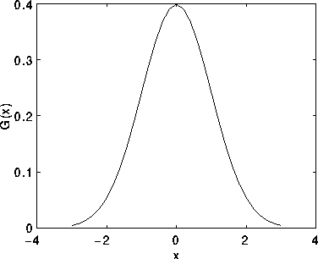
Continuous Distributions
Distribution describes an entire population
  Discrete distributions
    Binomial, Poisson
  Continuous distributions
    Normal
    Uniform
    Exponential

Slide 47
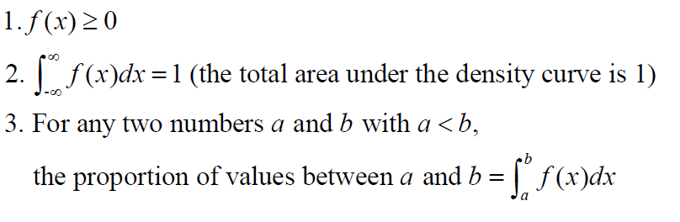
Density Function
A Density Function f(x) has the following properties:

Slide 48
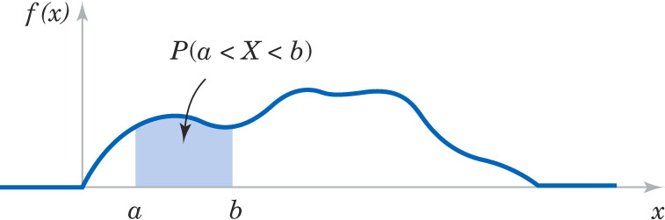
Probability Density Function
A probability density function (p.d.f.) f(x) describes the probability distribution of a continuous random variable.
Probability is determined from the area under f(x) from a to b.

Slide 49
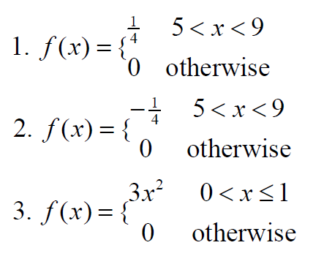
Are these density functions?

Slide 50
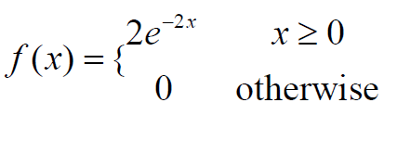
Is this a density function?
e is the base of the natural logarithm, and is approximately 2.71828

Slide 51
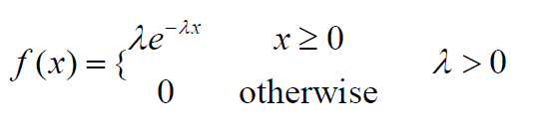
Exponential Distribution
Terminology: If variable x has an exponential density function f(x),
we say that x is exponentially distributed, or x has a exponential distribution
Review Exercise: Verify that the above function is indeed a density function.

Slide 52
Example 1
Let x be the response time (sec) at a certain on-line computer. The value of x varies from inquiry to inquiry. Suppose the density function for the distribution of x is
  f(x) = 0.2 e ^{-0.2x} for x≥0
  0 otherwise
what is the proportion of inquiries with a response time less than 5 seconds? Exceeding 5 seconds?
What is the 90th percentile of the response time?
What is the median (50th percentile) of the response time?

Slide 53
Example 1
63.2%; 36.8%
11.5 seconds – 90% of all inquiries will have response time less than 11.5 seconds (90th percentile)
5ln(2)=3.47 min

Slide 54
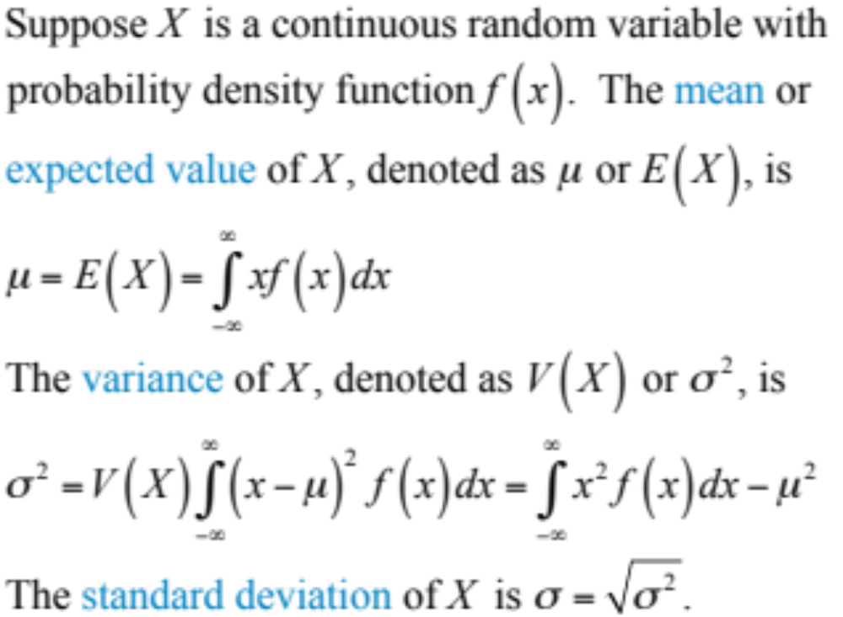
Mean & Variance

Slide 55
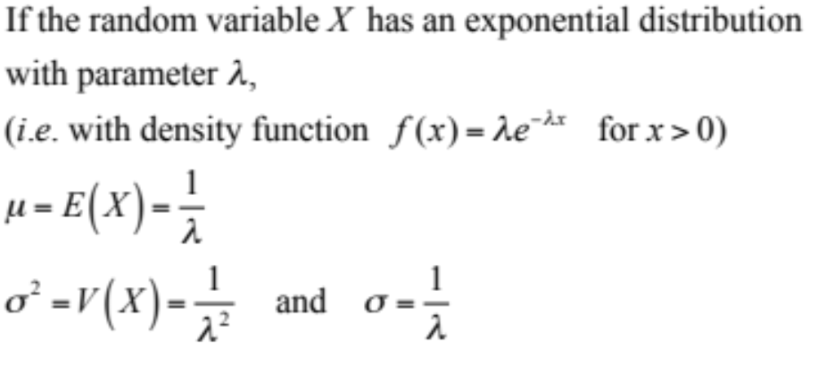
Exponential Mean & Variance

Slide 56
Example 1
Let x be the response time (sec) at a certain on-line computer. The value of x varies from inquiry to inquiry. Suppose the density function for the distribution of x is
  f(x) = 0.2 e ^{-0.2x} for x≥0
  0 otherwise
d) What is the mean response time?
e) What is the standard deviation of the response time?

Slide 57
Example 1
Let x be the response time (sec) at a certain on-line computer. The value of x varies from inquiry to inquiry. Suppose the density function for the distribution of x is
  f(x) = 0.2 e ^{-0.2x} for x≥0
  0 otherwise
d) What is the mean response time?
Mean = 1/0.2 = 5 (sec) > median=3.47 ➔ right skewed
e) What is the standard deviation of the response time?
Standard deviation = 1/0.2 = 5 sec

Slide 58
Example 2
Let X denote the flight delay (in minutes) of a major airline at O’Hare International Airport. Suppose X has an exponential distribution with mean equal to 10 minutes. Determine the proportion of flights whose delays are
  more than 10 minutes, more than 20 minutes, no
  More than 20 minutes
  No more than 30 minutes
  Find the value of D such that P(X<D) = 0.95
Solution:
1. Write the pdf for X.
2. E[X] = 10 ➔ λ =?
0.3679, 0.1353, 0.9502, 29.96

