Slide 1

The Practice of Statistics for Business and Economics
Third Edition
David S. Moore
George P. McCabe
Layth C. Alwan
Bruce A. Craig
William M. Duckworth
© 2011 W.H. Freeman and Company

Slide 2
The Sampling Distribution of a Sample Mean
Which statement below best describes the law of large numbers? (Assume that the samples mentioned are simple random samples.)
The larger the sample size, the more likely it is that the sample mean is close to the true mean.
The larger the sample size, the less likely the sample mean will be biased.
The larger the sample, the more likely you are to see an unusual event.
The larger the sample size, the more likely the sample mean will be normally distributed.

Slide 3
The Sampling Distribution of a Sample Mean (answer)
Which statement below best describes the law of large numbers? (Assume that the samples mentioned are simple random samples.)
The larger the sample size, the more likely it is that the sample mean is close to the true mean.
The larger the sample size, the less likely the sample mean will be biased.
The larger the sample, the more likely you are to see an unusual event.
The larger the sample size, the more likely the sample mean will be normally distributed.

Slide 4
The Sampling Distribution of a Sample Mean
Nationally, the scores of individual students on the ACT have a normal distribution with mean 18.6 and standard deviation 6.0. At Northside High, 36 seniors take the test. If the scores at this school have the same distribution as national scores, the sampling distribution of the average (sample mean) score for the 36 students is:
approximately normal, but the approximation is poor.
approximately normal, and the approximation is good.
exactly normal.
neither normal nor non-normal. It depends on which 36 students are selected.

Slide 5
The Sampling Distribution of a Sample Mean (answer)
Nationally, the scores of individual students on the ACT have a normal distribution with mean 18.6 and standard deviation 6.0. At Northside High, 36 seniors take the test. If the scores at this school have the same distribution as national scores, the sampling distribution of the average (sample mean) score for the 36 students is:
approximately normal, but the approximation is poor.
approximately normal, and the approximation is good.
exactly normal (note: because the “parent” distribution is Normal).
neither normal nor non-normal. It depends on which 36 students are selected.

Slide 6
The Sampling Distribution of a Sample Mean
The average annual return for a sample of 10 randomly chosen stocks is ___ than the average annual return for a sample of 20 randomly chosen stocks.
higher
lower
more variable
less variable

Slide 7
The Sampling Distribution of a Sample Mean (answer)
The average annual return for a sample of 10 randomly chosen stocks is ___ than the average annual return for a sample of 20 randomly chosen stocks.
higher
lower
more variable (note: the variance of average returns is σ²/n)
less variable

Slide 8
Introduction to Inference
Estimating with Confidence
PSBE Chapter 6.1
© 2011 W.H. Freeman and Company

Slide 9
Objectives (PSBE Chapter 6.1)
Estimating with confidence
  Statistical confidence
  Confidence intervals
  Behavior of confidence intervals
  Choosing the sample size
  Cautions

Slide 10
Overview of inference
Statistical Inference:
  methods for drawing conclusions about a population from sample data
Methods
    Confidence Intervals - estimating a value of a population parameter
    Tests of significance - assess evidence for a claim about a population
Inference is appropriate when data are produced by either
      a random sample or
      a randomized experiment

Slide 11
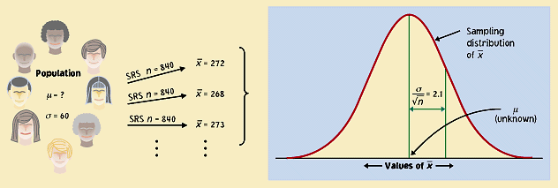
Uncertainty and confidence
Although the sample mean, , is a unique number for any particular sample, if you pick a different sample you will probably get a different sample mean.
In fact, you could get many different values for the sample mean, and virtually none of them would actually equal the true population mean, μ.
x

Slide 12
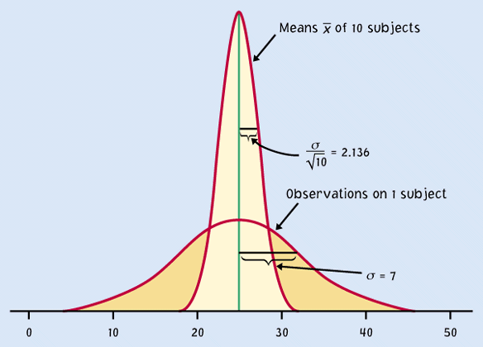

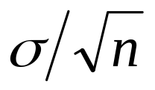

But the sample distribution is narrower than the population distribution, by a factor of √n.
Thus, the estimates
gained from our samples
are always relatively
close to the population
parameter µ.
n
Sample means,
n subjects
Population, x
individual subjects
μ
If the population is Normally distributed N(µ,σ),
so is the sampling distribution N(µ,σ/√n).

Slide 13
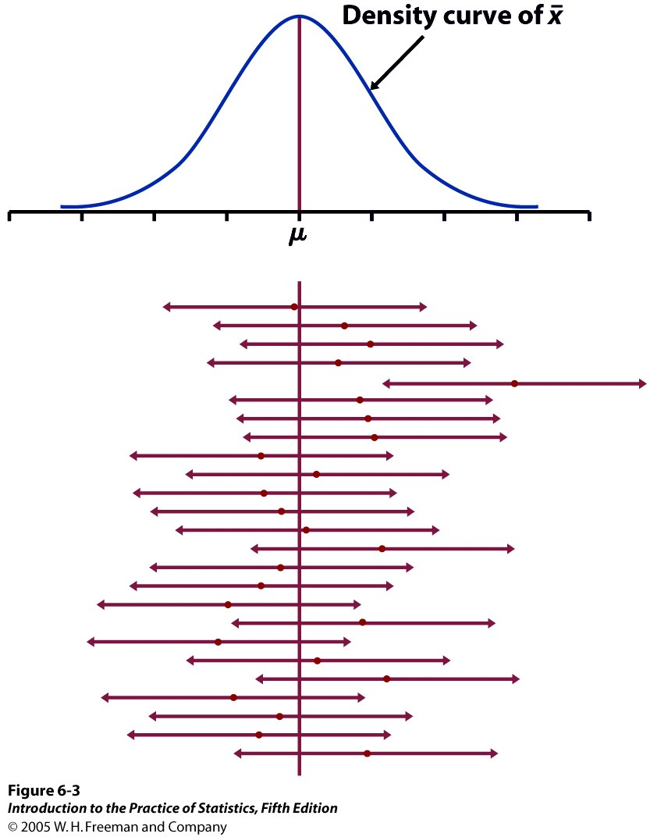


95% of all sample means will be within roughly 2 standard deviations (2*σ/√n) of the population parameter μ.
Because distances are symmetrical, this implies that the population parameter μ must be within roughly 2 standard deviations from the sample average , in 95% of all samples.
Red dot: mean value
of individual sample
This reasoning is the essence of statistical inference.

Slide 14
Example 6.5 Health Insurance
The Kaiser Family Foundation (Kaiser) and the Health Research & Educational Trust (HRET) conduct an annual national survey of firms on a variety of health coverage issues, including premiums and employee contributions.1 The 2008 survey included 2832 randomly selected public and private firms with three or more employees. Firms are categorized as “large” if they have 200 or more employees. In the sample, nearly 100% of large firms offer health benefits.
The survey considers different health plans such as health maintenance organizations (HMOs), preferred-provider organizations (PPOs), point-of-service plans (POS), and high-deductible health plans with a savings option (HDHP/SO). Let us consider the mean monthly cost of the premium for single-coverage HMO plans for workers in large firms. For this situation, we find 453 firms in the sample. For these firms, the mean monthly premium is . What can we say about μ, the mean monthly single-coverage premium per worker for all large firms in the United States?

Slide 15



Example 6.5 Health Insurance
Sample mean
  Natural estimator for μ
  Unbiased estimator for μ
  Sample mean → population mean when n large
Sample mean
  How reliable?
  Could we get a sample mean of 500 (or 300) on repeated samples?
  We know sample standard deviation: s=112.08
    Population standard deviation ≈ s = 112.08
    What is the standard deviation for ? ( )

Slide 16
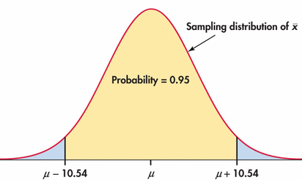

Example 6.5 Health Insurance
In 95% of all samples, lies with +/- 10.54 of u. So, u also lies within
+/- 10.54 of in those samples

Slide 17
Example 6.5 Health Insurance
In 95% of all samples, lies with +/- 10.54 of u. So, u also lies within +/- 10.54 of in those samples
Our sample mean is 405.02. So, we are 95% confident that the unknown monthly premium for all large firms lies between
$394.48 and $415.56.

Slide 18
Confidence Intervals
In 95% of all samples, lies with +/- 10.54 of u. So, u also lies within +/- 10.54 of in those samples
Our sample mean is 405.02. Our 95% confidence interval for μ is ($394.48, $415.56).
Two possibilities:
The interval between $394.48 and $415.56 contains the true μ.
Our SRS was one of the few samples for which X is not within 10.54 of the true μ. Only 5% of all samples give such inaccurate results.

Slide 19
Confidence intervals
A level C confidence interval for a parameter has two parts:
An interval calculated from the data, usually of the form
  Estimate ± Margin of Error
    (e.g. 405.12 ± 10.54)
A confidence level C, which gives the probability that the interval will capture the true parameter value in repeated samples.
Example 6.5: confidence level C=95% ➔ 405.12 ± 10.54
  What about C=90% or C=99%?

Slide 20

Confidence Interval for a Population Mean
Choose an SRS of size n from a population having unknown mean μ and known standard deviation σ. A level C confidence interval for μ is
z* is the critical value with area C between − z* and z* under the standard Normal curve.
Margin of Error:
The interval is exact when the population distribution is Normal and is approximately correct when n is large in other cases.

Slide 21
Case 6.1 Bankruptcy Attorney Fees
In 2005, Congress passed the Bankruptcy Abuse Prevention and Consumer Protection Act. This act made significant changes to the administration of bankruptcy relief. The Government Accountability Office (GAO) was commissioned to study the effects of the bankruptcy reform law on consumers. Attorney fees in consumer bankruptcy cases were studied by the GAO and reported in their 2008 Bankruptcy Reform report.² In the period February to March 2007, there were 71,106 Chapter 7 consumer bankruptcy cases.
To estimate legal fees for Chapter 7 consumer bankruptcy cases, the GAO conducted a nationwide random sample of Chapter 7 bankruptcy filings. Business bankruptcy cases and cases not involving attorneys were excluded. In the end, the GAO had n = 292 consumer cases with attorney involvement. The mean attorney fee in the sample is $1078 and the standard deviation is s = $592.

Slide 22
The fees in a sample n= 292 bankruptcy cases was examined. = $1078 and s = $592.
Bankruptcy fees
What is the distribution of the sample means ?
Normal (mean μ, standard deviation σ/√n) = N(μ, $34.6).
Find the middle 95% of the sample means distribution.
  Roughly ± 2 standard deviations from the mean, or μ ± 2x$34.6.
The 95% confidence interval is approximately ($1043.40, 1112.60).

Slide 23
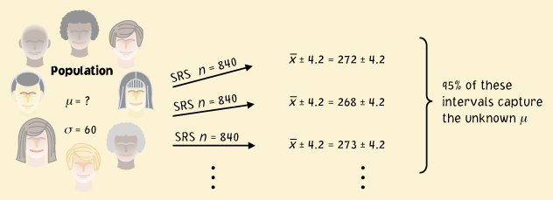
Confidence interval
The confidence interval is a range of values with an associated probability or confidence level C. The probability quantifies the chance that the interval contains the true population parameter.
± 4.2 is a 95% confidence interval for the population parameter μ.
This equation says that in 95% of the cases, the actual value of μ will be within 4.2 units of the value of .

Slide 24
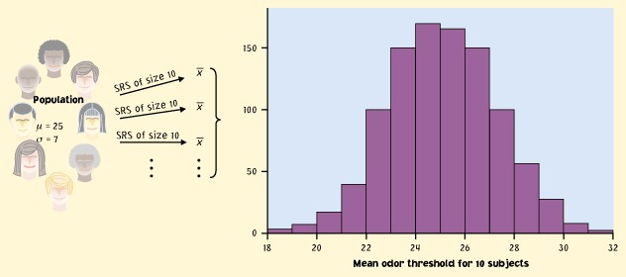
Implications
We don’t need to take a lot of random samples to “rebuild” the sampling distribution and find μ at its center.
n
All we need is one SRS of size n and relying on the properties of the sample means distribution to infer the population mean μ.
Sample
Population
n
μ

Slide 25
Reworded
With 95% confidence, we can say that µ should be within roughly 2 standard deviations (2*σ/√n) from our sample mean .
  In 95% of all possible samples of this size n, µ will indeed fall in our confidence interval.
  In only 5% of samples would be farther from µ.

Slide 26
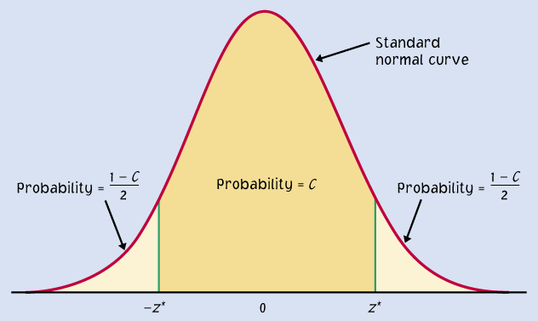
A confidence interval can be expressed as:
Mean ± m
m is called the margin of error
μ within ± m
Ex: 120 ± 6
Two endpoints of an interval
μ within ( − m) to ( + m)
Ex: 114 to 126
A confidence level C (in %) indicates the probability that the µ falls within the interval.
It represents the area under the Normal curve within ± m of the center of the curve.
m
m

Slide 27
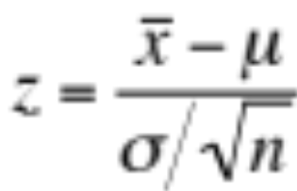
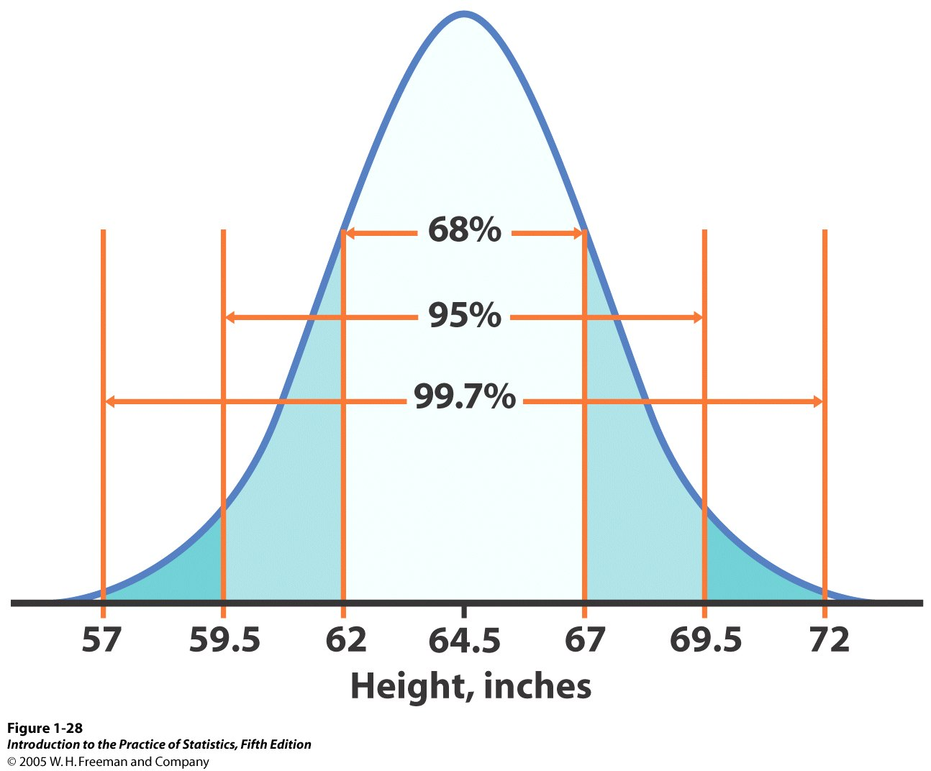
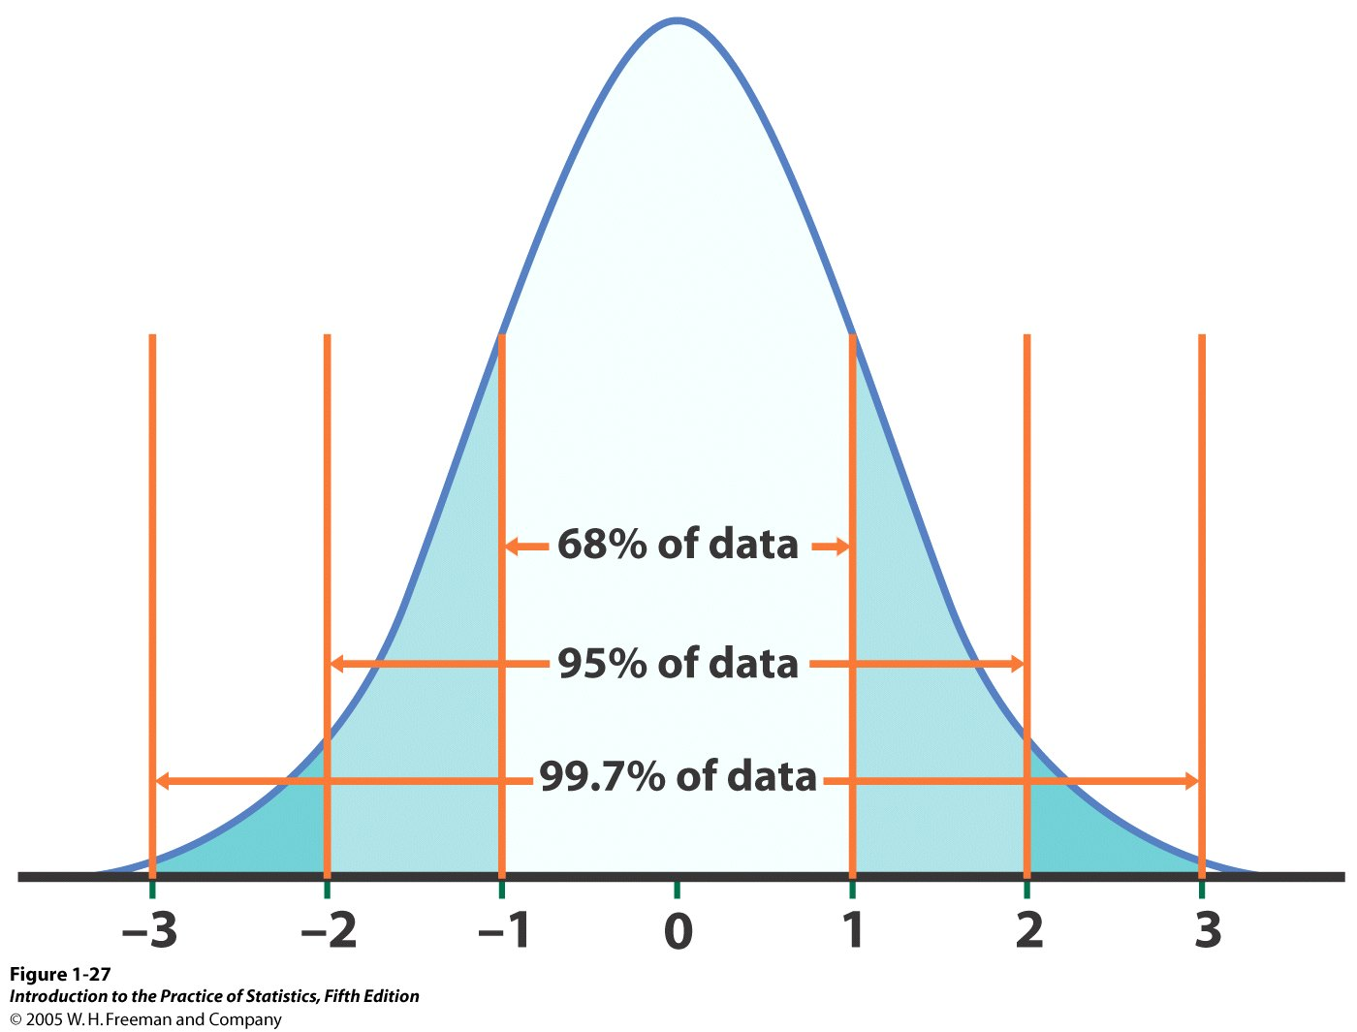


Review: standardizing the Normal curve using z
N(64.5, 2.5)
N(µ, σ/√n)
N(0,1)
Standardized height (no units)
Here, we work with the sampling distribution,
and σ/√n is its standard deviation (spread).
Remember that σ is the standard deviation of the original population.

Slide 28
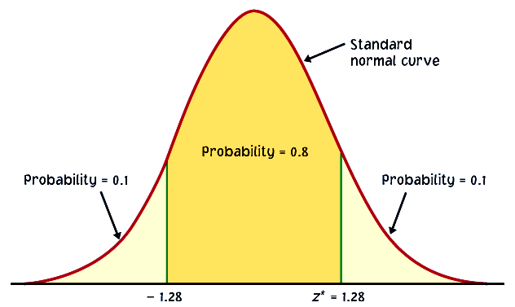

Varying confidence levels
Confidence intervals contain the population mean μ in C% of samples. Different areas under the curve give different confidence levels C.
Practical use of z: z*
The critical value z* is related to the chosen confidence level C.
C is the area under the standard Normal curve between −z* and z*.
C
The confidence interval is thus:
−z*
z*
Ex: For an 80% confidence level C, 80% of the Normal curve’s
area is contained in the interval.

Slide 29

How do we find specific z* values?
We can use a table of z/t values (Table C). For a particular confidence level C, the appropriate z* value is just above it.
Ex: For a 98% confidence level, z*=2.326.
We can use software. In Excel:
=NORMINV(probability,mean,standard_dev)
gives z for a given cumulative probability.
Since we want the middle C probability, the probability we require is (1 - C)/2 .
Ex: For a 98% confidence level, =NORMINV(.01,0,1) = −2.32635 (= neg. z*).

Slide 30
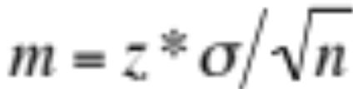
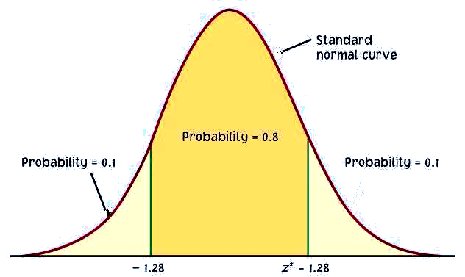
Link between confidence level and margin of error
The confidence level C determines the value of z* (in Table C).
The margin of error also depends on z*.
Higher confidence C implies a larger margin of error m (thus less precision in our estimates).
A lower confidence level C produces a smaller margin of error m (thus better precision in our estimates).
C
m m
−z*
z*

Slide 31
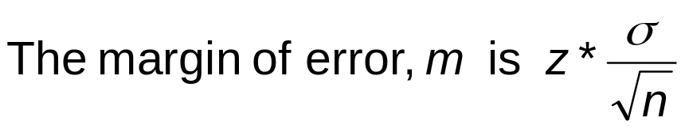
How confidence intervals behave
The margin of error gets smaller:
When z* gets smaller. Smaller z* is the same as lower confidence level C.
When σ gets smaller. It is easier to estimate μ when σ is small.
When n gets larger.

Slide 32
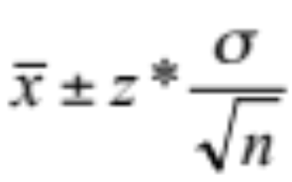

Changing the sample size n
Banks’ Loan-to-Deposit Ratio (LTDR)
The mean LTDR for 110 banks is 76.7 and the standard deviation s = 12.3. The sample is large enough for us to use s as σ. Give a 95% confidence interval for mean LTDR.
Suppose there were only 25 banks in the survey, and the sample mean and σ are unchanged. The margin of error increases for the smaller sample.
95% confidence interval for the mean LTDR, z* = 1.96, n = 110.
= 76.7 ± 1.96(12.3/√110)
= 76.7 ± 2.3
= (74.4, 79.0)
95% confidence interval for the mean LTDR, z* = 1.96, n = 25.
= 76.7 ± 1.96(12.3/√25)
= 76.7 ± 4.8
= (71.9, 81.5)

Slide 33
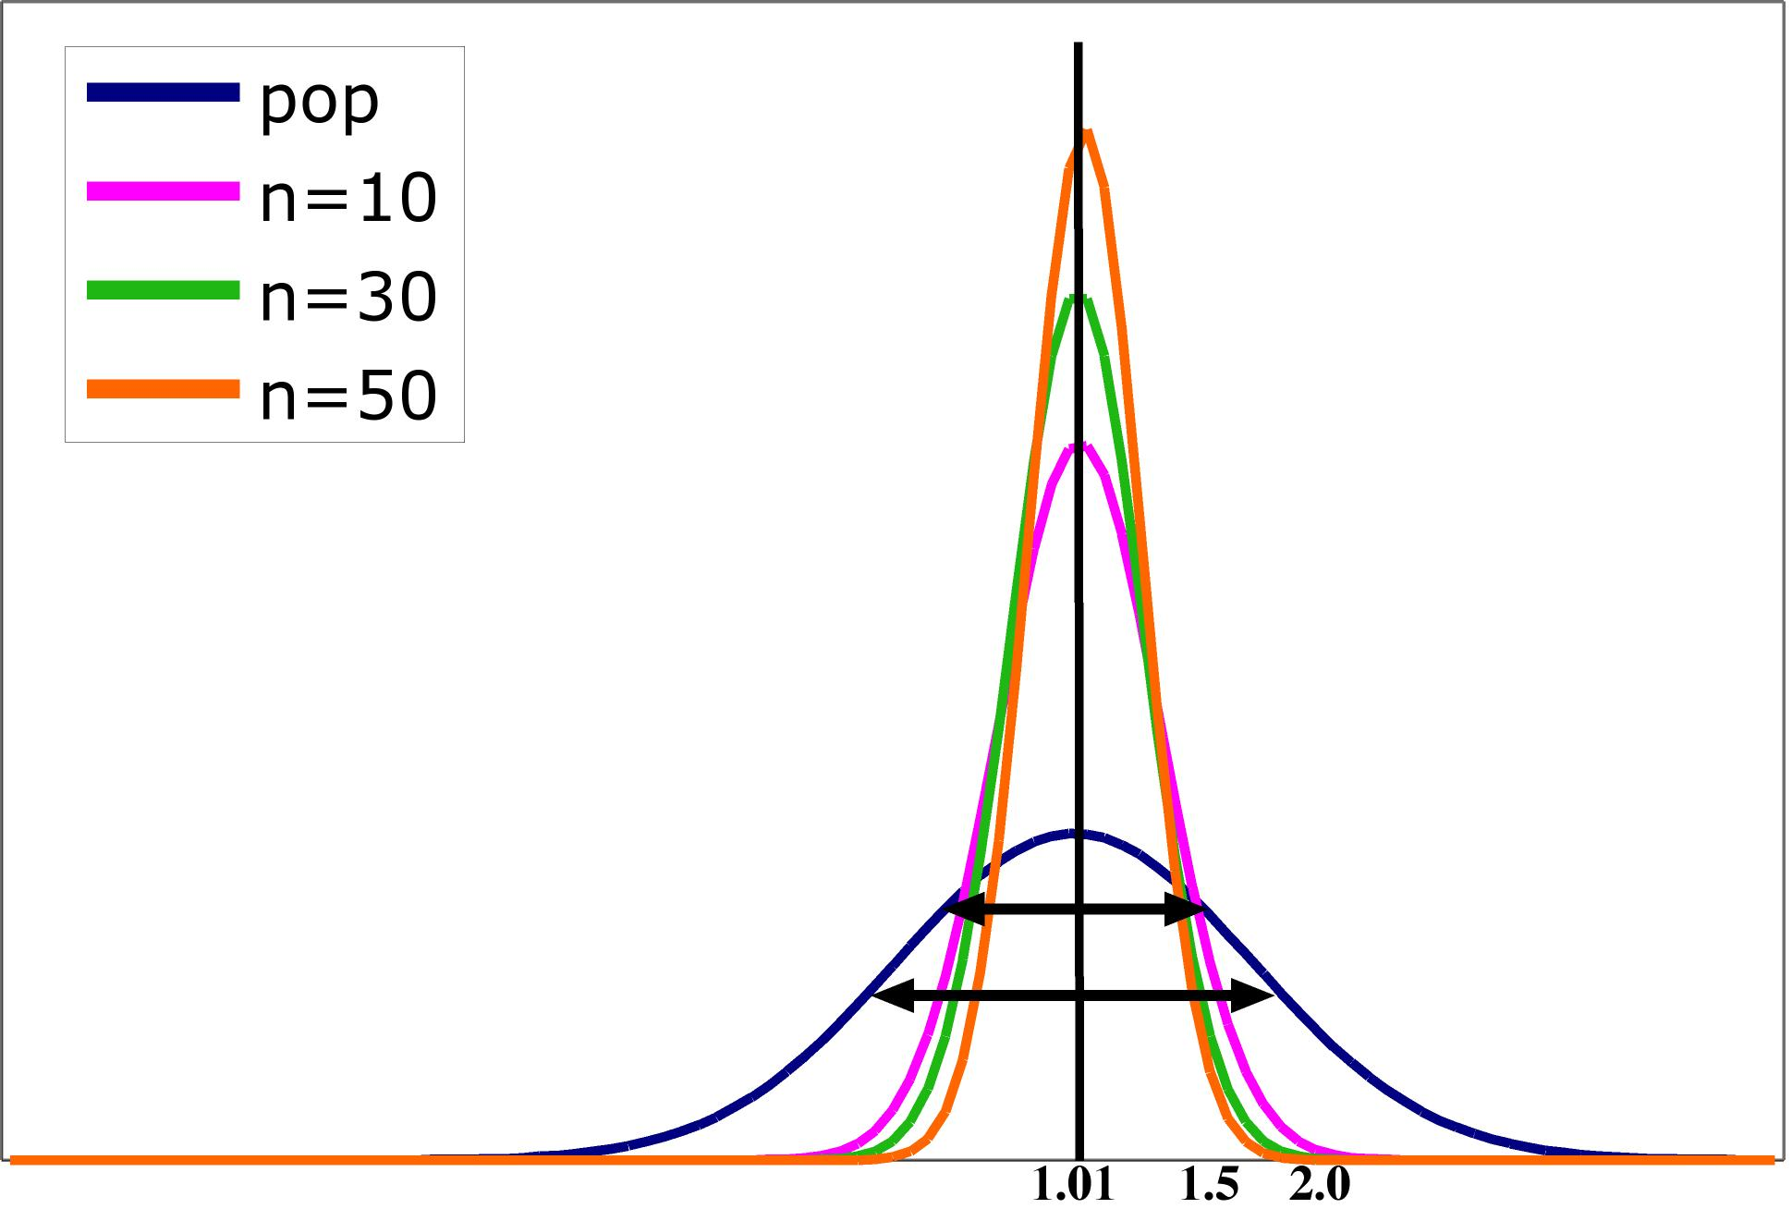
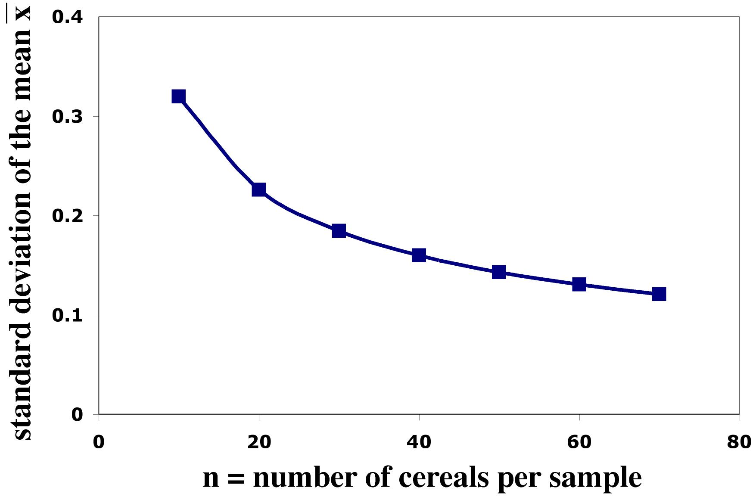
Impact of sample size
The spread in the sampling distribution of the mean is a function of the number of individuals per sample.
  The larger the sample size, the smaller
  the standard deviation (spread) of the
  sample mean distribution.
  But the spread only decreases at a rate
  equal to √n.
Standard error σ ⁄ √n
Sample size n

Slide 34
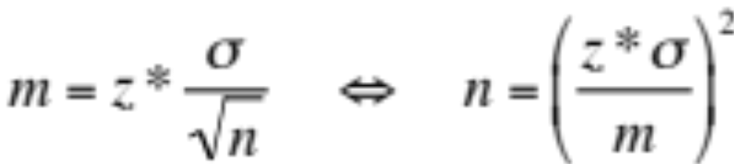
Sample size and experimental design
You may need a certain margin of error (e.g., drug trial, manufacturing specs). In many cases, the population variability (σ) is fixed, but we can choose the number of measurements (n).
So plan ahead what sample size to use to achieve that margin of error.
Remember, though, that sample size is not always stretchable at will. There are typically costs and constraints associated with large samples. The best approach is to use the smallest sample size that can give you useful results.

Slide 35
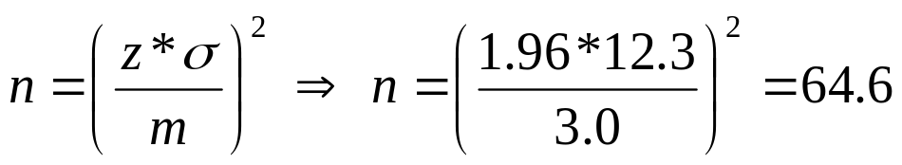
What sample size for a given margin of error?
Banks’ Loan-to-Deposit Ratio (LTDR)
Recall that we found margin of error = 2.3 for estimating the mean LTDR of banks with n = 110 and 95% confidence. We are willing to settle for margin of error 3.0 next year. How many banks should we survey?
For 95% confidence, z* = 1.96, assume σ = 12.3.
Using only 64 observations will not be enough to ensure that m is no more than 3.0. Therefore, we need at least 65 observations.

Slide 36
Some cautions
The data must be an SRS from the population.
The formula is not correct for sampling designs more complex than an SRS (such as multistage or stratified samples).
Outliers can have a large effect on the confidence interval.
Examine your data carefully for skewness and other signs of non-Normality.
You must know the standard deviation σ of the population.

Slide 37
Introduction to Inference
Tests of Significance
PSBE Chapter 6.2
© 2011 W.H. Freeman and Company

Slide 38
Objectives (PSBE Chapter 6.2)
Tests of significance
  Reasoning of significance tests
  Stating hypotheses
  Test statistics and P-values
  Tests for a population mean
  The significance level α
  Two-sided tests and confidence intervals
  P-values versus fixed α

Slide 39

Reasoning of significance tests
We have seen that the properties of the sampling distribution of the sample mean help us estimate a range of likely values for population mean μ.
We can also rely on the properties of the sample distribution to test hypotheses.
Ex: You are in charge of quality control in your food company. You sample randomly four packs of cherry tomatoes, each labeled 1/2 lb. (227 g).
The average weight from your four boxes is 222 g. Obviously, we cannot expect boxes filled with whole tomatoes to all weigh exactly half a pound. Thus,
  Is the somewhat smaller weight simply due to chance variation?
  Is it evidence that the calibrating machine that sorts
  cherry tomatoes into packs needs revision?

Slide 40

Stating hypotheses
A test of statistical significance tests a specific hypothesis using sample data to decide on the validity of the hypothesis.
In statistics, a hypothesis is an assumption or a theory about the characteristics of one or more variables in one or more populations.
  What you want to know: Does the calibrating machine that sorts cherry tomatoes into packs need revision?
  The same question reframed statistically: Is the population mean µ for the distribution of weights of cherry tomato packages equal to 227 g (i.e., half a pound)?

Slide 41
Stating hypotheses
The statement being tested in a test of significance is called the null hypothesis, H₀. The test of significance is designed to assess the strength of the evidence against the null hypothesis. It is usually a statement of “no effect” or “no difference.”
The alternative hypothesis is the statement we suspect is true instead of the null hypothesis. It is labeled H_{a}.
Weight of cherry tomato packs:
  H₀ : µ = 227 g (µ is the average weight of the population of packs)
  H_{a} : µ ≠ 227 g (µ is either larger or smaller)

Slide 42
One-sided and two-sided tests
A two-tail or two-sided test of the population mean has these null and alternative hypotheses:
  H₀ : µ = [a specific number] H_{a} : µ ≠ [a specific number]
A one-tail or one-sided test of a population mean has these null and alternative hypotheses:
  H₀ : µ = [a specific number] H_{a} : µ < [a specific number] OR
  H₀ : µ = [a specific number] H_{a} : µ > [a specific number]
  The FDA tests whether a generic drug has an absorption extent similar to the known absorption extent of the brand-name drug it is copying. Higher or lower absorption would both be problematic, thus we test:
  H₀ : µ_{generic} = µ_{brand} H_{a} : µ_{generic} ≠ µ_{brand} two-sided

Slide 43
How to choose?
What determines the choice of a one-sided versus a two-sided test is what we know about the problem before we perform a test of statistical significance.
  A company tests whether the mean volume of tea in their bottles is 500 ml, as stated on the label.
  Here, the company would likely be more concerned that the bottles contain less than advertised, which would likely lead to consumer complaints of false advertising.
  Thus, this is a one-sided test: H₀ : µ = 500 ml H_{a} : µ < 500 ml
It is important to make that choice before performing the test or else you could make a choice of “convenience” or fail in circular logic.

Slide 44
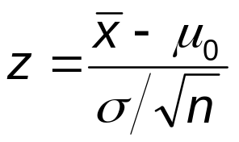
Test statistics
The test statistic is based on the statistic that estimates the parameter.
Because Normal calculations require standardized variables, we use as our test statistic the standardized sample mean.
This random variable has the standard Normal distribution N(0, 1).

Slide 45
The P-value
The packaging process has a known standard deviation, σ = 5 g.
H₀ : µ = 227 g versus H_{a} : µ ≠ 227 g
The average weight from your four random boxes is 222 g.
What is the probability of drawing a random sample such as yours if H₀ is true?
Tests of statistical significance quantify the chance of obtaining a particular random sample result if the null hypothesis were true. This quantity is the P-value.
This is a way of assessing the “believability” of the null hypothesis given the evidence provided by a random sample.

Slide 46
Interpreting a P-value
Could random variation alone account for the difference between the null hypothesis and observations from a random sample?
  A small P-value implies that random variation because of the sampling process alone is not likely to account for the observed difference.
  With a small P-value we reject H₀. The true property of the population is significantly different from what was stated in H₀.
Thus, small P-values are strong evidence AGAINST H₀.
But how small is small…?

Slide 47
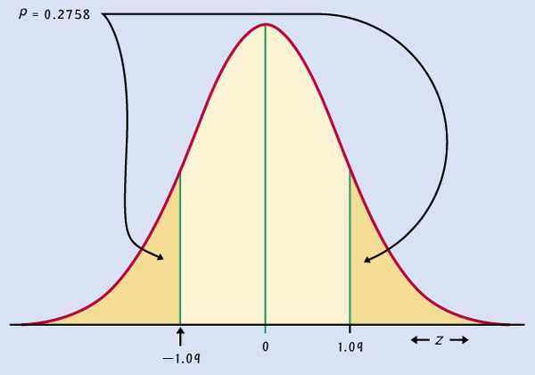
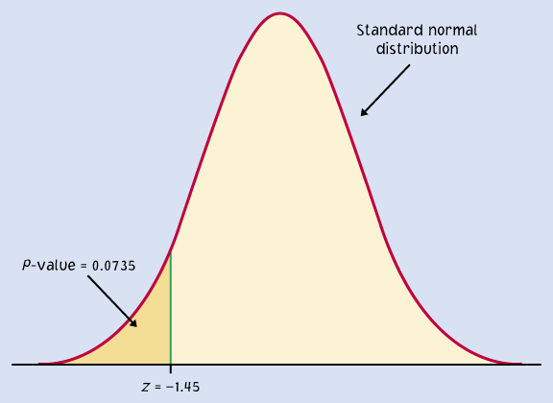
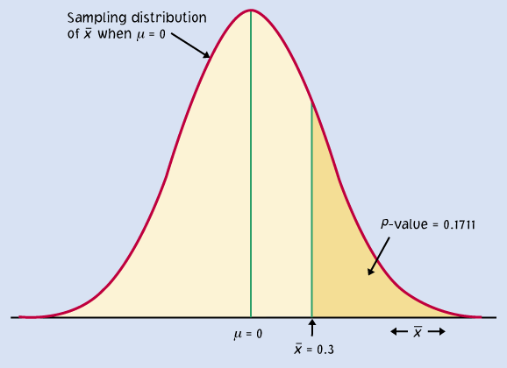
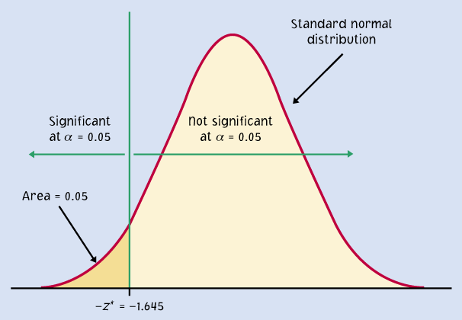
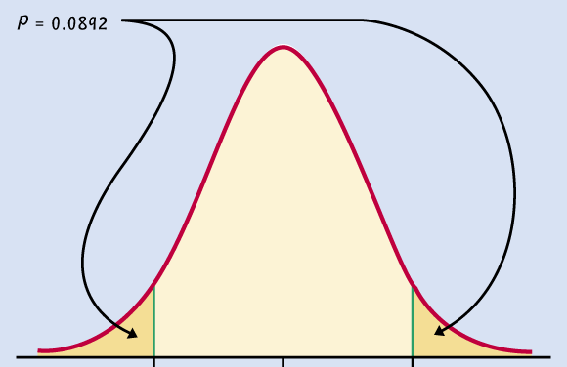
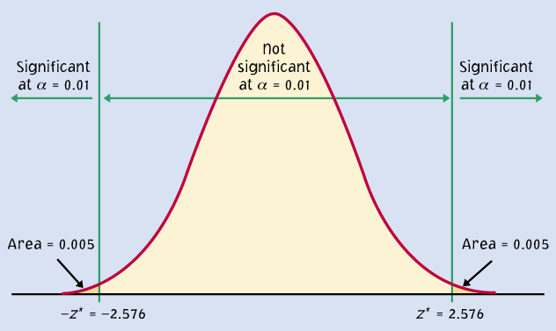
P = 0.2758
P = 0.0735
Significant P-value
???
P = 0.1711
P = 0.05
P = 0.0892
P = 0.01
When the shaded area becomes very small, the probability of drawing such a sample at random gets very slim. Oftentimes, a P-value of 0.05 or less is considered significant: The phenomenon observed is unlikely to be entirely due to chance event from the random sampling.

Slide 48
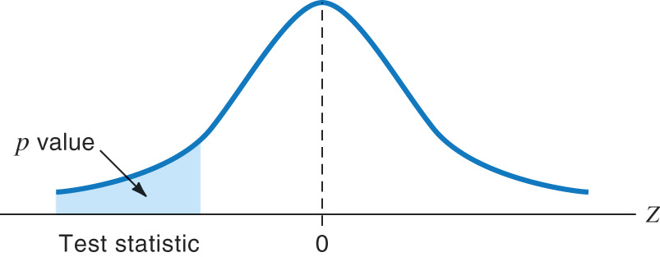

Tests for a population mean
To test the hypothesis H₀ : µ = µ₀ based on an SRS of size n from a Normal population with unknown mean µ and known standard deviation σ, we rely on the properties of the sampling distribution N(µ, σ/√n).
The P-value is the area under the sampling distribution for values at least as extreme, in the direction of H_{a}, as that of our random sample.
Again, we first calculate a z-value
and then use Table A.
Sampling distribution
σ/√n
µ
defined by H₀

Slide 49
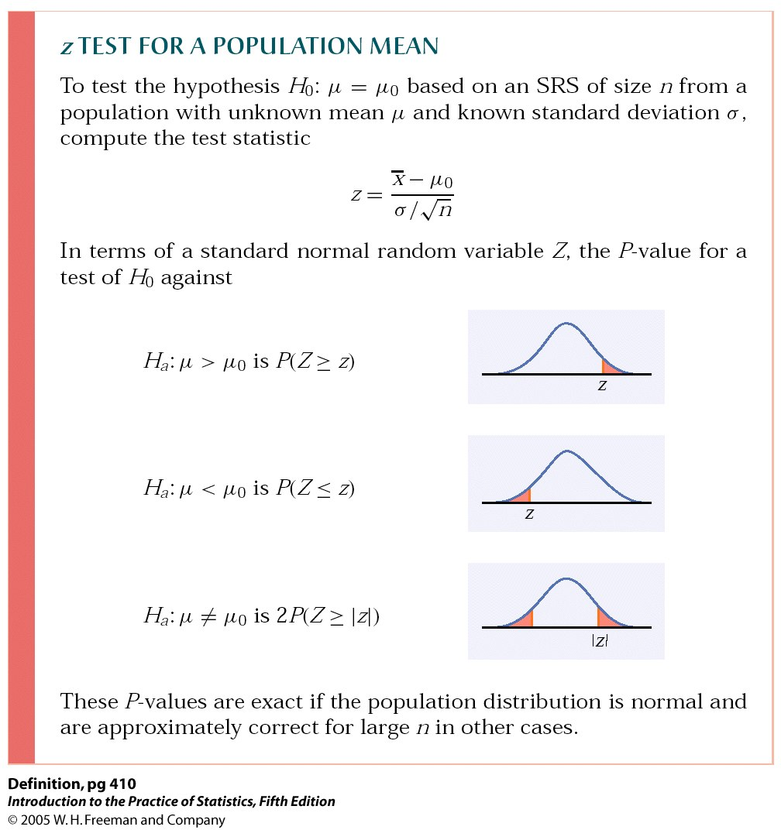
P-value in one-sided and two-sided tests
One-sided (one-tailed) test
Two-sided (two-tailed) test
To calculate the P-value for a two-sided test, use the symmetry of the Normal curve. Find the P-value for a one-sided test and double it.

Slide 50

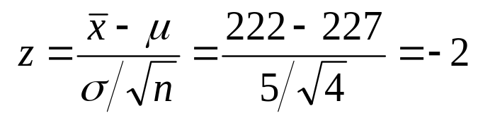

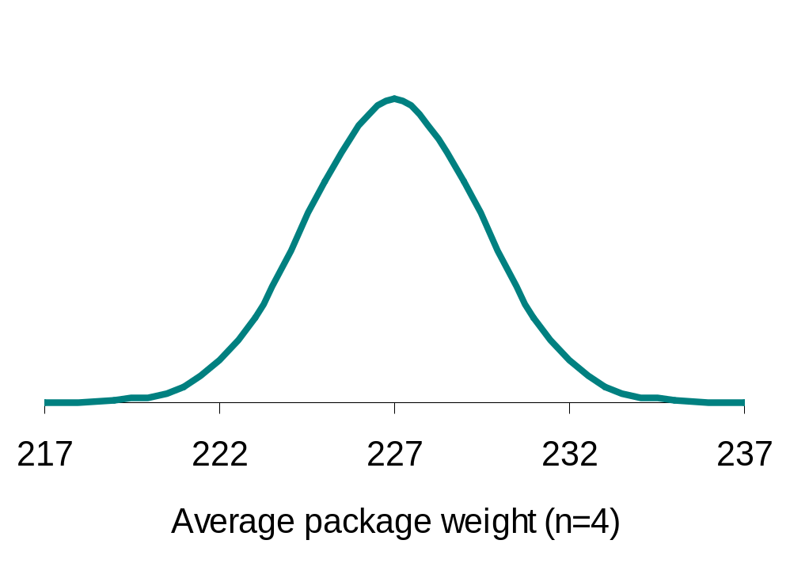
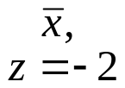
Does the packaging machine need revision?
  H₀ : µ = 227 g versus H_{a} : µ ≠ 227 g
  What is the probability of drawing a random sample such as yours if H₀ is true?
From Table A, the area under the standard Normal curve to the left of z is 0.0228.
Thus, P-value = 2*0.0228 = 4.56%.
Sampling distribution
σ/√n = 2.5 g
The probability of getting a random
sample average so different from
µ is so low that we reject H₀.
➔The machine does need recalibration.
2.28%
2.28%
µ (H₀)

Slide 51
The significance level, α
We compare the P-value with a level that we regard as decisive called the significance level, α. This value is decided arbitrarily before conducting the test.
  If the P-value is equal to or less than α (P ≤ α), then we reject H₀.
  If the P-value is greater than α (P > α), then we fail to reject H₀.
Does the packaging machine need revision?
Two-sided test. The P-value is 4.56%.
* If α had been set to 5%, then the P-value would be significant.
* If α had been set to 1%, then the P-value would not be significant.

Slide 52
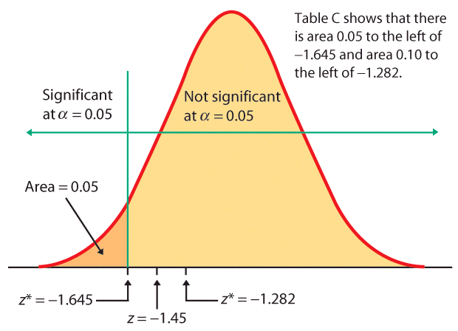
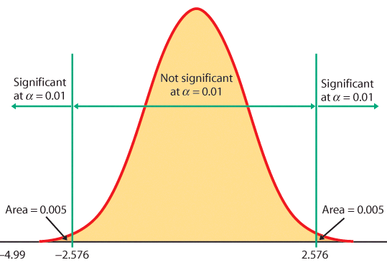
When the z score falls within the rejection region (shaded area on the tail side), the P-value is smaller than α and you have shown statistical significance.
z = -1.645
One-sided test, α = 5%
Two-sided test, α = 1%
Z

Slide 53
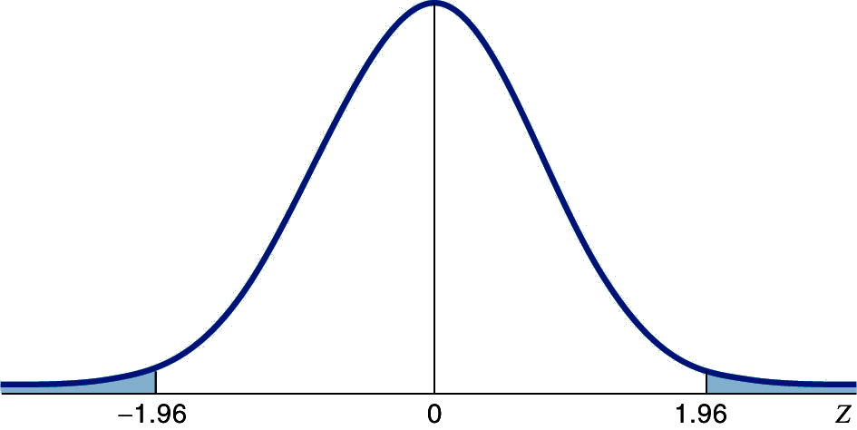

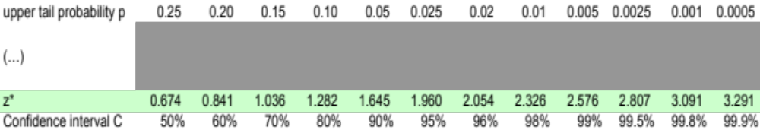
Rejection region for a two-tailed test of µ with α = 0.05 (5%)
A two-sided test means that α is spread between both tails of the curve, thus:
-A middle area C of 1 − α = 95%, and
-An upper tail area of α /2 = 0.025.
0.025
0.025
Table C

Slide 54
Test of significance
State the null hypothesis H₀ and the alternative hypotheses H_{a}.
The test is designed to assess the strength of evidence against H₀; H_{a} is the statement we will accept if we reject H₀.
Select a significance level.
Calculate the test statistic.
Find the P-value for the observed data.
State a conclusion.
If the P-value ≤ α reject H_{o}
If the P-value > α accept H_{o}

Slide 55
Case 6.2
Fill the Bottles Perhaps one of the most common applications of hypothesis testing of the mean is the quality control problem of assessing whether or not the underlying population mean is on “target.” Consider the case of Bestea Bottlers. One of Bestea’s most popular products is the 500 milliliters (ml) bottle of raspberry-flavored green tea. There is some variation from bottle to bottle because the filling machinery is not perfectly precise. Bestea has two concerns: whether there is a problem of underfilling (customers are then being shortchanged, which is a form of false advertising), or whether there is a problem of overfilling (unnecessary cost to the bottler).

Slide 56
Example 6.10 Are the Bottles Being Filled as Advertised?
The filling process is not new to Bestea. Data on past production shows that the distribution of the contents is Normal with standard deviation σ = 2 ml. To assess the state of the bottling process, an inspector measures the contents of 10 randomly selected bottles. The results are
  502.9 499.8 503.2 502.8 500.9
  503.0 498.2 502.5 503.8 501.4
For this sample of 10 observations, the mean content is 501.94 ml. Is a sample mean of 501.94 ml convincing evidence that the mean fill of all bottles produced by the current process differs from the advertised 500 ml?

Slide 57
Example 6.10 Test of Significance
Step 1: H0 vs H1
Step 2: Calculate test statistic
Step 3: Find P-Value
Step 4: Conclusion

Slide 58
Example 6.17 Blood Pressures of Executives
The medical director of a large company is concerned about the effects of stress on the company’s younger executives. According to the National Center for Health Statistics, the mean systolic blood pressure for males 35 to 44 years of age is 128 and the standard deviation in this population is 15.
The medical director examines the records of 72 executives in this age group and finds that their mean systolic blood pressure is 129.93. Is this evidence that the mean blood pressure for all the company’s young male executives is higher than the national average? As usual in this chapter, we make the unrealistic assumption that the population standard deviation is known, in this case that executives have the same σ = 15 as the general population.

Slide 59
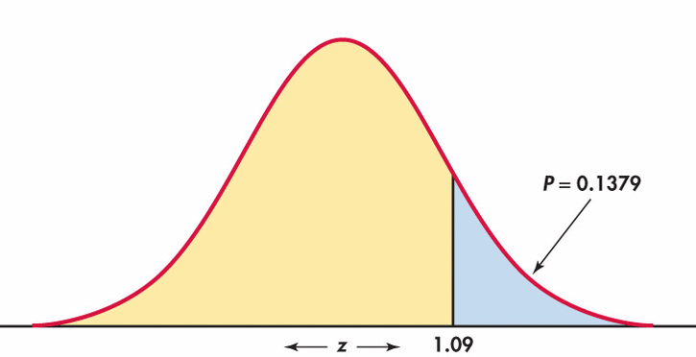
Example 6.17
Conclusion: About 14% of the time an SRS of size 72 from the general male population would have a mean blood pressure as high as that of the executive sample. The observed sample mean 129.93 is not significantly higher than the national average at any of the usual significance levels.

Slide 60
Confidence intervals to test hypotheses
Because a two-sided test is symmetrical, you can also use a confidence interval to test a two-sided hypothesis.
In a two-sided test,
C = 1 – α.
C confidence level
α significance level
α /2
α /2
Packs of cherry tomatoes (σ = 5 g): H₀ : µ = 227 g versus H_{a} : µ ≠ 227 g
Sample average 222 g. 95% CI for µ = 222 ± 1.96*5/√4 = 222 g ± 4.9 g
227 g does not belong to the 95% CI (217.1 to 226.9 g). Thus, we reject H₀.

Slide 61
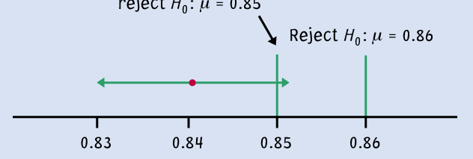

Logic of confidence interval test
Ex: Your sample gives a 99% confidence interval of .
With 99% confidence, could samples be from populations with µ = 0.86? µ = 0.85?
Cannot reject
H₀: μ = 0.85
Reject H₀ : μ = 0.86
99% C.I.
A confidence interval gives a black and white answer: Reject or don't reject H₀. But it also estimates a range of likely values for the true population mean µ.
A P-value quantifies how strong the evidence is against the H₀. But if you reject H₀, it doesn’t provide any information about the true population mean µ.

Slide 62
P-values versus fixed α
A P-value is more informative than a reject-or-not finding at a fixed significance level.
Ex: We conclude that the test statistic z = -4.99 is significant at the 1% level for a two-sided test. However, the actual P-value, P = 0.0000006 (from software), gives a better sense of how strong the evidence is.
Knowing the P-value allows us to assess significance at any level.

Slide 63
Introduction to Inference
Using Significance Tests, Power, and Inference as a Decision
PSBE Chapters 6.3 and 6.4
© 2011 W.H. Freeman and Company

Slide 64
Objectives (PSBE Chapters 6.3 and 6.4)
Using significance tests
Power and inference as a decision
  How small a P-value?
  Statistical significance vs. practical significance
  Cautions for tests
  The power of a test
  Type I and II errors

Slide 65
Type I and II errors
A Type I error is made when we reject the null hypothesis and the null hypothesis is actually true (incorrectly reject a true H₀).
The probability of making a Type I error is the significance level α.
A Type II error is made when we fail to reject the null hypothesis and the null hypothesis is false (incorrectly keep a false H₀).
The probability of making a Type II error is labeled β.
The power of a test is 1 − β.

Slide 66
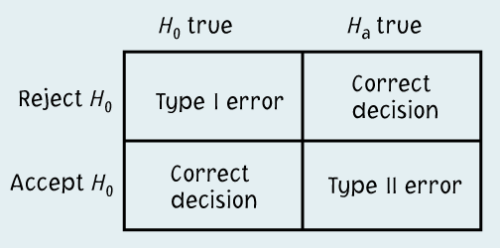
Running a test of significance is a balancing act between the chance α of making a Type I error and the chance β of making a Type II error. Reducing α reduces the power of a test and thus increases β.
It might be tempting to emphasize greater power (the more the better).
  However, with “too much power” trivial effects become highly significant.
  A Type II error is not definitive since a failure to reject the null hypothesis does not imply that the null hypothesis is wrong.

Slide 67
Example 6.23 Exercise and Bones
Can a 6-month exercise program increase the total body bone mineral content (TBBMC) of young women? A team of researchers is planning a study to examine this question. Based on the results of a previous study, they are willing to assume that
σ = 2 for the percent change in TBBMC over the 6-month period. A change in TBBMC of 1% would be considered important, and the researchers would like to have a reasonable chance of detecting a change this large or larger. Are 25 subjects a large enough sample for this project?

Slide 68
The power of a test
The power of a test of hypothesis with fixed significance level α is the probability that the test will reject the null hypothesis when the alternative is true.
In other words, power is the probability that the data gathered in an experiment will be sufficient to reject a wrong null hypothesis.
Knowing the power of your test is important:
  When designing your experiment: Select a sample size large enough to detect an effect of a magnitude you think is meaningful.
  When a test found no significance: Check that your test would have had enough power to detect an effect of a magnitude you think is meaningful.

Slide 69
Increasing the power
Increase α. More conservative significance levels (lower α) yield lower power. Thus, using an α of .01 will result in lower power than using an α of .05.
The size of the effect is an important factor in determining power. Larger effects are easier to detect.
Increasing the sample size decreases the spread of the sampling distribution and therefore increases power. But there is a tradeoff between gain in power and the time and cost of testing a larger sample.
Decrease σ. A larger variance σ² implies a larger spread of the sampling distribution, σ/√n. Thus, the larger the variance, the lower the power. The variance is in part a property of the population, but it is possible to reduce it to some extent by carefully designing your study.

Slide 70
Example 6.23
Step 1: State H0 and H1, and significant level
Step 2: When do you reject H0?
Step 3: Calculate the probability of rejecting H0 when the alternative is true (u=1)

Slide 71
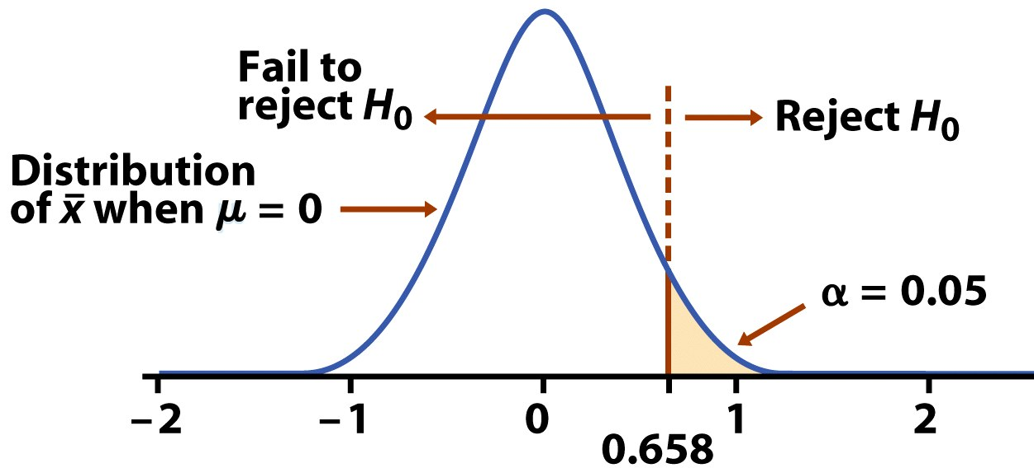
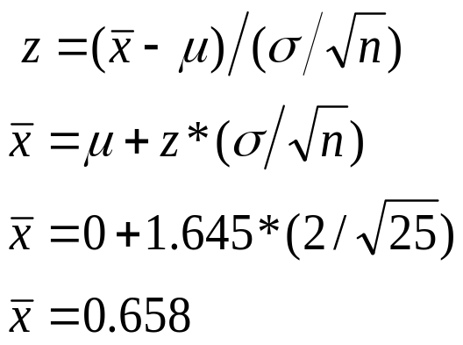
Test of hypothesis at significance level α = 5%:
H₀: µ = 0 versus H_{a}: µ > 0
Can an exercise program increase bone density? From previous studies, we assume that σ = 2 for the percent change in bone density and would consider a percent increase of 1 medically important.
Is 25 subjects a large enough sample for this project?
A significance level of 5% implies a lower tail of 95% and z = 1.645. Thus:
All sample averages larger than 0.658 will result in rejecting the null hypothesis.

Slide 72
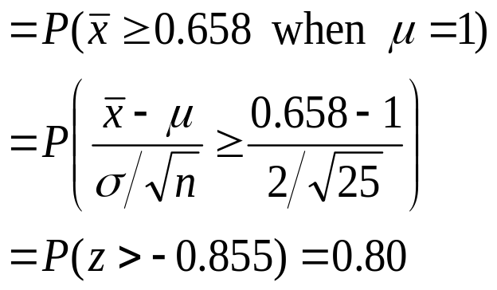
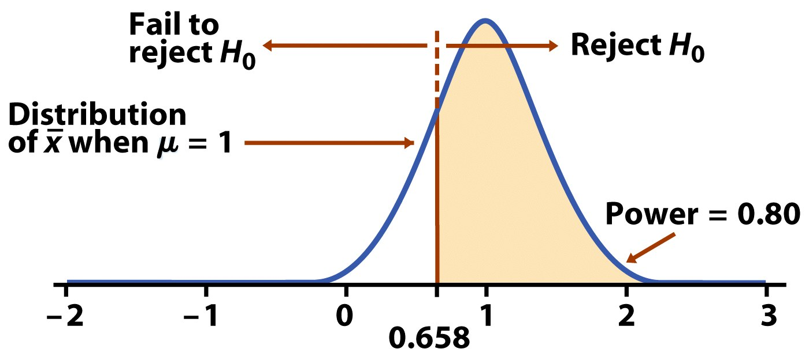
What if H0 is wrong and the true population mean is 1?
The power against the alternative µ = 1% is the probability that H₀ will be rejected when in fact µ = 1%.
A test power of 80% or more is considered good statistical practice.

Slide 73
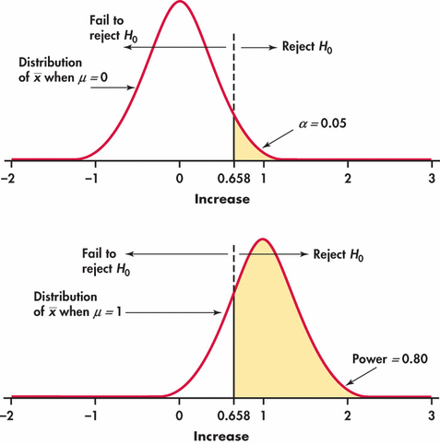
Example 6.23

Slide 74
Example
Can a 6-month exercise program increase the total body bone mineral content (TBBMC) of young women? σ=2 for the percent change in TBBMC over the 6-month period.
An increase in TBBMC of 1 percent would be considered important, and the researchers would like to have a reasonable chance of detecting a change this large or larger. Is 25 subjects a large enough sample for this project?

Slide 75
Approach to Problem
Step 1:
  State H0 and Ha; significant level α
  The particular alternative we want to detect
Step 2:
  Find the values of the sample mean that will lead us to reject H0
Step 3:
  Calculate the probability of observing these values of the sample mean when the alternative is true

Slide 76
Step 1
H0: μ = 0 vs Ha: μ>0
α=0.05
The particular alternative of interest is:
μ = 1 (percent)

Slide 77
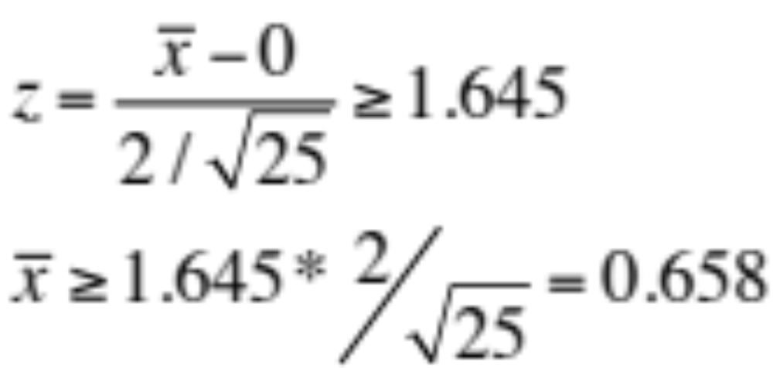
Find the Rejection Region
The z test rejects H0 at the α=0.05 level whenever
This event has probability 0.05 of occurring when the population mean is 0

Slide 78
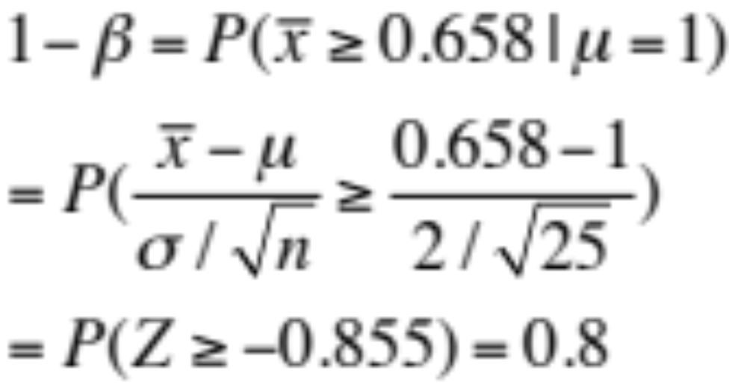
Calculating the Power
The power against the alternative μ=1 is the probability that H0 will be rejected when in fact u=1.

Slide 79
Increasing the Power 1-β
Same as decreasing the probability of type II error β
  Increase α
  Consider a particular alternative μ1 that is farther away from μ0
  Increase the sample size n
  Decrease σ
    By improving the measurement process
    By restricting attention to a subpopulation

Slide 80
Example (cont’d)
Can a 6-month exercise program increase the total body bone mineral content (TBBMC) of young women?
Investigate the effect of
  α= 0.01 vs 0.05
  μ1=2(percent) vs μ1=1
  n=100 vs n=25
  σ=1 vs σ=2

Slide 81
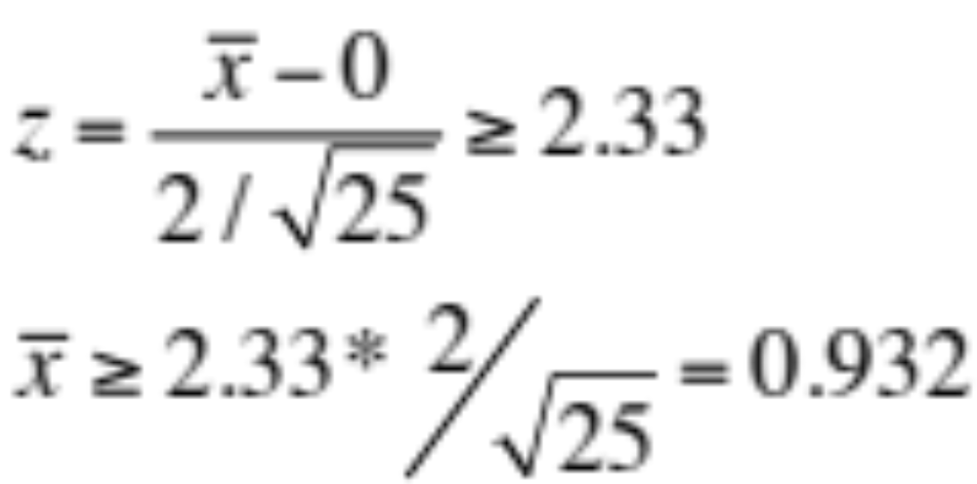
Increase Power by increasing α
Consider α=0.01. The z test rejects H0 at the α=0.01 level whenever

Slide 82
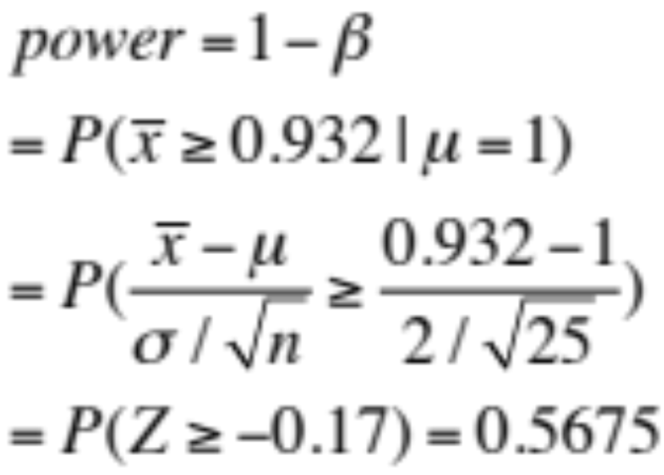
Power when α=0.01
The power against the alternative μ=1 is the probability that H0 will be rejected when in fact u=1.
Power=0.8 when α=0.05

Slide 83
Consider μ1=2 while α=0.05
The z test rejects H0 at the α=0.05 level whenever
This event has probability 0.05 of occurring when the population mean is 0

Slide 84
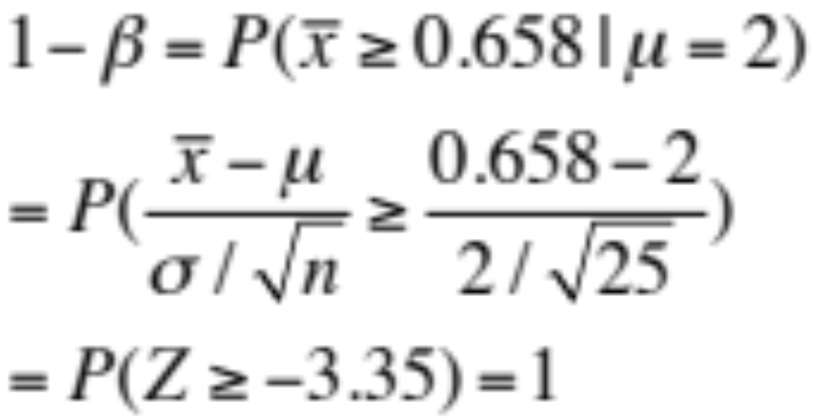
Power when α=0.05, u1=2
The power against the alternative μ=2 is the probability that H0 will be rejected when in fact u=1.
Power=0.8 when α=0.05

Slide 85
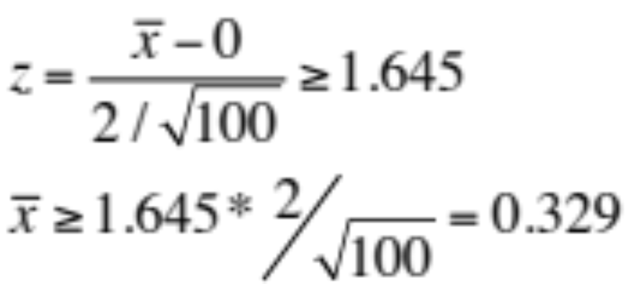
Increase Power by increasing n to 100
The z test rejects H0 at the α=0.05 level whenever
This event has probability 0.05 of occurring when the population mean is 0

Slide 86

Power when n=100
The power against the alternative μ=1 is the probability that H0 will be rejected when in fact u=1.
Power=0.8 when α=0.05

Slide 87

Increasing power by decreasing σ to 1
The z test rejects H0 at the α=0.05 level whenever
This event has probability 0.05 of occurring when the population mean is 0

Slide 88
Power when n=100
The power against the alternative μ=1 is the probability that H0 will be rejected when in fact u=1.
Power=0.8 when α=0.05

Slide 89
Summary
Power of a significance test measures its ability to detect an alternative hypothesis.
Higher power is desirable, and 80% power is becoming a standard.
The calculation of the power requires the knowledge of the sampling distribution of the test statistics under the alternative hypothesis.

