Slide 1

The Practice of Statistics for Business and Economics Third Edition
David S. Moore
George P. McCabe
Layth C. Alwan
Bruce A. Craig
William M. Duckworth
© 2011 W.H. Freeman and Company

Slide 2
Inference for Distributions Inference for the Mean of a Population
PSBE Chapter 7.1
© 2011 W.H Freeman and Company

Slide 3
Objectives (PSBE Chapter 7.1)
Inference for the mean of a population
The t distributions
The one-sample t confidence interval
The one-sample t test
Matched pairs t procedures
Robustness
Power of the t test
Inference for non-Normal distributions

Slide 4

Sweetening colas
Cola manufacturers want to test how much the sweetness of a new cola drink is affected by storage. The sweetness loss due to storage was evaluated by 10 professional tasters (by comparing the sweetness before and after storage):
Taster Sweetness loss
1 2.0
2 0.4
3 0.7
4 2.0
5 −0.4
6 2.2
7 −1.3
8 1.2
9 1.1
10 2.3
Obviously, we want to test if storage results in a loss of sweetness, thus:
H₀: μ = 0 versus H_{a}: μ > 0
This looks familiar. However, here we do not know the population parameter σ.
The population of all cola drinkers is too large.
Since this is a new cola recipe, we have no population data.
This situation is very common with real data.

Slide 5
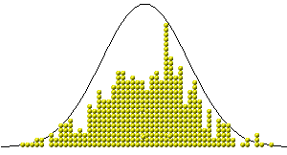
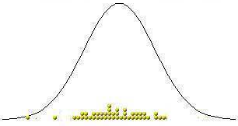
When σ is unknown
The sample standard deviation s provides an estimate of the population standard deviation σ.
When the sample size is large, the sample is likely to contain elements representative of the whole population. Then s is a good estimate of σ.
But when the sample size is small, the sample contains only a few individuals. Then s is a more mediocre estimate of σ.
Population distribution
Large sample
Small sample

Slide 6
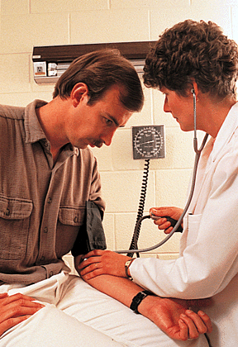
Standard error
For a sample of size n, the sample standard deviation s is:
n − 1 is the “degrees of freedom.”
The value s/√n is called the standard error of the mean, or SE.
Scientists often present sample results as mean ± SE.
A study examined the monthly expenditures for landline telephone service. The results, presented as mean ± SE for 8 households, are 43.5 ± 1.92.
What is the standard deviation s of the sample data?
SE = s/√n <=> s = SE*√n
s = 1.92*√8 = 4.53

Slide 7
Exercise 7.1 Apartment Rents
Your local newspaper contains a large number of advertisements for unfurnished one-bedroom apartments. You choose 16 at random and calculate that their mean monthly rent is $508 and that the standard deviation of their rents is $78.
(a) What is the standard error of the mean?
(b) What are the degrees of freedom for a one-sample t statistic?

Slide 8
The t distributions
Suppose that an SRS of size n is drawn from an N(µ, σ) population.
When σ is known, the sampling distribution is N(μ, σ/√n).
When σ is estimated from the sample standard deviation s, the sampling distribution follows a t distribution with degrees of freedom n − 1.
is the one-sample t statistic.

Slide 9
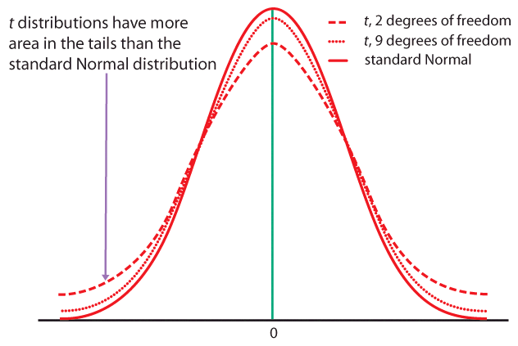
When n is very large, s is a very good estimate of σ and the corresponding t distributions are very close to the Normal distribution.
The t distributions become wider for smaller sample sizes, reflecting the lack of precision in estimating σ from s.

Slide 10
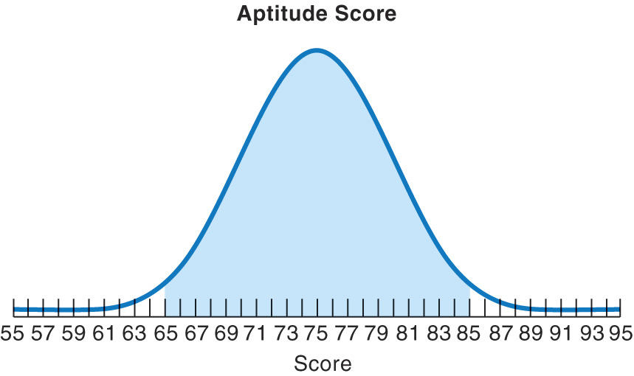
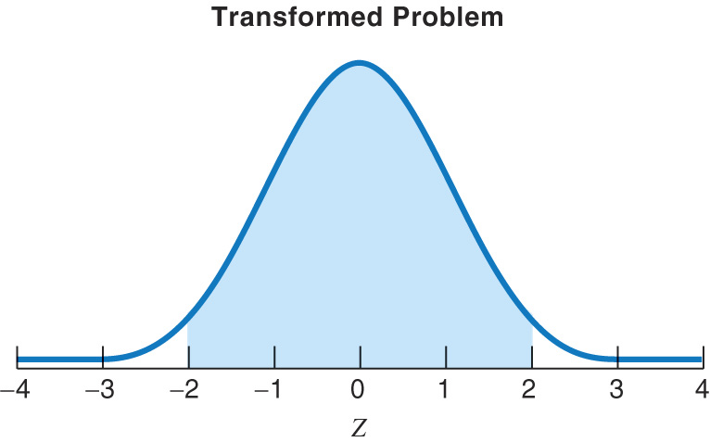
Standardizing the data before using Table D
As with the Normal distribution, the first step is to standardize the data. Then we can use Table D to obtain the area under the curve.
t(μ,s/√n)
df = n − 1
t(0,1) df = n − 1
s/√n
1
μ
0
t
Here, μ is the mean (center) of the sampling distribution, and the standard error of the mean s/√n is its standard deviation (width). You obtain s, the standard deviation of the sample, with your calculator.

Slide 11
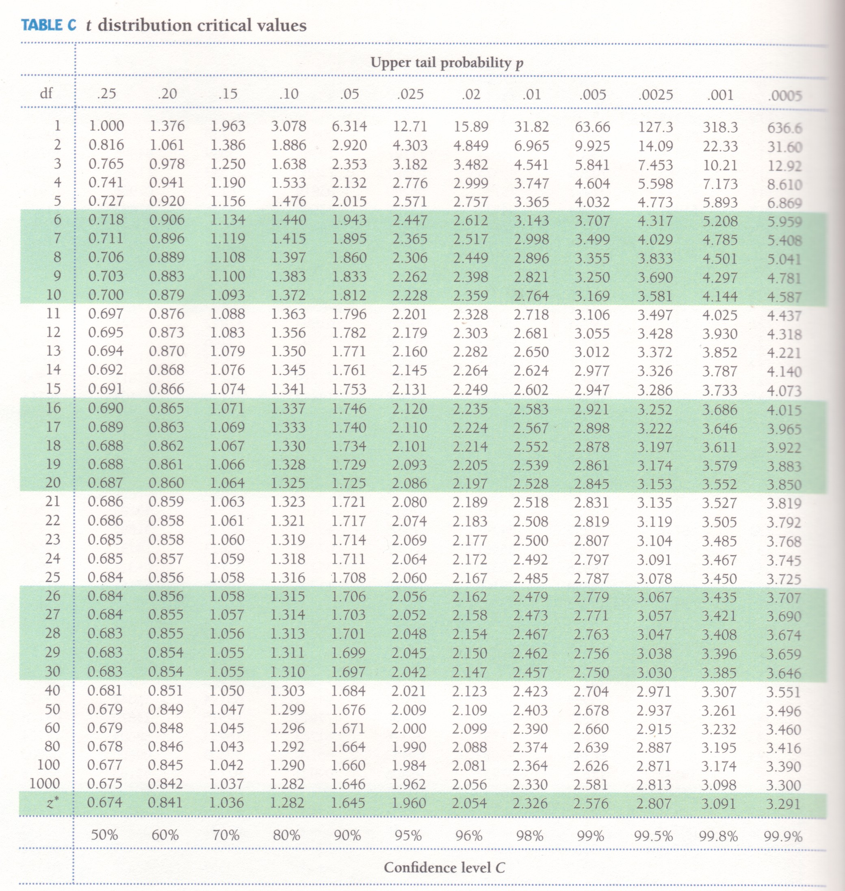
Table D
When σ is unknown, we use a t distribution with “n−1” degrees of freedom (df).
Table D shows the z-values and t-values corresponding to landmark P-values/ confidence levels.
When σ is known, we use the Normal distribution and the standardized z-value.

Slide 12
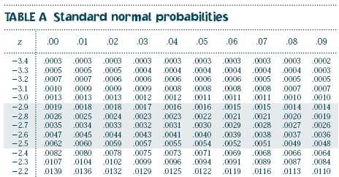
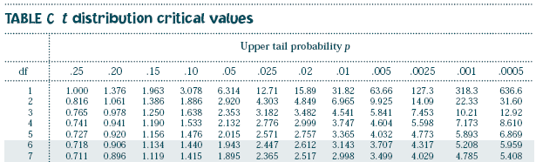

Table A vs. Table D
Table A gives the area to the LEFT of hundreds of z-values.
It should only be used for Normal distributions.
(…)
Table D
Table D gives the area to the RIGHT of a dozen t or z-values.
It can be used for t distributions of a given df, and for the Normal distribution.
(…)
Table D also gives the middle area under a t or Normal distribution comprised of the negative and positive value of t or z.

Slide 13
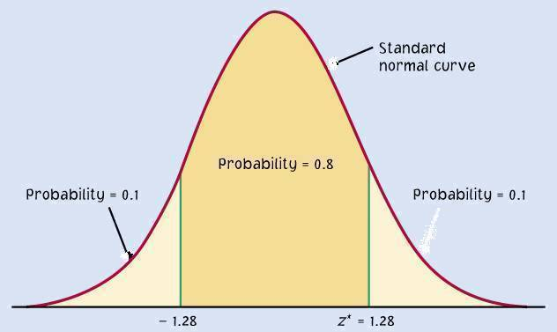
The one-sample t confidence interval
The level C confidence interval is an interval with probability C of containing the true population parameter.
We have a data set from a population with both μ and σ unknown. We use to estimate μ, and s to estimate σ, using a t distribution, df = n − 1.
Practical use of t : t*
C is the area between −t* and t*.
We find t* in the line of Table D for df = n − 1 and confidence level C.
The margin of error m is:
C
m m
−t*
t*

Slide 14


Red wine, in moderation
Drinking red wine in moderation may protect against heart attacks. The polyphenols it contains act on blood cholesterol and thus are a likely cause.
To see if moderate red wine consumption increases the average blood level of polyphenols, a group of nine randomly selected healthy men were assigned to drink half a bottle of red wine daily for two weeks. Their blood polyphenol levels were assessed before and after the study, and the percent change is presented here:
First, are the data approximately Normal?
0.7 | 3.5 | 4 | 4.9 | 5.5 | 7 | 7.4 | 8.1 | 8.4
There is a low value, but overall the data can be considered reasonably normal.

Slide 15
What is the 95% confidence interval for the average percent change?
Sample average = 5.5; s = 2.517; df = n − 1 = 8
(…)
The sampling distribution is a t distribution with n − 1 degrees of freedom. For df = 8 and C = 95%, t* = 2.306.
The margin of error m is: m = t*s/√n = 2.306*2.517/√9 ≈ 1.93.
The 95% confidence interval is: 5.5 + 1.93.
With 95% confidence, the population average percent increase in polyphenol blood levels of healthy men drinking half a bottle of red wine daily is between 3.6% and 7.4%. Important: The confidence interval shows how large the increase is, but not if it can have an impact on men’s health.

Slide 16
Exercise 7.3 Apartment Rents
Your local newspaper contains a large number of advertisements for unfurnished one-bedroom apartments. You choose 16 at random and calculate that their mean monthly rent is $508 and that the standard deviation of their rents is $78.
Construct a 95% confidence interval for the mean monthly rent of all advertised one-bedroom apartments.

Slide 17
Example 7.1 Estimating Monthly Expenditures for Landline Telephone Service
The following data are the monthly dollar amounts for landline telephone service for a random sample of 8 households in your community:
Find a 95% confidence interval for μ, the average monthly expenditure for landline telephone service.

Slide 18

Example 7.1 Estimating Monthly Expenditures for Landline Telephone Service
Sample mean = 43.5
s=5.42
N=8 ➔ df=7
t*=2.365
The 95% CI is
43.5 +/- 2.365*5.42/sqrt(8) =(39.0, 48.0)

Slide 19
The one-sample t test
As in the previous chapter, a test of hypotheses requires a few steps:
Stating the null and alternative hypotheses (H₀ versus H_{a})
Deciding on a one-sided or two-sided test
Choosing a significance level α
Calculating t and its degrees of freedom
Finding the area under the curve with Table D
Stating the P-value and interpreting the result

Slide 20
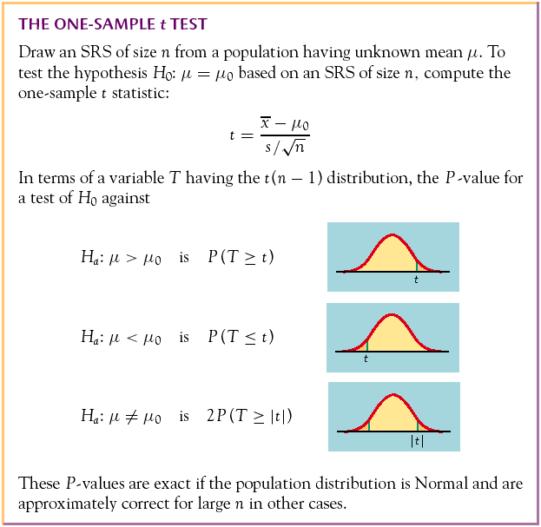
The P-value is the probability, if H₀ is true, of randomly drawing a sample like the one obtained or more extreme, in the direction of H_{a}.
The P-value is calculated as the corresponding area under the curve, one-tailed or two-tailed depending on H_{a}:
One-sided (one-tailed)
Two-sided (two-tailed)

Slide 21
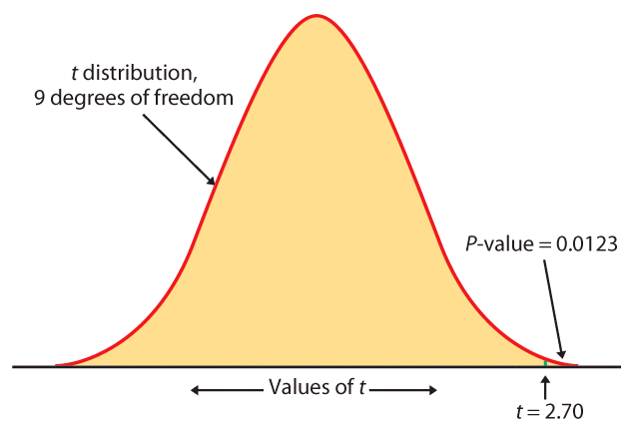
Table D How to use:
For df = 9 we only look into the corresponding row.
The calculated value of t is 2.7. We find the 2 closest t values.
2.398 < t = 2.7 < 2.821
thus
0.02 > upper tail p > 0.01
For a one-sided H_{a}, this is the P-value (between 0.01 and 0.02);
for a two-sided H_{a}, the P-value is doubled (between 0.02 and 0.04).

Slide 22
Sweetening colas (cont.)
Is there evidence that storage results in sweetness loss for the new cola recipe at the 0.05 level of significance (α = 5%)?
H₀: μ = 0 versus H_{a}: μ > 0 (one-sided test)
2.398 < t = 2.70 < 2.821, thus 0.02 > p > 0.01. p < α, thus the result is significant.
The t test has a significant P-value. We reject H₀. There is a significant loss of sweetness, on average, following storage.
Taster Sweetness loss
1 2.0
2 0.4
3 0.7
4 2.0
5 -0.4
6 2.2
7 -1.3
8 1.2
9 1.1
10 2.3
___________________________
Average 1.02
Standard deviation 1.196
Degrees of freedom n − 1 = 9

Slide 23
Example 7.2 Estimating Monthly Expenditures for Landline Telephone Service
The following data are the monthly dollar amounts for landline telephone service for a random sample of 8 households in your community:
Suppose that the overall U.S. average monthly expenditure for landline service is $49. We can test a null hypothesis that the average monthly landline expenditure in your community is equal to this amount.

Slide 24


Example 7.2
Recall: n=8, sample mean=43.5, s=5.42
Compute Test Statistic:
P-Value:
DF = 7 ➔
From Table D we see that P(T > 2.517) = 0.02 and P(T > 2.998) = 0.01. Therefore, we conclude that the P-value is between 2 × 0.01 = 0.02 and 2 × 0.02 = 0.04.

Slide 25
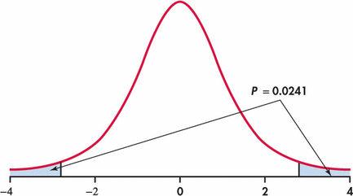
P-Value (obtained from software)

Slide 26

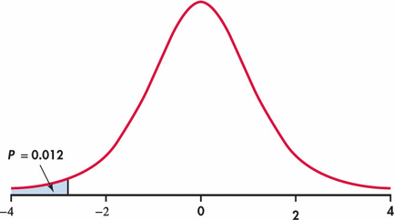
Example 7.3
To test whether the average monthly landline expenditure is less than the U.S. average (perhaps expected because your community’s cost of living is below the average) our hypotheses are
Solution:
the test statistic t = -2.87 (no change from example 7.2)
P-Value = P(T<-2.87) :
0.01 < P-Value < 0.02

Slide 27
Matched pairs t procedures
Sometimes we want to compare treatments or conditions at the individual level. These situations produce two samples that are not independent—they are related to each other. The members of one sample are identical to, or matched (paired) with, the members of the other sample.
Ex: Pretest and posttest studies look at data collected on the same sample elements before and after some experiment is performed.
Ex: Twin studies often try to sort out the influence of genetic factors by comparing a variable between sets of twins.
Ex: Using people matched for age, sex, and education in social studies allows canceling out the effect of these potential lurking variables.

Slide 28
In these cases, we use the paired data to test the difference in the two population means. The variable studied becomes X_{difference} = (X₁ − X₂), and H₀: µ_{difference}= 0 ; H_{a}: µ_{difference}>0 (or <0, or ≠0)
Conceptually, this is not different from tests on one population.

Slide 29
Sweetening colas (revisited)
The sweetness loss due to storage was evaluated by 10 professional tasters (comparing the sweetness before and after storage):
Taster Sweetness loss
1 2.0
2 0.4
3 0.7
4 2.0
5 −0.4
6 2.2
7 −1.3
8 1.2
9 1.1
10 2.3
We want to test if storage results in a loss of sweetness, thus:
H₀: μ = 0 versus H_{a}: μ > 0
Although the text didn’t mention it explicitly, this is a pre-/post-test design and the variable is the difference in cola sweetness before minus after storage.
A matched pairs test of significance is indeed just like a one-sample test.

Slide 30
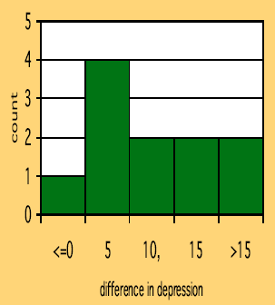
Does lack of caffeine increase depression?
Individuals diagnosed as caffeine-dependent are deprived of caffeine-rich foods and assigned to receive daily pills. Sometimes, the pills contain caffeine and other times they contain a placebo. Depression was assessed.
There are 2 data points for each subject, but we’ll only look at the difference.
The sample distribution appears appropriate for a t test.
11 “difference” data points.

Slide 31
Does lack of caffeine increase depression?
For each individual in the sample, we have calculated a difference in depression score (placebo minus caffeine).
There were 11 “difference” points, thus df = n − 1 = 10. We calculate that = 7.36; s = 6.92
H₀: μ_{difference} = 0; H₀: μ_{difference} > 0
For df = 10, 3.169 < t = 3.53 < 3.581 ➔ 0.005 > p > 0.0025
Caffeine deprivation causes a significant increase in depression.

Slide 32
Example 7.7 The Effects of Language Instruction
A company contracts with a language institute to provide individualized instruction in foreign languages for its executives who will be posted overseas. Is the instruction effective?
Last year, 20 executives studied French. All had some knowledge of French, so they were given the Modern Language Association’s listening test of understanding of spoken French before the instruction began. After several weeks of immersion in French, the executives took the listening test again. (The actual French spoken in the two tests was different, so that simply taking the first test should not improve the score on the second test.)

Slide 33
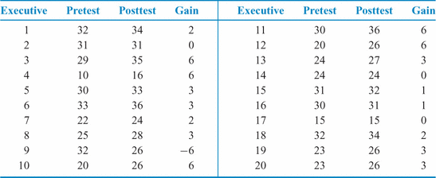
Table 7.2 French Listening Scores

Slide 34
Example 7.7 The Effects of Language Instruction
A company contracts with a language institute to provide individualized instruction in foreign languages for its executives who will be posted overseas. Is the instruction effective?
Solution:
Let μ be the mean improvement that would be achieved if the entire population of executives received similar instruction.
H0:
H1:

Slide 35

Example 7.7 The Effects of Language Instruction
A company contracts with a language institute to provide individualized instruction in foreign languages for its executives who will be posted overseas. Is the instruction effective?
Solution:
Let μ be the mean improvement that would be achieved if the entire population of executives received similar instruction.
H0: μ = 0
H1: μ > 0
Sample mean = 2.5, s=2.893
Df = 20 – 1 = 19
t=2.5/(2.893/sqrt(20))=3.86
0.001 > p-value > 0.0005

Slide 36
Example 7.8 The Effects of Language Instruction
Compute a 90% confidence interval for the mean improvement in the entire population.
Solution:
Sample mean = 2.5, s=2.893
Df = 20 – 1 = 19
t* = 1.729
2.5 +/- 1.729*2.893/sqrt(20)
=(1.38, 3.62)

Slide 37
Key Points Concerning Matched Pairs:
A matched pairs analysis is needed when subjects or experimental units are
matched in pairs or
two measurements or observations on each individual or experimental unit

Slide 38
Key Points Concerning Matched Pairs:
The analysis is based on the difference between the two measures for each individual or pair of experimental units.
Use the one-sample confidence interval and significance-testing procedures that we learned in this section.

Slide 39
Robustness
The t procedures are exactly correct when the population is distributed exactly Normally. However, most real data are not exactly Normal.
The t procedures are robust to small deviations from Normality—the results will not be affected too much. Factors that strongly matter:
Random sampling. The sample must be an SRS from the population.
Outliers and skewness. They strongly influence the mean and therefore the t procedures. However, their impact diminishes as the sample size gets larger because of the central limit theorem.
Specifically:
When n < 15, the data must be close to Normal and without outliers.
When 15 > n > 40, mild skewness is acceptable but not outliers.
When n > 40, the t statistic will be valid even with strong skewness.

Slide 40
Power of the t test
The power of the one-sample t test against a specific alternative value of the population mean µ assuming a fixed significance level α is the probability that the test will reject the null hypothesis when the alternative is true.
Calculation of the exact power of the t test is a bit complex. But an approximate calculation that acts as if σ were known is almost always adequate for planning a study. This calculation is very much like that for the z test.
When guessing σ, it is always better to err on the side of a standard deviation that is a little larger rather than smaller. We want to avoid a failing to find an effect because we did not have enough data.

Slide 41
Is the Sample Size Large Enough?
The company in Example 7.7 is planning to evaluate the next language instruction session. They decide that an improvement of 2 points or more is large enough to be useful in practice. Can they rely on a sample of 20 executives to detect an improvement of this size?
Solution:
We wish to compute the power of the t-test for
H0: μ = 0
H1: μ > 0
against the alternative μ = 2 when n=20

Slide 42
Step 1: Find rejection region
The t test with 20 observations rejects H0 at the 5% significance level if the t statistic
exceeds the upper 5% point of t (19), which is 1.729. Taking s = 3, the event that the test rejects H0 is therefore

Slide 43

Step 2: Find Power

Slide 44
Conclusion:
A true difference of 2 points in the population mean scores will produce significance at the 5% level in 89% of all possible samples of 20 executive. The company can be reasonably confident of detecting a difference this large.

Slide 45
Does lack of caffeine increase depression?
Suppose that we wanted to perform a similar study but using subjects who regularly drink caffeinated tea instead of coffee. For each individual in the sample, we will calculate a difference in depression score (placebo minus caffeine). How many patients should we include in our new study?
In the previous study, we found that the average difference in depression level was 7.36 and the standard deviation 6.92.
We will use µ = 3.0 as the alternative of interest. We are confident that the effect was larger than this in our previous study, and this amount of an increase in depression would still be considered important.
We will use s = 7.0 for our guessed standard deviation.
We can choose a one-sided alternative because, like in the previous study, we would expect caffeine deprivation to have negative psychological effects.

Slide 46
Does lack of caffeine increase depression?
How many subjects should we include in our new study? Would 16 subjects be enough? Let’s compute the power of the t test for
against the alternative µ = 3. For a significance level α 5%, the t test with n observations rejects H₀ if t exceeds the upper 5% significance point of
t(df:15) = 1.729. For n = 16 and s = 7:
H₀: μ_{difference} = 0 ; H_{a}: μ_{difference} > 0
The power for n = 16 would be the probability that ≥ 1.068 when µ = 3, using σ = 7. Since we have σ, we can use the Normal distribution here:
The power would be about 86%.

Slide 47
Inference for Distributions Comparing Two Means
PSBE Chapter 7.2
© 2011 W.H. Freeman and Company

Slide 48
Objectives (PSBE Chapter 7.2)
Comparing two means
Two-sample z statistic
Two-sample t procedures
Two-sample t test
Two-sample t confidence interval
Robustness
Details of the two-sample t procedures

Slide 49
Two-sample problems
(A)
Population 1
Population 2
Sample 2
Sample 1
Which is it?
We often compare two treatments used on independent samples.
Is the difference between both treatments due only to variations from the random sampling as in (B), or does it reflect a true difference in population means as in (A)?
(B)
Population
Sample 2
Sample 1
Independent samples: Subjects in one sample are completely unrelated to subjects in the other sample.

Slide 50
Two-sample z statistic
We have two independent SRSs (simple random samples) coming maybe from two distinct populations with (μ₁,σ₁) and (μ₂,σ₂). We use ₁ and ₂ to estimate the unknown μ₁ and μ₂.
When both populations are Normal, the sampling distribution of ( ₁− ₂) is also Normal, with standard deviation:
Then the two-sample z statistic has the standard Normal N(0, 1) sampling distribution.

Slide 51
Two independent samples t distribution
We have two independent SRSs (simple random samples) coming maybe from two distinct populations with (μ₁,σ₁) and (μ₂,σ₂) unknown. We use ( ₁,s₁) and ( ₂,s₂) to estimate (μ₁,σ₁) and (μ₂,σ₂), respectively.
To compare the means, both populations should be Normally distributed. However, in practice, it is enough that the two distributions have similar shapes and that the sample data contain no strong outliers.

Slide 52
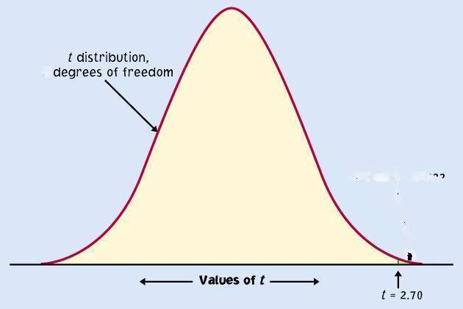
The two-sample t statistic follows approximately the t distribution with a standard error SE (spread) reflecting variation from both samples:
Conservatively, the degrees of freedom is equal to the smallest of (n₁ − 1, n₂ − 1).
df
μ₁-μ₂

Slide 53
Two-sample t test
The null hypothesis is that both population means μ₁ and μ₂ are equal, thus their difference is equal to zero.
H₀: μ₁ = μ₂ <=> μ₁ − μ₂ = 0
with either a one-sided or a two-sided alternative hypothesis.
We find how many standard errors (SE) away from (μ₁ − μ₂) is ( ₁− ₂) by standardizing with t:
Because in a two-sample test H₀ poses (μ₁ − μ₂) = 0, we simply use
With df = smallest(n₁ − 1, n₂ − 1)

Slide 54
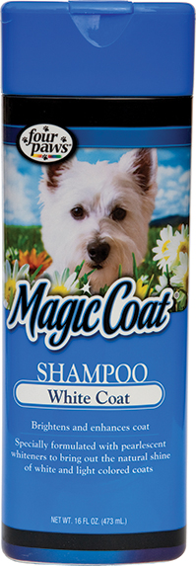
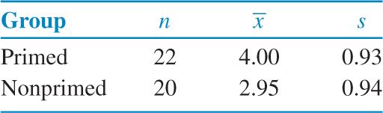
Wine labels with animals?
Do consumers have a more favorable reaction to a product label if they have been “primed” to the image beforehand?
(1)
(2)
We want to know whether the primed group views the product more favorably than the non-primed group.
Is the mean score lower in the population of non-primed consumers?

Slide 55
Example 7.11
Traditional brand research argues that successful logos are ones that are highly relevant to the product they represent. For example, pictures of grapes or a vineyard would be considered highly appropriate for a table wine. However, a market research firm recently reported that nearly 20% of all table wine brands introduced in the last three years feature an animal on the label. Since animals have little to do with the product, why are marketers using this tactic?

Slide 56
Example 7.11
A recent study sheds some light on this tactic’s success.¹⁴ The researchers found that consumers have an easier time processing visual information when they are “primed” – in other words, when they’ve thought about the image earlier in an unrelated context.
To demonstrate this, one of the researchers’ experiments compared product preference for a group of consumers who were “primed” and a group of consumers who were not primed.

Slide 57
Example 7.11
Product: A bottle of MagicCoat pet shampoo, with a picture of a collie on the label
Evaluation: participants indicated their attitude toward this product on a seven-point scale (from 1-dislike very much to 7-like very much).
Prior to giving this score, participants were asked to do a “word find” where four of the words were common across groups (pet, grooming, bottle, label) and four were either related to the image (dog, collie, puppy, woof) or conflicted with the image (cat, feline, kitten, meow).

Slide 58
Wine labels with animals?
Do consumers have a more favorable reaction to a product label if they have been “primed” to the image beforehand?
(1)
(2)
We want to know whether the primed group views the product more favorably than the non-primed group.
Is the mean score lower in the population of non-primed consumers?

Slide 59
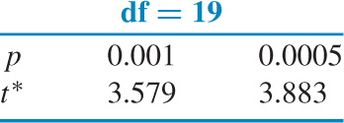
Wine labels with animals?
H₀: μ₁ = μ₂
H_{a}: μ₁ > μ₂
(1)
(2)
We calculate the t statistic: (df = 20 – 1 = 19)
In Table D, for df = 19 we find: P(t) > 3.63 => p < 0.001 (one-sided)
It’s a very significant difference. we reject H₀.
Consumers who were primed view the dog shampoo more favorably.

Slide 60
Two-sample t confidence interval
Because we have two independent samples we use the difference between both sample averages ( ₁ − ₂) to estimate (μ₁ − μ₂).
Practical use of t: t*
C is the area between −t* and t*.
We find t* in the line of Table D for df = smallest (n₁−1; n₂−1) and the column for confidence level C.
The margin of error m is:
C
m m
−t*
t*

Slide 61
Wine labels with animals?
To determine how large the increase in preference was, we use a two-sample t confidence interval.
(1)
(2)
95% confidence interval for (µ₁ − µ₂),
with df = 19 conservatively → t* = 2.022:
With 95% confidence, (µ₁ − µ₂)
falls within 1.05 ± 0.58 or (0.47, 1.63).

Slide 62
Robustness
The two-sample t procedures are more robust than the one-sample t procedures. They are the most robust when both sample sizes are equal and both sample distributions are similar. But even when we deviate from this, two-sample tests tend to remain quite robust.
➔ When planning a two-sample study, choose equal sample sizes if you can.
As a guideline, a combined sample size (n₁ + n₂) of 40 or more will allow you to work even with the most skewed distributions.

Slide 63
Details of the two-sample t procedures
The true value of the degrees of freedom for a two-sample t distribution is quite lengthy to calculate. That’s why we use an approximate value, df = smallest(n₁ − 1, n₂ − 1), which errs on the conservative side (often smaller than the exact).
Computer software, though, gives the exact degrees of freedom—or the rounded value—for your sample data.

Slide 64
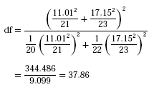
95% confidence interval for the reading ability study using the more precise degrees of freedom:
Table C
Excel
t*
Independent Samples Test
SPSS
Levene's Test for
Equality of Variances
t-test for Equality of Means
95% Confidence
Interval of the
Mean
Std. Error
Difference
F
Sig.
t
df
Sig. (2-tailed)
Difference
Difference
Lower
Upper
Reading Score
Equal variances
2.362
.132
2.267
42
.029
9.95445
4.39189
1.09125
18.81765
assumed
Equal variances
2.311
37.855
.026
9.95445
4.30763
1.23302
18.67588
not assumed

Slide 65
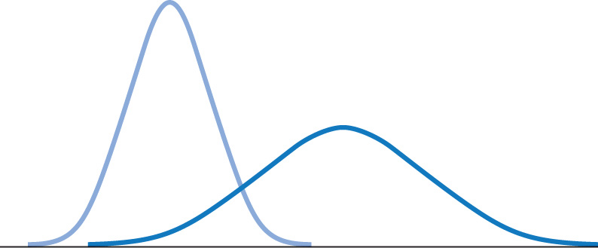
Pooled two-sample procedures
There are two versions of the two-sample t test: one assuming equal variance (“pooled 2-sample test”) and one not assuming equal variance (“unequal” variance, as we have studied) for the two populations. They have slightly different formulas and degrees of freedom.
The pooled (equal variance) two-sample t test was often used before computers because it has exactly the t distribution for degrees of freedom n₁ + n₂ − 2.
However, the assumption of equal variance is hard to check, and thus the unequal variance test is safer.
Two normally distributed populations with unequal variances

Slide 66



When both populations have the same standard deviation, the pooled estimator of σ² is:
The sampling distribution has exactly the t distribution with (n₁ + n₂ − 2) degrees of freedom.
A level C confidence interval for µ₁ − µ₂ is
(with area C between −t* and t*).
To test the hypothesis H₀: µ₁ = µ₂ against a one-sided or a two-sided alternative, compute the pooled two-sample t statistic for the t(n₁ + n₂ − 2) distribution.

Slide 67
Case 7.2 Healthy Companies versus Failed Companies
In what ways are companies that fail different from those that continue to do business? To answer this question, one study compared various characteristics of 68 healthy and 33 failed firms.¹⁷ One of the variables was the ratio of current assets to current liabilities. Roughly speaking, this is the amount that the firm is worth divided by what it owes.

Slide 68
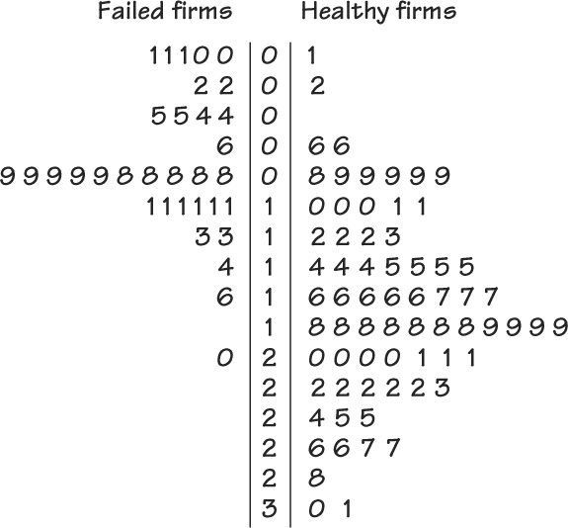
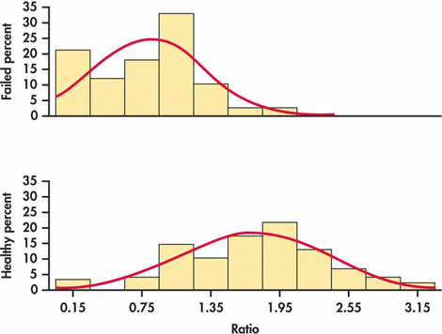
Case 7.2 Do Mean Asset/Liability Ratios Differ?
Take Group 1 to be the firms that were healthy and Group 2 to be those that failed. The question of interest is whether or not the mean ratio of current assets to current liabilities is different for the two groups

Slide 69
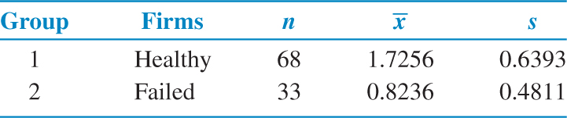


Comparing healthy and failed firms
Is the mean asset ratio different for healthy and failed firms?
H₀: μ₁ = μ₂
H_{a}: μ₁ ≠ μ₂
Since the standard deviations are close, we will use the pooled t test.

Slide 70
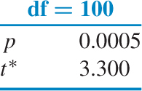
Comparing healthy and failed firms
Is the mean asset ratio different for healthy and failed firms?
H₀: μ₁ = μ₂
H_{a}: μ₁ ≠ μ₂
The P-value is P(T > 7.17), using df = 100
so the P-value < 2*0.005 = 0.001, so there is
a significant difference in mean asset ratios
for healthy and failed firms.

Slide 71
Comparing healthy and failed firms
How different are the mean asset ratios for healthy and failed firms?
95% confidence interval for (µ₁ − µ₂).
The margin of error (with df = 100 → t* = 1.984) is:
= 0.25
With 95% confidence, (µ₁ − µ₂) falls within (1.7256 – 0.8236) ± 0.25
= 0.902 ± 0.25 or (0.65, 1.15).

Slide 72
Which type of test? One-sample, paired samples, two-sample?
Comparing vitamin content of bread immediately after baking vs. 3 days later (the same loaves are used on day one and 3 days later).
Comparing vitamin content of bread immediately after baking vs. 3 days later (tests made on independent loaves).
Average fuel efficiency for 2005 vehicles is 21 miles per gallon. Is average fuel efficiency higher in the new generation “green vehicles”?
Is blood pressure altered by use of an oral contraceptive? Comparing a group of women not using an oral contraceptive with a group taking it.
Review insurance records for dollar amount paid after fire damage in houses equipped with a fire extinguisher vs. houses without one. Was there a difference in the average dollar amount paid?

