Slide 1

The Practice of Statistics for Business and Economics
Third Edition
David S. Moore
George P. McCabe
Layth C. Alwan
Bruce A. Craig
William M. Duckworth
© 2011 W.H. Freeman and Company

Slide 2
Inference for Proportions
Inference for a Single Proportion
PSBE Chapter 8.1
© 2011 W.H. Freeman and Company

Slide 3
Objectives (PSBE Chapter 8.1)
Inference for a single proportion
Conditions for inference on p
Large-sample confidence interval for p
Plus four confidence interval for p
Significance test for a proportion
Choosing a sample size

Slide 4
Introduction
Many studies collect data on categorical variables, such as race or occupation of a person, the make of a car, etc.
The parameters of interest in these settings are population proportions.
The statistic used to estimate a population proportion is the sample proportion.

Slide 5

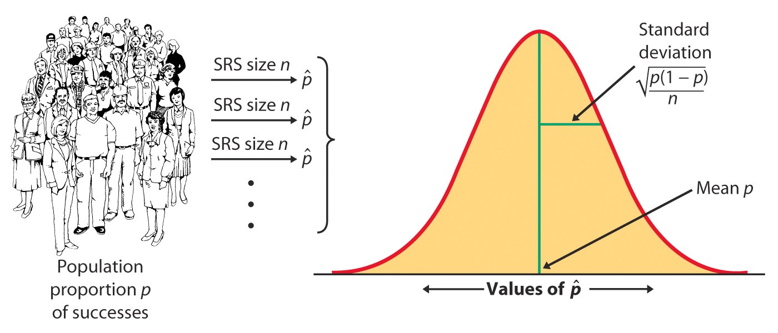
Sampling distribution of a sample proportion
The sampling distribution of a sample proportion is approximately normal (normal approximation of a binomial distribution) when the sample size is large enough.

Slide 6
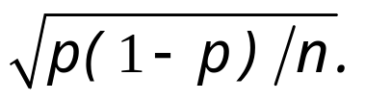
Conditions for inference on p
Assumptions:
The data used for the estimate are an SRS from the population studied.
The population is at least 10 times as large as the sample used for inference. This ensures that the standard deviation of is close to
The sample size n is large enough that the sampling distribution can be approximated with a normal distribution. How large a sample size is required depends in part on the value of p and the test conducted. Otherwise, rely on the binomial distribution.

Slide 7
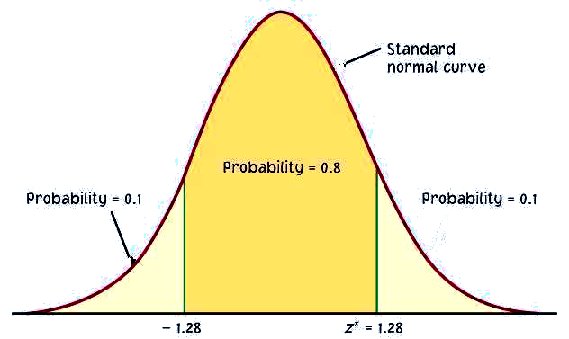
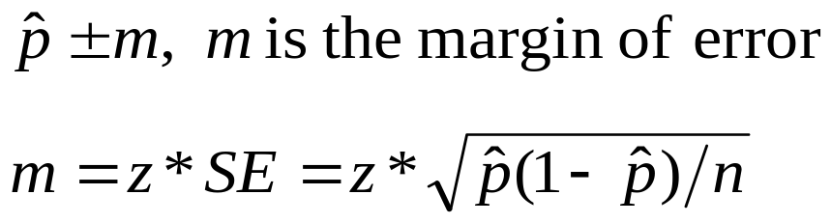
Large-sample confidence interval for p
Confidence intervals contain the population proportion p in C% of samples. For an SRS of size n drawn from a large population and with sample proportion calculated from the data, an approximate level C confidence interval for p is:
C
m m
Use this method when the number of successes and the number of failures are both at least 15.
−Z*
Z*
C is the area under the standard normal curve between −z* and z*.

Slide 8

The proportion of adults playing video games
A PEW survey found that 1063 of a sample of 2054 of adults said they played video games.

Slide 9
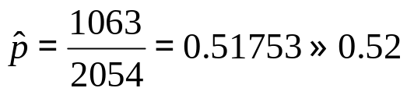


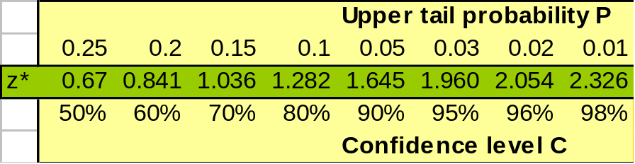
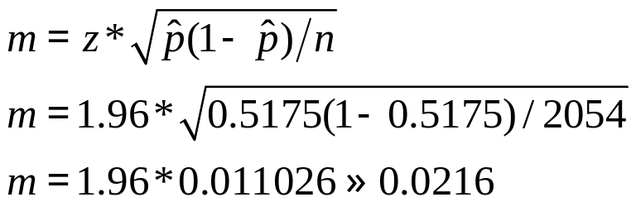
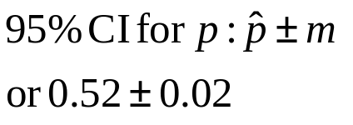
Let’s calculate a 95% confidence interval for the population proportion of adults who play video games.
What is the sample proportion ?
What is the sampling distribution for the proportion of adults who play video games for samples of 2054?
For a 95% confidence level, z* = 1.96.
Using the large sample method, we calculate a margin of error m:
➔ With 95% confidence level, between 50% and 54% of adults play video games.

Slide 10
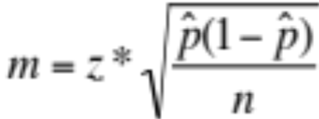
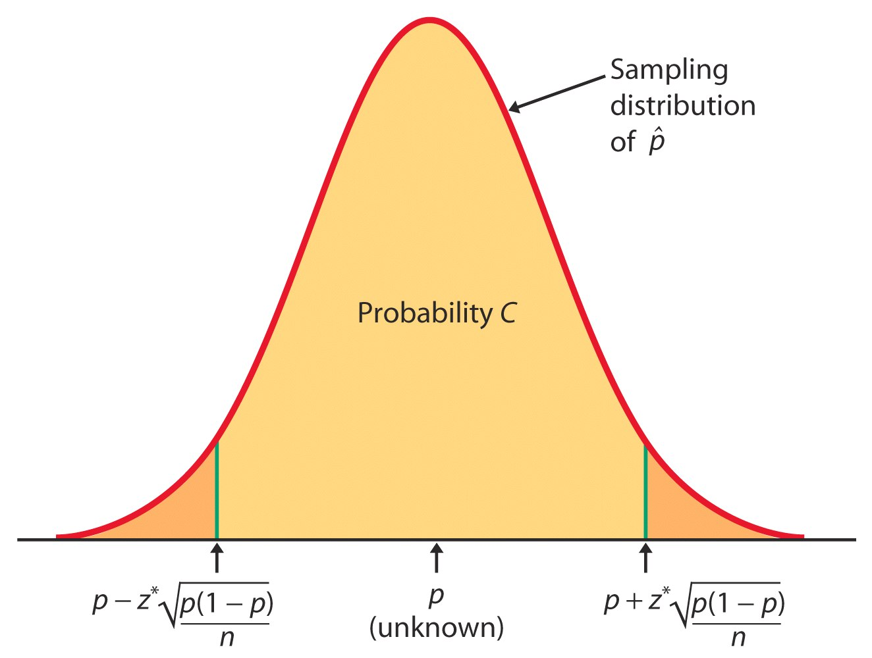
Because we have to use an estimate of p to compute the margin of error, confidence intervals for a population proportion are not very accurate.
Specifically, we tend to be incorrect more often than the confidence level would indicate. But there is no systematic amount (because it depends on p).
Use with caution!

Slide 11
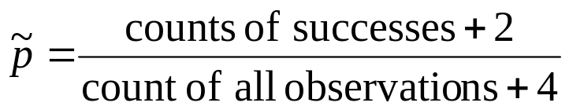
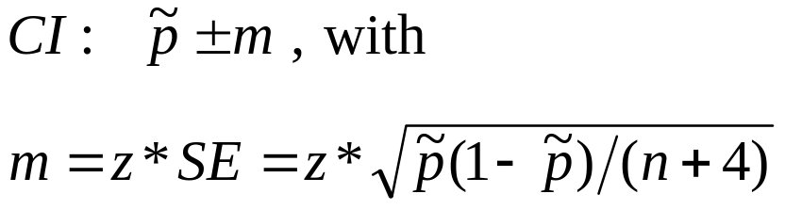
Plus four confidence interval for p
A simple adjustment produces more accurate confidence intervals. We act as if we had four additional observations, two being successes and two being failures. Thus, the new sample size is n + 4 and the count of successes is X + 2.
The “plus four” estimate of p is:
And an approximate level C confidence interval is:
Use this method when C is at least 90% and sample size is at least 10.

Slide 12
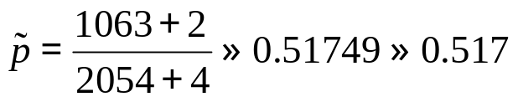
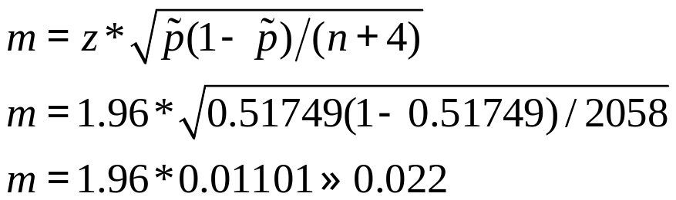
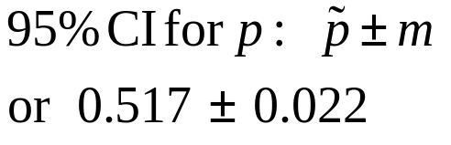
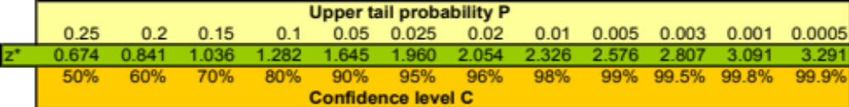
We now use the “plus four” method to calculate the 95% confidence interval for the population proportion of adults that play video games.
What is the value of the plus four estimate of p?
An approximate 95% confidence interval for p using the plus four method is:
➔ With 95% confidence level, between 49.5% and 53.9% of adults play video games.

Slide 13

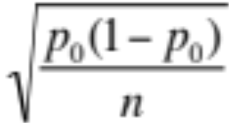


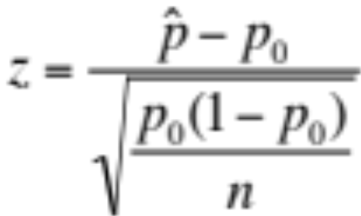

Significance test for p
The sampling distribution for is approximately normal for large sample sizes and its shape depends on p and n.
Thus, we can easily test the null hypothesis:
H₀: p = p₀ (a given value we are testing).
If H₀ is true, the sampling distribution is known →
The likelihood of our sample proportion given the null hypothesis depends on how far from p₀ our is in units of standard deviation.
This is valid when both expected counts—expected successes np₀ and expected failures n(1 − p₀)—are each 10 or larger.

Slide 14
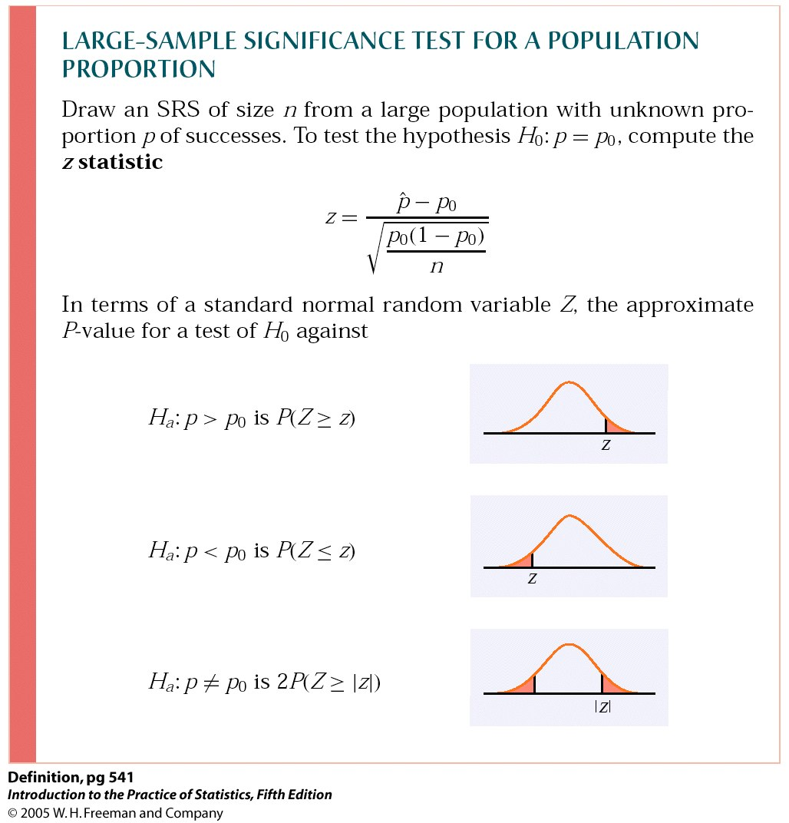
P-values and one- or two-sided hypotheses—reminder
If the P-value is as small or smaller than the chosen significance level α, then the difference is statistically significant and we reject H₀.

Slide 15
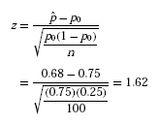
A national survey by the National Institute for Occupational Safety and Health on restaurant employees found that 75% said that work stress had a negative impact on their personal lives.
You investigate a restaurant chain to see if the proportion of all their employees negatively affected by work stress differs from the national proportion p₀ = 0.75.
H₀: p = p₀ = 0.75 vs. H_{a}: p ≠ 0.75 (two-sided alternative)
In your SRS of 100 employees, you find that 68 answered “Yes” when asked, “Does work stress have a negative impact on your personal life?”
The expected counts are 100 × 0.75 = 75 and 25.
Both are greater than 10, so we can use the z test.
The test statistic is:

Slide 16

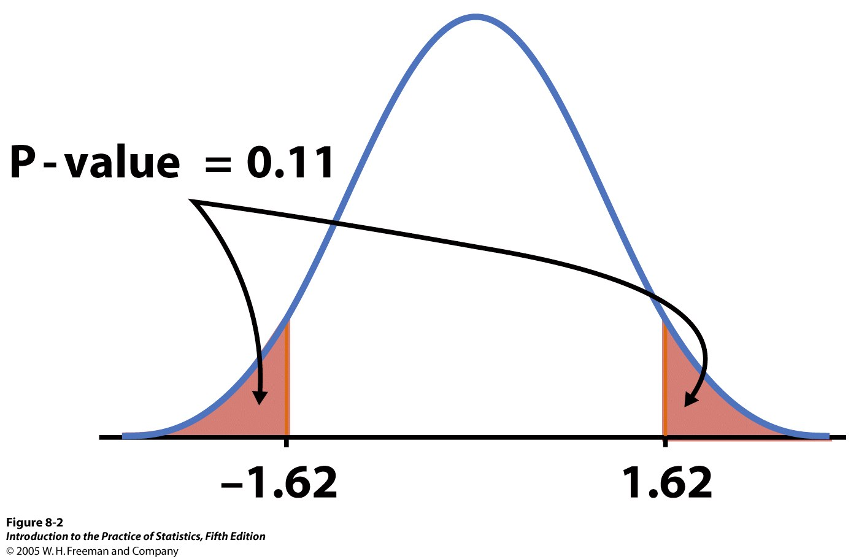
From Table A we find the area to the left of z = 1.62 is 0.9474.
Thus P(Z ≥ 1.62) = 1 − 0.9474, or 0.0526. Since the alternative hypothesis is two-sided, the P-value is the area in both tails, and P = 2 × 0.0526 = 0.1052.
➔ The chain restaurant data are not significantly different from the national survey results ( = 0.68, z = 1.62, P = 0.11).

Slide 17
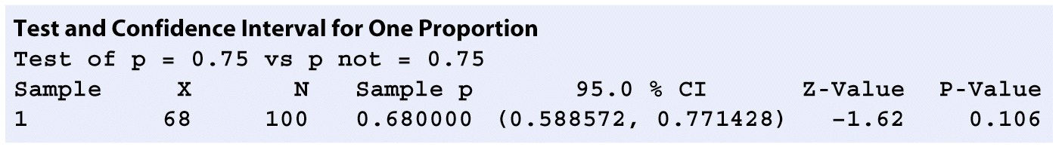
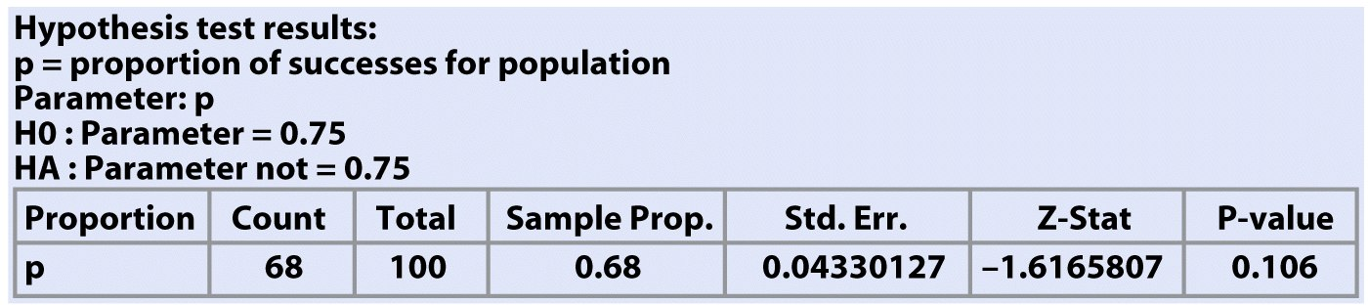
Software gives you summary data (sample size and proportion) as well as the actual p-value.
Minitab
Crunch It!

Slide 18
Interpretation: magnitude vs. reliability of effects
The reliability of an interpretation is related to the strength of the evidence. The smaller the p-value, the stronger the evidence against the null hypothesis and the more confident you can be about your interpretation.
The magnitude or size of an effect relates to the real-life relevance of the phenomenon uncovered. The P-value does NOT assess the relevance of the effect, nor its magnitude.
A confidence interval will assess the magnitude of the effect. However, magnitude is not necessarily equivalent to how theoretically or practically relevant an effect is.

Slide 19
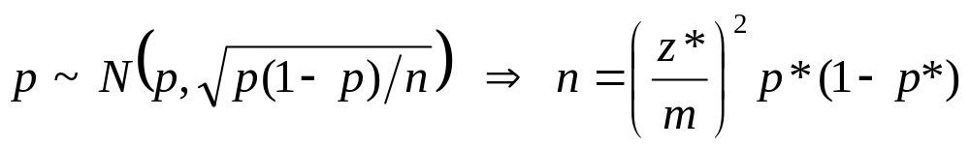
Sample size for a desired margin of error
You may need to choose a sample size large enough to achieve a specified margin of error. However, because the sampling distribution of is a function of the population proportion p, this process requires that you guess a likely value for p: p*.
The margin of error will be less than or equal to m if p* is chosen to be 0.5.
Remember, though, that sample size is not always stretchable at will. There are typically costs and constraints associated with large samples.

Slide 20
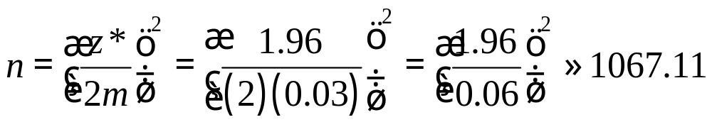
What sample size would we need in order to achieve a margin of error of no more than 0.03 (3%) for a 95% confidence interval for the population proportion of adults who play video games.
We will use 0.5 for our guessed p*.
For a 95% confidence level, z* = 1.96.
➔ To obtain a margin of error no more than 3%, we would need a sample size n of at least 1068 adults.

Slide 21
Inference for Proportions
Comparing Two Proportions
PSBE Chapter 8.2
© 2011 W.H. Freeman and Company

Slide 22
Objectives (PSBE Chapter 8.2)
Comparing two proportions
Comparing two independent samples
Large-sample confidence interval for two proportions
Plus four confidence interval for two proportions
Significance tests
Relative risk

Slide 23
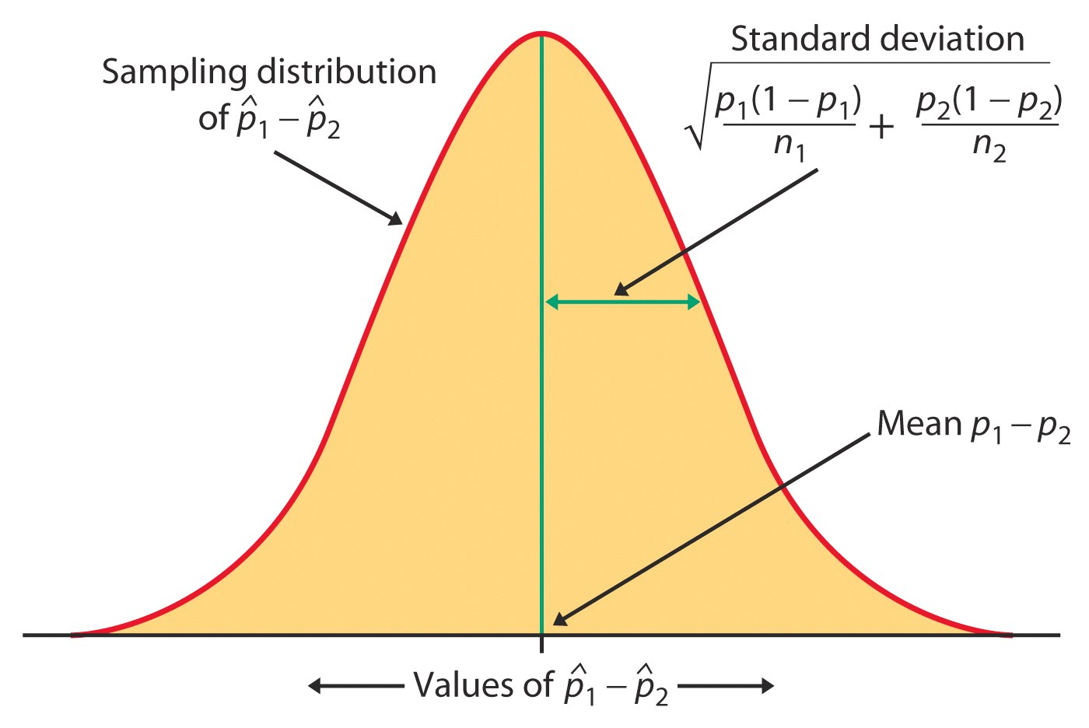
Comparing two independent samples
We often need to compare two treatments used on independent samples. We can compute the difference between the two sample proportions and compare it to the corresponding, approximately normal sampling distribution for ( ₁ – ₂):

Slide 24
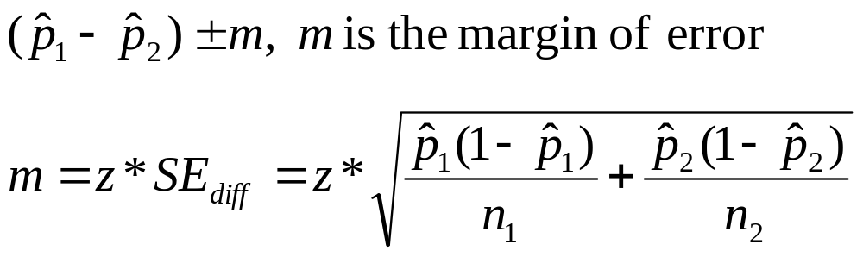
Large-sample CI for two proportions
For two independent SRSs of sizes n₁ and n₂ with sample proportion of successes ₁ and ₂ respectively, an approximate level C confidence interval for p₁ – p₂ is
C is the area under the standard normal curve between −z* and z*.
Use this method only when the populations are at least 10 times larger than the samples and the number of successes and the number of failures are each at least 10 in both samples.

Slide 25
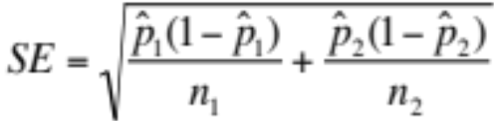
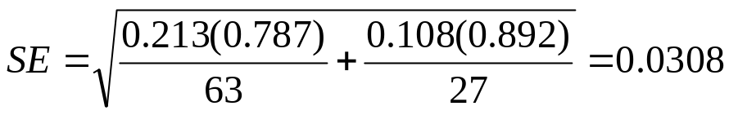
“No Sweat” garment labels
“No Sweat” labels on apparel indicate proper working conditions. Is there a gender difference in the proportion of label users? We want to calculate a 95% confidence interval for the difference in the proportions of label users.
Standard error of the difference p₁− p₂:
 | X | n
Women (1) | 63 | 296 | 0.213
Men (2) | 27 | 251 | 0.108
So the 95% CI is 0.105 ± 1.96*0.0308 = 0.105 ± 0.060
We are 95% confident that the difference in the proportions is between 0.04 and 0.16.

Slide 26
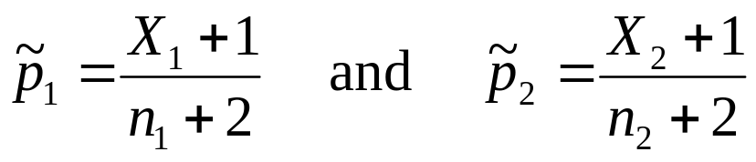
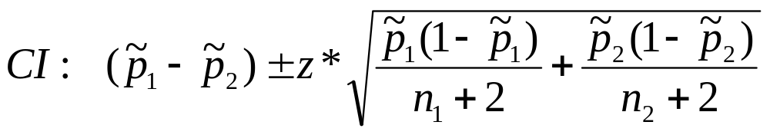
Plus four CI for two proportions
The plus four method again produces more accurate confidence intervals. We act as if we had four additional observations: one success and one failure in each of the two samples. The new combined sample size is n₁ + n₂ + 4 and the proportions of successes are:
An approximate level C confidence interval is:
Use this when C is at least 90% and both sample sizes are at least 5.

Slide 27
“No Sweat” garment labels – plus four CI
“No Sweat” labels on apparel indicate proper working conditions. Is there a gender difference in the proportion of label users? We want to calculate a 95% confidence interval for the difference in the proportions of label users.
 | X | n
Women (1) | 63 | 296 | 0.213
Men (2) | 27 | 251 | 0.108
For the plus four procedure, we would
use X₁ = 64, n₁ = 298, X₂ = 28, and
n₂ = 253.

Slide 28
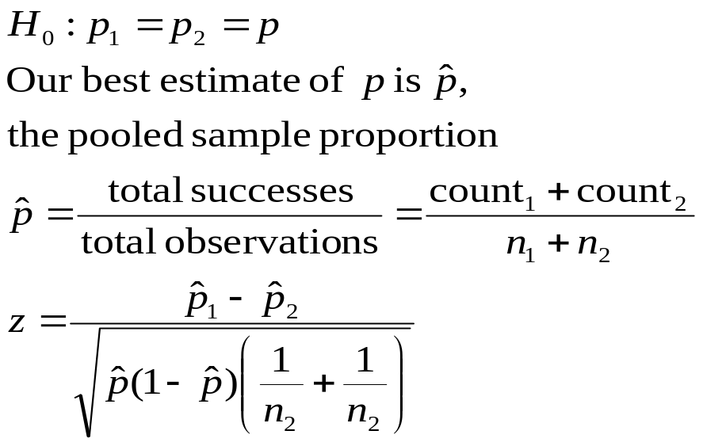
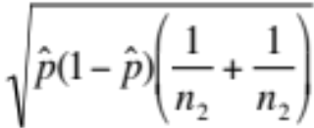
Test of significance
If the null hypothesis is true, then we can rely on the properties of the sampling distribution to estimate the probability of drawing two samples with proportions ₁ and ₂ at random.
=0
This test is appropriate when the populations are at least 10 times as large as the samples and all counts are at least 5 (number of successes and number of failures in each sample).

Slide 29
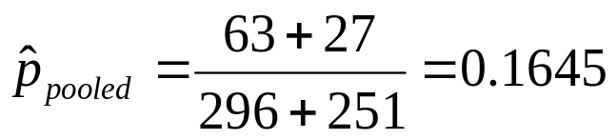
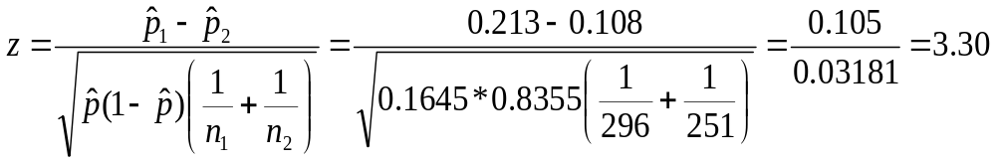
“No Sweat” garment labels
“No Sweat” labels on apparel indicate proper working conditions. Is there a gender difference in the proportion of label users? Are men and women equally likely to be label users?
Here is the data summary:
 | X | n
Women (1) | 63 | 296 | 0.213
Men (2) | 27 | 251 | 0.108
H₀: p₁ = p₂
H_{a}: p₁ ≠ p₂
The P-value is 2P(Z > 3.3) = 2(0.0005) = 0.001. The difference is statistically significant.

Slide 30
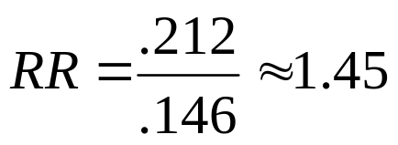
Relative risk
Another way to compare two proportions is to study the ratio of the two proportions, which is often called the relative risk (RR). A relative risk of 1 means that the two proportions are equal.
The procedure for calculating confidence intervals for relative risk is more complicated (use software) but still based on the same principles that we have studied.
The age at which a woman gets her first child may be an important factor in the risk of later developing breast cancer. An international study selected women with at least one birth and recorded if they had breast cancer or not and whether they had their first child before their 30th birthday or after.
 | Birth age 30+ | Sample size
Cancer | 683 | 3220 | 21.2%
No | 1498 | 10,245 | 14.6%
Women with a late first child have 1.45 times the risk of developing breast cancer.

