Slide 1
One-Way ANOVA:
One-Way Analysis of Variance
PSBE Chapter 14.1
© 2011 W.H. Freeman and Company

Slide 2

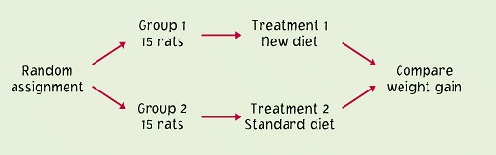
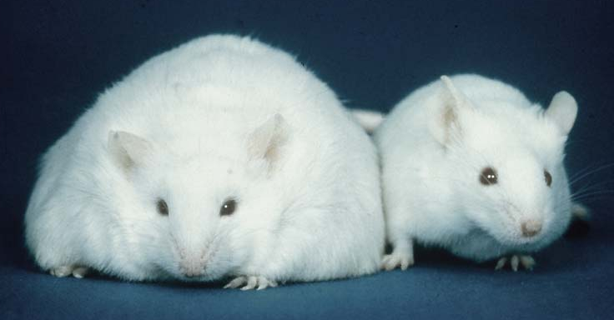
Completely randomized designs (Chapter 3)
Completely randomized experimental designs:
Individuals are randomly assigned to groups, then
the groups are randomly assigned to treatments.

Slide 3
Treatment or Factor (Chapter 3)
In an experiment, we do something to the subject and measure the response. The “something” we do is called a treatment, or factor.
  The factor may be the administration of a drug.
  One group of people may be placed on a diet/exercise program for six months (treatment), and their blood pressure (response variable) would be compared with that of people who did not diet or exercise.

Slide 4
The idea of ANOVA
A factor is a variable that can take one of several levels used to differentiate one group from another.
An experiment has a one-way or completely randomized design if several levels of one factor are being studied and the individuals are randomly assigned to its levels. (There is only one way to group the data.)
  Example: Which of four advertising offers mailed to sample households produces the highest sales?
  Will a lower price in a plain mailing draw more sales on average than a higher price in a fancy brochure? Analyzing the effect of price and layout together requires two-way ANOVA.
Analysis of variance (ANOVA) is the technique used to determine whether more than two population means are equal.
One-way ANOVA is used for completely randomized, one-way designs.

Slide 5
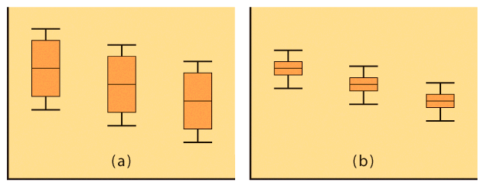
The ANOVA setting: comparing means
We want to know if the observed differences in sample means are likely to have occurred by chance just because of the random sampling.
This will likely depend on both the difference between the sample means and how much variability there is within each sample.

Slide 6
Connection with the two-sample t statistic
A two sample t test assuming equal variance and an ANOVA comparing only two groups will give you the exact same p-value (for a two-sided hypothesis).
H₀: μ₁ = μ₂
H_{a}: μ₁ ≠ μ₂
One-way ANOVA
F-statistic
H₀: μ₁ = μ₂
H_{a}: μ₁ ≠ μ₂
t test assuming equal variance
t statistic
F = t² and both p-values are the same.
But the t test is more flexible: You may choose a one-sided alternative instead, or you may want to run a t test assuming unequal variance if you are not sure that your two populations have the same standard deviation σ.

Slide 7
An overview of ANOVA
We first examine the multiple populations or multiple treatments to test for overall statistical significance, as evidence of any difference among the parameters we want to compare. ➔ANOVA F-test
If that overall test showed statistical significance, then a detailed follow-up analysis is legitimate.
  If we planned our experiment with specific alternative hypotheses in mind (before gathering the data), we can test them using contrasts.
  If we do not have specific alternatives, we can examine all pair-wise parameter comparisons to define which parameters differ from which, using multiple comparisons procedures.

Slide 8
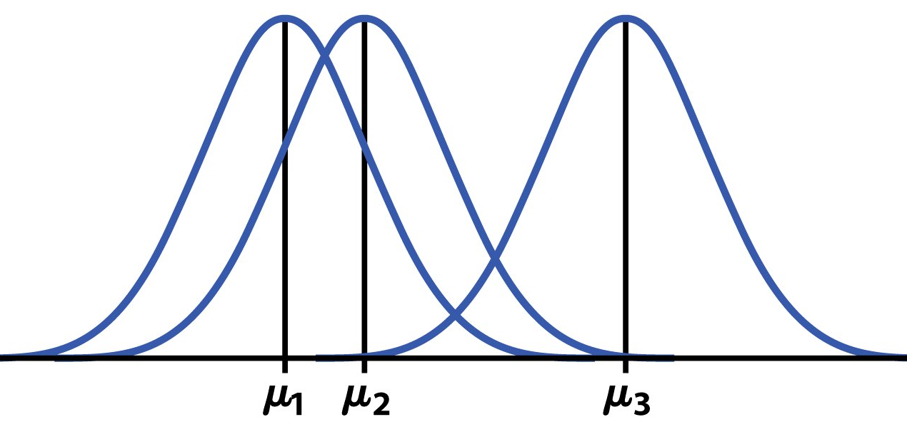
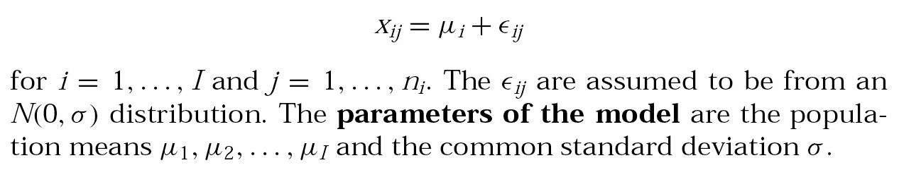
The ANOVA model
Random sampling always produces chance variations. Any “factor effect” would thus show up in our data as the factor-driven differences plus chance variations (“error”):
Data = fit (“factor/groups”) + residual (“error”)
The one-way ANOVA model analyses
situations where chance variations are
normally distributed N(0,σ) so that:

Slide 9
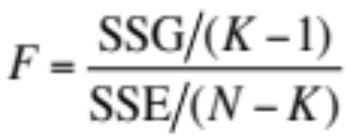
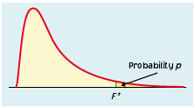
Testing hypotheses in one-way ANOVA
We have K independent SRSs, from K populations or treatments.
The k^{th} population has a normal distribution with unknown mean µ_{k}.
All K populations have the same standard deviation σ, unknown.
The ANOVA F statistic tests:
H₀: μ₁ = μ₂ = … = μ_{K}
H_{a}: not all the μ_{i} are equal
When H₀ is true, F has the F distribution with K − 1 (numerator) and N − K (denominator) degrees of freedom.

Slide 10
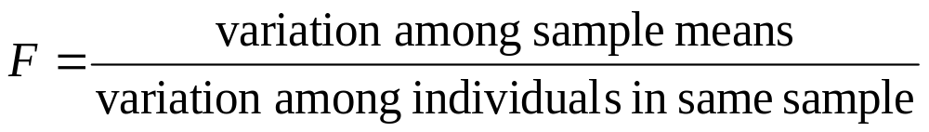
The ANOVA F-test
The ANOVA F-statistic compares variation due to specific sources (levels of the factor) to variation among individuals who should be similar (individuals in the same sample).
Difference in means large relative to overall variability
Difference in means small relative to overall variability
➔ F tends to be small
➔ F tends to be large
Larger F-values typically yield more significant results. How large depends on the degrees of freedom (K − 1 and N − K).

Slide 11
Checking ANOVA assumptions
1. Each of the #K populations must be normally distributed. But the test is robust to normality deviations for large enough sample sizes, thanks to the central limit theorem.
2. The ANOVA F-test requires that all populations have the same standard deviation σ. Since σ is unknown, this can be hard to check.
Practically: The results of the ANOVA F-test are approximately correct when the largest sample standard deviation is no more than twice as large as the smallest sample standard deviation.
(Equal sample sizes also make ANOVA more robust to deviations from the equal σ rule)

Slide 12



The ANOVA table
Source of variation | Sum of squares SS | DF | Mean square MS | F | P-value | F crit
Among or between “groups” |  | K -1 | SSG/DFG | MSG/MSE | Tail area above F | Value of F for α
Within groups or “error” |  | N - K | SSE/DFE
Total | SST=SSG+SSE | N – 1
R² = SSG/SST √MSE = s_{p}
Coefficient of determination Pooled standard deviation
The sum of squares represents variation in the data: SST = SSG + SSE.
The degrees of freedom likewise reflect the ANOVA model: DFT = DFG + DFE.
Data (“Total”) = fit (“Groups”) + residual (“Error”)

Slide 13
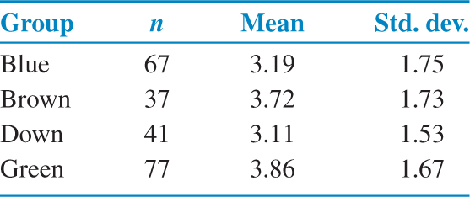
Case: Do eyes affect ad response?
A study investigated the affect of the color of a model’s eyes in a viewer’s response to an ad. In three groups of students, viewers see a picture of the model looking directly at the camera, with only the eye color being changed. A fourth group of students saw a picture of the model looking down.
The table below summarizes the responses :

Slide 14
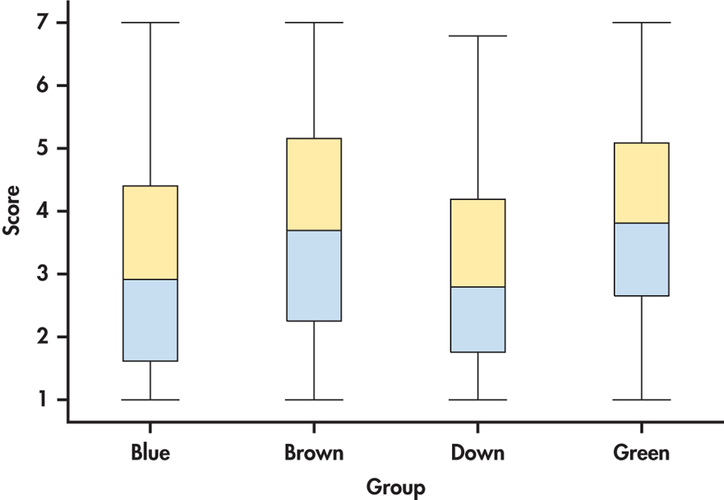
Verifying conditions for ANOVA
Side-by-side boxplots of the scores for the four groups.
The data appear relatively symmetric with some skewness.

Slide 15
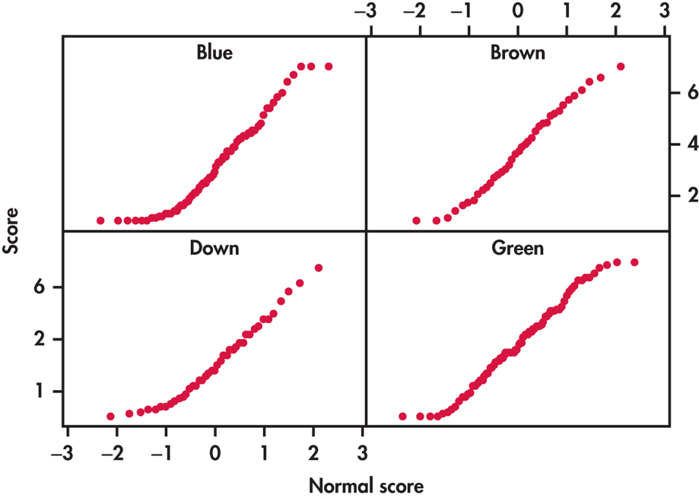
Verifying conditions for ANOVA
Normal quantile plots of the scores for the four groups.
The data looks reasonably Normal.

Slide 16
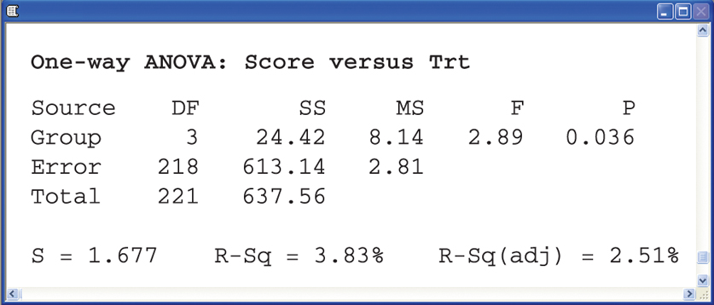
ANOVA results
The pooled standard deviation s_{p} is reported as 1.677. The value of F is 2.89, with a P-value of 0.036. We have evidence at the 5% significance level to reject the null hypotheses that the four populations have equal means. There is evidence that the four groups of students do not all have the same mean attitude score.

Slide 17
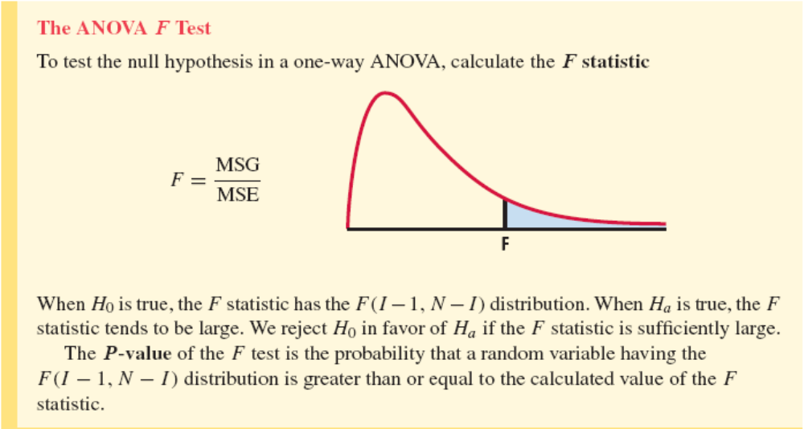
Using Table E
The F distribution is asymmetrical and has two distinct degrees of freedom. This was discovered by Fisher, hence the label “F.”
Once again, what we do is calculate the value of F for our sample data and then look up the corresponding area under the curve in Table E.

Slide 18
Yogurt preparation and taste
Yogurt can be made using three distinct commercial preparation methods: traditional, ultra filtration, and reverse osmosis.
To study the effect of these methods on taste, an experiment was designed in which three batches of yogurt were prepared for each of the three methods. A trained expert tasted each of the nine samples (presented in random order), and judged them on a scale of 1 to 10.
Variables, hypotheses, assumptions, calculations?
ANOVA table
Source of variation | SS | df | MS | F | P-value | F crit
Between groups | 17.3 | I-1=2 | 8.65 | 11.283
Within groups | 4.6 | N-I=6 | 0.767
Total | 17.769

Slide 19
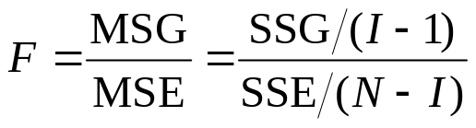
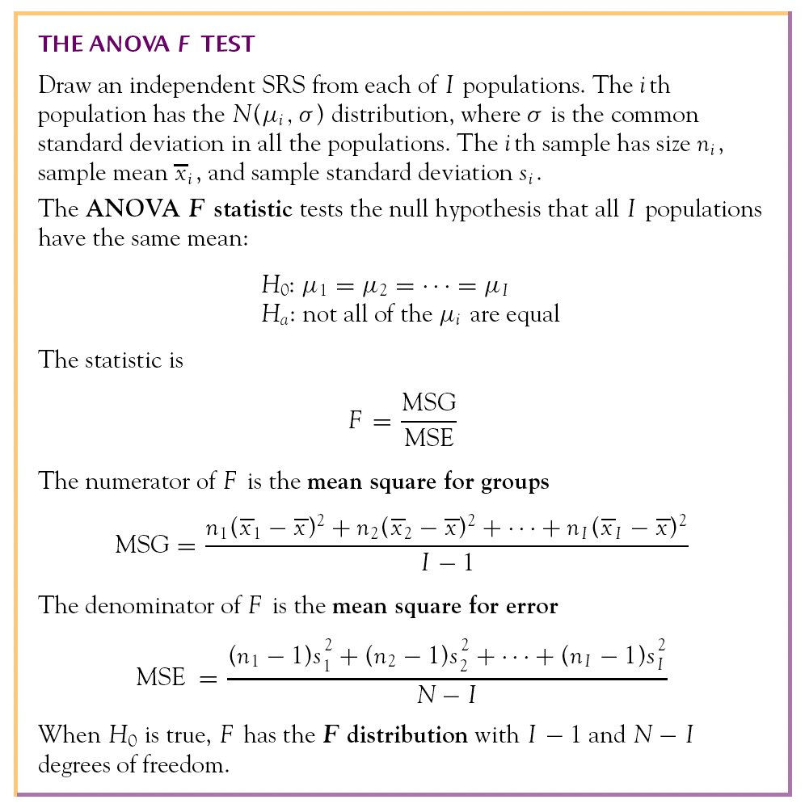
Computation details
MSG, the mean square for groups, measures how different the individual means are from the overall mean (~ weighted average of square distances of sample averages to the overall mean). SSG is the sum of squares for groups.
MSE, the mean square for error, is the pooled sample variance s_{p}² and estimates the common variance σ² of the I populations (~ weighted average of the variances from each of the I samples). SSE is the sum of squares for error.

Slide 20
One-Way ANOVA
Comparing Group Means and the Power of the ANOVA Test
PSBE Chapters 14.2 and 14.3
© 2011 W.H. Freeman and Company

Slide 21
Objectives (PSBE Chapters 14.2 and 14.3)
Comparing group means and the power of the ANOVA test
Contrasts: planned comparisons
Multiple comparisons
Simultaneous confidence intervals
Power of the ANOVA test

Slide 22
You have calculated a p-value for your ANOVA test. Now what?
If you found a significant result, you still need to determine which treatments were different from which.
  You can gain insight by looking back at your plots (boxplot, mean ± s).
  There are several tests of statistical significance designed specifically for multiple tests. You can choose, apriori, contrasts or, aposteriori, multiple comparisons.
  You can find the confidence interval for each mean μ_{i} shown to be significantly different from the others.

Slide 23
Contrasts can be used only when there are clear expectations BEFORE starting an experiment, and these are reflected in the experimental design. Contrasts are planned comparisons.
  Patients are given either drug A, drug B, or a placebo. The three treatments are not symmetrical. The placebo is meant to provide a baseline against which the other drugs can be compared.
Multiple comparisons should be used when there are no justified expectations. Those are aposteriori, pair-wise tests of significance.
  We compare gas mileage for eight brands of SUVs. We have no prior knowledge to expect any brand to perform differently from the rest. Pair-wise comparisons should be performed here, but only if an ANOVA test on all eight brands reached statistical significance first.
It is NOT appropriate to use a contrast test when suggested comparisons appear only after the data is collected.

Slide 24
Chapter 14 StatTutor on Portal
“The Analysis of Variance F test” – about 8 minutes
- Explains problem 2 of Lab 7
“The Idea of Analysis Of Variance” is also very good.

