Slide 1
Examining Relationships Scatterplots
PSBE Chapter 2.1
© 2011 W. H. Freeman and Company

Slide 2
Objectives (PSBE Chapter 2.1)
Scatterplots
Explanatory and response variables
Scatterplots
Interpreting scatterplots
Outliers
The log transformation
Categorical variables in scatterplots

Slide 3
Looking at relationships
Start with a graph
Look for an overall pattern and deviations from the pattern
Use numerical descriptions of the data and overall pattern (if appropriate)

Slide 4
Explanatory and response variables
A response variable measures or records an outcome of a study. Also called dependent variable.
An explanatory variable explains changes in the response variable (also called independent variable).

Slide 5
CASE 2.1 Spam Botnets: A $140 Billion Problem
A botnet is a remotely and silently controlled collection of networked computers. Botnets are illicitly created through the use of viruses, Trojans, and other malware to assimilate computers, or bots, into the botnet, generally without the knowledge of the computer owner. Some botnets can grow to many thousands of bots located all over the world.
A botnet that is used to send unwanted commercial emails, called spam, is called a spam botnet. About 120 billion spam messages are sent per day, and the cost of dealing with spam messages is estimated to be $140 billion per year.

Slide 6
Scatterplot example
Here, we have two quantitative variables for each of 10 botnets.
The number of bots
Spams per day
We are interested in the relationship between the two variables: How is one affected by changes in the other one?
Botnet | Bots (thousands) | Spams (billions)
Srizbi | 315 | 60
Bobax | 185 | 9
Rustock | 150 | 30
Cutwail | 125 | 16
Storm | 85 | 3
Grum | 50 | 2
Ozdok | 35 | 10
Nucrypt | 20 | 5
Wopla | 20 | 0.06
Spamthru | 10 | 0.035

Slide 7
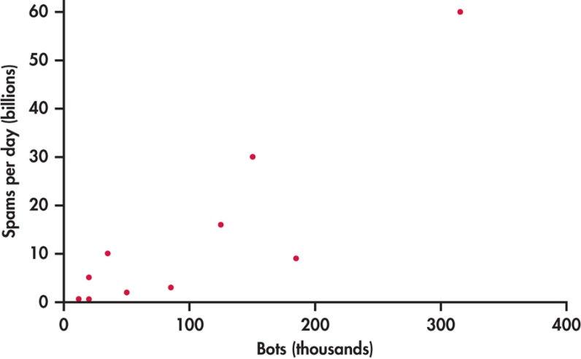
Scatterplot example
Botnet | Bots | Spams
Srizbi | 315 | 60
Bobax | 185 | 9
Rustock | 150 | 30
Cutwail | 125 | 16
Storm | 85 | 3
Grum | 50 | 2
Ozdok | 35 | 10
Nucrypt | 20 | 5
Wopla | 20 | 0.06
Spamthru | 10 | 0.035

Slide 8
Scatterplot
A scatterplot shows the relationship between two quantitative variables measured on the same individuals.
Typically, the explanatory or independent variable is plotted on the x axis, and the response or dependent variable is plotted on the y axis.
Each individual in the data appears as a point in the plot.

Slide 9
Interpreting scatterplots
After plotting two variables on a scatterplot, we describe the relationship by examining the form, direction, and strength of the association. We look for an overall pattern …
Form: linear, curved, clusters, no pattern
Direction: positive, negative, no direction
Strength: how closely the points fit the “form”
… and deviations from that pattern.
Outliers

Slide 10
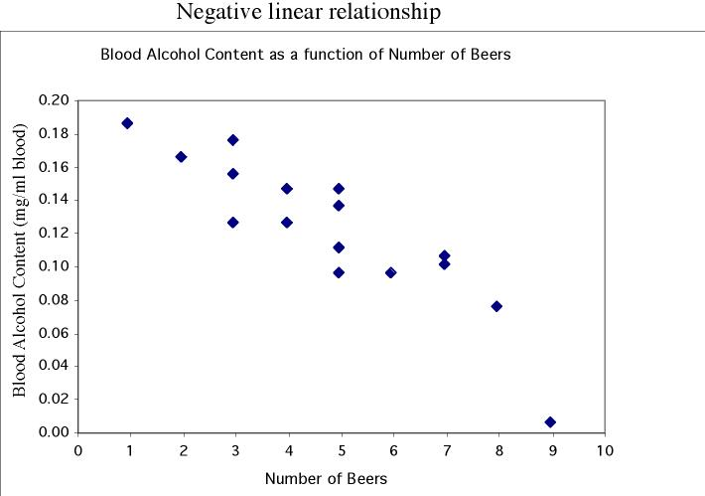
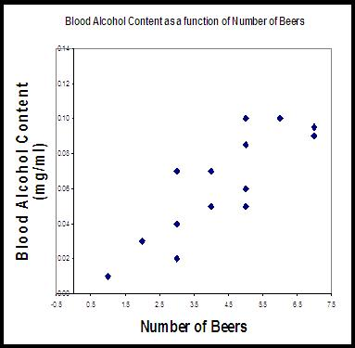
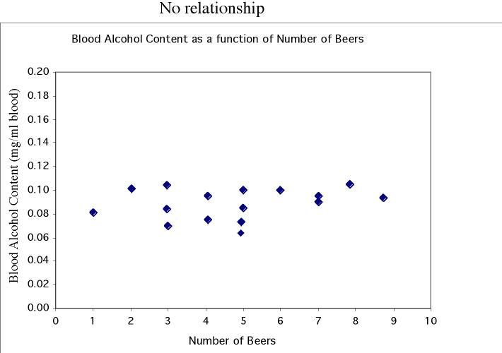
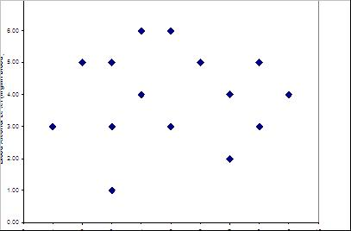
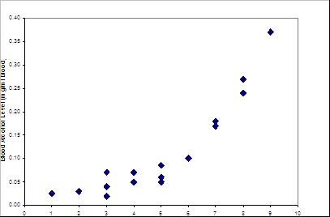
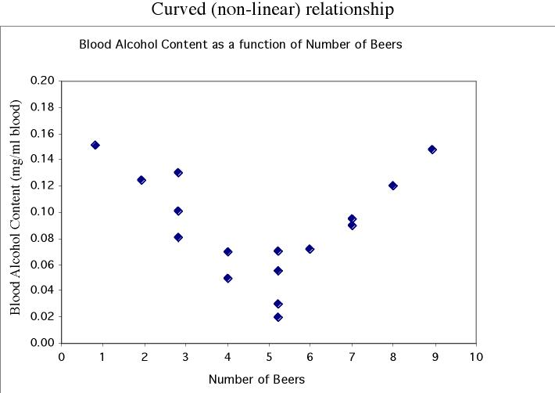
Form and direction of an association
Linear
No relationship
Nonlinear

Slide 11
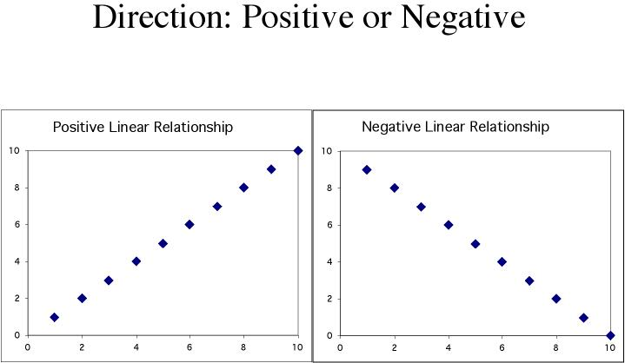
Positive association: High values of one variable tend to occur together with high values of the other variable.
Negative association: High values of one variable tend to occur together with low values of the other variable.

Slide 12
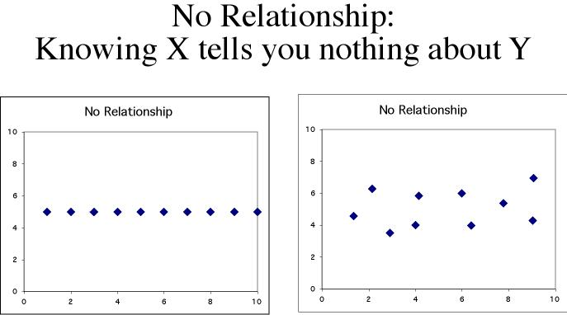
No relationship: X and Y vary independently. Knowing X tells you nothing about Y.

Slide 13
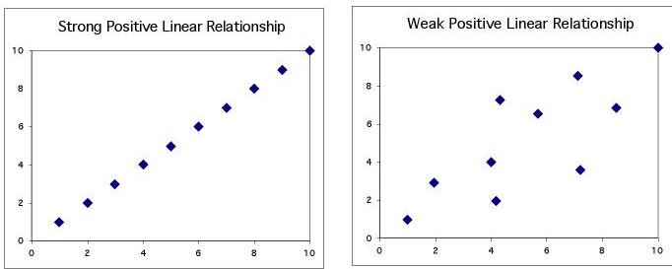
Strength of the association
The strength of the relationship between the two variables can be seen by how much variation, or scatter, there is around the main form.
With a strong relationship, you can get a pretty good estimate of y if you know x.
With a weak relationship, for any x you might get a wide range of y values.

Slide 14
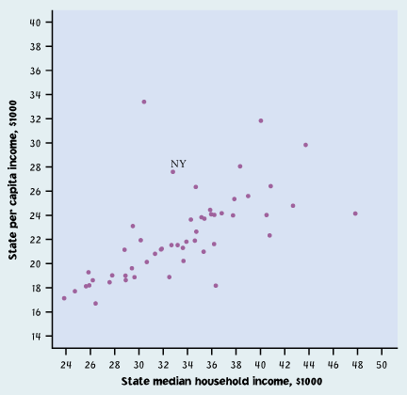
Strength of the association
This is a weak relationship. For a particular state median household income, you can’t predict the state per capita income very well.

Slide 15
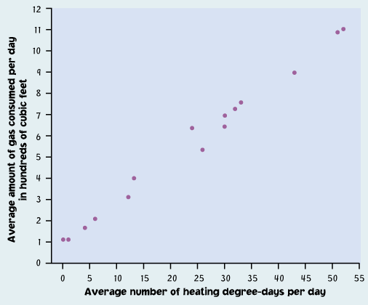
Strength of the association
This is a very strong relationship. The daily amount of gas consumed can be predicted quite accurately for a given temperature value.

Slide 16
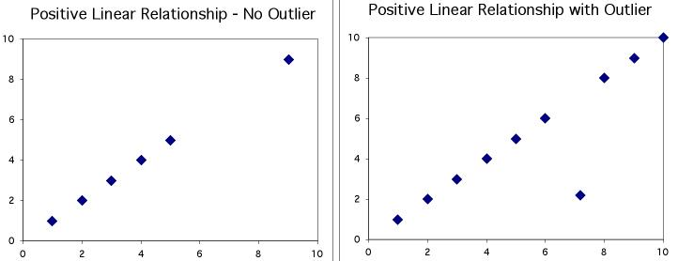
Outliers
An outlier is a data value that has a low probability of occurrence (i.e., it is unusual or unexpected).
In a scatterplot, outliers are points that fall outside of the overall pattern of the relationship.

Slide 17
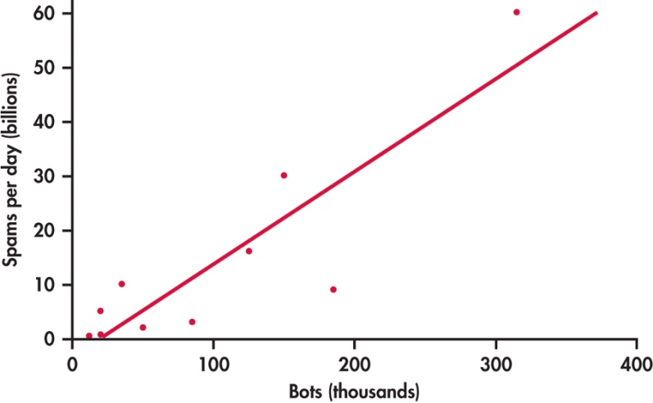
Outliers
The upper-right-hand point here is not an outlier of the relationship—It is what you would expect for this number of bots given the linear relationship between spams per day and bots.
Not an outlier
This point is not in line with the
others, so it is an outlier of the relationship.
Outlier

Slide 18
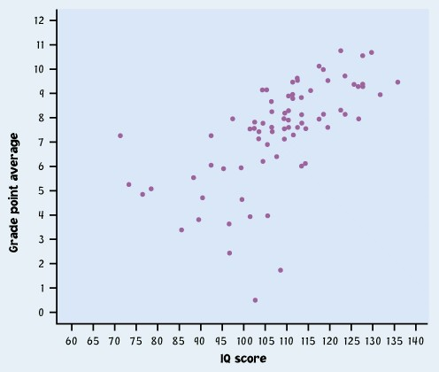
Outliers
IQ score and
Grade Point Average
Describe in words what this plot shows.
Describe the direction, shape, and strength. Are there outliers?
What might explain these people?

Slide 19
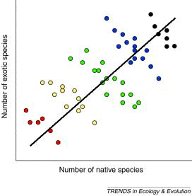
Categorical variables in scatterplots
Often, things are not simple and one-dimensional. We need to group the data into categories to reveal trends.
What may look like a positive linear relationship is in fact a series of negative linear associations.
Plotting different habitats in different colors allows us to make that important distinction.

Slide 20
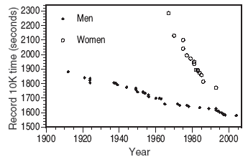
Categorical variables in scatterplots
Comparison of men’s and women’s racing records over time.
Each group shows a very strong negative linear relationship that would not be apparent without the gender categorization.

Slide 21
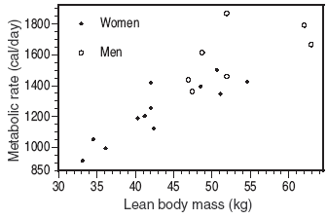
Categorical variables in scatterplots
Relationship between lean body mass and metabolic rate in men and women. Both men and women follow the same positive linear trend, but women show a stronger association. As a group, males typically have larger values for both variables.

Slide 22
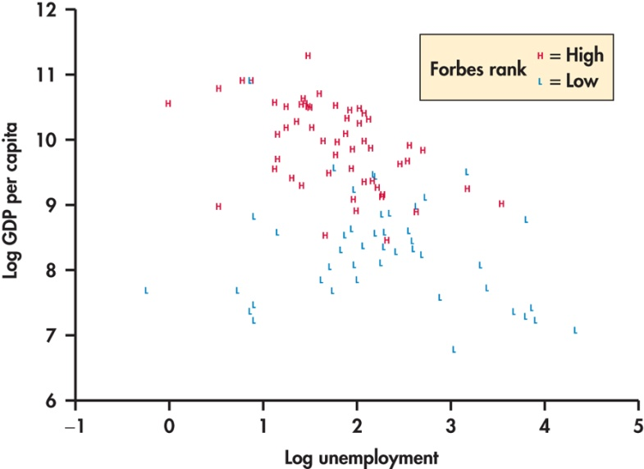
Categorical variables in scatterplots
Comparison of GDP of high- and low-ranked countries versus unemployment rate.
Countries with higher GDP are ranked higher. Unemployment does not appear to be a factor in determining ranking

Slide 23
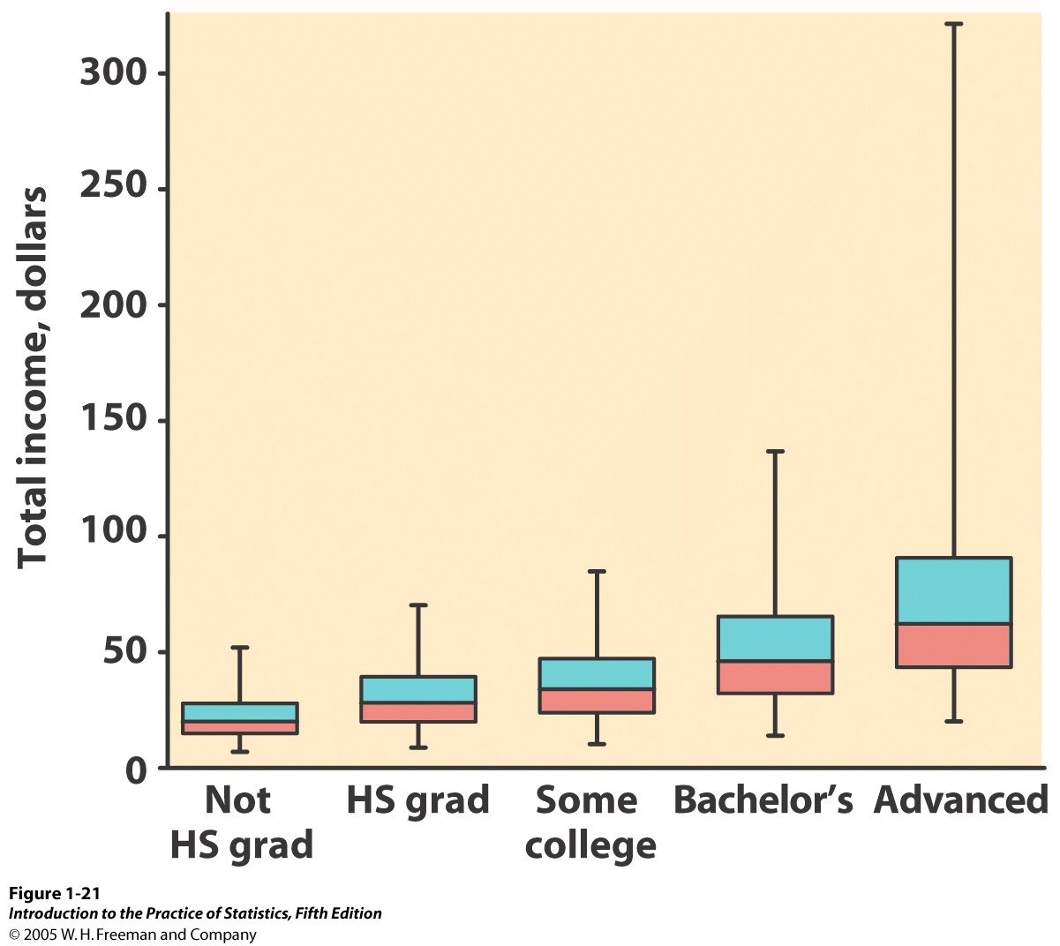
Categorical explanatory variables
When the explanatory variable is categorical, you cannot make a scatterplot, but you can compare the different categories side-by-side on the same graph (boxplots, or mean +/− standard deviation).
Comparison of income (quantitative response variable) for different education levels (five categories).
But be careful in your interpretation: This is NOT a positive association because education is not quantitative.

Slide 24
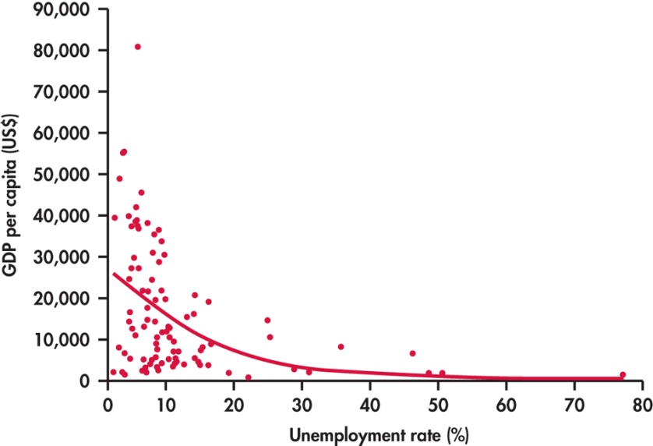
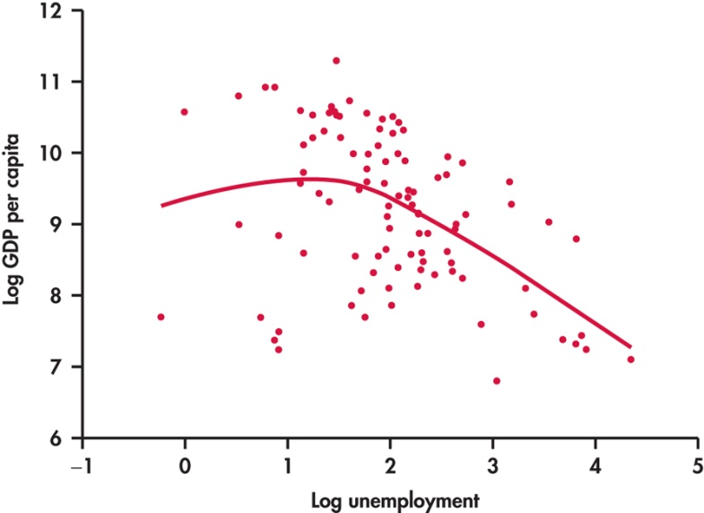
The log transformation
When the data are skewed toward large values, a log transformation may provide more information.
Notice the data fill up much of the central part to the graph after the log transformation.

Slide 25
Examining Relationships Correlation
PSBE Chapter 2.2
© 2011 W.H. Freeman and Company

Slide 26
Objectives (PSBE Chapter 2.2)
Correlation
The correlation coefficient “r”
r does not distinguish between x and y
r has no units of measurement
r ranges from -1 to +1
Influential points

Slide 27
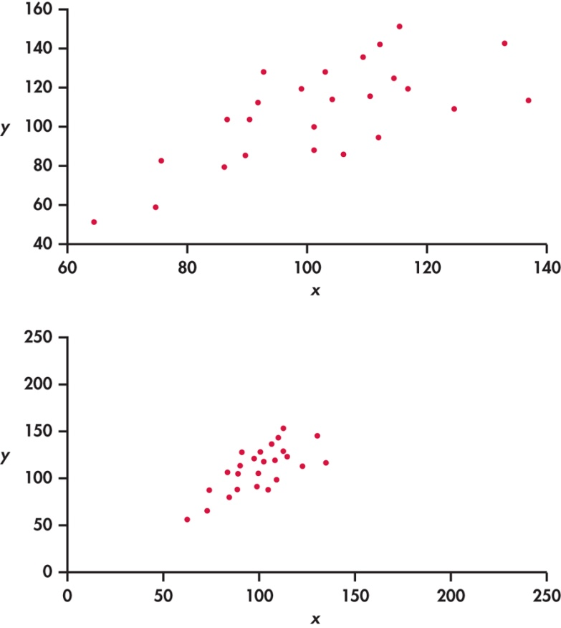
Stronger association?
Two scatterplots of the same data.
The straight-line pattern in the lower plot appears stronger because of the surrounding open space.

Slide 28
The correlation coefficient “r”
The correlation coefficient is a measure of the direction and strength of a linear relationship.
It is calculated using the mean and the standard deviation of both the x and y variables.
Correlation can only be used to describe quantitative variables. Categorical variables don’t have means and standard deviations.

Slide 29
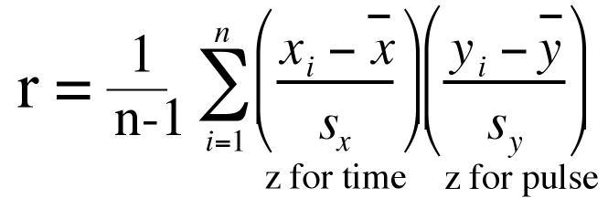
The correlation coefficient “r”
= 0.885
Bots: x = 99.5, s_{x} = 96.9
Spams per day: y = 13.51 s_{y} = 18.71

Slide 30
Facts about correlation
r ignores the distinction between response and explanatory variables
r measures the strength and direction of a linear relationship between two quantitative variables
r is not affected by changes in the unit of measurement
Positive value of r means association between the two variables is positive
Negative value of r means association between the variables is negative
r is always between -1 and +1
r is strongly affected by outliers

Slide 31
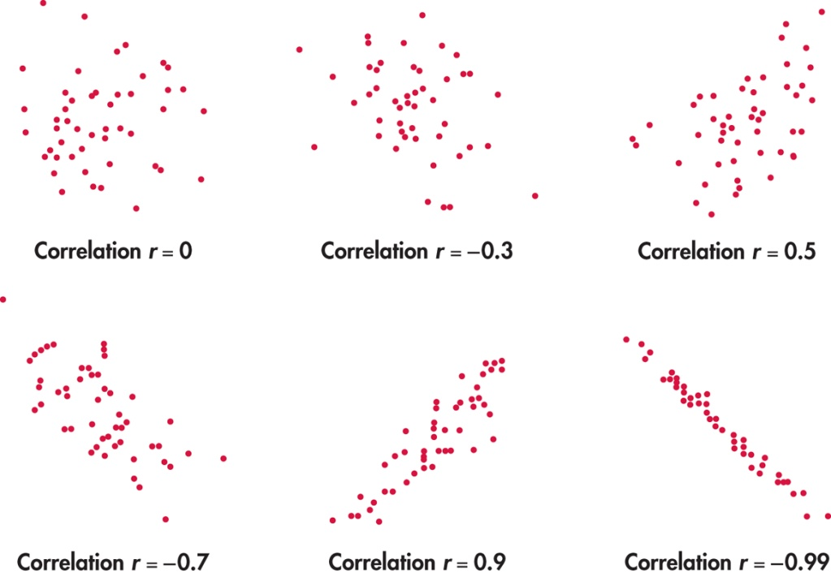
“r” ranges from -1 to +1
Strength: how closely the points follow a straight line.
Direction: is positive when individuals with higher X values tend to have higher values of Y.

Slide 32
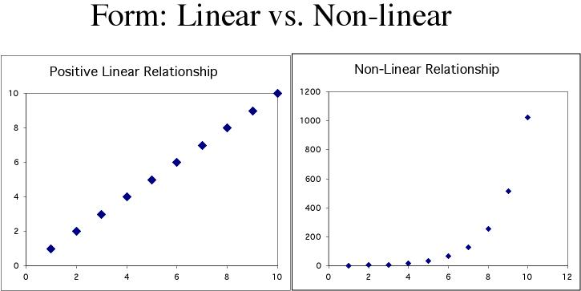
Correlation only describes linear relationships
No matter how strong the association, r does not describe curved relationships.

Slide 33
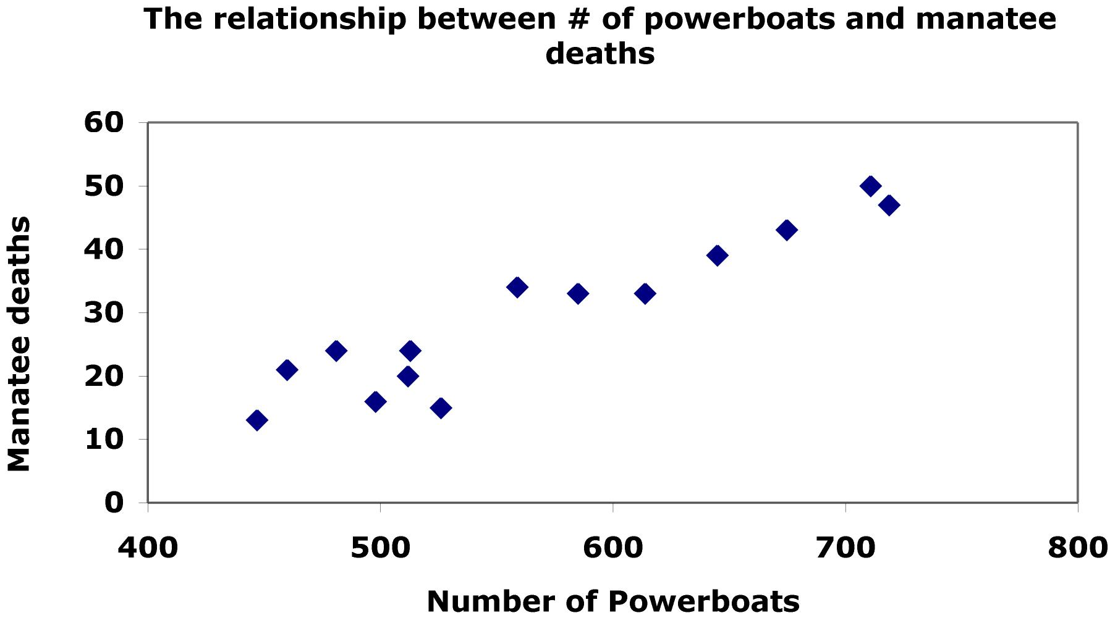
Review example
Estimate r
r = 1.00
r = -0.94
r = 1.12
r = 0.94
r = 0.21
(in 1000’s)

Slide 34
Review Question
An employee of an auction house has a list of 25 recently sold paintings. Eight artists were represented in these sales. The sale price of each painting is on the list. Would the correlation coefficient be an appropriate way to summarize the relationship between artist (x) and sale price (y)? Why or why not?

Slide 35
Review Question
Which of the following statements about the correlation r are true?
I) It is not affected by changes in the measurement units of the variables
II) It is not affected by which variable is called x and which is called y
III) It is not affected by extreme value

Slide 36
Review Question
A study of department chair ratings and student ratings of the performance of high school statistics teachers reports a correlation of r=1.15 between the two ratings. What can we can conclude from this information ?

Slide 37
Examining Relationships Least-Squares Regression & Cautions about Correlation and Regression
PSBE Chapters 2.3 and 2.4
© 2011 W. H. Freeman and Company

Slide 38
Objectives (PSBE Chapters 2.3 and 2.4)
Least-Squares Regression
The regression line
Facts about least-squares regression
Residuals
Influential observations
Cautions about Correlation and Regression
Correlation/regression using averages
Lurking variables
Association is not causation

Slide 39
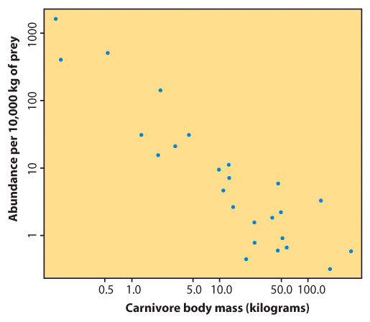
Linear regression
Correlation tells us about strength (scatter) and direction of the linear relationship between two quantitative variables.
In addition, we would like to have a numerical description of how both variables vary together. For instance, is one variable increasing faster than the other one? And we would like to make predictions based on that numerical description.
But which line best describes our data?

Slide 40
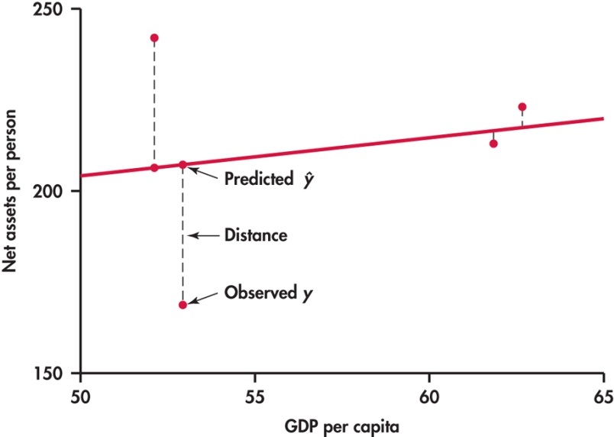
The regression line
The least-squares regression line is the unique line such that the sum of the squared vertical (y) distances between the data points and the line is the smallest possible.
Distances between the points and line are squared so all are positive values.

Slide 41
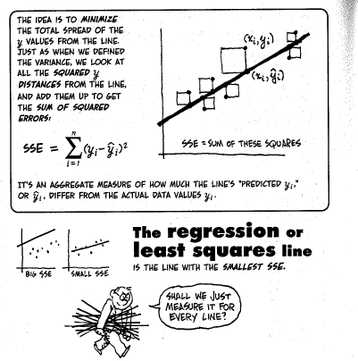

Slide 42
Equation of the regression line
The least-squares regression line is the line:
“y-hat” is the predicted response for any x
b₁ is the slope
b₀ is the intercept

Slide 43
How to:
First we calculate the slope of the line, b₁; from statistics we already know:
r is the correlation.
s_{y} is the standard deviation of the response variable y.
s_{x} is the the standard deviation of the explanatory variable x.
Once we know b₁, the slope, we can calculate b₀, the y-intercept:
where x and y are the means of the x and y variables
But typically, we use a 2-var stats calculator or stats software.

Slide 44
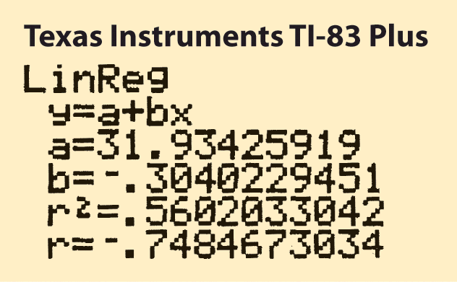
BEWARE!!!
Not all calculators and software use the same convention. Some use:
And some use:
Make sure you know what YOUR calculator gives you for a and b before you answer homework or exam questions.

Slide 45
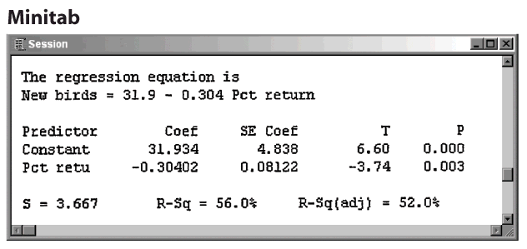
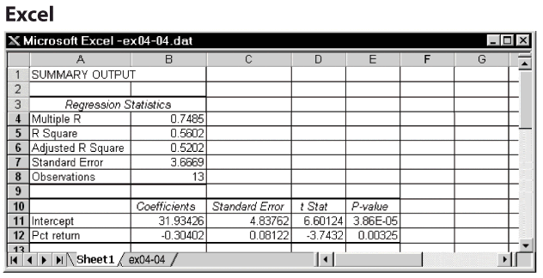
Software output
intercept
slope
R²
r
R²
intercept
slope

Slide 46
Example
Regression Analysis: Selling Price ($) vs. Square Footage of Houses
The regression equation is
Selling Price = 4795 + 92.8 Square Footage ($)
Predictor Coef SE Coef T P
Constant 4795 13452 0.36 0.723
Square F 92.802 8.844 10.49 0.000
S = 30344 R-Sq = 69.6% R-Sq(adj) = 69.0%
Slope: What is the change in selling price for a unit increase in square footage?
Intercept: Is the intercept meaningful?
Prediction: If the square footage of a house is 2500, what do we predict as the selling price?

Slide 47
Facts about least-squares regression
If we reverse the roles of the explanatory and response variables, we will get a different regression line
The slope, b₁ is related to the correlation coefficient, r.
The least-squares line passes through the means of the x and y variables.
The fraction of the variation in the values of y that is explained by the regression of y on x is r².

Slide 48
Coefficient of determination, r²
r², the coefficient of determination, is the square of the correlation coefficient.
r² represents the percentage of the variance in y (vertical scatter from the regression line) that can be explained by changes in x.

Slide 49
Coefficient of determination, r²
Changes in x explain 100% of the variations in y.
Y can be entirely predicted for any given value of x.
r = -1
r² = 1

Slide 50
Coefficient of determination, r²
Changes in x explain 0% of the variations in y.
The value(s) y takes is (are) entirely independent of what value x takes.
r = 0
r² = 0

Slide 51
Coefficient of determination, r²
Here the change in x only explains 78% of the change in y. The rest of the change in y (the vertical scatter, shown as red arrows) must be explained by something other than x.
r = 0.885
r² = 0.783

Slide 52
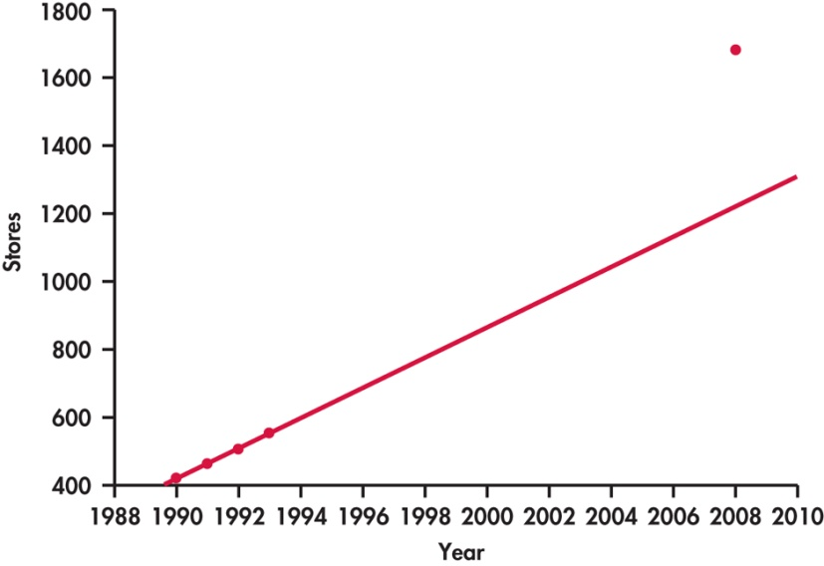

Extrapolation
Using the regression line results in a poor prediction of the number of stores in 2008.
Extrapolation is the use of a regression line for predictions outside the range of x values used to obtain the line.
Here are data on the number of Target stores in operation at the end of each year in the early 1990s and in 2008:

Slide 53
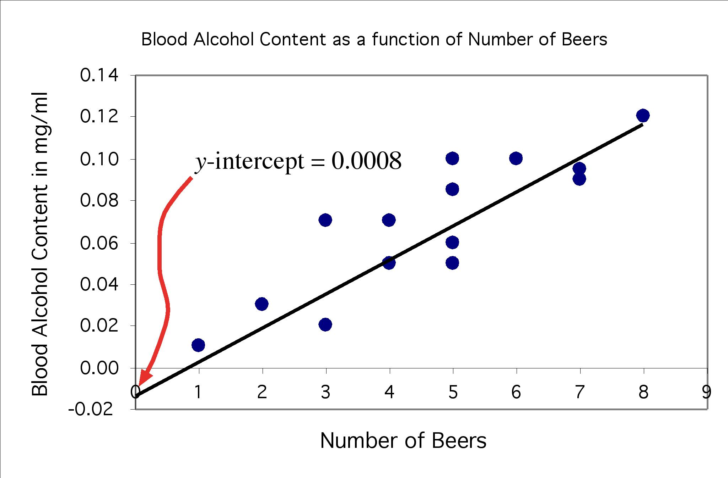
The y-intercept
Sometimes the y-intercept is not biologically possible. Here we have negative blood alcohol content, which makes no sense…
y-intercept shows negative blood alcohol
But the negative value is appropriate for the equation of the regression line.

Slide 54
Grade performance If GDP per capita explains 58% of the variation in net assets per capita, what is the correlation between GDP per capita and net assets per capita?
1. GDP per capita and net assets per capita are positively correlated. So r will be positive too.
2. r² = 0.58, so r = +√0.58 = + 0.76

Slide 55
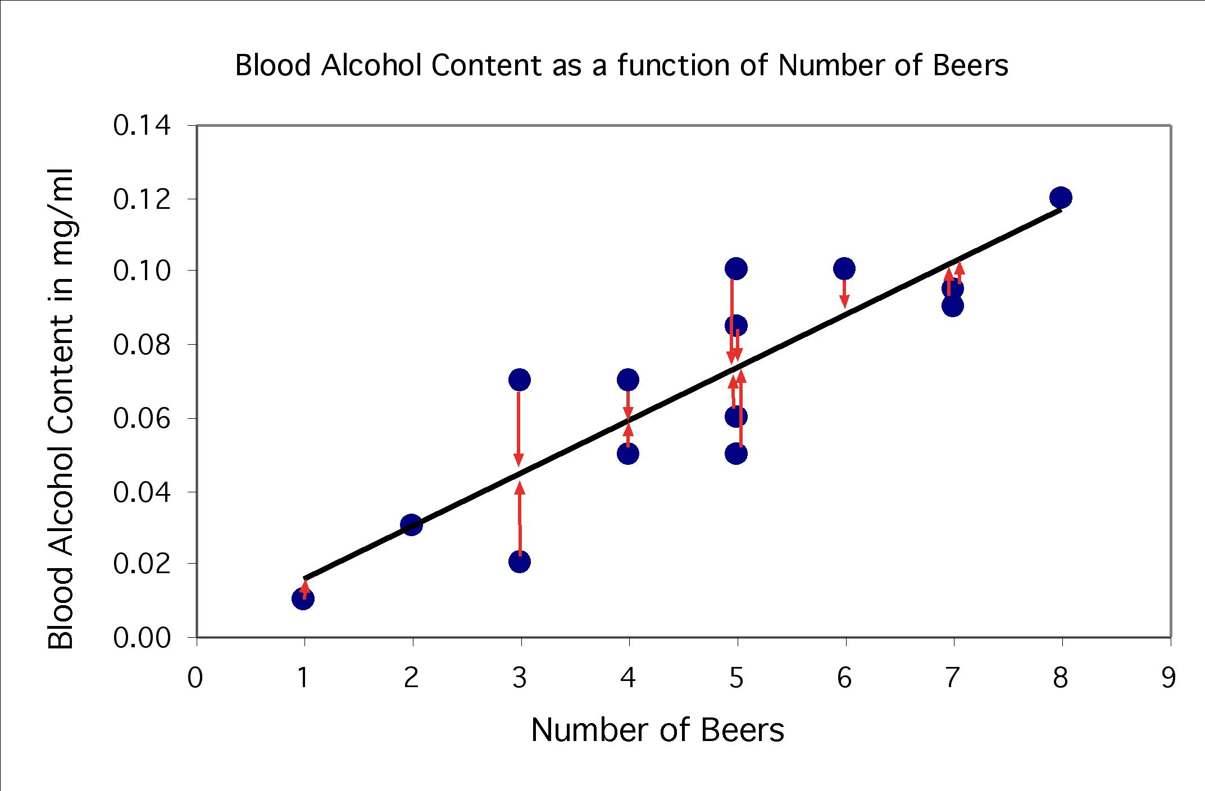
Residuals
The distances from each point to the least-squares regression line give us potentially useful information about the contribution of individual data points to the overall pattern of scatter.
These distances are called “residuals.”
The sum of these residuals is always 0.
Points above the line have a positive residual.
Points below the line have a negative residual.
Predicted ŷ
Observed y

Slide 56
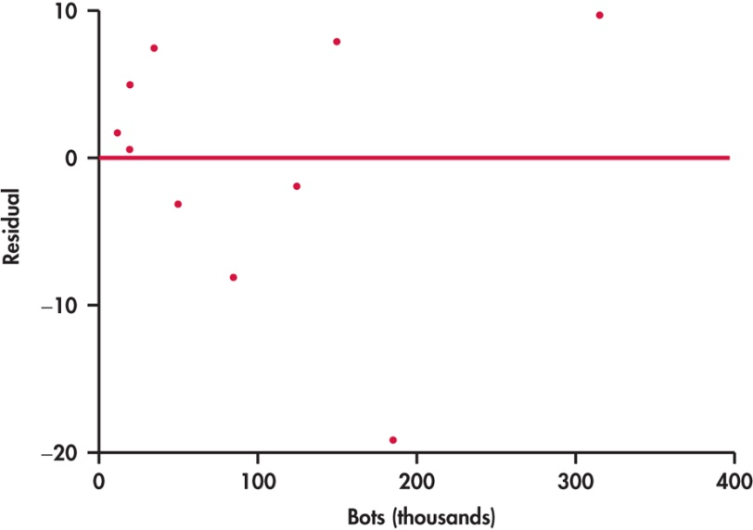
Residual plots
Residuals are the distances between y-observed and y-predicted. We plot them in a residual plot.
If residuals are scattered randomly around 0, chances are your data
fit a linear model, were normally distributed, and you didn’t have outliers.

Slide 57
Residual plots
The x-axis in a residual plot is the same as on the scatterplot.
Only the y-axis is different.

Slide 58
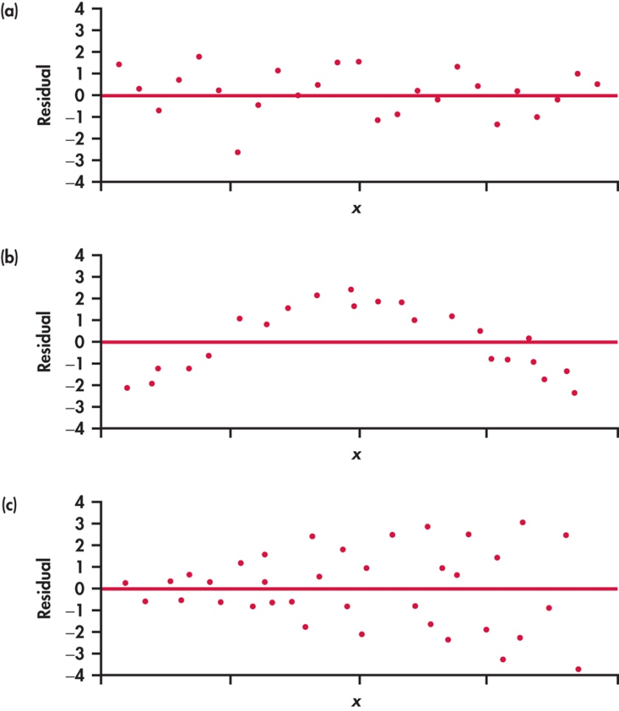
Residuals are randomly scattered—good!
Curved pattern—means the relationship
you are looking at is not linear.
A change in variability across plot is a warning sign. You need to find out why it is, and remember that predictions made in areas of larger variability will not be as good.

Slide 59
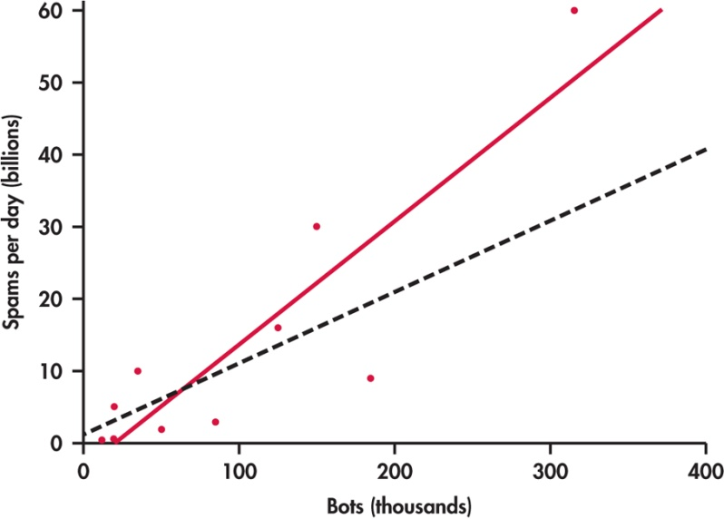
Outliers and influential points
Outlier: observation that lies outside the overall pattern of observations.
“Influential individual”: observation that markedly changes the regression if removed. This is often an outlier on the x-axis.
Srizbi is an influential point.
All data
Without Srizbi

Slide 60
Always plot your data
A correlation coefficient and a regression line can be calculated for any relationship between two quantitative variables. However, outliers can greatly influence the results. Also, running a linear regression on a nonlinear association is not only meaningless but misleading.
So, make sure to always plot your data before you run a correlation or regression analysis.

Slide 61
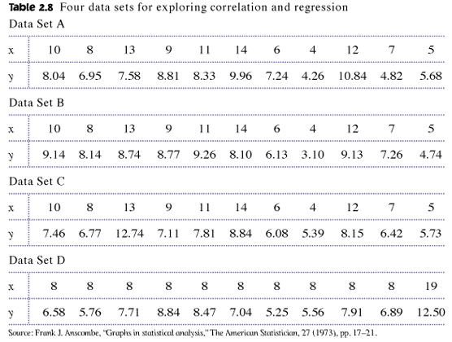
Always plot your data!
The correlations all give r ≈ 0.816, and the regression lines are all approximately ŷ = 3 + 0.5x. For all four sets, we would predict ŷ = 8 when x = 10.

Slide 62
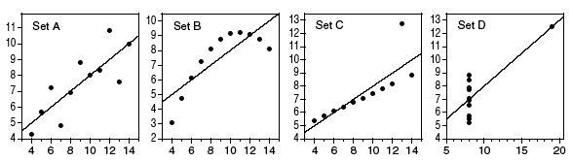
However, making the scatterplots shows us that the correlation/ regression analysis is not appropriate for all data sets.
Moderate linear association; regression OK.
Obvious nonlinear relationship; regression not OK.
One point deviates from the highly linear pattern; this outlier must be examined closely before proceeding.
Just one very influential point; all other points have the same x value; a redesign is due here.

Slide 63
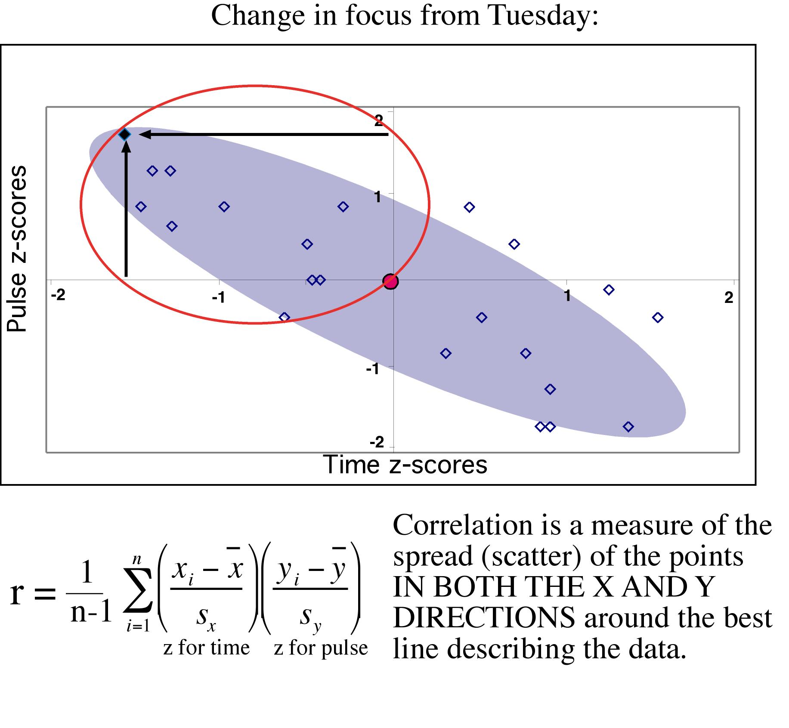
Correlation/regression using averages
Many regression or correlation studies use average data.
While this is appropriate, you should know that correlations based on averages are usually much higher than when made on the raw data.
The correlation is a measure of spread (scatter) in a linear relationship. Using averages greatly reduces the scatter.
Therefore r and r² are typically greatly increased when averages are used.

Slide 64
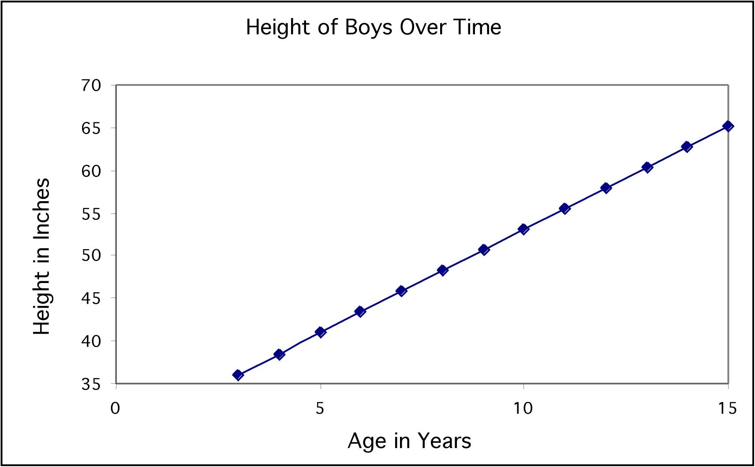
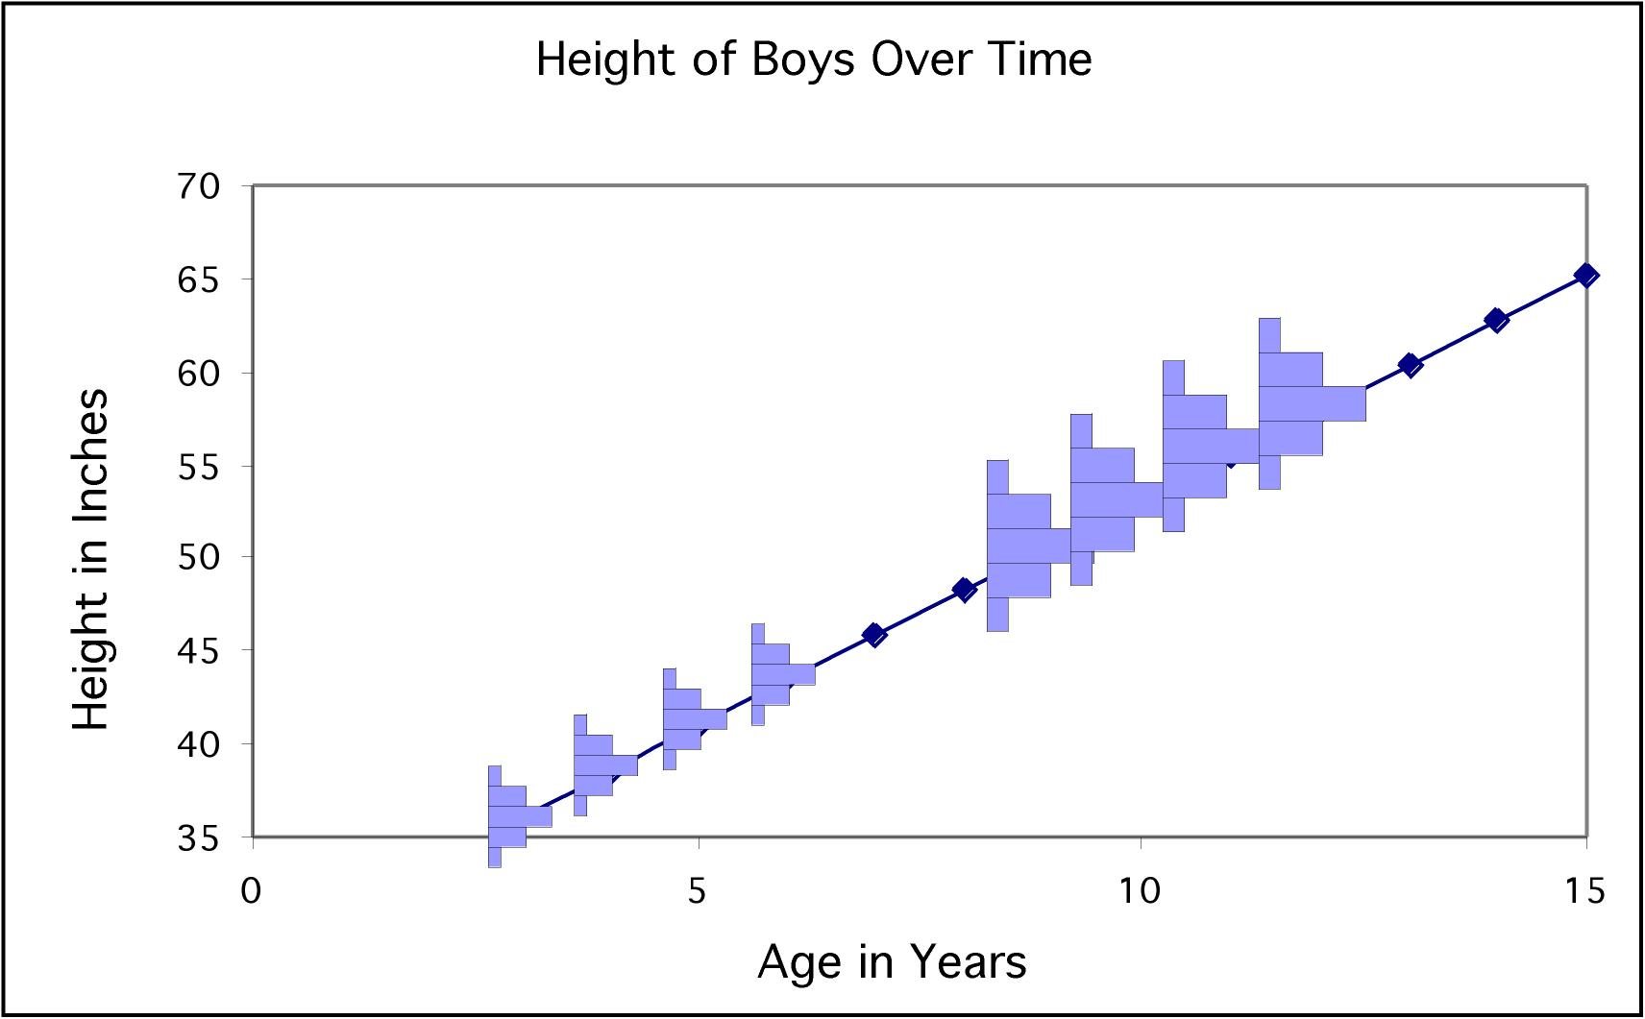
Boys
Boys
Each dot represents an average. The variation among boys per age class is not shown.
These histograms illustrate that each mean represents a distribution of boys of a particular age.
Should parents be worried if their son does not match the point for his age?
If the raw values were used in the correlation instead of the mean there would be a lot of spread in the y-direction, and thus the correlation would be smaller.

Slide 65
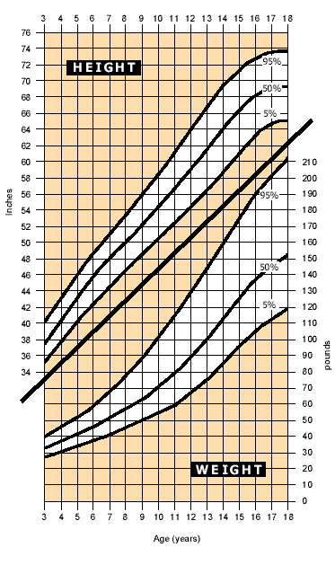
That's why typically growth charts show a range of values (here from 5th to 95th percentiles).
This is a more comprehensive way of displaying the same information.

Slide 66


Lurking variables
A lurking variable is a variable not included in the study design that does have an effect on the variables studied.
Lurking variables can falsely suggest a relationship.
What is the lurking variable in these examples?
How could you answer if you didn’t know anything about the topic?
Strong positive association between number of firefighters at a fire site and the amount of damage a fire does.
Negative association between moderate amounts of wine drinking and death rates from heart disease in developed nations.

Slide 67
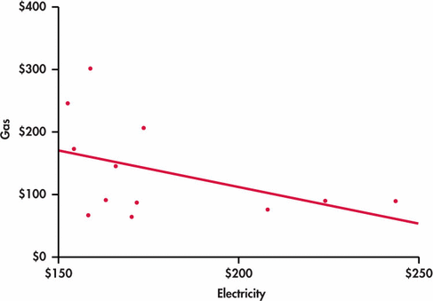
Example 2.25 Gas and Electricity Bills
A single-family household receives bills for gas and electricity each month. The 12 observations for a recent year are plotted with the least-squares regression line. Does this mean that a high electricity bill causes the gas bill to be low and vice versa?
Lurking Variable:
Time of Year

Slide 68
Vocabulary: lurking vs. confounding
A lurking variable is a variable that is not among the explanatory or response variables in a study and yet may influence the interpretation of relationships among those variables.
Two variables are confounded when their effects on a response variable cannot be distinguished from each other. The confounded variables may be either explanatory variables or lurking variables.
But you often see them used interchangeably…

Slide 69
Association is not causation
An association between an explanatory variable x and a response variable y, even if it is very strong, is not by itself good evidence that changes in x actually cause changes in y.
Example: There is a high positive correlation between the number of television sets per person (x) and the average life expectancy (y) for the world’s nations. Could we lengthen the lives of people in Rwanda by shipping them TV sets?
The best way to get evidence that x causes y is to do an experiment in which we change x and keep lurking variables under control.

Slide 70
Caution before rushing into a correlation or a regression analysis
Do not use a regression on inappropriate data.
Pattern in the residuals
Presence of large outliers Use residual plots for help.
Clumped data falsely appearing linear
Beware of lurking variables.
Avoid extrapolating (going beyond interpolation).
Recognize when the correlation/regression is performed on averages.
A relationship, however strong, does not itself imply causation.

Slide 71
Examining Relationships Relations in Categorical Data
PSBE Chapter 2.5
© 2011 W.H. Freeman and Company

Slide 72
Objectives (PSBE Chapter 2.5)
Data analysis for two-way tables
Two-way tables
Marginal distributions
Relationships between categorical variables
Conditional distributions
Simpson’s paradox

Slide 73
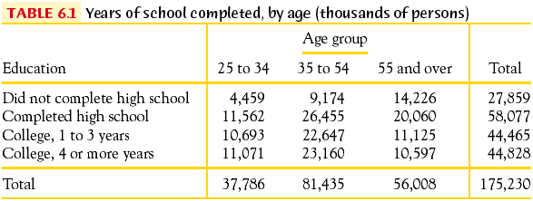
Two-way tables
An experiment has a two-way, or block, design if two categorical factors are studied with several levels of each factor.
Two-way tables organize data about two categorical variables obtained from a two-way, or block, design. (There are now two ways to group the data.)
Group by age
Record education
First factor: age
Second factor: education

Slide 74
Two-way tables
We call education the row variable.
Age group is the column variable.
Each combination of values for these two variables is called a cell.

Slide 75
Marginal distributions
We can look at each categorical variable separately in a two-way table by studying the row totals and the column totals. They represent the marginal distributions, expressed in counts or percentages (They are written as if in a margin.)
2000 U.S. census

Slide 76
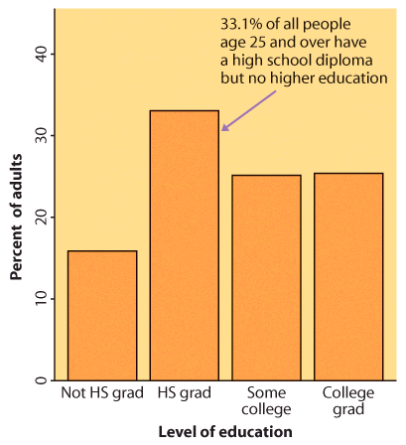
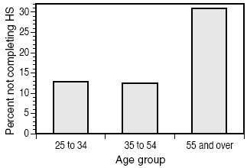
The marginal distributions can then be displayed on separate bar graphs, typically expressed as percents instead of raw counts. Each graph represents only one of the two variables, completely ignoring the second one.

Slide 77
Case 2.2 Does the Right Music Sell the Product?
Market researchers know that background music can influence the mood and the purchasing behavior of customers. One study in a supermarket in Northern Ireland compared three treatments: no music, French accordion music, and Italian string music. Under each condition, the researchers recorded the numbers of bottles of French, Italian, and other wine purchased.

Slide 78
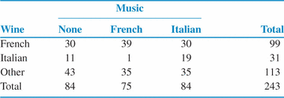
Case 2.2 Does the Right Music Sell the Product?

Slide 79


Case 2.2 Does the Right Music Sell the Product? (Marginal Distribution)
The percent of bottles of French wine sold is
99/243 =40.74%

Slide 80
Case 2.2 Does the Right Music Sell the Product? (Marginal Distribution)
Find the Marginal distribution for the type of music?
None:84/243 = 34.6%
French:30.9%
Italian:34.6%

Slide 81
Conditional distribution
In the table below, “Italian Music” occupies the third column. To find the complete distribution of wine sold when Italian music is played, look only at that column. Compute each count as a percent of the column total.
These percents should add up to 100%. These three percents together are the conditional distribution of music, given “Italian Music” is played.

Slide 82



Music and wine purchase decision
What is the relationship between type of music played in supermarkets and type of wine purchased?
Example: When no music was played, there were 84 bottles of wine sold. Of these, 30 were French wine.
30/84 = 0.357 ➔ 35.7% of the wine sold was French when no music was played.
The conditional distribution of type of wine purchased given the type of music played

Slide 83



For every two-way table, there are two sets of possible conditional distributions.
Does background music in supermarkets influence customer purchasing decisions?
Wine purchased for each kind of music played (column percents)
Music played for each kind of wine purchased (row percents)

Slide 84
Conditional distribution
In the table below, the 25 to 34 age group occupies the first column. To find the complete distribution of education in this age group, look only at that column. Compute each count as a percent of the column total.
These percents should add up to 100% because all persons in this age group fall in one of the education categories. These four percents together are the conditional distribution of education, given the 25 to 34 age group.
2000 U.S. census

Slide 85
Conditional distribution
In the table below, the 25 to 34 age group occupies the first column. To find the complete distribution of education in this age group, look only at that column. Compute each count as a percent of the column total.
These percents should add up to 100% because all persons in this age group fall in one of the education categories. These four percents together are the conditional distribution of education, given the 25 to 34 age group.
2000 U.S. census

Slide 86

Conditional distributions
The percents within the table represent the conditional distributions. Comparing the conditional distributions allows you to describe the “relationship” between both categorical variables.
Here the percents are calculated by age range (columns).
29.30% = 11071
37785
= cell total .
column total

Slide 87

The conditional distributions can be graphically compared using side by side bar graphs of one variable for each value of the other variable.
Here the percents are calculated by age range (columns).

Slide 88

Simpson’s paradox
An association or comparison that holds for all of several groups can reverse direction when the data are combined (aggregated) to form a single group. This reversal is called Simpson’s paradox.
Example: Customer Service
On the surface, Alexis would seem to have a better record.

Slide 89

Simpson’s paradox
An association or comparison that holds for all of several groups can reverse direction when the data are combined (aggregated) to form a single group. This reversal is called Simpson’s paradox.
Example: Customer Service
But once the week is taken into account,
we see that Payton has a better record for both weeks.
Here the week was the lurking variable.

